Slide 1

Your Baby Can Hack!
Successfully Fostering the Next Generation of Geeks

Slide 2

...
(Your baby can't hack.)
(Nor should they.)

Slide 3
Side Effects of Screen Media on Children's Development:
- Disrupts sleep.
- Risk of delays in language development.
- Raises cortisol levels in the brain.
- Interferes with unstructured play time.

Slide 4
American Academy of Pediatrics:
“Television and other entertainment media should be avoided for infants and children under age 2. A child's brain develops rapidly during these first years, and young children learn best by interacting with people, not screens.”

Slide 5
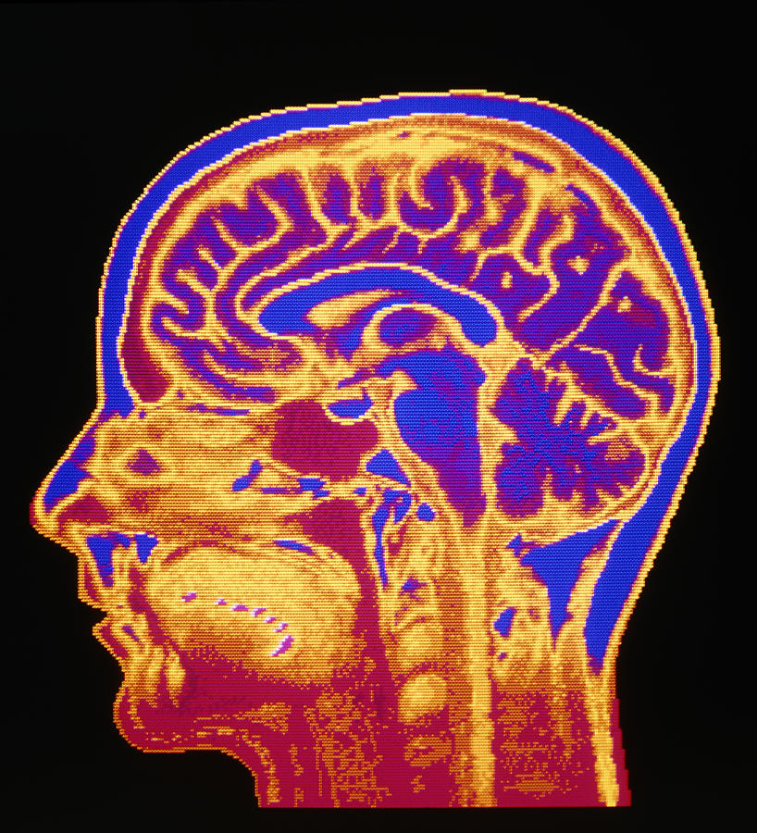

Slide 6
The Questions:
What skills are of value in technology?
How do children best acquire these skills?
How is FLOSS suited to support the development of these skills?

Slide 7

The interview pool:
- Systems engineering.
- Software development.
- Technical support.
- Community & Social Media Management.

Slide 8
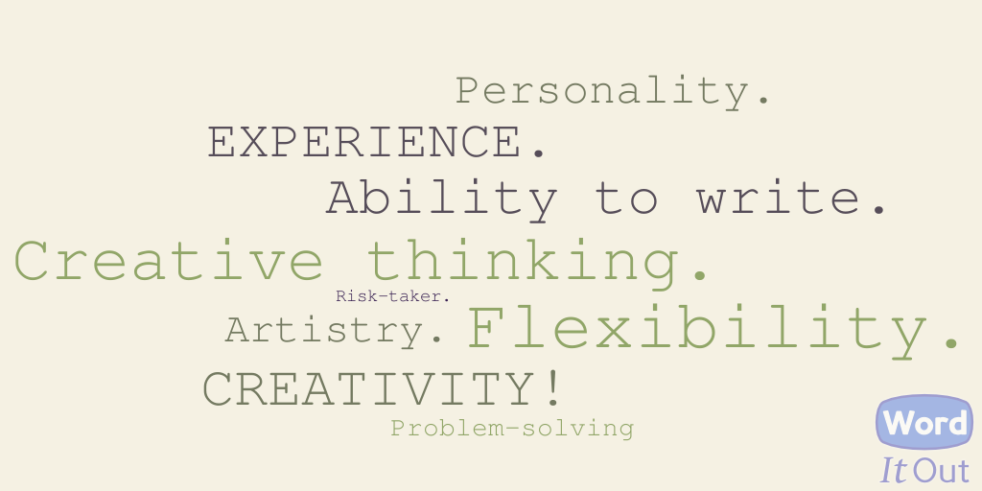

Slide 9
“The ability to experiment and not be afraid of breaking things. Often times I find people who are unable to start a project or process without a set of steps they need to follow to the letter.”
- Gareth Greenaway, SCALE Co-Founder

Slide 10

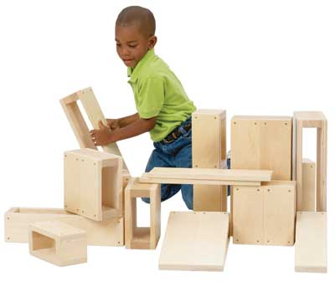
Foster creative thinking and problem solving with:
- Open-ended questions.
- Open-ended materials.
- Opportunities to both succeed and fail.
- Free-as-in-freedom time.
- Modeling persistence, curiosity, and passion.

Slide 11

“In play it is as though he were a head taller than himself.”
- Lev Vygotsky

Slide 12

Favorite Toys:
Legos.
Tinker toys.
Computers.

Slide 13
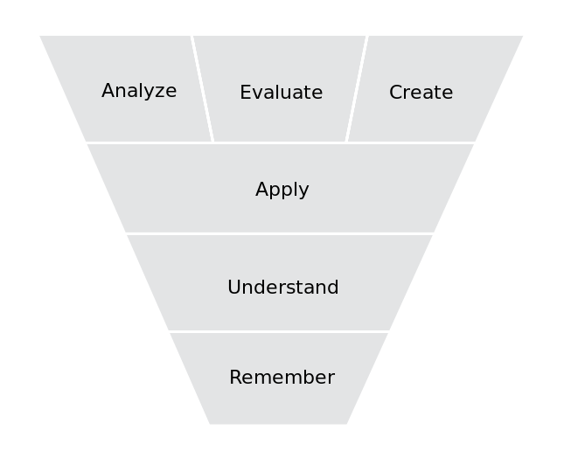
Bloom's Taxonomy

Slide 14

“We learn more by looking for the answer to a question and not finding it than we do from learning the answer itself.”
- Lloyd Alexander

Slide 15

Dumbed down technology has been designed to make life easier and more efficient for adults. It has not been designed to be of educational value to children.
Children who know how to drag-and-drop and swipe possess a valuable skill: observation.

Slide 16

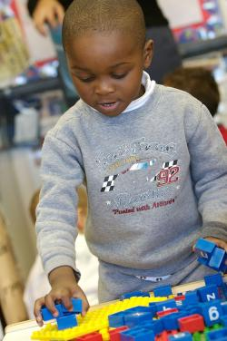
Rote Learning vs.
Active Learning

Slide 17
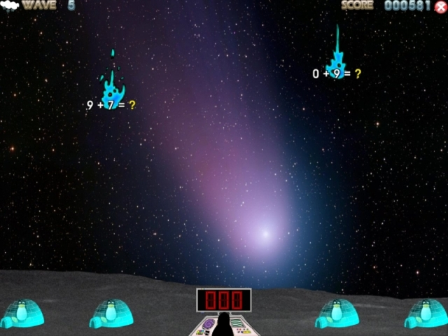
Tux, of Math Command

Slide 18
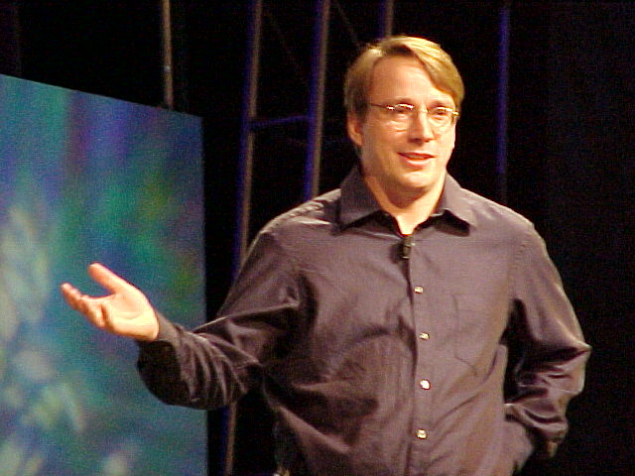
“The Linux philosophy is, 'Laugh in the face of danger!' Oops. Wrong one. 'Do it yourself.' Yes, that's it.”
- Linus Torvalds

Slide 19
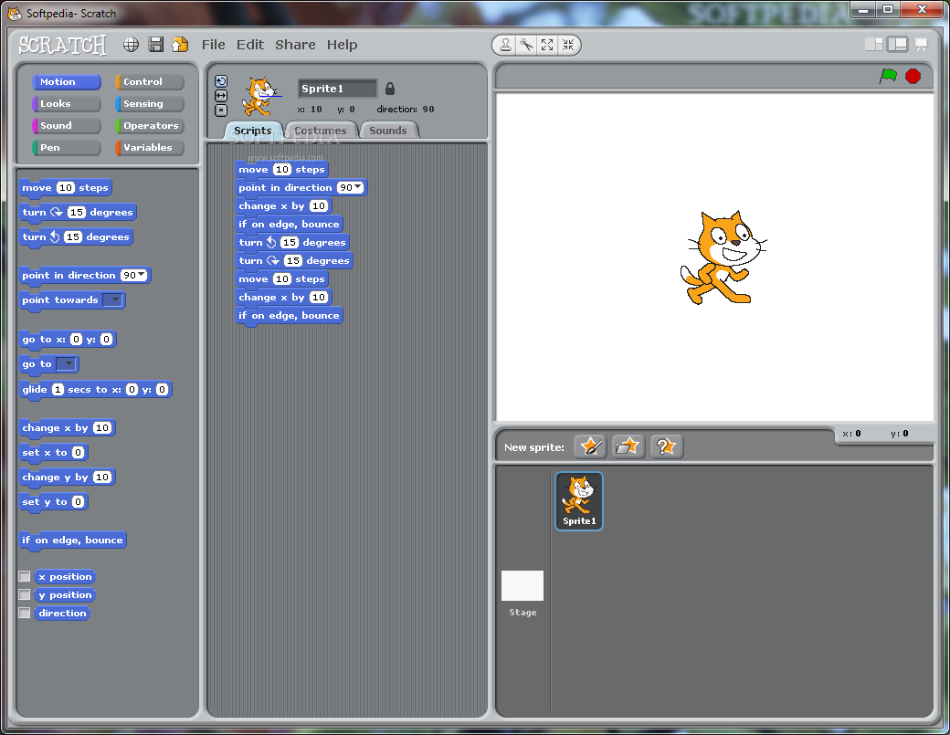
scratch.mit.edu

Slide 20
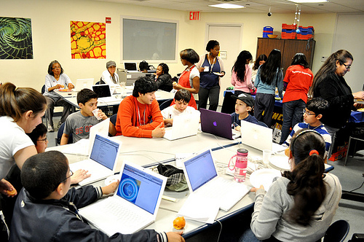
hackasaurus.org

Slide 21
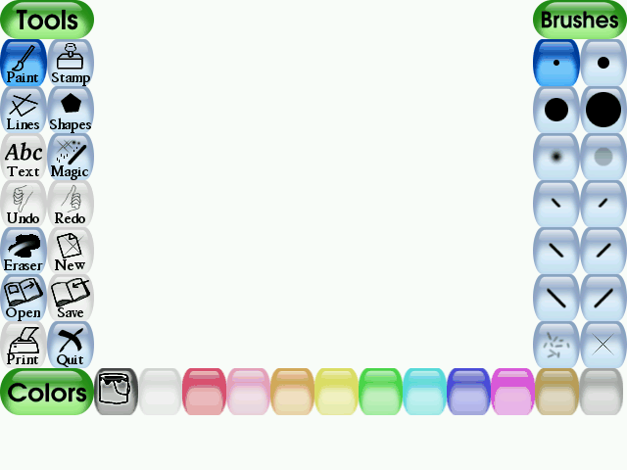
tuxpaint.org

Slide 22
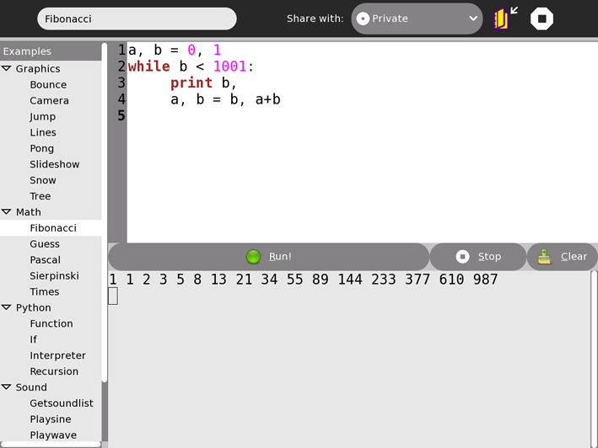
sugarlabs.org

Slide 23
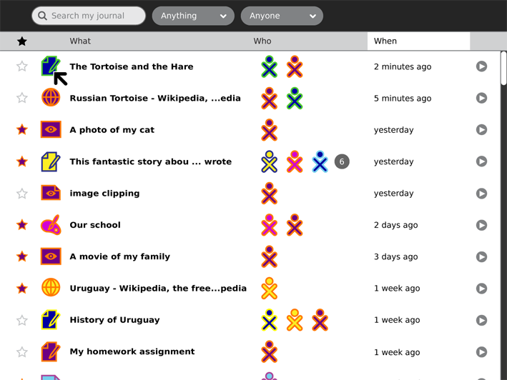
sugarlabs.org

Slide 24
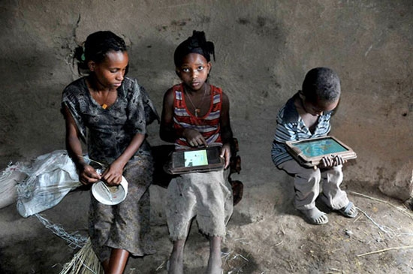
"We left the boxes in the village. Closed. Taped shut. No instruction, no human being. I thought, the kids will play with the boxes! Within four minutes, one kid not only opened the box, but found the on/off switch. He'd never seen an on/off switch. He powered it up. Within five days, they were using 47 apps per child per day. Within two weeks, they were singing ABC songs [in English] in the village. And within five months, they had hacked Android. Some idiot in our organization or in the Media Lab had disabled the camera! And they figured out it had a camera, and they hacked Android." - Nicholas Negroponte

Slide 25
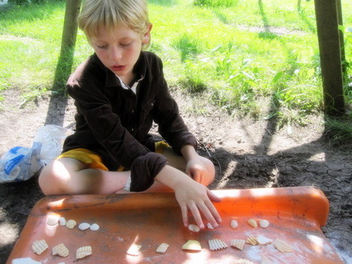
“The computer is just a tool.”

Slide 26
Thank you!

