Slide 1
Non proprietary material based on public sources
My DoD Open Source Public Meeting Experience
aka “Mr Obejas Goes to Washington”
Mario Obejas,
SCALE 11
23 February 2013

Slide 2
About this talk …..
Lets set audience expectations: This is not a technical talk
  It has more to do with US law, open source misconceptions, esoteric impediments, US Government policy …. and at least two disturbing use cases
  Process, regulations, and policy can be contradictory, illogical, Dark Arts ….
  If you prefer a technical deep dive:
    stay here for the next talk, or
    go to Phil's “How we chose Chef” talk ☺
This is about my experience attending a US Government (USG) meeting on Open Source Use and industry concerns, and how that relates to using Open Source in USG deliverable projects
  Presentations I saw, the presentation I gave, discussions that resulted, takeaways

Slide 3
Quick Housekeeping (and a little CYA) …..
I am absolutely not representing my Employer
  They have their opinions, I have mine
  Only an official spokesperson is authorized to speak for ${WORK}
  I am representing my opinions here as a private citizen, as I presented them at the DoD hearing.
Please put your electronics on “quiet” mode:
  If you're not sure how to do that, just turn it off
Our Journey begins …......

Slide 4
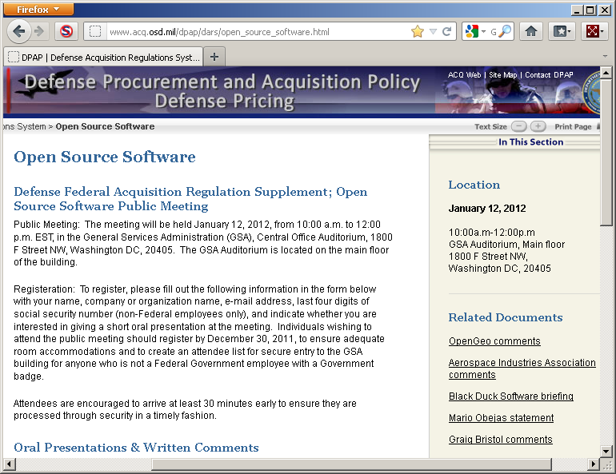
The announcement (published Dec 7, 2011)
Notes:
http://www.acq.osd.mil/dpap/dars/open_source_software.html
DFARS = Defense Federal Acquisition Regulation Supplement

Slide 5
The Meeting Agenda (verbatim from the Federal Register)
What are the risks that open source software may include proprietary or copyrighted material incorporated into the open source software without the authorization of the actual author, thereby exposing the Government and contractors who use or deliver the open source software to potential copyright infringement liability?
Are contractors facing performance and warranty deficiencies to the extent that the open source software does not meet contract requirements, and the open source software license leaves the contractors without recourse?
To what extent should the DFARS be revised to specify clearly the rights the Government obtains when a contractor acquires open source software for the Government, and why?
  DFARS=Defense Federal Acquisition Regulation Supplement
I confirmed w/GSA organizer that it was OK to add another topic to the agenda
  and I did
Agenda topics are color coded for subsequent reference
Notes:
You had to go to the Federal Register to find out what this is about
DFARS = Defense Federal Acquisition Regulation Supplement

Slide 6
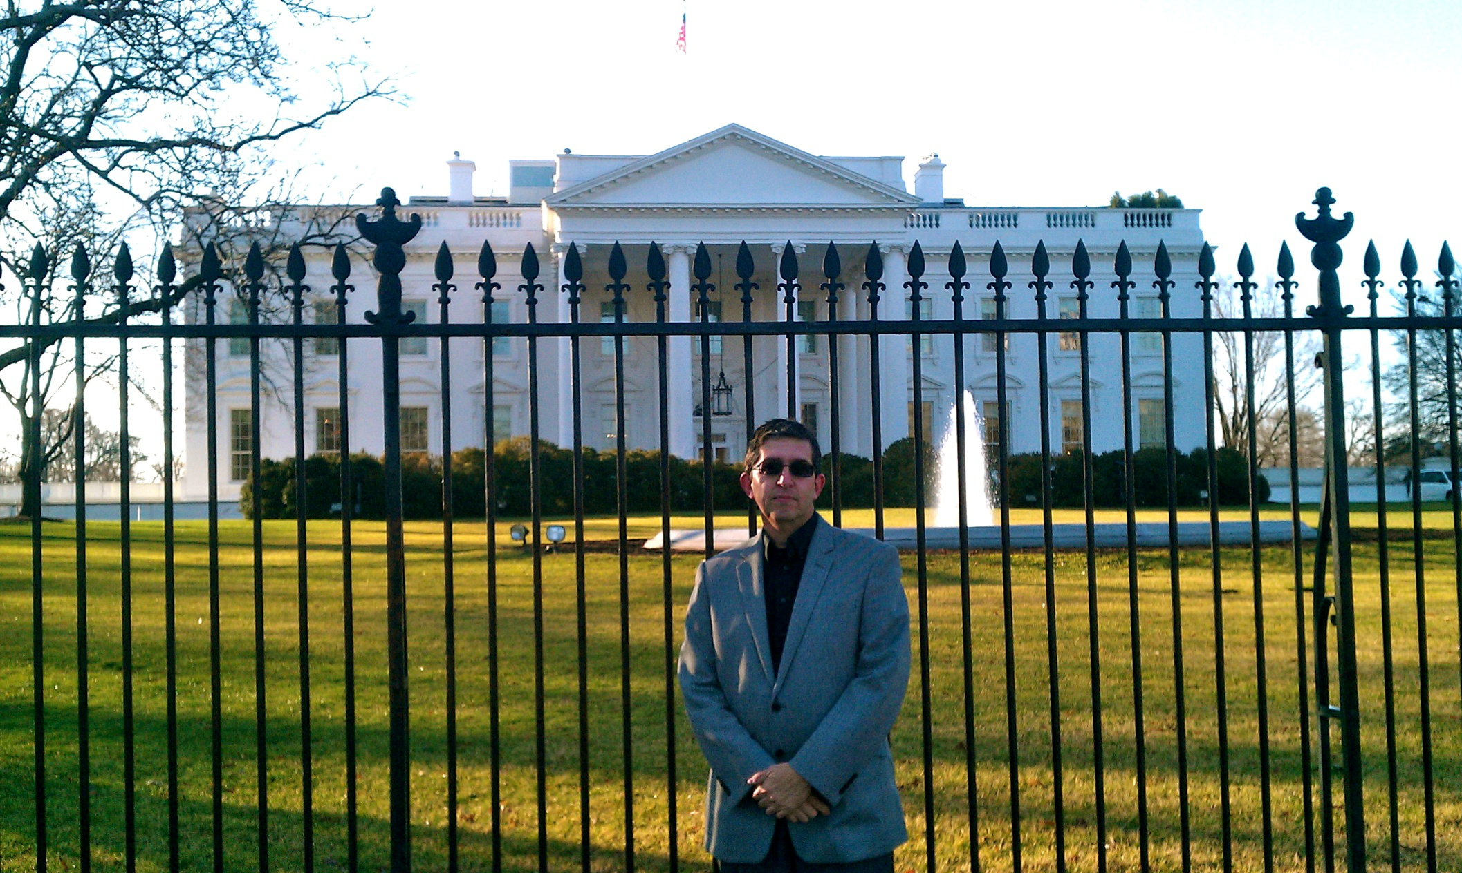
This man is not a Protester and is not interested in being arrested

Slide 7
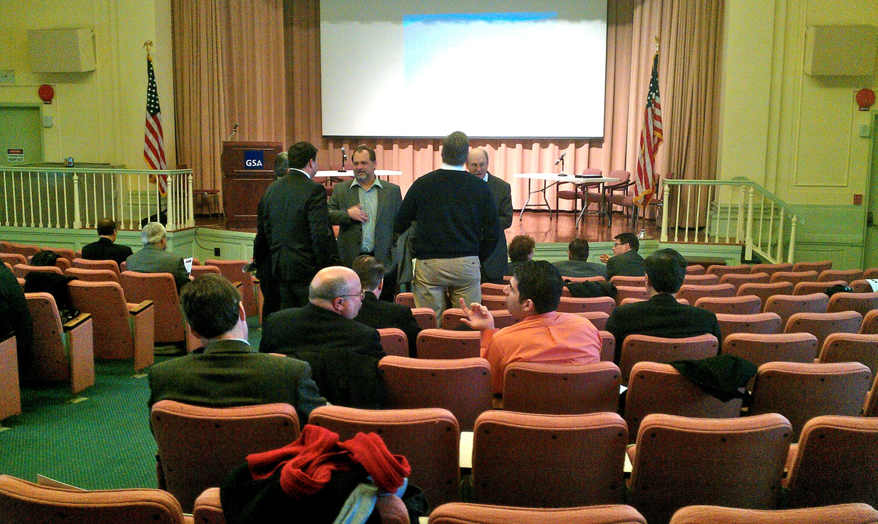
No fancy auditorium, but this is how policy gets crafted

Slide 8
Presentation: Black Duck
Black Duck analyzes source code; often contracted when companies are bought
Pressure on software developers has lead to a process of assembling components from a variety of sources and increasingly open source.
  “Multi-source Development” = the “new normal” for software development
risks that open source software may include proprietary or copyrighted material
  Proprietary code is less likely to “wander” than is open source
  More common finding: incompatible open source licenses in an open source component or in proprietary code.
performance and warranty deficiencies risk?
  Contractors can go to third party Open Source companies (e.g., Red Hat)
should the DFARS be revised to specify clearly the rights
  No clear answer given
Summary:
  little choice about using open source. The benefits are too great to ignore.
  DoD should ensure their contractors are sufficiently open source savvy to manage the risks.

Slide 9
Presentation: Mario Obejas
I cite the The DoD’s Open Source FAQ and its written assertion: “It is important to understand that open source software is commercial software”.
It logically follows that these two risks:
  risks that open source software may include proprietary or copyrighted material
  performance and warranty deficiencies risk?
should be addressed identical to how they are addressed for proprietary code
On the 3rd agenda item
  should the DFARS be revised to specify clearly the rights:
I must be too much of an engineer but I don't see the downside of the DFARS being more specific …..
Then I addressed the major point that I came to share …..
  The Gnu Public Licence (GPL) represents between 50-66% of all the Open Source
  Fear of forced public disclosure of proprietary source impedes GPL use, and hence impedes Open Source use in DoD deliverables
Public Record: My ${WORK} has delivered GPL components, but only with great effort
Notes:
http://dodcio.defense.gov/sites/oss/Open_Source_Software_(OSS)_FAQ.htm

Slide 10
Presentation: Mario Obejas
The Gnu.org site’s entire guidance on mixing GPL and proprietary code:
we can’t “incorporate GPL-covered software in a proprietary system” but we can “distribute the GPL-covered software alongside your proprietary system”
“To do this validly, you must make sure that the free and non-free programs communicate at arms length”
The difference between incorporating and distributing alongside is given as “partly a matter of substance and partly form”
Alongside? Arms’s length? Substance and partly form? WT*?
Real time audience survey: Do you have a firm grasp of what this means?
Specifics are needed … for success and to counter FUD.
DoD FAQ: “"DoD contractors who always ignore components because they are OSS, or because they have a particular OSS license they don't prefer, risk losing projects to more competitive bidders.”
I plead with DoD to work with the Software Freedom Law Center to provide better education and guidance on prudent use of GPL components in deliverables.
  It turns out they have, but haven’t published any MOUs or other record of it …
  I should have also discussed the disconnect between DoD policy and ISSOs on the ground..
Specific GPL guidelines are needed to counter FUD, encourage GPL Open Source use
Notes:
http://dodcio.defense.gov/sites/oss/Open_Source_Software_(OSS)_FAQ.htm
https://www.gnu.org/licenses/gpl-faq.html#GPLInProprietarySystem
(This is the sum total of guidance you have from the entity that might sue you if you get it wrong)

Slide 11
Presentation: OpenGeo
risks that open source software may include proprietary or copyrighted material
  Open source is no more likely to have proprietary or copyrighted materials incorporated in it than proprietary software.
  guidance for selecting open source is similar: know your source.
  despite decades of use, examples of legal actions against end-users due to allegations of improper code in FOSS projects is vanishingly small.
    mitigation in these cases is always clear for projects that have mistakenly embedded encumbered code:
    remove it when notified, the software is automatically updated, and the users move on to the unencumbered version.
performance and warranty deficiencies
  If system integrators are providing performance guarantees for the systems they provide, that includes the components they embed, open source and proprietary.
should the DFARS be revised to specify clearly the rights
  defer to expertise of other colleagues (e.g., David Wheeler)

Slide 12
Presentation: Aerospace Industries Association
AIA = lobbyists; ${WORK} is a member. No presenter, but they provided a major written statement.
risks that open source software may include proprietary or copyrighted material
  Examples of risks provided but no assertions about prevalence - acknowledged lack of suits other than the SCO suit
performance and warranty deficiencies
  “Contractors are absolutely without recourse in most cases … but that’s also the case with much commercial software”
  Claimed (incorrectly) that open source licenses may prohibit use of the software in “hazardous activities”
should the DFARS be revised to specify clearly the rights
  They say it is commercial software. Then they say others might say it isn’t.
  Some reasonable request for clarity on GPL and copyleft provisions
  They correctly cited the USG (Army) issue with Apache and indemnification (more on that in a bit)
  Incorrectly asserted export Law and GPL are at odds (they are not)
Negative: seems a bit wishy washy at times; dead wrong at least once
Positive: raised a plethora of points that realistically should be addressed (open source or not)
Correctly addressed the Apache debacle
Notes:
http://www.acq.osd.mil/dpap/dars/docs/AIA_-_Public_Meeting_DFARS_-_Open_Source_Software.pdf

Slide 13
Presentation: Craig Bristol (Raytheon)
Discussion primarily driven by the Apache license debacle
Stressed that greater clarity on GPL and export controls are needed
Stated publicly that he did not believe Open Source and Commercial Software should be treated the same (but that is not in his written statement)
Craig and I respectfully disagreed on that point - I hope his view evolves
  I did say I’m not an IP lawyer, correct?
  But I am concerned about a major Defense contractor's IP lawyer taking a public stance that is at odds with USG written legal declarations.
  There is momentum, very clear from reps at the meeting, that many orgs are adopting “Open Source = Commercial Software” mantra. And moving on.
USG is not backing down on “Open Source = Commercial Software”.
Notes:
http://www.acq.osd.mil/dpap/dars/docs/Craig_Bristol.pdf

Slide 14
Presentation: Red Hat
Did not address the two agenda questions, only the DFARS question
Stressed important to remove discrimination against Open Source use
Hailed the DoD Open Source 2009 memo
Hailed OMB CIO 2011 memo calling for focus on merit and mission need (i.e., nondiscrimination against open source or licenses)
should the DFARS be revised to specify clearly the rights
  Make sure questions are addressed at Software (regardless of open source or not)
  Make sure not based on legacy misconceptions
  Wary of DFARS change – make sure nothing to discourage Open Source or promote old misconceptions. Focus should be on mission need.
Hailed tools coming to Market, such as Black Duck’s, for provenance
Believe market forces are responding well to needs
Encouraged more commercial companies involvement in Linux kernel development – be part of the process

Slide 15

And now for the disturbing edge cases …….
The Apache license debacle
A request by a company (that I will not name) to get a USG waiver to explicitly violate US Copyright law

Slide 16
Edge case #1: The Apache debacle
Apache License, clause #9:
9. Accepting Warranty or Additional Liability. While redistributing the Work or Derivative Works thereof, You may choose to offer, and charge a fee for, acceptance of support, warranty, indemnity, or other liability obligations and/or rights consistent with this License. However, in accepting such obligations, You may act only on Your own behalf and on Your sole responsibility, not on behalf of any other Contributor, and only if You agree to indemnify, defend, and hold each Contributor harmless for any liability incurred by, or claims asserted against, such Contributor by reason of your accepting any such warranty or additional liability.
Are there lawyers in the room who parse conditional clauses differently?
Notes:
https://mail-archives.apache.org/mod_mbox/www-legal-discuss/201203.mbox/%3CCB89093A.A1CDB%25podence@blackducksoftware.com%3E
www.fiercegovernmentit.com/story/army-lawyers-dismiss-apache-license-indemnification-snafu/2012-03-08

Slide 17
Edge case #1: The Apache debacle
RTN, BA, others, tripped up by USG (Army) Lawyer
  Claim: Apache license 2.0 loads indefinite liability onto USG, contrary to Anti Deficiencies Act (ADA)
  Indemnification runs afoul of the ADA because the Government is agreeing to an unknown monetary amount in absence of Congressional appropriation.
  Apache.org argued to the Army: indemnification clause does not apply so long as they merely use the software program as a consumer
  The Obvious™: I/others asserted Apache code is widespread within the DoD
  My opinion: one Army lawyer created this issue
Thankfully, reason prevailed in March:
  the trigger would be activated only should the licensee - Army Material Command - extend indemnification to a third party. Ain’t gonna happen …
  Army lawyers dropped their concern – but they don't want this cited as “indemnification doesn't matter”
Notes:
https://mail-archives.apache.org/mod_mbox/www-legal-discuss/201203.mbox/%3CCB89093A.A1CDB%25podence@blackducksoftware.com%3E
www.fiercegovernmentit.com/story/army-lawyers-dismiss-apache-license-indemnification-snafu/2012-03-08

Slide 18
Edge case #2: Large Company X
Tortuous story - They distribute a unclassified binary, created from classified (modified) GPL source, and want a waiver from Copyright Law compliance
They believed (incorrectly, IMO) that handing source code to delivery customer (USG) means USG could give source code to uncleared third party (WT*?)
They want a waiver from USG to knowingly violate Copyright Law.
Dan Risacher claims in meeting summary : “public release” misconception is a misread of the GPL license
Risacher: Free Software Foundation believes existing law (National Security Law and Export Law) is orthogonal to Copyright law, i.e., they are existing restrictions that you apply, not new law that causes GPL violation. DoD intends to include this in new FAQ revision.
Little sympathy for entity that begins with components with a known license, then proceeds with development knowing license restrictions (correct interpretation or not) and expects USG relief to violate Copyright Law
Please don’t willfully violate licenses! (I can’t believe I need to say that ….)

Slide 19
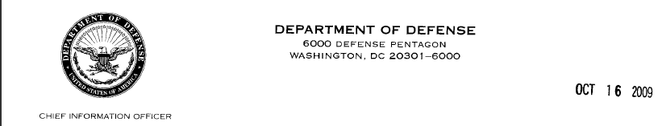
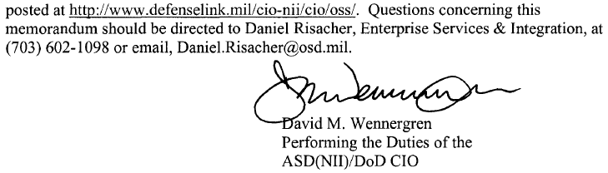
The DoD meeting’s Q&A session:
I asked that discussions with FSF and Eben Moglen and MOUs be publicized
An assertion was made: Complexity around software development regulations is not helping, complexity needs to be reduced.
And then Dan Risacher spoke …….. (here’s why you care):
Dan is the principal author of the 2009 DoD memo

Slide 20
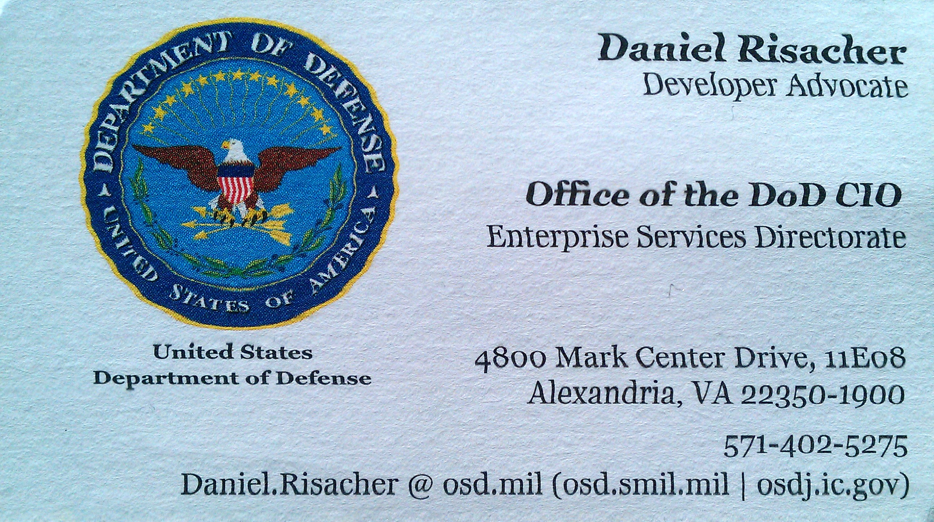
Who Dan Risacher is today:

Slide 21
Dan Risacher statements
We’ve done the legal research to determine that :
“Open Source is commercial computer software, as it is already defined in the FARS”
  DoD declared this in the 2009 memo after heavy consultation with USG Legal staff.
(There was some back and forth between Believers and the few Non Believers )
Open Source is Commercial Computer Software
Notes:
52:04 in my original audio file

Slide 22
Dan Risacher statements
  The next two slides are recordings of Dan making two important points relative to the Aircraft Industries Association written statement..
    #1 is on the myth about GPL requiring “public” disclosure
    #2 is warranties and open source
    i.e., Don’t take it from me, hear it straight from the source
Open Source is Commercial Computer Software
Notes:
52:04 in my original audio file

Slide 23
Dan Risacher on : Warranty issues
  Context: “I look at the AIA letter ….As a government employee who’s worked in this space extensively:”
”It talks about warranties and the sorts of problems that there’s no warranty in the open source software, so how can we as a contractor warranty that, and that’s come up I think in some of the other issues.
As a Government guy looking into this space, my issue is … my reaction is: that’s your problem. Right? That you have the source code so you can fix it , so the idea that there’s not a warranty from the copyright holder …. is kind of irrelevant and I don’t think there’s a need for a DFARS change or any other sort of policy change, right? If your contract says you’re responsible for warranting that software, you’re responsible for … open source, for proprietary, for all those components. And your selection of those modules is up to you. So, I’m not impressed with that one.”

Slide 24
Dan Risacher on: Public code release
  “There was some language suggesting that we change the DFARS to say that contractors should not be obligated to ever release code to the public, or to incorporate software that could release code to the public. Last time I checked there was like what 60 or – I’ve forgotten how many licenses – like 79 licenses that are considered Open Source licenses by the Open Source Institute. None of those – to my knowledge and I’m willing to be educated – actually ever require that you release code to the public. They do – in some cases, in what we call the reciprocal licenses – require that you release the code to whoever the users are that you are distributing to. Which is a totally different issue. So the idea that I can’t use GPL code because I would have to give the code to the public is completely a misunderstanding of the license.”
(I told Dan he needs to put this in the next FAQ, in 28 point font …..)
Notes:
47 seconds audio : 121C420_Obejas_Dan Risacher_No Public Code Release.wav

Slide 25
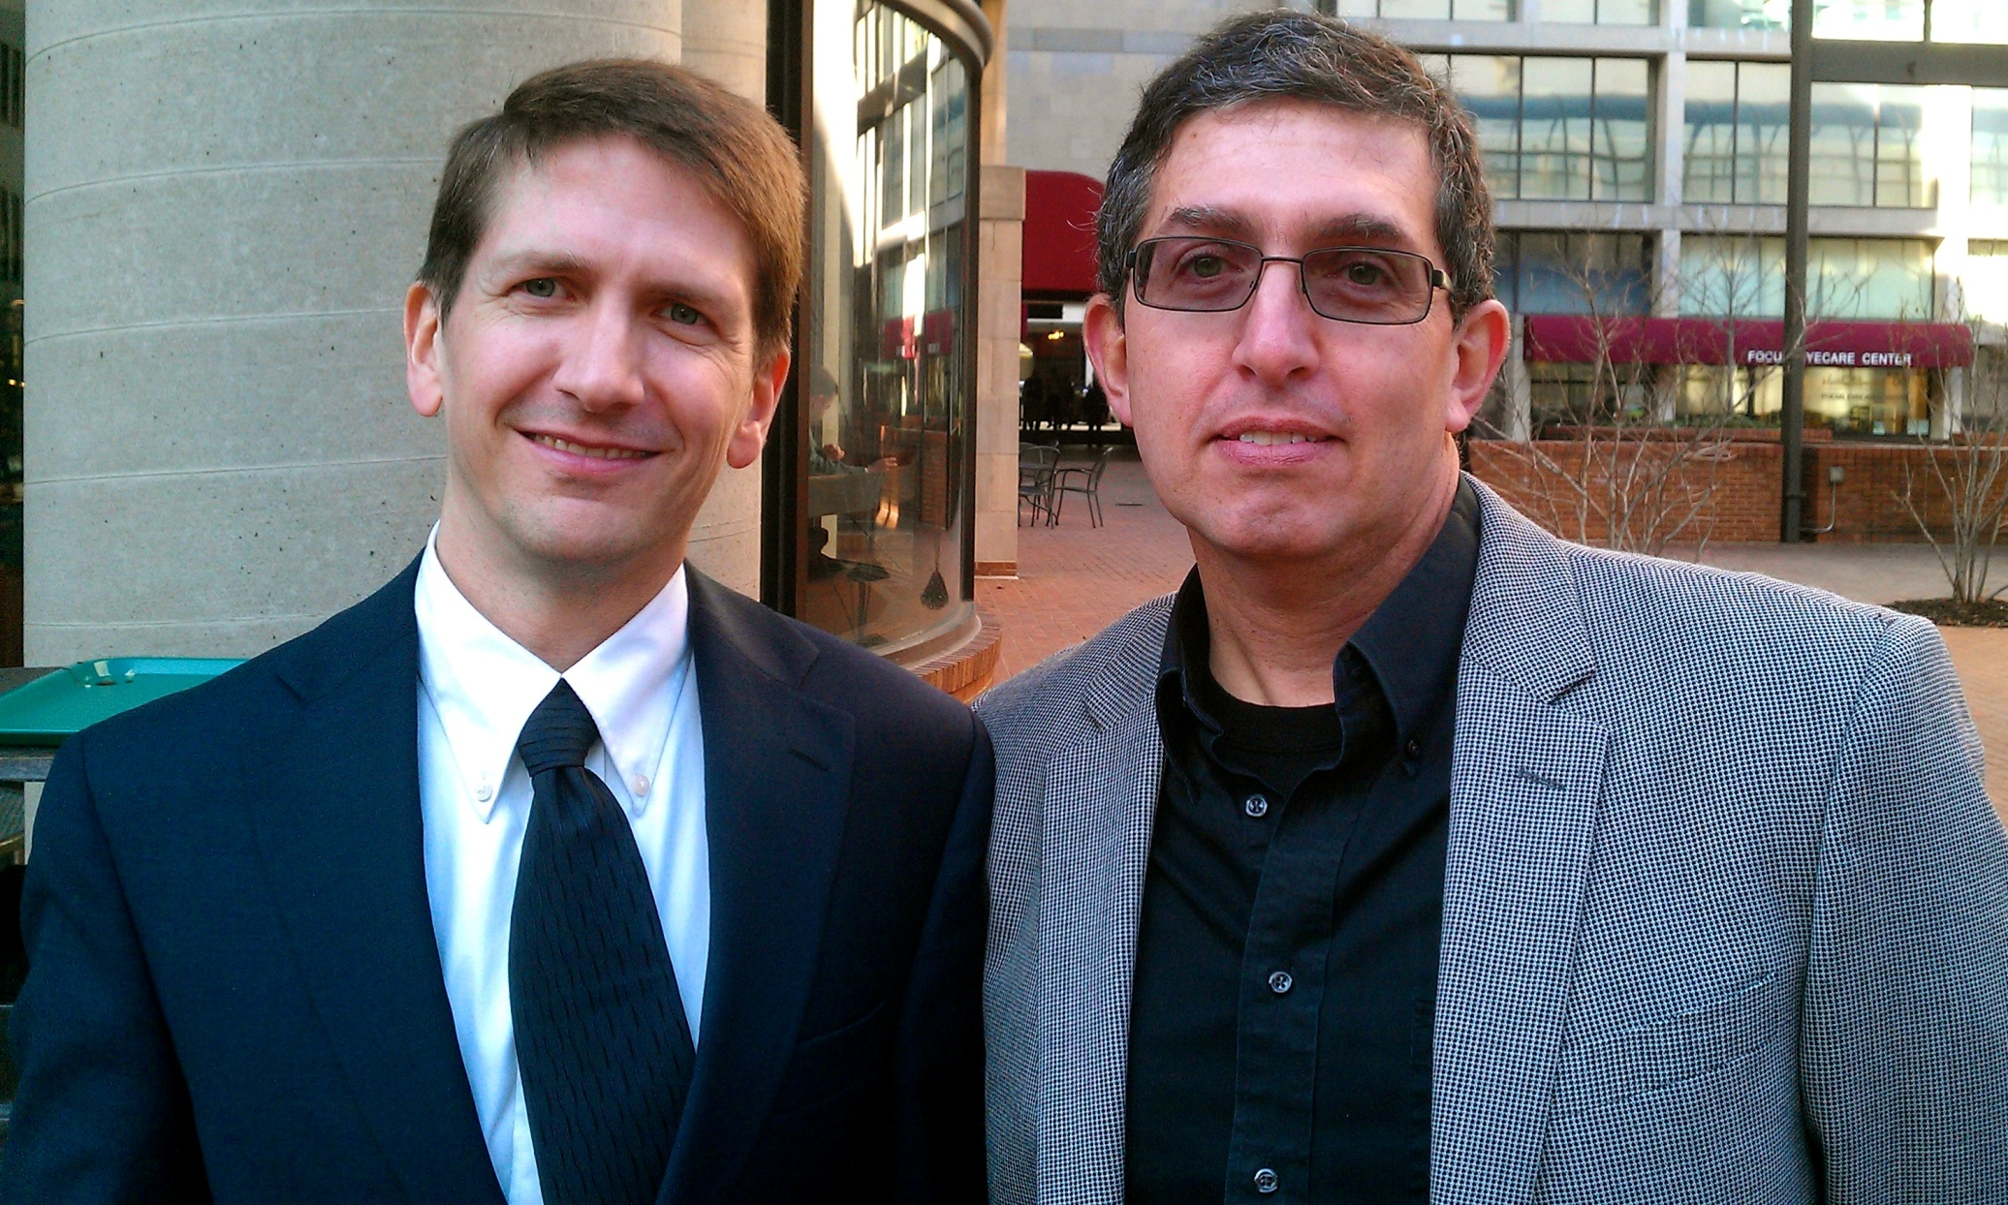
Dan Risacher and some goofy Engineer/IT guy

Slide 26
Summary:
Open Source should be treated like COTS
  A huge portion of the closing discussion was on this point
  The US Government asserts this in writing – since 2009.
  Plenty of other Industry peers are in sync
  The more an employer pushes back on this, the more that employer risks being out of sync with USG and Industry
  Public code disclosure = red herring, but license compliance matters

Slide 27
Summary: continued
Contractors are responsible for the components they deliver
  Pick your components prudently – quality and supportability matter
  A COTS vendor’s support contract does not guarantee supportability
  The US Government expects us to deal with problems found in the field
Odd edge cases should not preclude us from leveraging Open Source for maximum benefit
  DoD FAQ: “"DoD contractors who always ignore components because they are OSS, or because they have a particular OSS license they don't prefer, risk losing projects to more competitive bidders.”
  I want ${WORK} to be the more competitive bidder.

Slide 28
Food for thought: the DoD is a huge friend of Open Source
What the DoD thinks about open source and open technology:
“Open Technology Development (OTD): Lessons Learned & Best Practices for Military Software” (2011-05-16)
http://dodcio.defense.gov/Portals/0/Documents/FOSS/OTD-lessons-learned-military-signed.pdf
“Imagine if only the manufacturer of a rifle were allowed to clean, fix, modify or upgrade that rifle. The military often finds itself in this position with taxpayer funded, contractor developed software: one contractor with a monopoly on the knowledge of a military software system and control of the software source code. This is optimal only for the monopoly contractor, but creates inefficiencies and ineffectiveness for the government, reduction of opportunities for the industrial base, severely limits competition for new software upgrades, depletes resources that can be used to better effect and wastes taxpayer-provided funds.”

Slide 29
DoD policy and ISSO/ISSM interpretations don't always agree
ISSO = Information Systems Security Officer
ISSM = Information Systems Security Manager
ISSO/ISSMs have incentives independent of DoD policy
  Precedent matters often; so few will go first
  Inertia is real
  It's a fact on the ground that approving use involves more more than denying use
There is also what I call the Flag Test:
  Does the software have foreign origin?
  Should be: scrutiny over foreign developers planting malware
  Often devolves: find Company Headquarters; where is it?

Slide 30
Further Reading
http://opensourcedelivers.com/2012/02/01/dod-thinks-that-open-source-is-the-bomb/
http://opensourcedelivers.com/2012/03/29/us-army-comes-to-the-defense-of-apache/
The latest AppDev STIG (Version 3, Release 4) removes discrimination against open source: http://iase.disa.mil/stigs/app_security/app_sec/app_sec.html

Slide 31
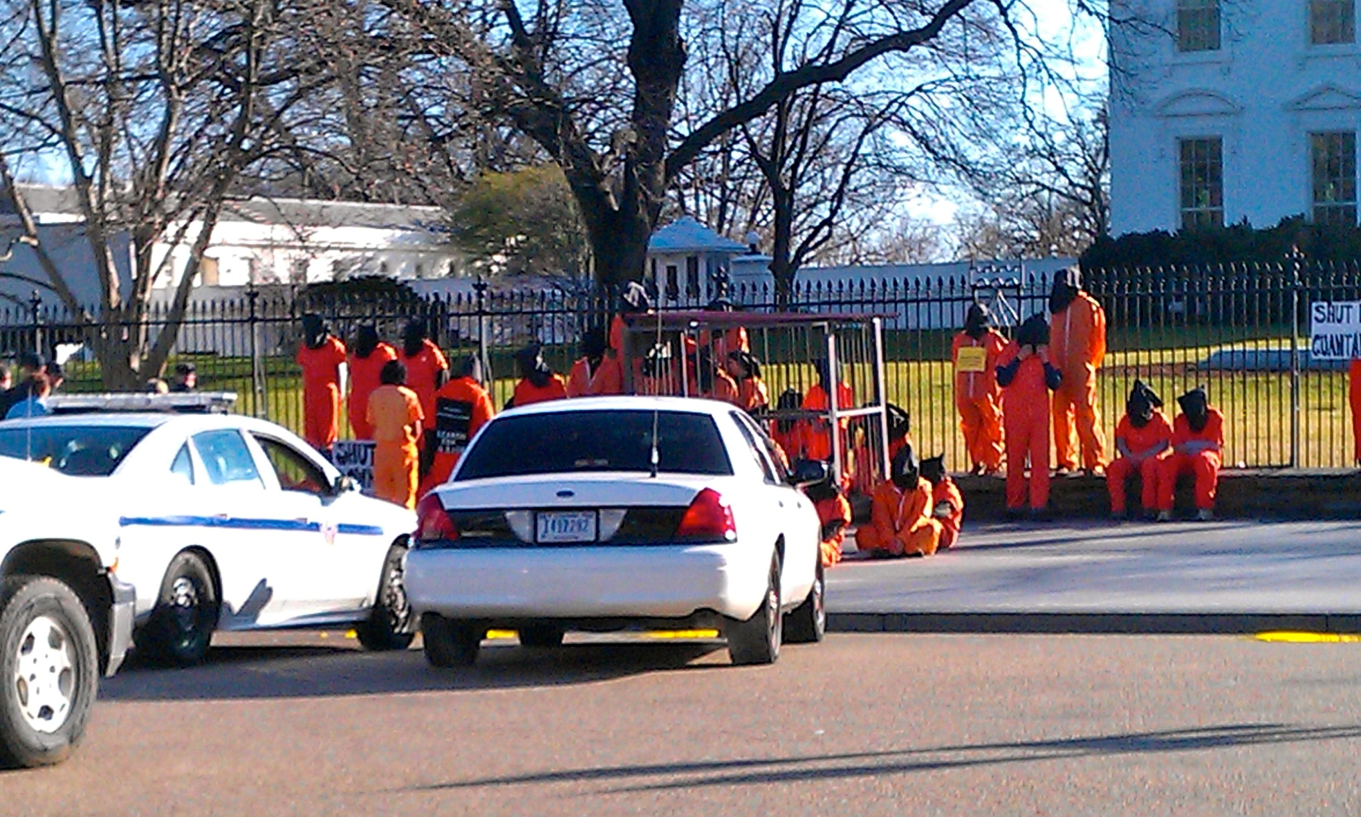
4 hours later: These folks are Protesters and are interested in being arrested

Slide 32
Questions?
Can you repeat everything you said after the 3rd slide?
I was on my phone.
Did you ask me something?
Who are you again?
Could you talk a little longer?
I haven’t finished this email ….
What’s wrong with the wireless? I need to catch an earlier flight …..

Slide 33
Biography: Mario Obejas
Work life (hired @ Hughes Aircraft: June 10, 1980)
Current: Open Source Subject Matter Expert (SME), Senior Information Security Drone – need something authorized? ☺
Current Title: Information Systems Fellow
Previous:
    1990 – mid 2000s : Professional System Administrator
    1980-1990: Software Developer, Air Defense and Air Traffic Control
  Recent employer awards: 2009-2011 ISaC “Best Presentation” winner; 2010,2011: “CIO Excellence in IT” recipient; 2002-2012: Technical ”With Honors” recipient
  External: 2009 USENIX LISA Speaker, “Employee Monitoring”; 2008 USENIX LISA Program Chair; 2003-2006,2008,2009,2012 USENIX LISA Program Committee; Founding Member #4, League of Professional System Administrators ( http://lopsa.org )
Not Work life
  Married since 1984; Dad since 1990 ; “I Love L.A.”
  Daily Show fan
  Avid live music fan (recent: Roger Daltrey and Pete Townsend doing Quadrophenia)
  Road Cyclist (Personal best : March, 2012: 96 hilly miles, including Latigo Canyon)
Ed-yer-kation: BA: 1980, Wabash College; MS: 1983, USC
  Continuing education credits: Hard Knocks University

