Slide 1
The Secure Boot Journey
Matthew Garrett
<matthew.garrett@nebula.com>

Slide 2
2006
UEFI 2.0 describes a method for signing drivers

Slide 3
2008
UEFI 2.2 describes a method for image validation

Slide 4
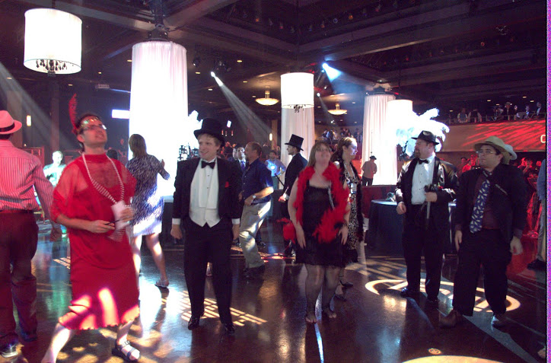
August 2011

Slide 5
August 2011
Microsoft release Windows 8 hardware certification requirements
All Windows 8 client hardware must default to enforcing UEFI Secure Boot

Slide 6
August 2011
Microsoft release Windows 8 hardware certification requirements
All Windows 8 client hardware must default to enforcing UEFI Secure Boot
(I am far too hungover to deal with this)

Slide 7
What is UEFI Secure Boot?
Generate a cryptographic hash of a binary
Sign hash with a private key
On boot, check that the hash matches the binary
And check that the signature was made with a trusted key
Refuse to boot it if these fail

Slide 8
But why?
Attackers are getting more sophisticated
If you can run code before the OS, it's impossible for the OS to trust the hardware
Perfectly designed malware could be virtually impossible to detect
Controlling people's computers is becoming more and more financially rewarding

Slide 9
What are our options?

Slide 10
What are our options?
(Drink)

Slide 11
What are our options?
(Drink)
(No, really, drink)

Slide 12
What are our options?
(Drink)
(No, really, drink)
(Break RSA, taking down HTTPS with it)

Slide 13
What are our options?
(Drink)
(No, really, drink)
(Break RSA, taking down HTTPS with it)
(Ha no drink)

Slide 14
Upon sober reflection
When in doubt, cause trouble
(I am good at causing trouble)

Slide 15
September 2011
I blog about the Windows 8 requirements

Slide 16
“It's probably not worth panicking yet. But it is worth being concerned.”

Slide 17
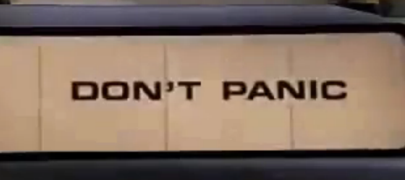

Slide 18
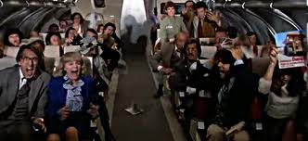

Slide 19
September 2011
2 days later, Microsoft respond.

Slide 20
“Secure boot is a UEFI protocol not a Windows 8 feature“

Slide 21
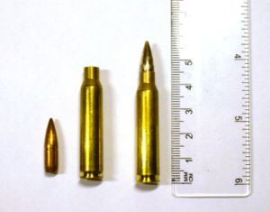

Slide 22
STANAG 4172

Slide 23
Aren't you glad it's a standard?

Slide 24
“Microsoft does not mandate or control the settings on PC firmware that control or enable secured boot from any operating system other than Windows”

Slide 25
(Translation: Blame the system vendors)

Slide 26
Now what?

Slide 27
Now what?
(Stop drinking due to strange liver pains)

Slide 28
Now what?
Effective strategies involve multiple components

Slide 29
Now what?
Effective strategies involve multiple components
Don't just run around

Slide 30
Now what?
Effective strategies involve multiple components
Don't just run around
Run around and scream

Slide 31
Start thinking about technical options
Can we convince vendors to ship a Linux key?
Who would control a Linux key?
Who would get access to a Linux key?
What are the licensing issues around shipping objects signed with a Linux key?

Slide 32
Other options
Can we convince vendors to ship a Red Hat key?
Who would get access to a Red Hat key?
What would the PR issues of having a Red Hat key be?

Slide 33
Other options
Can we get access to Microsoft's key?
Would other people also be able to get access to Microsoft's key?
What would the PR issues of working with Microsoft be?

Slide 34
Other options
Can we avoid this idea of pre-installed keys completely?
Can we define a mechanism for installing OS keys at install time?
Can we convince people to adopt this mechanism?

Slide 35
Other options
Give up on this Linux thing, take up goat farming
(Oddly tempting)

Slide 36
Late 2011
Red Hat and Canonical became active in the UEFI specification community
Proposals made regarding key management
Little acceptance from the wider UEFI community (for reasonable reasons)

Slide 37
December 2012
Microsoft update Windows 8 requirements
Vendors must provide a mechanism to disable Secure Boot
Vendors must provide a mechanism for users to install their own keys

Slide 38
Did we win?
No standardised way of handling key management
No standardised way of disabling Secure Boot
No way of handling this for remote deployments
Documentation nightmare

Slide 39
February 2012
Sunnyvale

Slide 40
Sunnyvale
Makes LAX seem like a great place to be

Slide 41
Sunnyvale
Makes LAX seem like a great place to be
Location of the Spring 2012 UEFI plugfest

Slide 42
Sunnyvale
Makes LAX seem like a great place to be
Location of the Spring 2012 UEFI plugfest
Our first opportunity for face-to-face discussion of the issues

Slide 43
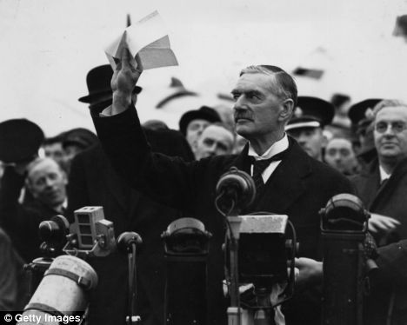
Success!

Slide 44
Microsoft play ball
Commitment to provide open access to the UEFI signing service
Signatures are contingent upon not being used to attack Windows
Potential outcomes include revocation of existing signatures

Slide 45
Solved?
Ha ha ha no.

Slide 46
Licenses
Everyone knows that GPLv3 requires you to release signing keys

Slide 47
Licenses
Everyone knows that GPLv3 requires you to release signing keys
(everyone is wrong)

Slide 48
GPLv3
“Installation Information" for a User Product means any methods, procedures, authorization keys, or other information required to install and execute modified versions of a covered work in that User Product from a modified version of its Corresponding Source.

Slide 49
Two getouts
If it's possible to replace it, you don't need to ship the keys
If it's not a User Product, you don't need to ship the keys
(Software isn't a User Product)

Slide 50
What, really?
We asked the copyright holders
We asked the license authors

Slide 51
What, really?
We asked the copyright holders
We asked the license authors
(They were the same people)

Slide 52
User control
User freedom is important
Users need to be able to perform key management
Distributions need to have options

Slide 53
Machine Operator Key
Variables can be limited to pre-boot environment
Keys stored in them can't be modified by the running OS
Key installation can be limited to physically present users
Code written and contributed by Suse

Slide 54
Some measure of success
Ubuntu 12.10 released in October
Fedora 18 released in January
Ubuntu 12.04.2 released in February
Several smaller distributions

Slide 55
Pre-signed Shim
Signed binary with no intrinsic trust
Install distribution key as first step of install
Don't have to deal with Microsoft
No real risk of revocation
Reasonable compromise?

Slide 56
What's left?

Slide 57
Third party modules
Linux Foundation offered to set up a working group

Slide 58
Third party modules
Linux Foundation offered to set up a working group
(crickets)

Slide 59
Third party modules
Embed a key in a PE-COFF binary
Get Microsoft to sign it
Have the kernel load keys if signed by a trusted key

Slide 60
Third party modules
Embed a key in a PE-COFF binary
Get Microsoft to sign it
Have the kernel load keys if signed by a trusted key
(Linus unenthusiastic)

Slide 61
Linus' proposal
Same as before, but extract the signed key and re-sign it as an X.509 certificate
Requires a trusted body to perform this role
Requires a trusted key in the kernel by default

Slide 62
Linux Foundation loader
Initially intended to be a simple physical-presence test
Scope creep means significant overlap with shim
Perceived by many as an “official” solution
Aim is to merge the two loaders

Slide 63
So, where did we end up?
Linux distributions can be installed on systems without disabling Secure Boot or changing other firmware settings
Users can install and manage their own keys
Microsoft are still the root of trust

Slide 64
What did we learn?
Even commercial Linux distributions can work well together

Slide 65
What did we learn?
Even commercial Linux distributions can work well together
And they can even work with Microsoft

Slide 66
What did we learn?
Even commercial Linux distributions can work well together
And they can even work with Microsoft
Improved communication with vendors

Slide 67
What did we learn?
Even commercial Linux distributions can work well together
And they can even work with Microsoft
Improved communication with vendors
Even when things look bad, we can find solutions

