Slide 1
Build a PaaS with OpenShift Origin
Steven Citron-Pousty
PaaS Dust Spreader, Red Hat
@TheSteve0
Bill DeCoste
Principal Software Engineer
wdecoste@redhat.com

Slide 2
Agenda
See a PaaS in action
See how we build it under the hoods
Look at how to get involved with the community
SIGN UP CODE:
SCaLE11
Notes:
So, what you need is the ease of use and access of a SaaS application, but you need it with your purpose-built, mission-critical, applications.
PaaS gives you just that. It allows you to quickly and easily build the application that YOU need. Whether this is for your group, your enterprise, or your next BIG IDEA, you can build it and launch your specific code on a PaaS and not have to deal with the underlying infrastructure, middleware, and management headaches.
Because of the built-in auto-scaling and elasticity provided by the PaaS infrastructure, PaaS's are ideal for modern data-hungry Big Data, Mobile, and Social applications.
With a PaaS, you can focus on what you should be focused on... your application code.
And let the Cloud provide what it is suppose to: Ease, Scale and Power

Slide 3
Assumptions
You know Linux
You are either a developer or a sysadmin
You will ask questions

Slide 4
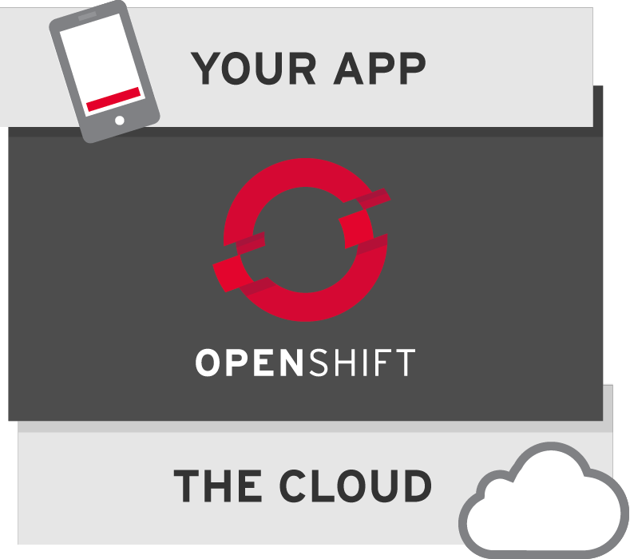
What is OpenShift?
Red Hat’s free platform as a service for applications in the cloud.

Slide 5

Dalbera on Flickr

Slide 6
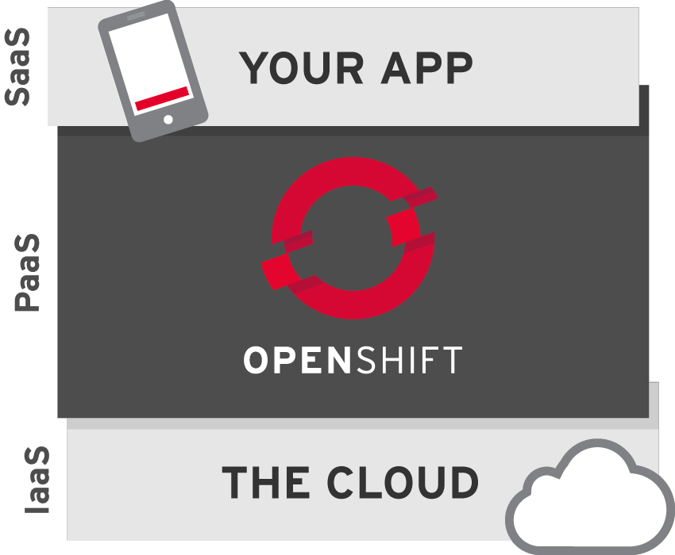
Kind of like Amazon, right? Nope.

Slide 7

Cook24v on Flickr

Slide 8
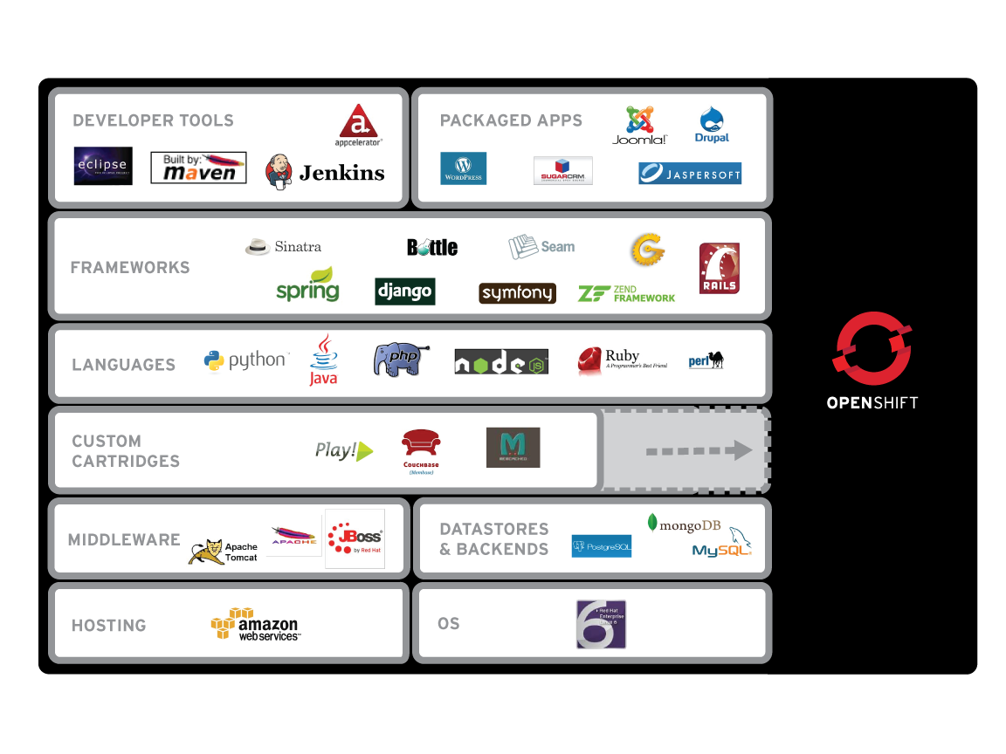
What’s supported?

Slide 9

Operations care about stability and performance
Developers just want environments without waiting
OpenShift Enterprise creates a peaceful
environment for both parties

Slide 10
Demo
Bring up a Python App
Push a code change
Add a MySQL database

Slide 11
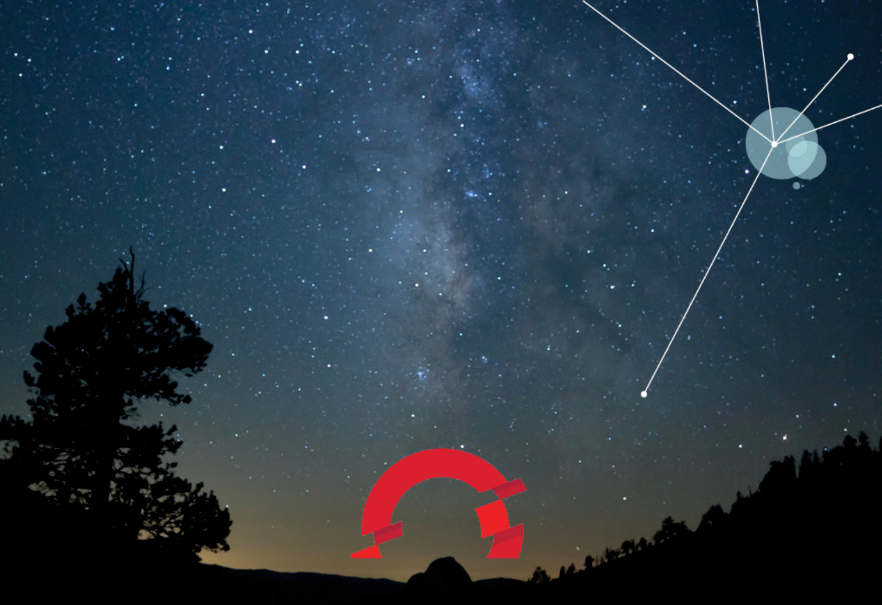
OpenShift
OPENSHIFT OVERVIEW

Slide 12



FLAVORS OF OPENSHIFT
Open Source Project
origin
Public Cloud Service
On-premise or Private Cloud Software

Slide 13
KEY TERMS
Broker – Management host, orchestration of Nodes
Node – Compute host containing Gears
Gear – Allocation of fixed memory, compute, and storage resources for running applications
Cartridge – A technology/framework (PHP, Perl, Java/JEE, Ruby, Python, MySQL, etc.) to build applications
Client Tools – CLI, Eclipse, Web Console for creating and managing applications

Slide 14

RUNS ON IaaS
OpenShift Origin is a PaaS that runs on top of..... Infrastructure
Amazon EC2
Rackspace
Bare Metal
OpenStack
RHEV
VMWare

Slide 15

SERVER TYPES
Each OpenShift Origin server will be one of the following types:
  Broker Host
  Node Host

Slide 16
BROKER
An OpenShift Broker can manage multiple node hosts.
Nodes are where User Applications live.
Fedora/RHEL
Fedora/RHEL
Fedora/RHEL
Brokers
Node
Node

Slide 17
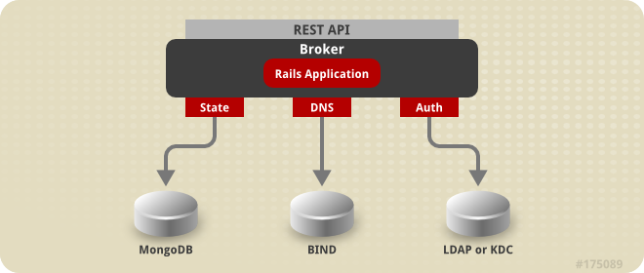
BROKER
The Broker is responsible for state, DNS, and authentication.

Slide 18
SELINUX
SELinux Policies securely subdivide
the Node instances.
Fedora/RHEL
Fedora/RHEL
Brokers
Node
Node

Slide 19
GEARS
OpenShift GEARS represent secure containers in RHEL
RHEL
RHEL
Brokers
Node
Node

Slide 20

CARTRIDGES
Web Console
Eclipse IDE
Cmd Line
MYSQL
JBOSS
Fedora/RHEL
Fedora/RHEL
Brokers
Node
Node

Slide 21
CARTRIDGES
Java
MySQL
PHP
Postgres
CUSTOM
Python
Etc.
Ruby
Etc.
OpenShift Default
Cartridges

Slide 22
SCALING
HA-Proxy
Code
Code
Code
Java
Java
Java
RHEL
MySQL
Notes:
And, once the application is launched within the OpenShift PaaS, OpenShift provides the elasticity expected in a Cloud Application Platform by automatically scaling the application as needed to meet demand.
When created, applications can be flagged as “Scalable” (some apps may not want to be scaled). When OpenShift sees this flag, it creates an additional Gear and places an HA-Proxy software load-balancer in front of the application. The HA-Proxy then monitors the incoming traffic to the application. When the number of connections to the application crosses a certain pre-defined threshold, OpenShift will then horizontally scale the application by replicating the application code tier of the application across multiple Gears.
For JBoss applications, OpenShift will scale the application using JBoss Clustering which allows stateful or stateless applications to be scaled gracefully. For Ruby, PHP, Python, and other script-oriented languages, the application will need to be designed for stateless scaling where the application container is replicated across multiple gears. The Database tier is not scaled in OpenShift today.
Automatic application scaling is a feature that is unique to OpenShift among the popular PaaS offerings that are out there.
Automatic scaling of production applications is another example of how OpenShift applies automation technologies and a cloud architecture to make life better for both IT Operations and Development.
<next slide>

Slide 23
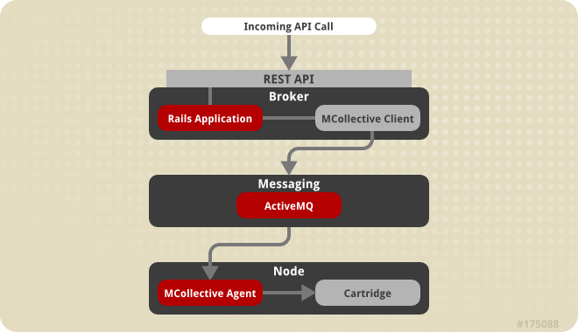
COMMUNICATION
Communication from external clients occurs through the REST API
The Broker then communicates through the messaging service to nodes

Slide 24
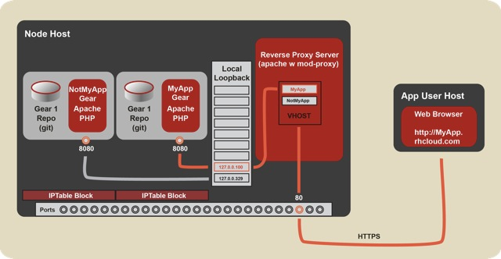
HTTP FLOW
Notes:
OpenShift Origin - Port Proxy
Linux handles the loopback interface's 127.0.0.0/8 address block specially: A request from an address in this block can only go to an address in the same block (put another way, a connection on the loopback interface is confined to the loopback interface). OpenShift uses this fact to contain hosted applications: a gear is prohibited by iptables from listening on an external network interface, and so a given gear can only respond to connections that come from processes on the same node.
For the common case of Web connections, the system Apache instance acts as a reverse proxy, forwarding requests that come in on the external interface to the appropriate 127.x.y.z address; see the documentation on the node component.
However, sometimes gears need to accept other types of connections. The two most common such scenarios are the following:
A gear needs to connect to another gear (which may be on the same node or another node).
A gear needs to listen for connections on a public interface besides HTTP connections to port 80.
For example, a game server needs to expose a port to receive incoming connections from clients, and a database needs to expost a port so that other gears can connect to it.
To meet these needs, OpenShift uses haproxy to proxy TCP connections between an external-facing network interface and the loopback interface. Each gear is assigned five exposable ports, and the gear may establish a forwarding rule for each of these ports to forward connections on the the port on the external interface to an arbitrary port on the gear's assigned loopback address.
To provide haproxy with adequate ports, we shift the ephemeral port range down to 15000-35530, so that Linux will not use ports outside of this range for connections for which no port is given explicitly. This means that ports 35531-65535 will be available for haproxy's exclusive use.
Note: Given that each gear is assigned 5 ports, this imposes a limit of 6000 gears per node.
The interaction with haproxy is implemented on the cartridge side in cartridges/openshift-origin-cartridge-abstract/abstract/info/lib/network
and:
OpenShift Origin - Node Component
Hosted applications are run in containers called "gears." These gears are run on hosts (which can be physical hosts or virtual machines) called "nodes."
Each node runs a system Apache instance with mod_proxy that listens on port 80 on a public-facing network interface. Each gear is assigned an address in the 127.0.0.0/8 block, and a hosted Web application listens on port 8080 on its assigned private 127.x.y.z address.
When a Web client requests a URL for a hosted Web application, the request goes to the node's system Apache instance. The system Apache instance examines the virtual-host header (the "Host:" HTTP header) and dispatches the request to the 127.x.y.z:8080 private address of the appropriate gear.
For an explanation of how connections other than regular HTTP connections are handled, see the documentation on the port-proxy.

Slide 25
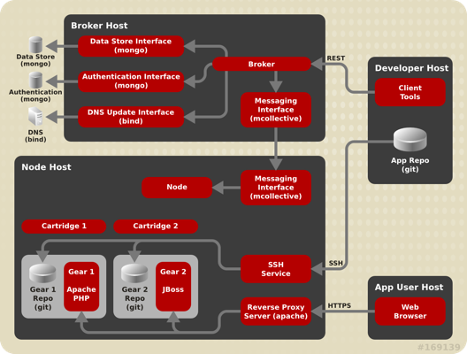
COMPLETE PICTURE

Slide 26
Easy to install on Fedora 18
Using Vagrant and Puppet
    http://www.krishnaraman.net/installing-openshift-origin-using-vagrant-and-puppet/
Also install on Fedora 17
    Using kickstart
      http://www.krishnaraman.net/building-a-multi-node-openshift-origin-paas-from-source/

Slide 27

GET INVOLVED!
CHANNELS
G+ Community
https://plus.google.com/communities/114361859072744017486
E-Mail
  OpenShift Users: users@lists.openshift.redhat.com
  Origin Developers: dev@lists.openshift.redhat.com
IRC: irc.freenode.net
  OpenShift Users: #openshift
  Origin Developers: #openshift-dev

Slide 28
GET INVOLVED!
CHANNELS
Forums
http://openshift.redhat.com/community/forums/openshift
Blogs
  https://openshift.redhat.com/community/blogs/
  http://mattoncloud.org/
  http://www.billdecoste.net
  http://www.krishnaraman.net
  http://cloud-mechanic.blogspot.com

Slide 29
GET INVOLVED!
OPENSOURCE
GitHub: https://github.com/openshift
  Origin: origin-server
  Internal Extensions: li
  Community Cartridges: origin-community-cartridges
    https://github.com/jwhonce/origin-server/tree/dev/cartridge_refactor
  Quickstarts, Examples
  Watch, Star, Contribute!!!

Slide 30
Conclusion
PaaS is a Developers AND Sysadmins dream
We are doing really cool things with Linux to make it happen
Easy to get started on Fedora
Fun and interesting place to spend your time – COME JOIN US!!!
SIGN UP CODE:
SCaLE11
http://openshift.redhat.com

