Slide 1
Introduction to FreeNAS development
John Hixson
john@ixsystems.com
iXsystems, Inc.
Notes:
Who am I? John Hixson ...
What do I do? FreeNAS ...
Ixsystems are the corporate sponsors for FreeNAS and PC-BSD
Ixsystems contributes heavily to FreeBSD
Ixsystems sponsors lots of open source conferences
Several FreeBSD committers are on our staff

Slide 2
A bit about me
BSD geek that does geeky BSD things
Maintains jail, plugin, and directory service systems on FreeNAS
Occasional committer to PC-BSD
Hacks on FreeBSD once in a blue moon
All my time goes into FreeNAS!

Slide 3
A bit about iXsystems
Corporate sponsor of PC-BSD
Corporate sponsor of FreeNAS
Employ several FreeBSD committers
Sponsor several open source conferences every year
Contribute heavily to FreeBSD

Slide 4
What this talk will cover
What FreeNAS is
Adding a feature to the UI
Adding software to the operating system
How to contribute

Slide 5
What FreeNAS is:
100% free and open source network attached storage operating system
Built on FreeBSD and ZFS
CIFS, NFS, AFP, iSCSI, etc
Over 6 million downloads to date

Slide 6
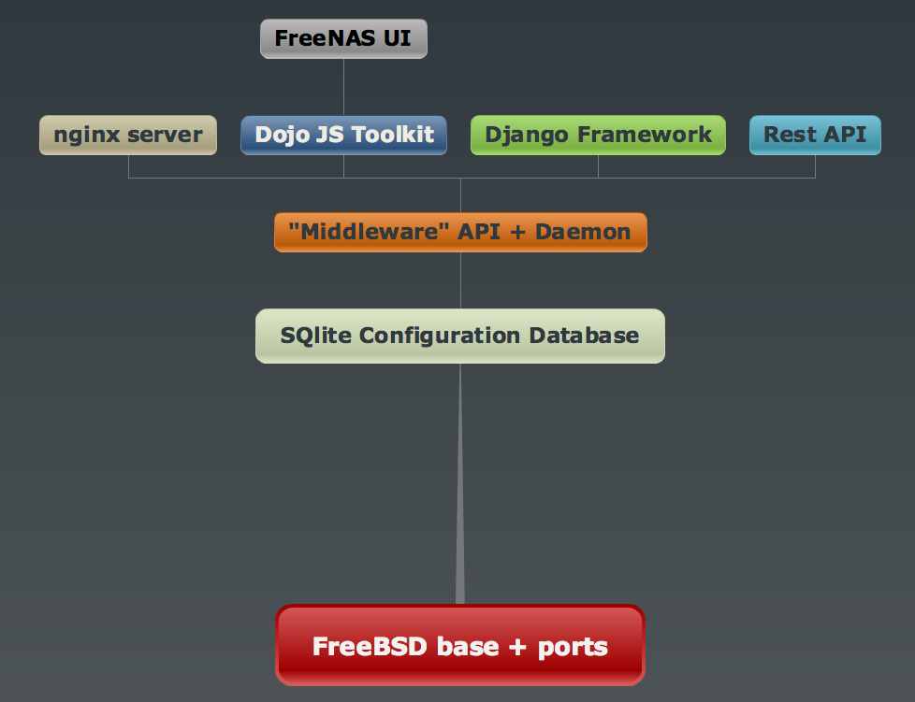

Slide 7
A quick look at FreeNAS

Slide 8
Adding a feature to the UI
Add service entry for the feature
Create feature model, form and view
Make the middleware aware of feature
Add a startup / shutdown script for the feature
Javascript to toggle feature on and off

Slide 9
Adding a feature to the UI
Add service entry for the feature
Create feature model, form and view
Make the middleware aware of feature
Add a startup / shutdown script for the feature
Javascript to toggle feature on and off

Slide 10
class Migration(SchemaMigration):
def forwards(self, orm):
....
p = orm.Ponies()
p.save()
s = orm.Services()
s.srv_service = 'ponies'
s.srv_enable = False
s.save()

Slide 11
Adding a feature to the UI
Add service entry for the feature
Create feature model, form and view
Make the middleware aware of feature
Add a startup / shutdown script for the feature
Javascript to toggle feature on and off

Slide 12
class Ponies(Model):
class Meta:
verbose_name = _(u"Ponies")
verbose_name_plural = _(u"Ponies")
class FreeAdmin:
deletable = False

Slide 13
class PoniesForm(ModelForm):
class Meta:
fields = '__all__'
model = models.Ponies

Slide 14
def core(request):
....
return render(request, 'services/core.html', {
...
'ponies': ponies,
})
def servicesToggleView(request, formname):
form2namemap = {
....
'ponies_toggle': 'ponies',
}
....

Slide 15
Adding a feature to the UI
Add service entry for the feature
Create feature model, form and view
Make the middleware aware of feature
Add a startup / shutdown script for the feature
Javascript to toggle feature on and off

Slide 16
class notifier:
....
def _started_ponies(self):
self._system("/usr/sbin/service ponies status")
def _start_ponies(self):
self._system("/usr/sbin/service ponies start")
def _stop_ponies(self):
self._system("/usr/sbin/service ponies stop")
def _restart_ponies(self):
self._system("/usr/sbin/service ponies restart")

Slide 17
Adding a feature to the UI
Add service entry for the feature
Create feature model, form and view
Make the middleware aware of feature
Add a startup / shutdown script for the feature
Javascript to toggle feature on and off

Slide 18
exit 0

Slide 19
Adding a feature to the UI
Add service entry for the feature
Create feature model, form and view
Make the middleware aware of feature
Add a startup / shutdown script for the feature
Javascript to toggle feature on and off

Slide 20
ponies_on = false;
toggle_ponies = function(obj, onSuccess) {
if (ponies_on == false) {
BrowserPonies.start();
ponies_on = true;
} else {
BrowserPonies.stop();
ponies_on = false;
}
return toggle_service(obj, onSuccess);
}

Slide 21
Let's see the newly added feature

Slide 22
Adding software to the system
Add sound driver to kernel config
Add mp3 program to NanoBSD config
Build images
Upgrade system

Slide 23
Adding audio to FreeNAS
Add sound driver to kernel config
Add mp3 program to NanoBSD config
Build images
Upgrade system

Slide 24
...
add_nano_modules \
sound sound/driver/ich sound/driver/hda

Slide 25
Adding audio to FreeNAS
Add sound driver to kernel config
Add mp3 program to NanoBSD config
Build images
Upgrade system

Slide 26
...
add_port audio/mpg123

Slide 27
Adding audio to FreeNAS
Add sound driver to kernel config
Add mp3 program to NanoBSD config
Build images
Upgrade system

Slide 28
[root@freenas /mnt/vol0/git/freenas]# make
No git repo choice is set. Please use "make git-external" to build as an external developer or "make git-internal" to build as an iXsystems internal developer. You only need to do this once.
*** [git-verify] Error code 1
Stop in /mnt/vol0/git/freenas.
[root@freenas /mnt/vol0/git/freenas]# make git-external
You are set up for external (github) development. You can use the standard make targets (e.g. build or release) now.

Slide 29
Adding audio to FreeNAS
Add sound driver to kernel config
Add mp3 program to NanoBSD config
Build images
Upgrade system

Slide 30
FreeNAS with audio

Slide 31
Debugging
Logging
/var/log/messages
/var/log/nginx-*
/var/log/debug.log
settings.py: DEBUG = True
freenas-debug
Javascript debuggers in web browsers
Notes:
Debugging FreeNAS is no different from debugging any other web framework, logs of logging and lots of javascript debugging
/var/log/messages contains a plethora of general information about what is going on
/var/log/nginx-error.log will show you lots of django python errors when things go wrong
/var/log/debug.log can be turned on in syslog.conf and a wealth of debugging information will be logged to it
When things don't go well in the interface and it isn't immediately obvious what is going on, the javascript debuggers available for your web browser are very useful

Slide 32
How to get involved
FreeNAS always needs help!
Patches can be submitted
Pull requests on github can be made
Documentation can be contributed
Bugs can be filed
Use cases can be documented
Help with translations
Notes:
FreeNAS needs all the help it can get! We are constantly trying to improve it
Anyone can contribute to FreeNAS! You don't need to be a developer or any kind of expert, if if you just use FreeNAS you can contribute back!
Code can be contributed, documentation can be contributed, there are numerous ways
Even if you just use FreeNAS, we want to hear how you use it, how well it's worked for you, what improvements can be made
When problems occur or feature requests are wanted, file a bug! We screen them vigorously !
We can all make FreeNAS the best open source NAS out there!

Slide 33
Where to get the code
FreeNAS source code is hosted on GitHub
git clone http://github.com/freenas/freenas.git freenas
Must be built on FreeBSD or PC-BSD 9.2 system with a full development environment
README file at root of checkout contains build requirements and instructions
Notes:
Github is used to host the FreeNAS source code
The github repo is actually a mirror of our internal iX freenas repo
All changes from internal iX repo are synchronized with github
Pull requests can be made to make modifications github repo
How are github pull requests synchronized with internal repo?
To get code, just do a git clone, this will get you the master branch. All other branches can be checked out from this branch.

Slide 34
Resources
Website: http://www.freenas.org
Docs: http://doc.freenas.org
Forum: http://forums.freenas.org
Bugs: http://bugs.freenas.org
Email: http://lists.freenas.org
IRC channel on freenode

Slide 35
Conclusion
FreeNAS is 100% open source
FreeNAS is very powerful
FreeNAS can be extended and customized to fit your needs
Demonstrating a simple application will hopefully give those interested that extra kick to do so!
Everyone can contribute to FreeNAS!
Notes:
FreeNAS can do anything you want it too
Developing for FreeNAS is not very well documented and hopefully by demonstrating how you go about writing an application, more people will be interested
Anybody can contribute to FreeNAS

Slide 36
Questions?

