Slide 1
Introduction to Kali Tools:
Unicornscan,
Nmap and
OpenVAS
Nathan Chan

Slide 2
Who am I?
Software background
Flight simulators
Defense and aerospace avionics
Some commercial applications
Relatively new to security but
have CISSP, CEH and CPT certs

Slide 3
Who am I?
Spent a year writing scripts for an
incident response team for a very
large intranet
Current company works with audit
committees to find vulnerabilities in
internal and external networks

Slide 4
Agenda:
Why do we need this?
Legal Warning
Tools: Kali, Unicornscan, Nmap
OpenVAS, MagicTree
Demo

Slide 5
Why do we need this?
Check networks periodically for
vulnerabilities, which are possible
avenues for attack
These tools are only a few of many
available that can help find
vulnerabilities

Slide 6
Why do we need this?
While these tools may help, it is better
to have a professional audit or
penetration test to determine system
vulnerabilities

Slide 7
Legal Warning
These tools must not be used on
networks that you or your company
do not own!
If your company does not own the
network, check with your lawyer or
legal department to determine if you
have permission to scan the network.

Slide 8
Legal Warning
This is especially true if you are doing
scans from "outside" your network
(via the Internet). You can be legally
charged with committing a crime.
Good providers should have IPS/IDS
(Intrusion Prevention/Detection
System) that monitor if their system is
being probed or monitored

Slide 9
Tools
Kali (formally Backtrack)
Well known penetration testing and
hacking live Linux distribution
Can be run live on a DVD or thumb
drive, be installed virtually or as its
own machine

Slide 10
Tools
Kali contains many tools for
penetration testing and hacking
http://www.kali.org/

Slide 11
Tools
Unicornscan
Known for fast UDP port scans, also
scans TCP ports
May have to be installed separately
http://www.unicornscan.org/

Slide 12
Tools
Nmap
"Network Mapper" - very versatile
and configurable
http://nmap.org/

Slide 13
Tools
OpenVAS
"Open Vulnerability Assessment
System" - a free branch from
Nessus
Results aren't guaranteed to be
correct and need to be interpreted
http://www.openvas.org/

Slide 14
Tools
MagicTree
Can produce reports from Nmap
and OpenVAS output files
Need to install openoffice.org
separately to get it to work
http://www.gremwell.com/what_is_magictree

Slide 15
Demo
Show Kali and three other vulnerable
operating systems on a virtual network
Run a shell script that runs
unicornscan then pipes the output to
nmap
Show configuration of OpenVAS

Slide 16
Demo
Demonstrate how the results of scans
can be put together in a report by
using MagicTree
Utilize onetwopunch.sh by Harold
Rodriguez (superkojiman) found at
http://blog.techorganic.com/2012/05/port-scanning-one-two-punch.html

Slide 17
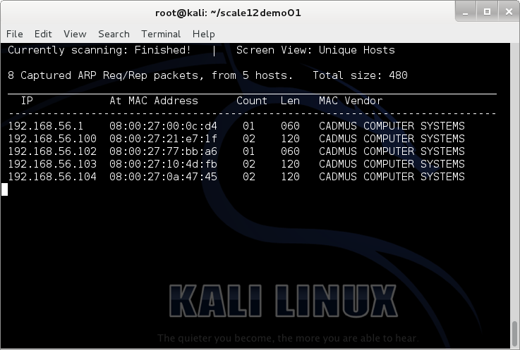
Netdiscover

Slide 18
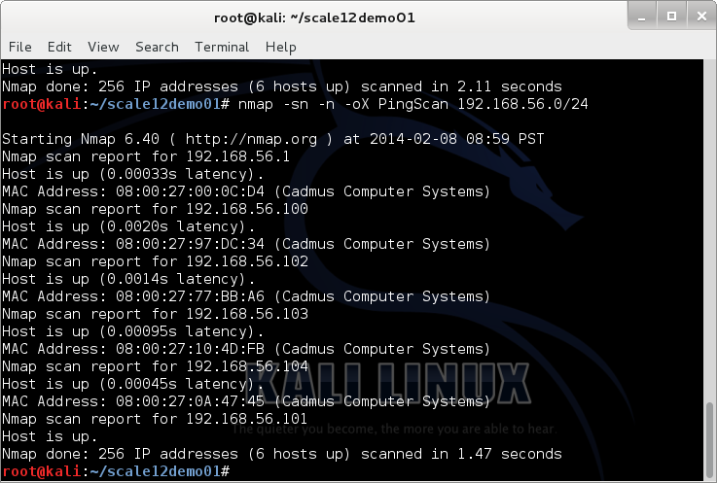
Nmap Ping Scan

Slide 19
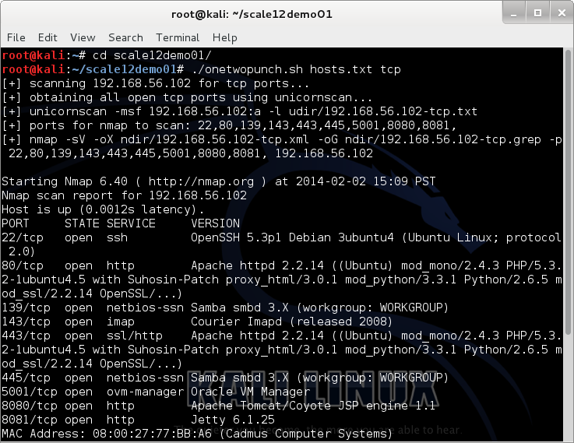
onetwopunch TCP 102

Slide 20
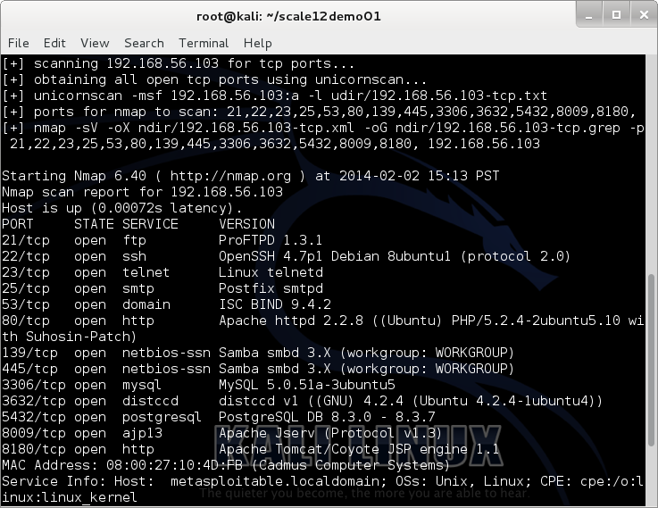
onetwopunch TCP 103

Slide 21
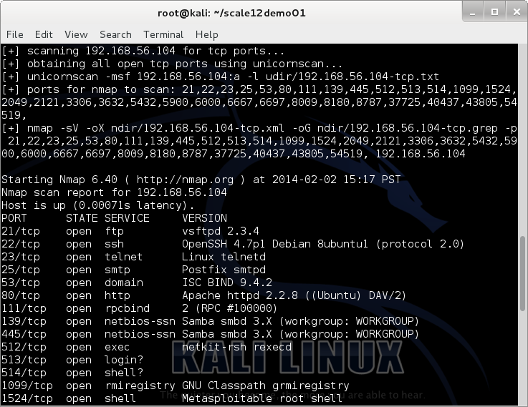
onetwopunch TCP 104 #1

Slide 22
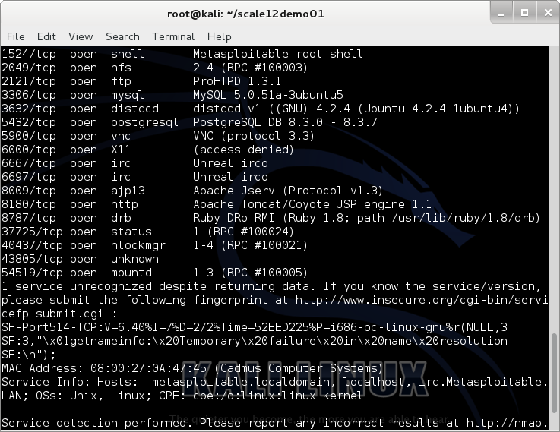
onetwopunch TCP 104 #2

Slide 23
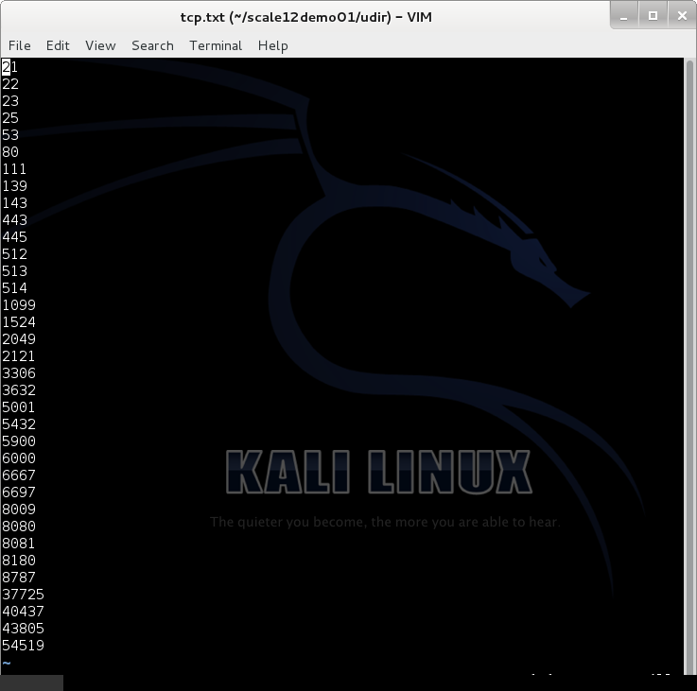
TCP ports

Slide 24
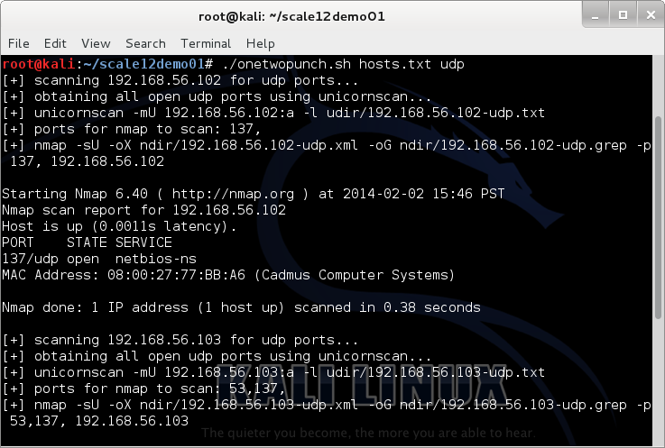
onetwopunch UDP 102

Slide 25
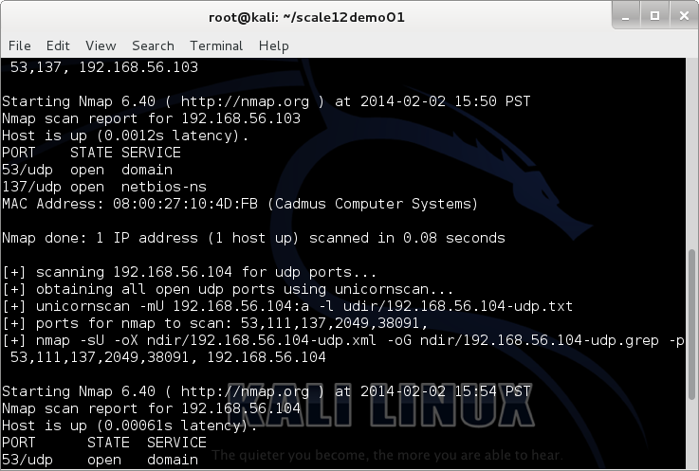
onetwopunch UDP 103

Slide 26
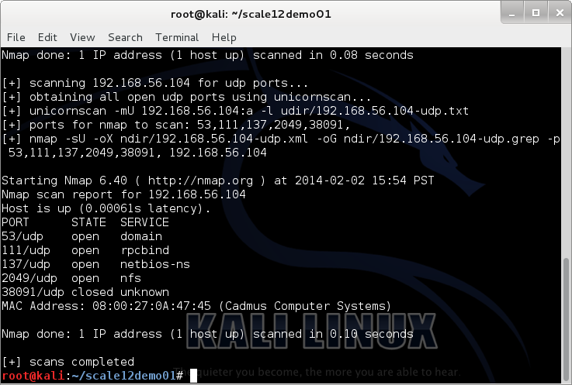
onetwopunch UDP 104

Slide 27
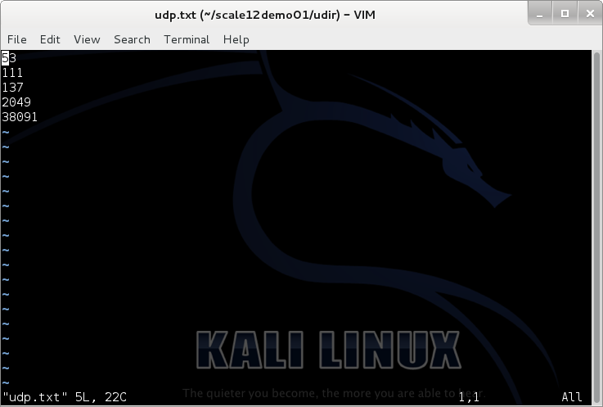
UDP ports

Slide 28
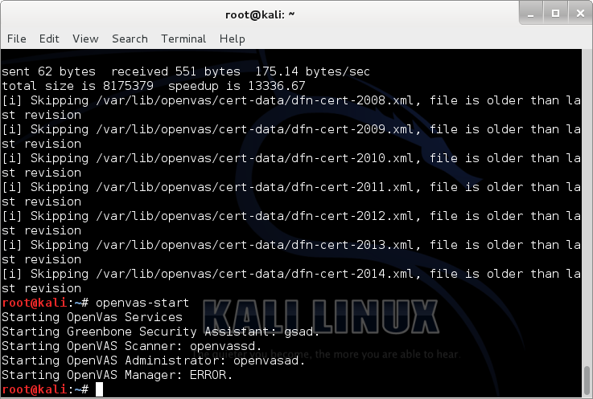
Openvas-start

Slide 29
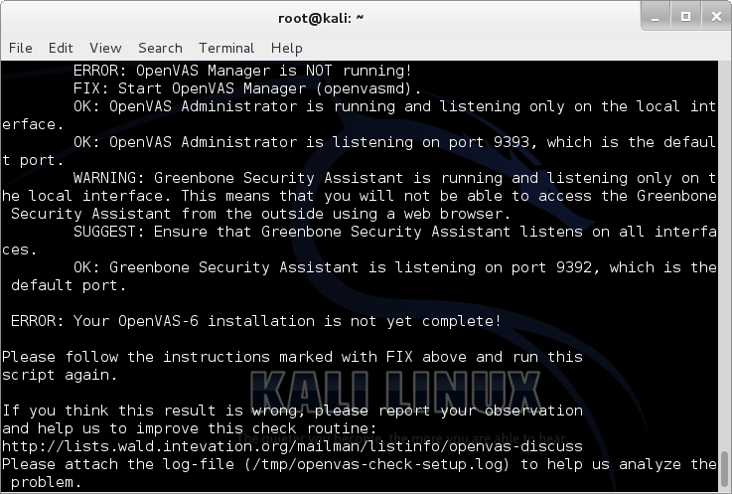
Openvas-check-setup (Manager)

Slide 30
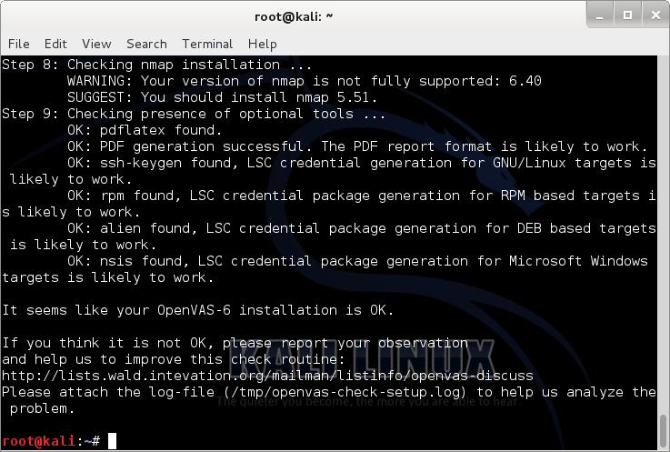
Openvas-check-setup OK

Slide 31
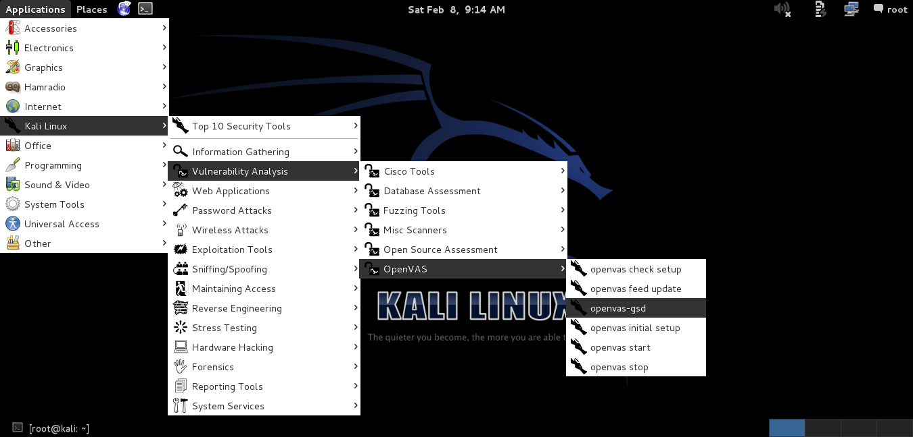
Start OpenVAS

Slide 32
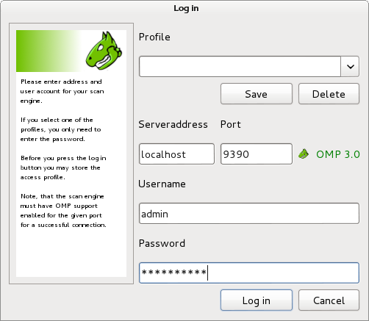
OpenVAS Login

Slide 33
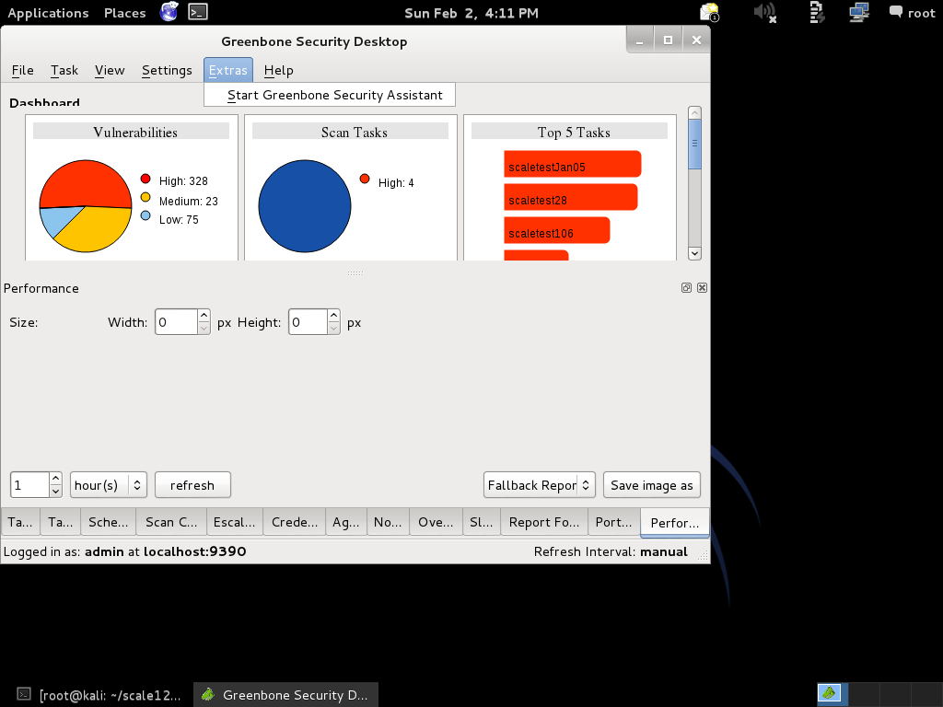
Greenbone Security Desktop

Slide 34
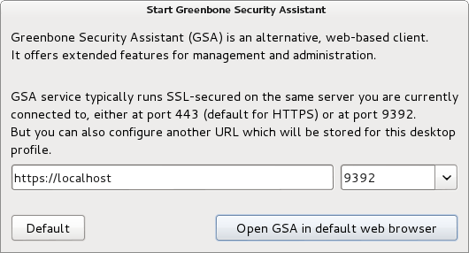
Start Greenbone Security Assistant

Slide 35
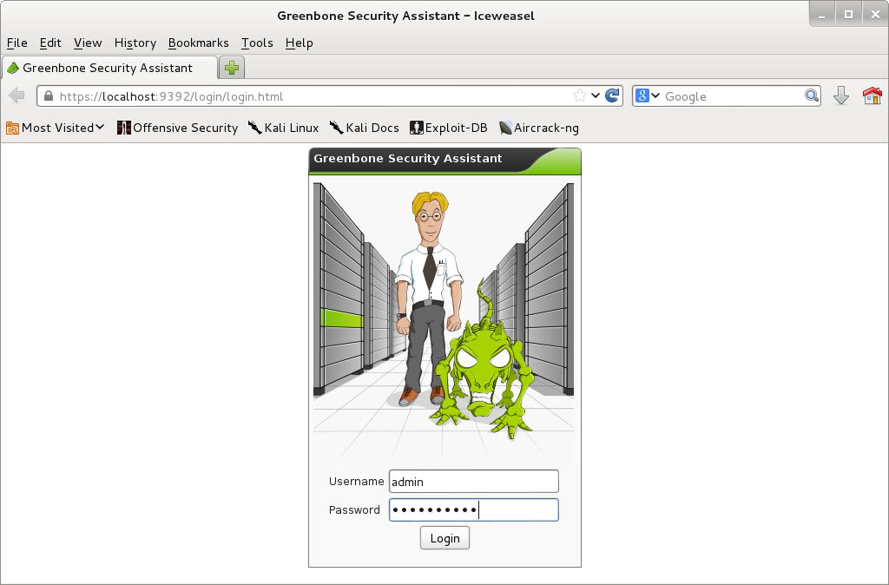
GSA Web Login

Slide 36
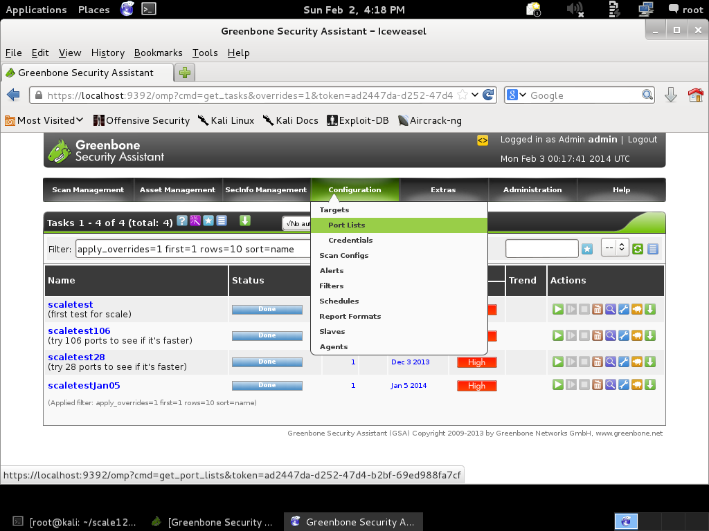

Slide 37
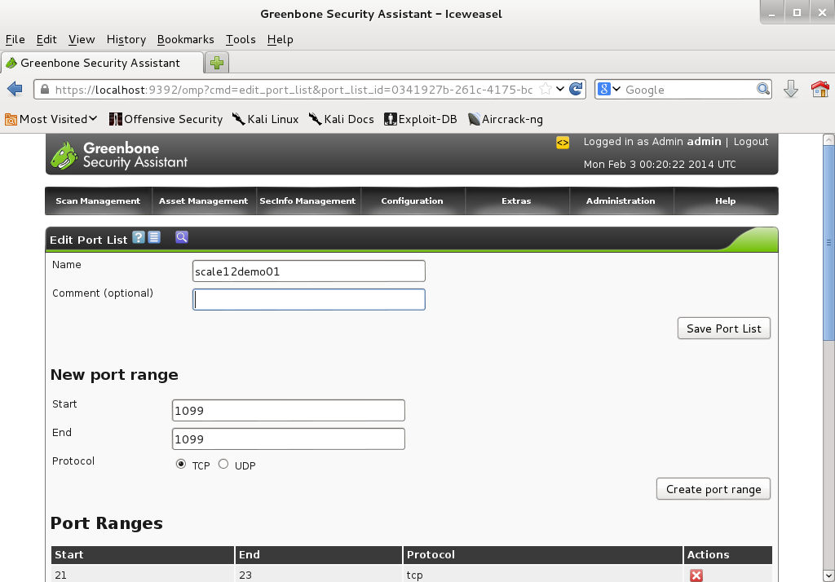

Slide 38
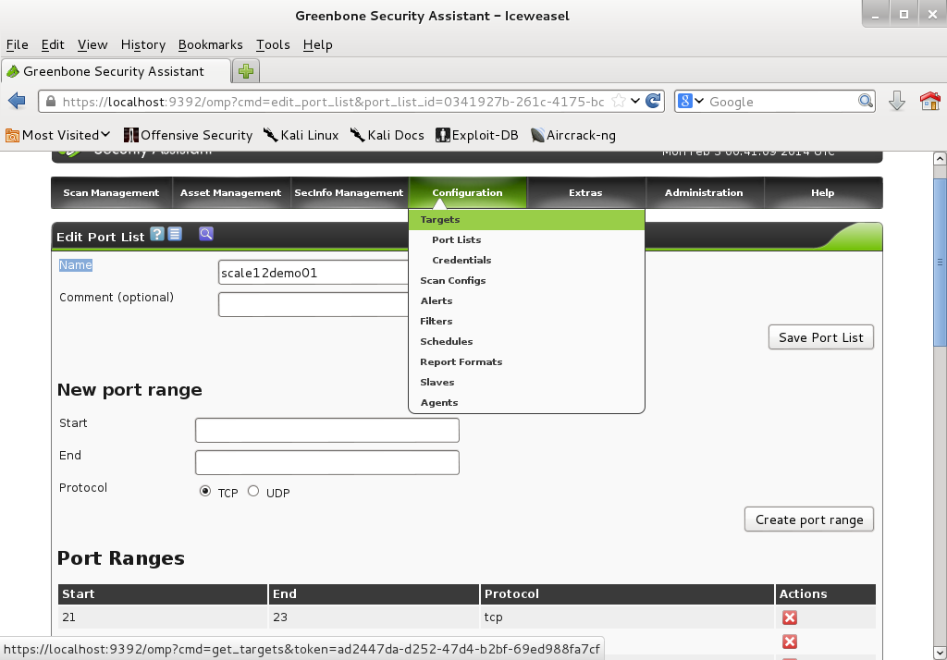

Slide 39
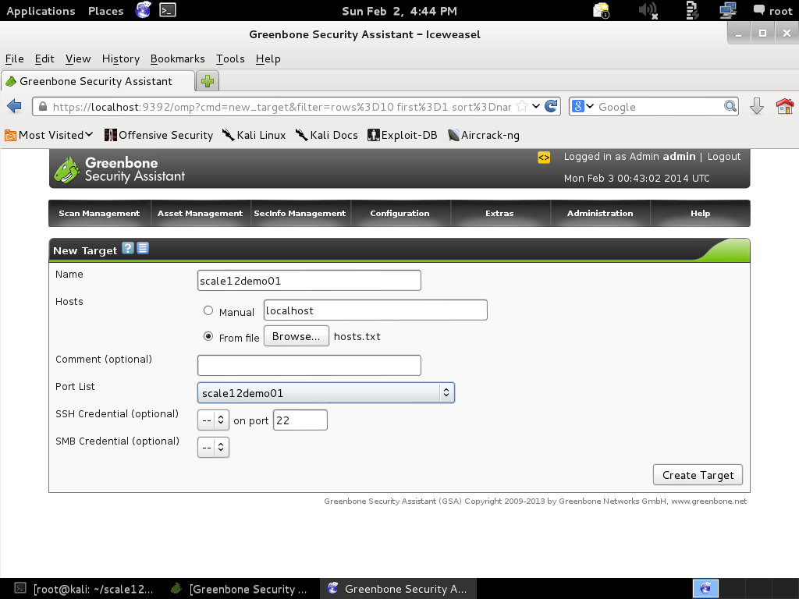

Slide 40
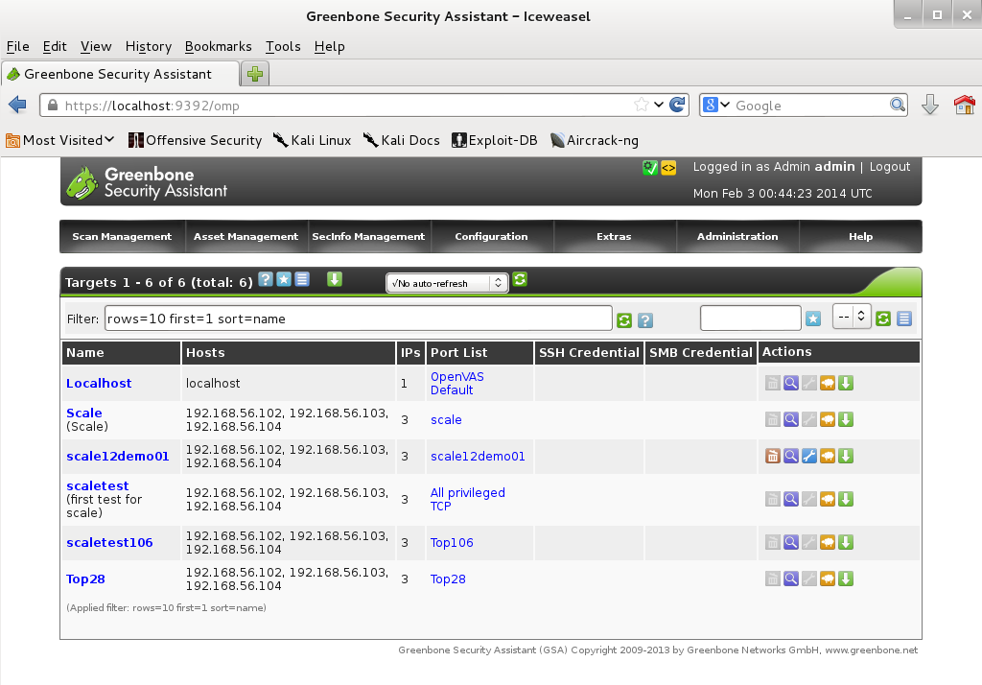

Slide 41
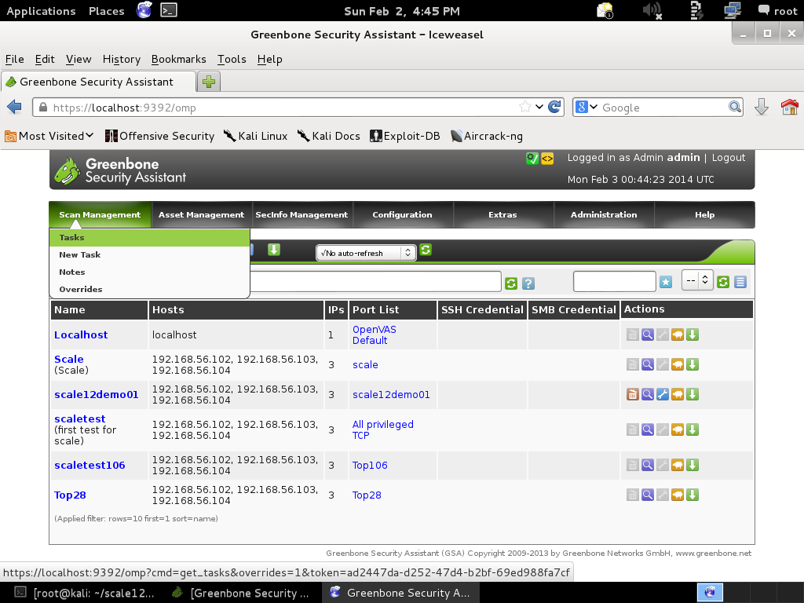

Slide 42
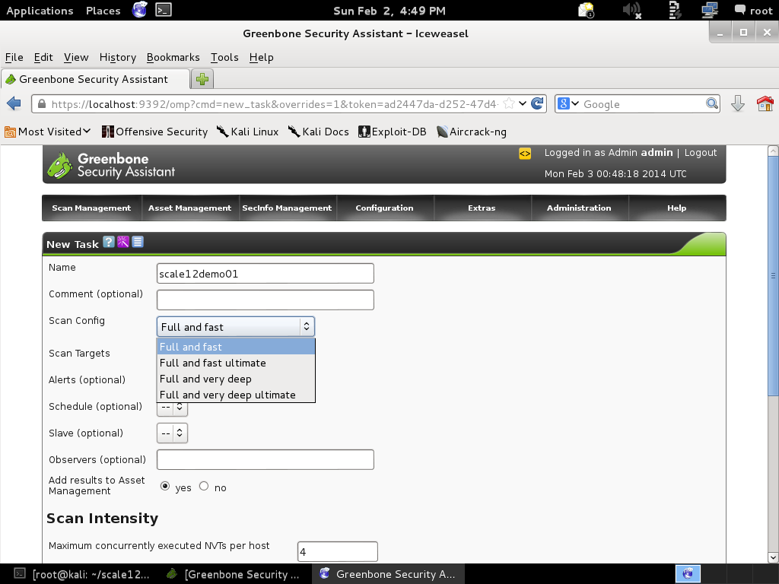

Slide 43
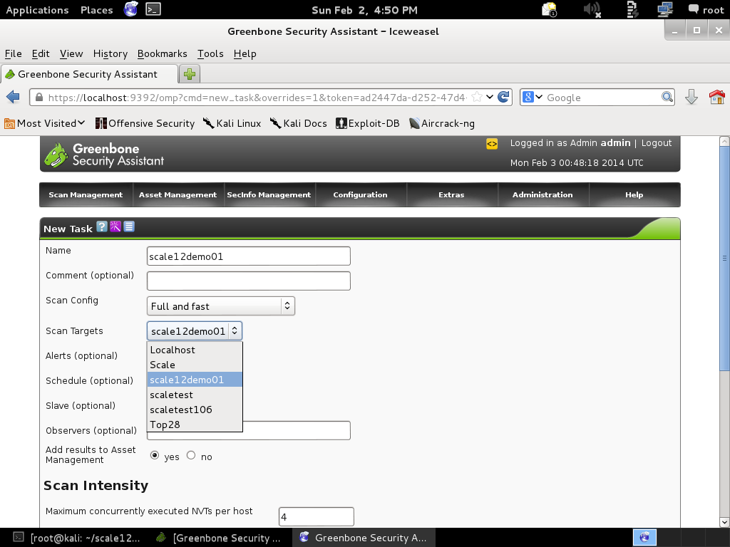

Slide 44
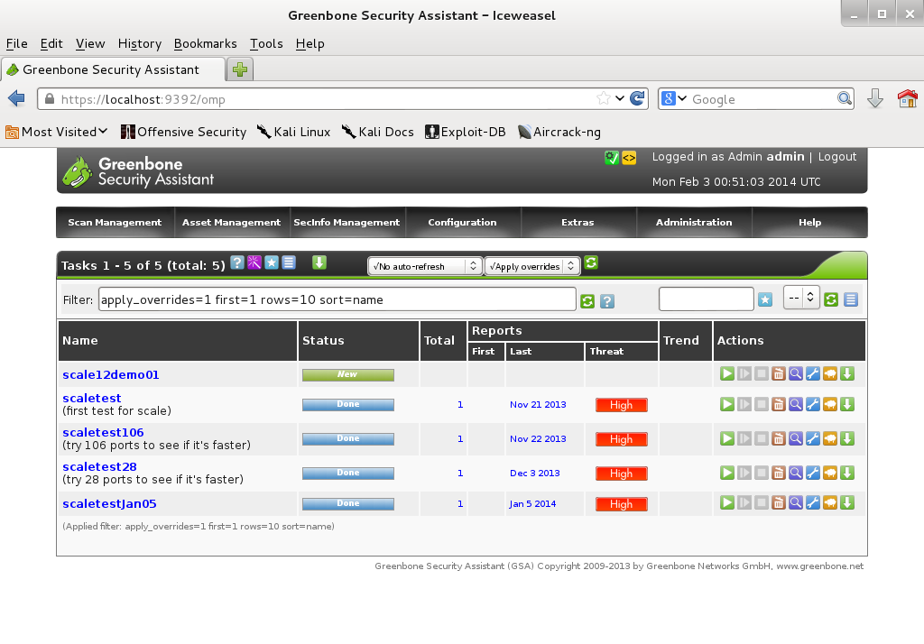

Slide 45
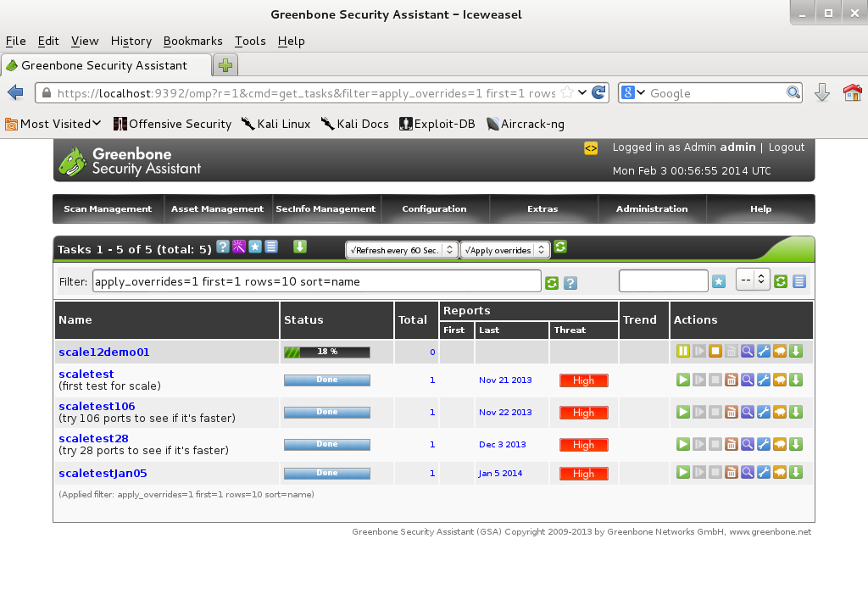

Slide 46
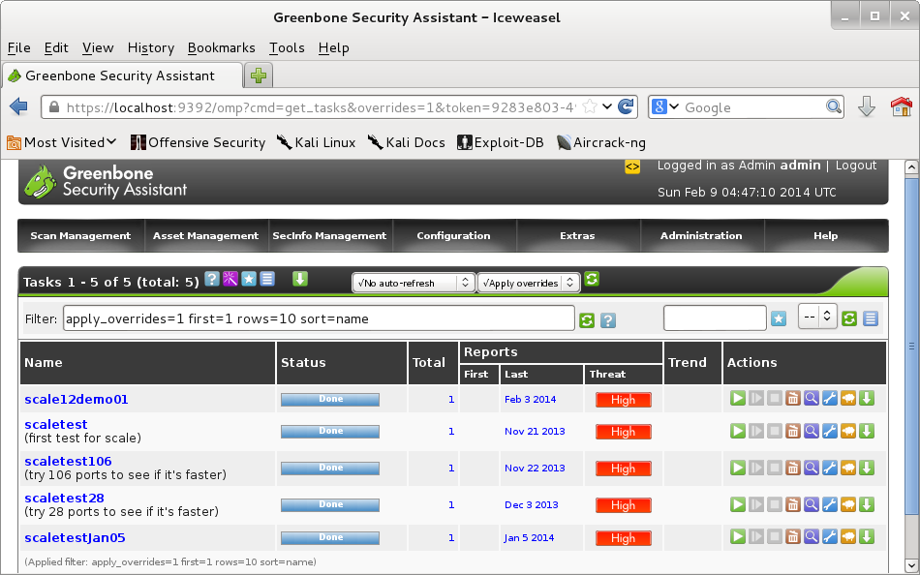

Slide 47
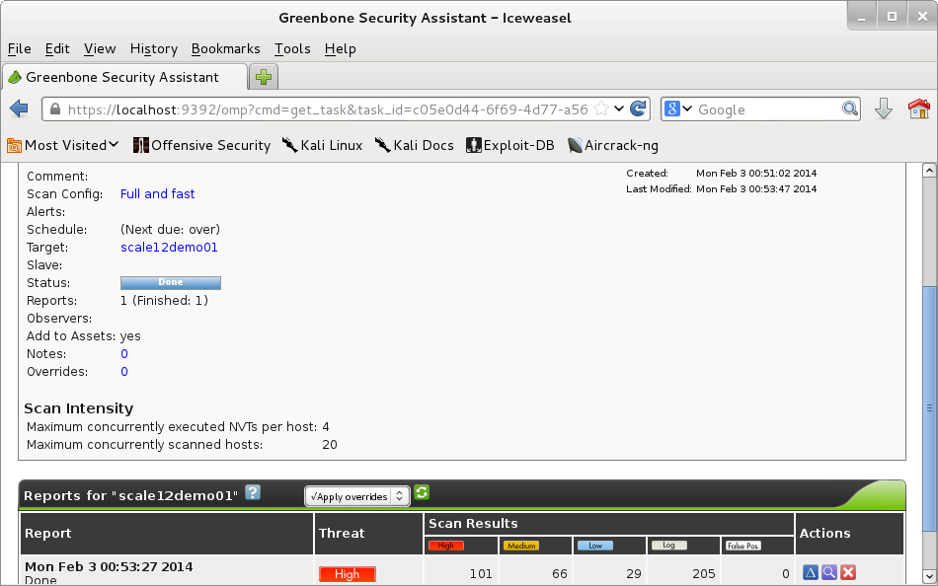

Slide 48
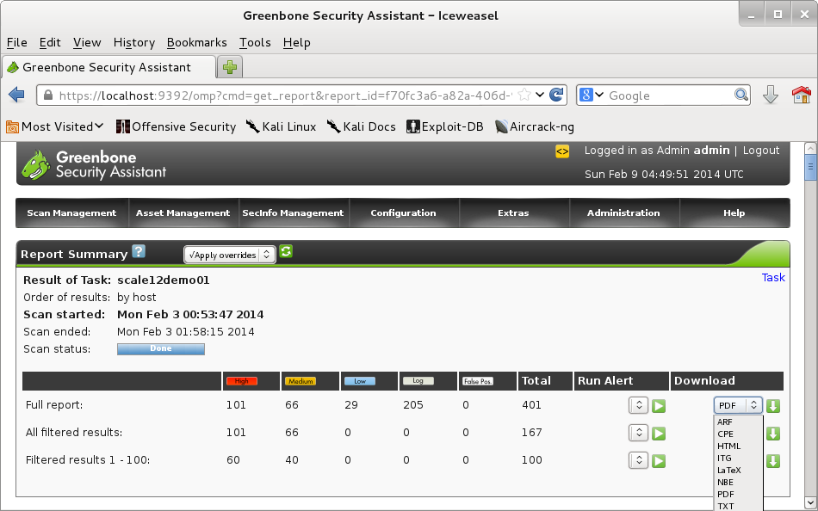

Slide 49
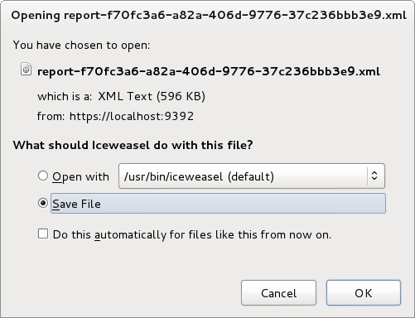
Download XML Report

Slide 50
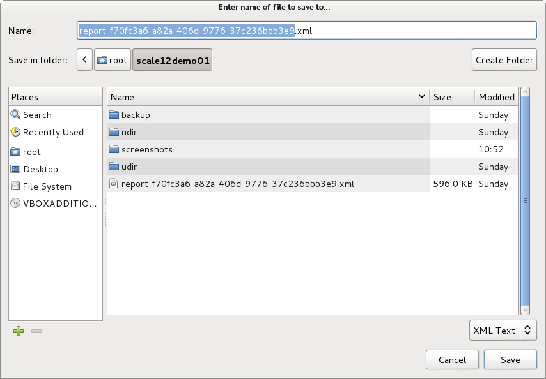

Slide 51
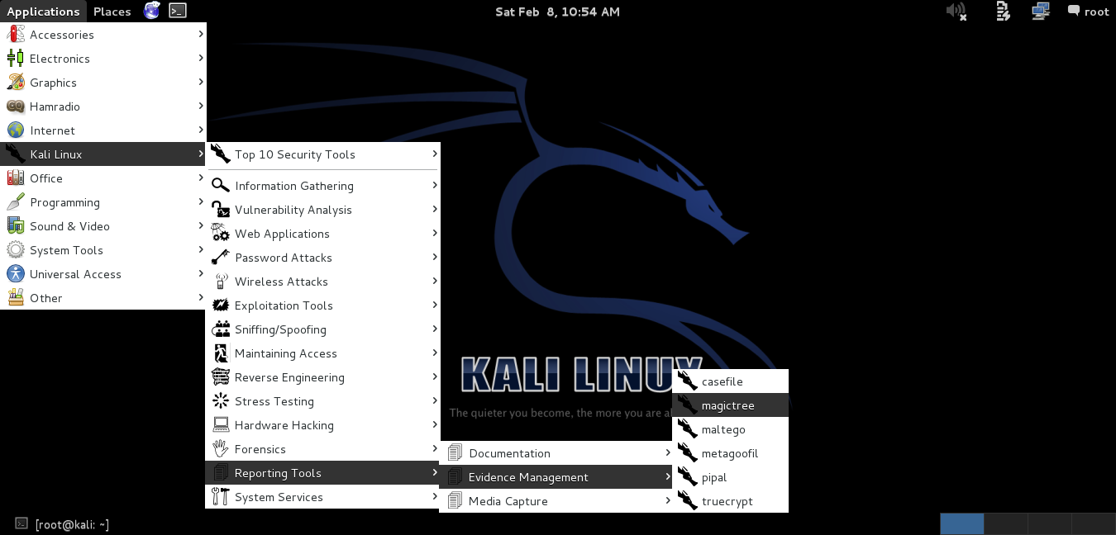
Starting Magictree

Slide 52

Magictree Splash

Slide 53
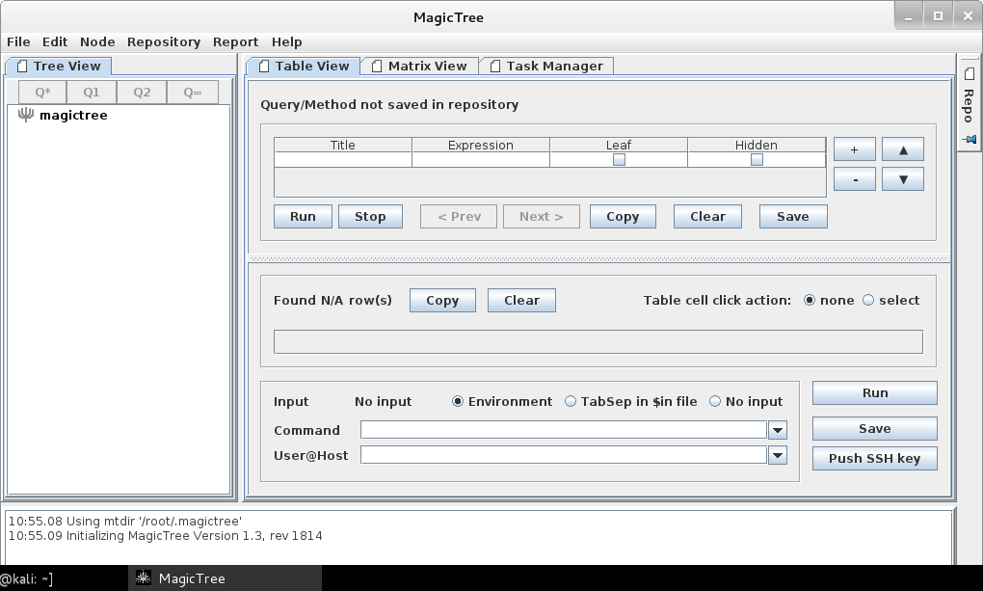
Magictree Panel

Slide 54
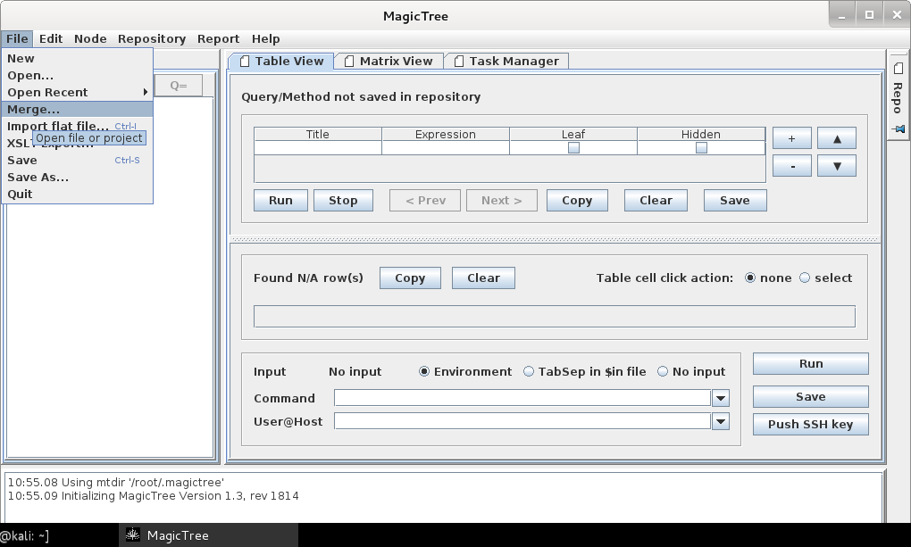
Magictree File Menu → Merge

Slide 55
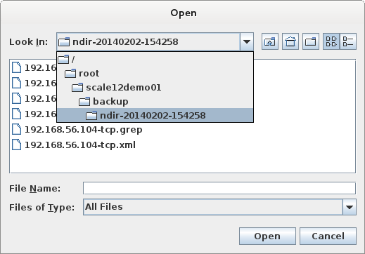
Magictree Merge → Open TCP

Slide 56
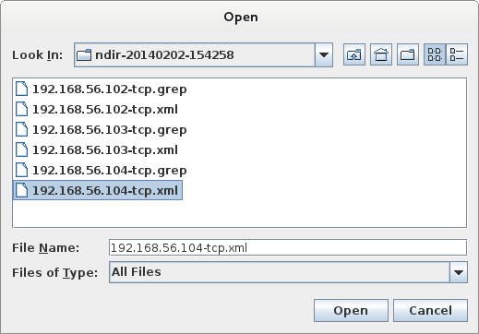
Magictree Select TCP 104

Slide 57
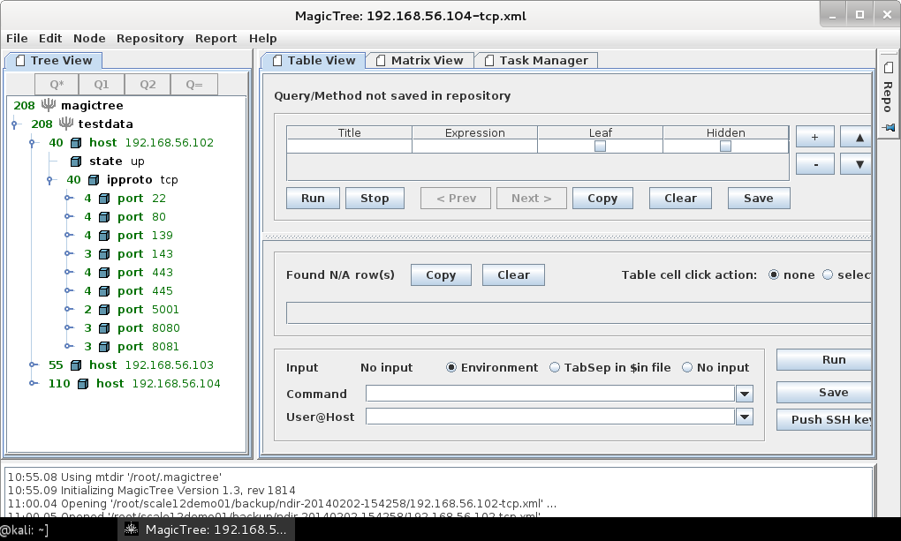
Magictree 102 TCP Ports

Slide 58
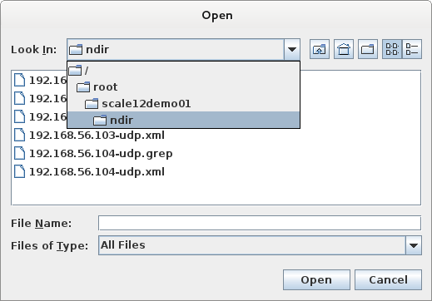
Magictree Merge → Open UDP

Slide 59
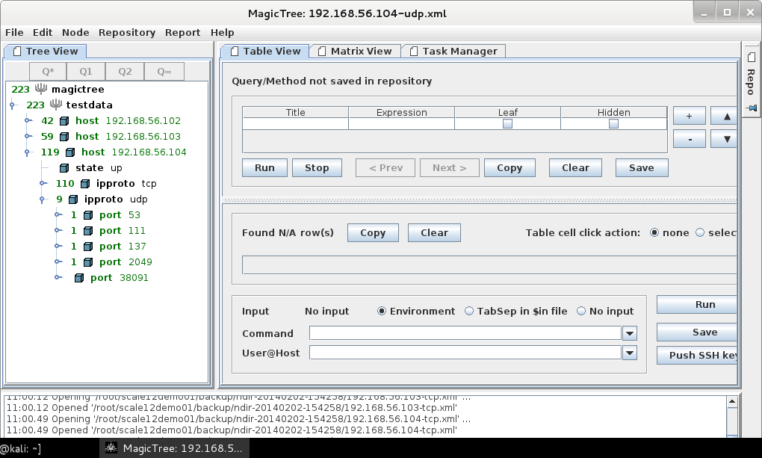
Magictree 104 UDP Ports

Slide 60
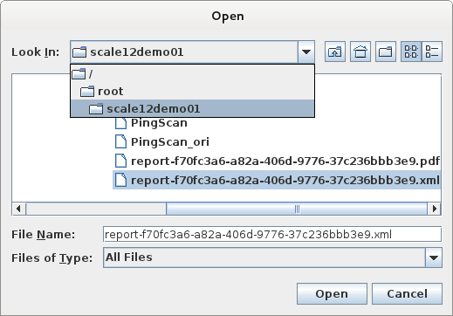
Magictree Merge → Open OpenVAS

Slide 61
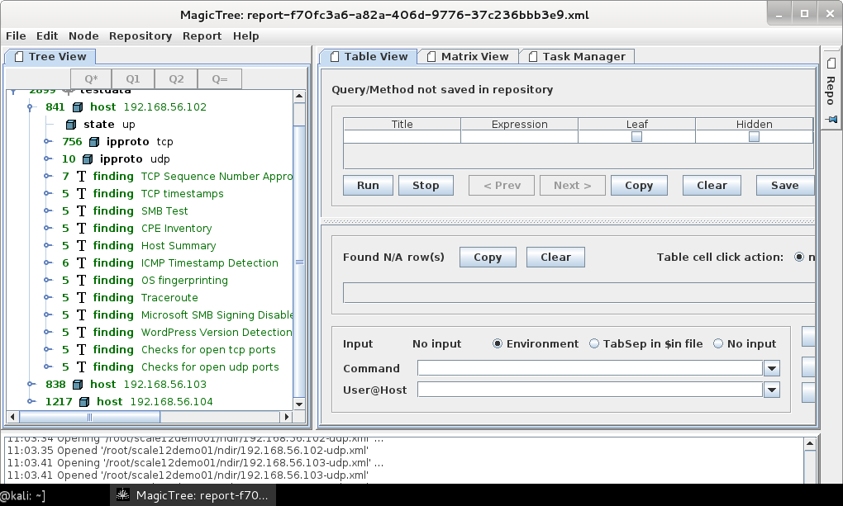
Magictree 102 OpenVAS Findings

Slide 62
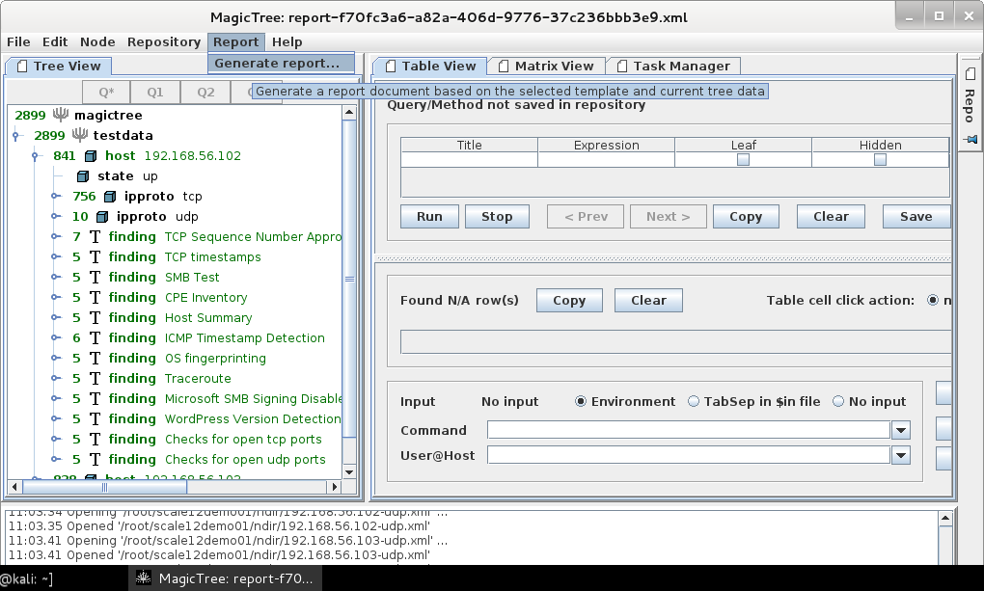
Magictree Menu Generate Report

Slide 63
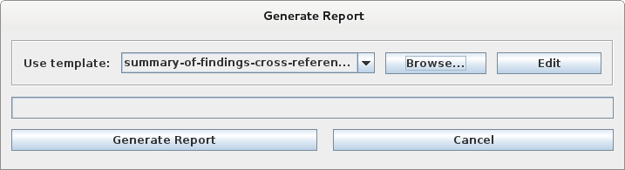
Magictree Generate Report

Slide 64
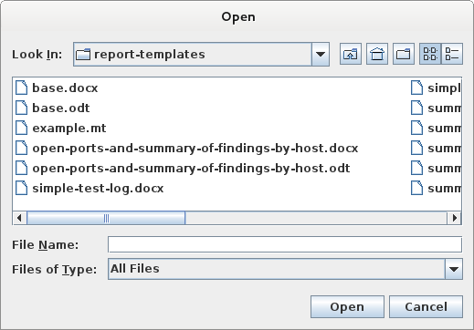
Magictree Report Browse

Slide 65
Questions?

Slide 66
Contact
chan8w111@gmail.com
Also on LinkedIn, but say how we met
on your request

Slide 67
Notes
Virtualbox
https://www.virtualbox.org/wiki/Downloads
If not installing Kali in hardware, can try it
out by installing Kali on Virtualbox.
(VMWare Player is not free for commercial
Use.)
See
http://kanishkashowto.wordpress.com/2013/09/03/how-to-install-kali-linux-in-virtualbox-step-by-step-guide/

Slide 68
Notes
VMWare Player
https://my.vmware.com/web/vmware/free#desktop_end_user_computing/vmware_player/6_0
VMWare Player is not free for commercial
use. See also
http://docs.kali.org/general-use/install-vmware-tools-kali-guest
KVM (on Linux hosts)
http://www.linux-kvm.org/page/Downloads

Slide 69
Notes
Once virtual machine is created,
install Kali on it.
Get the latest version of Kali at
http://www.kali.org/downloads/
Make sure to use “Install”, not
“Graphical install”

Slide 70
Notes
Once Kali is installed in VirtualBox,
install VirtualBox Guest Additions.
This enables transfer of files between
Kali and the host machine.
See http://docs.kali.org/general-use/kali-linux-virtual-box-guest
Then update to the latest software
apt-get update
apt-get dist-upgrade

Slide 71
Notes
apt-get upgrade
Also install
apt-get install openoffice.org
apt-get install pure-ftpd

Slide 72
Notes
Setup OpenVAS
See
http://www.openvas.org/install-packages-v5.html#openvas_debian_obs
Install other needed packages
apt-get -y install texlive-latex-base*
apt-get -y install texlive-latex-extra*
apt-get -y install texlive-latex-recommended*
apt-get -y install htmldoc

Slide 73
Notes
apt-get -y install alien
apt-get -y install rpm
apt-get -y install nsis
apt-get -y install fakeroot*
These can be installed in fewer lines.
The link given does it in two lines.

Slide 74
Notes
Configure OpenVAS
Make sure /usr/bin/openvas-setup is
test -e /var/lib/openvas/CA/cacert.pem || openvas-mkcert -q
openvas-nvt-sync
test -e /var/lib/openvas/users/om || openvas-mkcert-client -n om -i
/etc/init.d/openvas-manager stop
/etc/init.d/openvas-scanner stop
openvassd
openvasmd --rebuild
openvas-scapdata-sync
openvas-certdata-sync
test -e /var/lib/openvas/users/admin || openvasad -c add_user -n admin -r Admin
killall openvassd
sleep 15
/etc/init.d/openvas-scanner start
/etc/init.d/openvas-manager start
/etc/init.d/openvas-administrator restart
/etc/init.d/greenbone-security-assistant restart

Slide 75
Notes
Once openvas-setup is corrected,
run:
openvas-setup
Accept all defaults. The initial setup
will take time.

Slide 76
Notes
Once a day, run:
apt-get update
apt-get dist-upgrade
apt-get upgrade
openvas-feed-update
If there are updates to OpenVAS, run
openvas-setup

Slide 77
Vulnerable OS for Practice
Vulnhub
http://vulnhub.com/
This demo used from Vulnhub:
OWASP Broken Web Applications
Metasploitable
Metasploitable2

Slide 78
When Practicing
Using virtual machines, make sure
Kali and the practice operating
systems are all in Host Only Network.
You do not want vulnerable operating
systems exposed to the world,
possibly providing an attack vector.

Slide 79
Kali as Virtual Machine
If Kali does not have its own
designated hardware, use Kali on a
virtual machine using a Bridged
network.

Slide 80
To Learn More
A really good value pen test
certification is offered by Offensive
Security – the OSCP
http://www.offensive-security.com/information-security-certifications/oscp-offensive-security-certified-professional/
http://www.offensive-security.com/information-security-training/penetration-testing-with-kali-linux/
An online course must be completed
before the 24 hour exam is taken.
I think the online course and labs
are an excellent value.

