Slide 1
Linux Authentication
Craig Zeller
St. Jude Medical, Inc.
czeller@sjm.com zeller@zdi.net

Slide 2
Assumptions
Assumptions
  You are a system admin
  You admin enough systems that the workload associated with account add-mod-del is taking too much of your time
  System security and user privileges are an issue
  Fixing it now is better than waiting
  This is not a deep-dive – just enough to whet your appetite

Slide 3
Local Authentication
Even with scripting, provisioning accounts in installations with more than ~50 hosts is time consuming
Inconsistencies in UID/GID mappings
Privilege management is difficult to track

Slide 4
Why Centralize Authentication?
Authentication needs to become “Identity Management”
Belongs at the Global Infrastructure level
Improve time to provision / de-provision accounts
Improve Security posture

Slide 5
What Did You Inherit?
Very few of us are able to build from a clean slate
Wide variety of operating systems
Pre-existing accounts and authentication systems
Acquisitions and Mergers

Slide 6
Leveling The Landscape
If you have older operating systems in your support matrix, UID / GID numbers matter
  NFS < v4
  Don't use recursive chown, chgrp
  Hints in the presentation notes
Password encryption hashes
  NIS, NIS+
  DES 56-bit 8-character password limit
  Older Solaris <10 difficult to move to MD5 and SHA
Notes:
Use:
usermod -u <newuid> <username>
find /startdir -uid <olduid> -exec chown -h <username> {} \;
groupmod -g <newgid> <groupname>
find /startdir -gid <oldgid> -exec chgrp -h <groupname> {} \;

Slide 7
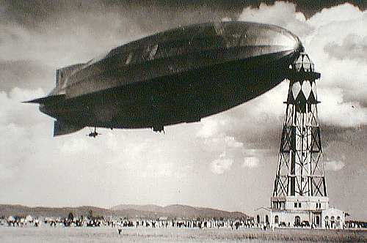
A.D.
Active Directory 2008 r2 UNIX Extension
  NIS Domain
  UID
  Login Shell
  Home Directory
  Primary group name / GID
Simple password match with Kerberos setup
Other UNIX Extensions require LDAP setup
Inheriting Windows groups may overrun UNIX group space

Slide 8
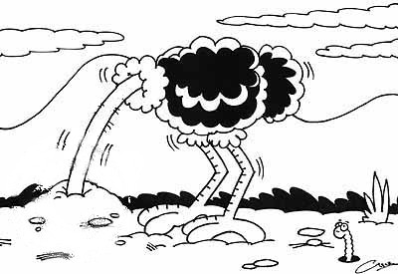
NIS / NIS+
Master / Slave
DES 56-bit encryption hash
8-character password limit
NIS info plain text. NIS+ adds encryption, but still has 8-char password limit
Simple to setup, manual text file edits to admin
Any user can recover all password hashes on systems which combine passwd / shadow files

Slide 9
NIS / NIS+
Provides
  passwd & shadow (combined or separate)
  group
  hosts
  automount maps
  aliases
  services... others
Edit /var/yp/Makefile to enable additional maps

Slide 10
NIS / NIS+
Map location: /var/yp
Once maps are in place – “ypinit -m” on master, “ypinit -s <ypmaster name>” on slaves
After editing map sources: “make -f Makefile” in /var/yp
Test with ypwhich, ypmatch
  ypmatch -kt <username> passwd.byname
  Should return passwd (with passwd crypt from shadow)

Slide 11
LDAP
Active Directory (~LDAP + ~Kerberos)
OpenLDAP
389-ds and Sun One Directory Server
  Share common ancestry from venerable Netscape Directory Server which was acquired by Red Hat

Slide 12
IPA
Red Hat IPA / FreeIPA
Multi-Master / replication
Uni-directional or Bi-directional A.D. trust relationships
Password change with A.D. requires a plug-in on the A.D. servers
Combines LDAP, Kerberos KDC, “Dogtag” PKI Certificates, optional DNS and NIS (migration) into a package with a single web GUI or command line interface

Slide 13
Red Hat IPA or FreeIPA Install
Remove mod_ssl if installed
  IPA uses mod_nss on port 443
Simple setup – ipa-server-install
  ~20 minutes
  domain name, Kerberos realm, and two passwords
  modifies your NTP setup, so if you don't like the changes restore your original settings and restart NTP
Simple uninstall – ipa-server-install –uninstall
  Remove server cert from your browser if you re-install

Slide 14
IPA Ports
TCP
  80, 443 HTTP/HTTPS
  389, 636 LDAP / LDAPS
  88, 464 Kerberos
UDP
  88, 464 Kerberos
  123 NTP

Slide 15
IPA Install Notes
IPA Install produces a template zone entry to advertise the LDAP, Kerberos, and NTP services: /tmp/sample.zone.*.db
Backup the /root/cacert.p12 CA Cert. It is required to create replicas. The password for this file is the Directory Manager password.

Slide 16
IPA Access Management Features
Push sudoers rules and SSH public keys through sssd
Access permissions by HBAC, Host Groups, Services, Service Groups, and traditional netgroups – single host to allow_all
Access inheritance by Role, Automember

Slide 17
IPA Administration
Login to the IPA server and “kinit admin”
  You can then run IPA CLI or scripts
Web GUI
  https://<ipaserver>/ipa/ui
  login as “admin”

Slide 18
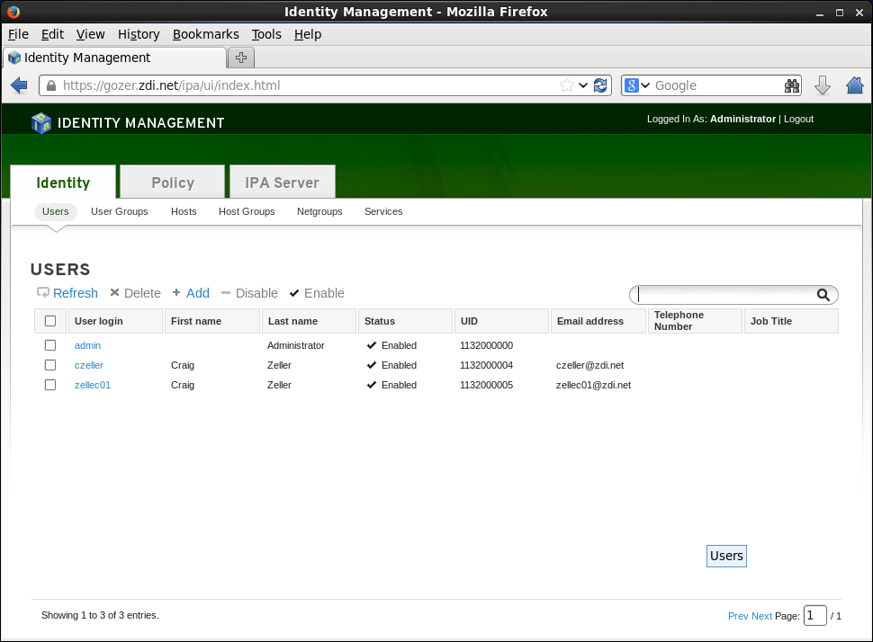
Users

Slide 19
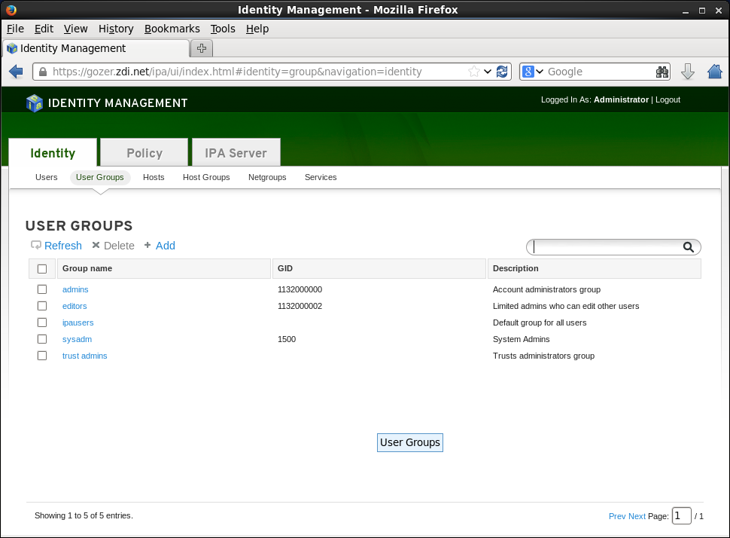
User Groups

Slide 20
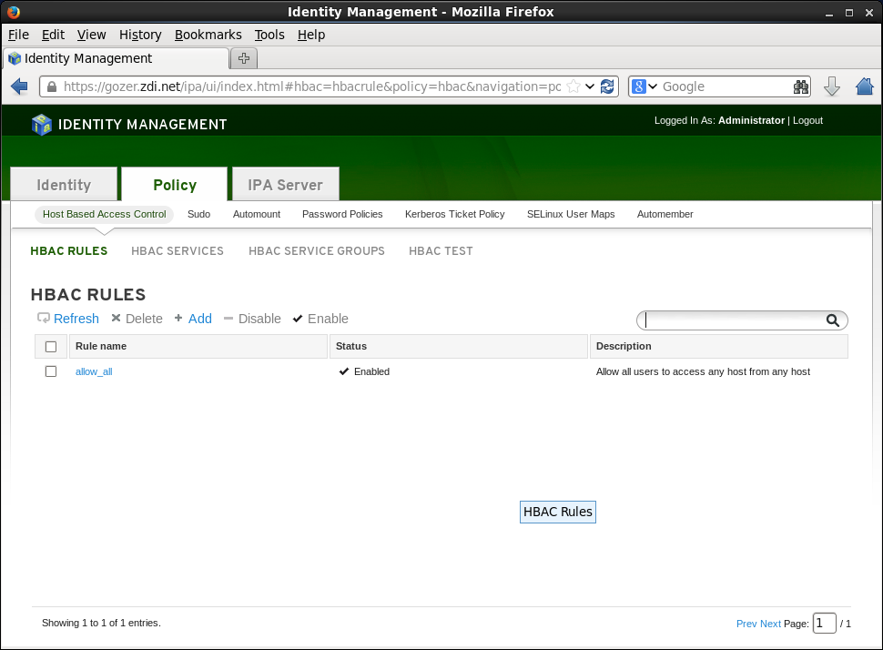
Host Based Access Control HBAC

Slide 21
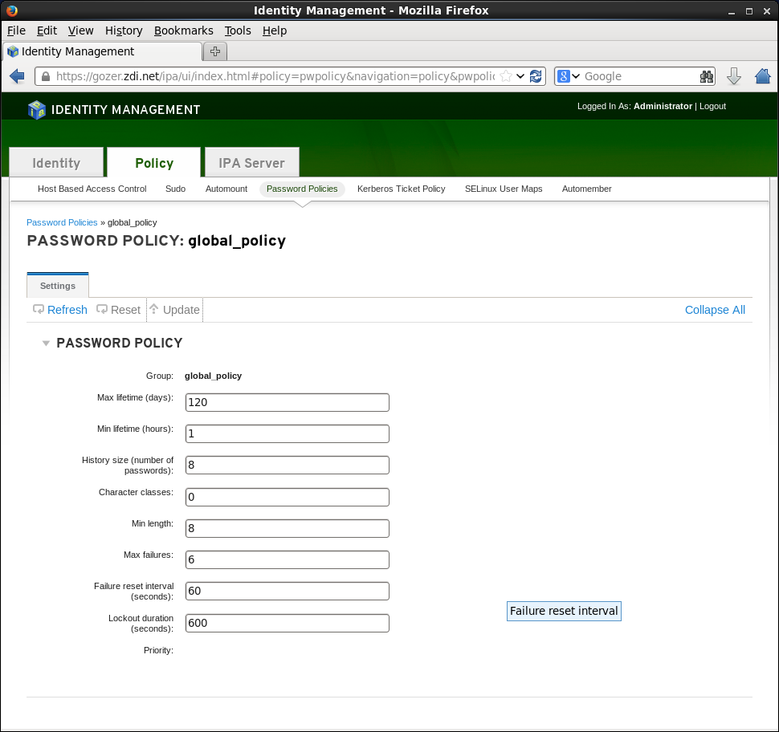
Password Policy

Slide 22
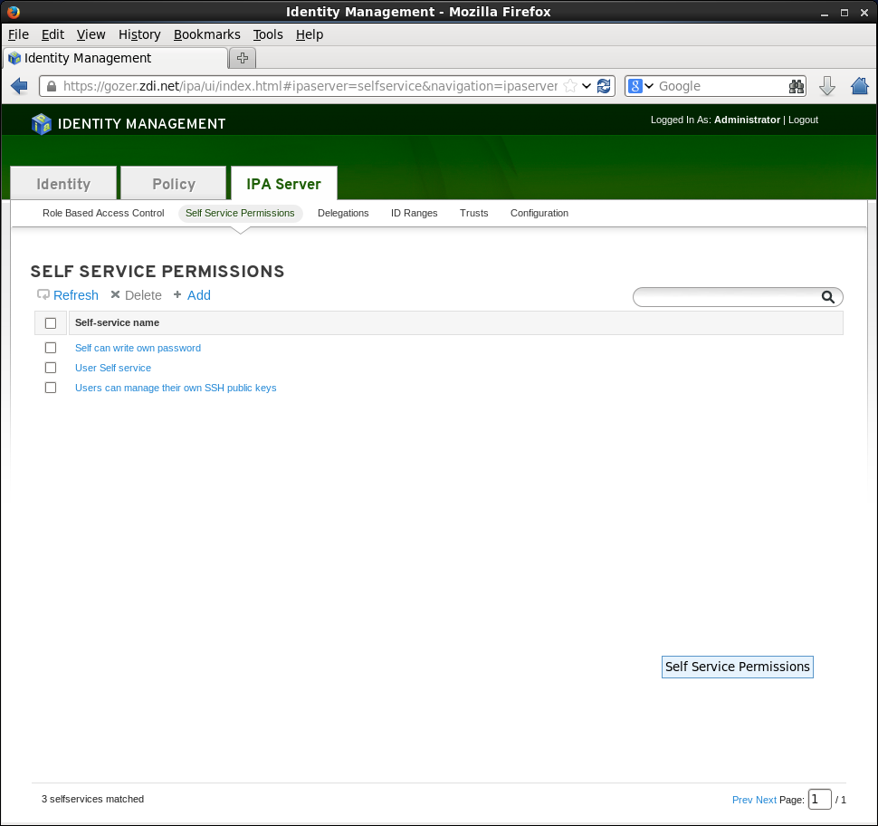
User Self-Service

Slide 23
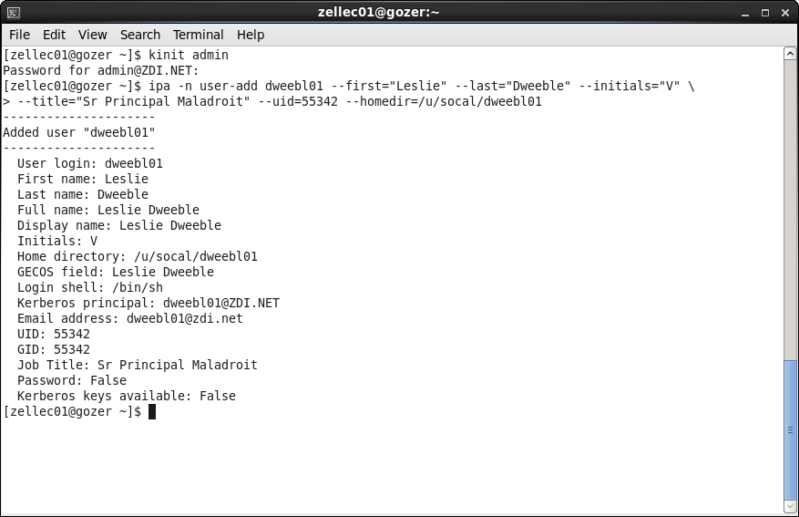
CLI – Add a user

Slide 24
IPA Private Group
Unless you use the CLI –noprivate option, IPA will create a private group with the same GID number as the user's UID... though it will not be displayed in the Group list

Slide 25
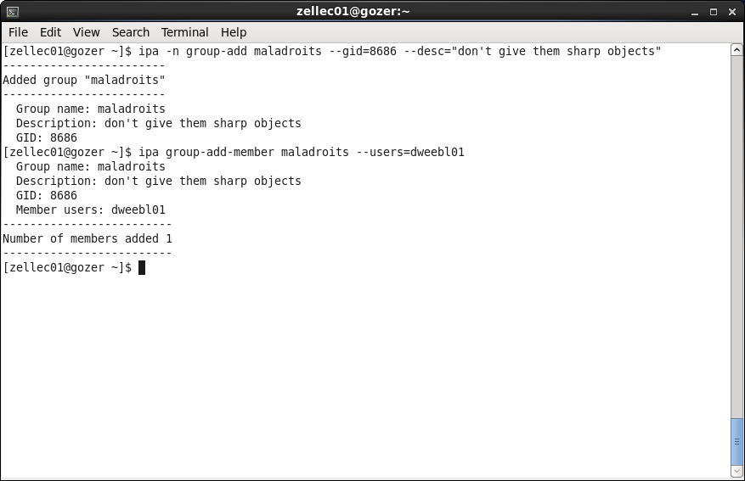
CLI - Add a group, and a member

Slide 26
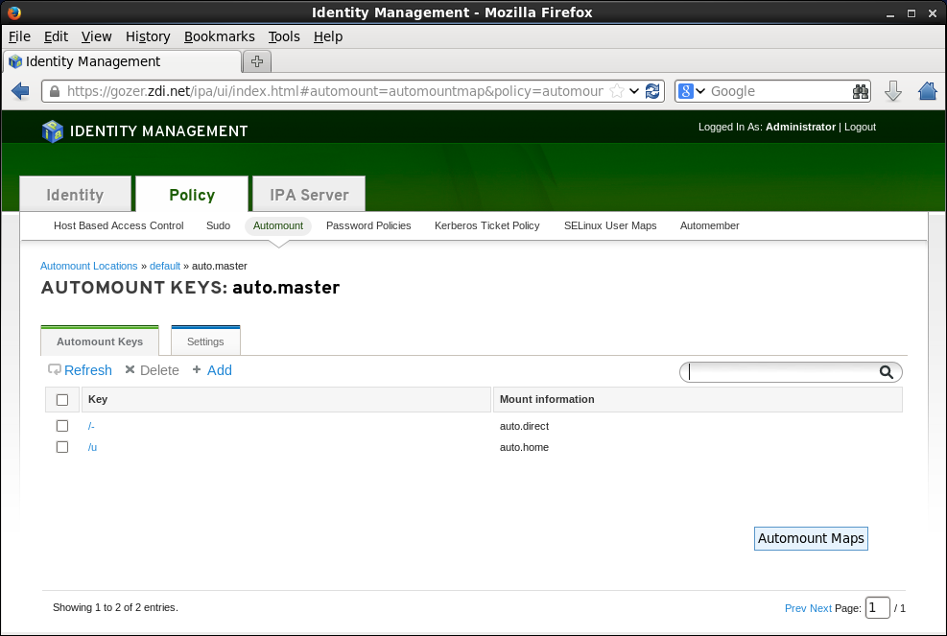
Automount Maps - auto.master

Slide 27
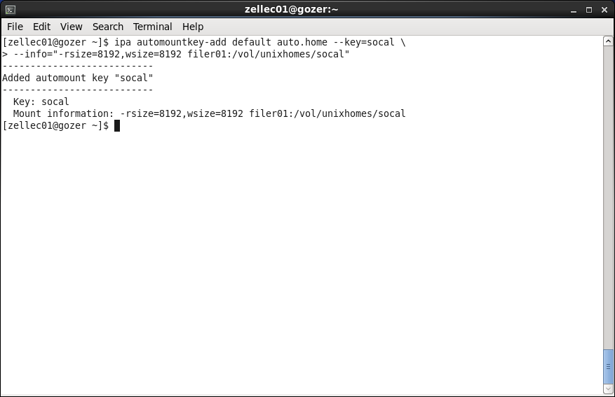
CLI – Add automount map entry

Slide 28
IPA Documentation
RHEL 6 documentation available for download from Red Hat contains two documents on Identity Management – use the 2012 copyright version
FreeIPA http://www.freeipa.org/

