Slide 1
Raspberry Pi Hacks
Presented by
Ruth Suehle Tom Callaway
@suehle @spotrh

Slide 2


Slide 3

The history of the RasPi
Early 2006 concept based on Atmel ATmega644
Designed for educational use
Intended for Python (but of course is friendly to all)
Notes:
By 2008 Eben was a chip architect at Broadcom joined with others
First alpha boards Aug 2011
Jan 2012 Model B manufacture started
Shipping April 2012
October 512 RAM
irst run was 10k boards. First day 100k orders. About 1 million out now.

Slide 4
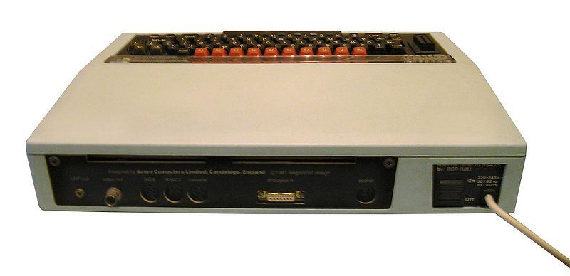
Pop quiz!
Notes:
Inspired by BBC Micro, which launched in December 1981 as Model A and Model B
2 MHz processor and Model A had 16 kb RAM, B had 32

Slide 5
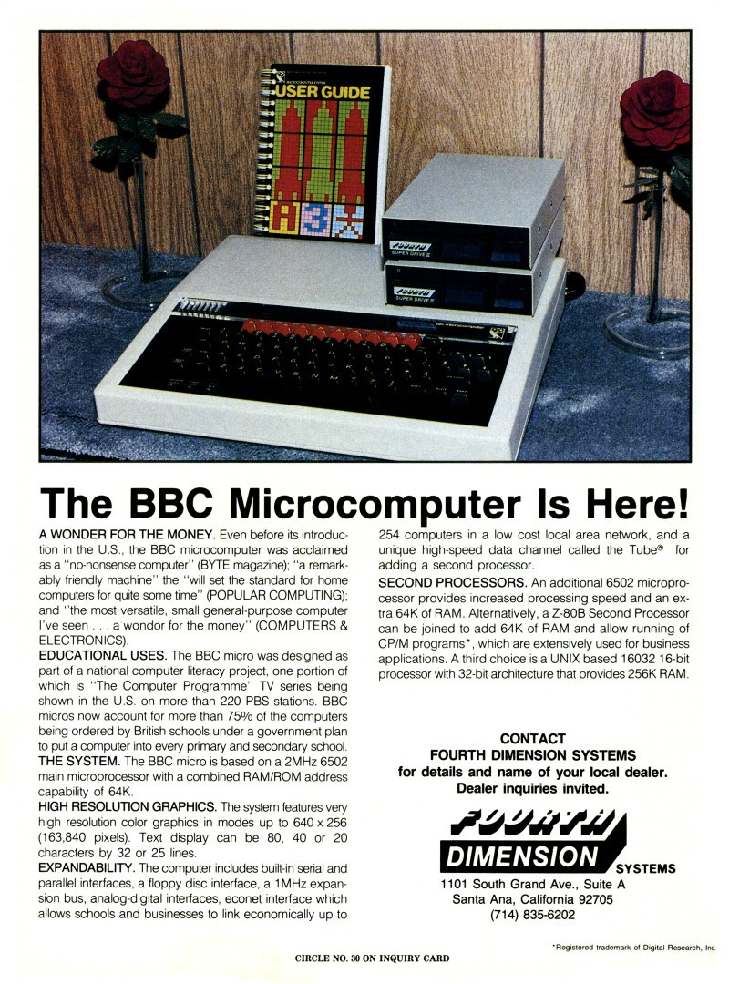
Notes:
in December 1981 as Model A and Model B
2 MHz processor and Model A had 16 kb RAM, B had 32

Slide 6
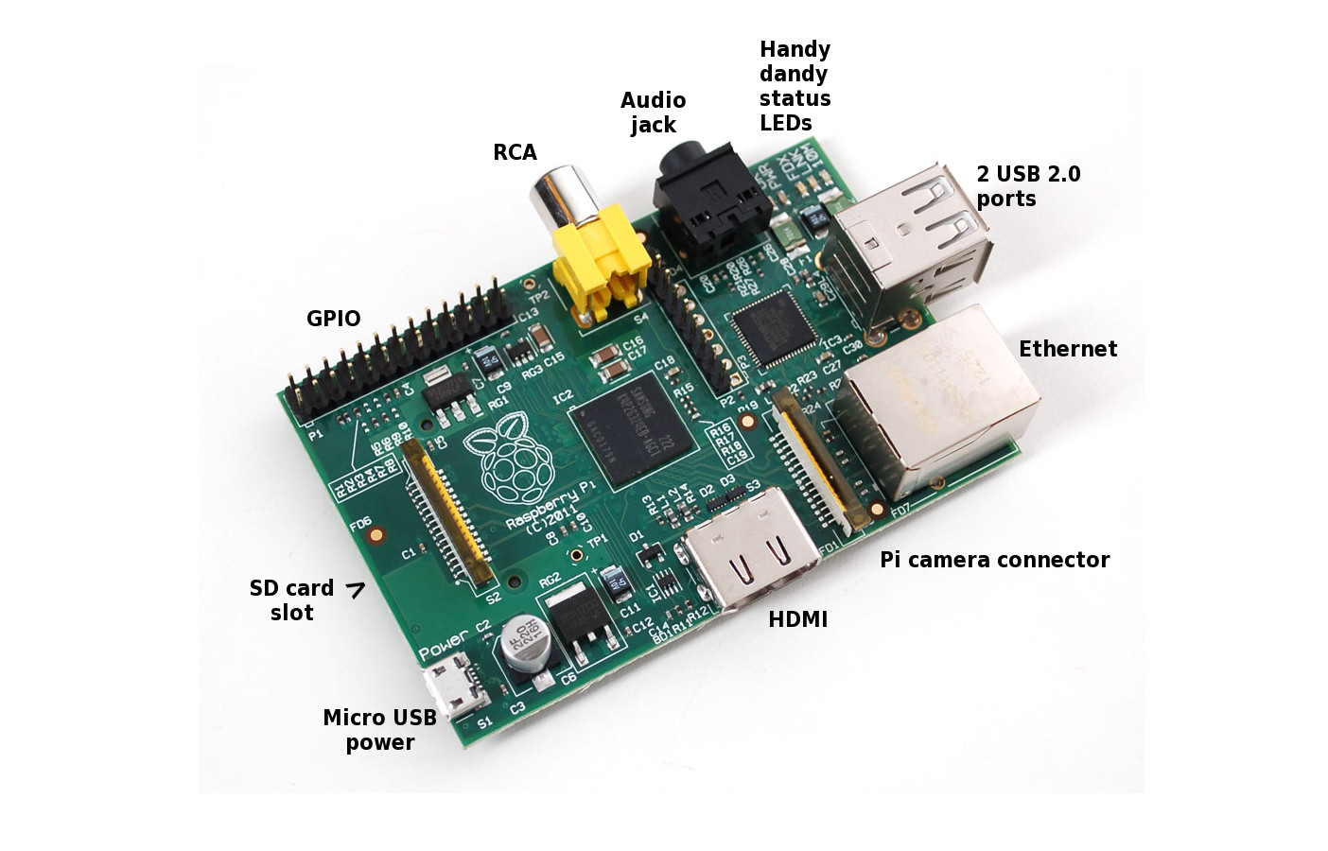
Slicing up the Pi
Notes:
Talking about the Model B
SoC: Broadcom BCM2835
CPU: 700 MHz (ARM11 family)
GPU: Broadcom VideoCore IV, OpenGL ES 2.0, MPEG-2 and VC-1, 1080p30 h.264/MPEG-4 AVC high-profile decoder and encoder
SDRAM: 512 MB, can't add mroe
USB: 2 2.0 ports
Video: HDMI primarily, composite or DSI
Audio: 3.5 mm, I²S
Storage: SD card
Networking: 10/100 Ethernet
graphics capabilities are roughly equivalent to Xbox 1 level of performance. Overall real world performance is something like a 300MHz Pentium 2,
You can overclock it, raspbian includes it at first boot or in raspi-config

Slide 7
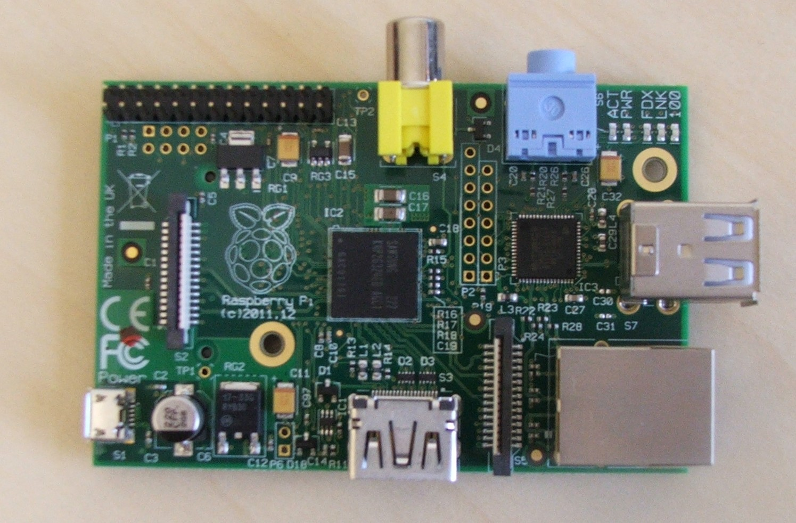
Slicing up the Pi
Notes:
Talking about the Model B
SoC: Broadcom BCM2835
CPU: 700 MHz (ARM11 family)
GPU: Broadcom VideoCore IV, OpenGL ES 2.0, MPEG-2 and VC-1, 1080p30 h.264/MPEG-4 AVC high-profile decoder and encoder
SDRAM: 512 MB, can't add mroe
USB: 2 2.0 ports
Video: HDMI primarily, composite or DSI
Audio: 3.5 mm, I²S
Storage: SD card
Networking: 10/100 Ethernet
graphics capabilities are roughly equivalent to Xbox 1 level of performance. Overall real world performance is something like a 300MHz Pentium 2,
You can overclock it, raspbian includes it at first boot or in raspi-config

Slide 8
Find your Pi
cat /proc/cpuinfo
Processor : ARMv6-compatible processor rev 7 (v6l)
CPU architecture: 7
[...]
Hardware : BCM2708
Revision : 000e
Serial : 0000000011185abc
Notes:
0002-0006 Model B with 256 (rev 1 are 2 and 3)
0007-0009 Model A with 256 MB
000d-000f Model B424100
with 512

Slide 9
Buying parts
Element14 (newark.com)
Adafruit.com
MakerShed.com
DX.com
Sparkfun.com (for parts)
Amazon
And in a pinch... Radio Shack
Notes:
$35 – don't buy a pi on amazon

Slide 10

Getting started
Get the right SD card
Get the right distro
Don't break off C6
???
Profit!
Notes:
Remember that the power plug is your on/off switch

Slide 11
1. Get the right SD card
Most quality cards are OK
Micro with adapter?
elinux.org/RPi_SD_cards
Notes:
Makes the Pi awesome. Switch out.
Used to be a class 10 bug
Cheap cards can be mislabeled as having more capacity than they really do

Slide 12
Display options
HDMI 1.3 and 1.4 supported; audio and video output, does not support HDMI input
PAL and NTSC supported through RCA with audio through 3.5 mm to red/white RCA connector
DSI
No VGA
Notes:
Switch NTSC or PAL in config.txt
TV
Motorola Atrix Lapdock
Was expensive now cheap
Has connector challenges
forums
Kindleberry Pi
Recommends spare kindle
Connects with microsusb
Terminal emulator

Slide 13
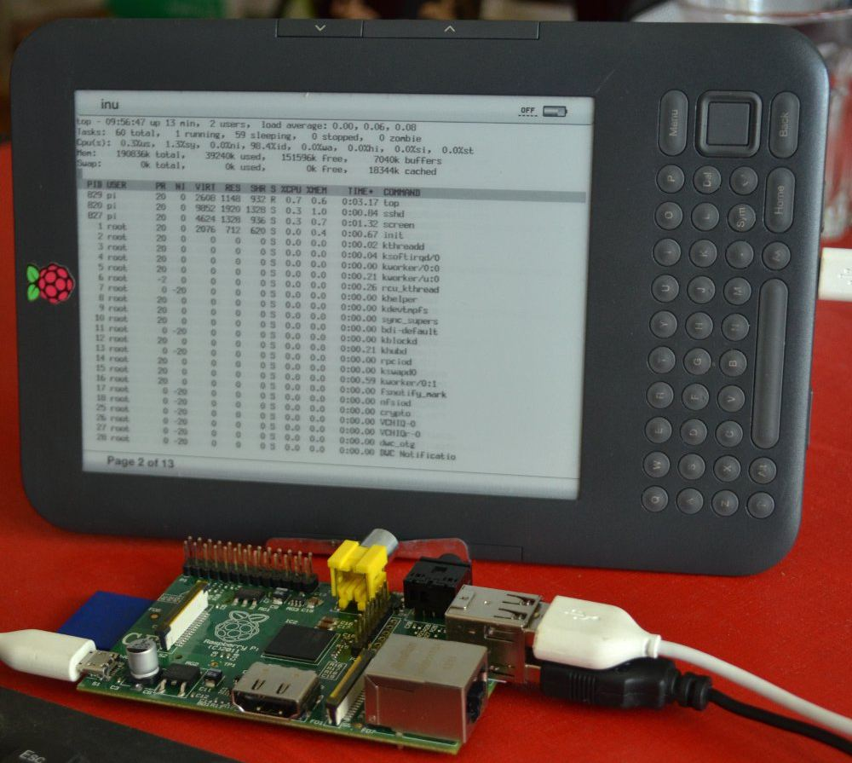
Fun display alternatives
Atrix Lapdock
Kindleberry Pi
www.ponnuki.net
2012/09/
kindleberry-pi/
Notes:
Switch NTSC or PAL in config.txt
TV
Motorola Atrix Lapdock
Was expensive now cheap
Has connector challenges
forums
Kindleberry Pi
Recommends spare kindle
Connects with microsusb
Terminal emulator
“if you don’t know what a terminal is, well, I am not sure why you are reading this article in the first place”

Slide 14

Touchscreens
Ooh, look! DSI connector!
Mimo 720
  USB DisplayLink Framebuffer Driver CONFIG_FB_UDL/udlfb.ko
  USB DisplayLink Kernel Mode Setting (KMS) driver
  CONFIG_DRM_UDL/udl.ko
Won't work with OpenELEC without rebuilding the kernel
Notes:
Display Serial Interface (DSI) connector, a 15-way flat flex connector labeled S2, next to the Raspberry Pi logo. The GPU firmware which enables the native video output needs code to explicitly support any device connected to the DSI port. Since this firmware is not open-source, it is not currently possible to add support for any DSI connected screens, nor are there any known devices that the GPU firmware supports on the DSI connector. It is widely expected that at some point, the Raspberry Pi Foundation will release official peripherals that can connect to the DSI connector, which will make this a much simpler task (assuming that one of those peripherals is a touchscreen).
Mimo is small, cheap, light, USB driven, and fairly cheap ($129-199)
does not use Xorg. Since OpenELEC relies entirely on the VideoCore output devices,
Neither the USB Touchscreen Driver or the UDL Framebuffer Driver is enabled by default in the pre-built kernel but this is easily remedied with a custom kernel.

Slide 15
Couture kernel
rpi-3.2.27
rpi-3.6.y (.11)
rpi-3.8.y, rpi-3.9.y, rpi-3.10.y, rpi-3.11.y
$ git clone git://github.com/raspberrypi/linux.git
$ tar xvfz rpi-3.6.y.tar.gz
$ make mrproper
Notes:
Linux kernel contains a “make clean” target in addition to the “make mrproper” target. The “make mrproper” target is a sort of “super clean”, as it does everything that the “clean” target does, but a whole lot more (the “clean” target leaves generated artifacts behind, while “mrproper” brings the kernel source tree back to a pristine state). But why is it called “mrproper”? It stands for “Mr. Proper”, the international name of a well recognized mascot for cleaning solution products. In the US, he is known as “Mr. Clean”.

Slide 16


Slide 17

2. Get the right distro
Pidora (of course)
Raspbian
  Moebius
RaspBMC
Occidentalis
Notes:
No hard float in Debian
Raspbian is hard float port of Wheezy

Slide 18
2.14 Or get brave
Android Arch ARM AROS Chromium OS Debian Squeeze Firefox OS FreeBSD Gentoo Haiku IPFire NetBSD PiBang Plan 9 from Bell Labs QtonPi RISC Slackware ARM Squeezed ARM Puppy WebOS

Slide 19

Pidora
Graphical firstboot configuration (with additional modules specifically made for the Raspberry Pi)
Compact initial image size (for fast downloads) and auto-resize (for max storage afterwards)
Auto swap creation available to allow for larger memory usage
C, Python, & Perl included in the SD card image
Includes libraries capable of supporting external hardware such as motors and robotics (via GPIO, I2C, SPI)
For graphical operation, Gedit text editor can be used with plugins (python console, file manager, syntax highlighting) to serve as a mini-graphical IDE

Slide 20
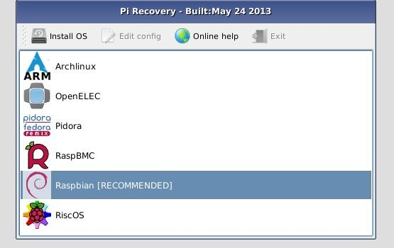
NOOBS
New Out Of Box Software

Slide 21


Android on your Pi
+
http://androidpi.wikia.com
Notes:
It is possible to run CyanogenMOD 7.2, which is based on Android 2.3. It's not speedy
#razdroid channel on Freenode
Cyanogen 9, unusable
There is no recommended image since Android is dysfunctional on the Raspberry Pi's

Slide 22
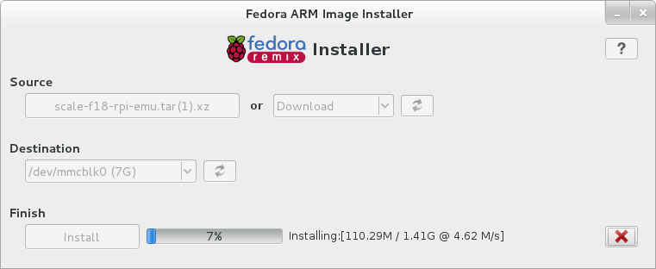
Installing it
Fedora ARM installer
  fedoraproject.org/wiki/Fedora_ARM_Installer
  yum install fedora-arm-installer
Notes:
These are the easy ways

Slide 23
Installing it
Fedora ARM installer
  fedoraproject.org/wiki/Fedora_ARM_Installer
  yum install fedora-arm-installer
On a Mac, Rpi-sd card builder or RasPiWrite
  Google “Rpi-sd builder”
  github.com/exaviorn/RasPiWrite

Slide 24
1 + 2 – worrying =
Buy pre-loaded
Notes:
The Pi Hut, Element14, maybe Adafruit sell cards preloaded with Raspbian and OpenELEC

Slide 25
Power
5V. 5V. 5V.
Why you shouldn't use iPhones
Your laptop's USB port is not the droid you're looking for
Put a power brick on your shopping list
Did I mention C6?
Notes:
Usb, wall wart, car charger
Always shut down
Need a powered hub:
USB limited to 140 mA per port with fuses. The point is to keep them from dragging down the whole power supply. If you're brave and/or crazy, you can bridge the fuses with some wire or flat out switch them out.

Slide 26
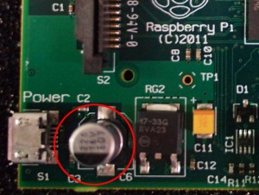
Write down these words
220 uF 16v electrolytic capacitor

Slide 27
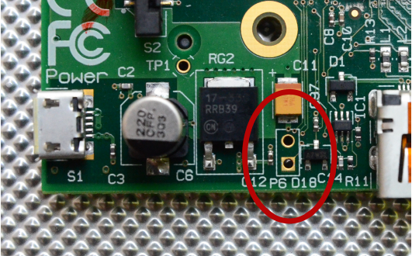
Add an off switch
Notes:
Near hdmi

Slide 28
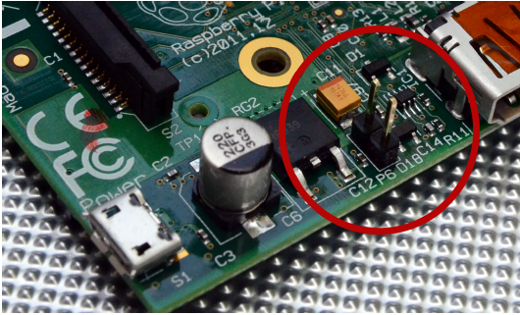
Johnny Five alive!
Notes:
Solder pair of header pins
Reset the cpu from shutdown for start

Slide 29
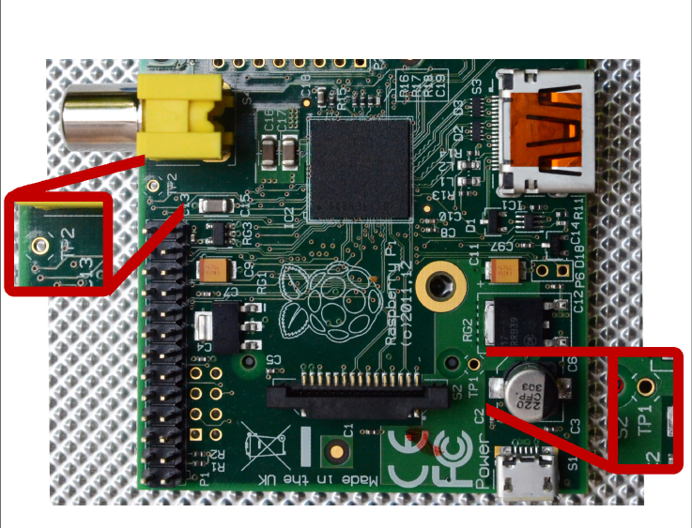
Test your might! (In volts)
Notes:
Plug in peripherals, set your multimeter range to 20 V.
Touch the red lead of your multimeter to TP1 (5v) and the black lead to TP2 (grnd)
Min 4.8, tolerance .25

Slide 30
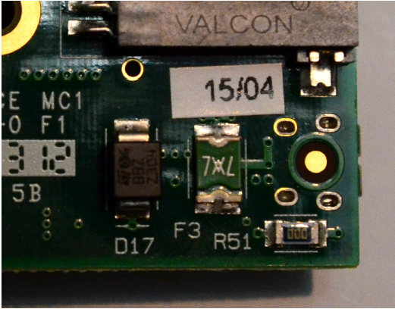
Test your might! (In volts)
Notes:
Polyfuse: back side of TP2 and part of F3 facing the SD
Remove everything
One lead to TP2 and the other to F3 on the SD card side – tells voltage from fuse
Switch to other side—tells voltage coming in

Slide 31
Decode the LEDs
D5 OK (Rev 1.0) ACT (Rev 2.0) Green SD card access, connected to GPIO 16
D6 PWR Red 3.3 V Power, connected to 3V3
D7 FDX Green Full Duplex LAN
D8 LNK Green Link/Activity LAN
D9 10M (Rev 1.0) 100 (Rev 2.0) Yellow 10/100Mbit LAN

Slide 32
Why didn't it start?
Red light off = No power
Red light on, green light off = The Pi can't read the image on the card. The voltage is below 5V.
Green light blinks 3 times = start.elf was not found
Green light blinks 4 times = start.elf did not launch
Green light blinks 7 times = kernel.img was not found
Notes:
These are based on the October 2012 firmware
Boot partition must contain:
- start.elf, the GPU binary firmware image
- kernel.img, the OS kernel
- bootcode.bin, 2nd stage bootloader
- cmdline.txt, passed to kernel on boot

Slide 33
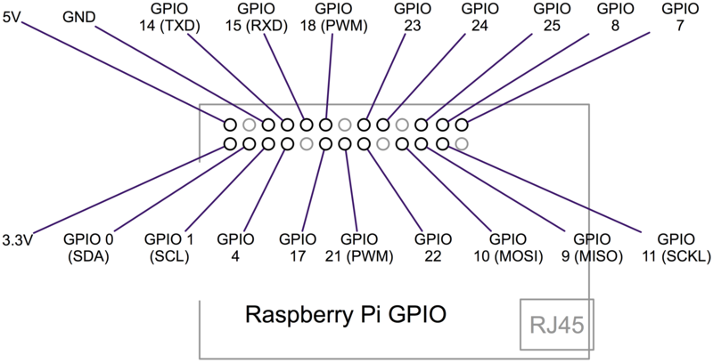
GPIO
http://elinux.org/RPi_Low-level_peripherals
Notes:
GPIO are the little pins. It's called “general” because you can control its behavior, incl in or out, with sw
These are 3volt, not 5 like arduino
There is no overvoltage protection, so you should probably use an external board for that instead of soldering directly onto the pi.

Slide 34
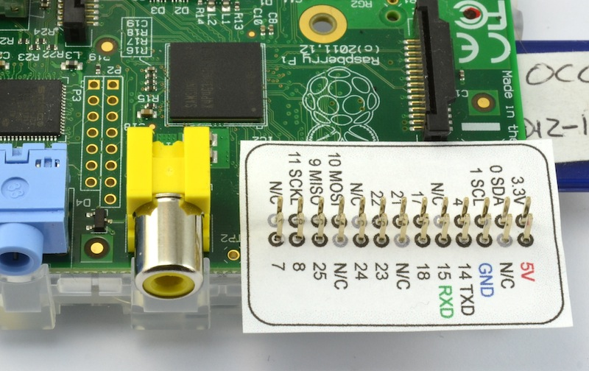
Raspberry Leaf
http://www.doctormonk.com/2013/02/raspberry-pi-and-breadboard-raspberry.html

Slide 35
Building a cross-compiler
You could use an existing one... or you could DIY with crosstool-ng (crosstool-ng.org)
Get kernel source: github.com/raspberrypi/linux
Notes:
You can compile on the Pi, but it's going to take a few hours, so you should do it on another computer
Kernel.org source won'thave Broadcom SoC drivers and modules.

Slide 36
Blah blah blah.
Stop saying words and
show us pretty pictures
of cool things
people made.

Slide 37

Case closed.
Make one
3D print one
Buy one
(or use the one it comes in)
Notes:
Or use the box

Slide 38
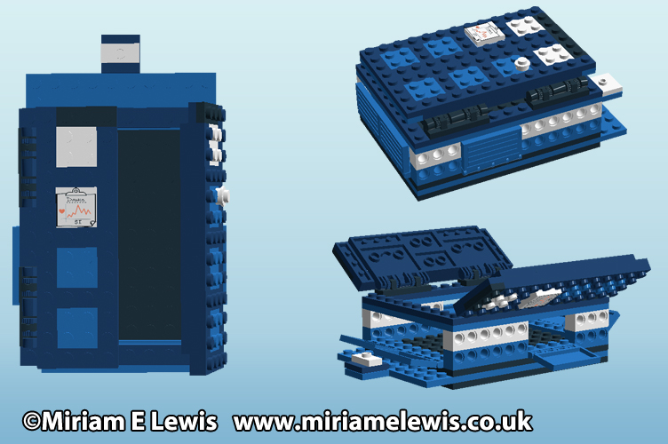
Not bigger on the inside.

Slide 39

Temple of Pi
Notes:
Lego digital designer
Or graph paper

Slide 40
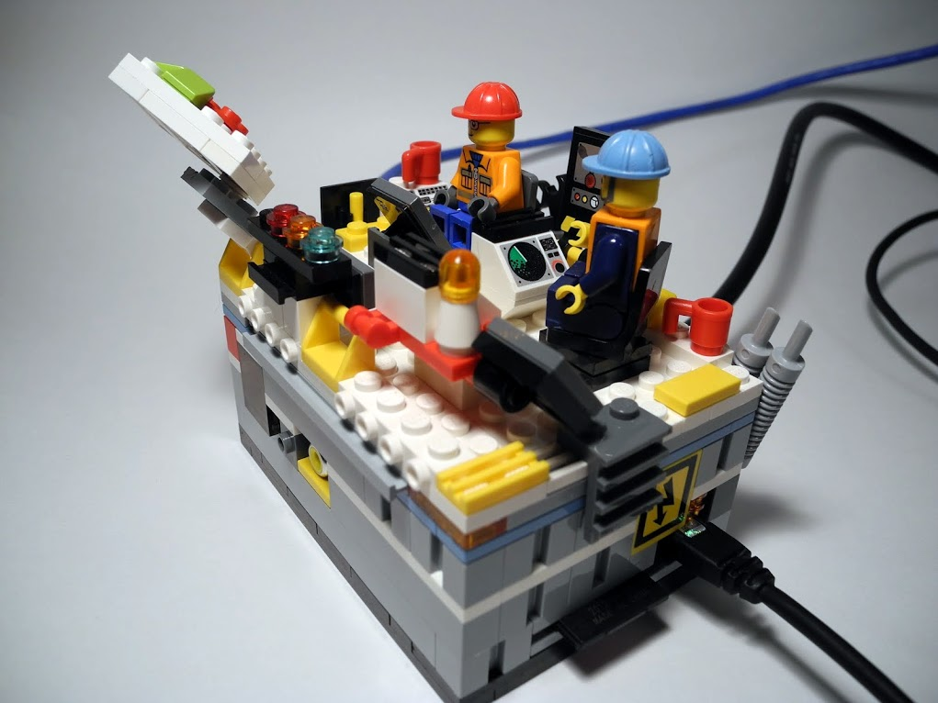
Lego my Pi-go...?
Brian Gillespie
Notes:
Brian Gillespie The Raspberry Pi Command Center is fully OSHA, ISO 9001, ASME, IEEE and Sarbanes-Oxley compliant.

Slide 41
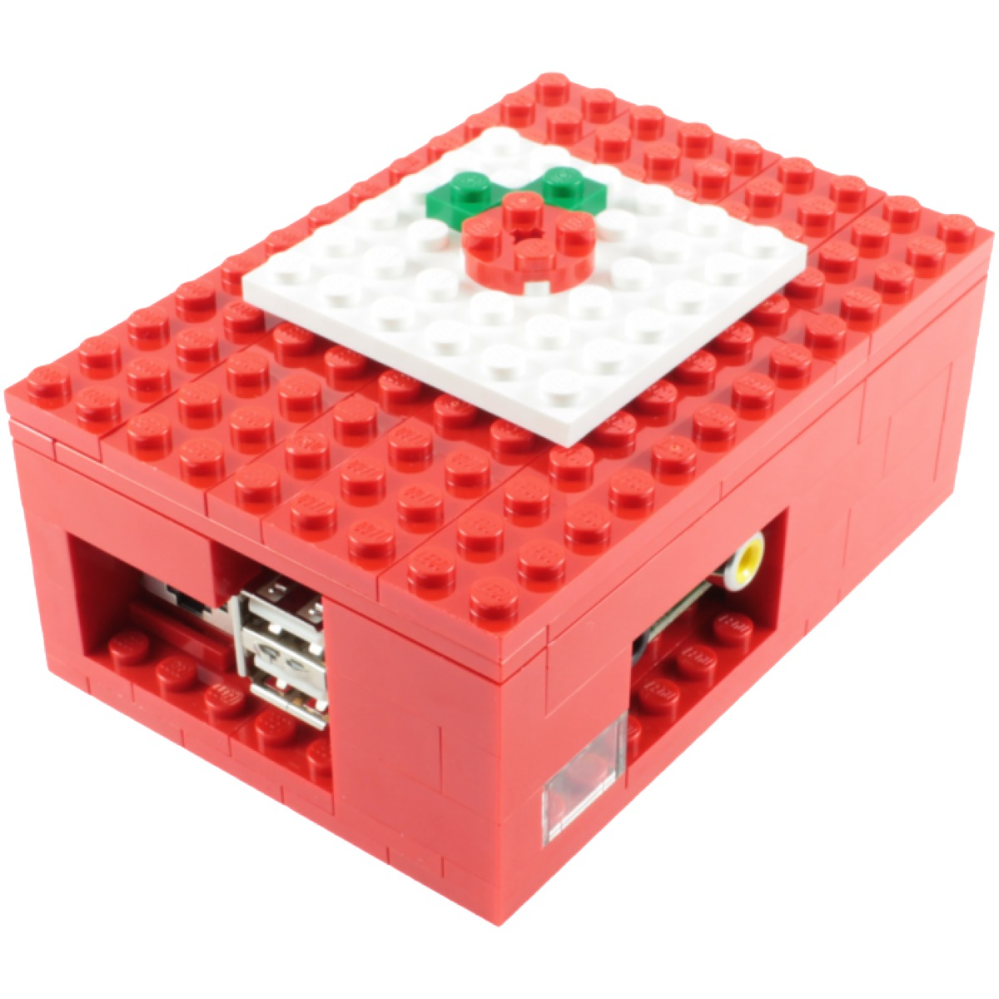
Or just buy it.
http://www.thedailybrick.co.uk/lego-sets/custom/lego-custom-raspberry-pi-case.html
Notes:
Also has build instructions
14 pounds = 21 dollars
87 bricks = .24/brick

Slide 42
Aren't you a little small for an HTPC?
RaspBMC/XBMC
  1080p
  Share over NFS, SMB, FTP, HTTP, USB, XYZ, and other acronyms
  Install to SD, USB, or run off NFS Embedded Samba TVHeadend FTP SSH

Slide 43
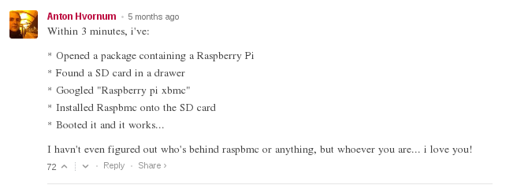
Can you do it?

Slide 44
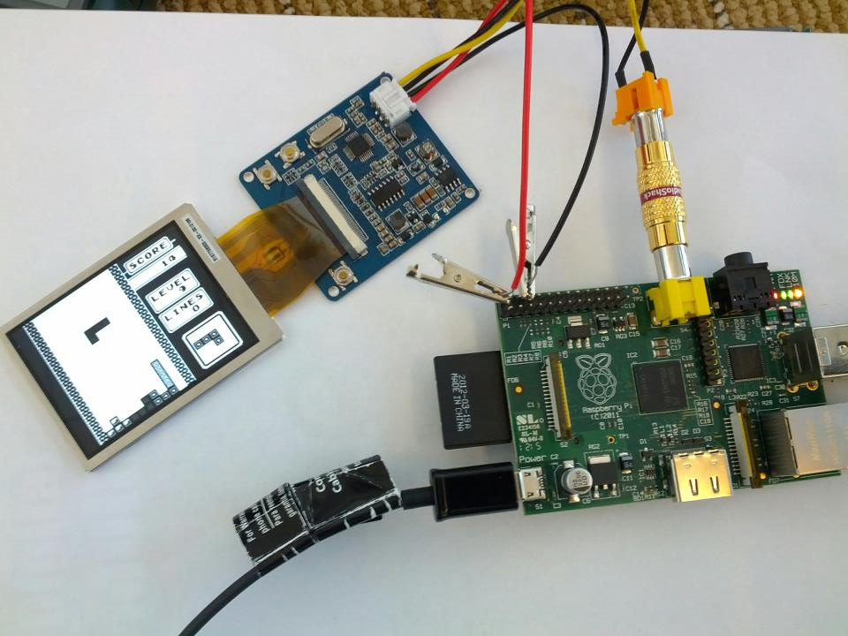
PiBoy
Notes:
What do you get when you add a p to PiBoy?

Slide 45
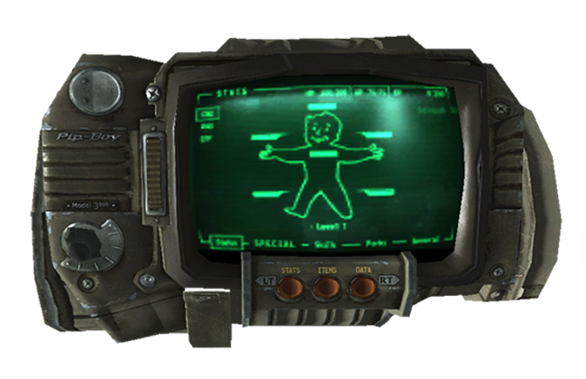
PIP-Boy 3000
Notes:
What do you get when you add a p to PiBoy?

Slide 46
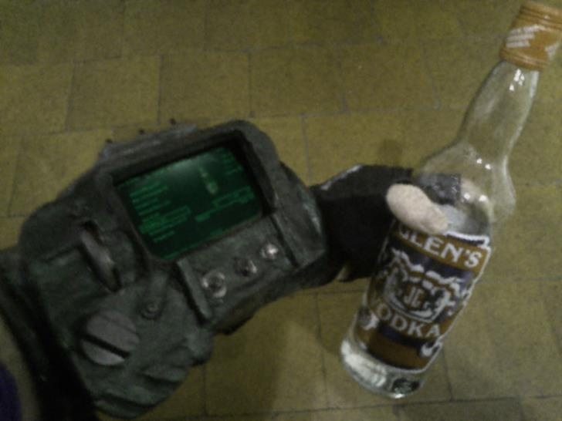
RIP Pi-PIP-Boy
http://blog.ryangrieve.com/the-raspberry-pipboy/
Notes:
Fallout

Slide 47
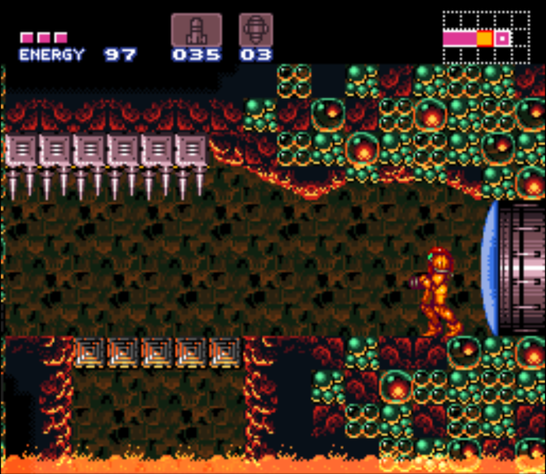
Emulating your childhood

Slide 48
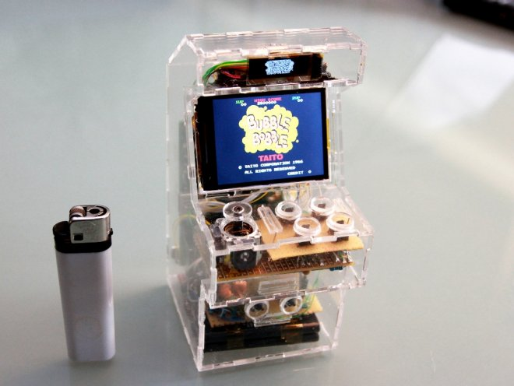
SpritesMods.com

Slide 49
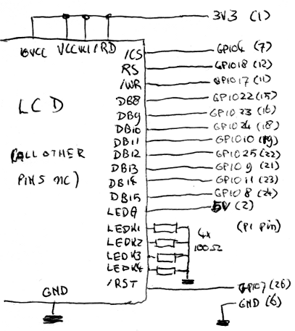
Teeny arcade!

Slide 50
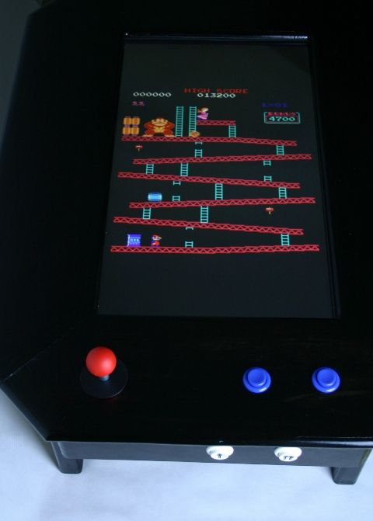
www.instructables.com/id/Coffee-Table-Pi

Slide 51
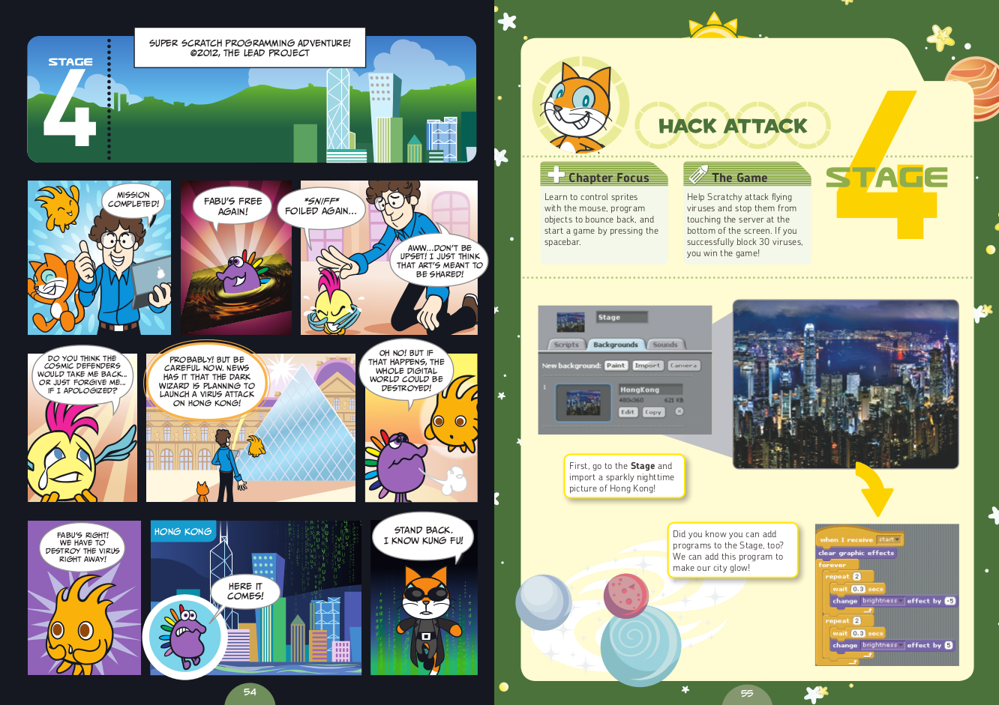
Scratch an itch
Notes:
RPi at the checkout on No Starch you’ll get 30% off scratch and python for kdis

Slide 52
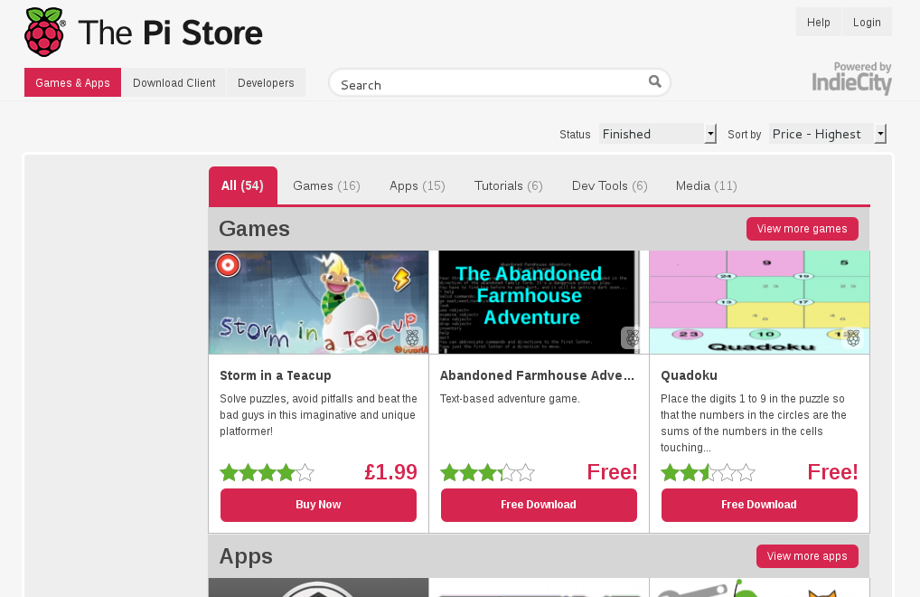
store.raspberrypi.com

Slide 53
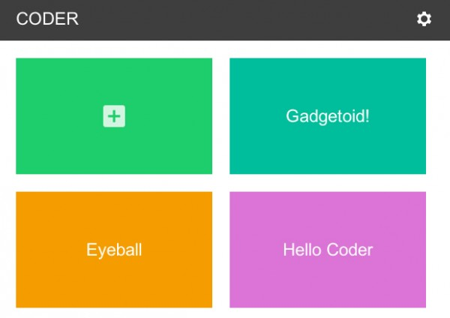
Googler Coder

Slide 54
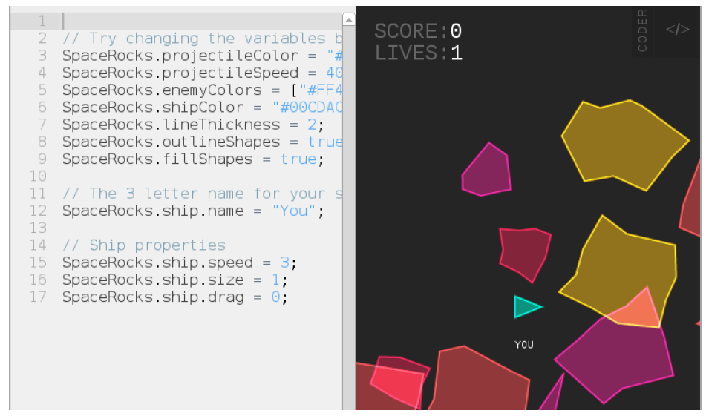
Googler Coder

Slide 55
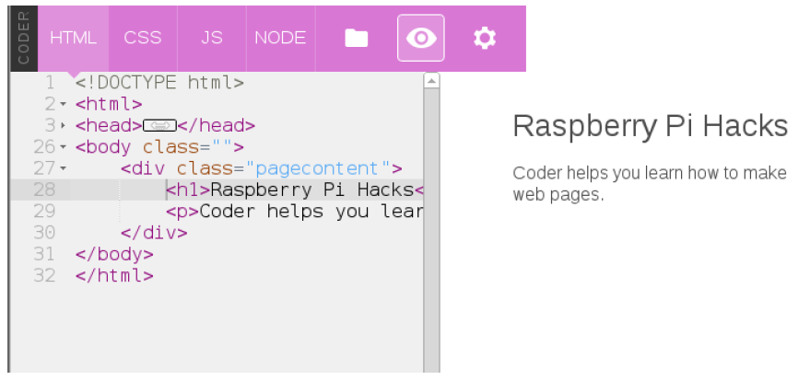
Googler Coder

Slide 56
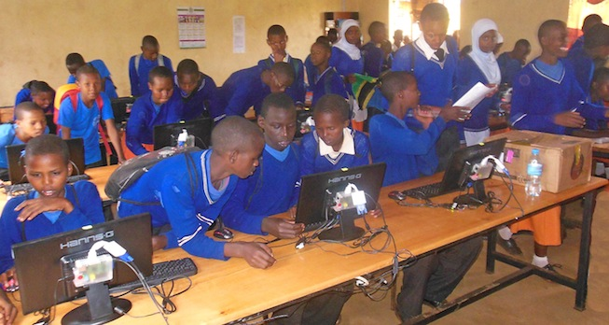
Powering Potential
PoweringPotential.org

Slide 57
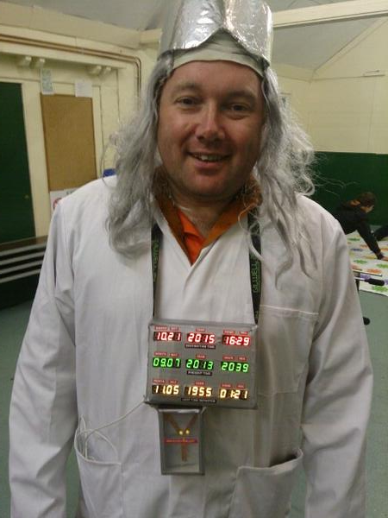
PiLorean
fortoffee.org.uk/raspberry-pi-delorean/

Slide 58
PiLorean
http://www.youtube.com/watch?v=ncXxBmbuFII

Slide 59
LCARS Home Automation
http://www.youtube.com/watch?v=176YaM5jta4
Notes:
Play any sound in your home directory
Get more range with any 50cm wire to GPIO4 to be an antenna (extra 50m)
How it works:
Frequency mod means changing the signal from positive to negative very quickly. Like 10.3 million times per second.
The Pi's on board clock manager can accurately produce any clock frequency you want by dividing the system processor clock (which is normally around 500Mhz) down to any other rate you want. To tell it what to do, you set a register (a special piece of memory) to a number saying what you want the system clock divided by to make the FM radio clock.

Slide 60
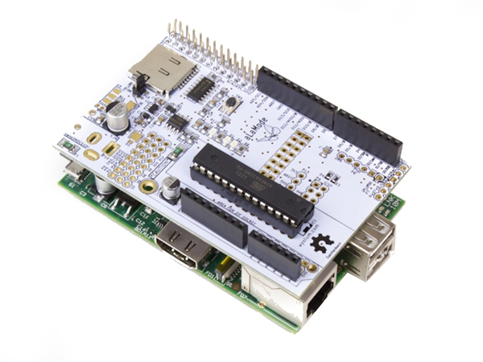
Ice cream with your Pi

Slide 61
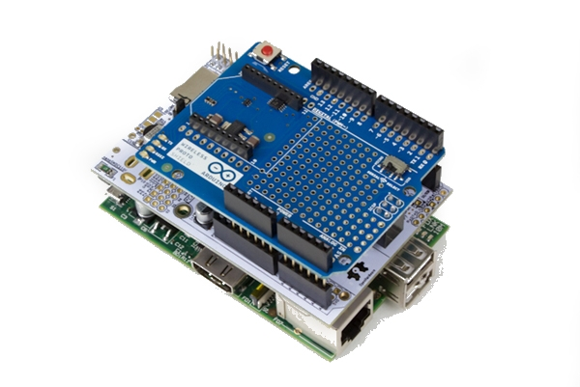
Ice cream with your Pi

Slide 62
Coffee ordering
http://www.youtube.com/watch?v=BQBOPGSfFwY

Slide 63
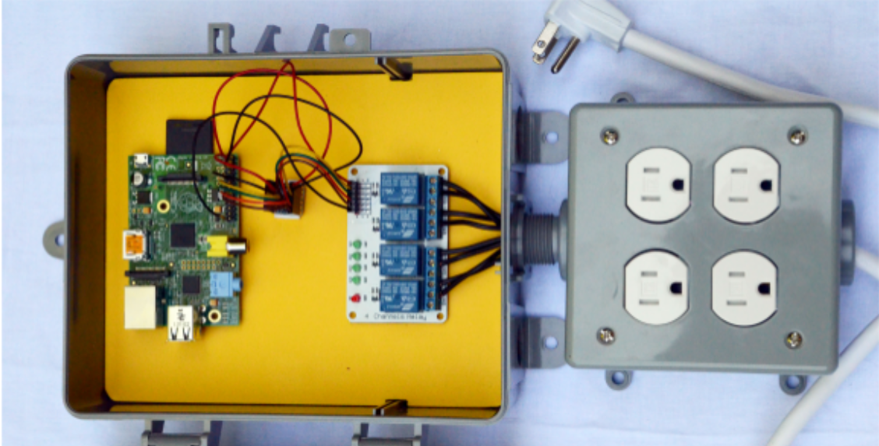
Control Christmas lights

Slide 64
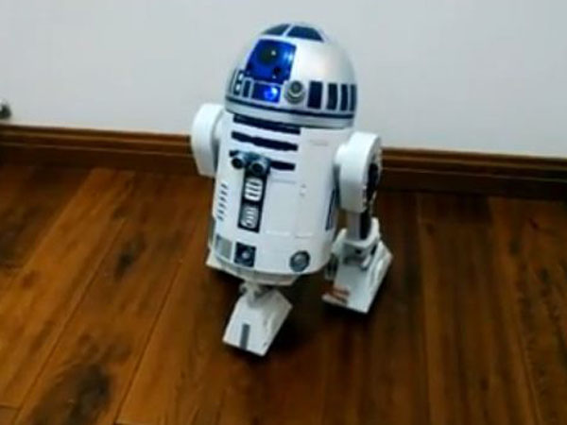
Best Valentine EVER

Slide 65
Notes:
Next is geiger counter

Slide 66
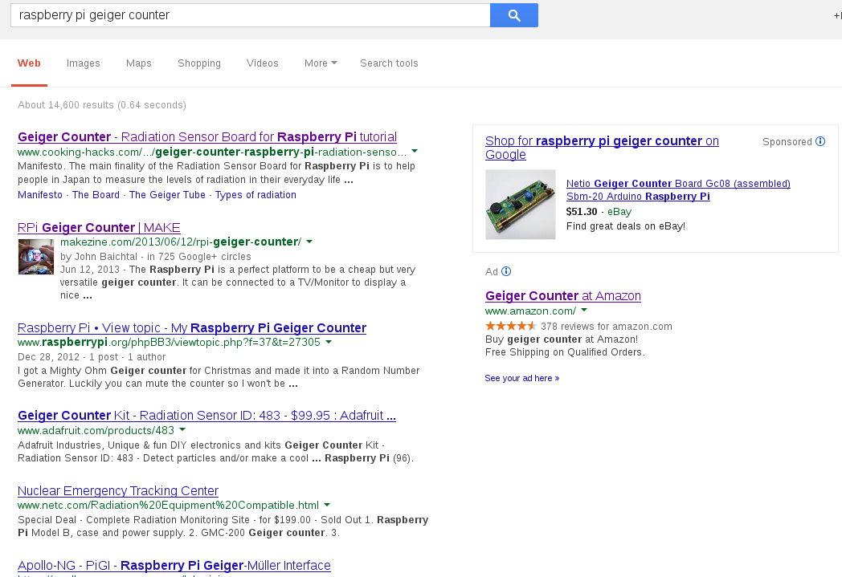

Slide 67

Notes:
Sd storage
Gpio for accelrometer, gyroscope, sensors
Video out for live
Camera

Slide 68
More ideas
Samba
Remote print server
LEGO robot
Temperature sensor
Light sensor
Listen to aircraft transponders
Spotify (Pi MusicBox)
Control 3D printer

Slide 69
Resources
learn.adafruit.com
elinux.org
instructables.com
Beginner's Guide to Raspberry Pi
Raspberry Pi Hacks
Contact:
  @suehle | ruth@redhat.com
  @spotrh | spot@fedoraproject.org

Slide 70

Download slides:
rsuehle.fedorapeople.org/raspi
Get the book:
http://oreil.ly/
raspberry_pi_hacks
OR GET IT FREE HERE!
t

