Slide 1
Deb Nicholson SCALE
Feb. 22, 2014
Trolls Aren't
The Only Threat
Under the Bridge

Slide 2


Slide 3
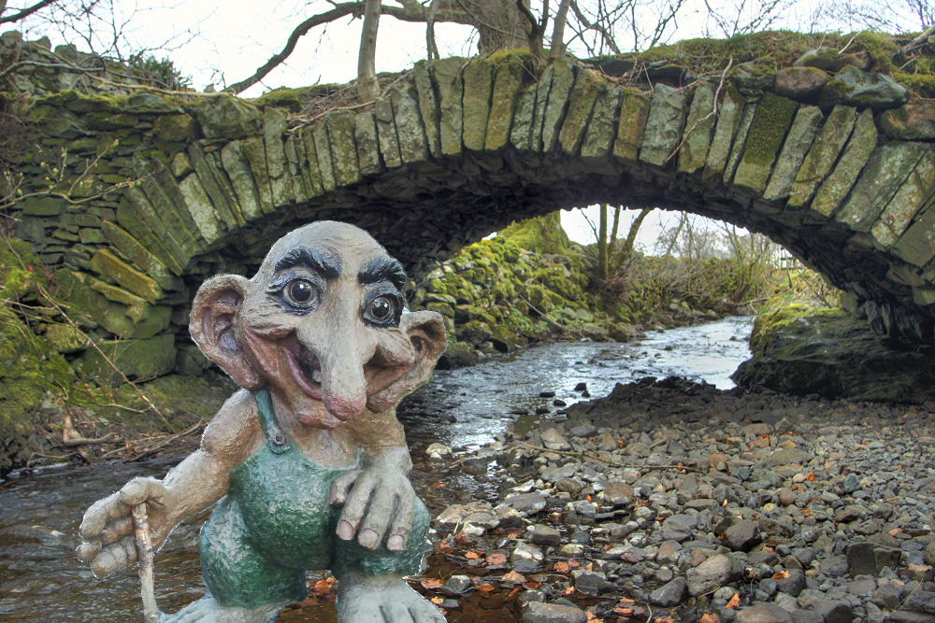

Slide 4
Just in case you've been hiding under a rock...

Slide 5
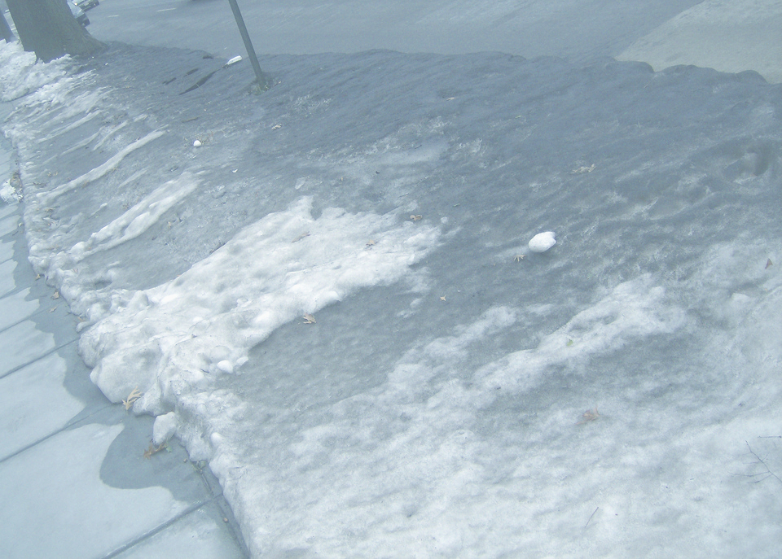
“...annual wealth lost from NPE lawsuits was about $80 billion...”
(Bessen et al. 2011)

Slide 6
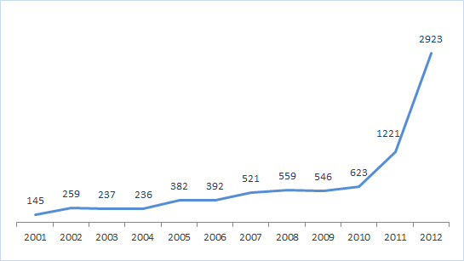
Patent suits involving “NPEs”
Source: PatentFreedom © 2013. Data captured as of January 18, 2013.

Slide 7
"...patent trolls... are increasingly targeting users and adopters, rather than makers of the technology: this tactic is used an estimated
40% of the time."
Colleen V. Chien: Tailoring the Patent System to Work for Software and Technology Patents

Slide 8
Plus it turns out they're everywhere

Slide 9
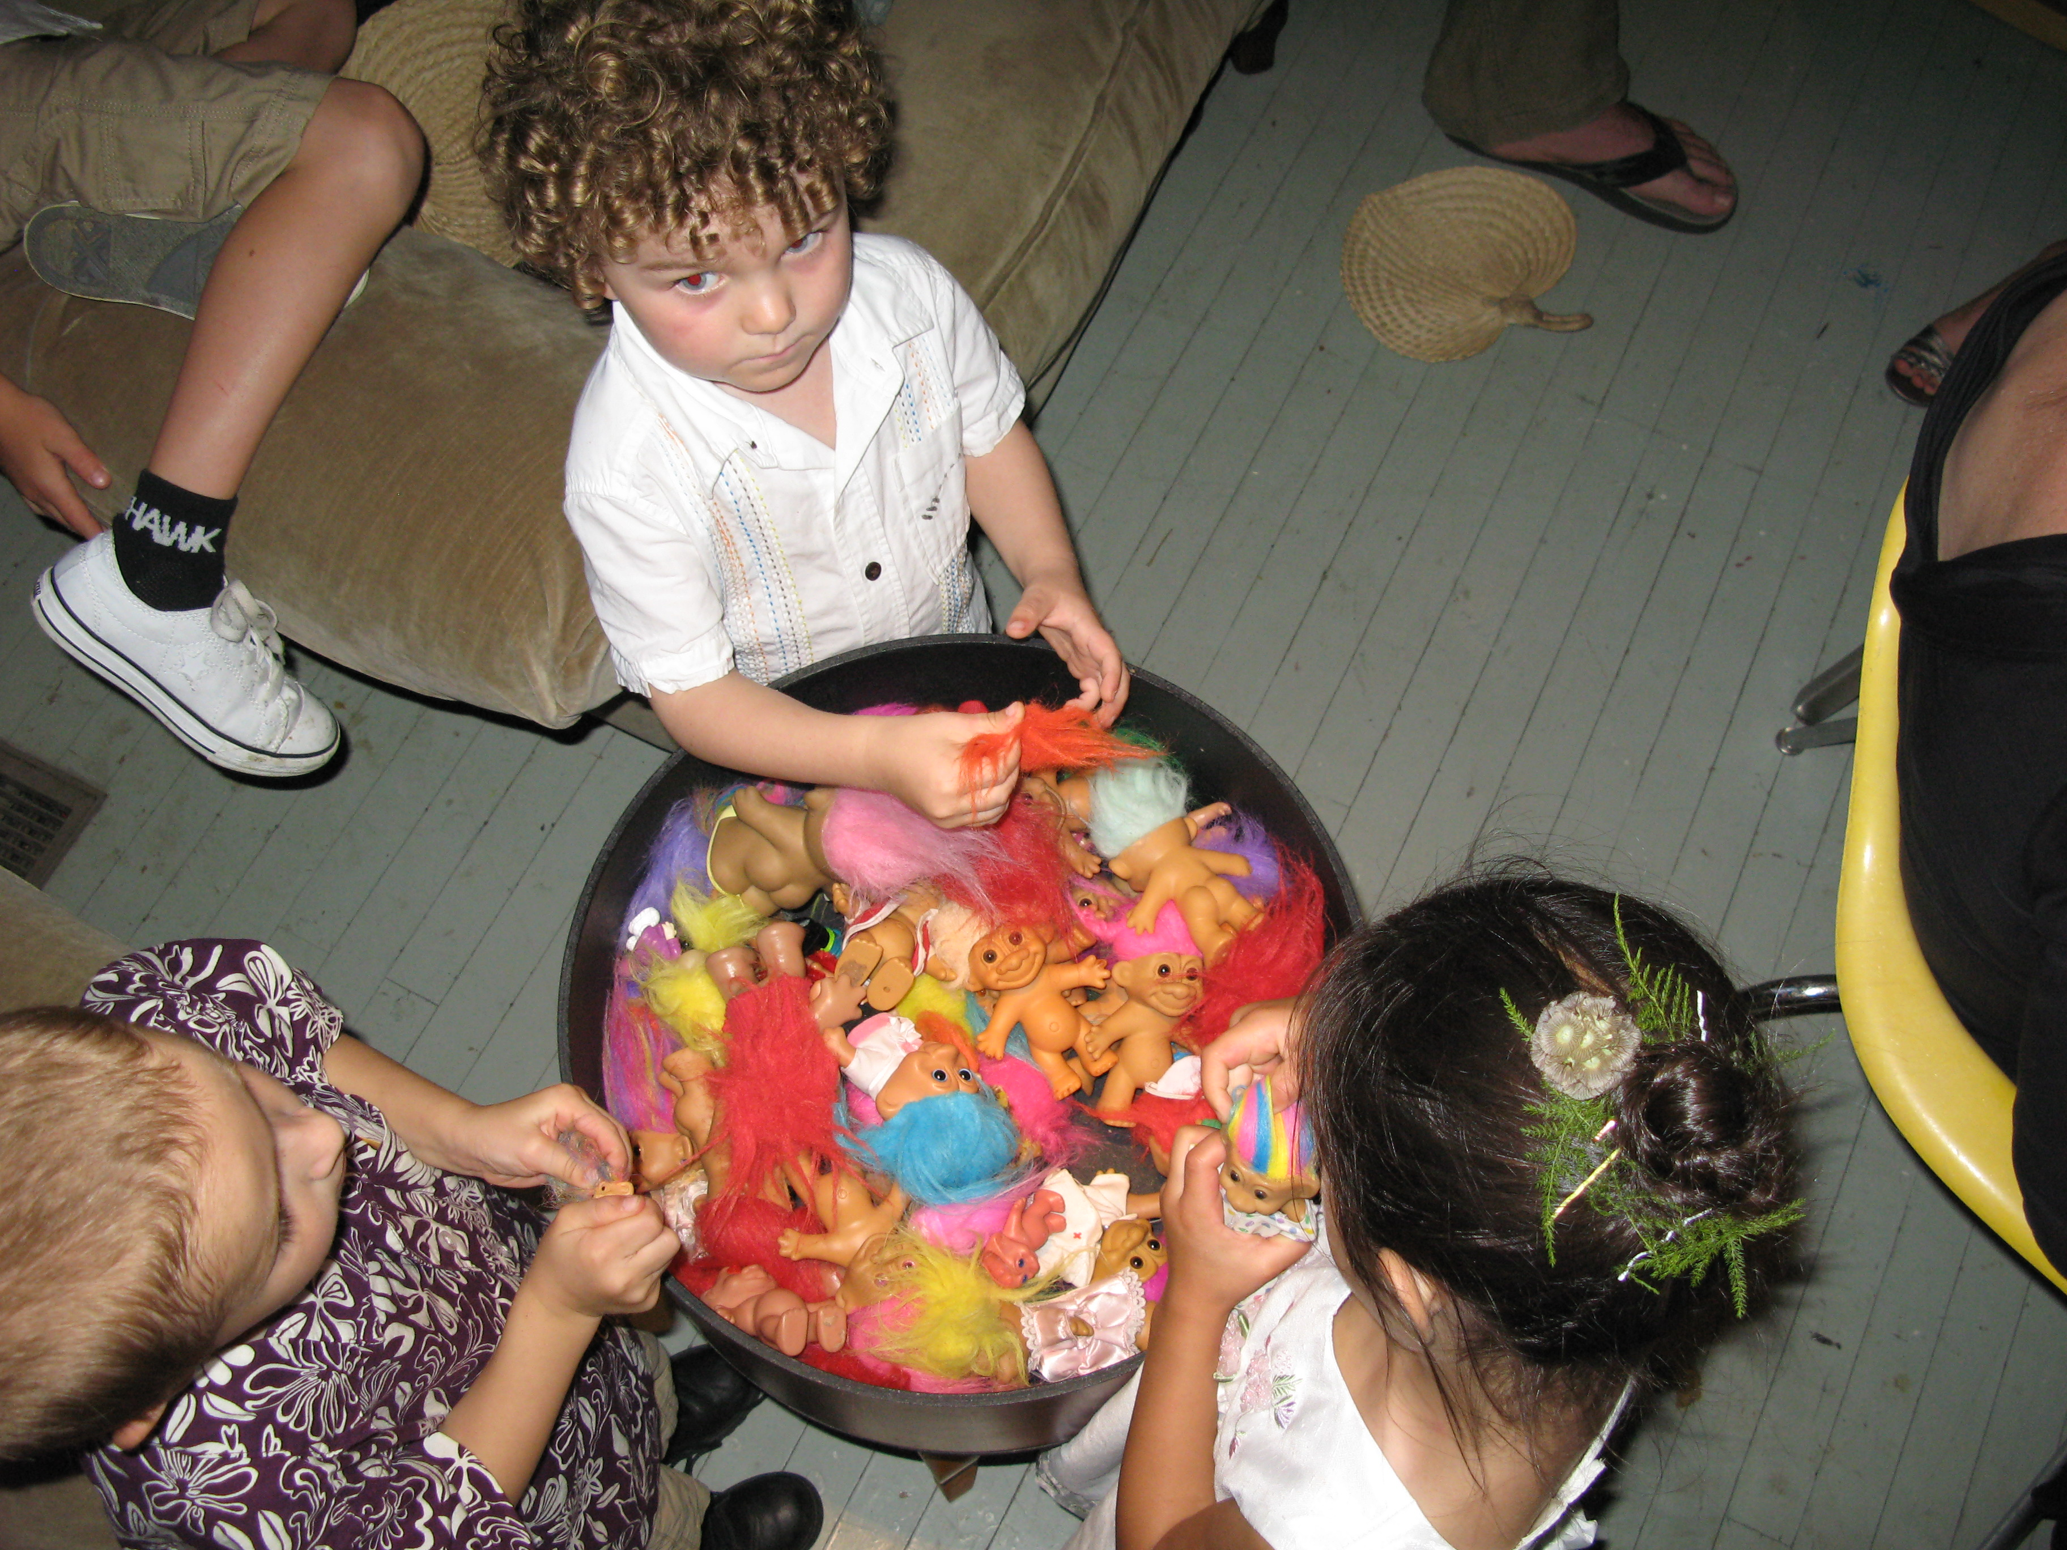

Slide 10
And everyone finally noticed...

Slide 11
And everyone finally noticed...
National Public Radio ran two spots

Slide 12
And everyone finally noticed...
National Public Radio ran two spots
Many academics wrote about the problem

Slide 13
And everyone finally noticed...
National Public Radio ran two spots
Many academics wrote about the problem
The Government Accounting Office did a study

Slide 14
And everyone finally noticed...
National Public Radio ran two spots
Many academics wrote about the problem
The Government Accounting Office did a study
The Federal Trade Commission has plans

Slide 15
Legislation is being
talked about

Slide 16
The Innovation Act

Slide 17
Heightened pleading

Slide 18
(a.k.a. say what you're
actually suing about)

Slide 19
Fee-shifting

Slide 20
Stop “discovery abuse”

Slide 21
Better transparency

Slide 22
Limited protection
for end-users

Slide 23
Review the patent
at the USPTO,
while litigation is on hold

Slide 24
Awesome, right?

Slide 25
Sadly, that's no longer
on the table

Slide 26
What does all this mean
for the future?

Slide 27


Slide 28
Again with
the awesome.

Slide 29
Except...

Slide 30
The patent system still
has huge problems.

Slide 31
The patent system still
has HUGE problems.

Slide 32
And just to recap
why we all care

Slide 33
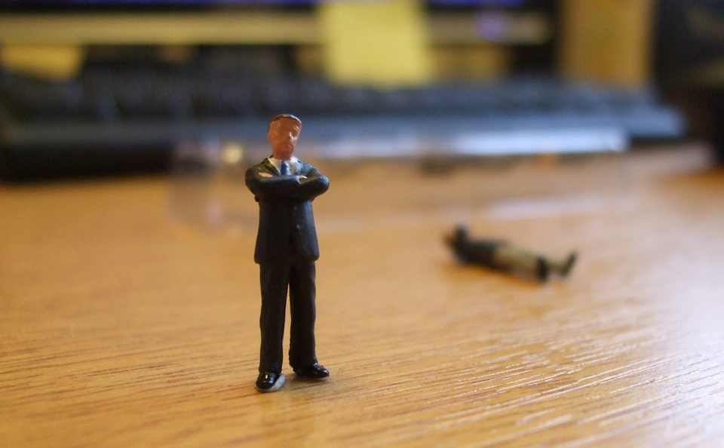

Slide 34
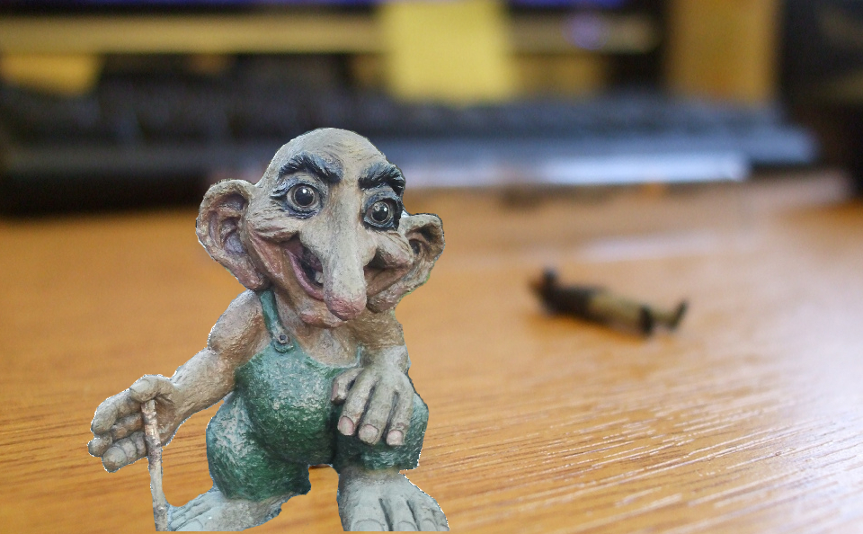

Slide 35
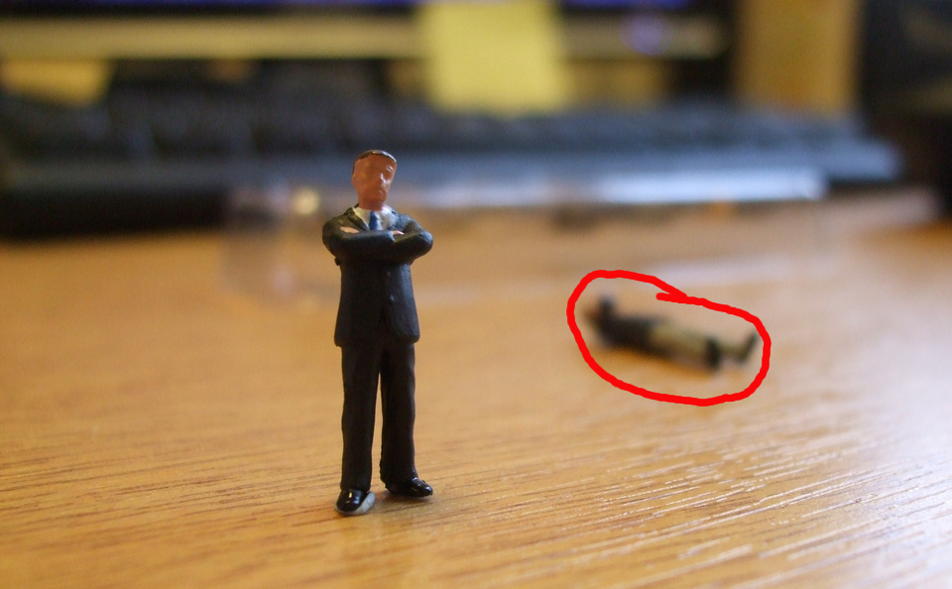

Slide 36
Practicing entities have
been selling their
patents to subsidiaries

Slide 37
Trolls don't have to care about FRAND

Slide 38


Slide 39
Anti-competitive suits

Slide 40
Cross-licensing “requests”

Slide 41
Universities have patents and need money

Slide 42
Intellectual Ventures has “relationships” with
over 300 schools

Slide 43
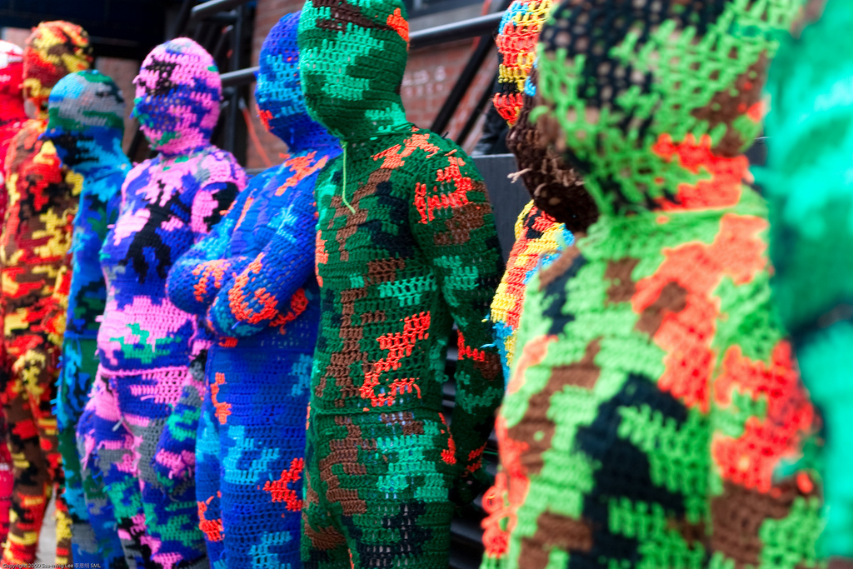

Slide 44
So legislation
is incomplete

Slide 45
But corporate back-dealing remains robust

Slide 46
Some glimmers of hope
from the US courts..

Slide 47
In New York, a troll was forced to return the money

Slide 48
"serious, good-faith effort"

Slide 49
Akamai v. Limelight

Slide 50
More end-user suits?

Slide 51
Biosig v. Nautilus

Slide 52
“indefiniteness”
vs. “obvious”

Slide 53
Soverain v. Newegg

Slide 54
"It's a really tough time
to be a patent owner."

Slide 55
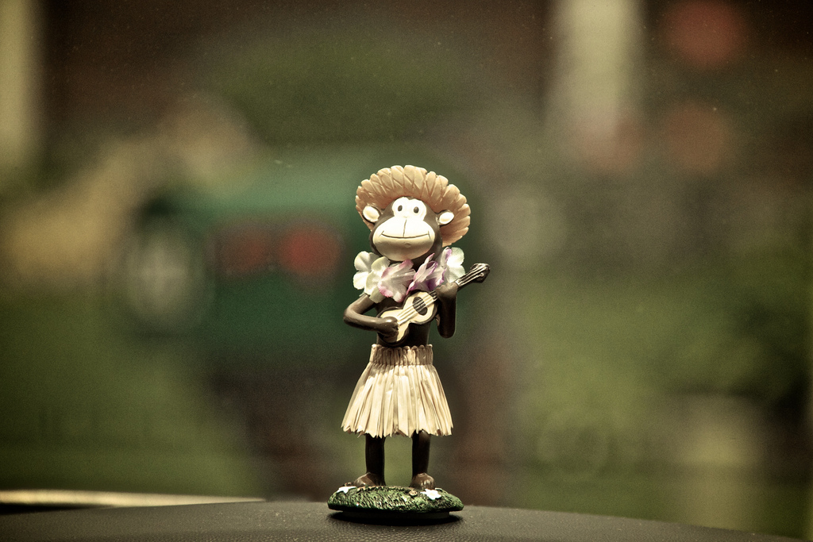
Sorry not sorry!

Slide 56
SCOTUS
is unpredictable

Slide 57

Predators may
not be affected

Slide 58
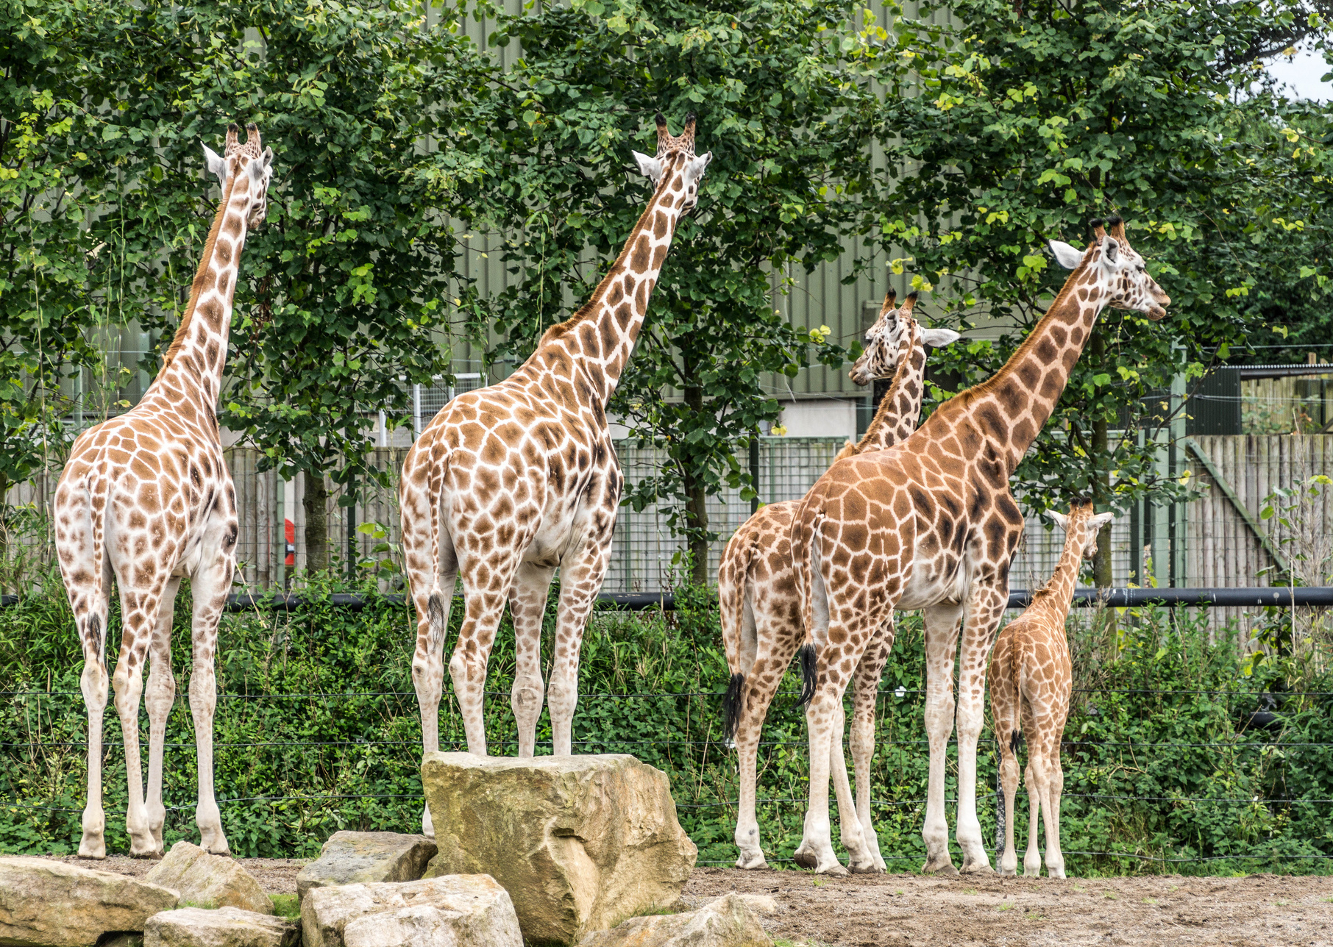

Slide 59
What can we do?

Slide 60
Community solutions

Slide 61
Community solutions
Non-aggression pact

Slide 62
Community solutions
Non-aggression pact
Defensive patent pool

Slide 63
Community solutions
Non-aggression pact
Defensive patent pool
Use the GPL (and the DPL)

Slide 64
Community solutions
Non-aggression pact
Defensive patent pool
Use the GPL (and the DPL)
Lobby for software specific reforms to your local patent regime

Slide 65
Every patent system has
it's own challenges

Slide 66
Strategic reforms

Slide 67
Strategic reforms
Complete transparency when suits are brought

Slide 68
Strategic reforms
Complete transparency when suits are brought
Much shorter lifespans for software patents

Slide 69
Strategic reforms
Complete transparency when suits are brought
Much shorter lifespans for software patents
Eliminate functional claiming by requiring less fuzziness in patent applications

Slide 70
Strategic reforms
Complete transparency when suits are brought
Much shorter lifespans for software patents
Eliminate functional claiming by requiring less fuzziness in patent applications
Don't financially incentive the patent office

Slide 71
Individual activities

Slide 72
Individual activities
Help with patent-busting

Slide 73
Individual activities
Help with patent-busting
Tell your lawmakers why this matters to you

Slide 74
Individual activities
Help with patent-busting
Tell your lawmakers why this matters to you
Talk to colleagues and friends about predators

Slide 75
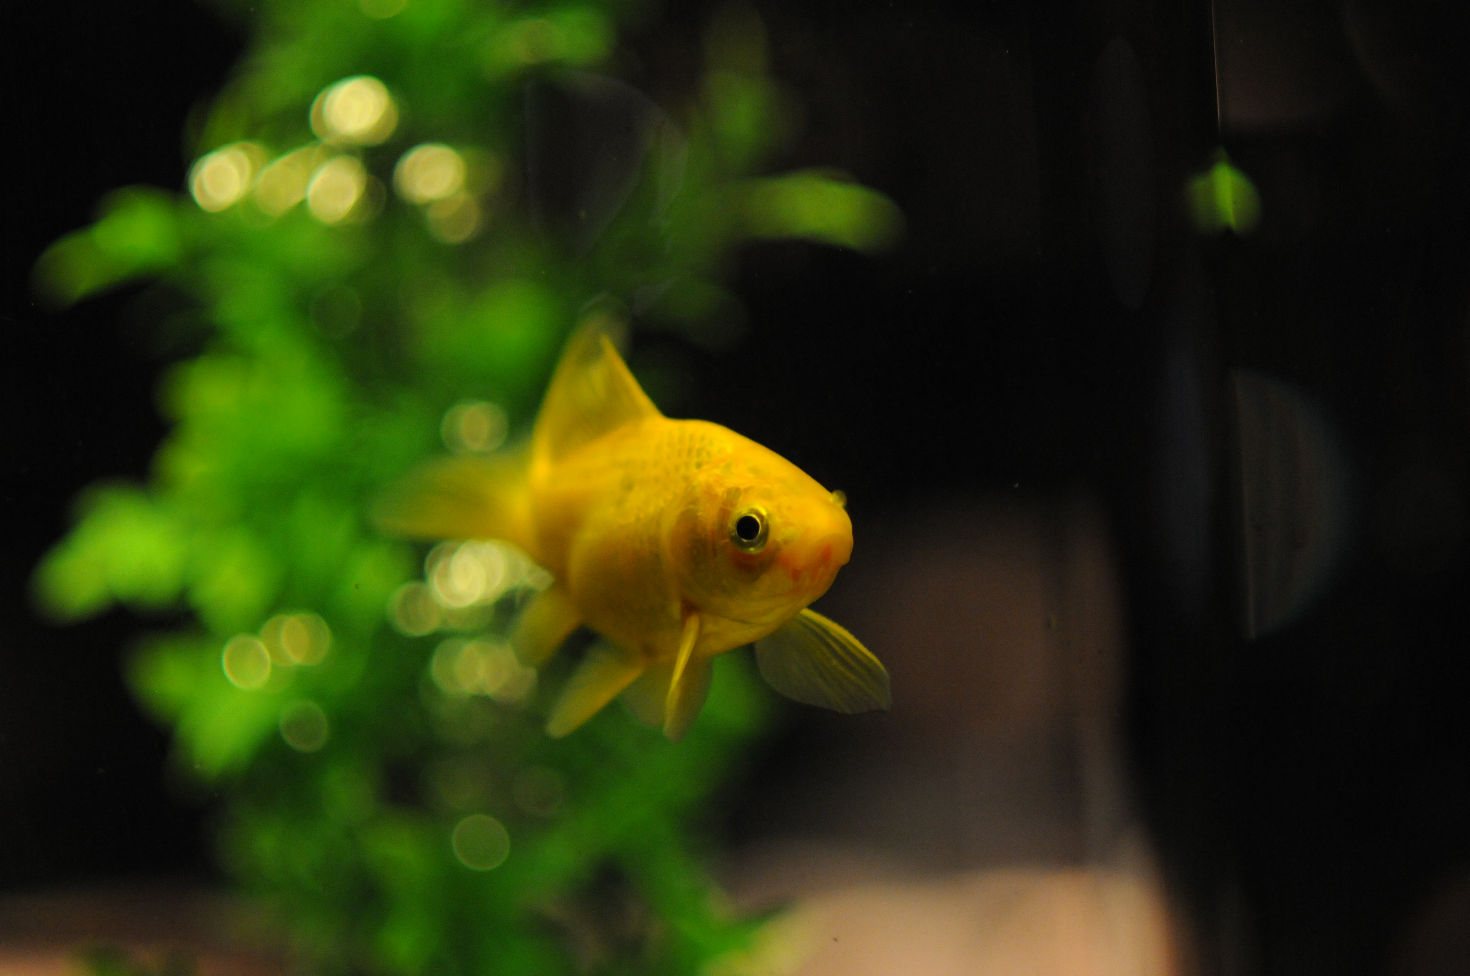
What we know about the general public's attention span

Slide 76
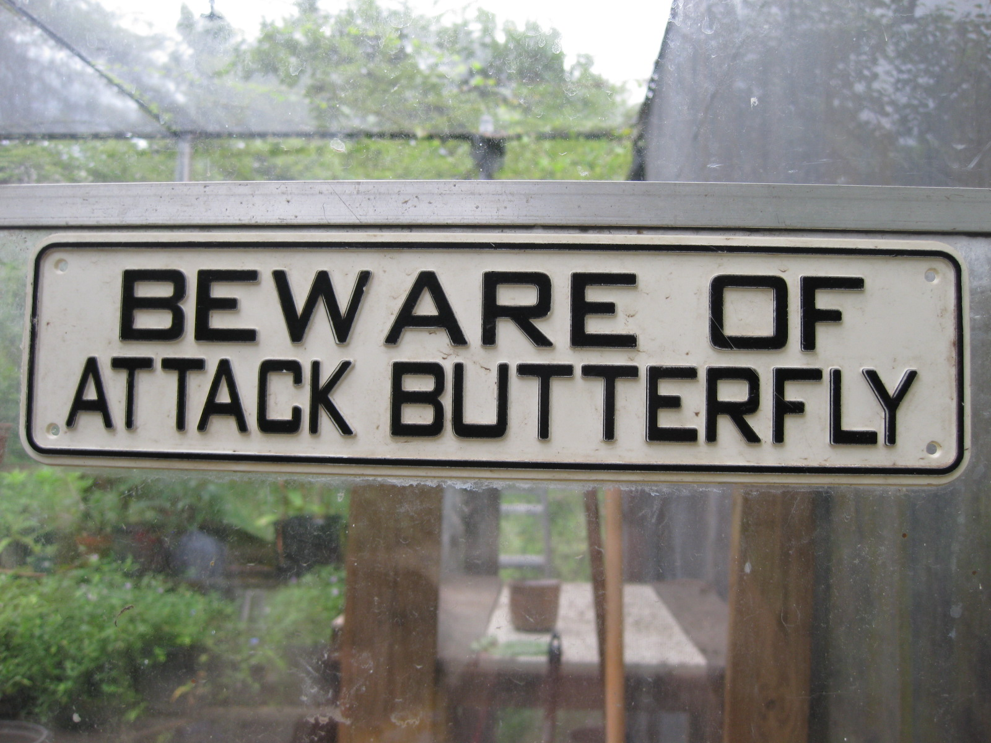
What we know about practicing entities

Slide 77
Picture Credits
CC.0 from Blendswap
Dromaeosaur Raptor, by Animaniac888
CC.BY from Flickr
Mushroom and Moss, by Jason Pratt - Packhorse Bridge, by Alan Cleaver - Bucket of Trolls, by grenade - Butterfly In Bed, by maxintosh - Beware of Butterfly, by Valentina Powers - Bridge Over Wey, by Steve Parker
CC.BY.SA from Flickr
Bad Boss, by noii - Giraffe Huddle, by infomatique - Goldfish, by Steven Lilley - Crotchet Camo, by See Ming Lee - Monkey With Guitar, by schatz
CC.BY.SA
Bergen Troll, by Deb Nicholson

Slide 78
Resources
Patent-busting sites
http://linuxdefenders.org/
https://trollingeffects.org/
http://patents.stackexchange.com/
Reading
Patent Assertion and Startup Innovation,
by Colleen V. Chien with OTI/New America Foundation,2013

Slide 79
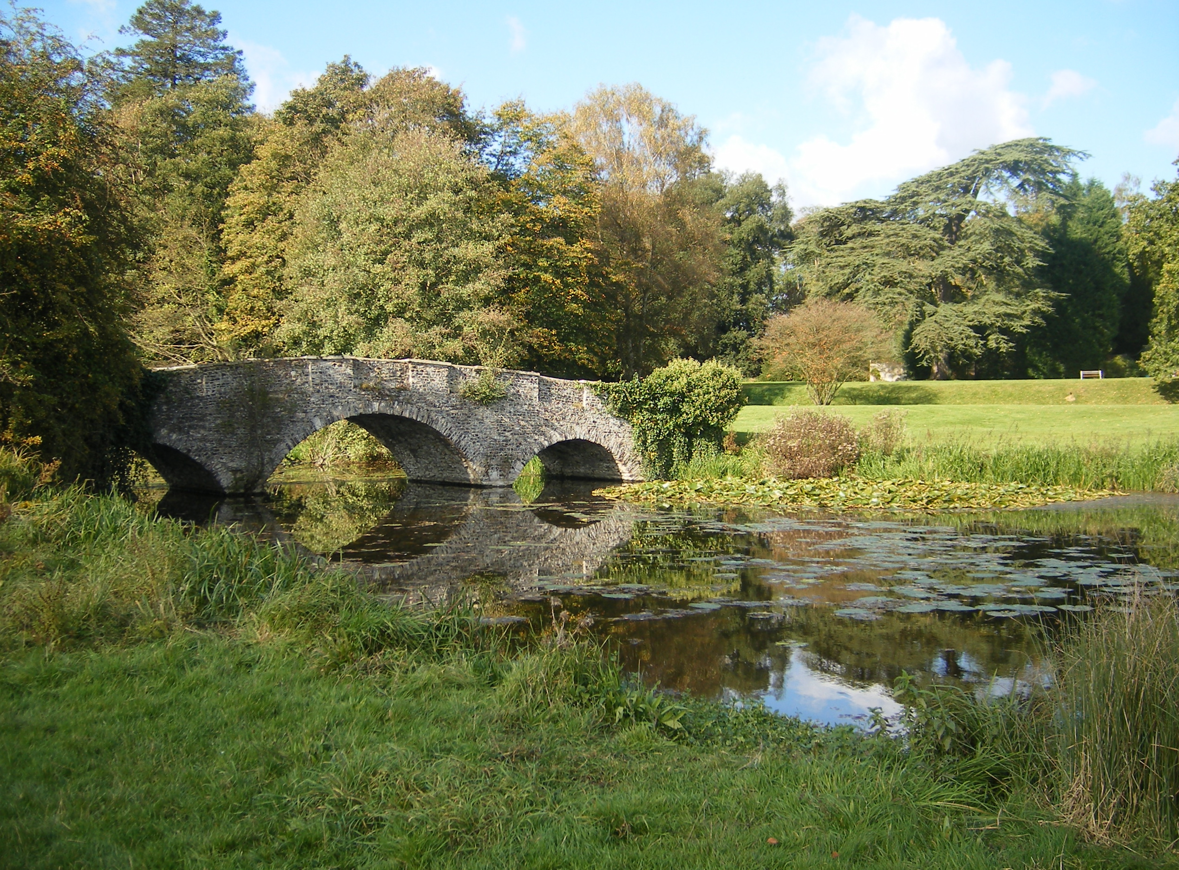
Questions? deb@openinventionnetwork.com

