Slide 1
Cylon.js:
The JavaScript Evolution Of Open Source Robotics

Slide 2
Good Afternoon

Slide 3
This is
SCaLE 12x

Slide 4



I am
@deadprogram

Slide 5
Ringleader
@hybrid_group

Slide 6
The other guy is
@adzankich

Slide 7
Serious
Programming Guy
@hybrid_group

Slide 8

hybridgroup.com

Slide 9


Slide 10
Open Source Robotics

Slide 11
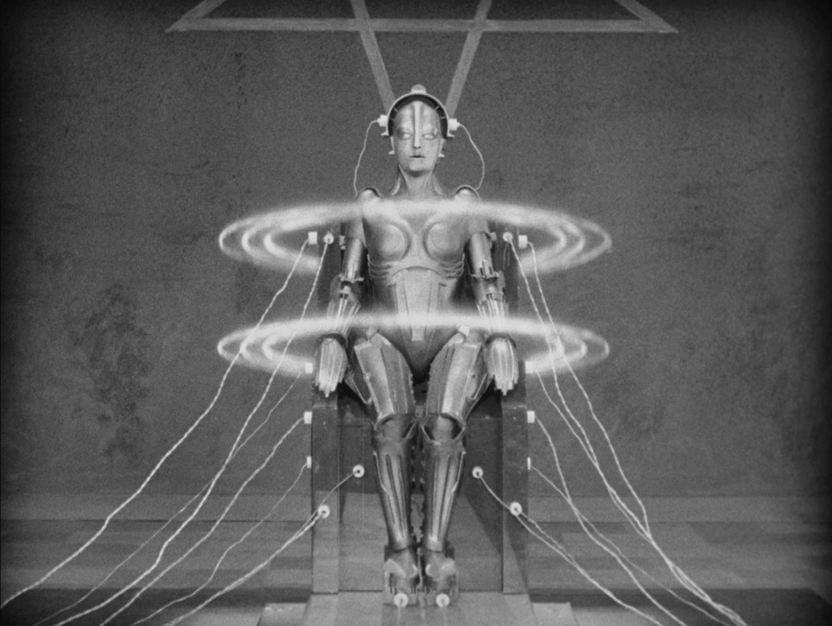

Slide 12
Is Innovation Dead?

Slide 13
“The future is
already here,
it's just not very evenly distributed”
- William Gibson

Slide 14
Innovating is
HARD

Slide 15


Slide 16
3 Frameworks for
Robotics & Physical
Computing

Slide 17



Slide 18


Slide 19


Slide 20
Multiple
Hardware Devices

Slide 21
Different
Hardware Devices

Slide 22
At the Same Time!

Slide 23
Robotics
Should Be As Easy As Web Development

Slide 24


Slide 25
Cylon.js Example
var Cylon = require('cylon');
Cylon.robot({
connection: {name: 'arduino',
adaptor: 'firmata',
port: '/dev/ttyACM0'},
device: {name: 'led',
driver: 'led',
pin: 13},
work: function(my) {
every((1).second(), {
function() {my.led.toggle()}
});
}
}).start();

Slide 26
Cylon.js
Architecture

Slide 27
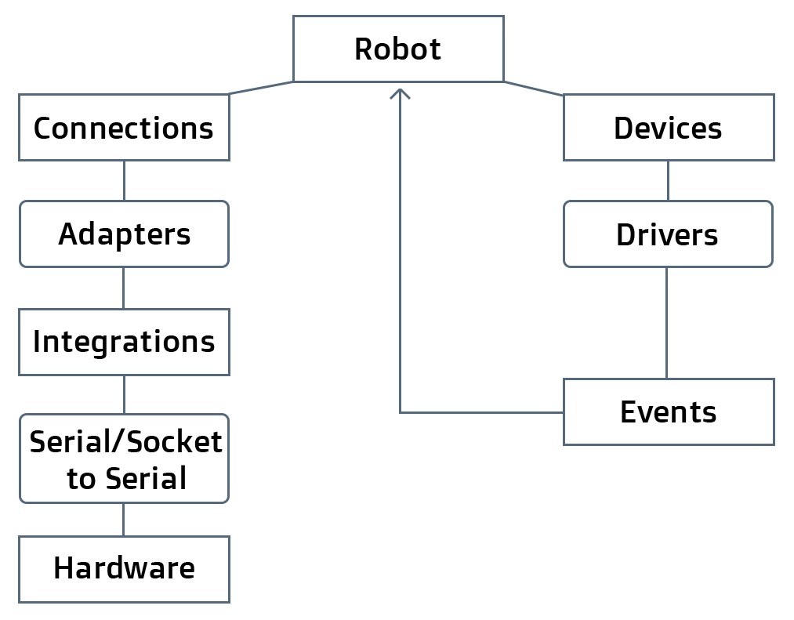

Slide 28
Cylon.js
API

Slide 29
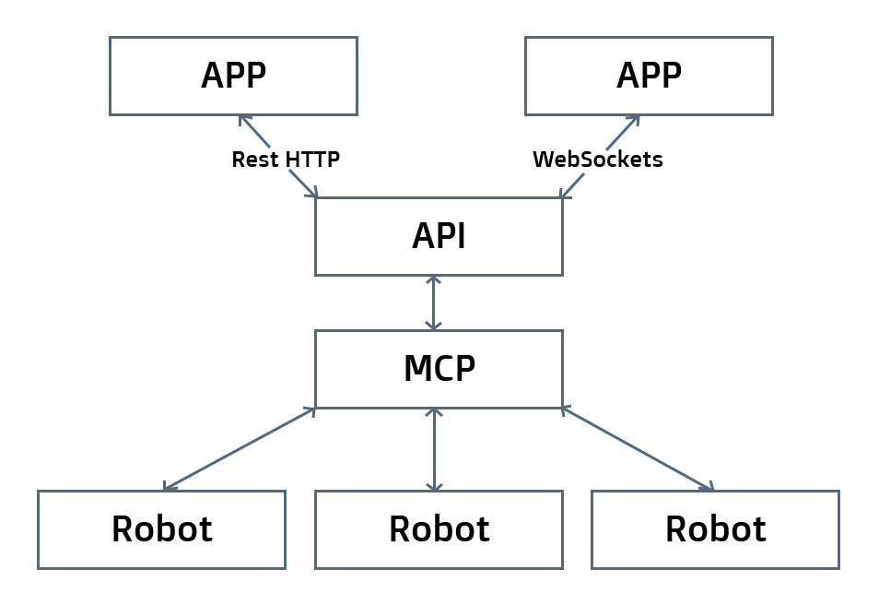

Slide 30
Test-Driven
Robotics

Slide 31
TDR Example
describe("robot", function () {
var robot = Cylon.findRobot("testor");
it("should have work", function () {
return robot.work.should.be.a('function');
});
it("should toggle the led after 1 second",
function (done) {
var led = robot.devices['led'];
var toggle = sinon.stub(led, 'toggle');
clock.tick((1).second());
toggle.should.have.been.called;
done();
});
});

Slide 32
Command Line Interface

Slide 33
Show Me
The Demo!

Slide 34
Demo - Arduino

Slide 35
Demo - Digispark

Slide 36
Demo – Beaglebone Black

Slide 37
Choose Your Own Hardware Adventure!

Slide 38
Tweet @cylonjs &
@arduino
To Win a
Arduino Starter Kit

Slide 39
Tweet @cylonjs &
@beagleboardorg
To Win a
Beaglebone Black

Slide 40
Tweet @cylonjs &
@gosphero To Win a
Sphero 2.0

Slide 41
Demo - Sphero

Slide 42
Conway's
Game Of Life

Slide 43


Slide 44


Slide 45
Conway's
Game Of Life…
With
ROBOTS!

Slide 46
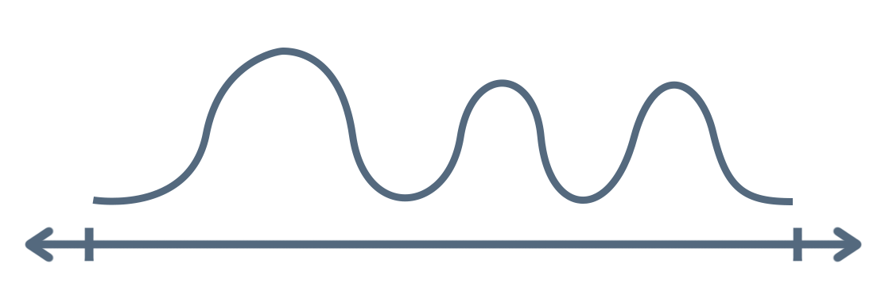

Slide 47
Demo – ARDrone

Slide 48
Demo – ARDrone,
OpenCV, & PS/3 Controller

Slide 49
Was that Fun?

Slide 50
Join the
Robot Evolution!

Slide 51
cylonjs.com
@cylonjs

Slide 52
artoo.io
@artooio

Slide 53
gobot.io
@gobotio

Slide 54
Welcome to
The Machines

Slide 55
Robot Economics

Slide 56
Robot Ethics

Slide 57
What is
Going to Happen?

Slide 58
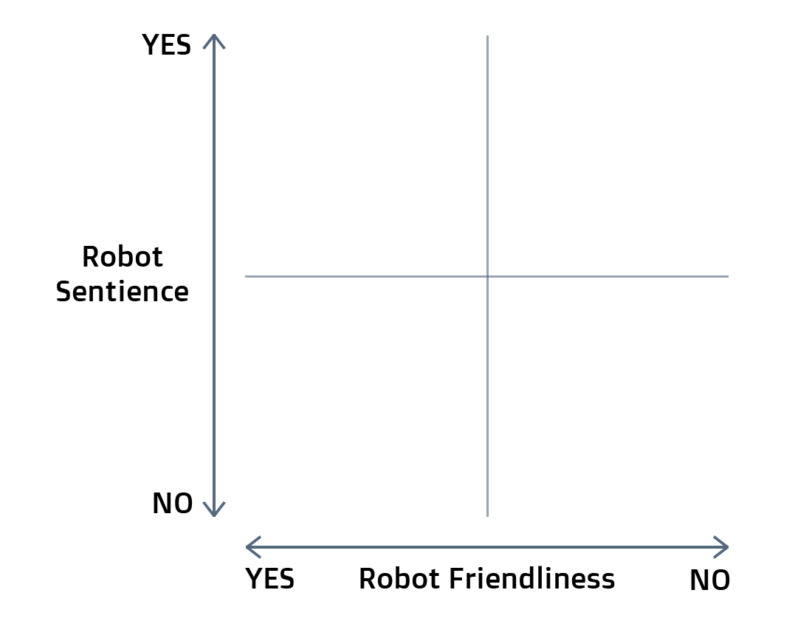

Slide 59
Brazil

Slide 60
Terminator
Brazil

Slide 61
Terminator
Power
Rangers
Brazil

Slide 62
Singularity
Terminator
Power
Rangers
Brazil

Slide 63
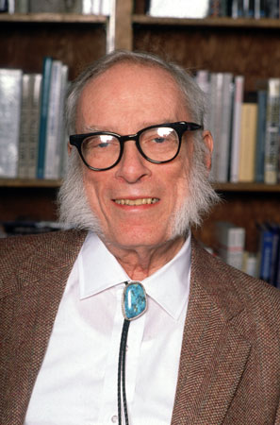

Slide 64
The Three
Laws of Robotics

Slide 65
#1
A robot may not injure a human being or, through inaction, allow a human being to come to harm.

Slide 66
#2
A robot must obey the orders given to it by human beings, except where such orders would conflict with the First Law.

Slide 67
#3
A robot must protect its own existence as long as such protection does not conflict with the First or Second Laws.

Slide 68
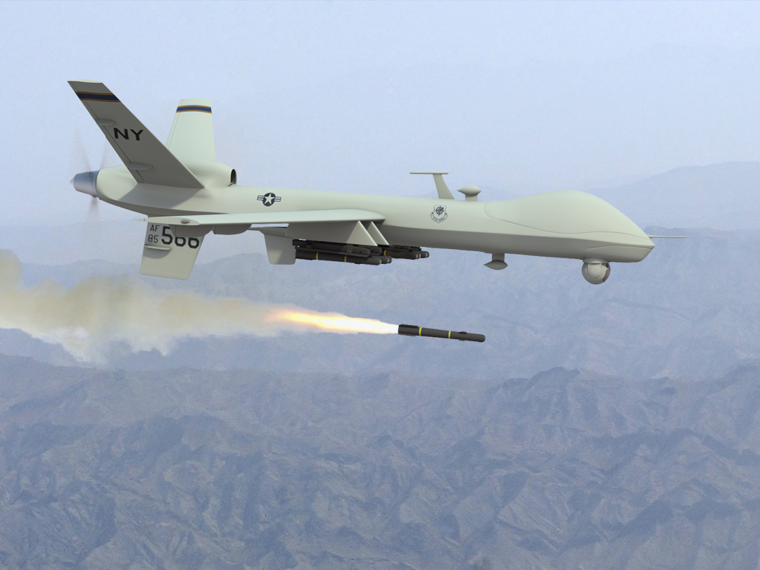

Slide 69
#1
A robot may not injure a human being or, through inaction, allow a human being to come to harm.

Slide 70
#1.1
A HUMAN may not injure a human being or, through inaction, allow a human being to come to harm.

Slide 71
cylonjs.com
@cylonjs
Thank You!
@deadprogram & @adzankich

