Slide 1
“If You Give a Programmer a Cookie...”
(A humorous take on a children's classic)
By Erik Johnson

Slide 2

If you give a programmer a cookie, he's going to ask for a beverage.

Slide 3
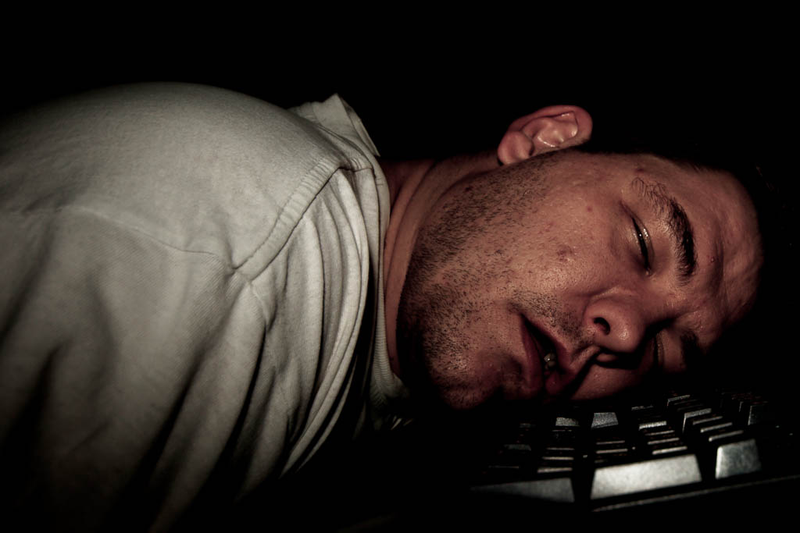
When you give him the beverage, flush with sugar and caffeine, he'll probably stay up until 3am writing code.

Slide 4
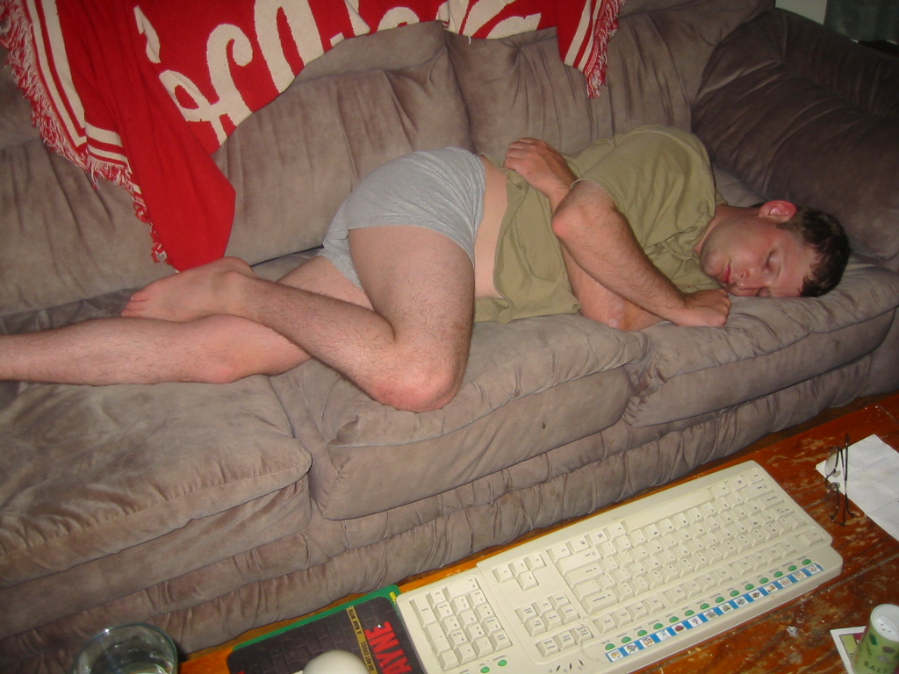
When he's finished, he'll pass out, still thinking about code.

Slide 5
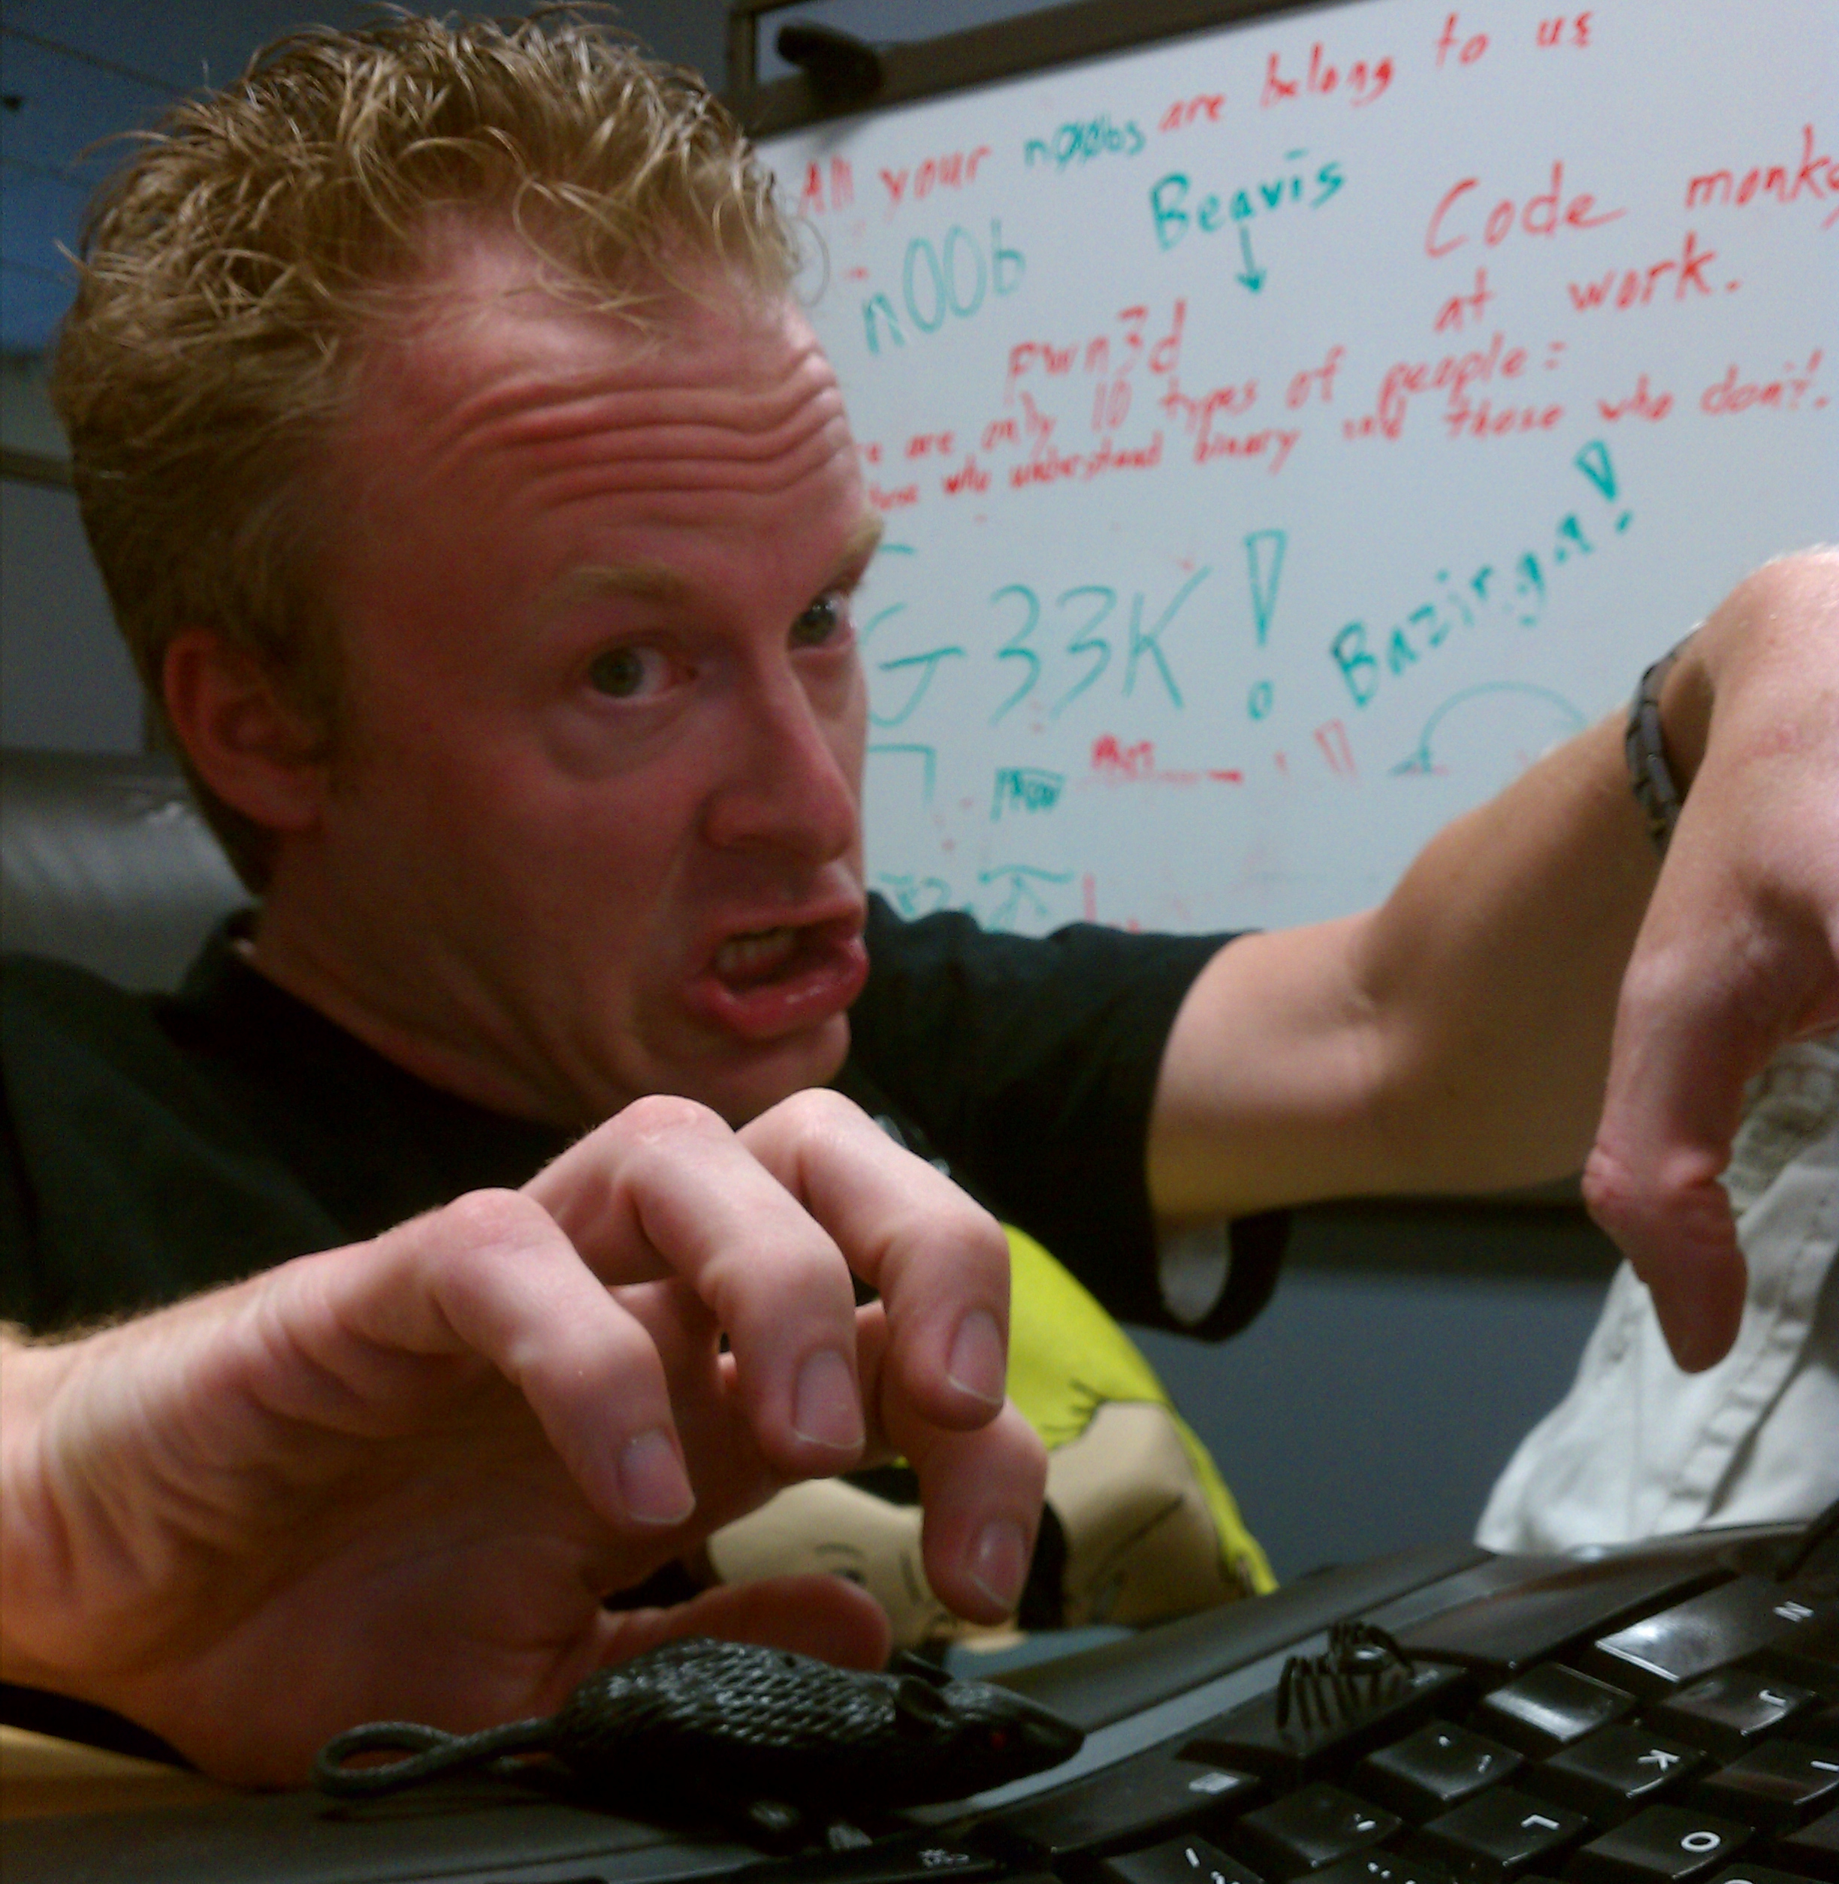
He'll dream he is still writing code, but can't figure out nagging bugs.

Slide 6
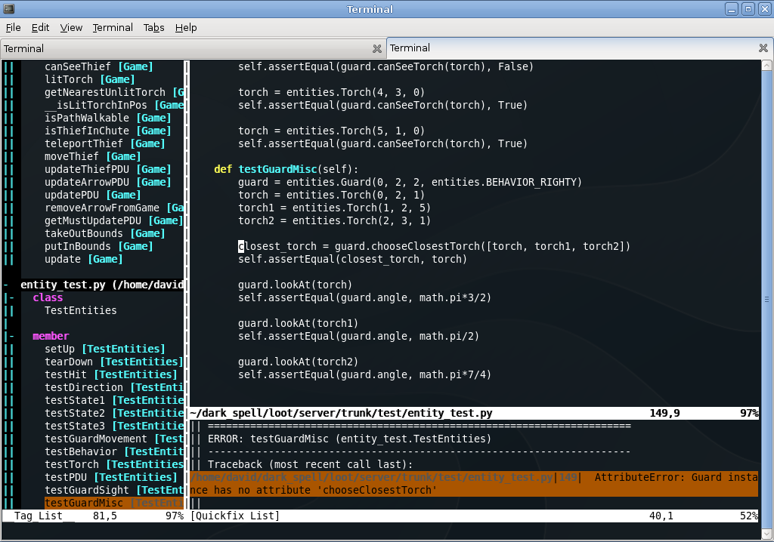
When he wakes up, he'll be convinced that he missed something.
So, he'll launch his IDE and audit the codebase.

Slide 7
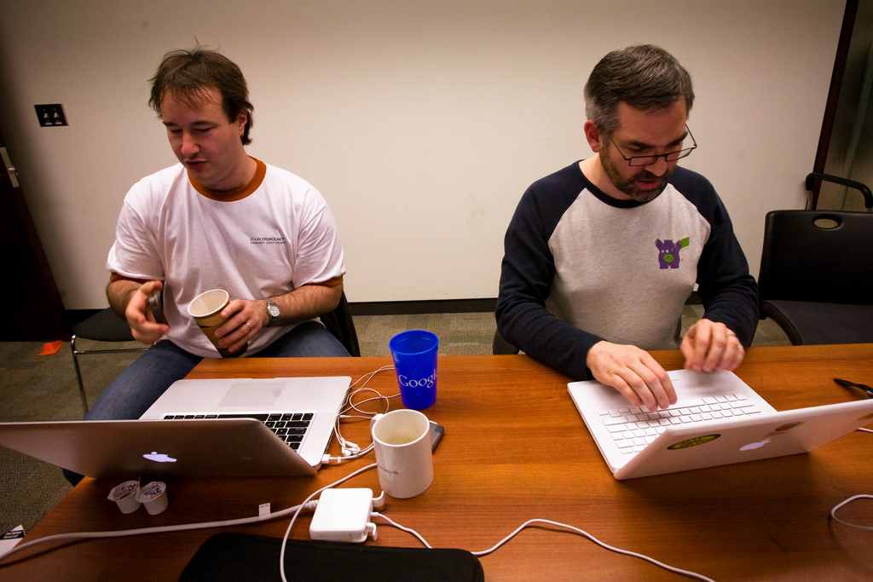
When he's finished auditing the codebase, he'll want to make a few changes.
So he'll start tweaking.

Slide 8

He might get carried away and rewrite the entire program.
(He may even end up changing the language as well!)

Slide 9
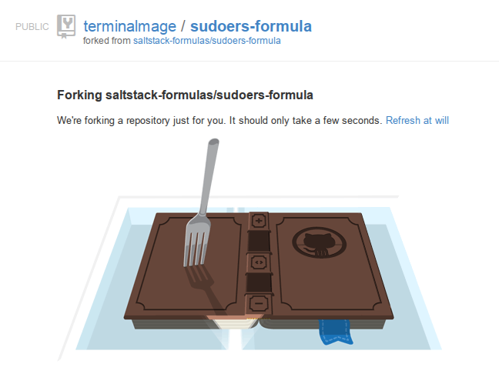

When he's done, he'll probably want to share the program.
He'll create a new repository on GitHub and share it with a few friends.

Slide 10
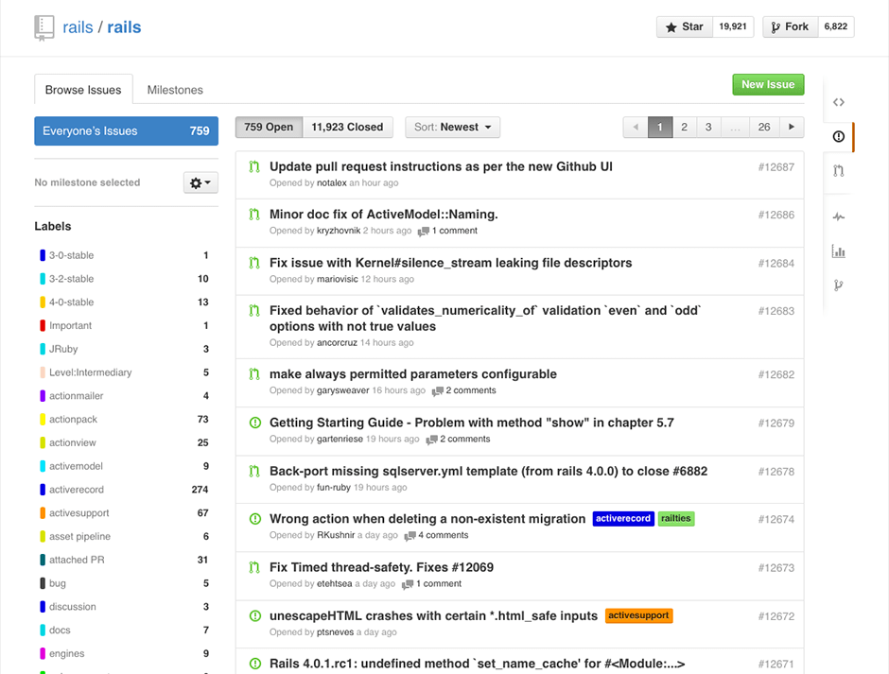
If you open an issue on his issue tracker...
...he'll push a few commits, and ask you to pull and test again.

Slide 11

So you'll try it out...
...and it'll segfault.
The programmer will ask for a coredump.

Slide 12
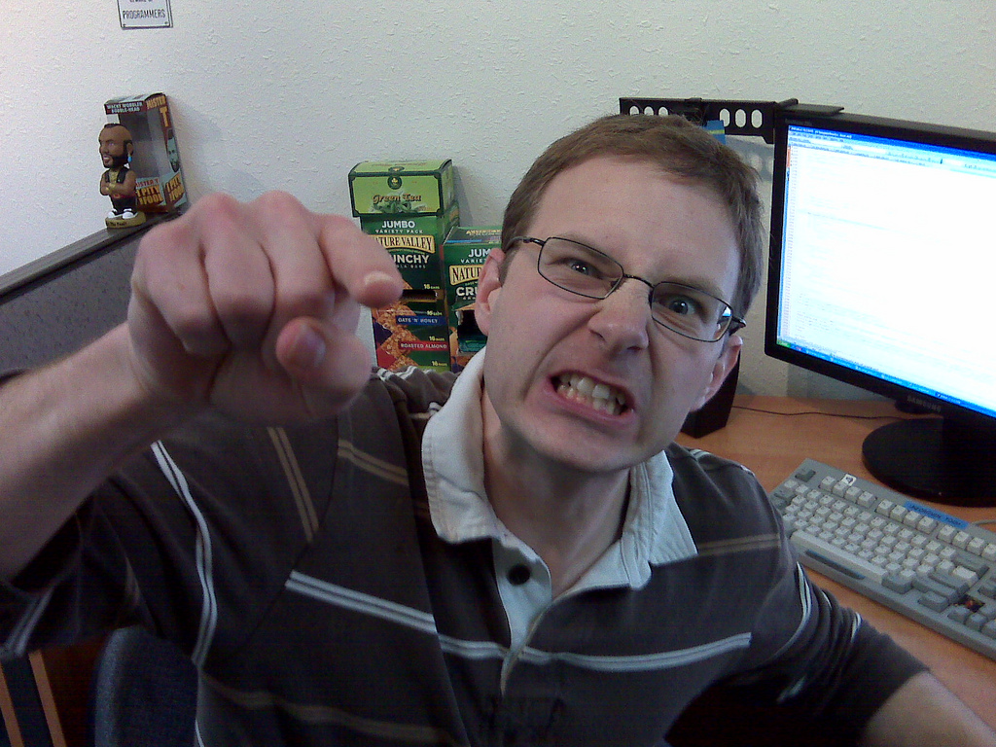
When he analyzes the coredump, he'll get angry because the binary was compiled without debugging symbols.

Slide 13
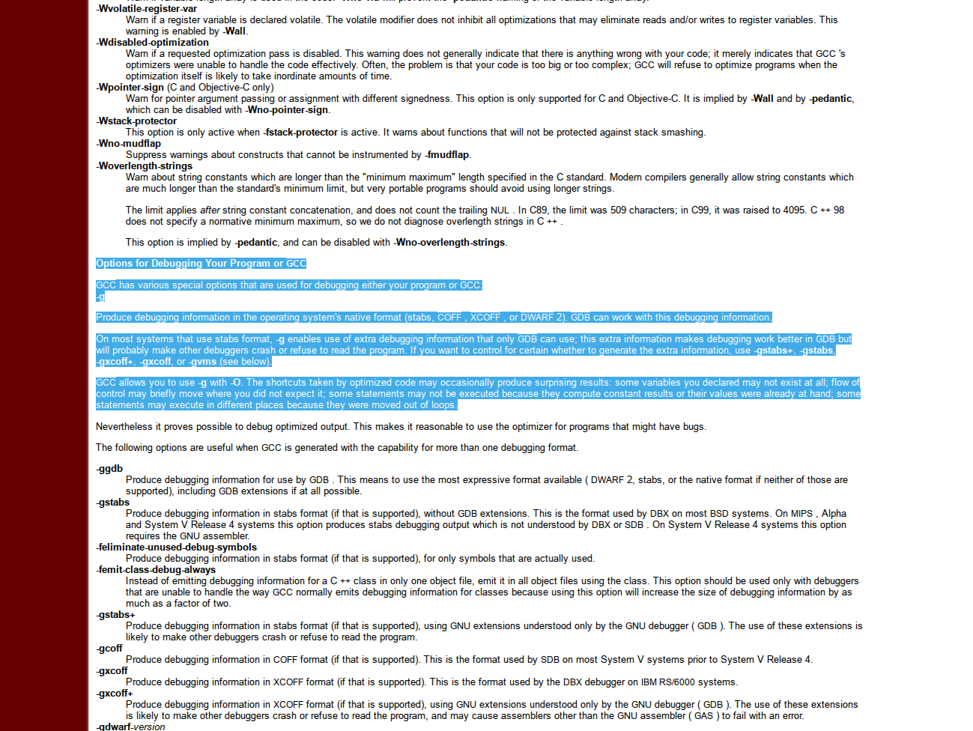
He'll ask you to recompile with -g.
If he's in a bad mood, he may send you a link to the GCC manpage and tell you to RTFM.

Slide 14
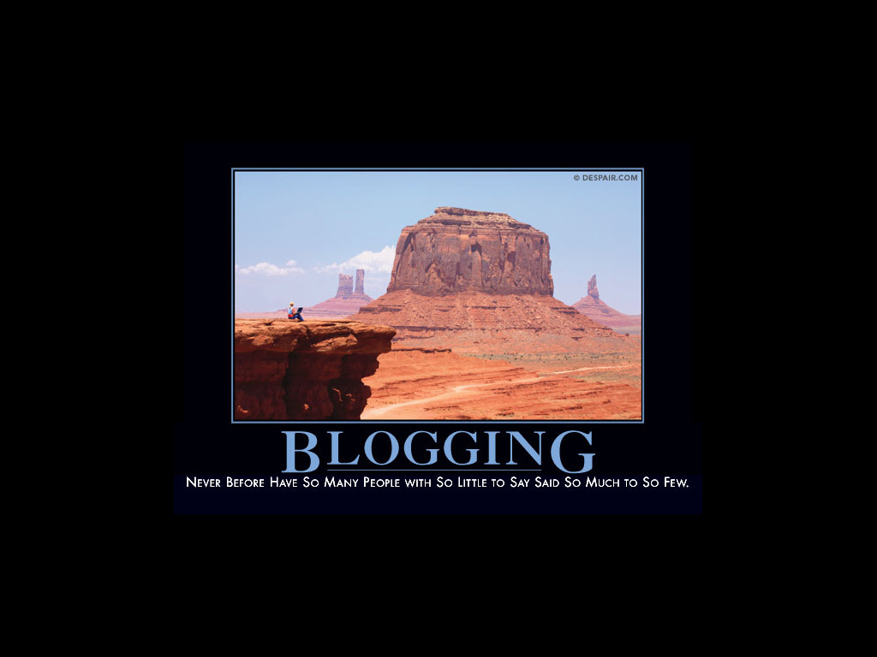
When the program has been properly debugged...
…he'll want to share it on his blog.

Slide 15
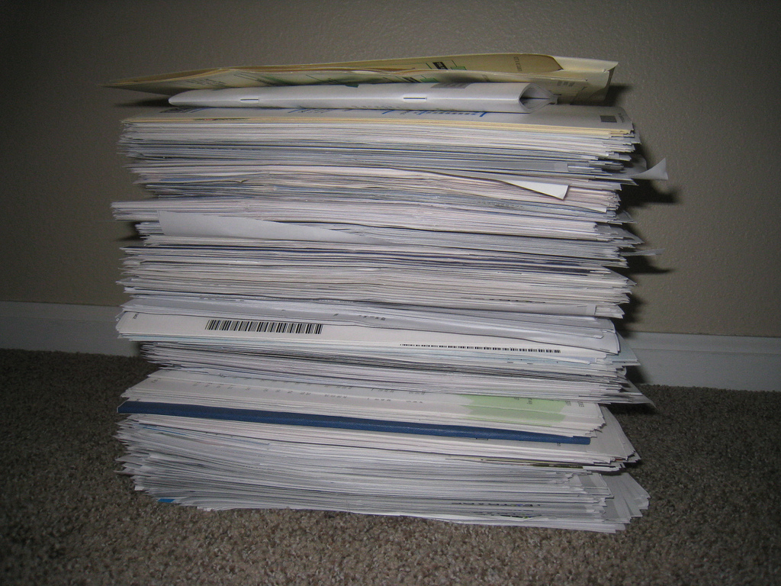
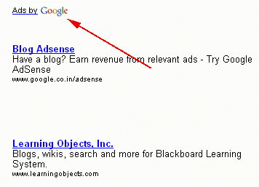
His blog will get so much traffic that hosting bills will start to pile up.
So he'll need to put ads on his blog to help pay them.

Slide 16
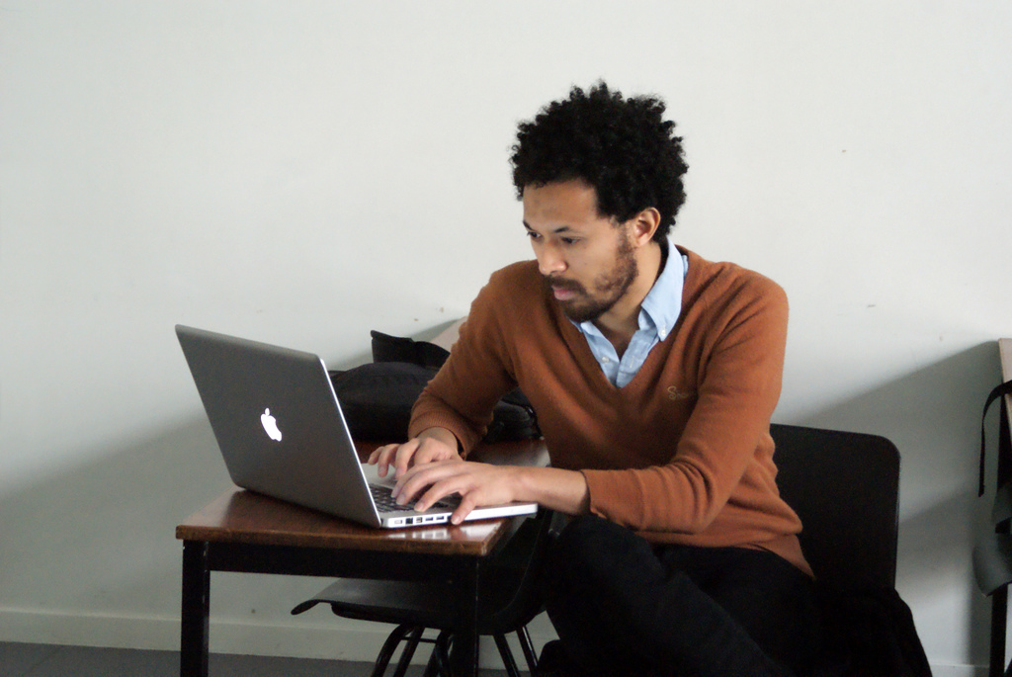

He'll go back to his blog, to check his stats and read the comment threads.
Looking at the ads will remind him that he is thirsty.

Slide 17
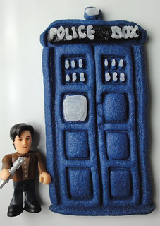
So... he'll get himself a beverage.
And, chances are, if he gets himself a beverage...
…he's going to want a cookie to go with it.

Slide 18
If you give a programmer a cookie, he's going to ask for a beverage.
And that's only the beginning!

Slide 19
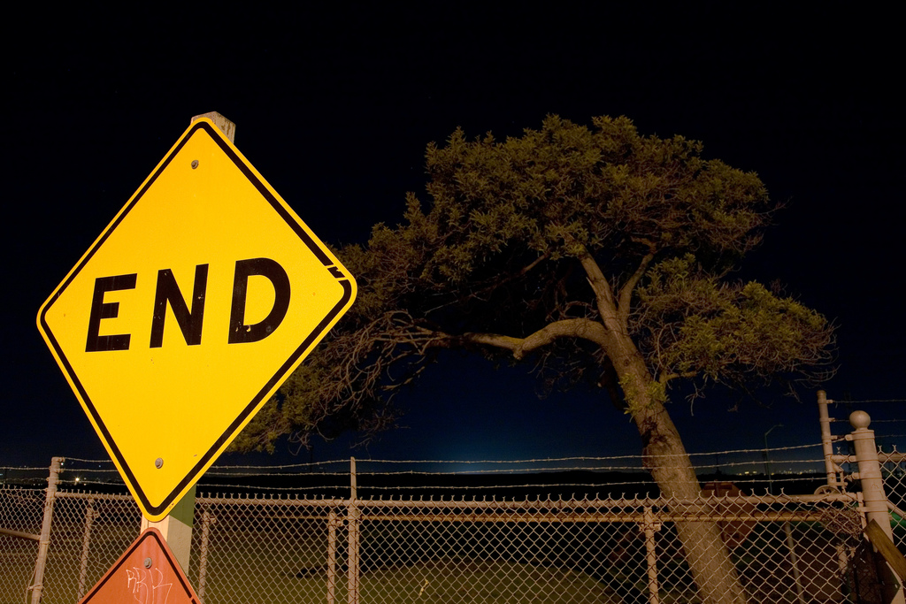

Slide 20

IMAGES USED
http://www.flickr.com/photos/davidhobby/447819702/
http://www.flickr.com/photos/fmgbain/4427106747/
http://www.flickr.com/photos/clintjcl/392383604/
http://www.flickr.com/photos/slworking/6906130886/
http://www.flickr.com/photos/nesdavid/2068252953/
http://www.flickr.com/photos/hyfen/3298931209/
http://www.flickr.com/photos/sbengineer/3636620858/
http://opensource.org/node/442
https://github.com/images/modules/features/rails-rails-issues@2x.png
http://www.flickr.com/photos/otubo/3342395287/
http://www.flickr.com/photos/fifthconspiracy/2494316642/
http://demotivators.despair.com/demotivational/bloggingdemotivator.jpg
http://www.flickr.com/photos/dvortygirl/8643961221/
http://www.seroundtable.com/adsense-google-logo1.png
http://www.flickr.com/photos/401forester/2709713728/
http://www.flickr.com/photos/paxtonholley/4340851272/
http://www.flickr.com/photos/justjenn/9559814698/
http://www.flickr.com/photos/mrjoro/89187454/
Come see me at the
booth and get some swag!

