Slide 1
Exploring the Open Source Movement
By John Kim
02/22/14

Slide 2
Objectives
Open Source Today
Origins of Open Source
Linus Torvalds and Richard Stallman
Key Ideologies

Slide 3
1. Open Source Today

Slide 4
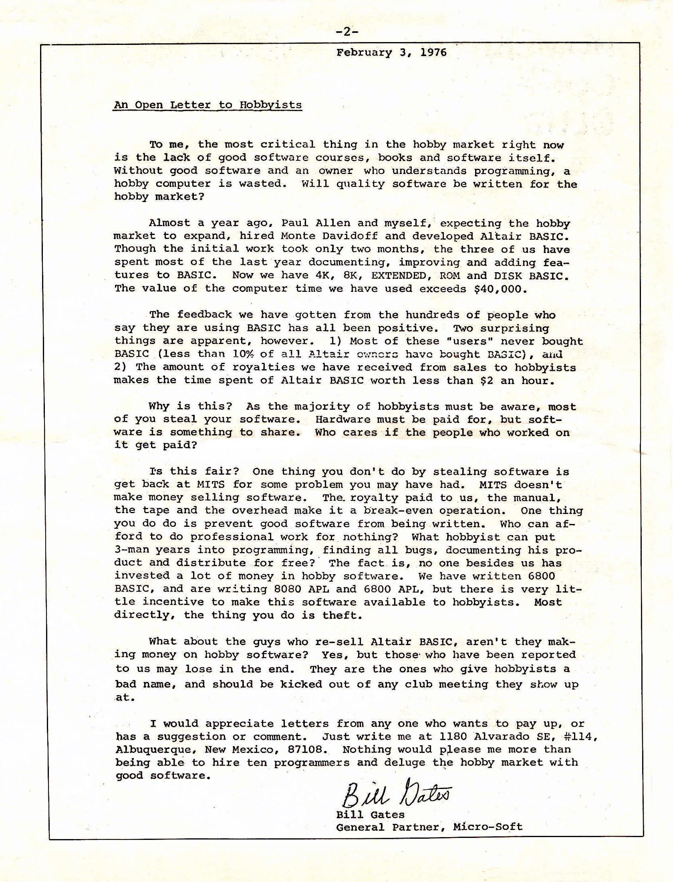

Slide 5



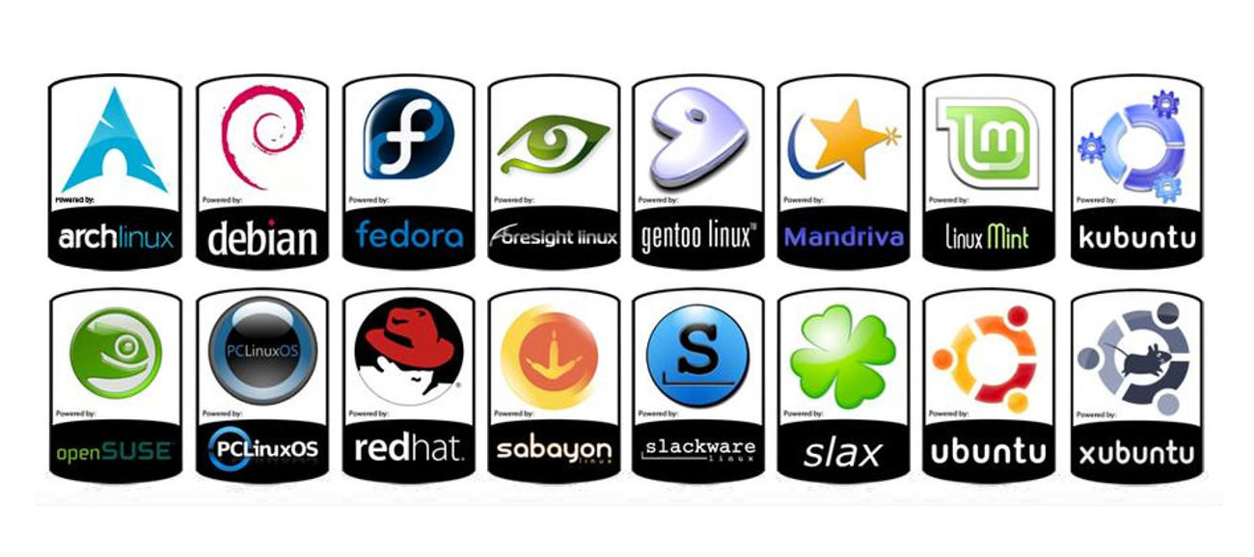
Examples

Slide 6
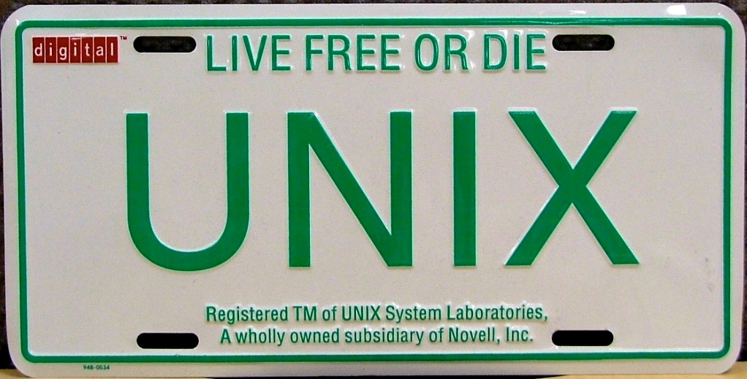

Significance
“No matter who you are, most of the smartest people work for someone else.” -Bill Joy, cofounder of Sun Microsystems

Slide 7
2. Origins of Open Source

Slide 8
The First Hackers
Baroque age of hackerdom
The term “hacker” comes from MIT's computer culture
ARPAnet
PDP-10's
Stanford, Carnegie Mellon, and MIT lead the way
XEROX PARC and mailing lists

Slide 9
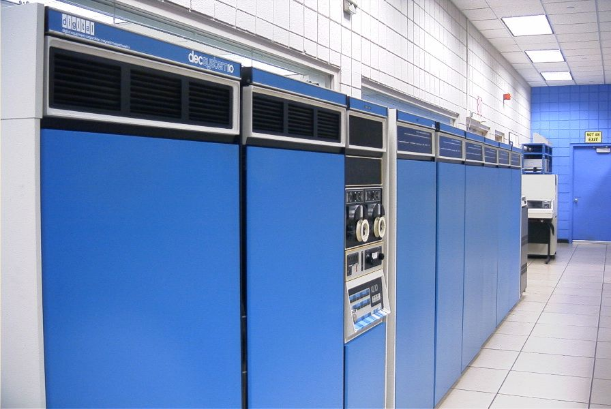

Slide 10

Rise of Unix

Slide 11
Rise of Unix
'70s: Classical age of hackerdom
Early Unix adopters used PDP-11s and VAX
UUCP
Usenet

Slide 12
Microcomputer Revolution
Microcomputer enthusiasts wanted to bring computers to the masses
First personal computer released (1975)
Apple founded (1977)
BASIC

Slide 13
Proprietary & Free Unixes
'80s: A major transition between three groups
Ethernet and Motorola 68000
Unix gains X Window System and “flavours”
Decline of Proprietary Unix
Dawn of Free Unixes

Slide 14

Why was Linux Successful?
Cathedral Model
Bazaar Model
Linux proved that the Bazaar model works

Slide 15
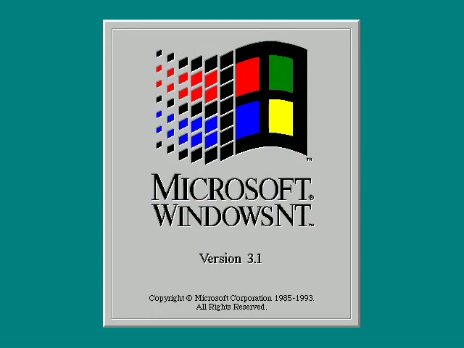
What about MC Revolution?
Windows 3.1 (1992)
Not a “network nation”
Development tools didn't come by default

Slide 16
3. Pivotal Figures

Slide 17
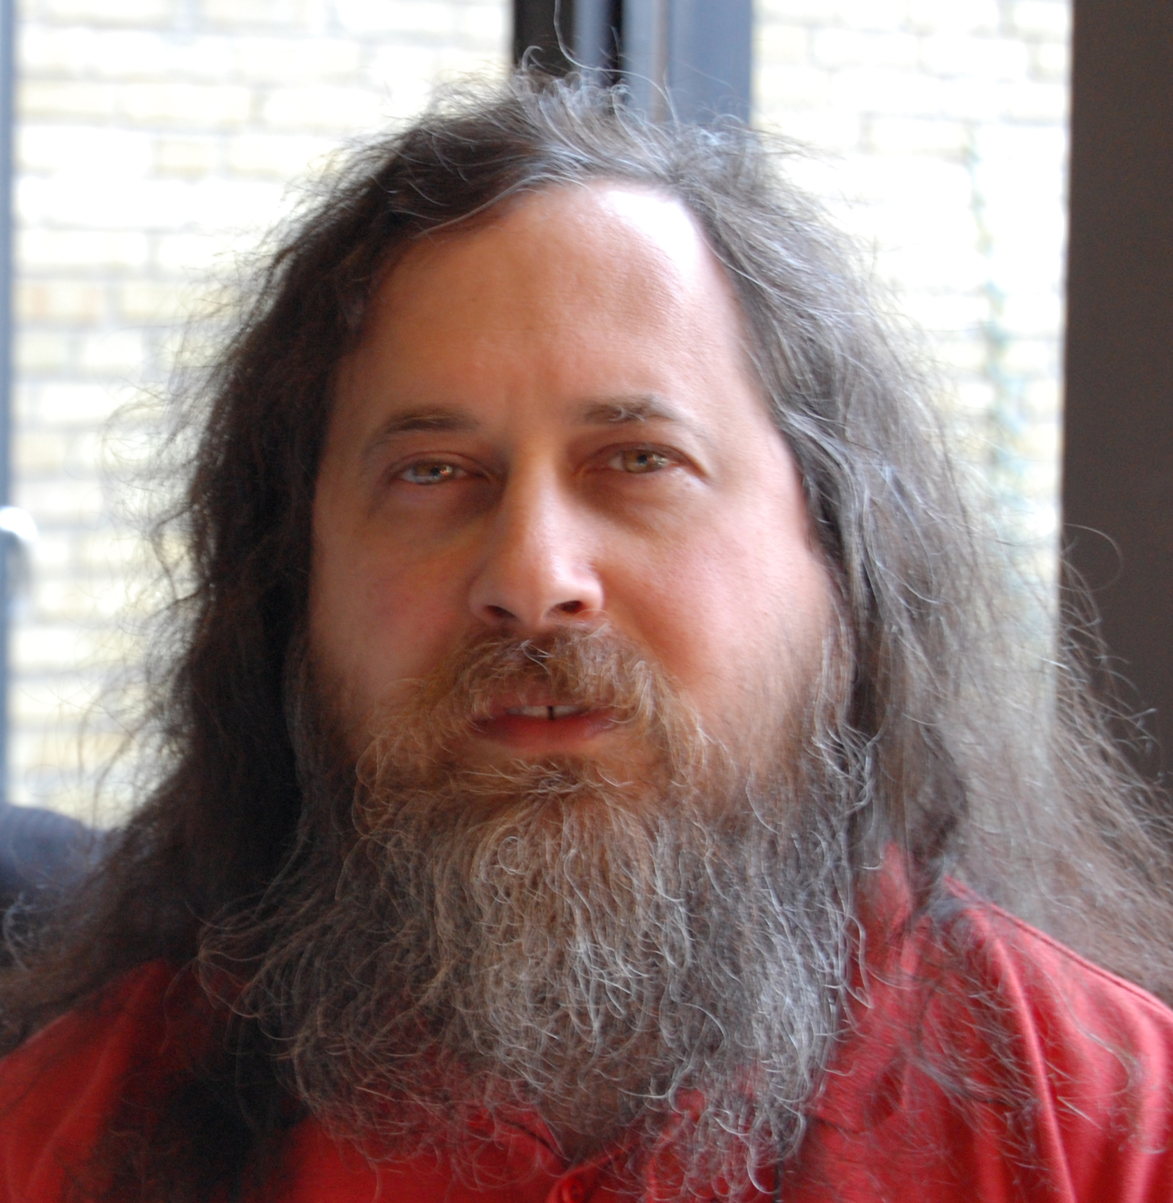
Richard Stallman

Slide 18
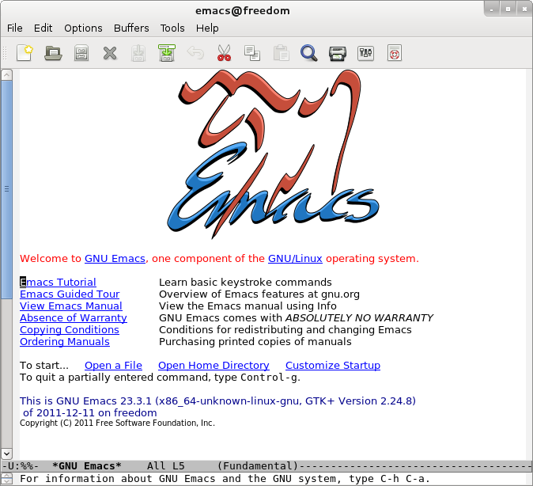
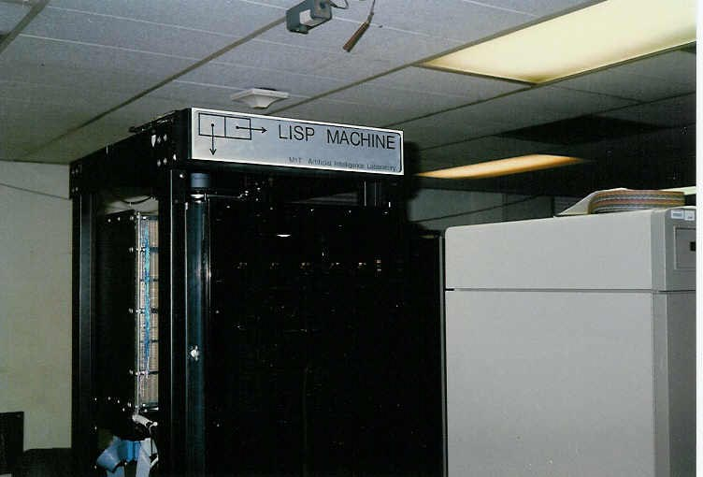




RMS's Contributions

Slide 19
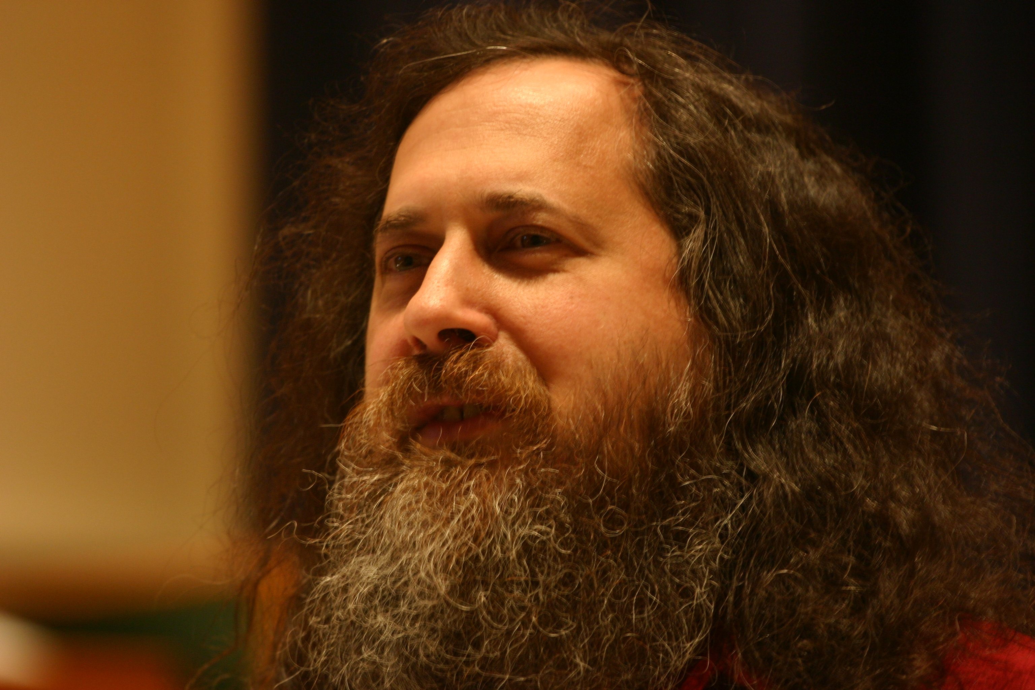
RMS's Impact

Slide 20

Linus Torvalds

Slide 21
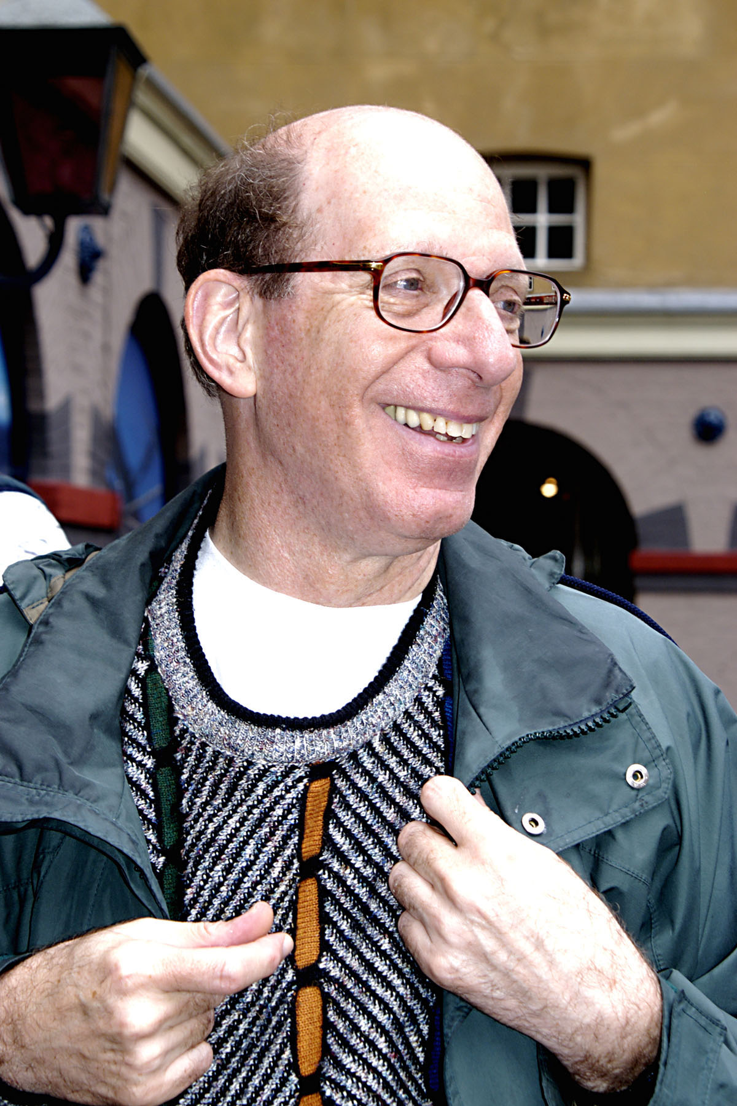
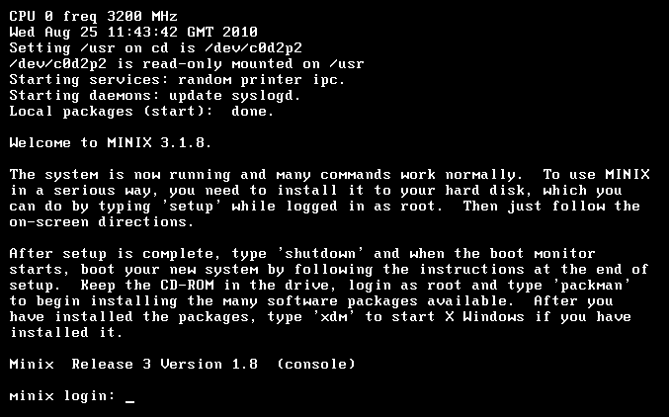
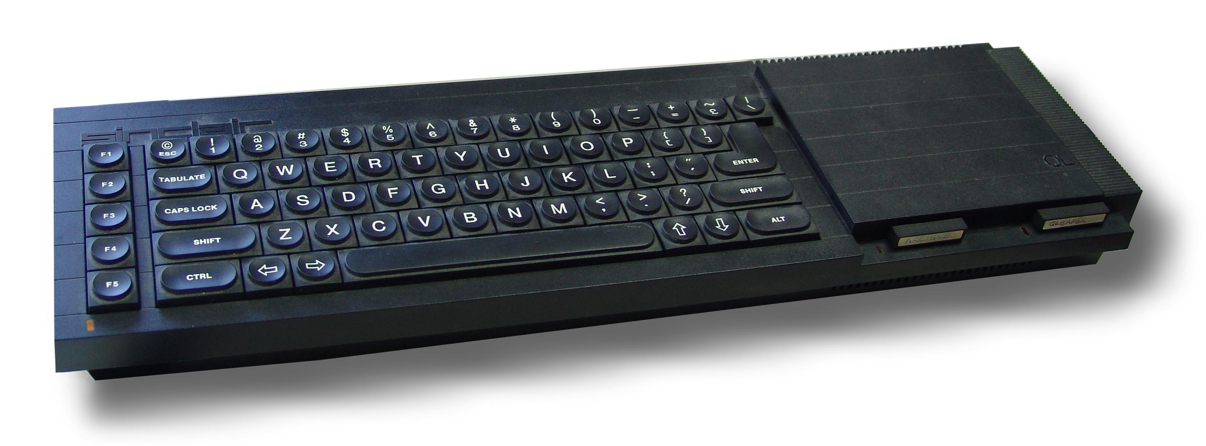

Accidental Revolutionary
“What would you like to see in Minix? -Linus Torvalds, August 25, 1991, on comp.os.minix
“Linux is Obsolete” -Andrew Tanenbaum, 1996, on comp.os.minix

Slide 22
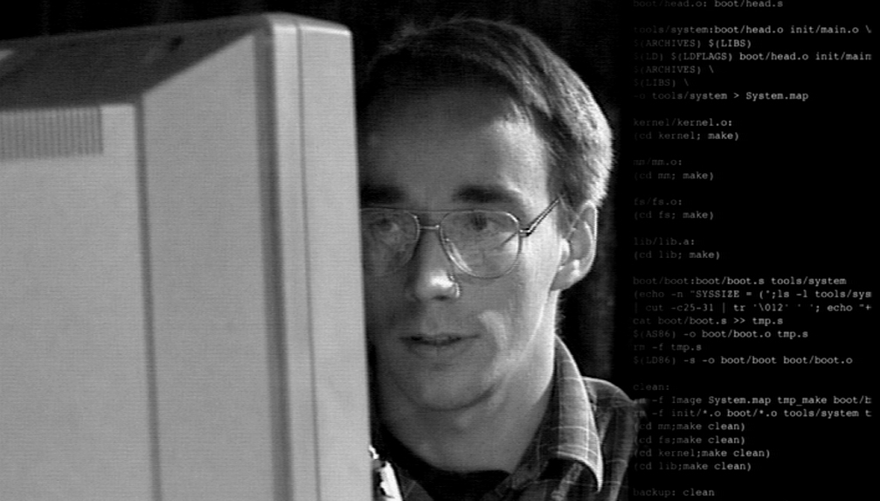
Linus's Impact

Slide 23
4. Key Ideologies

Slide 24
General Public License (GPL)
Make source code of copylefted software freely available.
Same code could be used elsewhere.
Users free to do whatever they want with software.

Slide 25
GPL's Impact
Robust, free software
Hotbed for aspiring coders.

Slide 26
Final Thoughts

Slide 27

Suggested Reading

Slide 28
Contact Me
John Kim
thinkndev@gmail.com
Twitter: @epikvision
Google+: +JohnKim96

