Slide 1

Hacking the Kernel, Hacking Myself
My experiences as an
intern with the
Gnome Outreach Program
for Women
Kelley Nielsen
salticidoftheearth.com

Slide 2
It's not just learning to code, it's learning about yourself.

Slide 3


Slide 4
<snarky comment deleted>

Slide 5
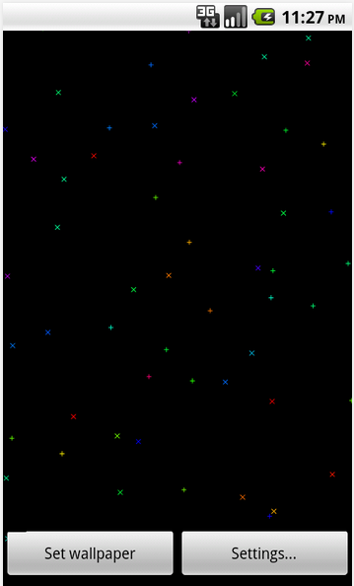
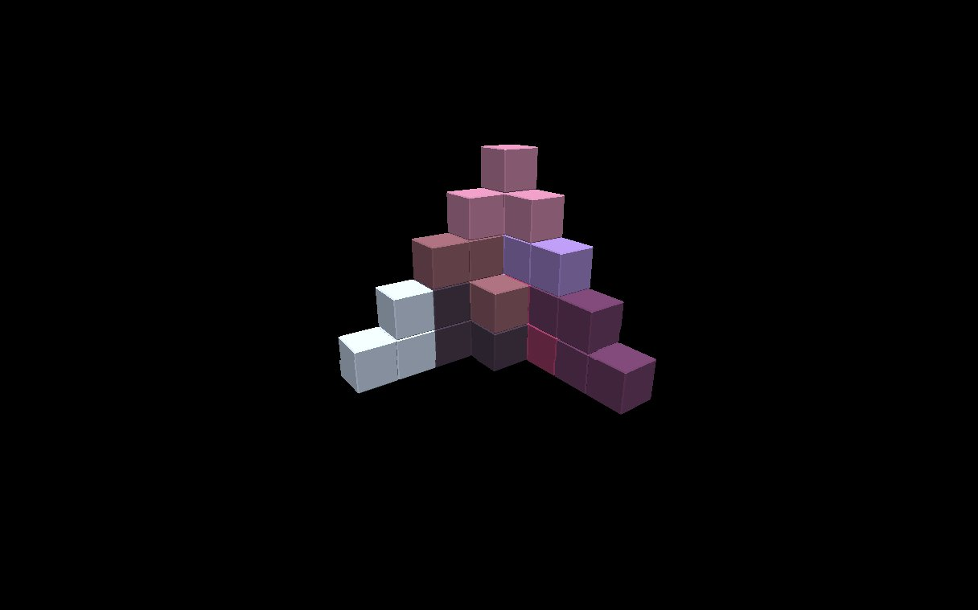


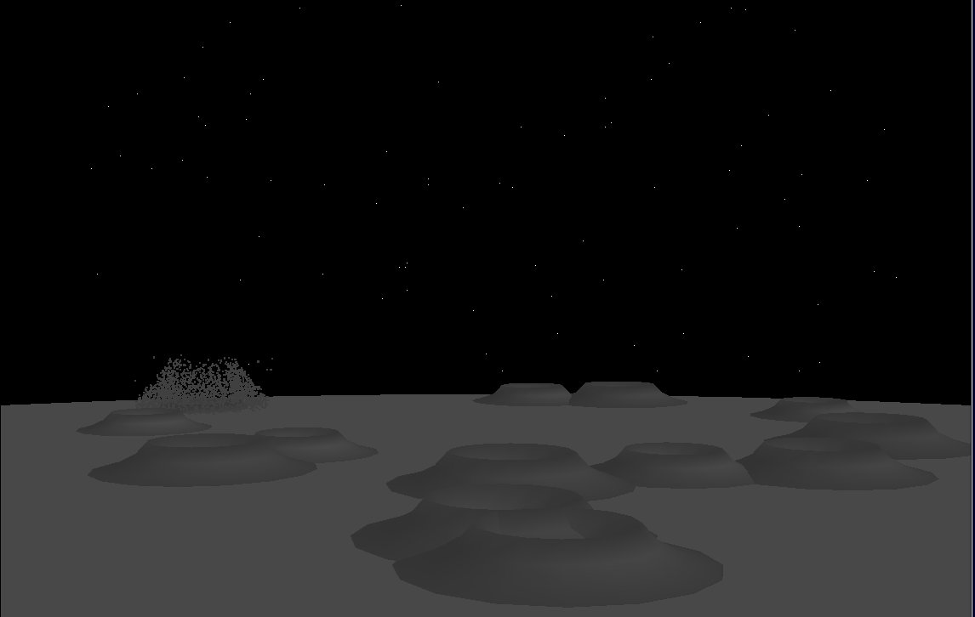

Slide 6
Surprise:
I'm Stubbornly Independent

Slide 7


Slide 8
Solution:
Get Involved in a Formal Program

Slide 9
Make a small contribution...

Slide 10
////////////////////////////////////
// Function: foobles
// Parameters: int foo, char ** bar
// Returns: int baz
// Actions: does stuff
// Side effects: none
// Author: Dwight Q. Coder
// Date: 01-01-1970
/////////////////////////////////////
/* does stuff */

Slide 11

[PATCH] Lotsa awesome code
[PATCH] 88th Contribution from
Same Person
[PATCH 8/11] Super Tricky Bug Fix
[PATCH] More Awesome Code
[PATCH 142/2378] Stuff Stuff Etc

Slide 12
[PATCH] My code
[PATCH] 88th Contribution from
Me
[PATCH 8/11] My Patchset
[PATCH] My Awesome Code
[PATCH 142/2378] My Stuff Etc

Slide 13
“Very nice work.”

Slide 14
My Job:
Re-write swapoff

Slide 15
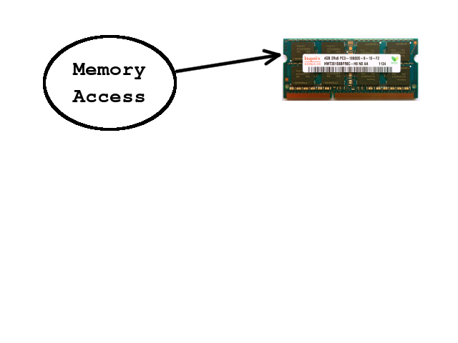

Slide 16
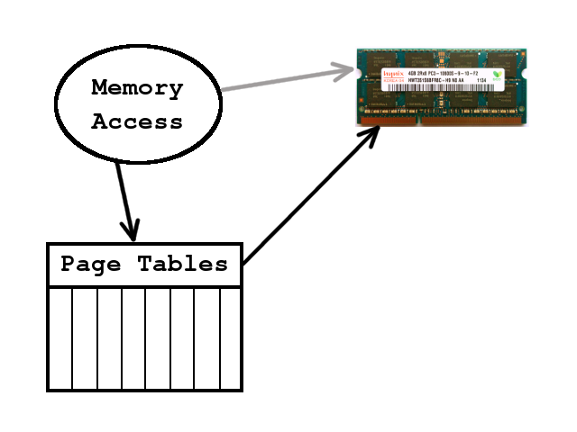

Slide 17
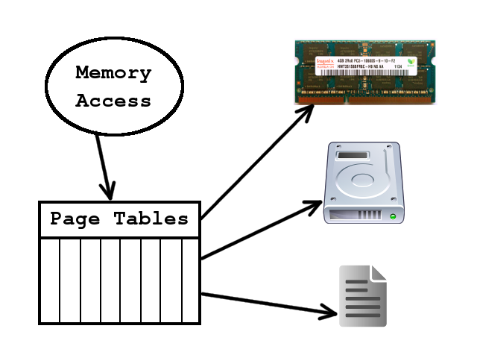

Slide 18
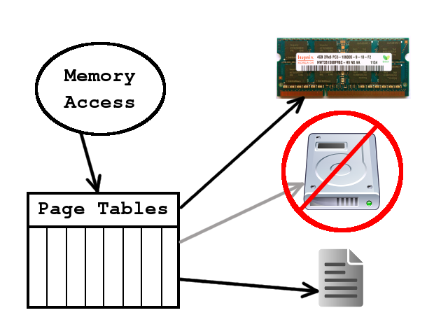

Slide 19
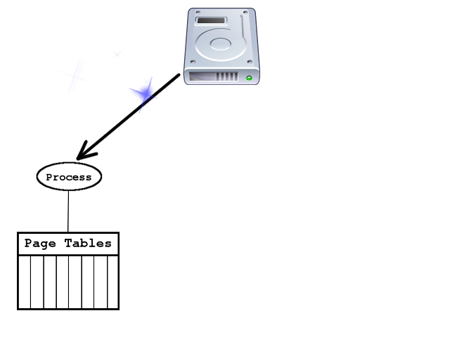

Slide 20
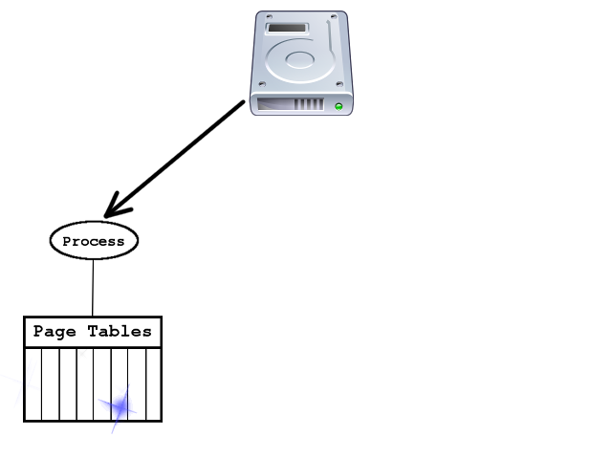

Slide 21
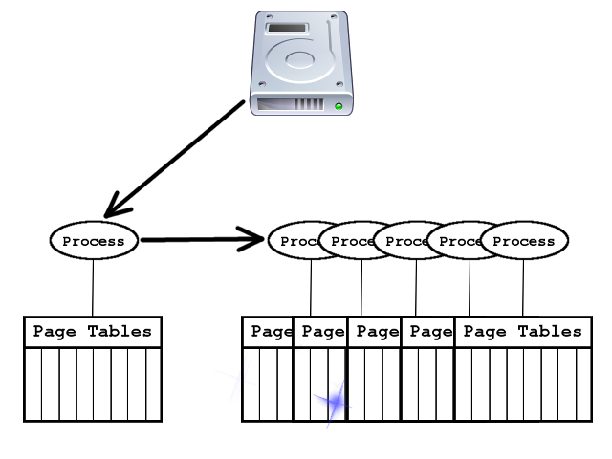

Slide 22
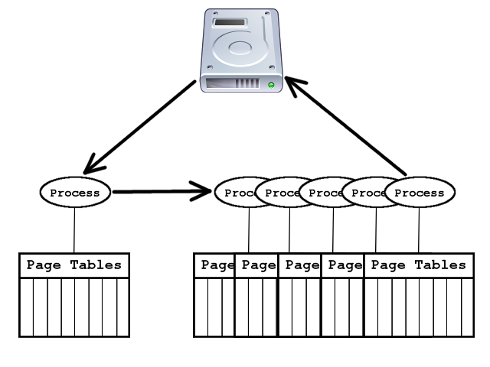

Slide 23
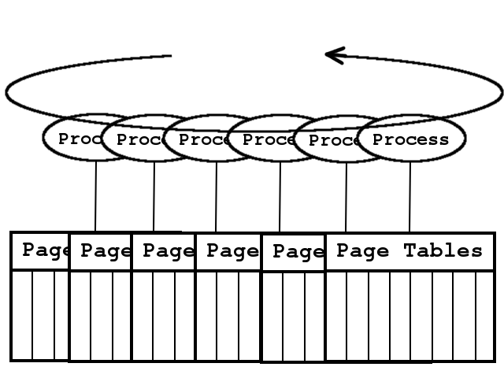

Slide 24
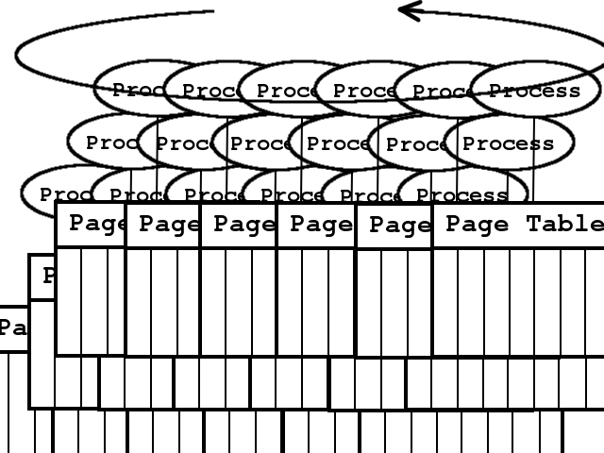

Slide 25
O(n²)

Slide 26
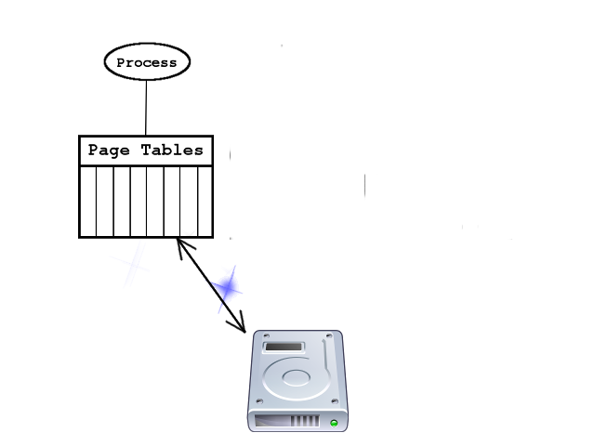

Slide 27
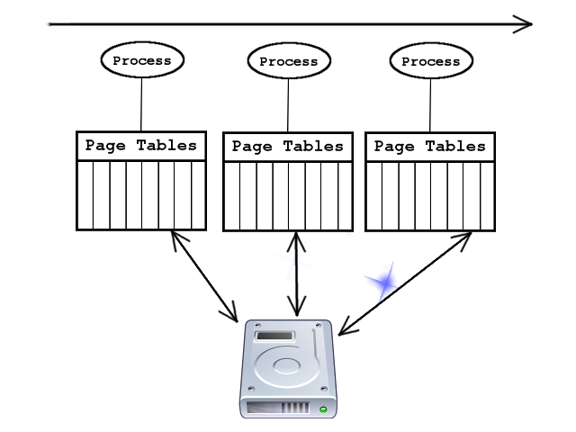

Slide 28
O(n)

Slide 29
Re-write one of the kernel's functions...

Slide 30
In three months,
with no experience...

Slide 31
While refusing help...

Slide 32


Slide 33
mem_cgroup_cache_charge(
page, current->mm, GFP_KERNEL);

Slide 34
cond_resched();

Slide 35
gfp = mapping_gfp_mask(mapping);
if (!down_read_trylock(
&mm->mmap_sem)) {
BUG_ON(!PageLocked(page));
if (unlikely(maybe_same_pte(
*pte, swp_pte))) {
pte_offset_map(pmd, addr)
mutex_lock(&shmem_swaplist_mutex);

Slide 36
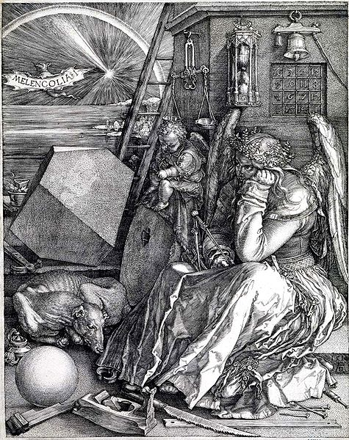

Slide 37
Surprise:
I Set Impossible Goals for Myself

Slide 38
Solution:
Don't Let the Perfect Be the Enemy of the Good

Slide 39

To: Kelley
From: Kelley's OPW Mentor
HEY!!!
Subject:

Slide 40
Solution:
Accept that
No One Does it Alone

Slide 41
From: Kelley
Subject: [RFC] Updated Swapoff
From: Kernel Developer
Subject: Looks Useful
From: Famous MM Guy
Subject: Some Welcome Advice
From: Kernel Developer
Subject: Much Improved

Slide 42
gnome.org/opw
wiki.gnome.org/OutreachProgramForWomen
google-melange.com

Slide 43
Kelley Nielsen
www.salticidoftheearth.com
@salticidsoft

