Slide 1
CAS and Shibboleth: Open Source Your Identity
Scott A. Williams
Claremont McKenna College
vwbusguy@fedoraproject.org

Slide 2
Introduction
Introduction
What is SSO?
What it isn't.
  A simple login form
  Identity Management
  Directory Service
Why it matters

Slide 3
An Interesting Scenario
Claremont Colleges
  Consortium, yet Federated
  Independent Directories
  Wireless sharing

Slide 4
Goals
Goals
  Minimal account maintenance
  Support federated directory services
  Easier to share services
  InCommon Federation

Slide 5
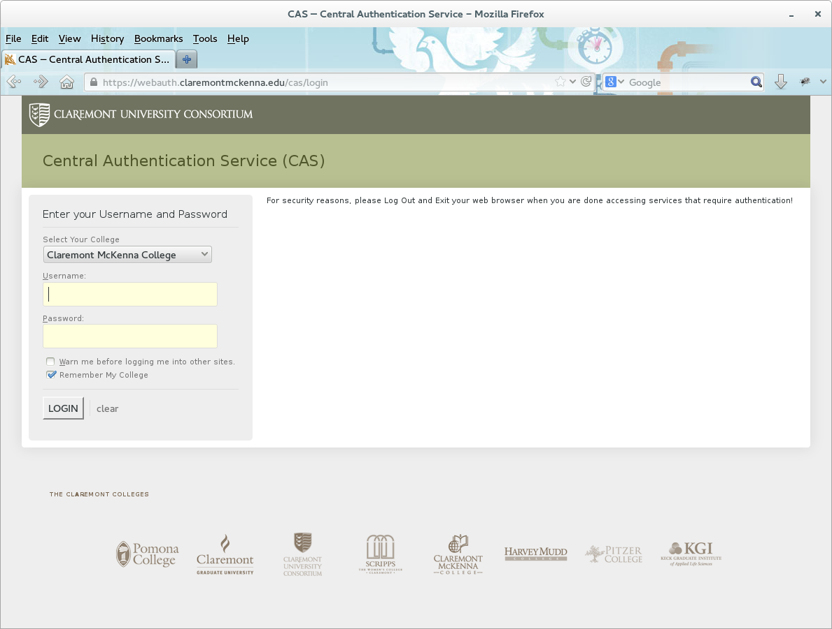
What is CAS?

Slide 6
CAS Workflow
2014-02-20 14:43:54,058 INFO [org.jasig.cas.authentication.AuthenticationManagerImpl] - <org.jasig.cas.adaptors.ldap.BindLdapAuthenticationHandler successfully authenticated [username: sawilliams@CMC]>
2014-02-20 14:43:54,059 INFO [org.jasig.cas.authentication.AuthenticationManagerImpl] - <Resolved principal sawilliams@CMC>
2014-02-20 14:43:54,059 INFO [org.jasig.cas.authentication.AuthenticationManagerImpl] - <org.jasig.cas.adaptors.ldap.BindLdapAuthenticationHandler@1ffc159e authenticated sawilliams@CMC with credential [username: sawilliams@CMC].>
2014-02-20 14:43:54,059 INFO [com.github.inspektr.audit.support.Slf4jLoggingAuditTrailManager] - <Audit trail record BEGIN
=============================================================
WHO: [username: sawilliams@CMC]
WHAT: supplied credentials: [username: sawilliams@CMC]
ACTION: AUTHENTICATION_SUCCESS
APPLICATION: CAS
WHEN: Thu Feb 20 14:43:54 GMT-08:00 2014
CLIENT IP ADDRESS: 134.173.180.6
SERVER IP ADDRESS: 134.173.180.144
=============================================================
2014-02-20 14:43:54,059 INFO [com.github.inspektr.audit.support.Slf4jLoggingAuditTrailManager] - <Audit trail record BEGIN
=============================================================
WHO: [username: sawilliams@CMC]
WHAT: TGT-792-huqOy7TJS6NEboubuMgzxp5zuFOr7YHDUOiscpNrwddwctXINL-webauth.claremontmckenna.edu
ACTION: TICKET_GRANTING_TICKET_CREATED
APPLICATION: CAS
WHEN: Thu Feb 20 14:43:54 GMT-08:00 2014
CLIENT IP ADDRESS: 134.173.180.6
SERVER IP ADDRESS: 134.173.180.144
=============================================================

Slide 7
CAS Workflow
2014-02-20 14:43:54,061 INFO [org.jasig.cas.CentralAuthenticationServiceImpl] - <Granted service ticket [ST-3823-XyhnhPax7fgXtIfra09F-webauth.claremontmckenna.edu] for service [http://ccb15.claremontmckenna.edu/sandbox/phpcas.php] for user [sawilliams@CMC]>
2014-02-20 14:43:54,061 INFO [com.github.inspektr.audit.support.Slf4jLoggingAuditTrailManager] - <Audit trail record BEGIN
=============================================================
WHO: sawilliams@CMC
WHAT: ST-3823-XyhnhPax7fgXtIfra09F-webauth.claremontmckenna.edu for http://ccb15.claremontmckenna.edu/sandbox/phpcas.php
ACTION: SERVICE_TICKET_CREATED
APPLICATION: CAS
WHEN: Thu Feb 20 14:43:54 GMT-08:00 2014
CLIENT IP ADDRESS: 134.173.180.6
SERVER IP ADDRESS: 134.173.180.144
=============================================================

Slide 8
What is Shibboleth
Federated IdP
  Also has SP component

Slide 9
Why CAS?
Simplicity
Community support/documentation
Easy to integrate into existing infrastructure
Ease of internal app integration

Slide 10
Why Shibboleth
Easy integrates with CAS
SAML2 encoding
  Great for 3rd party authentication
Extensible Data Store

Slide 11
CAS + Shibboleth
Flexibility
  Internal apps can use simplicity of CAS
Common interface even when using Shibboleth
Full SSO between CAS only and CAS+Shibboleth
Highly customizable
Account provisioning
  “Just In Time” provisioning

Slide 12
CAS + Shibboleth workflow
Basic Login (Example: Google)
  Redirected to Shibboleth
  Shibboleth makes service request to CAS
  If no TGT, user is taken to login page
  Service Ticket granted to Shibboleth service
  Shibboleth encodes name ID and returns SAML
  *If user is already logged into SSO they won't see any of this magic happen

Slide 13
Data Store
Attribute filtering and resolving
if 'OU=Students' in result[1]['distinguishedName'][0]:
  email = account['base'] + "@students.claremontmckenna.edu"
  account['google'] = account['base']
else:
  email = result[1]['mail'][0]
  account['email'] = email

Slide 14
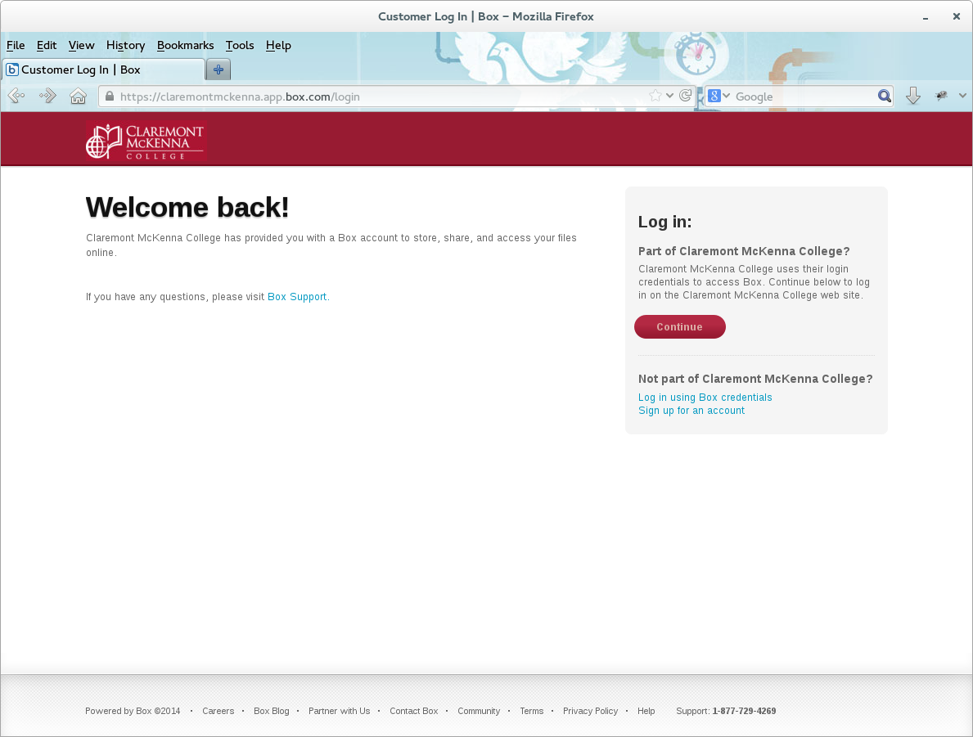
With Data Store

Slide 15
Customization
All authentication through CAS
Javascript driven school selection
&auto listener for CAS to support existing login forms
Branding/theming
  “Remember My College”

Slide 16
Existing form example
function login_google{
  var cas = "https://webauth.claremontmckenna.edu/cas/login";
  var username = $('input[name="username"]').val() + '@CMC';
  var password = $('input[name="password"]').val();
  var service = "https://mail.google.com/a/dev.claremontmckenna.edu/";
  var url = cas + "?service=" + service + "&username=" + username + "&password=" + password + "&auto=true";
  window.location.href = url;
});

Slide 17
In House and Beyond!
Joined InCommon
WAYF Ability

Slide 18
Replication - Galera wins!
Modified CAS to use MariaDB for Ticket Registry
Data Store in MariaDB with sync script in cron
Tomcat war deployment
Replicated in Rackspace Cloud Server instances

Slide 19
mod_auth_cas
<Location /foo.pdf>
AuthType CAS
require valid-user
<Location>

Slide 20
Webapps
<?php
require_once ('casconf.php');
require_once('../phpCAS/source/CAS.php');
phpCAS::setDebug();
phpCAS::client(CAS_VERSION_2_0, $cas_host, $cas_port, $cas_context);
phpCAS::setCasServerCACert($cas_server_ca_cert_path);
phpCAS::forceAuthentication();
if (isset($_REQUEST['logout'])) {
  phpCAS::logout();
}
echo "Hello " . phpCAS::getUser() . "</br>";
echo '<a href="' . $_SERVER['REQUEST_URI'] . '?logout">Logout</a>';
?>

Slide 21
Questions?

