Slide 1
You Know, for Kids!
7 tips for improving tech education in our schools
By Rikki Endsley
Red Hat
Open Source and Standards Community Evangelist
Inspired by a true story

Slide 2
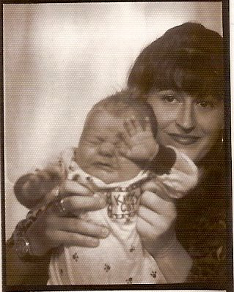
Mother of the Year-Not

Slide 3
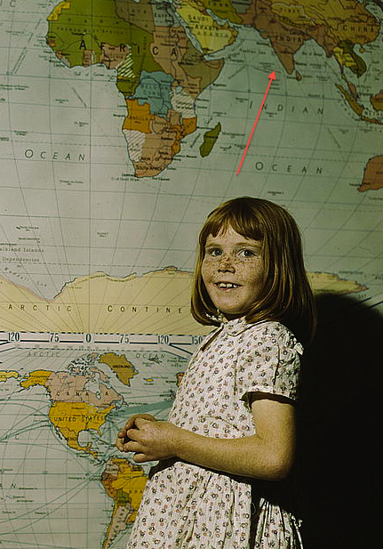
The Offspring

Slide 4
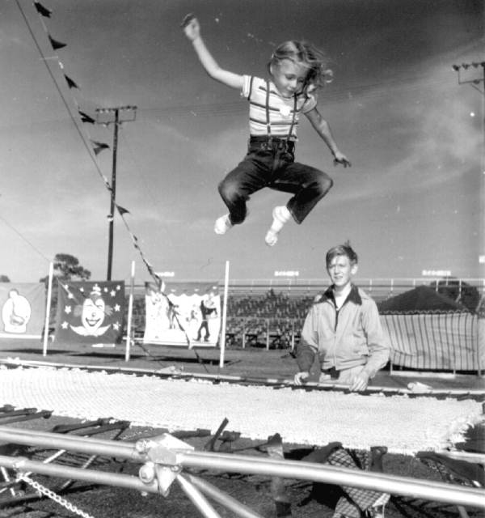
Jumping into Programming

Slide 5
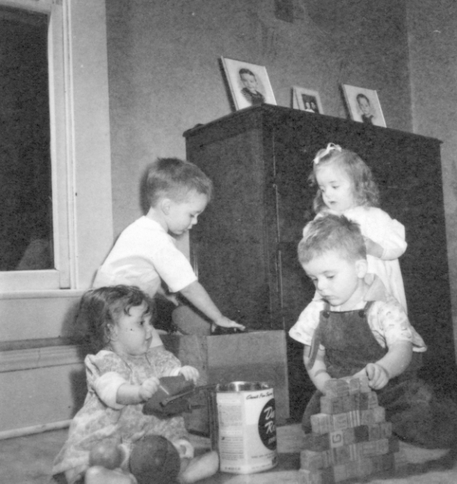
The Curriculum: Imagined

Slide 6
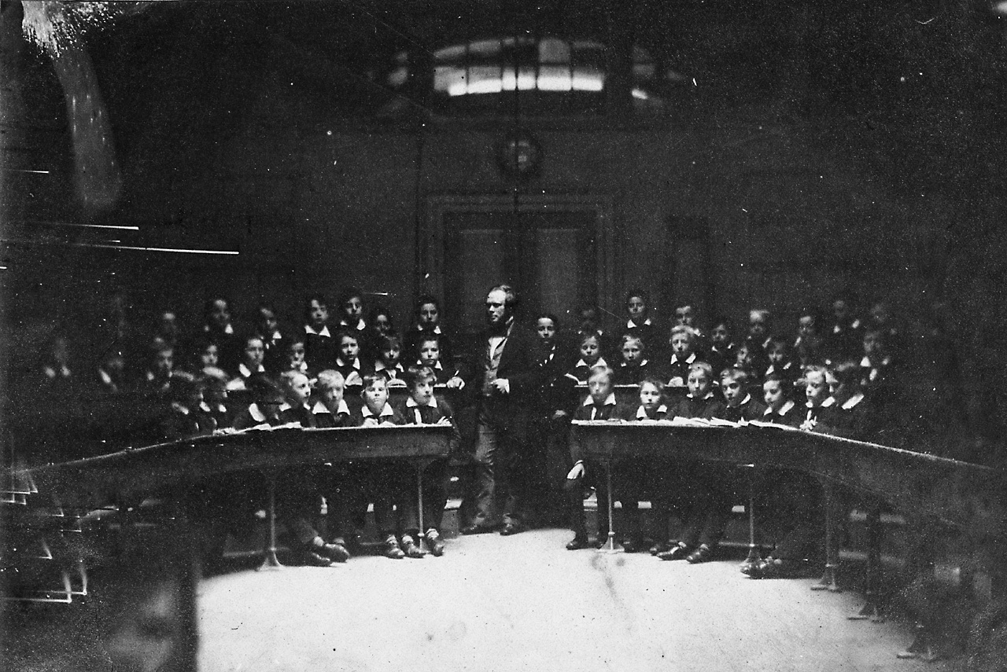
… and Reality

Slide 7

Why weren't other girls in the class?

Slide 8
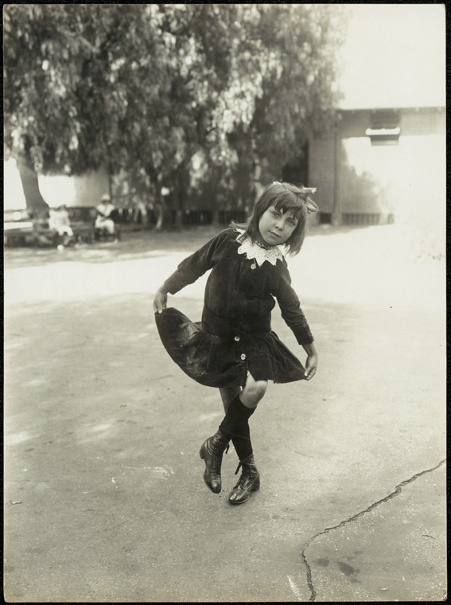
Flying solo

Slide 9
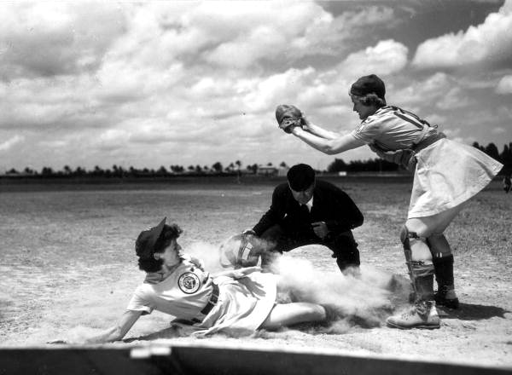
Assignments weren't the problem

Slide 10

Harassment started

Slide 11
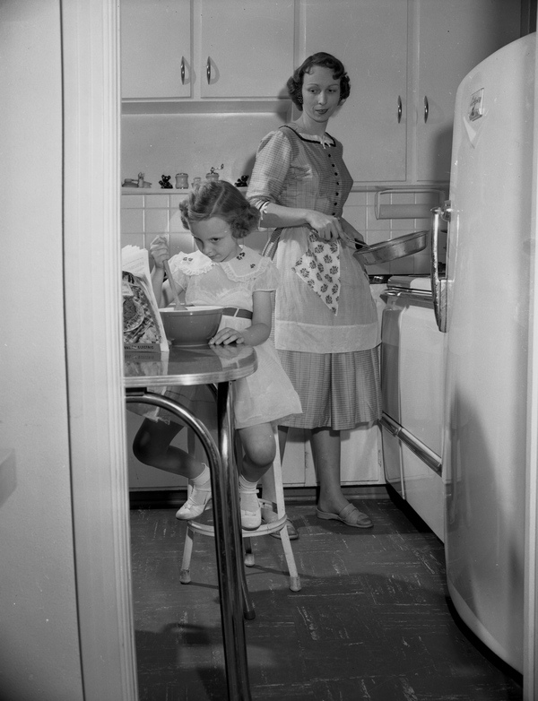
Her: “They told me to get in the kitchen and make them a sandwich.”
Me: “Did you tell them that we don't cook?”

Slide 12
How should a student handle harassment?

Slide 13
How my student handled harassment:
Asked the students to stop
Told a parent
Told the teacher
Offered to address the class with the teacher's support
Talked to the principal

Slide 14
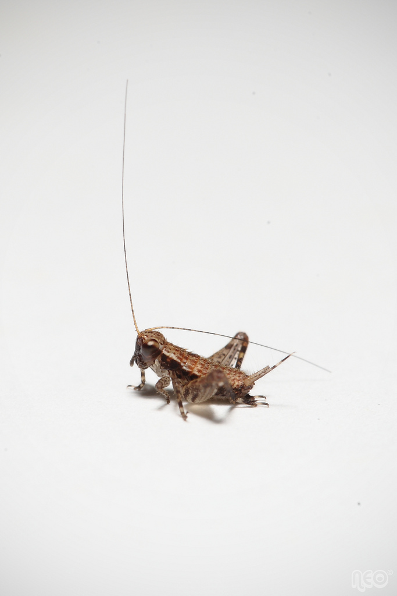
How the school addressed the harassment ...
Image from flickr courtesy of w3i_yu

Slide 15
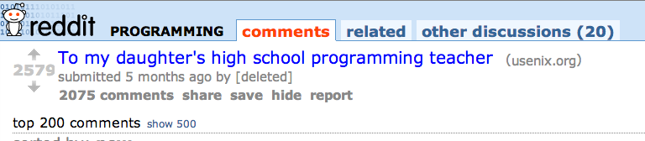
So I wrote about it … oops.
http://www.reddit.com/r/programming/comments/1m2paq/
to_my_daughters_high_school_programming_teacher/

Slide 16
7 suggestions for teaching high school computer programming
1. Recruit students to take your class.
2. Set the tone.
3. Outline, explain, and enforce an anti-harassment policy.
4. Don't be boring.
5. Pay attention.
6. Check in.
7. Follow up.
https://www.usenix.org/blog/
my-daughters-high-school-programming-teacher

Slide 17
And the comments rolled in
“Teach your daughter to HIT. THE. [bleep]. BACK.”
The solution to harassment is violence?
“Why doesn't she call the parents of the kids that are bullying her kid? Why blame the teacher, like it is the teachers responsibility?”
Teenagers don't want you fighting their battles. And it was the teacher's responsibility.
“This is so close to my own experiences it's painful.”
Yes, I've heard that a lot.
“Perhaps she should have talked to the teacher when she noticed something was wrong instead of waiting until the course was over and then writing a letter to no one.”
But I wrote the letter for someone and that someone is YOU.

Slide 18
… more than 2,500 comments...
“Is it strange that I assumed for the first quarter of the article that the author was the father?”
Nah. Rikki is a fabulously gender-neutral name.
“It starts okay, then devolves into 'generic advice for teachers from a non-teacher who still thinks he has the right to explain how to do your job.'”
So parents are not supposed to make suggestions for how to teach our children?
“This article doesn't really paint an empathetic picture when it goes to great lengths to first state how insanely privileged her daughter is.”
Well that was kind of the point.

Slide 19
… and my poor father read them.
“This lady sounds like a real ***hole.”
I've been called worse.
“The tone of the mother's letter makes my skin crawl.”
Tone argument. Bingo!
“I feel like a good point might have been made if the author wasn't so obsessed with her and her daughter's resume for half of the article, and if she were a bit less disingenuous about the whole VB thing.”
In hindsight, I went too easy on the whole VB thing.
“This is one of the most condescending and immature letters I've ever stumbled upon.”
Maybe you should stumble out more often.
“Pathetic self-aggrandizing waffle.”
Best.Insult.Ever.
“Whoever wrote this should take a slap to the face and learn to communicate respectfully with others.”
...I'm going to assume you were being ironic on purpose.

Slide 20
“Talk to people in a position to actually do something about it, like the teacher.”
Unless someone like you cares a whole awful lot, nothing is going to get better. It's not. ~ The Lorax
More than 2,500 comments on one Reddit link.
Dozens on the USENIX blog post.
Dozens of private emails and one-on-one conversations with the author.
Thousands of people read and discussed a blog post about one real experience in a single computing class.

Slide 21
Questions?
Comments?
Thank you for being part of the solution!
And thank you to SCALE for being so awesome.

