Slide 1
Shell Programming
Andrew Vandever
Scale 12x

Slide 2
What is a shell?
The command interpreter used to pass commands to an operating system; so called because it is the part of the operating system that interfaces with the outside world.

Slide 3
What is a CLI?
A Command Line Interface is one in which you type commands instead of choosing them from a menu

Slide 4
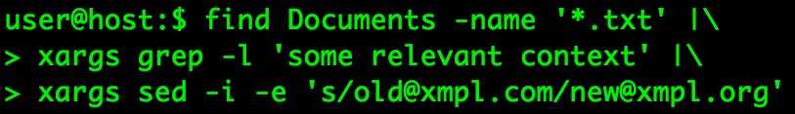
Putting it together...

Slide 5
The Unix Philosophy
Small components do one thing well
Chain these components together
Portability over efficiency
High leverage through reuse
Avoid captive user interfaces

Slide 6
Shell scripts are used by...
System V init/config
Docker and similar
Crond
...and more

Slide 7
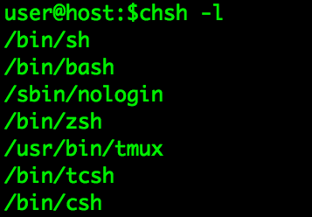
Pick a shell
bash is default on most linux distros
zsh is a popular modern alternative
dash had a run on ubuntu, but bash is back
(t)csh is a shell with c-style syntax
On most systems:

Slide 8

Anatomy of a command
program opt opt-arg pos-arg
Reality check: These are all arguments. The program decides what they mean.

Slide 9
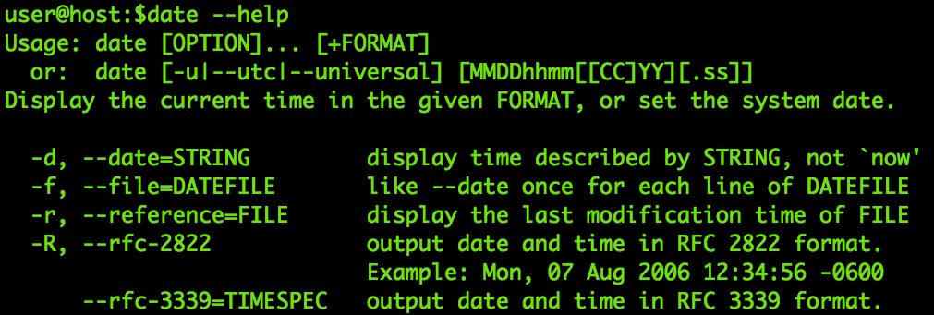
How to get help
--help

Slide 10
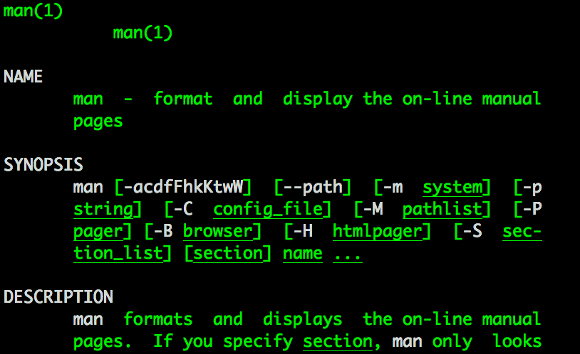
How to get help
man

Slide 11
Usage statements
Single-letter options: -abc
Full-word options: --some-option
Placeholders: <this> or THIS or this
Optional: [SOMEARG]
X and Y are optional, but Y needs X: [X [Y]]

Slide 12
Pro shell manipulation
Scroll through history with arrows
<ctrl>-r – search backwards through history
<ctrl>-<arrow> to move by word
cmd | less to view output by page (q to quit)
<tab> completion

Slide 13
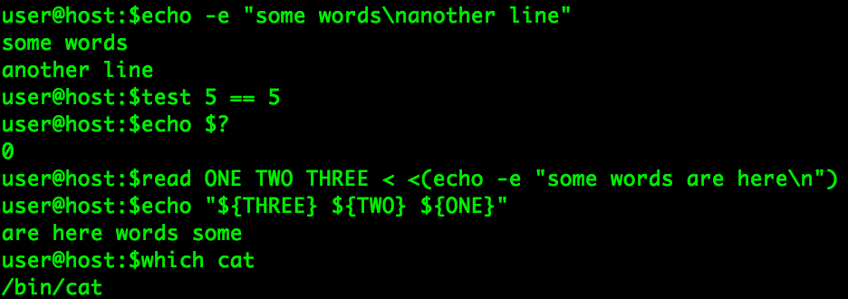
Useful builtins

Slide 14
Managing files
ls – list files, or files inside a directory
cd – change into a directory
mkdir – make a new directory
mv – rename and/or move a file
rm – remove files
rmdir – remove a directory

Slide 15
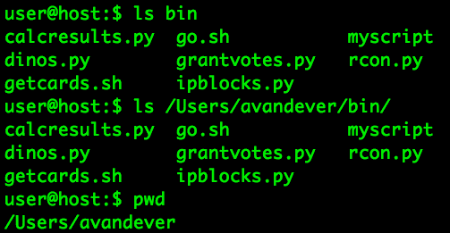
How paths work

Slide 16
Shell config
source – exec the lines from a file (also “.”)
~/.bashrc, /etc/bashrc – sourced by interactive shell instances
~/.profile, /etc/profile – sourced by login shell instances

Slide 17
Environment variables
Inherited by processes launched from shell
Set with export
Often set in /etc/profile, ~/.profile
See with “env”
Examples: HOME, LANG, EDITOR, PATH

Slide 18
Other config variables
DO NOT set in profile!
DO put in /etc/bashrc, ~/.bashrc or your shell's equivalent
Examples: PS1, PROMPT_COMMAND

Slide 19
rc file honorable mentions
aliases
functions
per-shell env variable overrides
other shell config (e.g. shopt)

Slide 20

Making scripts
Must set read and execute permissions:
Should have “shebang” magic on first line:
Easier to call if in PATH:

Slide 21

Variables
Spaces: No.
UPPERCASE is best practice, not required
Curlies not required, but work in more cases
Passed by value

Slide 22
Special variables
${?} - exit status of the last command
${$} - this shell's PID
${!} - PID of last backgrounded job
Positionals:
  ${0} – this script's name
  ${n} – nth arg to this script
  ${@} – all args
  ${#} – number of args

Slide 23
Other expansions
$((${num} * 5)) – math
$(cat /tmp/somefile) – command sub
A{0..3} – list expansion
~someuser – tilde expansion
>(head) – process substitution
*.txt – path expansion

Slide 24
Command interaction
Simple: cmd1; cmd2
Conditional: cmd1 && cmd2
Else: cmd1 || cmd2
Grouping: (cmd1; cmd2) &> /tmp/outfile
cmd1 || (cmd2 && exit 1)
Parens actually launch a subshell

Slide 25
Command interaction
Pass output to next command:
cmd1 | cmd2
Pass output as command line args:
cmd1 | xargs cmd2

Slide 26
Escaping
'Single quotes prevent parsing'
“Double quotes do too, except for $, `, \, !”
\ escapes the next character, even newline

Slide 27
I/O handling
Default channels:
  0 (STDIN)
  1 (STDOUT)
  2 (STDERR)
STDIN to a file: cmd < file
STDOUT to a file: cmd 1> file
STDIN to STDOUT: cmd 1>&2

Slide 28
I/O handling
STDOUT of cmd1 to STDIN of cmd2:
cmd1 | cmd2
STDERR of cmd1 to STDIN of cmd2:
lolno stopit
You usually wouldn't want to pass stderr
ok, fine...
cmd1 2>&1 > /tmp/logfile | cmd2

Slide 29
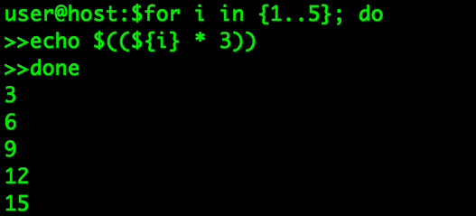
For

Slide 30
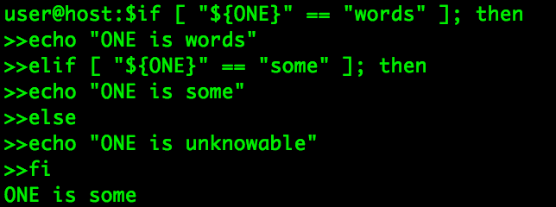
If

Slide 31
Other flow control stuff
While
Until
case

Slide 32
What else should I learn?
Other bash features: arrays, functions, aliases, job control
CLI text manipulation: grep, sed, awk, head, tail, sort, tr, wc, etcetera
Text-based editors: vi/emacs
Shell multiplexing/sharing: screen/tmux

Slide 33
More resources
Guides at tldp.org:
  Bash Guide for Beginners
  Advanced Bash Scripting Guide
  GNU/Linux Command-Line Tools Summary
Vimtutor
http://lmgtfy.com/?q=tmux+tutorial
python, ruby, perl, etc.

