Slide 1

OpenNMS Case Studies
SCALE 5x
2007 Feb 10

Slide 2
Agenda
What the heck is OpenNMS?
What can it do?
Case Studies
  New Edge Networks
  Hospitality Services (Swisscom)
  The Permanente Management Group

Slide 3
OpenNMS is the world's first enterprise-grade network management platform developed under the open source model.

Slide 4
“world's first”
NetSaint 2000-01-10 1323
OpenNMS 2000-03-29 4141
Nagios 2001-05-03 26589
RRDTool 2003-01-13 71544
Groundwork 2006-02-21 160654
ZenOSS 2006-03-20 163126
Hyperic 2006-07-17 172556

Slide 5
“enterprise-grade”
OpenNMS was designed from Day One to monitor tens of thousands of network services and interfaces.

Slide 6
“network management platform”
The Architecture of OpenNMS has been designed to allow for easy integration of other tools, both proprietary and open.

Slide 7
“open source model”
OpenNMS is published under the GPL and all components are licensed under an OSI-qualified free software license.

Slide 8
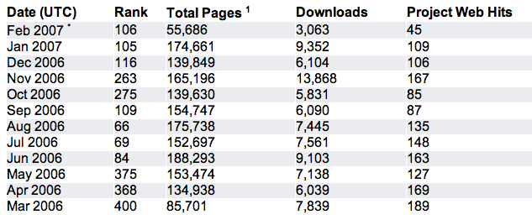
It's the community, stupid

Slide 9
What is network management?
Network Management can be loosely defined as the maintenance and monitoring of computer networks to insure service availability.

Slide 10
FCAPS
Fault Management
Configuration Management
Accounting
Performance
Security

Slide 11
FCAPS
Fault Management
Configuration Management
Accounting
Performance
Security

Slide 12
The 3 “halves” of OpenNMS
Service Monitoring: Is a particular network service reachable and available?
Performance Data Collection: Gather numeric data from across the network for display, trending and thresholding.
Event and Notification Management: Generate, receive, reduce and correlate various network alerts and feed them to a robust notification system.

Slide 13
Automation
Part of being “enterprise-grade” is to automate the management and discovery process.
Once OpenNMS is configured, newly discovered devices are automatically scheduled for service monitoring, data collection, and events.

Slide 14
Service Monitoring
Monitor network services like HTTP, DNS, Databases and even ICMP
Calculate availability over devices and categories.
Packages and adaptable downtime models
Support for plugins, including Nagios® and custom scripts
Distributed monitoring via webstart app

Slide 15
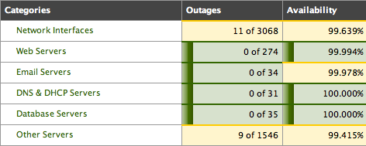
Categories

Slide 16
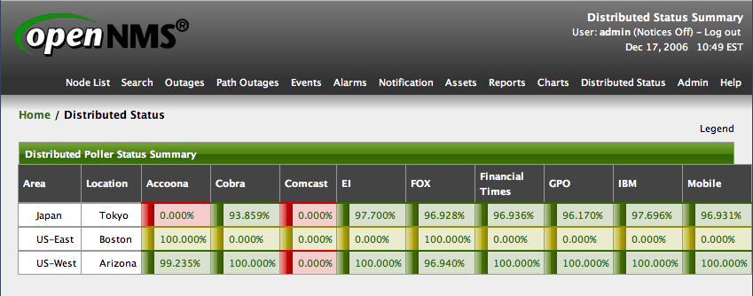
Distributed Monitoring

Slide 17
Performance data collection
Uses RRDTool (or JRobin) to store time series data
Support for
  SNMP (v1, v2c, v3)
  JMX
  HTTP
Automated configuration

Slide 18
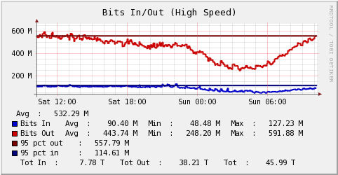
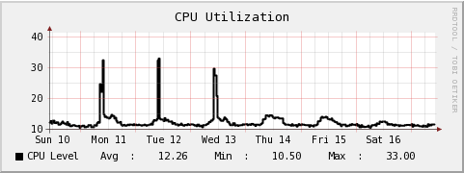
Performance reports

Slide 19
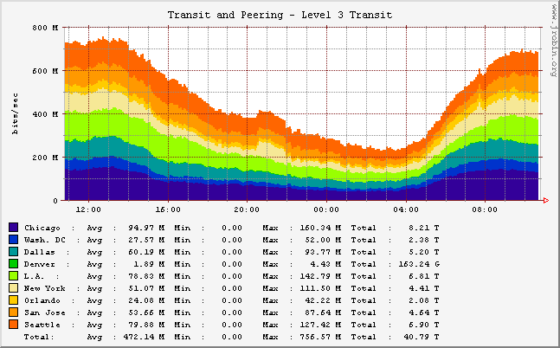
Performance reports

Slide 20
Events
OpenNMS can generate internal events, receive external events and SNMP traps
Events can be reduced – taking a number of events and representing them as a single line with a count
Events can be translated into other events
There are a variety of correlation methods to match problems with resolutions, identify widespread outages and “flapping”

Slide 21
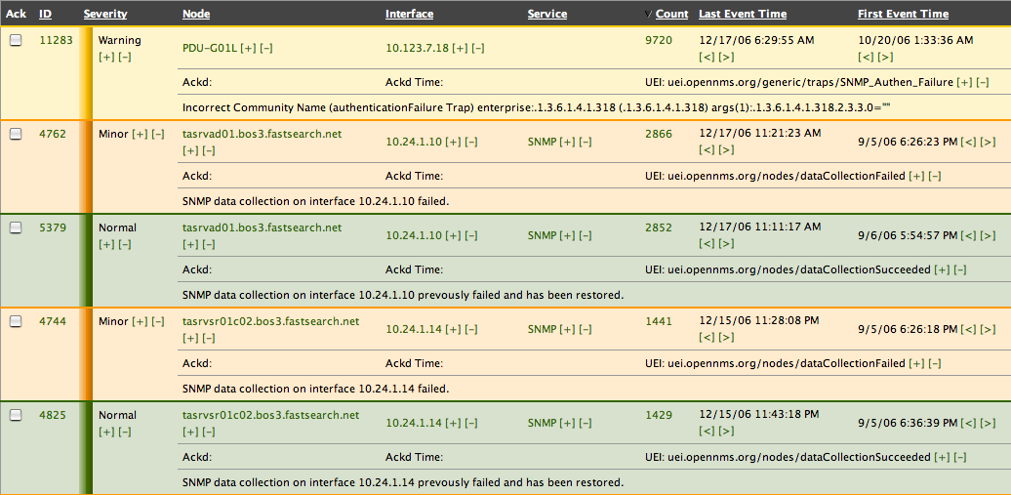
Event reduction

Slide 22
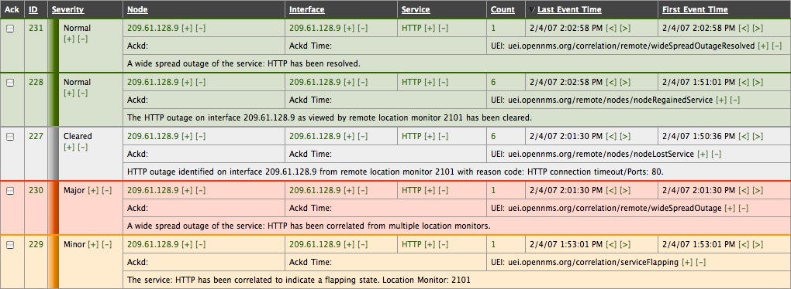
Correlation

Slide 23
Notifications
Any command line application can be used to send notices:
  Email
  Pages
  SMS messages
  IM's via XMPP (Jabber)
Includes
  Duty schedules and roles
  Escalations
  Auto acknowledgment

Slide 24
OpenNMS code
Written mostly in Java
  JNI for ICMP, PostgreSQL and RRDTool integration
  Does not run on Windows (yet)
Production and Development
  Stable releases 0.8, 1.0, 1.2 (current 1.2.9)
  Unstable releases 0.9, 1.1, 1.3 (current 1.3.2)

Slide 25
Case studies
New Edge Networks
Hospitality Services (Swisscom-Eurospot)
The Permanente Management Group

Slide 26
New Edge Networks
Large, secondary market Internet provider based in Vancouver, Washington, USA
Integrated OpenNMS into “MNS” - their customer portal
Running OpenNMS 1.2.9 on Solaris

Slide 27
NEN statistics
Nodes: 12278
Interfaces: 67738
find . -type f -name "*rrd" | wc -l
569188

Slide 28
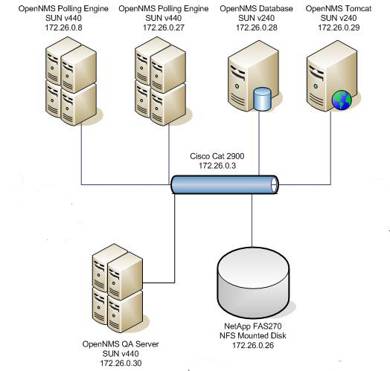

Slide 29
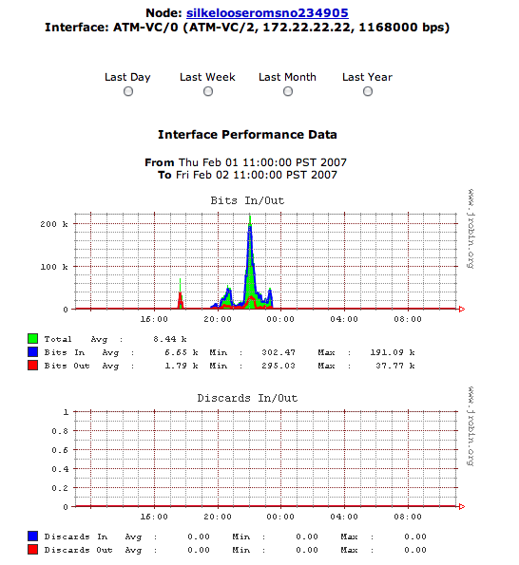

Slide 30
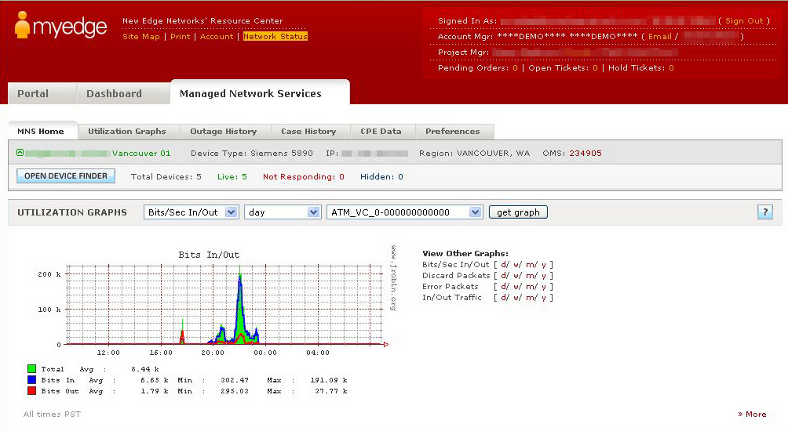

Slide 31
Hospitality Services
Provides wireless Internet access and computing services to hotels and conferences throughout Europe
A very large number of individual sites, each with routers, APs and servers
Running OpenNMS 1.3 on SuSE

Slide 32
Hospitality Services statistics
Sites: 2373
Nodes: 47603
Interfaces: 50001
find . -type f -name “*rrd” | wc -l
61601

Slide 33
Importer Service
<this:node this:node-label="beant32841_rt_612" foreign-id="c612" building="beant32841">
<this:category name="CTR_BE"/>
<this:category name="IMP_high"/>
<this:category name="CHN_ParkPlaza"/>
<this:category name="ISP_Scarlet"/>
<this:category name="DEV_ROUTER"/>
<this:category name="OPS_Online"/>
<this:interface ip-addr="10.1.1.238" status="1" snmp-primary="P" descr="Gateway interface">
<this:monitored-service service-name="ICMP"/>
</this:interface>
</this:node>

Slide 34
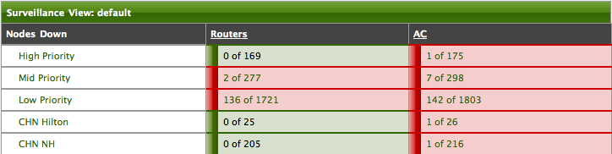
Surveillance view

Slide 35
Workflow

Slide 36
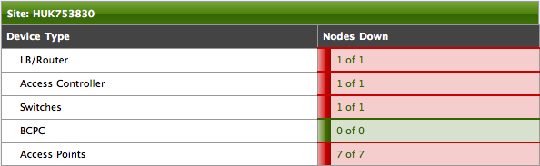
Site status

Slide 37
The Permanente Medical Group
Large provider of health plans in Northern California
Centralized web-based services for member organizations
Over 350 clinics and doctor's offices
Running OpenNMS 1.3

Slide 38
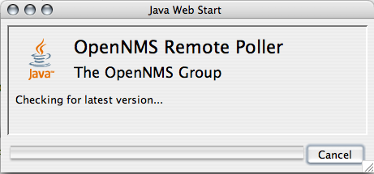
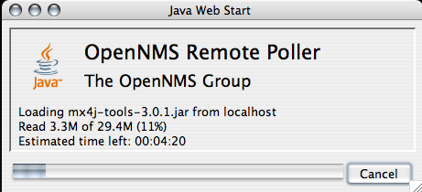
Distributed monitor

Slide 39
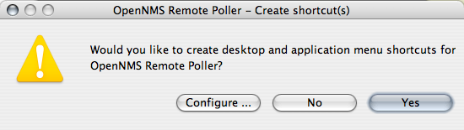
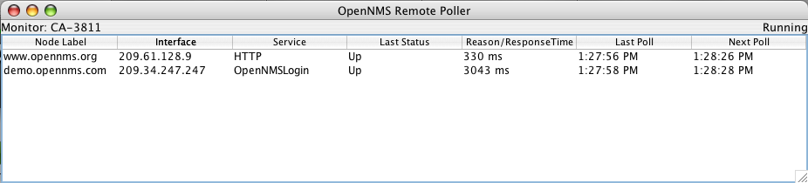
Starting up

Slide 40
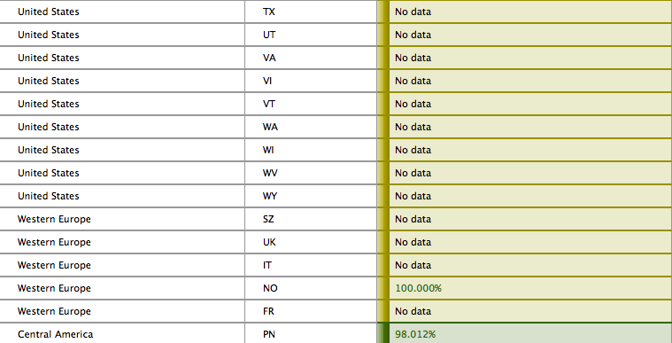
Distributed status

Slide 41
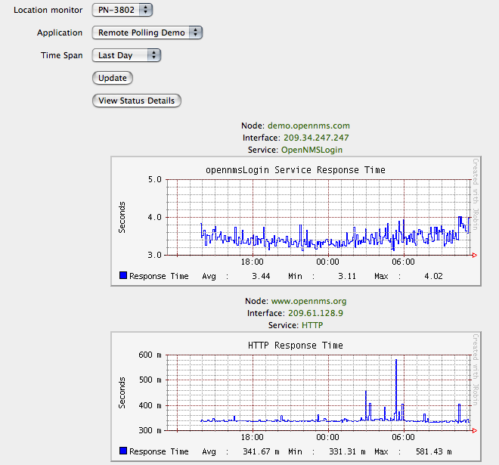

Slide 42
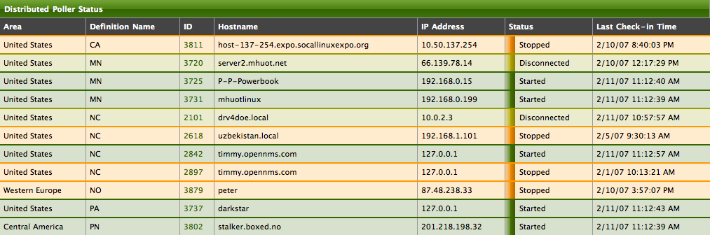
Monitor status

Slide 43
The OpenNMS Project
The Wiki: http://www.opennms.org
The Mailing Lists
  opennms-install
  opennms-discuss
  opennms-devel
  opennms-announce
IRC: #opennms on freenode.

