Slide 1
Linux Virtual Desktop Infrastructure (VDI) Access
Bringing Linux virtualization to the enterprise
Presenter: James Lui
Director of Technical Services, Ericom Software
Notes:
Part 1 – About 1 hour
Part 2 – About 1 hour
Part 3 – About 20 min

Slide 2
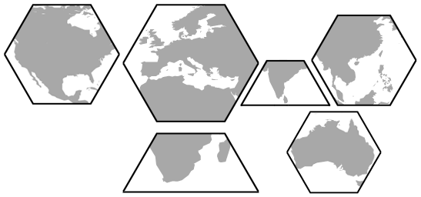
Ericom at a Glance
North America
Europe & Middle East
Far East
India
Ericom Offices
Ericom Channel Partners
South Africa
Australia
Ericom provides concrete business value through helping organizations unify their IT application access operations. The Ericom PowerTerm® Series combines industry expertise, with proven, reliable, scalable and adaptable technology, into solutions running on multiple platforms.
Started: 1993
Offices: USA, UK, EMEA, and APAC
Countries: Over 45
Customers: Over 30,000

Slide 3
Ericom’s Access Solutions
Enterprise-wide Application Access –
Done Right!
Server Based
Computing
Web-based Interface
Interaction
Security
Application Integration
Terminal
Emulation
Remote
Control
Host Access
Access
Central Admin
Terminal Servers
Access
Productivity
Virtualization
Desktop
Virtualization
Notes:
Speaker Notes:
Now that we have presented the company, let’s review the IT scene as we understand it at Ericom.
<<explain that the arrow at the top is a time axis, and the stages of IT evolution over time – from Host-centric computing through SBC**>>
We found that it is easy to demonstrate our view using three main dimensions:
1. The interaction, or user interface evolution dimension – from “Green screens” to portals
2. The access device dimension - from dumb terminals through mobile devices
3. And the Productivity dimension – starting with the basic administrative organizational tasks through personal and organizational working environments.
While it is easy to see how this evolution has created valuable assets, processes and productivity enhancements that can be translated into real-life benefits, it is also evident that we’re now at an intermediate phase where there are “islands” of efficiency and productivity, yet we’re still a step shy of reaching “terra firma” of integrated, converged and ubiquitous access to all core IT assets.
So the next step is basically putting it all into a converged, structured paradigm, that will ensure that Enterprise-wide application access is DONE RIGHT
<<Hit space>>
This paradigm consists Ericom’s four solution families – our SBC solution – the PowerTerm WebConnect product line, our EAI solution – PowerTerm HostPublisher, our TE solutions and our Thin Client one.
With these four solution families , we are able to provide a true value proposition to our customers, answering to the business needs and challenges
<<hit space>>
** for a more detailed explanation please refer to the LONG version of the corporate overview presentation

Slide 4
The Benefits of Centralized Computing
Reduce application deployment and maintenance costs
Improve security through a managed environment
Provide a reliable and consistent end-user interface
Promote business continuity by providing high availability of mission-critical applications
Lower hardware costs by reducing application dependencies on workstation resources
Two models include Virtual Infrastructure (LVDI) and Terminal Services (LTSP)

Slide 5
Choosing the Right Solution
Traditional models for Centralized Computing, such as Linux Terminal Servers, use a single OS instance to service all user sessions
These models may be ineffective when:
  Multiple users need different Linux distributions
  Multiple users require different versions of the same distributions
  Multiple users need incompatible versions of the same applications
  Applications or libraries conflict
  Certain users require root privileges within their sessions
    A user with root access does not necessarily require access to the entire system (i.e., other user’s files and folders)

Slide 6
Benefits of Linux-based VDI (LVDI)
LVDI provides each user with a dedicated Linux OS instance
  Provides total isolation between user sessions - improving security and preventing application conflicts
Allows full customization of each Linux instance to meet the user’s specific needs
  Virtual desktops for Power Users and Task-based users can be hosted on the same server
Full application compatibility
  Virtual desktops utilize workstation specific software versions
Enhanced performance for resource-intensive applications
  Computing resources are assigned to each user VM based on application resource requirements

Slide 7
LVDI Ingredients
Components for a LVDI based enterprise consists of:
One or more servers hosting Virtual Machine Monitors (Hypervisors)
  Each Virtual Machine Monitor hosts multiple Virtual Machines
  Each Virtual Machine hosts a single Linux instance
  Users connect to the Linux instances using a remote access protocol
An Access Broker manages user identification, authentication, and association of applications and desktops
  Provides user-friendly interface
  Centralized access management, deployment, and monitoring
Client devices connect to the Access Broker to reach VM's

Slide 8
Linux VDI Infrastructure Illustrated

Slide 9
What is an Access Broker?
Ensures that only permitted users have access to the Virtualized environment
  Provides ability to add security features, such as RSA SecurID
Adds ability to assign pools (set of rules that specifies the profile for the virtual device) directly to users, devices, or groups based on their roles
Eliminates the need for end-users to know the name or IP address of all permitted VM's
User-friendly interface to access appropriate virtual machines

Slide 10
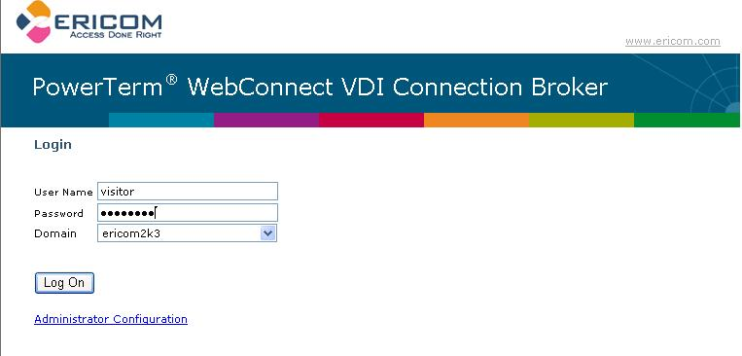
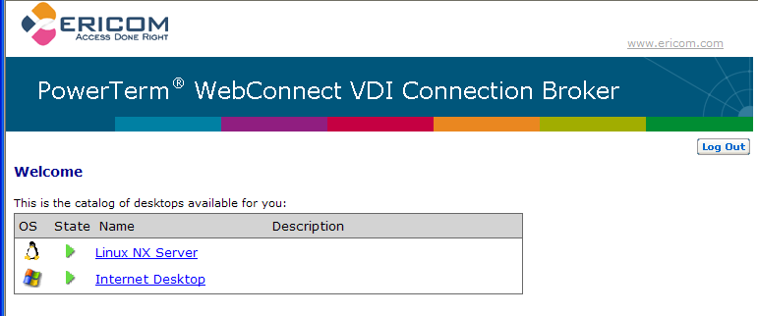
The Access Broker Process
End-user connects to a customized web page to authenticate into the virtual environment
Once authenticated, a list of assigned virtual desktops is presented to the end-user for selection
1
2

Slide 11
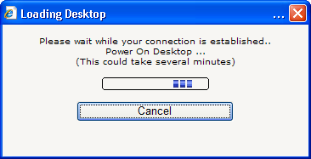
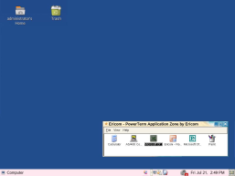
Personalized Desktop
Upon selection of the desired virtual desktop, the Access Broker relays the request to the Virtual Machine Monitors and selects the appropriate VM
The Linux desktop is displayed to the end-user and is ready for use.
3
4

Slide 12
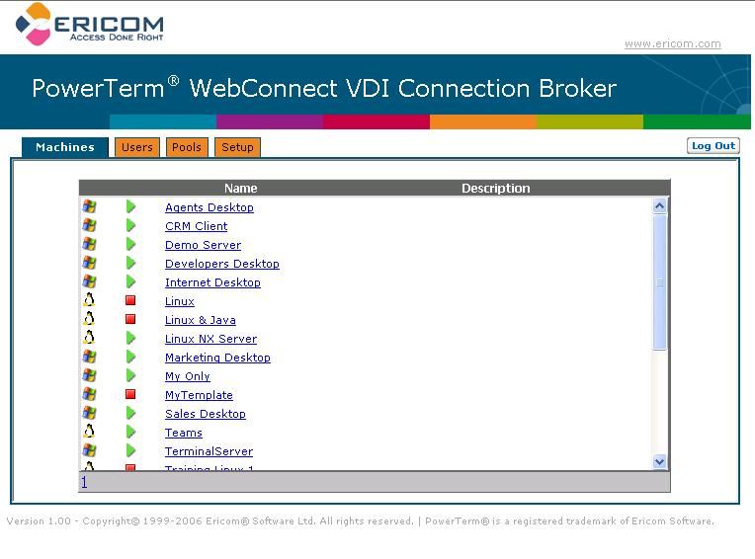
Web-based Administration
Easily manage your VDI broker platform with a web-based interface
  View available virtual machine in a simple and descriptive table
  Manage user permissions
  Add and configure desktop pools
  Available integration with LDAP based directory services
  Modify VirtualCenter configuration

Slide 13
Access Broker Compatibility
The access broker should be platform agnostic:
  VMWare GSX and ESX
  Xen
  Microsoft Virtual Server
The access broker should be protocol agnostic:
  NoMachine X (NX)
  X
  VNC
  RDP

Slide 14
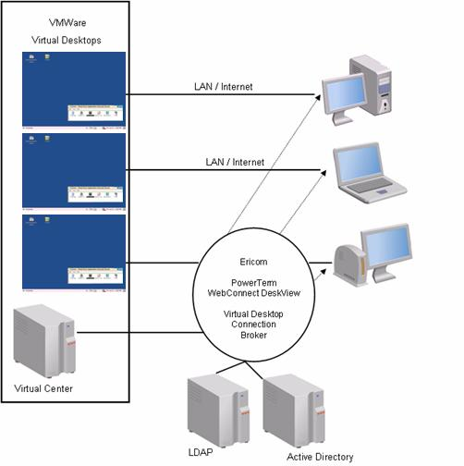
PowerTerm WebConnect LVDI Infrastructure
PowerTerm WebConnect DeskView® provides access to the Virtual Desktops
PowerTerm WebConnect Connection Broker® manages server objects and authentication process
VMWare® Desktops are hosted on series of centralized servers
Access is workstation friendly, get more out of existing devices

Slide 15
PowerTerm WebConnect for LVDI
Ericom’s LVDI Access Broker provides
  Optimizes usage of available virtual desktops with desktop pooling
  Policy-driven capabilities includes VM creation, deletion, suspension, power-on, power-off, and access control.
  Easily configurable virtual machine instances and pools
  Authenticates users before they can access a Linux session
  Presents each user with a personalized list of desktops and applications based on LDAP group associations
  Users access their virtual sessions simply by clicking on an icon
  Connector components automatically provisioned to the user’s device

Slide 16
PowerTerm WebConnect for LVDI (cont)
Additional benefits to look out for:
  Single Sign-On into assigned virtual sessions
  Centralized management with real-time view of user activity
  User-friendly Web-based interface
  Extensive logging and auditing
  Directory Service (LDAP) integration
  RSA SecurID for two-factor authentication
  Managed access to over 40 types of servers including Mainframes, Midrange systems and Windows Terminal Servers

Slide 17
Access to Legacy Applications
In addition to VM access brokering, PowerTerm WebConnect also provides the following on the Linux desktop:
  Windows based applications hosted on Microsoft Terminal Servers
  Character-based Terminal Emulation (over 35 emulation types)
This promotes migration to Linux by offering a cost-effective and simple to use platform to host existing applications.
Highlights include:
  High availability to Windows and Legacy based applications
  Enhanced security through application publishing
  Centralizing the management of mission-critical applications
  Seamless application windows on Linux and Windows based desktops
  Load balancing of Windows Terminal Servers
What does this mean??

Slide 18
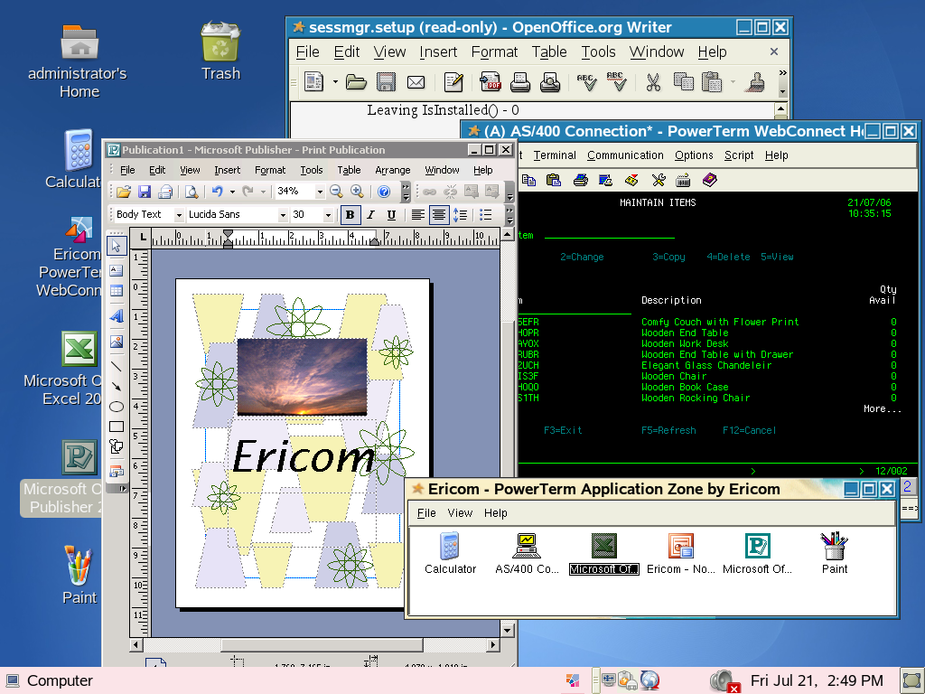
Application Access from Linux Desktops
    Unified access platform connects to virtualized Linux desktops running both Linux and Microsoft based applications for complete functionality

Slide 19
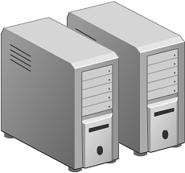
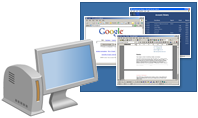
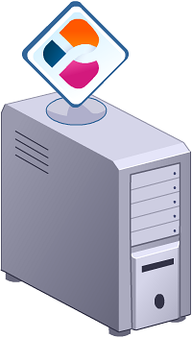
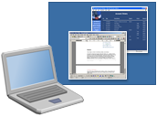
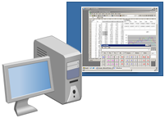
Total Access with PowerTerm WebConnect
PowerTerm
WebConnect Server
Remote
CRM
Local IE
Remote
Windows®
MS Word
Microsoft Windows
Terminal Server
Remote
CRM
Remote
Windows®
MS Word
Virtual Machine Monitor
Remote
Desktop
Legacy Hosts

Slide 20
Summary
PowerTerm WebConnect is Ericom’s enterprise application access solution enabling:
  Remote access to Terminal Servers, Virtual Desktops, and legacy systems
    Seamless windows functionality for Terminal Server applications
    Easy and managed access to Virtualized desktops
    Reliable and proven Terminal Emulation
  User centric, not PC centric, application access
  Centralized monitoring and control meets compliancy regulations
  Built-in SSL Gateway adds encryption to supported access protocols
  Integration with Portals and SSL VPN’s

Slide 21
Additional Reference Links
VDI Overview - http://www.msterminalservices.org/articles/Virtual-Desktop-Infrastructure-Overview.html
Xen - http://searchservervirtualization.techtarget.com/sDefinition/0,290660,sid94_gci1235552,00.html
NoMachine - http://www.nomachine.com/documentation/html/intr-technology.html#4

Slide 22
Thank You for Attending
Ericom Software
James Lui
Director of Technical Services
WWW.ERICOM.COM

