Slide 1

  The future of Communication over IP
  Dave Neary

Slide 2
What is OpenWengo?
  “"People don't want to buy a quarter-inch drill. They want a quarter-inch hole!”
  Theodore Levitt, Harvard Professor of Marketing

Slide 3

Our “hole” is communication

Slide 4
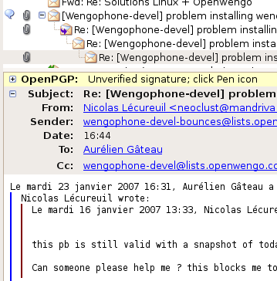

Communication
Actual words

Slide 5
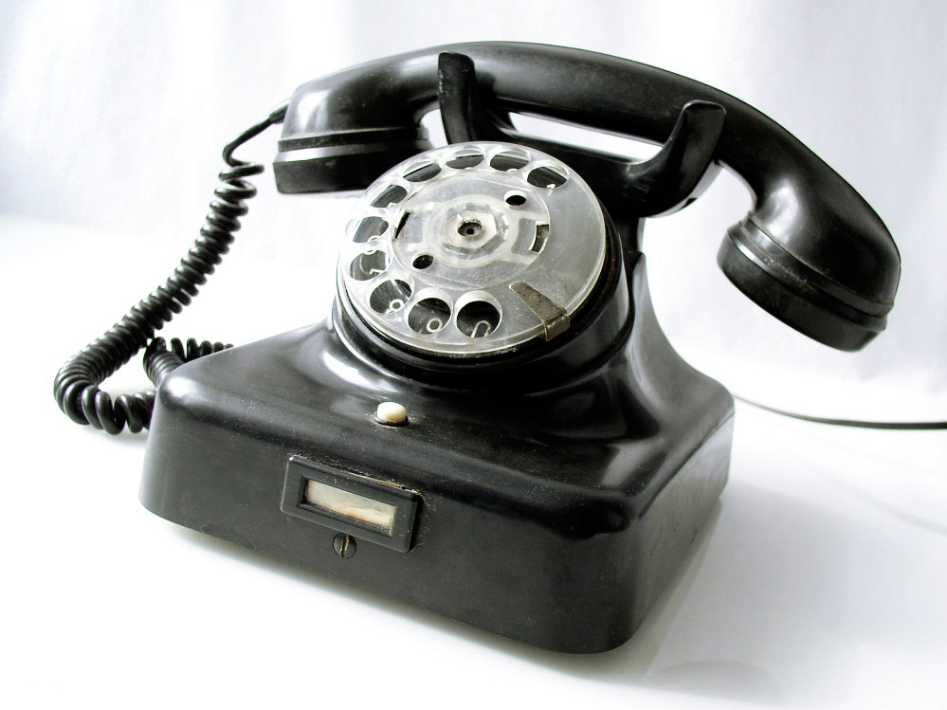
Communication
Voice

Slide 6



Communication
Non-verbal communication
Photo by ajd on flickr

Slide 7

http://headrush.typepad.com/

Slide 8
Communication
Les mots
7%
Non-verbal
38%
55%
Verbal

Slide 9
Measuring quality
Low-res
Hi-res
Notes:
axes
near....far away
low res...high res
read-only...read-write
synchronous...asynchronous

Slide 10
Measuring quality
Near
Far away
Notes:
axes
near....far away
low res...high res
read-only...read-write
synchronous...asynchronous

Slide 11
Measuring quality
Broadcast
Conversation
Notes:
axes
low res...high res
near....far away
read-only...read-write
synchronous...asynchronous

Slide 12
Measuring quality
Synchronous
Asyncrhronous
Notes:
axes
near....far away
low res...high res
read-only...read-write
synchronous...asynchronous

Slide 13
Measuring quality
Meh
Yeah!
“X factor” = f(synchronous distant conversation)
Notes:
axes
near....far away
low res...high res
read-only...read-write
synchronous...asynchronous

Slide 14

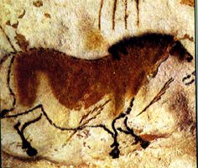

History of communication
Hi-res
Low-res
Meh
Yeah!

Slide 15
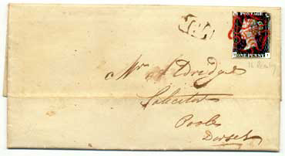
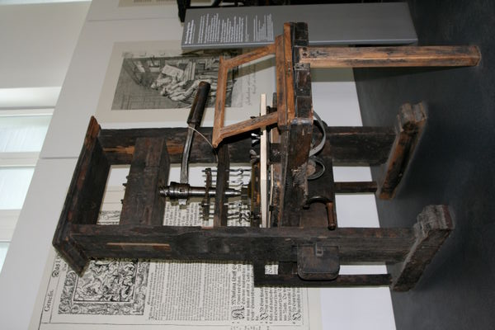
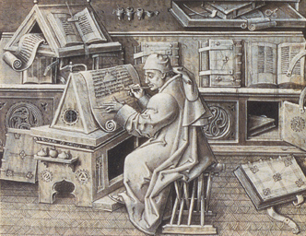
History of communication
Hi-res
Low-res
Meh
Yeah!

Slide 16
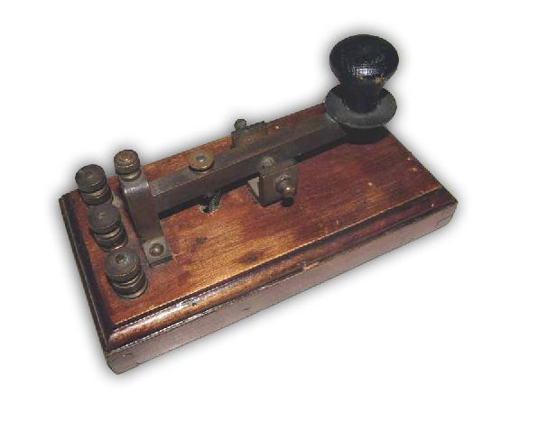
History of communication
Hi-res
Low-res
Meh
Yeah!

Slide 17

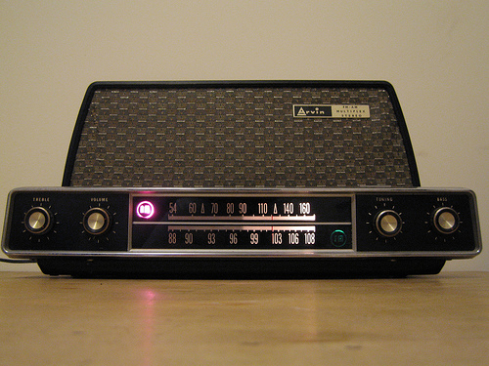
History of communication
Hi-res
Low-res
Meh
Yeah!

Slide 18
History of communication
Hi-res
Low-res
Meh
Yeah!

Slide 19
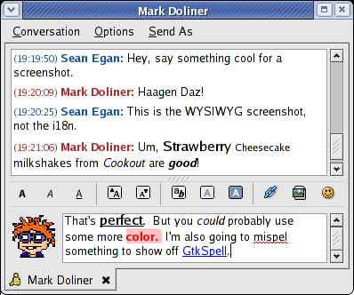
History of communication
Hi-res
Low-res
Meh
Yeah!

Slide 20

History of communication
Hi-res
Low-res
Meh
Yeah!

Slide 21
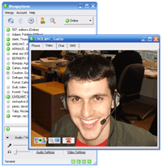
History of communication
Hi-res
Low-res
Meh
Yeah!

Slide 22




All your IM account
are belong to us

Slide 23
Free computer to computer voice & video calls

Slide 24
Call land-lines and mobile phones, send SMSes

Slide 25


Free software
open standards

Slide 26



Cross-platform
(but sound on Linux is a disaster)

Slide 27
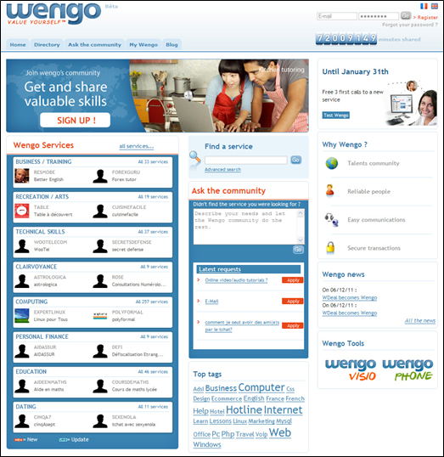
Wengo online marketplace

Slide 28

The elephant in the room

Slide 30

How big is SIP?

Slide 31
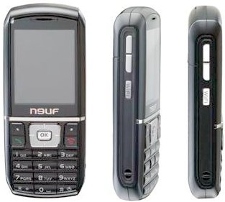
How big is SIP?

Slide 32
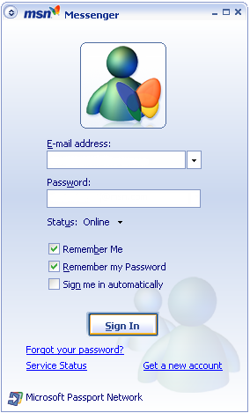
How big is SIP?

Slide 33
Open standards beat proprietary solutions (almost) every time
Notes:
Examples of standards imposing themselves over
proprietary solutions:
* http
* html
* javascript
* C
* Computer chassis
* Car accessories (cigarette lighters, car tyres, oil, ...)
* Railway gauges
Examples where consolidation is underway:
* IM
Industries where this still has to happen:
* Printer ink cartridges
* Mobile phone chargers

Slide 34
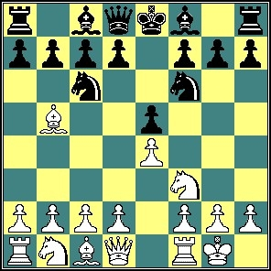


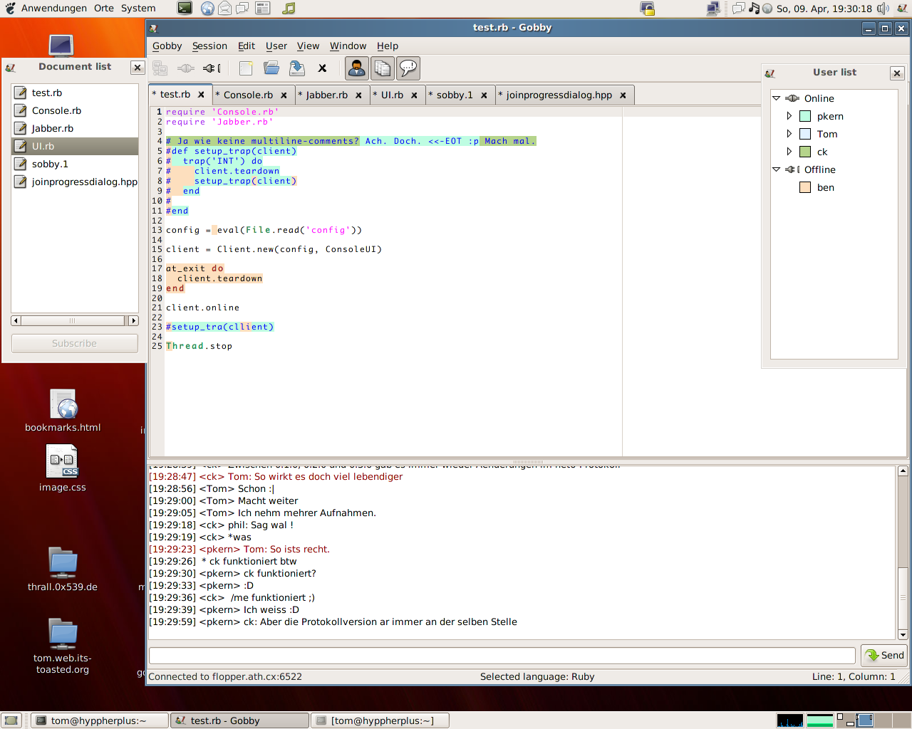


Innovation
Notes:
Terrible word, though...
- CoIP – plug-in architecture which will allow things like:
- Chess plug-in
- Go plug-in (yay Go!)
- Share music (à la shrooms)
- Share drawings (à la Inkboard)
- Share documents (à la Gobby)

Slide 35
Interoperability
Coming soon! Watch this space

Slide 36
That's all folks!
Any questions?
More information on the OpenWengo community at
http://www.openwengo.com

