Slide 1
The Challenges of Developing Games and Other High-Resolution Graphics Applications
  February 2007

Slide 2
Application Developers Challenges
Tight Schedules

Slide 3
Application Developers Challenges
Tight Schedules
Inexperience

Slide 4
Application Developers Challenges
Tight Schedules
Inexperience
Application complexity

Slide 5
Application Developers Challenges
Tight Schedules
Inexperience
Application complexity
Hardware and 3rd party library complexity

Slide 6
Application Developers Challenges
Tight Schedules
Inexperience
Application complexity
Hardware and 3rd party library complexity
“Hello World”
  100 DSO's
  2GB RAM
  Half dozen plugins

Slide 7
Application Developers Challenges
Tight Schedules
Inexperience
Application complexity
Hardware and 3rd party library complexity
“Hello World”
  100 DSO's
  2GB RAM
  Half dozen plugins
Geographically dispersed teams

Slide 8
Outcomes
Missed Deadlines
  Loss of investment in R&D
  QAS Software failure

Slide 9
Incorrect perceptions
“No time to test” syndrome
Mars Climate Orbiter
  Metric vs English units in navigation software
  Nav team unfamiliar with the spacecraft
  Failed to detect the error
  Loss of $125 million
  Systemic failure to follow a process which would have prevented the error.

Slide 10
Developer Syndrome
I don't have time to test
It's not my job – it's QA's job
Standards “cramp my style”
My Pointy-Haired Boss doesn't have a clue what I do
It's a cavalier attitude which can cost millions of dollars, or even lives.

Slide 11
“Find and fix” is no longer relevant
Once an error is found usually don't stop to ask:
    Have I made this error before?
    Has anyone else on the team?
    How would I know?
    How can I prevent this error from happening again?

Slide 12
Automated Error Prevention
Early test-case development:
  Validates the application
  Reduces risk of “all nighters” and resulting additional bugs

Slide 13
Use “down time”
Don't negatively impact the already overburdened developers.
  Nightly build
  Nightly code review
  Nightly Unit and regression testing

Slide 14
OpenGL ruleset
Use appropriate number and order of Begin() / End() and NewList() / EndList() function calls
Use GL command between only Begin() / End() or NewList() / Endlist() pairs
Don't use designated functions in Begin() / End() blocks or NewList() / Endlist() blocks

Slide 15
OpenGL rulesets (cont)
Don't use designated functions outside Begin() / End()
Don't use EndBlock() without a Begin().
Use appropriate vertex counts.
Don't use negative vertex or texture coordinates

Slide 16
OpenGL rulesets (cont)
Extend rules with custom rules eg: “Avoiding 16 OpenGL pitfalls”
http://www.opengl.org/resources/features/KilgardTechniques/oglpitfall/
Custom rules applied by the development teams

Slide 17
What's in it for me?
Reduce the risk of pulling an “all nighter”
Teams which implemented these practices spent 15%of their time finding and fixing bugs
Teams which did not spend up to 75% of their time finding and fixing bugs.

Slide 18
But.. tools alone won't help
Implementing these practices requires:
  Team culture
  Workflow
  Supporting infrastructure
Enforcement tools show that there is a problem, but overwhelm the team unless there is additional support

Slide 19
Project Managers
Design and Implement the new workflows
Motivate the developers to accept them.
Don't “find and fix”, “test and build” instead.

Slide 20
Deming Principles
Detect an error
Isolate the cause
Locate the point in production that created or allowed the error
Implement practices which prevent the error from reoccurring
Monitor for improvements

Slide 21
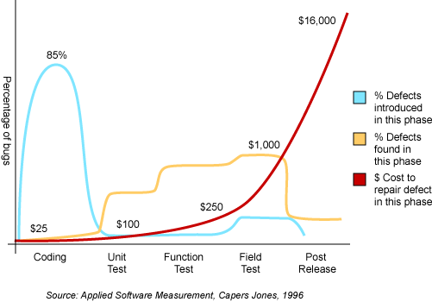
The Cost of Defects

Slide 22
AEP implements the Deming principals
Apply industry best practices to prevent common errors and establish a foundation
Modify practices as needed to prevent unique failures
Ensure each group implements AEP correctly and consistently
Phase in each practice incrementally
Use statistics to stabilize each process.

Slide 23
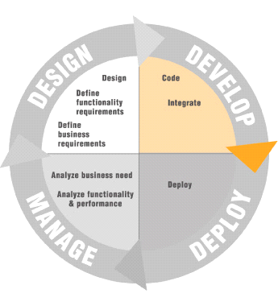
Typical Software Lifecycle

Slide 24
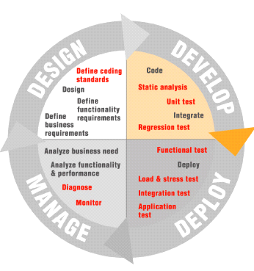
With Automated tools in place.

Slide 25
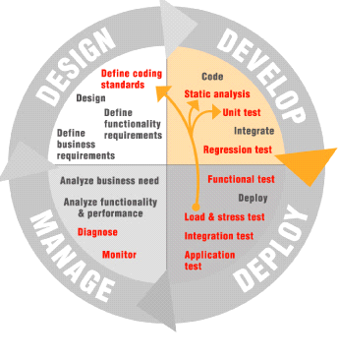
With Automated Error Prevention Methodology

Slide 26
Parasoft's Process for Development
Nightly build
Nightly Regression and Integration tests
Adding a new feature? Fixing a bug?
  Create a test-case which validates the new feature, then work on the feature itself.
  When the test-case passes, we know it was implemented correctly
  We also know that we haven't broken anything else.

Slide 27
Issues for senior management
Collaboration partners?
Outsourcing?
Strategic partnerships require a consensus not only of the development process, but of the testing processes too.

Slide 28
DirecTV Local channel Satellite Mission
Strategic Partners:
  BBC
  Telecom providers
  Local Channel providers
  Satellite launch and nav team

Slide 29
Consequences of failure
Loss of broadcast rights
Loss of millions of dollars
  Lost revenue
  Loss of orbital slot/satellite

Slide 30
Testing Strategy
Had to test early and often during development
  Testing of the complete system before satellite was in position was impossible
Mission successful
  Ground systems in place months before.
Concurrent testing is not only possible, it's good business.

