Slide 1



The State of the Linux Video Tools
Steve Oualline
http://www.oualline.com
oualline@www.oualline.com

Slide 2
Video Tools
Basic video terminology
Video media players
Playing DVDs
Copying DVDs
Encoding / Transcoding
Video Editing
The future of video

Slide 3

Technology Overview
Codecs & formats
  Container – Can hold multiple types of video
  Format – the contents of the file (how the bits are arranged).
  Codec – the encoder that created the contents of the files (arranger of bits).
Multiple encoders can write files in the same format. (DivX, Xvid -> mpeg4)

Slide 4
File Formats
Common Encoding
  mpeg4 – Official DVD format, not a codec.
  DivX – Microsoft mpeg4 compliant codec with limited capabilities.
  DivX5 – Replacement for DivX and DivX4. Closed source. Open Source version does not support all features.

Slide 5
Technology Overview
Common Encoding Formats (continued)
  XviD – Open Source codec that's really good at compression and quality. mpeg4 compliant.
  mpeg1, mpeg2 – Older format used for VCD and SVCD disks.
  dv – Format used by camcorders. Not compressed.

Slide 6
Technology Overview
Disk formats
  DVD – Digital Video Disk
  VCD – CD Video disk
  Emovix – Bootable video player

Slide 7
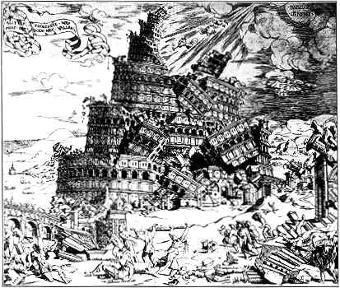
Codecs – The tower of Babel
Multiple competing codecs out there.
Attempts by vendors to lock users into their own property codec
Belief that controlling the codec means you control the videos
DRM

Slide 8
Media Players
xine
mplayer
vlc
RealPlayer
shockwave

Slide 9
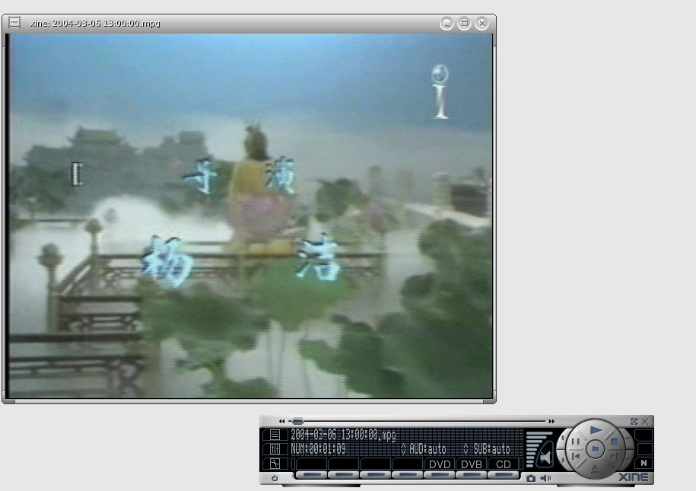
xine Player

Slide 10
xine Player
Handles most media types
Can use Microsoft DDL files for some codecs
Very nice command interface
Plays DVDs, but hampered by poor command interface – Selecting titles, subtitles, and such difficult.

Slide 11
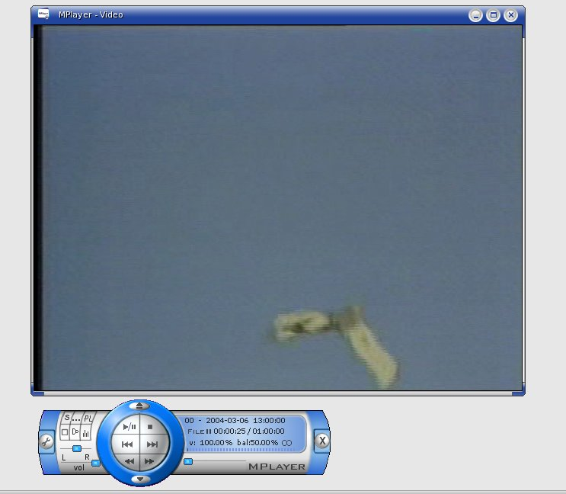
mplayer

Slide 12
mplayer
No GUI! -- Use gmplayer for that
Handles most media types
Can use Microsoft DDL files for some codecs

Slide 13
mplayer
Plays DVDs but user interface is extremely annoying
  Can not change subtitle without restarting movie.
Supports Edit Decision Lists (for skipping commericals)

Slide 14
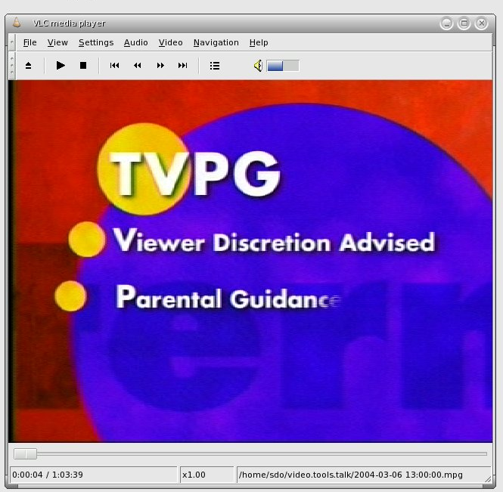
vlc

Slide 15
vlc
Very flexible player.
Works with DLLs for some codecs.
Can be a streaming server, receiver.
Keyboard control limited and buggy
Works very well with DVDs.
Skips to the main menu when starting a DVD.

Slide 16
vlc
Many many pieces
Must install many plugins (on Mandrivia at least)
Has the famous “ASCII Art” output module.

Slide 17
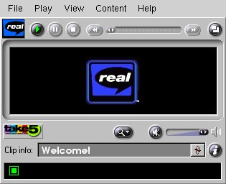
RealPlayer

Slide 18
RealPlayer
Now open.
Everyone else incorporates real codecs in their player.
Won't play most media types.
Never use

Slide 19
Shockwave
Linux version available
Finally you can watch www.youtube.com.

Slide 20
Playing DVDs
Legal vs. Illegal DVD players
libdecss
  If you own it, it's legal to play it.
  Actions of the MPAA created the whack-a-mole type protest.
ogle player.
  The RPM for Mandrivia 10.1 is broken, so no review.

Slide 21
TV Capture
Video 4 Linux – TV Capture API and tools
Buy capture cards with hardware encoders (software only capture / encoding never gets the sound in sync.)
Recode the videos just after capture to reduce size by at least 1/2.
zabs.zap2it.com – Free download of TV listings through tv_grab_dd_na.

Slide 22
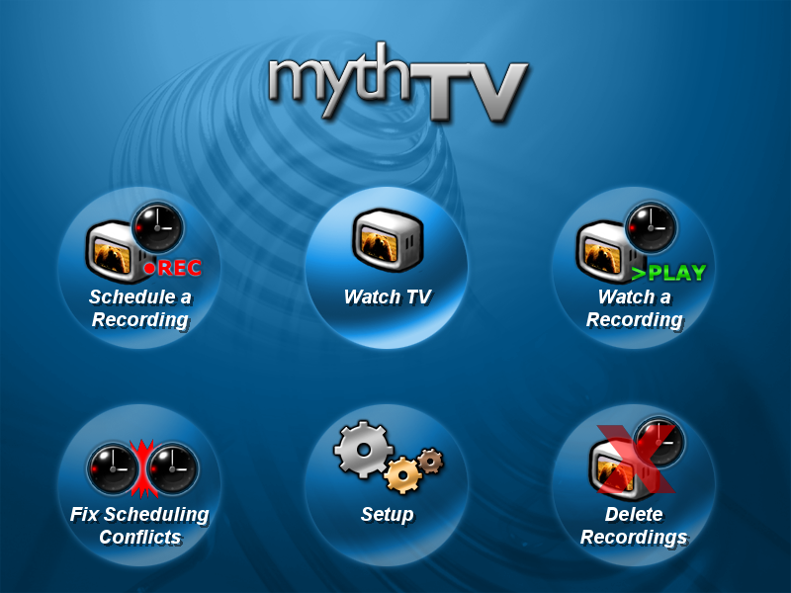
MythTV

Slide 23
MythTV
Difficult to install (but getting easier)
Wants to take over your entire screen.
Also wants a good hunk of your computer.
Keyboard interface only. Navigation difficult, especially setup.
Do not install if you do not have “click to type” set.

Slide 24
Encoding / Transcoding
Reasons to Transcode
  Create a DVD compatible video stream
  Compress an existing video
  Reduce the size or bitrate of a video
  Change the format so you can edit it.
Transcoding is slow. It easily take ten times as long to transcode a video as to watch it.

Slide 25
Transcoding
Every transcoding program has 5,000 options.
Plug-ins are used for encoding and decoding. Getting the right plug-ins is a challenge.
Every plug-in has it's own options.

Slide 26
Transcoding Problems
Transcoding takes time – Lots and lots of time
Not all tools work for all formats

Slide 27
Transcoding Tools
transcode
memencoder
ffmpeg

Slide 28
Transcoding Example
To convert a mpeg video into DV format for kino
transcode \
-i 'funny_dog_show.mpg' \
-y mov -F dv -Z720x480 \
-o dvz.mov

Slide 29
Transcoding Example
-i input-file
-y mov – Select the video output module. In this case the quicktime (mov) container.
-F dv – Select the format for use in the container. (And audio codec if applicable – only 1 codec for dv.)
-Z720x480 – Resize the video to the given amount (kino is fussy about this)
-o output-file

Slide 30
Transcoding Example
Time to process a 1 hour television show: 2 hours. (AMD Athlon(tm) XP 2400+)
Size of input: 877M
Size of output: 13G

Slide 31
Video Editing
Editing tasks
Cutting a clip out of a television show
Making DVD from a camcorder tape

Slide 32
Editors
kino
lve
lives
cinerama
avidemix2

Slide 33
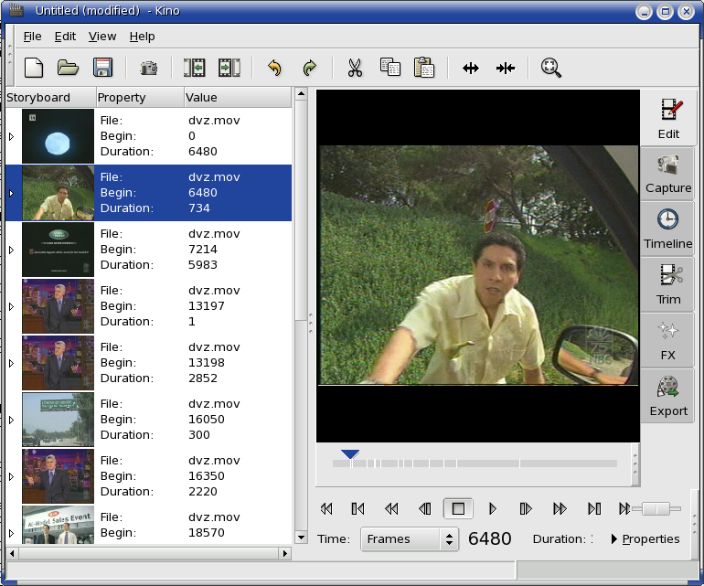
Video editing -- Kino

Slide 34
Video editing -- Kino
Works well for DV (camcorder files)
Very limited input support otherwise (annoying)
Works fast enough to not be annoying
Vi like keyboard controls.
Simple edits – No complex transitions or sound editing.
Good choice for home Camcorder to DVD projects

Slide 35
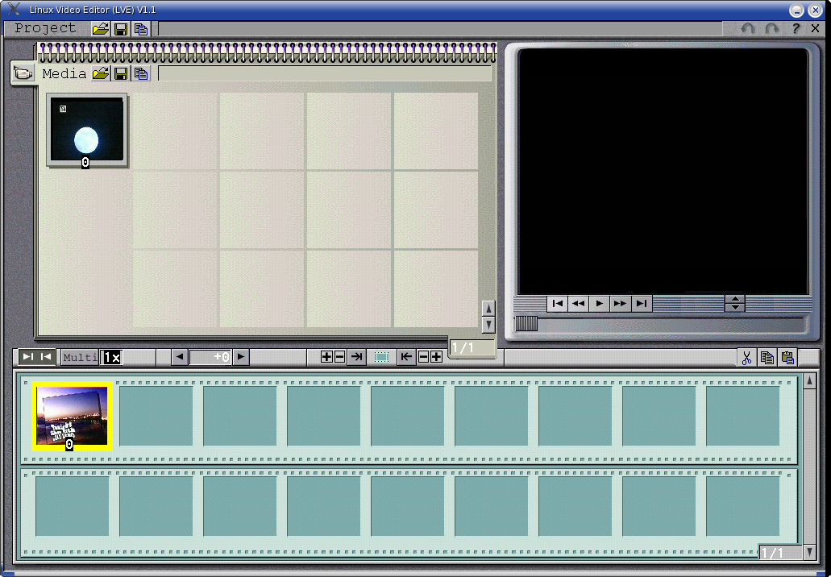
Video editing -- Lve

Slide 36
Video editing -- Lve
Fast
Works well with mpeg files
Better input / output support
No documentation to speak of
Suggest avidmux2 instead. Does more and is documented.

Slide 37
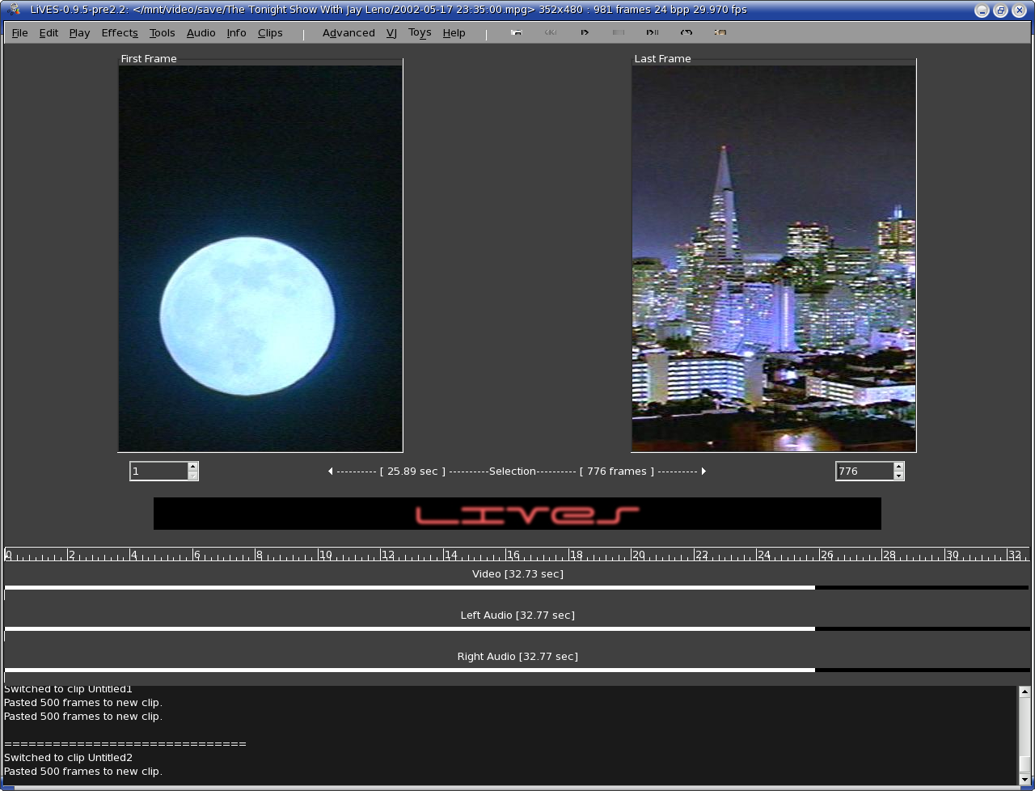
Video editing -- Lives

Slide 38
Video editing -- Lives
Appears to be full featured.
Very slow open speed.
Does not import the whole file by default.
Sound does work with my system. (ALSA only?)

Slide 39
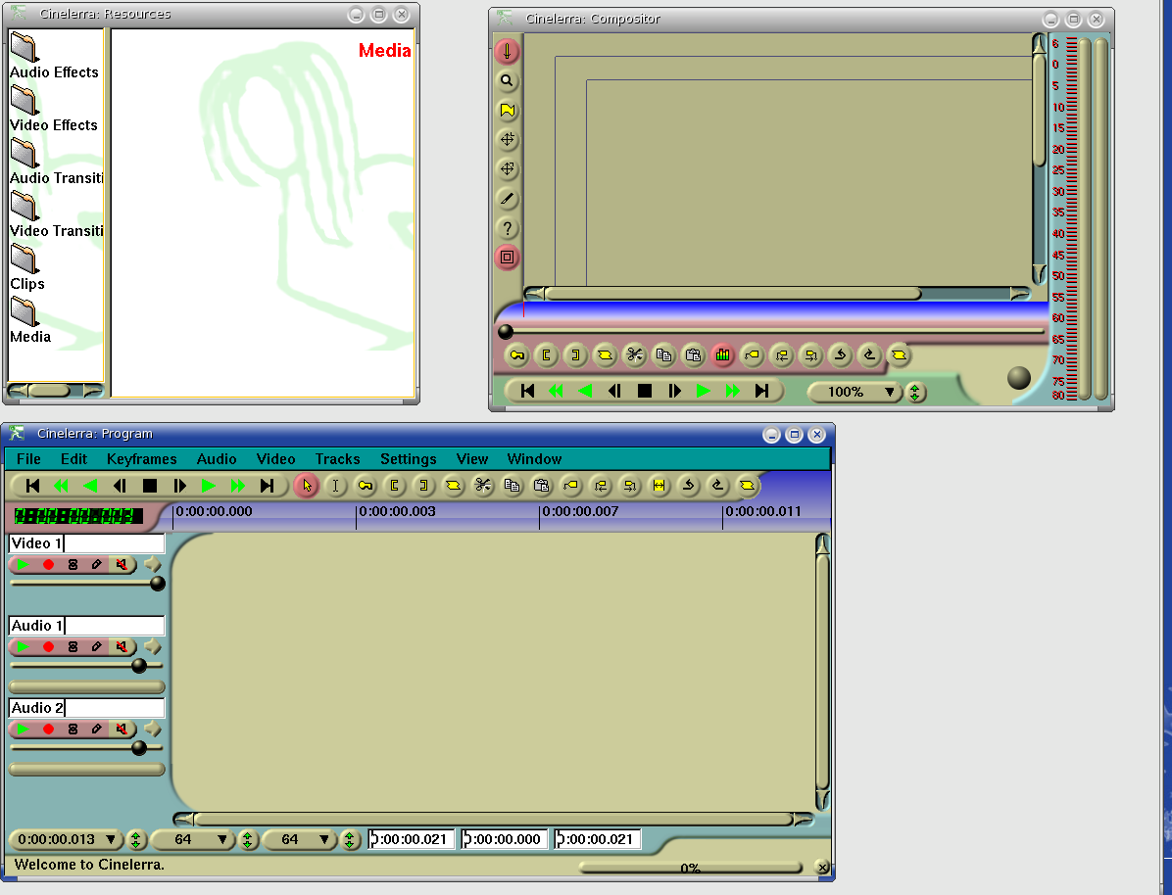
Video editing -- cinelerra

Slide 40
Video editing -- cinelerra
Supposed to be a professional class editing system.
Documentation 186 page manual
Never could figure it out.

Slide 41
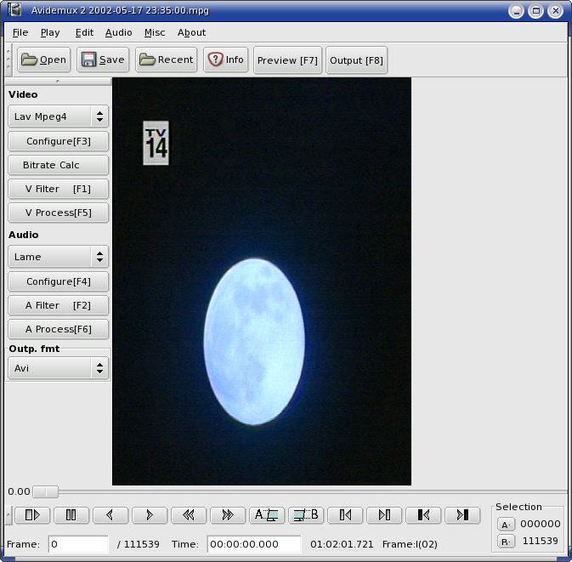
Video editing -- avidemix2

Slide 42
Video editing -- avidemix2
Fast
Full set of features
Find black feature – Commercial Skip
Scripting features

Slide 43
DVD Structure
Top level is a menu (a video clip with other information added)
Disk is divided into titles
Titles are divided into chapters
To display slides you need to turn a picture into short video clip.

Slide 44
Basic Tools for Making DVDs
tovid – Convert video to DVD mpeg stream
makemenu – Create top level menu
makexml – Create xml file describing the video
dvdauthor – Create DVD file set
mkisofs – Create DVD image

Slide 45
Creating a DVD file
tovid -dvd -in raw/video.avi \
-out dvd/video1.mpg
Uses mpeg2enc to transcode the file
Takes 2 hours to do an hour video

Slide 46
Creating the menu
makemenu “1: Birth” \
“2: Growing up” \
-background pict.png \
-out menu.mpg
Generates the short “menu” video and other meta data for a DVD menu

Slide 47
Make the DVD description
makexml -dvd -menu menu.mpg -chapters 5 \
video1.mpg video2.mpg \
dvd
dvdauthor uses a complex xml file to describe the DVD. This program creates it from simple input.

Slide 48

Make the DVD file system
dvdauthor -x dvd.xml
Creates a file system containing the files which make up the DVD
To test use vlc:
  vlc dvd://`pwd`

Slide 49
Make the DVD image
mkisofs --dvd-video \
-o ../dvd.iso .
Creates a burnable image of the DVD.
Do put output file in same directory as the input.
You can test the image too:
  vlc dvd://`pwd`/../dvd.iso

Slide 50
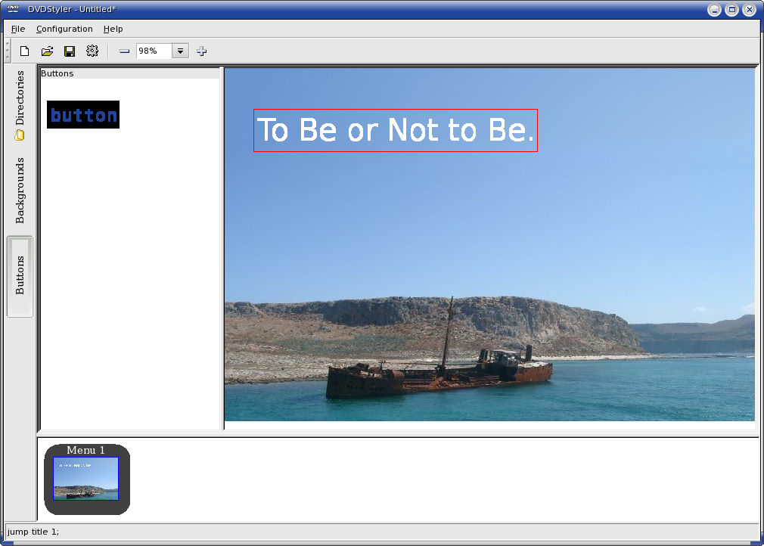
Interactive DVD Creation

Slide 51
Interactive DVD Creation
Handles menu creation
Adding clips to the DVD
Multiple Menus
Background images for menus
Front end to dvdauthor

Slide 52
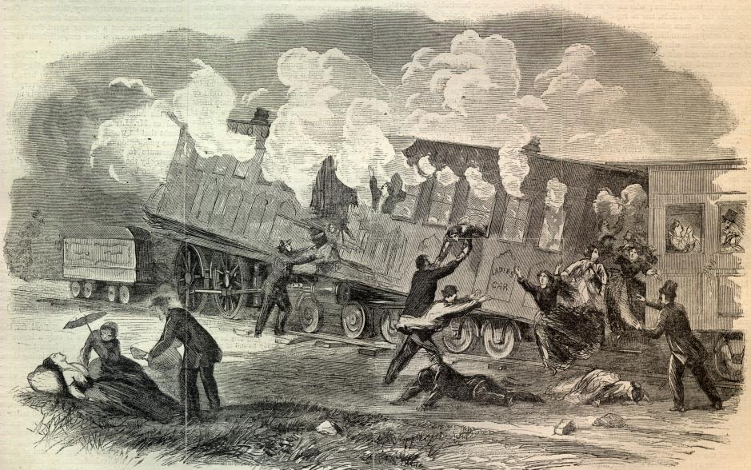
The Future
Microsoft Vista
.

Slide 53
Vista Lockdown
Basic Vista design rule:
If Microsoft doesn't approve it you can only use it in degraded mode.

Slide 54
Vista Lockdown
Devices carry unique manufacture Ids.
Devices must have circuits that prevent anyone from discovering how they work.
All drivers must be approved by Microsoft and provided with a Microsoft certificate.
If someone figures out how to use a device (Linux users) Microsoft can revoke the certificate.

Slide 55

Will Users Stand for it?
Anyone remember DIVX?
What's going to happen to legal users when a crack is found and a certificate revoked?

Slide 56
Linux Tools
Complex -> Simple
Slow -> Fast (Mostly due to hardware)
Political -> Very Interesting Political

