Slide 1
  The Zumastor Linux Storage Server
  Daniel Phillips
  phillips@google.com

Slide 2

or: It is high time Tux arrived in the storage space...

Slide 3
Zumastor Linux Storage Server
Multiple live volume snapshots
User accessible snapshots
Remote volume replication
Online volume backup
NVRAM acceleration
Kerberized NFS and Samba
Easy administration interface

Slide 4
Zumastor Linux Storage Server
NFS serving isn't just about NFS
An enterprise is paranoid about its data
  Live backup is not optional
  Offsite replication is highly desirable
Performance isn't the biggest issue
Admins want things to just work
Admins don't want users bothering them about restoring files

Slide 5
ddsnap virtual block device
ddsnap is the engine of zumastor
Originally designed for cluster snapshots
Small kernel driver coupled to biggish user space server
rpc-like interface between kernel and user space
  but not big and fat like rpc
Copy-before-write snapshot strategy

Slide 6
ddsnap virtual block device
Btree implements snapshot chunk sharing
  Bitmap for each chunk says which snapshots it belongs to
  64 snapshot limitation is due to bitmap size
Btree needs allocation bitmaps, journal, superblock... like a small filesystem
User space server was repurposed to implement...

Slide 7
ddsnap remote replication
Which chunks are different between two snapshots?
ddsnap server peeks into metadata
Then read snapshot data to build a volume delta
Get delta as a file or stream it
Various kinds of delta compression

Slide 8
Zumastor Volume Monitor
Hides the details of ddrain, dmsetup, virtual device names, mountpoints
Scheduled snapshot rotations
Implements complex replication topology
All driven by a filesystem based database
Easy to use database editing interface

Slide 9
Zumastor Volume Monitor
Zumastor is a bash script!
About 1500 lines
Daemons that talk over pipes... in bash...
Developed in 2.5 months
Great rapid prototyping performance
And now...

Slide 10
Kerberized NFS v3
Linux NFS all comes from CITI project
Offers a kerberized NFS v4 server as well as client
Little known fact: you can serve NFS v3 with the CITI code base
Just required some minor hackery to mountd, which isn't kerberized
Good, because NFS v3 is what folks have

Slide 11
Snapshot write performance
Test Zumastor performance under carefully controlled conditions
Take 64 successive snapshots, measuring time to untar a kernel at each step

Slide 12
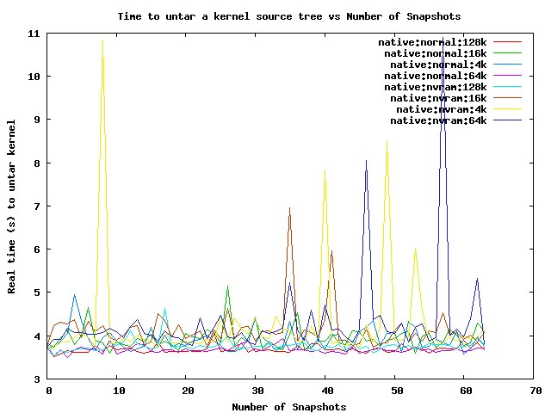
Snapshot write performance

Slide 13
Snapshot write performance
Oops, we forget to include the sync.

Slide 14
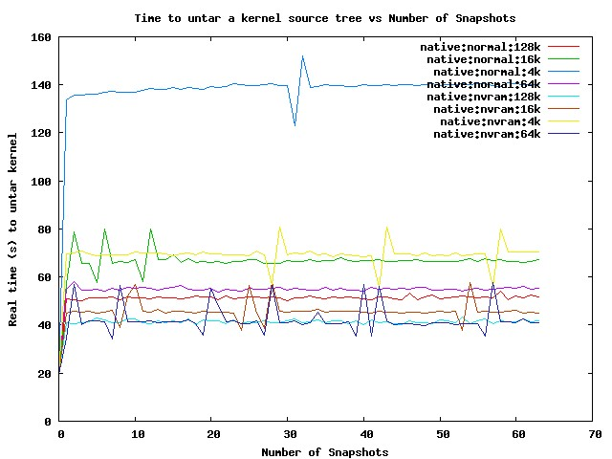
Snapshot write performance

Slide 15
Snapshot write performance
Oops, maybe we should unmount between tests

Slide 16
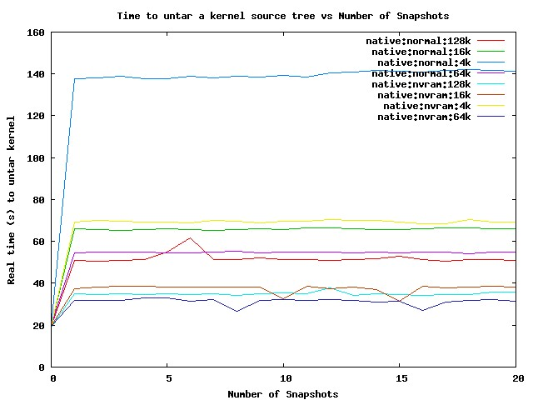
Snapshot write performance

Slide 17
Snapshot write performance
Ah, that one was just right!
Write performance does not degrade with number of snapshots
Write performance improves with larger chunk size
Write performance improves a lot with metadata in NVRAM

Slide 18
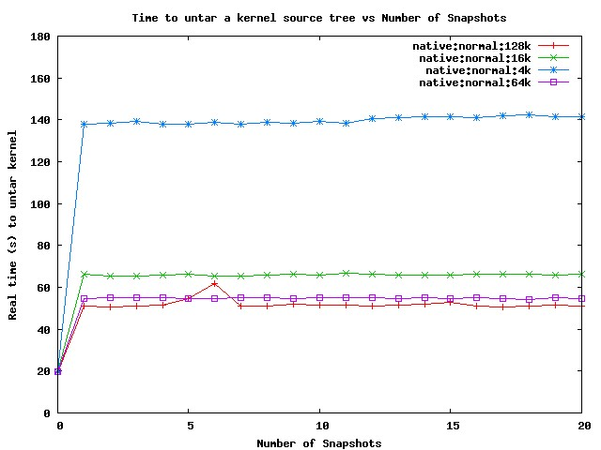
Write performance, no NVRAM

Slide 19
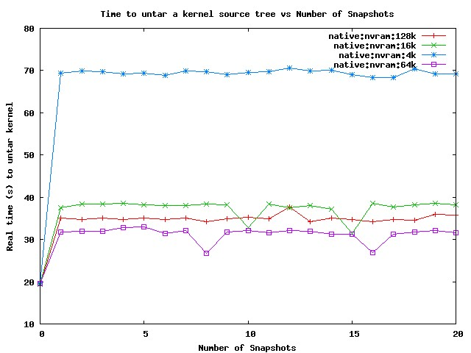
Write performance with NVRAM

Slide 20
Snapshot write performance
Ah, that one was just right.
NVRAM speeds up worst case writing by a factor of two
With NVRAM, largest chunk size isn't the fastest
Still some more NVRAM tricks to try

Slide 21
Delta compression performance
Delta size equates to replication time
Compression is a big payoff for slow links
Extent oriented, need big chunks to work on but still need to stream
zlib (gzip) for compression
xdelta for binary differencing
Compress or binary difference?
  Try both and pick the best

Slide 22
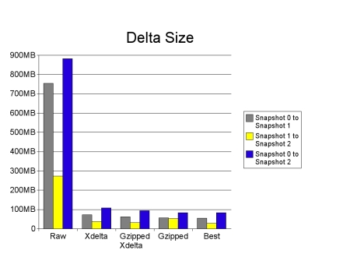
Delta compression performance

Slide 23
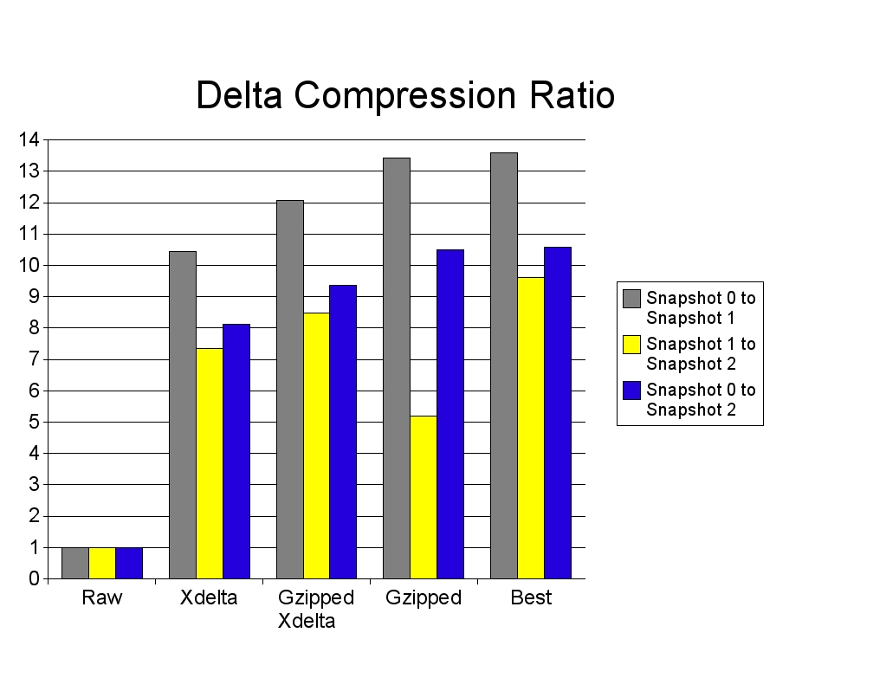
Delta compression performance

Slide 24
Zumastor Futures
It's going to get more features
It's going to get faster and more robust
It's going to get bigger

Slide 25
Zumastor Futures
Give me a graphical front end
Give it to me over the web
Give me a real volume manager
What about online resizing?
Can I have incremental backup too?
Faster, yah Faster!
I'm too cheap to buy NVRAM, can you make it so I don't need it?

Slide 26
Zumastor Linux Storage Server
Zumastor homepage:
http://zumastor.googlepages.com
Zumastor project page:
http://code.google.com/p/zumastor
IRC channel:
irc.oftc.net #zumastor

