Slide 1
  Wireless Networking
  For Beginners
  Dennis Rex
  SCALE 5X - 2007

Slide 2

Agenda
Why is it so hard?
Devices - USB, PCI, PCMCIA, “bridges”
Wireless chipsets – picking one that works
Finding and installing the right driver
Wireless tools and utilities
Securing your network
References and resources
Q & A

Slide 3
Why is wireless so hard?
Internet is the first thing you want
  Sometimes, wireless is the only option
Complex installation
  Download additional software
  Compile drivers
  Firmware
Notes:
You're told to bake a cake ... except you've never baked a cake before, you don't have a recipe and can't find the ingredients.
We'll walk through the basics steps on how to get wireless networking up and running under Linux.

Slide 4
Device Types
USB
PCMCIA/Cardbus
PCI
Mini-PCI
Wireless Ethernet adapters
Notes:
Selecting the right device often means using what you already have or working within the limits of your system. Each device type has unique advantages and disadvantages. We'll note some of the pro's and con's to consider if buying a new device.

Slide 5
USB
Flexible to position
Easy to install
Hotplug capable
Inexpensive
CPU consumption
Speed
No External antenna
Notes:
USB can chew up a lot of CPU, can be slow (1.0 in an 802.11G setup) and drivers tend to lag other types. Their construction usually means that they can be easily positioned for best reception and they tend to be inexpensive.
USB devices rarely have an external antenna option.
Some users have difficulty activating USB wireless devices on boot, a problem that can usually be addressed by adjusting the order in which things occur on boot.

Slide 6
PCMCIA/Cardbus
Nearly universal for laptops
Good driver support
Hotplug capable
Many with external antenna connections
High-power options
Can be fragile
Notes:
The favorite for travelers and war drivers. Easily swapped, these cards come in a wide range of chipsets and packages. Some allow an external antenna to be attached. Others can remove the antenna completely.
30-50mw transmit power is common, but 100, 200 and even 300mw versions are available (802.11B only – FCC regulations limit Tx power to 100mw in G mode)
Cardbus (32-bit) adapters might not be an option on that ancient laptop. Some combinations of h/w, BIOS and distro services and be troublesome (hangs on boot). Disabling hotplug on boot and blacklisting the offending device usually fixes this.

Slide 7
PCI
Good desktop choice
Most have a detachable antenna
Location can be a problem
IRQ conflicts, especially on older boxes
Notes:
What's the worst place for a wireless device? Under your desk, near the floor, mashed up against the wall, maybe. Most PCI adapters have a detachable antenna to allow users to overcome reception problems with an after-market antenna. (Factor the antenna and pigtail into the cost.)
IRQ conflicts can occur, but probably no more often that with other devices. Older system may be more finicky

Slide 8
Mini-PCI
Notebook-only
Great range with internal case antenna
No external antenna options
No hotswap
Difficult to upgrade
Notes:
Getting a new notebook? Adding an internal wireless card might be a good idea. Contained on a mini-PCI card, these devices often use an antenna wired into the case of the laptop – commonly around the screen. This tends to result in better performance than those built into PC Cards.
Because they are internal upgrading to a newer, faster card is a little trickier or in some cases, impossible.
Radio is often BIOS-controlled. Fn-F2, for example, can enable or disable (brand/model dependent). Common gotcha – check to make sure the card is activated.

Slide 9
Wireless Ethernet Adapters
No drivers needed
Plugs into Ethernet port
Great position flexibility
Usually routeable
Limited external antenna options
Relatively expensive: 2x-3x PCMCIA
Notes:
Sometimes called bridges by the marketeers, a wireless Ethernet adapter can dispense with driver issues by connecting directly to an Ethernet port. Ethernet chipsets tend to be far-better supported than some wireless chipsets.
Configuration is similar to a router via web UI. Because of cat5 distances, the device can be positioned with great flexibility for best reception.
Cost may be a show-stopper for some, with $150 price tags not unheard of. Lugging around another appendage is not desirable for the road warrior, so this is mostly a desktop or stationary laptop option.

Slide 10
Wireless Chipsets
Good: Native drivers, simple setup
  Cisco, ORiNOCO (classic), Prism
OK: Manufacturer or open source drivers
  Atheros, Intel, Ralink, RealTek, T.I.
Usable with a wrapper:
  Broadcom (or bcm43xx – limited function)
Good luck:
  ORiNOCO World Gold (Hermes II)
Notes:
This is only a partial list and a fluid one. The resources page gives more comprehensive set of references.

Slide 11
Wireless Drivers (a short list)
orinoco_cs: Works with most ORiNOCO and Prism cards
wlan-ng: Prism and Prism USB devices
Prism54: 802.11G Prism cards
HostAP: Prism 2-3
MadWiFi: Atheros
Ndiswrapper: Broadcom, via Windows drivers
Linuxant: A commercial wrapper
Notes:
Why is this so hard? Why so many drivers?
Part of it is the inevitable outcome of OEM suppliers competing for market share by adding new, often proprietary features to their products.
Some manufacturers (often really little more than re-labelers) frequently swap chipset suppliers while retaining the product model. A Widget v3 may work well but a v4 not at all.
The introduction of software-controlled radios changed the game. Cheaper to produce, easier to add features, such cards could be tuned to use improper bands or other errant behavior if full software control was given to end users. Unacceptable to both manufacturers and the FCC.
This leaves the open source community to either work with supportive companies (Intel) or around unsupportive ones (Broadcom) in order to come up with drivers. It can be a tedious process.

Slide 12
Getting Connected
Settings & Utilities
Wireless success is a two-step process:
  Finding/associating with wireless network
  Establishing a network connection
Managing the wireless connection can be by GUI or command line
  Network name, mode, encryption
Network interface settings and status
  GUI, CLI or distro scripts
Notes:
This is Linux. You weren't really expecting some cute little spinning happy face to pop up and tell you that a new wireless network was available, did you?
It's not that bad. There are some nice UIs that work, but you may find that a couple of quick keystrokes will work even better.

Slide 13
Command line options
Wireless Tools – iwconfig
  Used for setting wireless parameters, scanning for available networks or displaying status.
  Usually the data source for UI's.
  Portable across distros and configurations
  Settings are not persistent
    Frequently-used values can be stored in distro-specific script files.
    Ex: Fedora - /etc/sysconfig/network-scripts/ifcfg-wlan0
Notes:
The Wireless Tools package has been the standard method for managing wireless settings for some time, and is often still doing the heavy lifting even if you use another tool as a front end.
Not all cards and drivers support all of the available commands. Patched or release candidate orinoco_cs drivers are needed, for example, to put many cards into monitor mode. Some cards do not support scanning with the iwlist command.

Slide 14
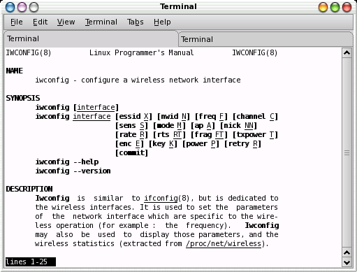
Notes:
A screen shot of the man page for iwconfig, listing the various options available for setting wireless parameters.

Slide 15

GUI Wireless Options
NetworkManager
  Full GUI front end for Ubuntu
KWiFiManager
  KDE utility
XFCE4 wavelan plugin
  Signal strength, SSID
Notes:
These are just three examples. Gkrellm also has a wireless plugin and there are probably many more from which to choose.

Slide 16
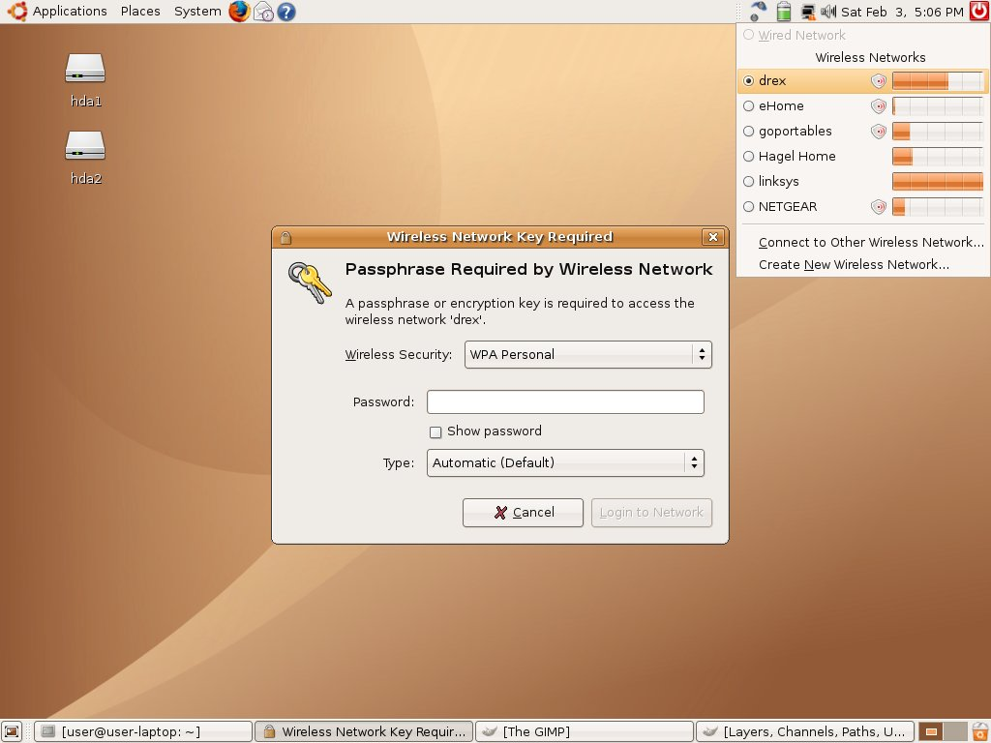
Notes:
A screen shot of an Ubuntu desktop (GNOME) and the NetworkManager dialog screens.

Slide 17
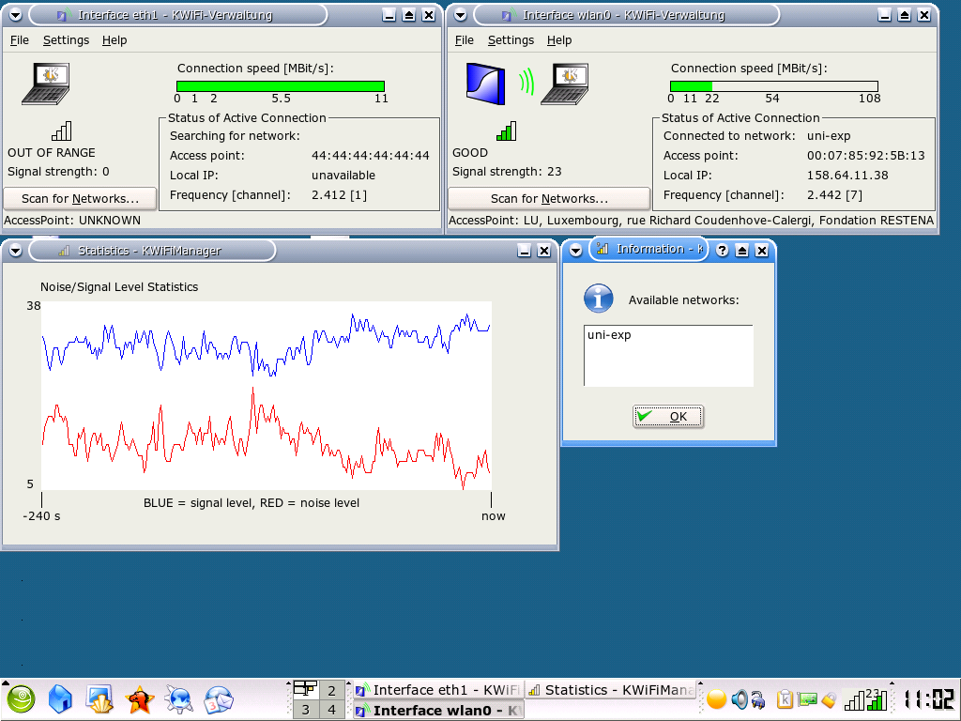
Notes:
A screen shot of KWiFiManager shows some of the features. You need at least some of the KDE libraries to run it, but you need not be running KDE to use this utility. It runs quite nicely under XFCE4.

Slide 18
Interface tools
CLI – ifconfig, route, dhclient or dhcpcd
  Activate and configure the interface
  Obtain or assign an IP address and gateway
  Usually scripted. Again, distro-specific locations
UIs – NetDrake, YaST, NetworkManager
  Almost universally, these tools simply overwrite a configuration file. Sometimes, knowing the location and syntax of the files makes changes quicker.
Notes:
At this point, the wireless interface behaves just like a wired one. IP address, gateway, DNS servers and the like will need to be entered or obtained from the DHCP server.

Slide 19

Wireless Security
Worthy of its own topic. We'll touch on the basics
Two primary wireless security objectives:
  Control access to the wireless LAN
  Protect the data

Slide 20
Wireless Security - Encryption
WEP – Wired Equivalent Privacy
  Encrypts data packets only
  Uses a 10 or 26 digit hex key on each client matching the access point
  Several published vulnerabilities
  Attack tools are easily obtained
Notes:
Early attacks that cracked the encryption key required that large amounts of data be gathered and relied on specific flaws which some manufacturers corrected (weak IVs).
More recent attacks exploit multiple WEP vulnerabilities and can reportedly produce a correct key guess in far less time.

Slide 21
Wireless Security - Access
ESSID Broadcast Disable - Security through obscurity
  Extended Service Set Identifier, the “network name”
  Needed for clients to associate
  Default setting is to beacon – announce the name to prospective client devices
  Access point is still visible
  SSID is broadcast in response to a probe
  Broadcast disable can cause connection problems
Notes:
One of the more common myths about wireless is that you can somehow hide from prying eyes by turning off the ESSID broadcast. The notion is reinforced by the marketing of wireless manufacturers and by the fact that NetStumber, a popular Windows scanning tool, does not “see” networks set up in this manner.
Reality: You can't hide a radio. Passive scanning tools such as Kismet will detect these”hidden” access points and the SSID is always sent in response to a probe request. A probe can be generated by either a legitimate user or a malicious one.
Disabling the SSID broadcast can also cause connection troubles in some configurations, particularly those using WPA.
SSID broadcast disable should not be considered a security feature.

Slide 22
Wireless Security - Access
MAC address filtering – access control
  Media access control address. A unique hexadecimal address assigned by the manufacturer to each network device. ex: A0:12:3E:00:00
  Routers can be set to deny or accept specific addresses
Notes:
MAC address filtering is weak security as best. It is arguably the easiest method to defeat. While it is often touted as a “better than nothing” option or one which will deter the casual war-driving kiddie, it offers little defense against a knowledgeable bad guy.
Relying on MAC address filtering is dangerous.

Slide 23
Wireless Security - Access
  MAC addresses are easily cloned, or “spoofed.”
  MAC addresses are sent in every 802.11 frame
  MAC addresses are never encrypted

Slide 24
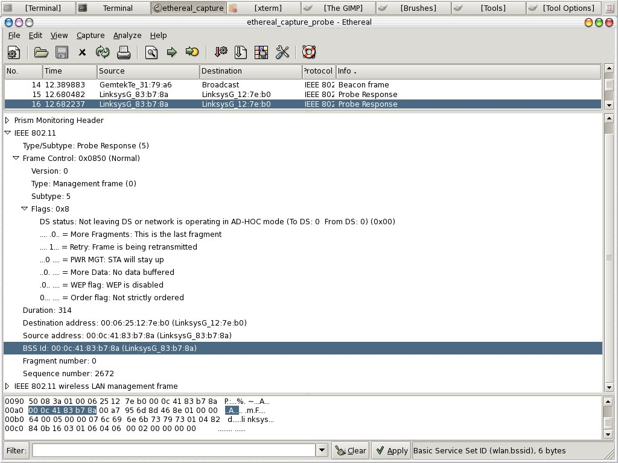
Notes:
This screen shot shows some of the information that can be obtained using Ethereal. Note that the MAC addresses of the client and the access point are visible.

Slide 25
Wireless Security - Access
Isolation via LAN configurations
  Turn off DHCP and use non-standard IP range
    Makes it a little harder for a hacker to get onto your LAN
    Sniffers often reveal IP range and manual setting is simple
Notes:
Various methods can be employed to contain any wireless users to a specific portion of the LAN.
The extent to which you can contain users usually depends on the sophistication of your LAN hardware. Enterprise-level products typically offer virtual LANs, demilitarized zones or port blocking firewalls. SOHO products may offer some isolation between the wired and wireless portions, especially with third-party firmware.

Slide 26
Wireless Security - Access
  DMZ, subnet or VLAN
    Fences off the wireless portion from the wired LAN
    Complex and often expensive
  Netbios or firewall options
    Some routers allow the blocking of file sharing or ports/protocols between wireless and wired

Slide 27
Wireless Security - Access
802.1x – effectively, a wireless gate
  Authenticates users based on various credentials
  Requires hardware support and/or external server
  Requires a client (supplicant)
    Xsupplicant (OSS), Meetinghouse (Commercial)
  No data encryption
  A basis for WPA
Notes:
Nearly a dozen protocols exist in order to authenticate wireless (or wired or even dial-up) users. In the case of wireless, the access point must support 802.1x.
A central device such as a RADIUS server maintains the credentials of authorized users. The access point blocks access to any user until the credentials are verified by the network authentication server.
EAP-TLS and EAP-TTLS are among the most secure wireless setups available.

Slide 28
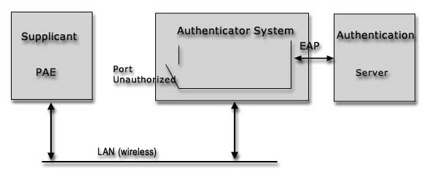
802.1x example
Notes:
A simple diagram of the functional blocks involved in 802.1x authentication, courtesy of Open1x.org.

Slide 29
Wireless Security - WPA
WiFi Protected Access
Combines 802.1x (access control) with WEP (encryption) and adds frequent key changes to dodge hacks that depend on large numbers of packets.
Other than dictionary attacks against WPA-PSK, no known vulnerabilities.
wpa_supplicant or XSupplicant required
Notes:
WPA is the wireless industry's response to the flaws in earlier implementations. By combining 802.1x and encryption and by frequently changing keys, WPA is not vulnerable to historic attacks.
WPA can be done locally with a pre-shared key between the client device and an access point or router or externally via a RADIUS server.
Weak pre-shared keys can be guessed using dictionary attacks (don't use “password” as your password). Otherwise, a WPA-based system is about as secure as a normal user can get.

Slide 30
Recap, by steps
Load the driver
Activate the interface
Set wireless parameters
Association
802.1x (if appropriate)
Set up TCP/IP
Surf
Notes:
Each of these steps is typically automated at the time of boot. While the specific location varies by distribution, a script or several scripts can be edited to make the right things happen in the right order.
/etc/init.d, /etc/rc.d, etc/pcmcia and /etc/sysconfig/network-scripts are good places to start and most or the relevant scripts are commented to help you figure out what to put where.

Slide 31
Resources and Links
Linux & Wireless LANs
Open1X.org
Unofficial 802.11 Security Web Page
AbsoluteValue Systems Adapter List
Linux wireless LAN support
DSLReports Wireless Networking Forum
Distro forums
Notes:
There are certainly too many good resources to list, but these should be a good start.
Real-time resources such as IRC channels or forums can be extremely helpful but can also be variable. Be persistent and patient. If you've done a little homework first, you'll usually get better results.

Slide 32
Resources and Links - 2
irc.freenode.net
  #ATU, #ndiswrapper, #hostap
WiFi Networking News
Manufacturer sites
  Cisco, Linksys, ZyXEL
LUGs

Slide 33
Questions?

