Slide 1

Java Parallel Processing Framework
Open Source Grid Computing Platform For Java
Laurent Cohen,
JPPF Founder

Slide 2
Agenda
Overview of Grid Computing
What is JPPF
Architecture
JPPF in your code
JPPF Components
JPPF Integrations
The project
The vision
Q&A

Slide 3
Overview of Grid Computing
Federate resources across organizations boundaries
  compute appliances, storage, memory, devices, services
Two sorts of Grid
  data grid
  compute grid
Heterogeneous resources
Virtualization of accessible resources
Applications
  3D rendering, AI, automated trading, data mining, ETL, scientific research, etc... It's a long list!

Slide 4
What is JPPF?
Computational grid platform
  for embarassingly parallel problems
  parallel distributed processing to speed-up computations
Focused on ease of use
  easy to install
  easy to use
Written in Java
  portability across platforms
Scales from local to hundreds of nodes
Open source licensing: Apache 2.0

Slide 5
JPPF Features
Deploy once, run anywhere
Easy and fast setup
  It doesn't take days to run a “Hello World”
  auto discovery without configuration
Abstracts the complexity of parallel programming
  Focus on your business / domain area
Highly scalable, distributed framework
  for small and large networks
Fine-grained monitoring and administration

Slide 6
JPPF Features
Fault-tolerance and self-repair capabilities
Integration with J2EE application servers
  empowerment of J2EE for large computations
Data grid integration - GigaSpaces
Multiple compute nodes deployment choices
  standalone, Windows service, Unix daemon, screen saver
Many configuration options
  topology, security, routing/dispatching, connectivity

Slide 7
Architecture - topology
Simple
Complex
Nodes
Nodes
Nodes
JPPF
Server
JPPF
Server
JPPF
Server
client
client
client
client
client
client
client
JPPF
Server
client
Nodes
Network / Organization boundary
JPPF
Server
client
client
Nodes

Slide 8
Architecture - components
Application
Client
Submit
JPPF Client
Return
results
Read request
Send response
Task Set
Tasks queue (FIFO)
Driver
. . .
Task Set
Task Bundler
Notify completion
Send for execution
Receive results
Decode
Execute
Send
results
Node
JPPF Node

Slide 9
Architecture – deployment-free
Where classes are loaded from
JPPF
Node
Node bootstrap
APIs
JPPF Server
JPPF
common
APIs
JPPF
Client
Application
libraries
3rd party
libraries
JPPF client
APIs

Slide 10
Architecture – distributed class loading
Application
Classes
Application
Classes
Clients
Classloader
delegate
. . .
Classloader
delegate
Class
provider
. . .
Class
provider
JPPF
classes
Server
JPPF Classloader
JPPF
classloader
. . .
JPPF
classloader
JPPF
classloader
. . .
JPPF
classloader
JPPF Classloader
. . .
JPPF Classloader
Nodes
Bootstrap
classes
Bootstrap
classes

Slide 11
JPPF in your code
JPPF Task
public class HelloWord extends JPPFTask
{
public void run()
{
String hello = "Hello, world";
System.out.println(hello);
this.setResult(hello);
}
}
JPPF-annotated Class
public class HelloWorld2
{
@JPPFRunnable
public String helloMethod(String message, int n)
{
String hello =
"Hello, world: " + message + ", " + n;
System.out.println(hello);
return hello;
}
}

Slide 12
JPPF in your code
POJO Task
public class MyHelloWord implements Serializable
{
public String myMethod(String message, int n)
{
String hello =
"Hello, world: " + message + ", " + n;
System.out.println(hello);
return hello;
}
}
Special cases
  Automatic recognition of:
    classes implementing Runnable
    classes implementing Callable<E>

Slide 13
JPPF in your code
Executing the tasks
public static void main(String...args)
{
JPPFClient jppfClient = null;
List<JPPFTask> results = null;
try
{
jppfClient = new JPPFClient();
JPPFJob job = new JPPFJob();
job.addTask(new HelloWorld());
job.addTask(new HelloWorld2(), "Hello Message", 10);
job.addTask("myMethod", new MyHelloWorld(), "Hello", 11);
results = jppfClient.submit(job);
}
catch(Exception e) { // ... process errors ... }
finally
{
if (jppfClient != null) jppfClient.close();
}
// ... process results ...
}

Slide 14
JPPF components: client
The client submits tasks and gets the results
Multiple deployment modes
  Standalone client, JCA Connector, Tomcat port
Connects to multiple servers
  connection pooling
  failover strategies
Local and Remote execution
  ideal for testing locally
  can be local, remote, or both
Automatic reconnection to the server(s)

Slide 15
JPPF components: client
Example client configuration
# List of drivers this client may connect to
jppf.drivers = quad-core
# Host name, or ip address, of the host the JPPF driver is running on
quad-core.jppf.server.host = localhost
# port number for the class server that performs remote class loading
quad-core.class.server.port = 11111
# port number the clients / applications connect to
quad-core.app.server.port = 11112
# Priority given to the driver
quad-core.priority = 10
# Information to connect to JMX server
quad-core.jppf.management.host = localhost
quad-core.jppf.management.port = 11198
# Automatic recovery: number of seconds before the first reconnection attempt
reconnect.initial.delay = 1
# Automatic recovery: time after which the system stops trying to reconnect
reconnect.max.time = -1
# Automatic recovery: time between two connection attempts, in seconds
reconnect.interval = 1
Not needed anymore
Superseded by automatic discovery

Slide 16
JPPF components: admin console
Monitors and manages servers and nodes
Graphical, JMX-based interface
Configurable charting capabilities
Multi-servers, multi-nodes
Remote stop / restart
Remote configuration
  servers and nodes performance tuning
User inputs automatically persisted
Based on JPPF client API
  same capabilities

Slide 17
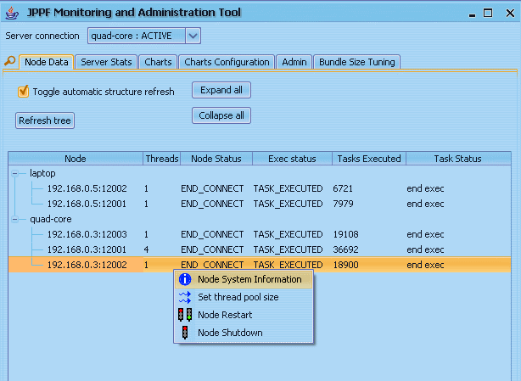
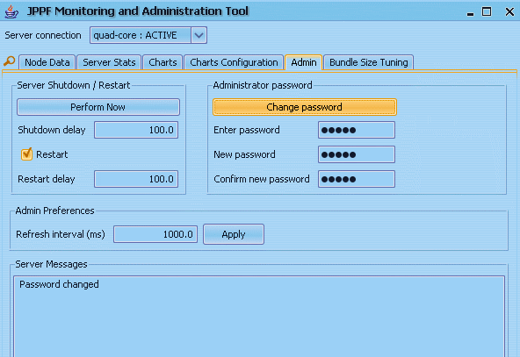
JPPF components: admin console

Slide 18
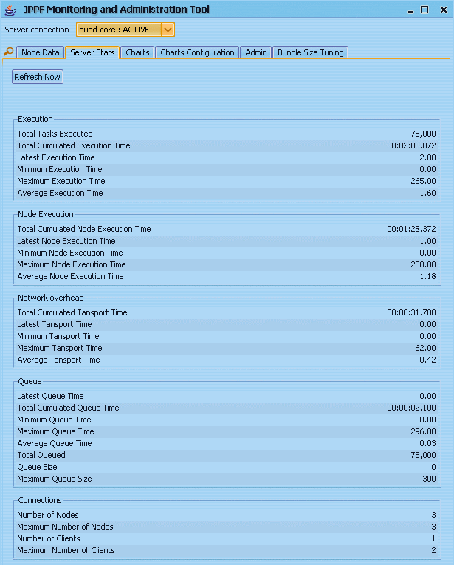
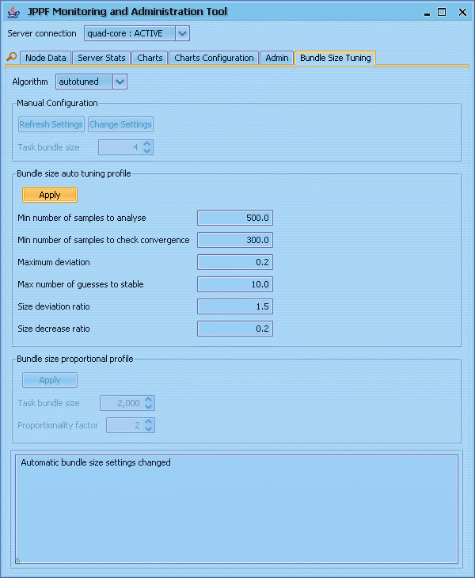
JPPF components: admin console

Slide 19
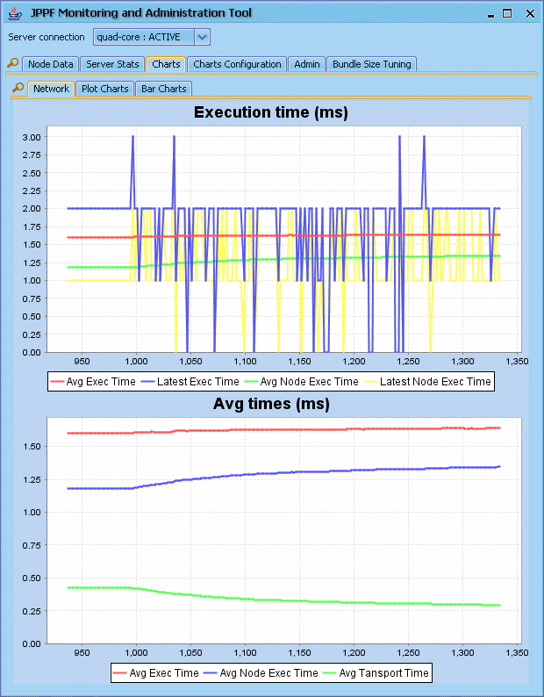
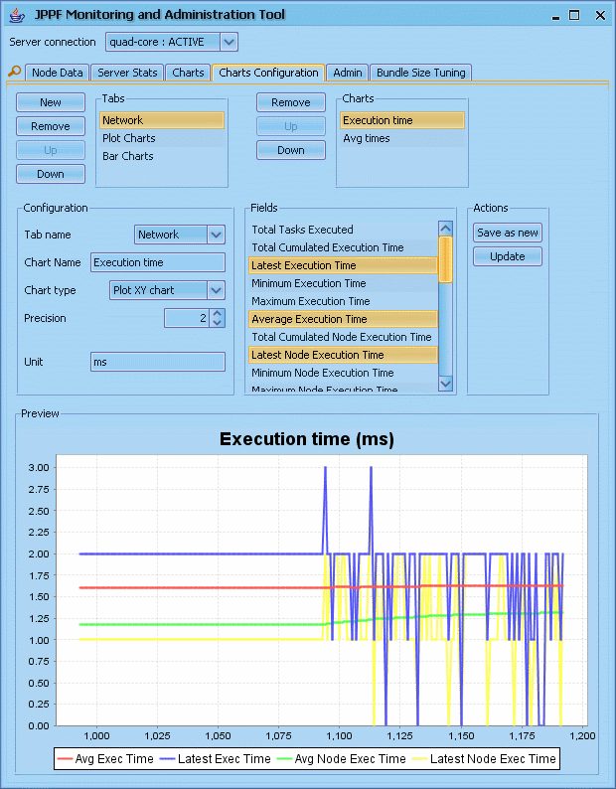
JPPF components: admin console

Slide 20
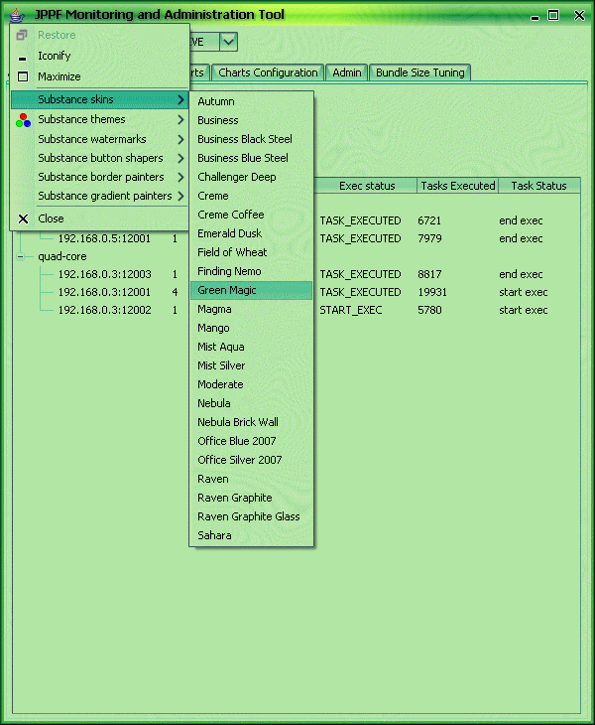
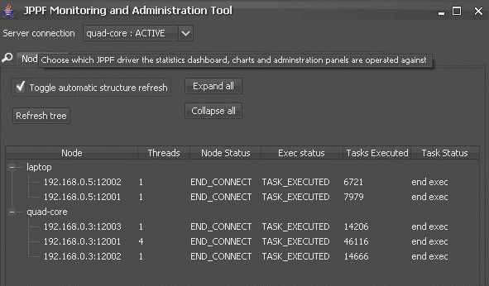
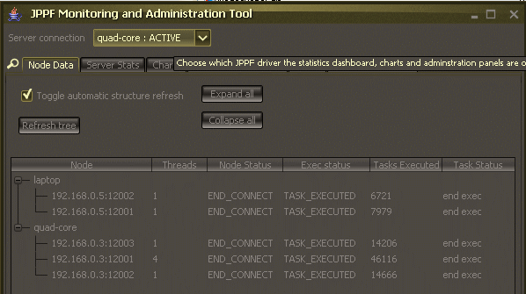
JPPF components: admin console

Slide 21
JPPF components: driver
The driver dispatches tasks to the nodes
Adaptive load-balancing
  multiple configurable algorithms
High throughput, highly scalable
  based on concurrent non-blocking I/O framework
Priority queue
Fault-tolerant
  node failure causes tasks to be resubmitted
Memory-aware
  large datasets automatically stored to disk

Slide 22
JPPF components: driver
Manageable, monitorable
  load-balancing parameters
  remote restart and shutdown
  active performance monitoring
Multiple drivers in P2P topology
  allows for expanded topologies
  gateways between JPPF networks
  joining of networks
  cycles automatically handled

Slide 23
JPPF components: driver
Example driver configuration
# port number for the class server that performs remote class loading
class.server.port = 11111
# port number the clients / applications connect to
app.server.port = 11112
# port number the nodes connect to
node.server.port = 11113
# Enabling JMX features
jppf.management.enabled = false
# JMX management
jppf.management.host = localhost
jppf.management.port = 11198
# Maximum memory, in megabytes, allocated to the JPPF driver
max.memory.option = 768
other.jvm.options = -server
# performance and load-balancing
task.bundle.size = 5
#task.bundle.strategy = manual | autotuned | proportional | rl
task.bundle.strategy = proportional
task.bundle.autotuned.strategy = test
strategy.test.performanceCacheSize = 2000
strategy.test.proportionalityFactor = 2
remote.debug.enabled = true
remote.debug.port = 8000

Slide 24
JPPF components: node
The node executes tasks dispatched by the driver
Multithreaded execution
  manageable
Security policy
  security constraints on what the client code can do
  downloadable from the driver
Dynamic remote class loading
  each client executes tasks in a separate container
  only bootstrap classes needed at startup
Multiple deployment modes
  standalone, Windows service, Unix daemon, screensaver

Slide 25
JPPF components: node
Self-repair and recovery mechanisms
Handles tasks management
  timeout, cancel, restart of active tasks
  tasks notifications through JMX
Manageable, monitorable
  processing threads
  remote shutdown and restart
  CPU time
  built on top of JVM MBean server

Slide 26
JPPF components: node
Example node configuration
# Host name, or ip address, of the host the JPPF driver is running on
jppf.server.host = localhost
# port number for the class server that performs remote class loading
class.server.port = 11111
# port number the clients / applications connect to
app.server.port = 11112
# port number the nodes connect to
node.server.port = 11113
# JMX features
jppf.management.enabled = false
jppf.management.host = localhost
jppf.management.port = 12001
# path to the security policy file. if not found, looked up on the server
jppf.policy.file = config/jppf.policy
# Automatic recovery
reconnect.initial.delay = 1
reconnect.max.time = 900
reconnect.interval = 1
# Processing Threads: number of threads running tasks in this node
processing.threads = 4
Not needed anymore
Superseded by automatic discovery

Slide 27
JPPF Components: TCP multiplexer
Multiplexer routes JPPF traffic through a single port
Workaround for firewalled environments
  enables used of authorized ports
JPPF components seen as if they were local
Optimized for JPPF network traffic
  based on the same high-troughput I/O framework
Currently prevents JMX features
  due to RMI-based JMX remote connector

Slide 28
JPPF Components: TCP multiplexer
multiplexer.ports = 443
Client Host
Server Host
11111
Multiplexer
Multiplexer
11111
JPPF
Server
JPPF
Client
Multiplexer
port (443)
11112
11112
11113
Multiplexer
port (443)
Node Host
remote.multiplexers = m1
remote.multiplexer.m1 = ServerHost:443
bound.ports = 11111 11112
mapping.11111 = m1
mapping.11112 = m1
Multiplexer
11111
JPPF
Node
11113
remote.multiplexers = m1
remote.multiplexer.m1 = ServerHost:443
bound.ports = 11111 11113
mapping.11111 = m1
mapping.11113 = m1

Slide 29
JPPF Integrations: J2EE
Seamless integration of the JPPF client
  JCA 1.5 resource adaptor
Tested with leading application servers
  JBoss, Sun AS, OC4J, Weblogic, Websphere
  can be easily ported to others
Effectively grid-enables enterprise applications
  delegates intensive computations to the Grid
Uses ootb JPPF infrastructure
  connector is seen as any other JPPF client

Slide 30
JPPF Integrations: J2EE
Application Server
Enterprise
Application
Enterprise
Application
JPPF Resource
Adapter
Standalone
client
JPPF
Server
Nodes

Slide 31
JPPF Integrations: GigaSpaces
Data Grid + Compute Grid = Power
Handle large, distributed datasets
Transaction management
Replication
Security
Clustering
Interoperability

Slide 32
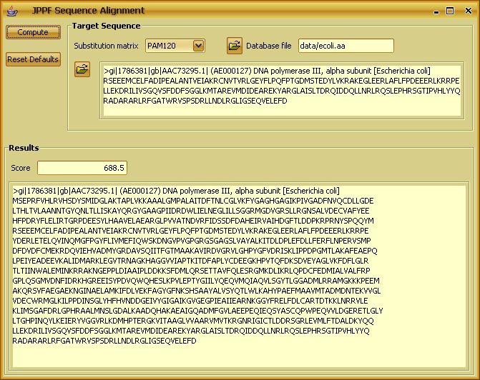
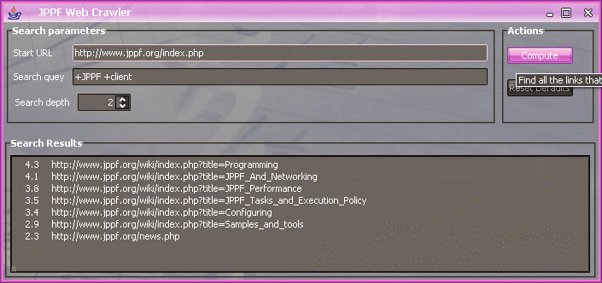
JPPF integrations: JAligner
JAligner: protein sequence alignment
Web crawler + Apache Lucene search engine

Slide 33
Currently in the works
ETL (Talend) integration
Hadoop / Map Reduce integration
Workflow / BPM integration
Plugin framework at the node and server level
  Extension through user-defined plugins
  Features adapted to specific environments / infrastructure
  e.g. DB access, inter-node communications, encryption, etc.
Grid management automation
  Automate how JPPF reacts to various events
  Grow or shrink the grid when needed
  Reports, alerts
  Etc...

Slide 34
The project
Project hosted on SourceForge.net
  features, bugs, CVS, release management
Web site on private hosting service
  front-end to the world
  user forums
  online documentation
Support is key for happy users
  a great source of feedback from users
  generates feature ideas
  improve quality through bug reports
  works when appropriate responsiveness is demonstrated

Slide 35
The project
Spreading the word
  press releases, announcements
  TSS, InfoQ, FreshMeat, JavaLobby, etc...
  JPPF blog
  Conferences, lectures
JPPF Team
  3 active members, incl. 1 active developer
Licensing: Apache 2.0
  business and academia-friendly

Slide 36
The vision
JPPF aims at being a reference in the Grid World
  no other offers its ease of use
Making grid technology accessible to all
Spreading in enterprise and scientific worlds
Inspiring talented developers
  growing the JPPF team
Our core values:
  Integrity
  Passion for the work
  Responsibility to our users and communities

Slide 37
The vision
Making a difference in the world
  easy, low-cost availability of large computing power
  for research labs, universities, individuals, small and large corporations
Inspiring by example
  user-oriented project
  small team
  completeness and diversity of the work
  professional-level open-source
  it is tough, but anyone can do it!

Slide 38
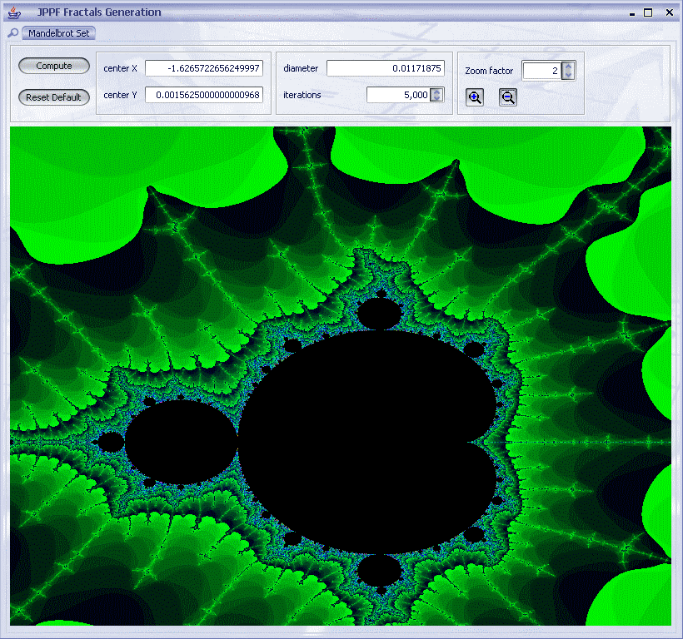
Demos

Slide 39
Q&A
Thank You!

