Slide 1
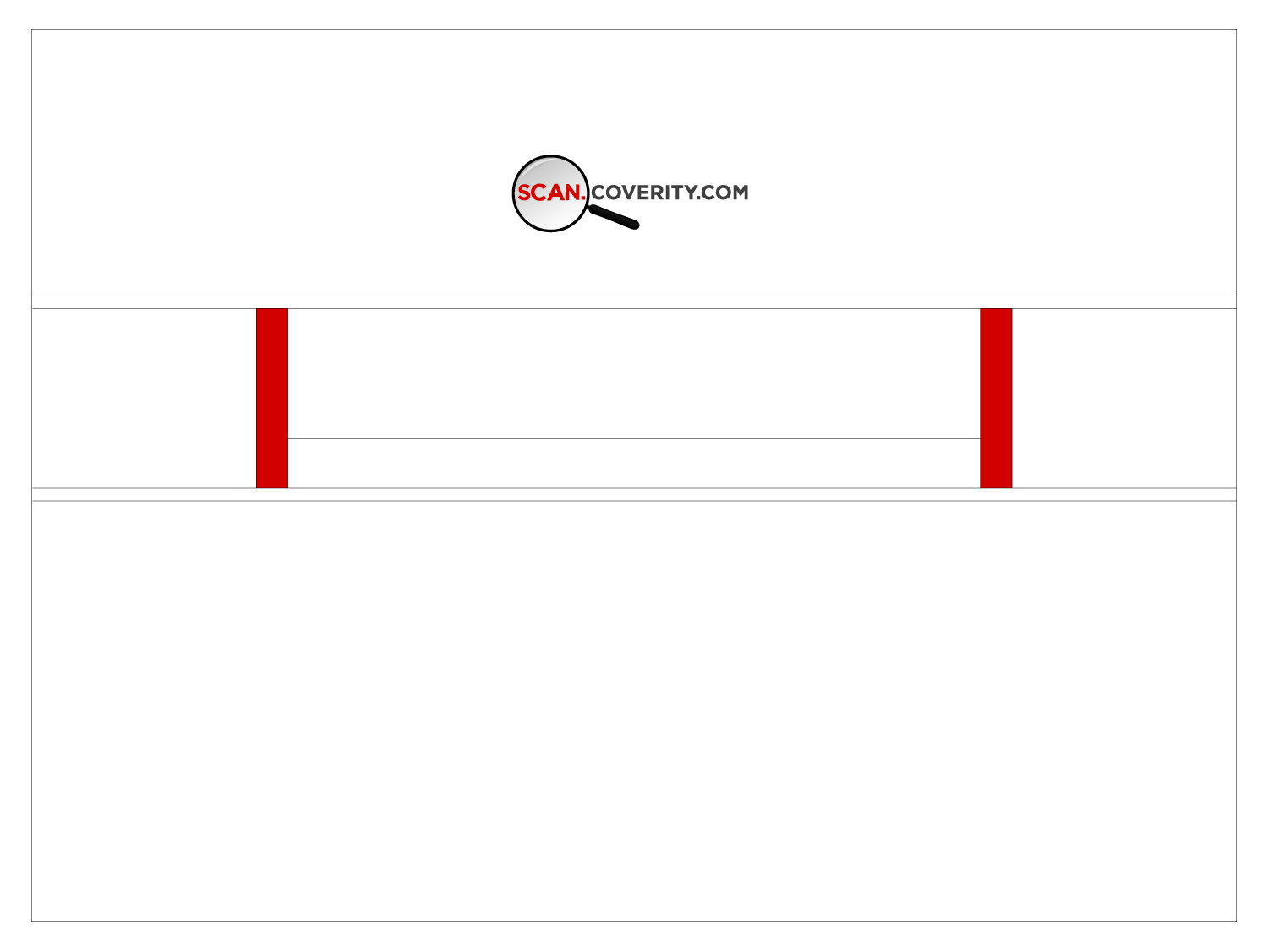
Analyzing Open Source Code
February, 2009
David Maxwell
Open Source Strategist
For
Southern California Linux Expo

Slide 2
Agenda
Background on the Scan
Open Source Report 2008
Self-Builds
Rung 3
Architectural Analysis + Architecture Library
Summary

Slide 3
Background on the Scan 1/2
Coverity Prevent is a static code analysis tool that does
  Path Simulation
  Data Flow Analysis
  False Path Pruning
By understanding the control flow of code, and the data flow, contradictions can be identified
  Memory freed, then used as if not freed
  Lock request issued, while already holding same lock, or a contrary lock
  Function can return an edge-case value (negative, or NULL) and calling function uses return value unsafely, without checking first
  Multiplication performed, but inputs lead to arithmetic overflow

Slide 4
A False Path
char buf[8];
if (a)‏
a
!a
b = new char [5];
if (a && b)‏
a && b
!(a && b)‏
buf[8] = a;
delete [] b;
*b = ‘x’;
*a = *b;
END

Slide 5
Background on the Scan 2/2
Under contract for US Dept. Homeland Security
  Cyber Security Open Source Hardening Project
Analyze Open Source codebases
  Static Analysis finds Quality and Security issues
  Provide access to the Open Source developers
  Developers fix identified issues
Codebases become more resistant to attack, more stable, more reliable
  Over 8,500 defects fixed, since project launch, March 2006

Slide 6
Open Source Hardening
How: scan.coverity.com
  Website and Service launched March 2006
  Open-source developers register their project
  Coverity automatically downloads and runs Prevent over it
  Developers get logins to the same defect manager interface customers use
    Coverity runs it as a service for the open source developers

Slide 7
Who is David Maxwell ?
Coverity's Open Source Strategist
Hired to maintain and coordinate Coverity's efforts on behalf of D.H.S.
Open Source developer on NetBSD operating system
  Software and network security specialist
  NetBSD Security Officer 2001-2006
  Over 24 year background in programming, network design, and operating systems

Slide 8
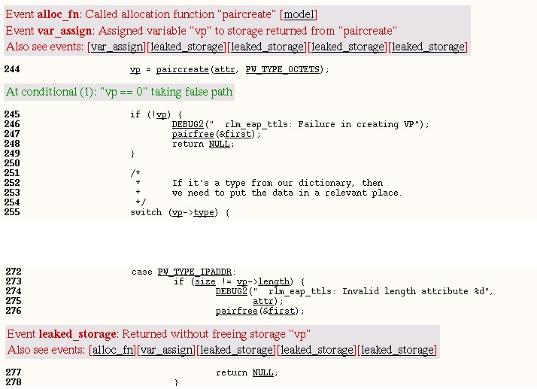
How is Open Source relevant to Homeland Security ?

Slide 9
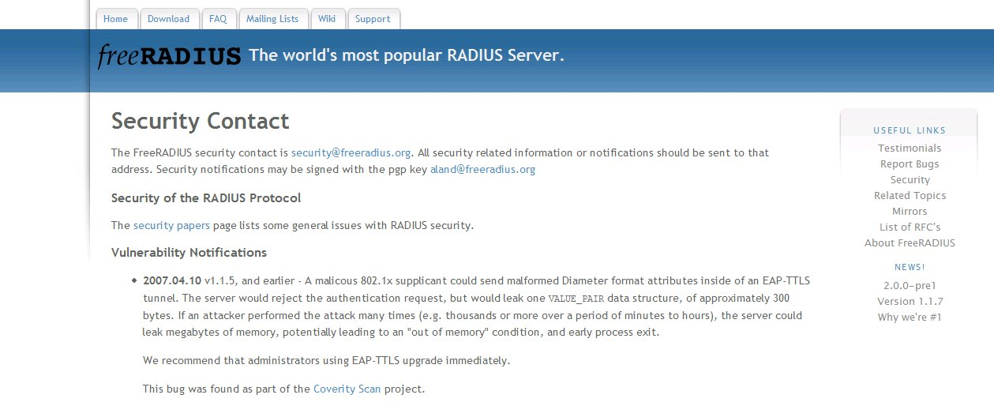
How is Open Source relevant to Homeland Security ?

Slide 10
Report on Open Source Software 2008
Original Scan/Coverity research
Based on the analysis of
  Over 55 million lines of code
  From more than 250 open source projects
  Representing 14,238 individual project analysis runs
  Totaling nearly 10 billion lines of code analyzed
All analysis performed with the same tools and configuration
  Scan Benchmark 2006
Let's Reconsider some common beliefs about good coding practices...

Slide 11
Function Length
What makes a function ‘long’?
  A single, sequential set of operations
    Are those operations common elsewhere in the code?
  A large switch statement
    Protocol decoding is a common example
  A function with many different code paths
    Conditional execution – lots of if() statements
Average function lengths in the Scan database ranged from
  Low of 14 lines
  High of 345 lines
  The longest average is almost 25x the shortest average

Slide 12
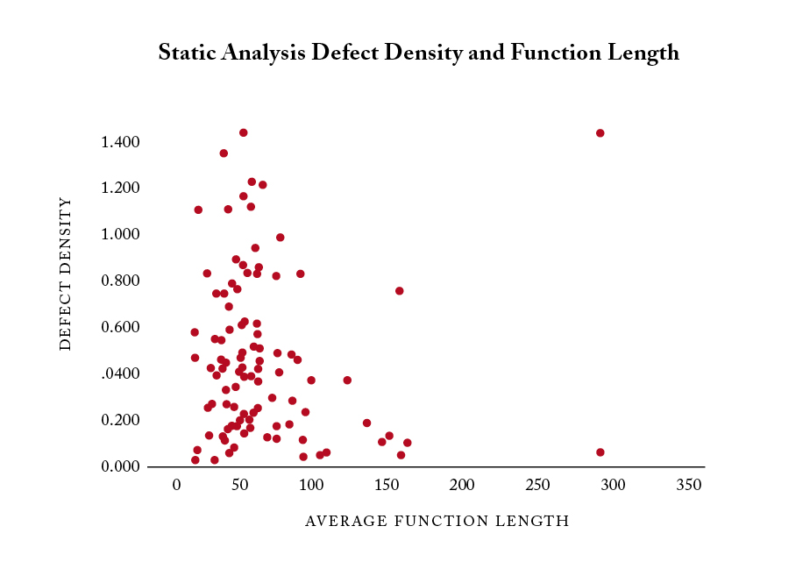
Defect Density/Function Length

Slide 13
Defect Count or Defect Density
Defect Counts
  Absolute number of defects identified in a particular piece of code
    314 defects in a particular codebase
Defect Density will be referred to many times during this session
  Number of defects per 1,000 lines of code
    1.0 = 1 defect in 1,000 lines of code
    0.5 = 1 defect in 2,000 lines of code

Slide 14
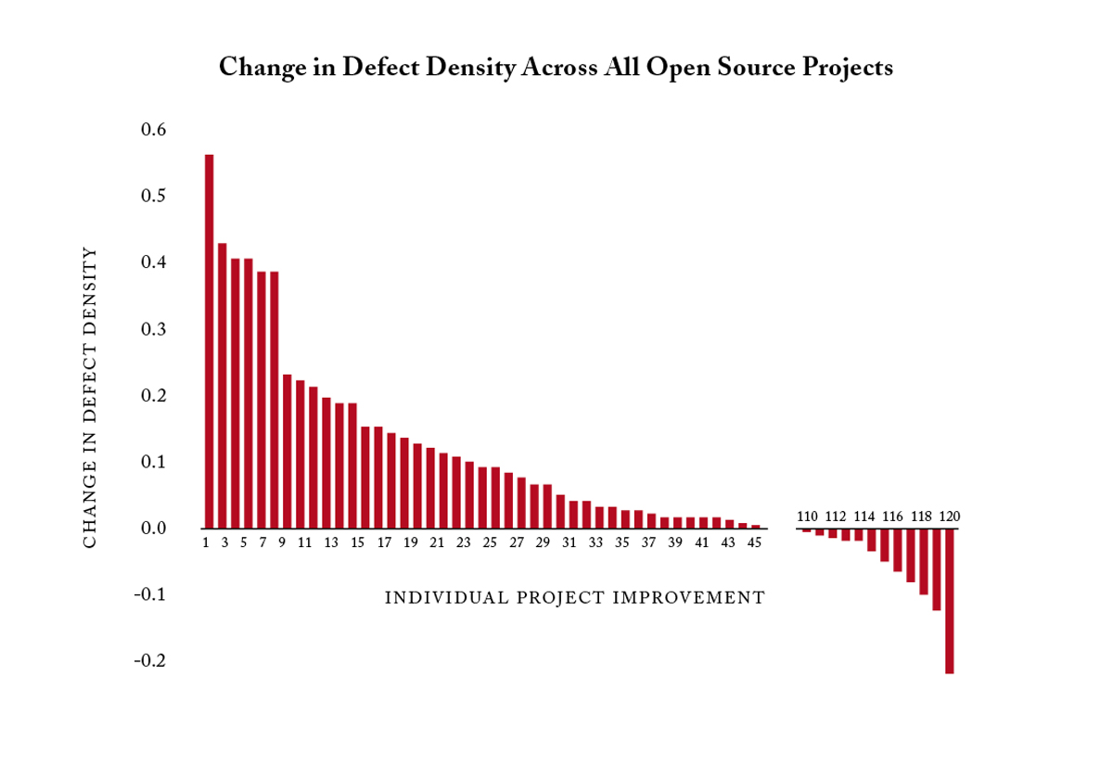
Overall Project Progress

Slide 15
Frequency of Defects
Defect Type
# of Defects
Percentage
NULL Pointer Dereference
6,448
27.95%
Resource Leak
5,852
25.73%
Unintentional Ignored Expressions
2,252
9.76%
Use Before Test (NULL)‏
1,867
8.09%
Buffer Overrun (statically allocated)‏
1,417
6.14%
Use After Free
1,491
6.46%
Unsafe use of Returned NULL
1,349
5.85%
Uninitialized Values Read
1,268
5.50%
Unsafe use of Returned Negative
859
3.72%
Type and Allocation Size Mismatch
144
0.62%
Buffer Overrun (dynamically allocated)‏
72
0.31%
Use Before Test (negative)‏
49
0.21%

Slide 16
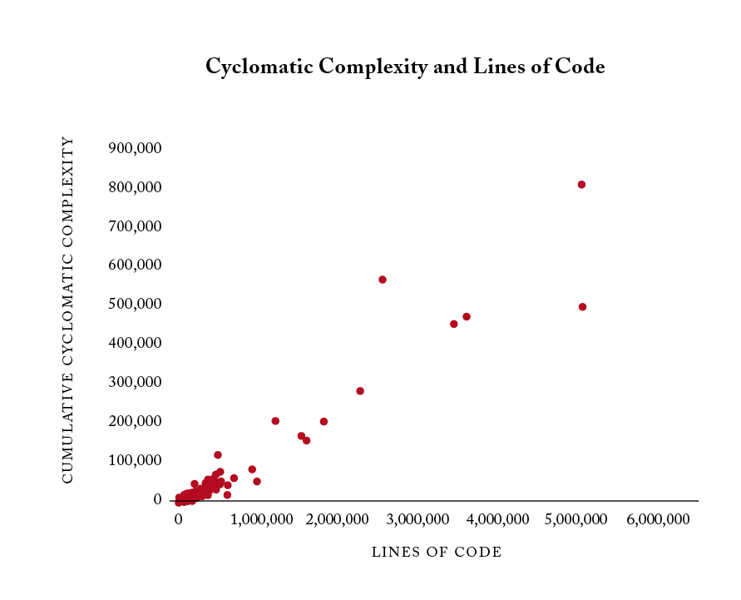
Cyclomatic Complexity/Lines of Code

Slide 17
Additional References
Gartner
  Jim Duggan & Mark Driver
Forrester Research
  Jeffrey Hammond
IDC
  Melinda Ballou
Voke
  Theresa Lanowitz

Slide 18
Summary Findings
Open source benefits from static analysis
  Overall defect density dropped 16% over the past two years
Prevalence of individual defect types
  There is a clear distinction between common and uncommon defect types across open source projects
  Defect frequency may directly relate to frequency of types of operations
False positives identified to date are a reasonably small percentage of results
  Currently below 14%

Slide 19
DHS Contract Expiry
Three year contract is over

Slide 20
DHS Contract Expiry
Three year contract is over
Scan will continue, and continue to grow...
  Sponsored by Coverity, and partners
Starting with the following 3 initiatives:

Slide 21
Self-Builds
Coverity's Analysis requires code be compiled
  Coverity has been managing builds for all Open Source projects in the Scan
    Changing version control systems
    Changing library dependencies
    Changing compiler dependencies
    Changing Environment dependencies
Creates a bottleneck on Scan staff time
Released to current Scan projects in Nov 2008
  Projects can now do their own builds, and submit them for analysis

Slide 22
Self-Builds
Coverity's Analysis requires code be compiled
  Coverity has been managing builds for all Open Source projects in the Scan
    Changing version control systems
    Changing library dependencies
    Changing compiler dependencies
    Changing Environment dependencies
Creates a bottleneck on Scan staff time
Released to current Scan projects in Nov 2008
  Projects can now do their own builds, and submit them for analysis
Will be opened to new projects in the near future
Coverity's Analysis requires code be compiled
  Coverity has been managing builds for all Open Source projects in the Scan
    Changing version control systems
    Changing library dependencies
    Changing compiler dependencies
    Changing Environment dependencies
Creates a bottleneck on Scan staff time
Released to current Scan projects in Nov 2008
  Projects can now do their own builds, and submit them for analysis
Coverity's Analysis requires code be compiled
  Coverity has been managing builds for all Open Source projects in the Scan
    Changing version control systems
    Changing library dependencies
    Changing compiler dependencies
    Changing Environment dependencies
Creates a bottleneck on Scan staff time
Released to current Scan projects in Nov 2008
  Projects can now do their own builds, and submit them for analysis

Slide 23
Rung 3
Conceptual Scan Ladder
  Open Source projects progress as they resolve defects
Supports common analysis configuration on a given Rung
  Allows comparison and statistical analysis
Rung 2 was announced January 2008

Slide 24
Rung 3
Conceptual Scan Ladder
  Open Source projects progress as they resolve defects
Supports common analysis configuration on a given Rung
  Allows comparison and statistical analysis
Rung 2 was announced January 2008
Rung 3 to be announced soon
  New Prevent version 4.2
  More Security checkers
  Concurrency checkers
  Boolean Satisfiability for False Path Pruning

Slide 25
Architectural Analysis
Separate data, about high level architecture of code, not low level code defects
Collected by the same analysis mechanisms

Slide 26
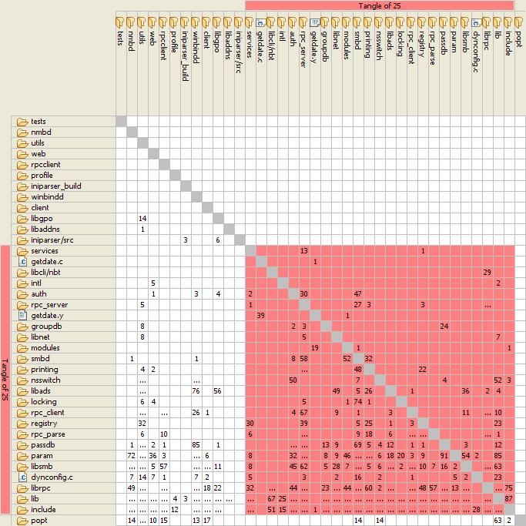

Architectural Analysis
Architectural Analysis

Slide 27
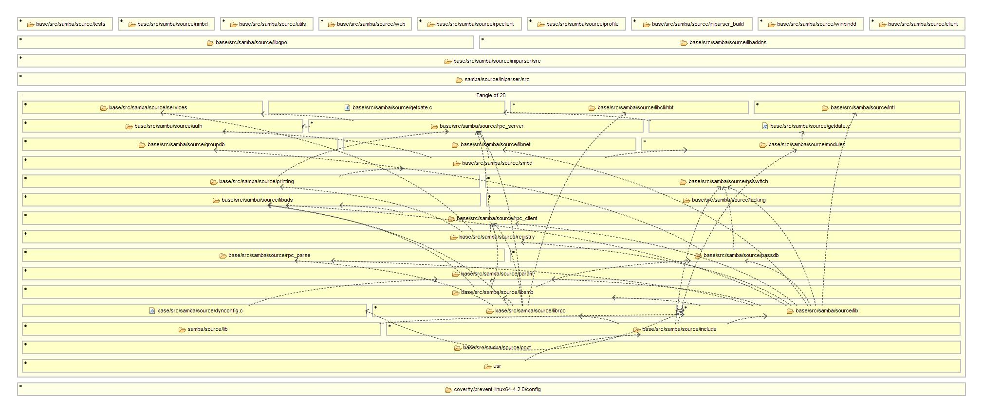
Architectural Analysis

Slide 28
Architectural Analysis
Will be available to Scan projects
  Starting with Rung 3

Slide 29
Q & A
Questions?

Slide 30

http://scan.coverity.com
http://scan.coverity.com/report/
David Maxwell
Open Source Strategist
dmaxwell@coverity.com

