Slide 1
THE CHANGING PATENT LANDSCAPE FOR FOSS
  Rob Tiller
  Vice President and Assistant General Counsel, IP
  Red Hat, Inc.
  rtiller@redhat.com
Red Hat
  World leader in open source software for the enterprise
  Red Hat Enterprise Linux and other open source products

Slide 2
Overview
The patent landscape for software
Understanding the patent system
How software patents proliferated
The practical effects of software patents
The Bilski decision
Possible changes

Slide 3
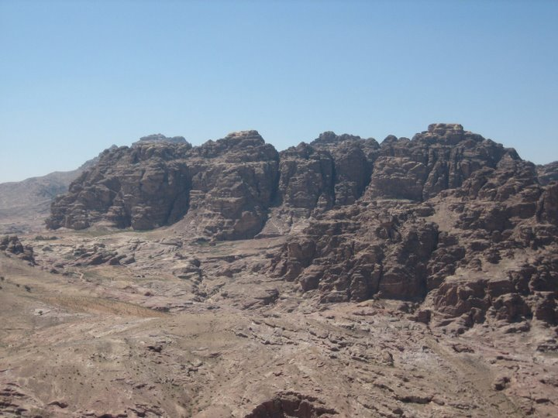
THE PATENT LANDSCAPE

Slide 4
The basic problem
Many poor quality patents
Many difficult-to-interpret patents
Patent boundaries are vague, and can even cover an invention the patent holder never conceived
Search methods unreliable
Difficult or impossible to know if code you have written could be covered by a patent

Slide 5
Risks -- patent litigation
Lawsuits are costly
  $3-5 million in attorneys fees
  Possibility of enormous damages
  Damages generally calculated based on the whole product, rather than the value of the patented invention that is only a part of the product
  Possibility of treble damages for willful infringement

Slide 6
Litigation costs can exceed profits from patents
Since 1994, U.S. litigation costs have substantially exceeded profits from patents in most industries
  Chemical and pharmaceutical firms are exceptions
  In other firms, Bessen and Meurer found that litigation costs in 1999 were about three times as much as patent profits
  Even outside the software area, there are deep problems with the patent system
But note – most firms are not sued
  Indirect litigation effects – defensive measures, anxiety

Slide 7

Understanding the Patent System

Slide 8

The objective of the U.S. patent system
Foster innovation
  U.S. Constitution, Art. 1, Sec. 8: “to promote the progress of Science and the useful Arts”
Inventor receives rewards – a period of monopoly rights
Society receives disclosure of invention

Slide 9
Patent protection in the U.S
Based on federal statute – U.S. Code Title 35
Issued by Patent and Trademark Office
Grant of rights:
  “the right to exclude others from making, using, offering for sale, or selling” the invention in the United States or “importing” the invention into the United States.
  Note: this is a right to exclude others – not the right to practice an invention
Patent term is for 20 years from filing of an application

Slide 10
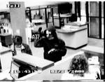
Patent infringement does not mean stealing someone else's idea
A common misunderstanding
An invention developed with no knowledge of a patent can still infringe a patent
An original invention can be the basis for a patent lawsuit

Slide 11
A footnote on copyright
Software generally is automatically protected by copyright
  Protection for “original works of authorship”
  Begins automatically when the work is fixed in a tangible medium of expression
  Rights held by author (or author's designee)
Copyright owner has the right to exclude others from distributing copies of the work, reproducing the work,or preparing derivative works
Protection lasts a very long time (e.g. 95 years for corporate works)
Protection is entirely separate from the patent system
FOSS licenses are grant copyright permissions

Slide 12
Basic requirements for patentability
Invention must be novel and non-obvious
  Novelty requirement – not covered by another patent, used by others or described in a printed publication anywhere in the world prior to the invention date
  Non-obviousness requirement – invention must be sufficiently different from prior art
    De minimis changes not enough

Slide 13
Four Types of Patentable Inventions
Process
  An act or series of acts that produces a result. (Gottschalk v. Benson)
Machine
  A concrete thing consisting of parts or combinations of devices. (Burr v. Duryee)
Manufacture
  Production of articles from raw or prepared materials. (Chakrabarty)
Composition of matter
  Compositions of two or more substances. (Chakrabarty)

Slide 14

Excluded Subject Matter
Laws of nature
Natural phenomena
Abstract ideas
Mental processes
Mathematical formulas
  These areas viewed as “basic tools of scientific technological work.” (Benson case)

Slide 15
Where does software fit in?
It may be a process that is useful, novel, and non-obvious
When it satisfies those criteria, it is eligible for patenting – unless it falls within one of the categories of excluded subject matter, such as abstract ideas, mental processes, and mathematical formulas

Slide 16
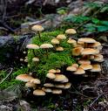
PROLIFERATION OF SOFTWARE PATENTS, AND ITS CONSEQUENCES

Slide 17
History of software patents
Software generally thought to be unpatentable in the early 1980s (pre-Diamond v. Diehr)
Most software companies and most software developers opposed software patents at least into the 1990s
Federal Circuit case law held software to be patentable in the mid -1990s
Large firms (e.g. IBM, Microsoft) began aggressively seeking patents
More than 200,000 software patents today
Microsoft got its 10,000th patent in February 2009

Slide 18
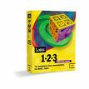


Do patents promote innovation in software?
Most of the important enterprise software in wide use today rests on ideas that pre-date the explosion of software patents in the 1990s.
  Lotus 1-2-3 released in 1982
  Microsoft Word released in 1983
  Oracle version 3 released in 1983
  Windows 3.0 released in 1990

Slide 19

More history – FOSS software
GNU C compiler released in 1984
Perl released in 1987
Linux released in 1991
Apache web server released in 1995
Mozilla Firefox 1.0 released 2004
Thousands more
Open source projects now expanding exponentially
  Doubling every 14 months

Slide 20
Innovation can happen without patents. Do patents ever hinder innovation?
Patents prevent others from using an idea without a license
  Patentee can hold up further development in an area
Patents may affect different industries differently
  Innovation in software is different from innovation in shoes
  New developments tend to rest on prior developments

Slide 21
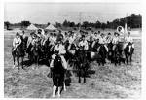
Bilski – the cavalry to the rescue (maybe)

Slide 22
The significance of Bilski
The CAFC signaled the possibility of a major change in the law
Court decided to review the matter en banc
Court invited amicus curiae briefs on the issue of what is patentable subject matter
Dozens of amici submitted briefs

Slide 23
Bilski background
U.S. Patent No. 08/833,892
Claims covered a method of hedging risk in commodities trading
  Note – not framed as a software claim, but rather as a business method
CAFC considered whether claims fell with the patent eligible subject matter areas of 35 U.S.C. Sec. 101 (processes, machines, manufactures, and compositions of matter)
“True issue” -- whether Bilski was trying to claim “a fundamental principle (such as an abstract idea) or a mental process”

Slide 24
Bilski decision has several parts
Majority opinion by Chief Judge Michel, joined by eight other judges.
  This opinion contains the controlling law
Concurring opinion of Judge Dyk, joined by one other
Dissenting opinion of Judge Newman
Dissenting opinion by judge Mayer
Dissenting opinion by Judge Rader

Slide 25
Majority opinion
Opinion reviews prior Supreme Court cases with care
  Diamond v. Diehr (1981), Parker v. Flook (1978), Gottschalk v. Benson (1972)
  Poses question – whether patent “recites a fundamental principle and, if so, whether it would pre-empt substantially all uses of that fundamental principle if allowed.”

Slide 26
The preemption theory of the Bilski majority
Apparent concern that overly broad patent protection could inhibit innovation
According to CAFC, patent claims should be narrowly tailored to take on only a particular application of a principle – not the principle itself
Use of a machine or a transformation “must impose meaningful limits on the claim's scope to impart patent-eligibility”

Slide 27
The Bilski test
To determine whether a process claim is tailored to encompass only a particular application of a fundamental principle
Process must be
  Tied to a particular machine or apparatus or
  Transform a particular article into a different state or thing
Process must constitute more than mere “insignificant postsolution activity”

Slide 28
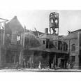
Prior case law gutted
Freeman-Walter-Abele test rejected
Useful, concrete, and tangible result test from Alappat and State Street cases rejected
Both tests replaced with the machine-or-transformation test

Slide 29
Statements regarding the software patent issue
“We decline to adopt a broad exclusion over software or any other category of subject matter beyond the exclusion of claims drawn to fundamental principles set forth by the Supreme Court.” Footnote 23
  The Bilski claim did not involve software so “the facts here would be largely unhelpful in illuminating the distinctions between those software claims that are patent-eligible and those that are not.”
“We leave to future cases the elaboration of the precise contours of machine implementation, as well as the answers to particular questions, such as whether or when recitation of a computer suffices to tie a process claim to a particular machine.”

Slide 30
What is meant by “tied to a specific machine”?
A key question for software patents
It must mean more than just using a general purpose computer
Benson example: algorithm “had no utility other than operating on a digital computer.”
  Therefore “all uses of the algorithm were . . . covered by the claim” -- which meant it was a fundamental principle
  In other words, a fundamental principle is defined based on the possibility it can be applied in various contexts
  A claim “tied to a particular machine . . . does not pre-empt all uses of a fundamental principle in any field but rather is limited to a particular use, a specific application.”

Slide 31
The rest of Bilski (128 pages total)
Majority – 32 pages.
Dyk and Linn concurring (20 pages) – history of the Patent Act of 1793 and its English precedents supports the result
Newman dissenting (41 pages) – disputes majority's interpretation of prior cases and worries that this decision will remove incentives to innovate
Mayer dissenting (25 pages) – thinks the majority didn't go far enough, and states he would overrule prior decisions in State Street Bank and AT&T. Discusses the problems of business method patents.
Rader dissenting (10 pages) –thinks Bilski's invention was unpatentable based on its being an abstract idea, but does not agree with the CAFC's new test

Slide 32
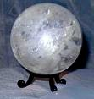
WHAT COMES NEXT?

Slide 33
A measured approach
Bilski Court left to future cases the determination of cases not directly before it.
  This is consistent with traditional jurisprudential theory
But the logic of the majority opinion suggests the possibility the the subject matter requirement of Section 101 may exclude many software patents
Future cases will address this issue

Slide 34
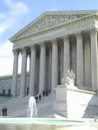
Possible Supreme Court review
Petition for certiorari (discretionary review) filed
Few such petitions are granted
But the Court has shown an interest in the patent area in recent years
Possibly the Court will decline review and let the lower courts experiment with the new standard

Slide 35
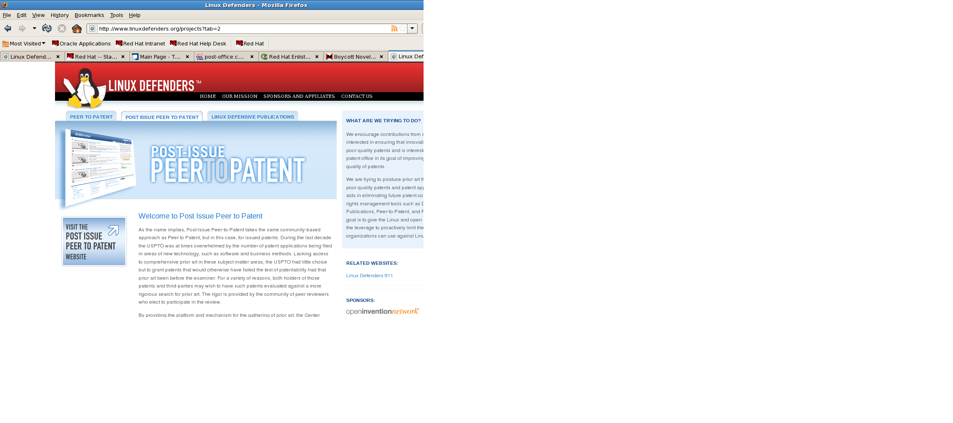
In the meantime – what is to be done
Possible community activity to address bad patents
  Linux Defender
  Defensive publications
  Reexaminations

Slide 36
Other possible incremental improvements
Discourage obvious patents by improved examinations
Improvements in search methods
Shorten patent period for software patents
Require filing of source code with software patents
Independent invention defense
Prior use defense
Higher burden for willful infringement claims
Clearer damages rules

Slide 37
Possible legislation and education
Congress considered legislation with incremental reforms last session
  Reforms on damages apportionment, reexamination procedures, willfulness, venue
  Likely that bill will be reintroduced this year
  Need to educate the public on the problems that the existing system poses for software – which means it's a problem for everybody

Slide 38
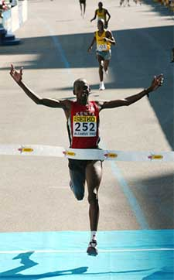
We made it! Thanks. Questions?

