Slide 1
Mozilla @
SCALE 2009
Christopher Blizzard
February 21st, 2009

Slide 2

O HAI

Slide 3
I was here last year.

Slide 4
What's changed since then?

Slide 5
Shipped Firefox 3.

Slide 6
More competition and
development.

Slide 7
Went from 2,000 extensions
to 6,000.

Slide 8
Went from 300,000,000 extension
downloads to 1,000,000,000.

Slide 9
Went from less than
30% market share in
Europe to more than 40%.

Slide 10
Added another 60M users.

Slide 11
Now the majority browser
in several countries.*
* Indonesia, Macedonia, Slovenia and Poland

Slide 12
Getting ready to ship
Firefox 3.1.

Slide 13
Firefox 3.1
Big on web development features
Private browsing
Awesomebar privacy
TraceMonkey

Slide 14
Firefox 3.1 is an upgrade
for the web.

Slide 15
Let's look at some of the
new stuff that's in it.

Slide 16
Native JSON
Tested speedups on real-world pages of about 3x
var jsonString = '{"name":"Ryan", "address":"Mountain View, CA"}';
var person = JSON.parse(jsonString);
// 'person' is now a JavaScript object with
// 2 properties; name and address
var personString = JSON.stringify(person);
// 'personString' now holds the string
// '{"name":"Ryan", "address":"Mountain View, CA"}'

Slide 17
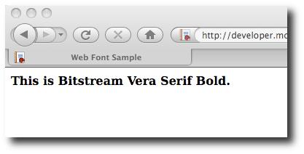
@font-face support
<style type="text/css" media="screen, print">
@font-face {
font-family: "Bitstream Vera Serif Bold";
src: url("http://yourserver.com/VeraSeBd.ttf");
}
body { font-family: "Bitstream Vera Serif Bold", serif }
</style>

Slide 18
DNS pre-fetching.

Slide 19
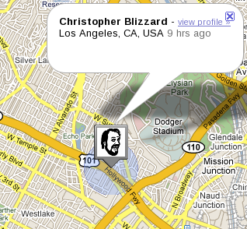
Geolocation Backend

Slide 20
Speculative Script
Parsing.

Slide 21
<video> and <audio>
Support for OGG Theora and OGG Vorbis
Support for .wav
Vorbis higher quality than MP3
Post-1.0 encoder on par with mpeg4
For lower-quality videos
HD-quality will require Dirac or post-Theora

Slide 22
[ Demo ]

Slide 23
Worker Threads
Spawn OS-threads to run JavaScript
Avoids window freezing
Simple communication methods with main thread
  postMessage(), onmessage and onerror
Has XMLHttpRequest Access, timeouts

Slide 24
Creating a Worker
var worker = new Worker("fibonacci.js");
worker.onmessage = function(event) {
document.getElementById("result").textContent = event.data;
dump("Got: " + event.data + "\n");
};
worker.onerror = function(event) {
dump("Worker error: " + event.data + "\n");
throw event.data;
};
worker.postMessage("5");

Slide 25
Inside a Worker
var results = [];
function resultReceiver(event) {
results.push(parseInt(event.data));
if (results.length == 2) {
postMessage(results[0] + results[1]);
}
}
function errorReceiver(event) {
throw event.data;
}
onmessage = function(event) {
var n = parseInt(event.data);
if (n == 0 || n == 1) {
postMessage(n);
return;
}
for (var i = 1; i <= 2; i++) {
var worker = new Worker("fibonacci.js");
worker.onmessage = resultReceiver;
worker.onerror = errorReceiver;
worker.postMessage(n - i);
}
}

Slide 26
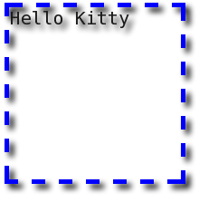
SVG Filters on Plain HTML
<html>
<head>
<style>
textarea {
filter:url(effects.xml#drop-shadow);
width:200px;
height:200px;
font-size:20px;
border:5px dashed blue;
background:transparent;
}
</style>
</head>
<body>
<textarea>Hello Kitty</textarea>
</body>
</html>

Slide 27
(What the SVG Looks Like)
<svg xmlns="http://www.w3.org/2000/svg">
<filter id="drop-shadow">
<feGaussianBlur in="SourceAlpha" stdDeviation="3"/>
<feOffset dx="5" dy="5"/>
<feBlend in="SourceGraphic" mode="normal"/>
</filter>
</svg>

Slide 28
[ Demo ]

Slide 29
XHR Cross-site Access Control
Allowing some simple cross-site XHR
Complex requests use pre-flighting with OPTIONS
Allows for sites to pick what you can access
Design to protect data, users and sites

Slide 30
XHR Progress Notification
Was there in Firefox 3 but wasn't well advertised
New calls use DOM Progress Events
var req = new XMLHttpRequest();
req.addEventListener("progress", updateProgress, false);
req.addEventListener("load", transferComplete, false);
req.addEventListener("error", transferFailed, false);
req.addEventListener("abort", transferCanceled, false);
req.open();

Slide 31
Offline Caching for Web Apps
Uses a manifest file for what you should cache
Will load items from the cache instead of network
Nice for offline use
Simple to add to your html:
<html manifest="foo.manifest">
<h1>Entry</h1>
</html>

Slide 32
Upgrading the web.

Slide 33
Resources
Web Tech - https://developer.mozilla.org/web-tech/
Newsletter - https://wiki.mozilla.org/About:mozilla
Air Mozilla - http://air.mozilla.com
Firefox 3.1 for Developers - http://developer.mozilla.org/en/Firefox_3.1_for_developers
#devrel on irc.mozilla.org
mozilla.evangelism mailing list

Slide 34
Bonus Demos!

