Slide 1

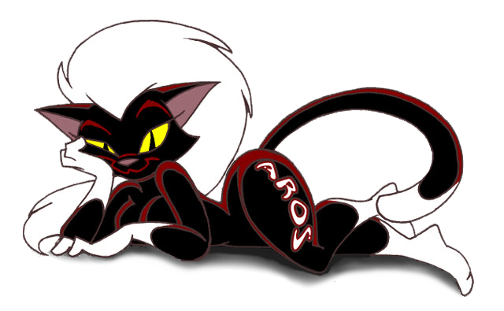
Introduction to

Slide 2
Introduction
The AROS Research Operating System is a lightweight, efficient and flexible desktop operating system, designed to help you make the most of your computer.
It's an independent, portable and free project, aiming at being compatible with AmigaOS 3.1 at the API level (like Wine, unlike UAE), while improving on it in many areas. The source code is available under an open source license, which allows anyone to freely improve upon it.

Slide 3
History of Amiga OSes
AmigaOS was the first pre-emptive multi-tasking operating system for the “Personal Computer” concept.
Launched in 1985 the Amiga 1000 sported the AmigaOS which unlike it’s 16-bit counterparts (IBM pc, Apple Mac and Atari st) was a true pre-emptive multi-tasking operating system taking advantage of the Custom Chip architecture.
Designed by the original Amiga Team (Carl Sassenrath, Dave Morse, R.J. Mical), it introduced a few novelties in the personal computer area which are now standard but were a novelty back then such as:
- system resource modularity
- shared library and device concept
- object oriented approach

Slide 4
History of Amiga OSes
Other features included:
- CLI/Shell and AmigaDOS script language which was
friendly and as powerful as the UNIX
counterparts at the time
- WIMP GUI user interface delivering true
control and multitasking feeling to the user.
- Dynamic screen allocation and easily switchable
allowing different applications to have it’s own
desktop space.
- Part of that was the Workbench which sported
memory usage and availability always on the desktop.
- friendly hierarchical file system and logical /
comprehensive OS directory structure (fonts / libs /…)‏

Slide 5
History of Amiga OSes
While the kernel and device drivers were implemented in assembly language the rest of the OS was plagued by the use of BCPL coding (TripOS contribution to Amiga OS). Later versions (2.x and above) were totally rewritten in C and assembler.
Another Amiga OS early handicap inherited by TripOS concepts was the non-memory-management approach (which delayed any form of memory protection over the years in Amiga OS).

Slide 6
History of Amiga OSes
The latest AmigaOS offering during the Commodore Amiga era was the 3.1 version in 1993 and offered a more stable and flexible OS that endured for many years and got different additions. This is regarded as the main fact that kept Amiga community active even after the Commodore demise. Among other, it sported the following features:
- Datatypes (file recognition, allowing to view share...)‏
- Amigaguide (Amiga own hypertext type language)‏
- Arexx script language
- Extended device and classes support
- (...)‏

Slide 7
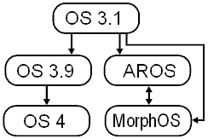
History of Amiga OSes
After that the AmigaOS itself had a very slow evolution, and other OS started to keep from where AmigaOS 3.1 left and providing a more modern update System Software for various systems (even for Classic Amigas). These are called the AmigaOS dev family tree (which includes AROS).
Another ones exist which base themselves on parts of the AmigaOS philosophy, or have ideas borrowed from it (syllable, dragonfly bsd)‏

Slide 8
Goals
The goals of the AROS project is it to create an OS which:
1. Is as compatible as possible with AmigaOS 3.1.
2. Can be ported to different kinds of hardware
architectures and processors, such as x86, PowerPC,
Alpha, Sparc, HPPA, and other.
3. Should be binary compatible on Amiga and source
compatible on any other hardware.
4. Can run as a standalone version, which boots
directly from hard disk and as an emulation which
opens a window on an existing OS to develop software
and run Amiga and native applications at the same time.
5. Improves upon the functionality of AmigaOS.

Slide 9


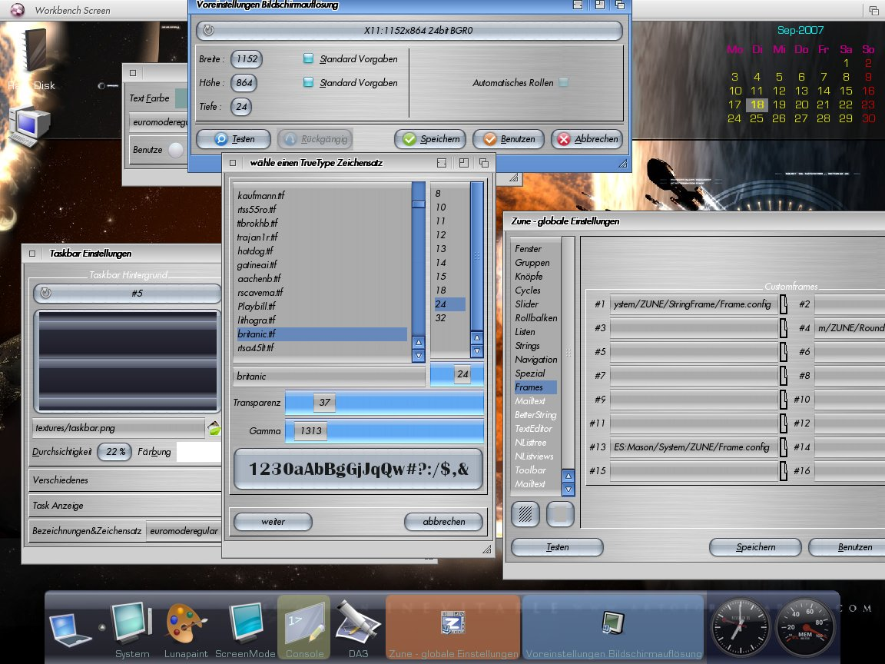
Features
User Interface
While maintaining full legacy with AmigaOS GUI style AROS improve on this area providing full skinable theme window layout as well as adding new options in navigation and handling of the gui components (Screen, windows, menus and gadgets). For maximum customisation of the GUI AROS introduced Zune. Zune is GUI toolkit developed in replacement and on the best traditions of MUI (Magic User Interface). This means that all aspects of AROS GUI are fully customisable by the user.

Slide 10

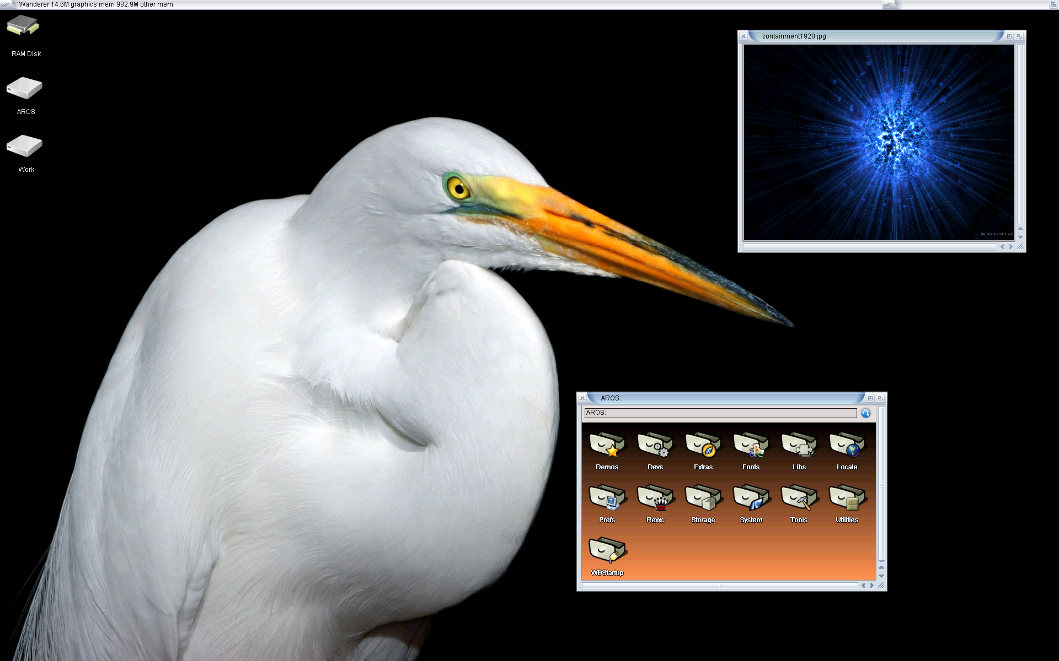
Features
Graphics Board Support
AROS provides support for native graphics drivers for video cards such as the GeForce range made by NVIDIA and Radeon by ATI (2d acceleration only at this time).
Other Graphic boards are usable through the use of AROS Vesa & VGA support.

Slide 11

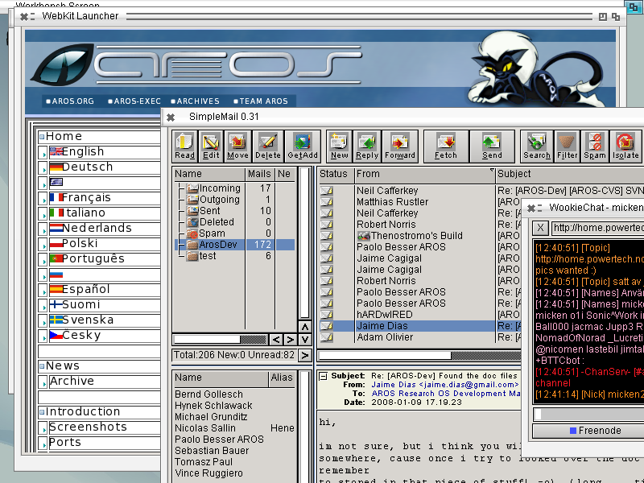
Features
Network Support
AROS has TCP/IP networking support, and a few number of common Internet-related applications are available such as email, irc, instant messenger clients...

Slide 12
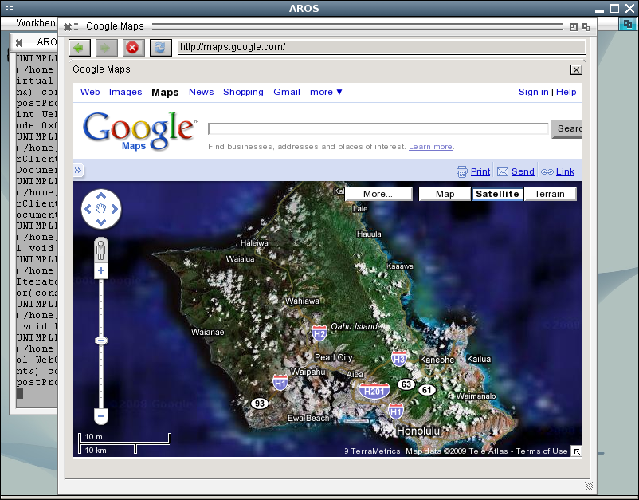
Features
Network Support
AROS has TCP/IP networking support, and a few number of common Internet-related applications are available such as email, irc, instant messenger clients...
...and soon OWB.
Currently there’s support for different network drivers such as i8255x (Intel Pro/100 chipset NIC), VIA Rhine, RTL8139, PCNet32, 3com 3c905, nForce.

Slide 13

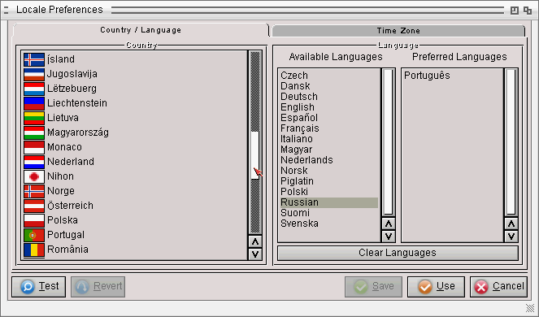
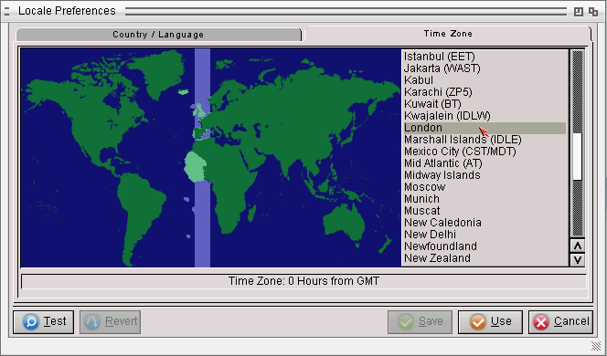
Features
International Support
Locale is the AmigaOS Family name given for the international software support, such as language, currency, decimal symbols and so on.
In its current form AROS supports the following Language sets: Czech, Dansk, Deutsch, English, Español, Français, Italiano, Magyar, Nederlands, Norsk, Piglatin, Português, Russian, Suomi, Svenska.

Slide 14

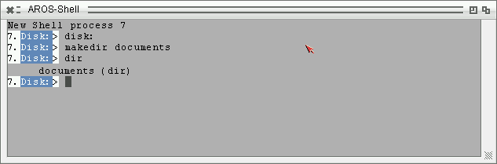
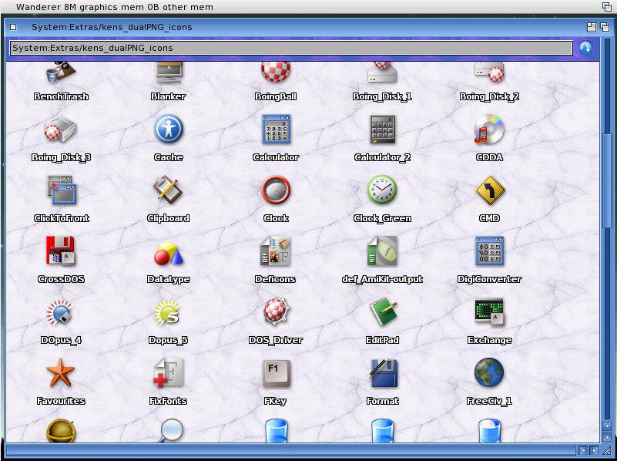
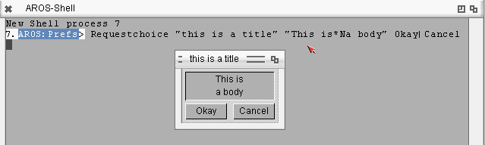
Features
AmigaOS Features
Several features which made AmigaOS unique are present such as dataype support (including amigaguide, iff-standard files…), AREXX compatibility, Icon format compatibility, AmigaDOS shell Script compatibility…

Slide 15

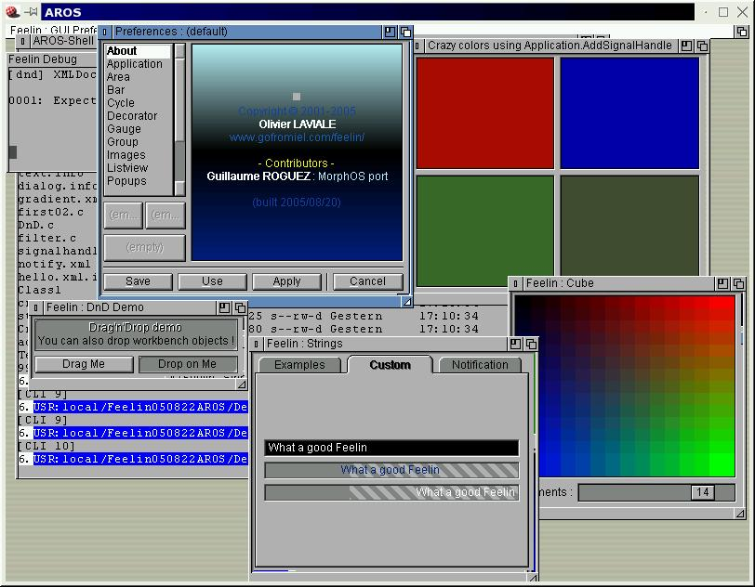
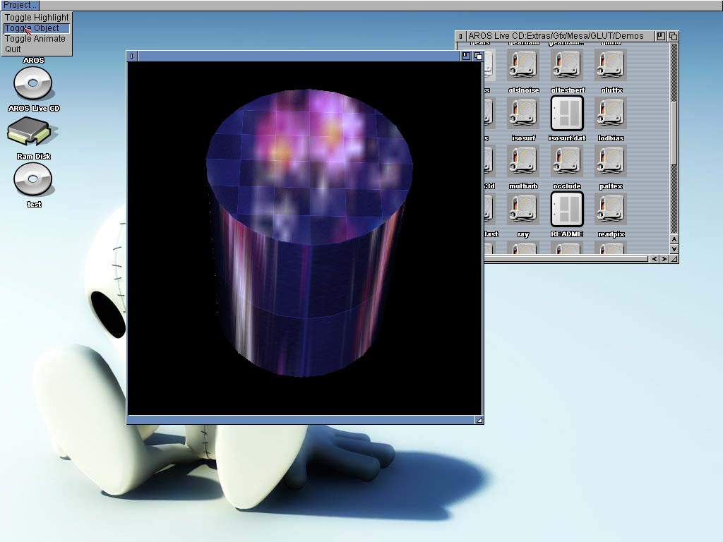
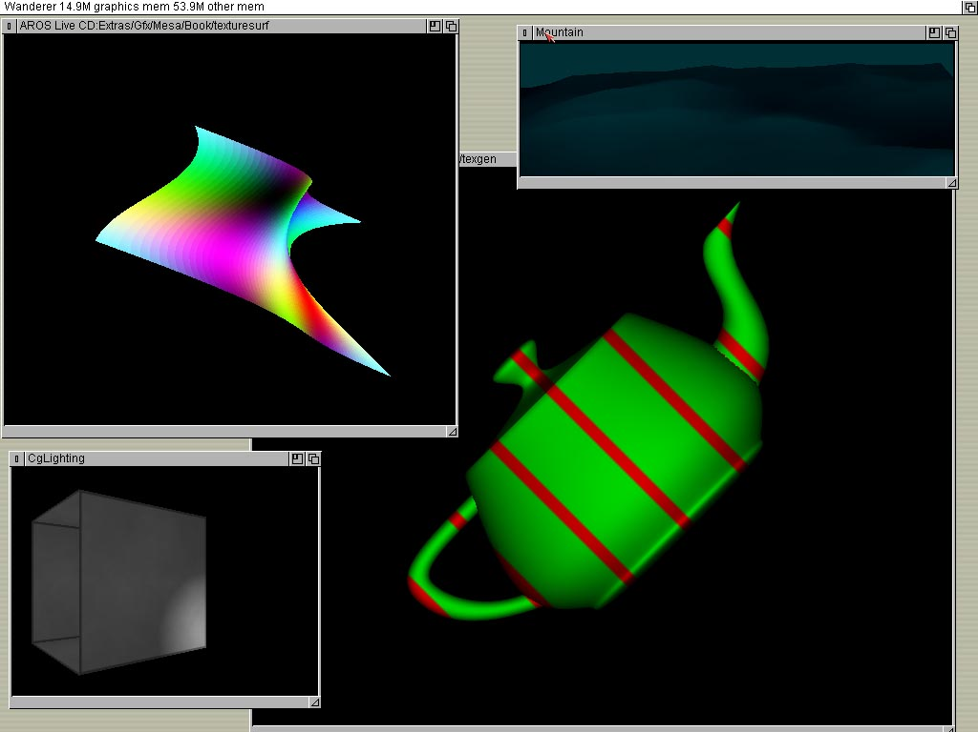
Features
Extended Development
Numerous ports of standard graphical layers and language support is introduced in AROS, Python, Feelin, Lua, SQLite, Mesa, SDL, Cairo...

Slide 16

Software
AROS Software
Although limited, the software base for AROS is growing with a number of ports from different platforms (amigaos/morphos/linux/…) and self written software.
These range from misc utilities, productivity to entertainment.

Slide 17

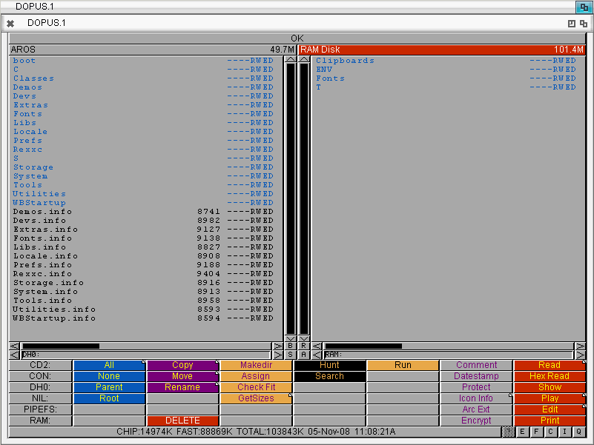
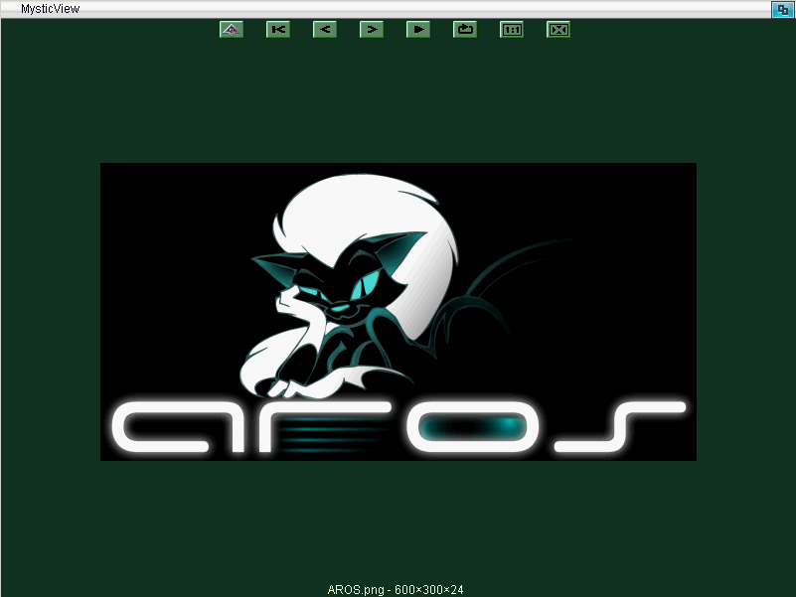
Software
Utilities
AROS has several utility software ported either from Amiga Os,MorphOs and
Linux, or coded natively. as Lunapaint.

Slide 18
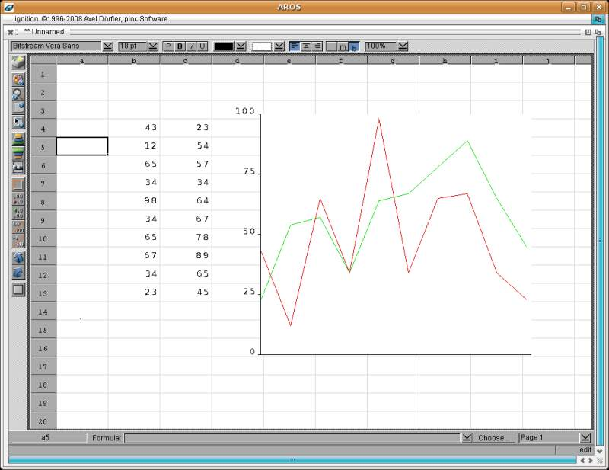
Software
Productivity Programs
AROS has several utility software but honestly lacks a bit in the office applications front;
MUIBase is a relational database quite powerful.
A port of Ignition, a spreadsheet program from Amiga Os, is on its way.

Slide 19

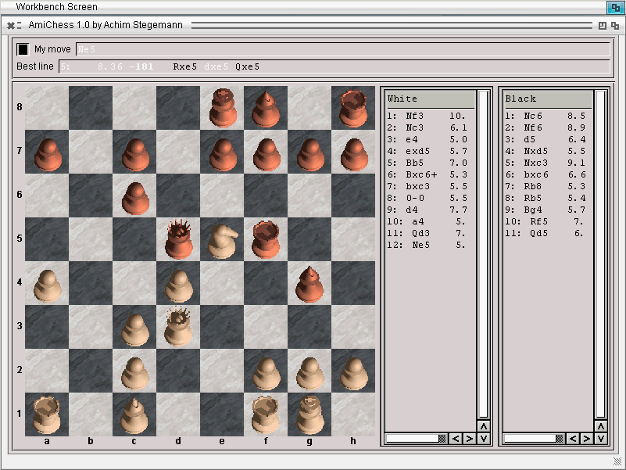
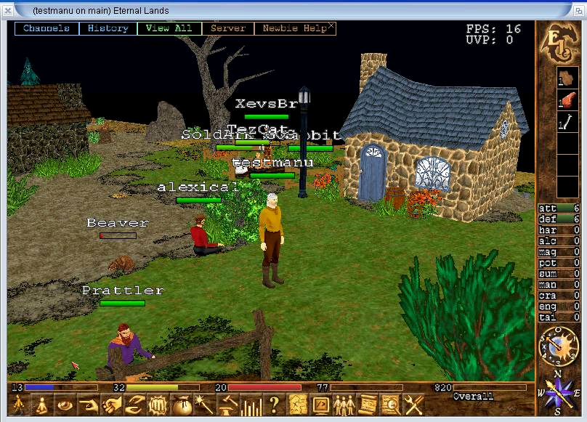
Software
Entertainment
AROS has plenty of games ranging from puzzle games to shoot'em ups and RPG.

Slide 20
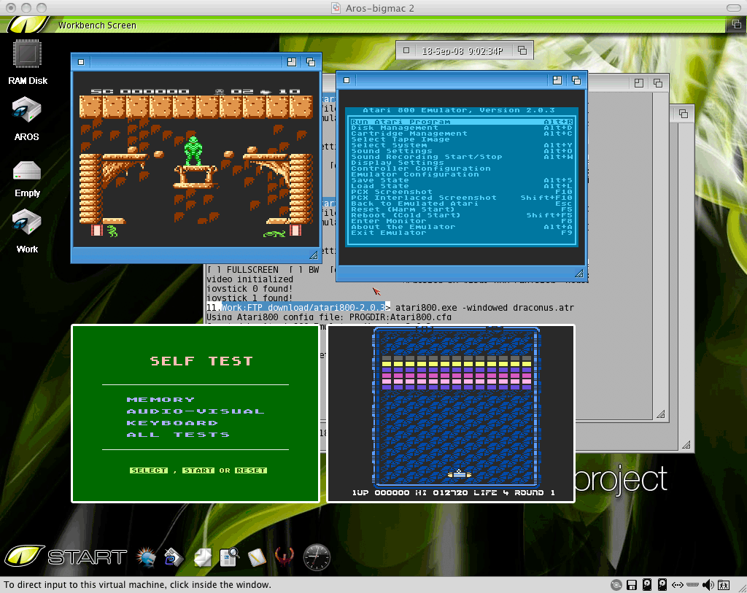
Software
Emulators
AROS has several emulators ranging from VICE (c64) to UAE (Amiga), FPSE (Playstation),Atari800,DosBox (in progress), SCUMMVm and others...
UAE is being integrated in order to work with AROS windows and icons; the name of the fork is Janus-UAE, actually in progress.

Slide 21

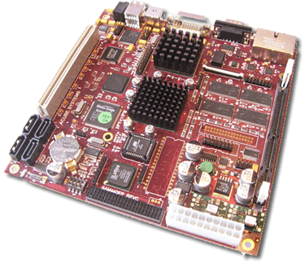
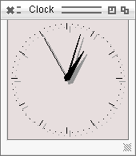
Requirements
Lightweight and Efficient
The requirements depend on the type of platform used. For x86 CPU native usage the AROS requires a PC with at least 32 Mb of memory and 80 Mb hd. It can currently be installed on most IBM PC compatibles.
PPC requirements are the same regarding memory and HD disk space. Currently Sam440 boards are supported with EFIKA in development.
Boot times under 20 seconds on cold boot on a 133 mhz cpu or above.
Responsive all the time with very minimal overhead response.
On Hosted systems and different distributions requirements may vary.

Slide 22

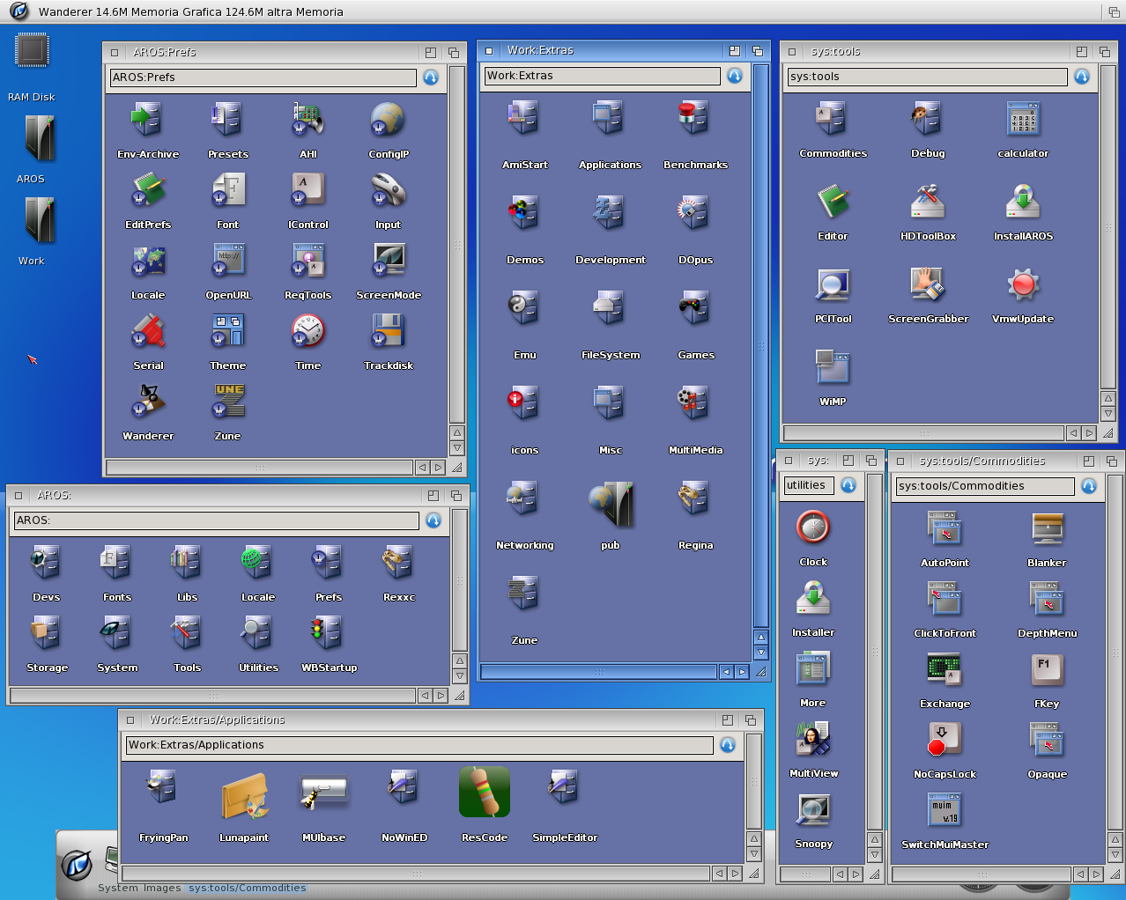
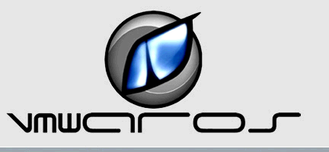
Contribution
Contribute Yourself!
AROS being a open-source Operating system advances on volunteer work. And while C/C++ knowledge is good to contribute directly, other tasks are accessible to most common users such as translating, documenting, promoting…
One of those cases is VmwAROS, the work of Paolo Besser with no previous programming knowledge. VmwAROS is currently the reference distribution to AROS.

Slide 23
Contribution
Links
AROS main website:
http://aros.sourceforge.net/
Developers mailing list: http://aros.sourceforge.net/contact.php#mailing-lists
IRC Channel: #aros on irc.freenode.net;
AROS-EXEC:
http://www.aros-exec.org/
AROS Wiki:
http://en.wikibooks.org/wiki/Aros
VmWAROS (AROS main Distro):
http://www.vmwaros.org/
AROS Archives (software repository):
http://archives.aros-exec.org/
Power2People – Bounty System:
http://www.power2people.org/projects.html
the AROS show:
http://arosshow.blogspot.com/
AROSWorld:
http://www.arosworld.org/
Binary Doodles – my own advocate blog: http://binarydoodles.ilcannocchiale.it/

Slide 24
Put a Kitty in Your PC!
Original Powerpoint presentaion content by João Ralha
Homepage: http://aros-wandering.blogspot.com/
Graphic Enhancement by Simone Bernacchia
The Kitty mascot is drawn by Eric Schwarz
AROS in February 2009

