Slide 1

Produce An Audio Podcast
Using Linux
Larry Bushey
Creator & Host
· Going Linux Podcast ·
goinglinux.com

Slide 2
What I'll Talk About
Have something interesting to say
Be predictable and consistent
Pay attention to audio quality
Build a community
Scale back if necessary
Why Linux?

Slide 3
Have Something Interesting To Say
Please everyone?
Please your target audience?
Please yourself?
Notes:
Doesn't have to be interesting to everyone
Does have to be interesting to your target audience
Does have to be interesting to YOU
... so you don't "podfade"

Slide 4
Be Predictable & Consistent
Timing
Content
Format
Notes:
Timing: Regularity is more important that frequent
Content: Stick to your topic
Ideal: 2-3 people – you can have a discussion
Depending on topic: 1 person
Be careful: 3+ people

Slide 5



Pay Attention To Audio Quality
You don't have to have professional equipment, but...
Notes:
You don't have to have professional equipment, but...
Use a computer with good audio
Use a headset or USB mic, not the built-in point mic on your laptop or webcam

Slide 6
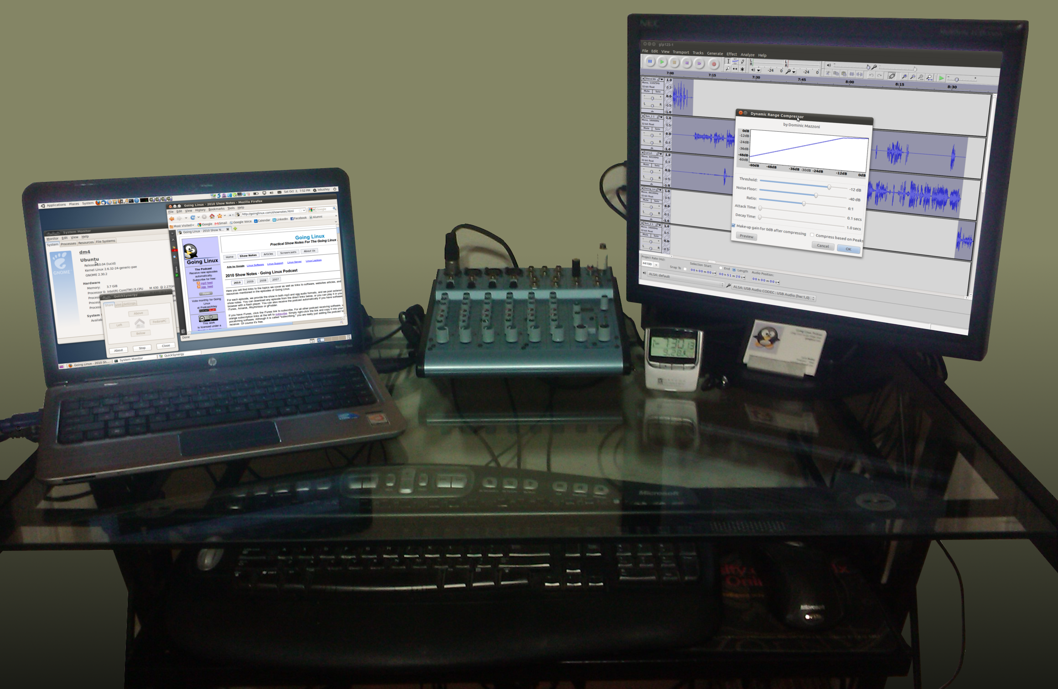
Going Linux Podcast Studio

Slide 7
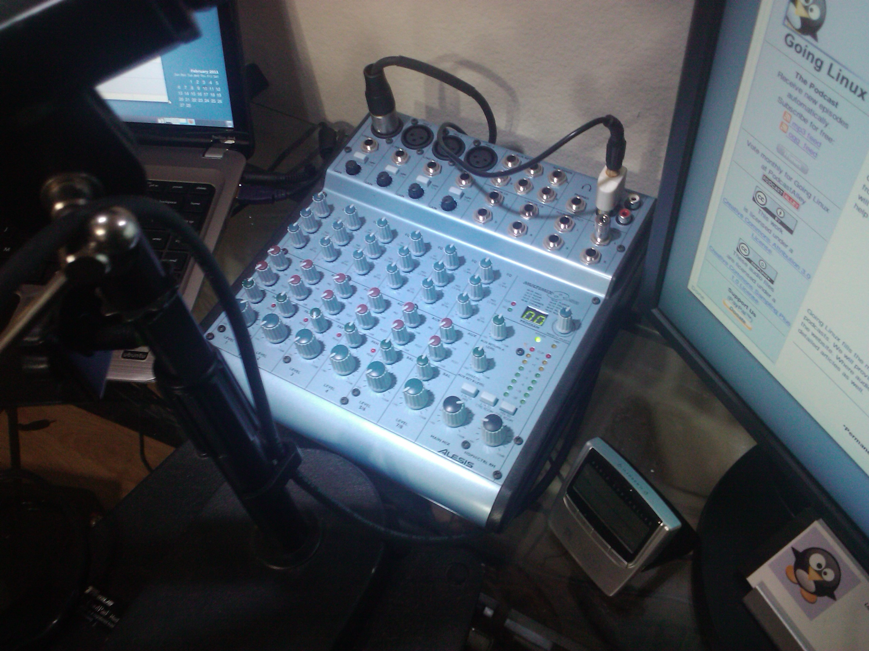
Mixer:
Alesis Multimix 8 USB

Slide 8
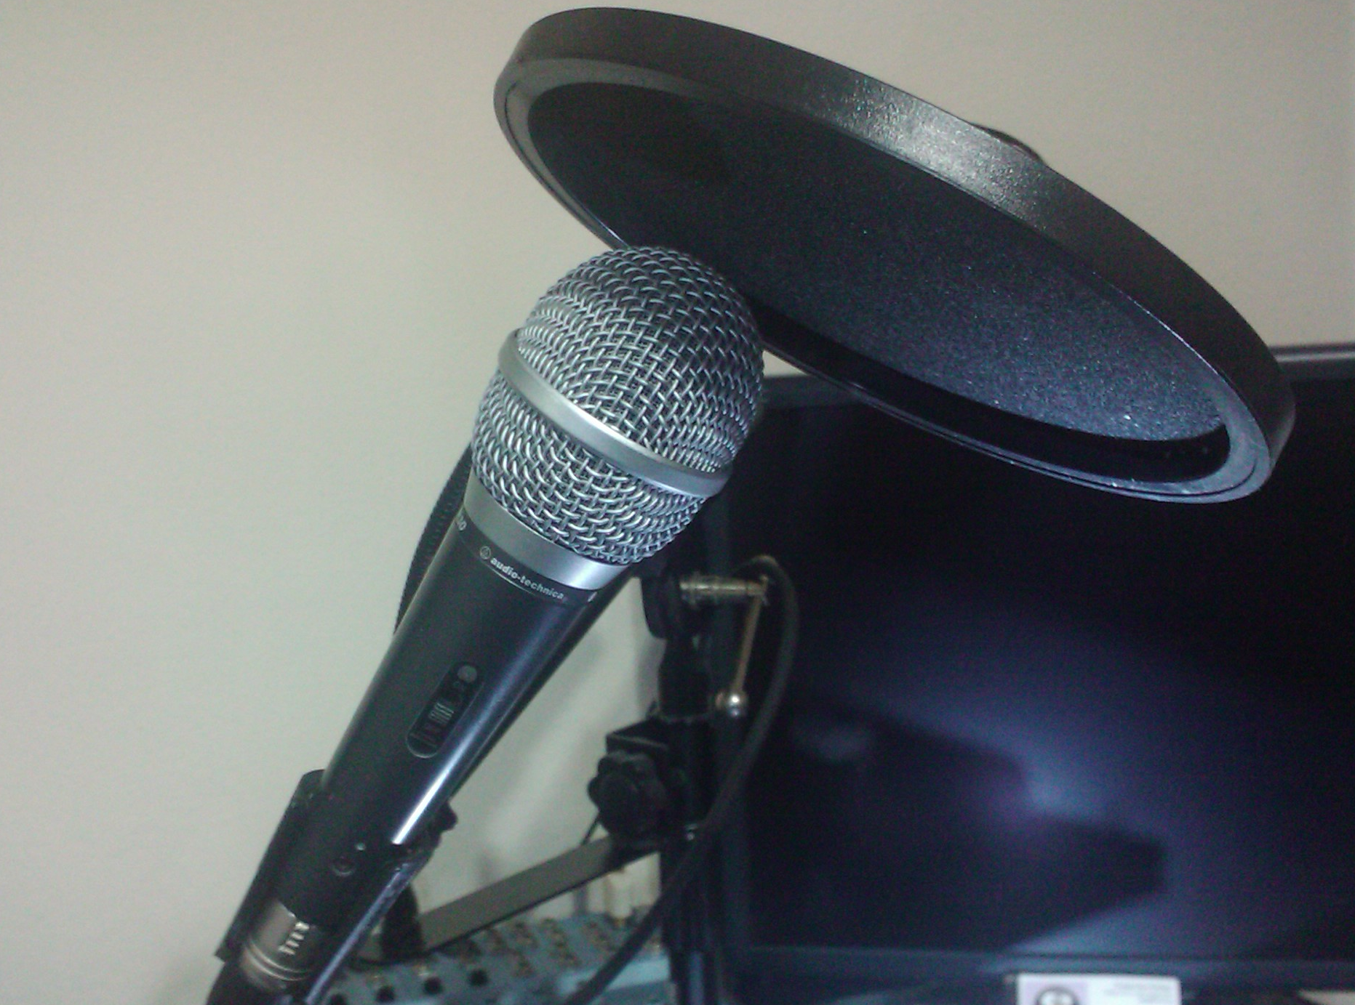
Microphone:
audio-technica ATR-30

Slide 9
Build A Community
Build Loyalty
Ask for feedback and use it... publicly
  Blog comments
  Web forum
  IRC chat room
  Voice mail number
  Email address for feedback
  Social Media (Twitter, Facebook, Identica)
Notes:
Why? Build loyalty
How? Ask for feedback and use it... publicly
Blog comments
comment back
Web forum
participate and add value
IRC chat room
join the discussion
Voice mail number
play and respond on the podcast
Email address for feedback
read and respond on the podcast
Social Media (Twitter, Facebook, Identica)

Slide 10
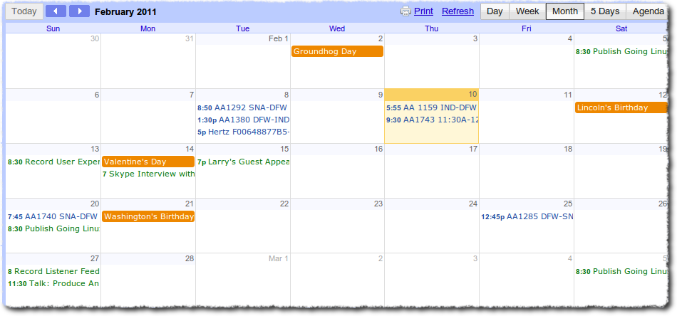




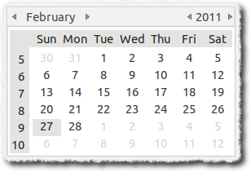



Scale Back If Necessary
Too many community tools?
Can't keep up a weekly pace?
Notes:
Many first-time podcasters begin with great intentions to publish and episode weekly, or even daily.
If you have followed my advice so far, you have a topic you're passionate about, and you are eager to share.
Resist the temptation to do too much. Allow time to research, record, edit and publish.
There are a wide variety of community tools you can use. Don't overdo it.
If you find the workload too much, avoid podfading. Reduce the frequency of your episodes. Use only 1 or 2 social media tools.

Slide 11
Why Linux?
It's not all about Linux
It applies to Windows and OSX, too
It's inexpensive
It's Free and Open Source... for the most part
Notes:
This is the SoCal LINUX expo, so if I talked about how to podcast using Win or Mac... you'd all be mocking me right now
Most of what I will discuss applies to producing a podcast using Mac and Windows, but that will cost you a lot more
With a Linux PC and a headset mic, you don't need to spend ANY money to produce, record, edit, encode, and post your podcast
It has all the software you need to do anything you want, while staying Free and Open Source... for the most part

Slide 12
Stuff I Use for Going Linux
Operating System
  100% Linux
Recording, Editing, id3 tags, Audio Processing, Format Conversion
  Audacity
ID3 tags
  EasyTag
Album Art
  OpenClipArt
  Gimp
Audio Processing
  The Levelator (from the Conversations Network)
Skype
Skype-call-recorder
  www.atdot.ch/scr
  Shawn Powers (Linux Journal) demo of skype-call-recorder:
  http://www.linuxjournal.com/video/skype-call-recorder?utm_source=feedburner&utm_medium=feed&utm_campaign=Feed%3A+linuxjournalcom+%28Linux+Journal+-+The+Original+Magazine+of+the+Linux+Community
Notes:
Operating System
100% Linux
Recording, Editing, id3 tags, Audio Processing, Format Conversion
Audacity
ID3 tags
EasyTag
Album Art
OpenClipArt
Gimp
Audio Processing
The Levelator (from the Conversations Network)
Skype
Skype-call-recorder
www.atdot.ch/scr
Shawn Powers (Linux Journal) demo of skype-call-recorder

Slide 13
Additional Resources
Allison Sheridan "Podcasting on Podcasting" series (12-step program)
  http://www.podfeet.com/wordpress/podcasting-on-podcasting/
Podcast411's Podcast 101 (11-step program)
  http://podcast411.com/podcast101/
Libsyn's Podcasting Starter Kit
  http://imake.libsyn.com/podcast-podcasting-starter-kit-for-absolute-newbies
Get Professional Help:
  Sallie Goetsch: http://www.podcastasylum.com
  Dave Jackson: http://schoolofpodcasting.com
  Donna Papacosta: http://trafcom.typepad.com/blog/the-podcasters-checklist.html
Notes:
Allison Sheridan "Podcasting on Podcasting" series (12-step program)
http://www.podfeet.com/wordpress/podcasting-on-podcasting/
Podcast411's Podcast 101 (11-step program)
http://podcast411.com/podcast101/
Libsyn's Podcasting Starter Kit
http://imake.libsyn.com/podcast-podcasting-starter-kit-for-absolute-newbies
Get Professional Help:
Sallie Goetsch: http://www.podcastasylum.com
Dave Jackson: http://schoolofpodcasting.com
Donna Papacosta: http://trafcom.typepad.com/blog/the-podcasters-checklist.html

Slide 14
Distribute Your Podcast
BlogTalkRadio: http://BlogTalkRadio.com
Internet Archive: http://www.archive.org
Blubrry: http://blubrry.com
Libsyn: http://libsyn.com
Podcast Alley: http://www.podcastalley.com
Tech Podcast Network: http://www.techpodcasts.com
Miro: https://miroguide.com
iTunes Store: http://www.apple.com/itunes/podcasts
Zune Market Place: http://social.zune.net/podcasts

Slide 15
Podcasting Success Factors
It should interest YOU
Don't take on too much
Quality Counts
Audience = Community
Use Linux
Notes:
Talk about something that interests YOU
It will interest others
Don't take on too much
Release regularly,
But at a pace you can maintain
Quality Counts
PC with good audio
Use a good mic
Audience = Community
View your audience as your podcast's community
Treat them that way
Use Linux

Slide 16
Contact Information
Larry Bushey
· Going Linux Podcast ·
Site: goinglinux.com
Email: goinglinux@gmail.com
Twitter: @goinglinux
Identica: @goinglinux
Skype: goinglinux
LinkedIn: Larry Bushey
… heck, just Google me!

