Slide 1

Introducing

Slide 2

Cutting Edge OS
Open
Mobile
Internet
Touch
http://www.flickr.com/photos/robiwan_kenobi/4565197834

Slide 3
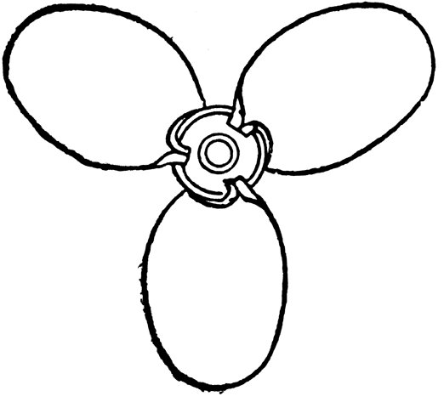



One engine, many functions
One MeeGo Core OS
Intel Atom & ARM
Powers many UXs
Common API
One SDK
http://etc.usf.edu/clipart/35100/35114/thorn_prop_35114.htm

Slide 4
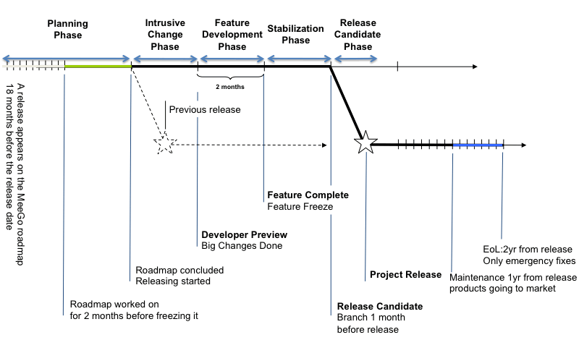
Designed to work like a clock
http://wiki.meego.com/Release_Engineering

Slide 5
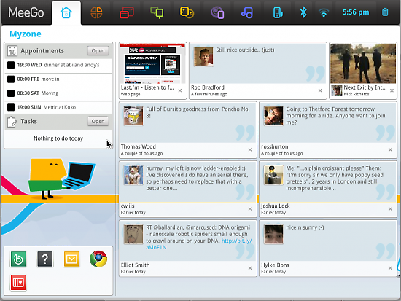
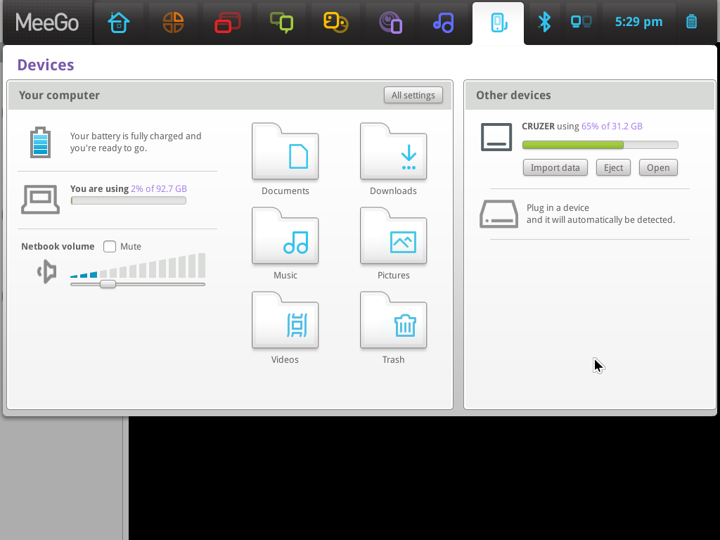
MeeGo 1.1 Netbook

Slide 6
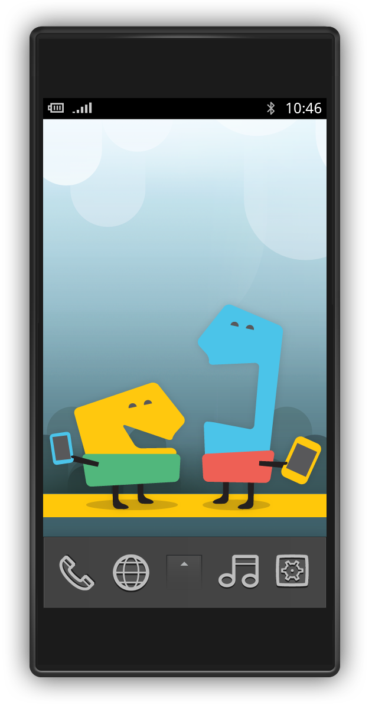
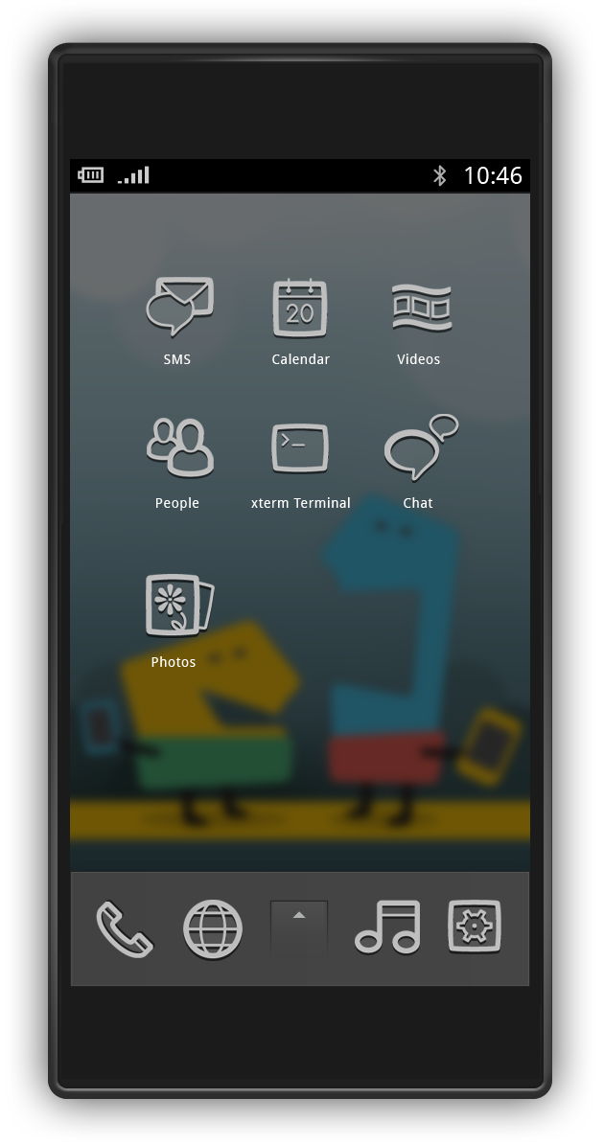
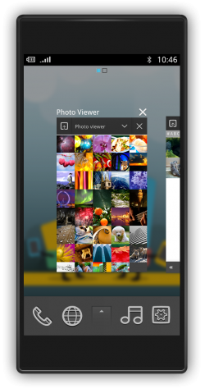
MeeGo 1.1 Handset

Slide 7
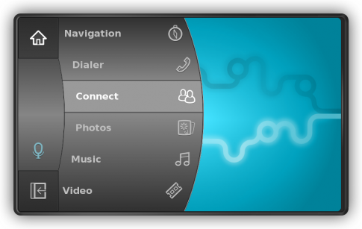
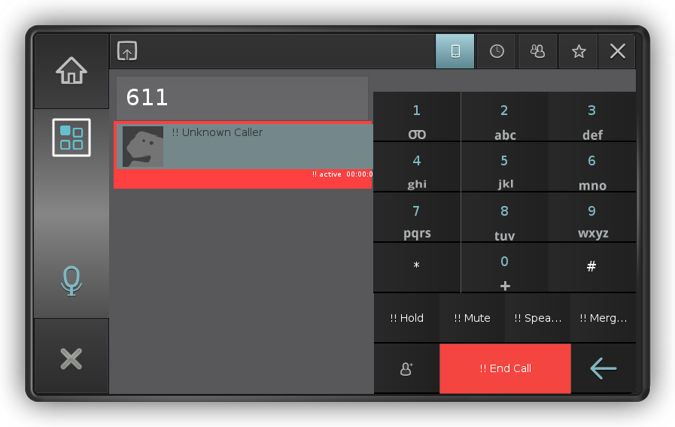
MeeGo 1.1 IVI

Slide 8
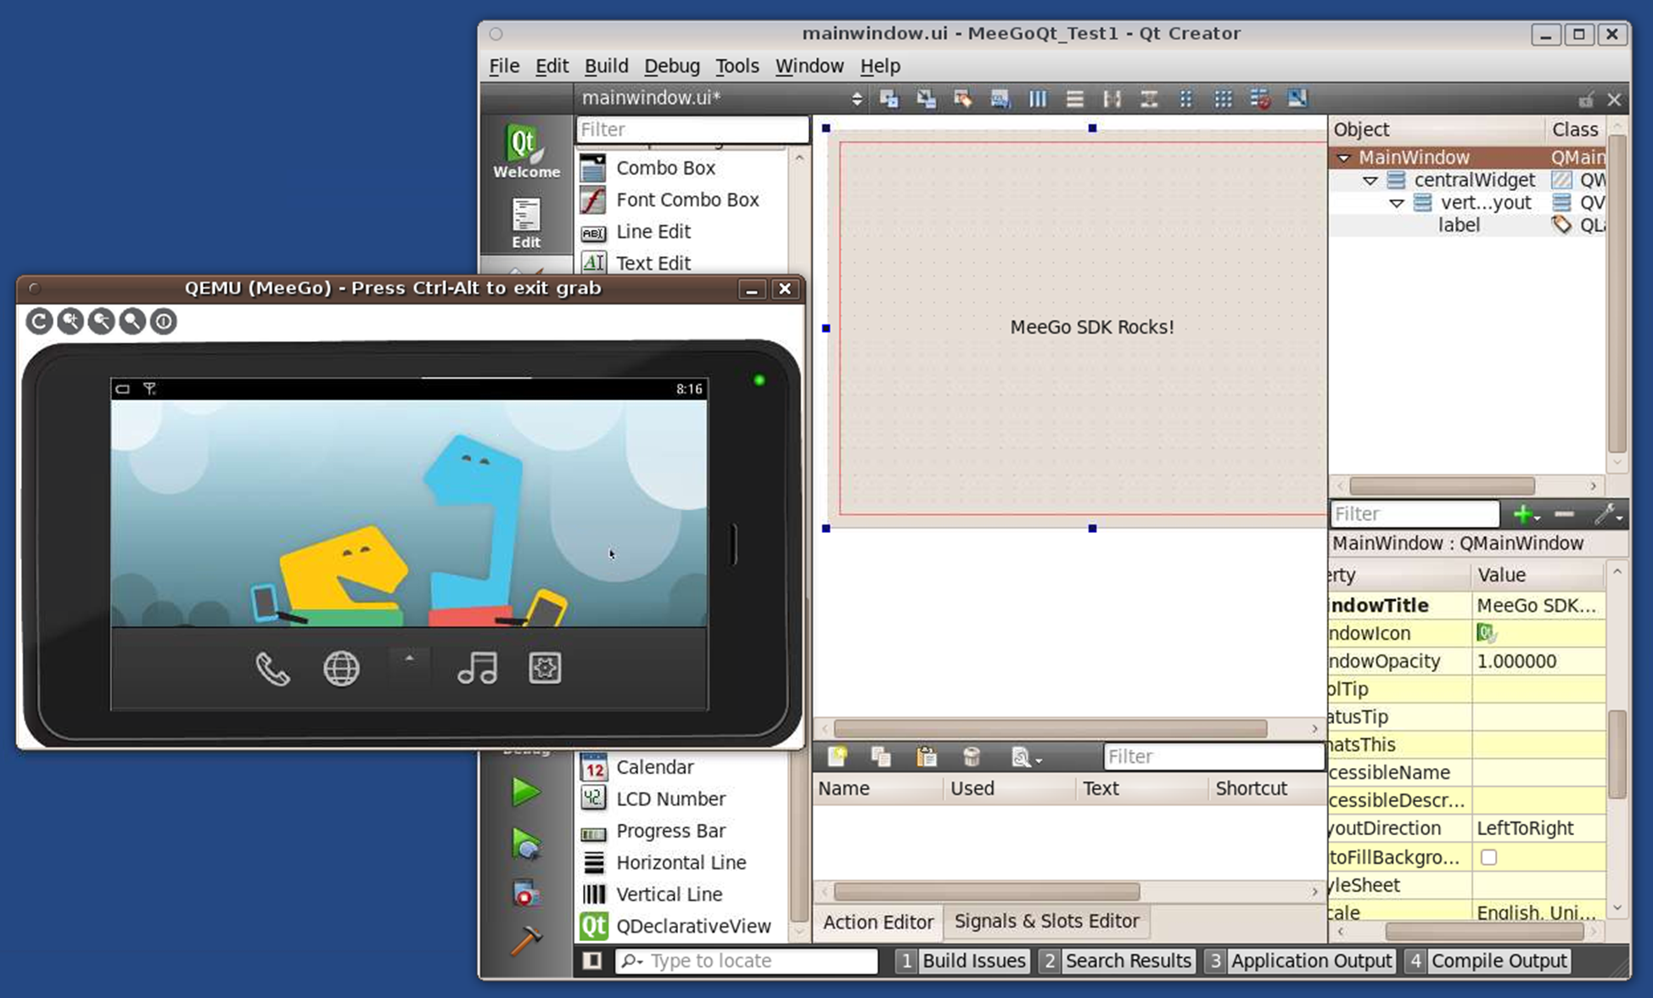
MeeGo 1.1 SDK Beta

Slide 9
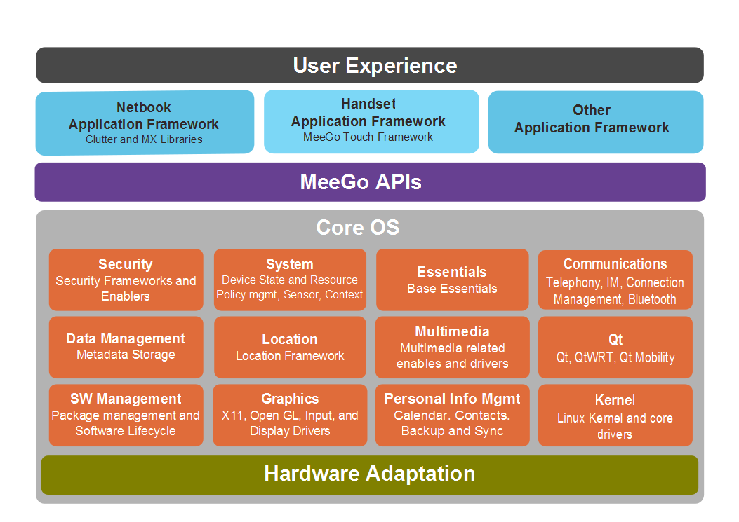
Open stack, business friendly

Slide 10
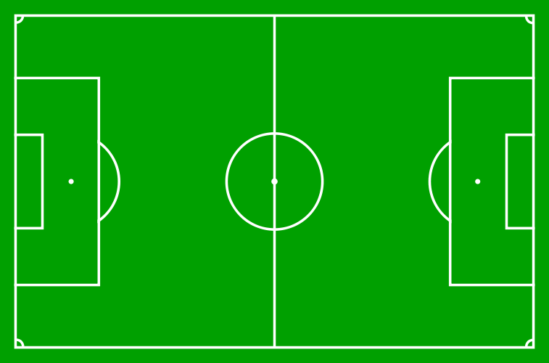









Real Linux champion team!

Slide 11
Qt Hero
Qt based UX
Qt based API
Qt Quick
Qt Mobility
Qt SDK
Primary distribution
Release alignment
Governance

Slide 12
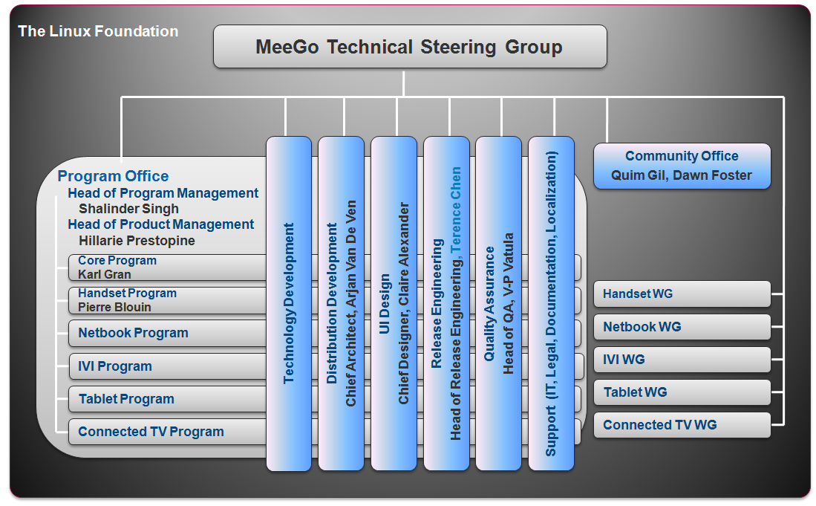
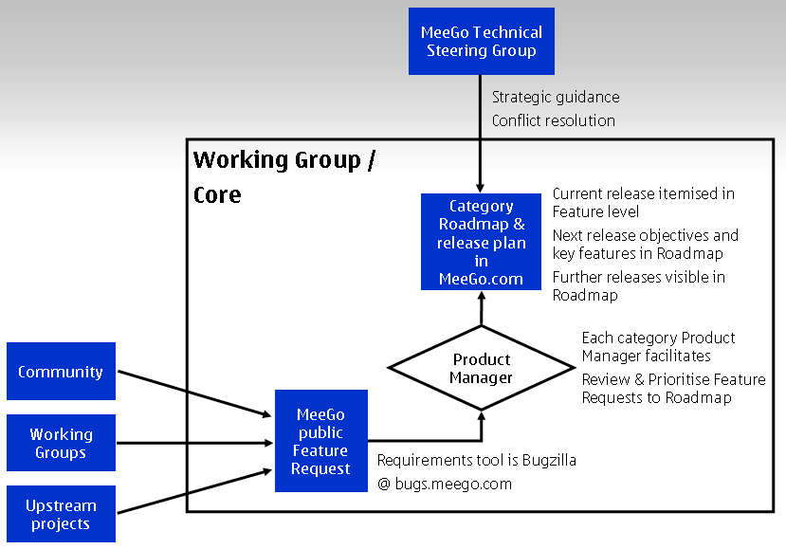
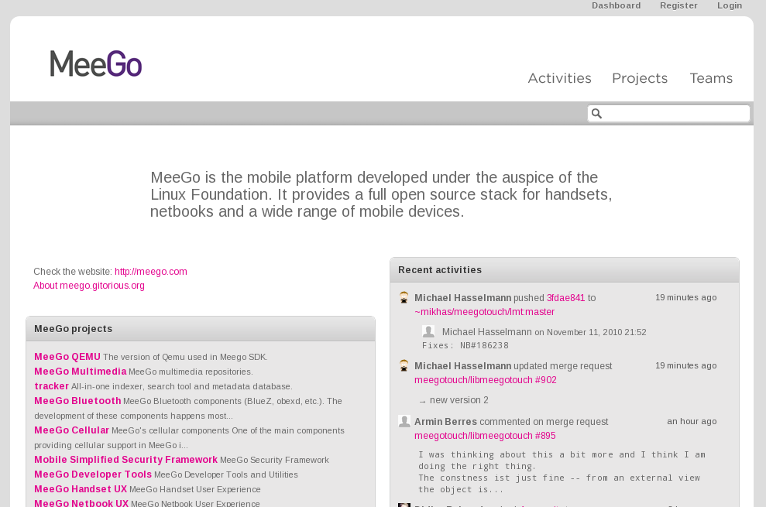
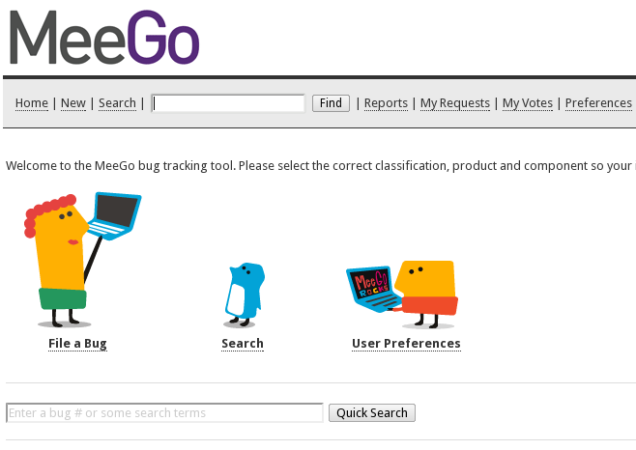
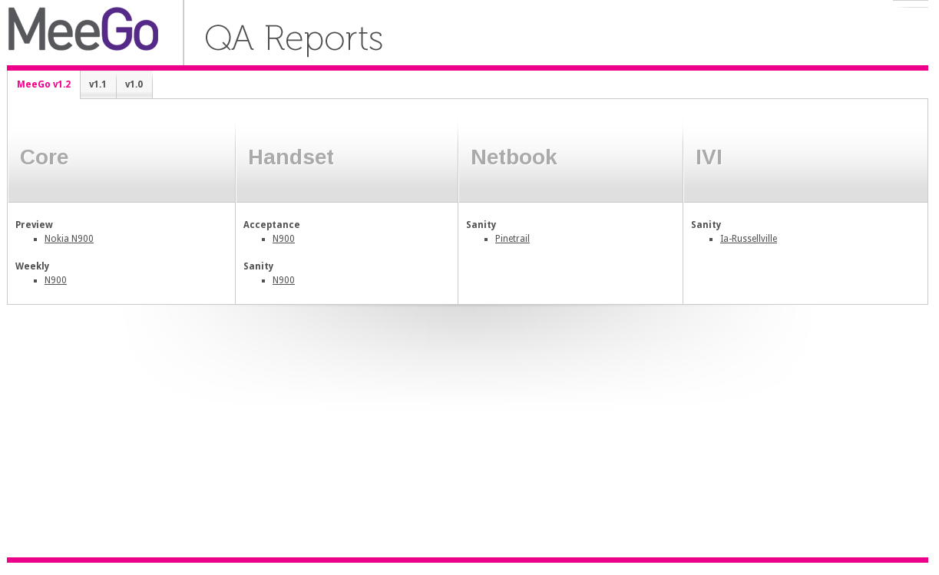

Openness
Meritocracy
Roadmapping
Development
Bugs & Features
Quality
Host

Slide 13

1.1 out, working on 1.2 now

Slide 14



February 15, 2010
+
=

Slide 15




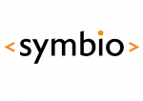







The community is growing...
Your logo here

Slide 16
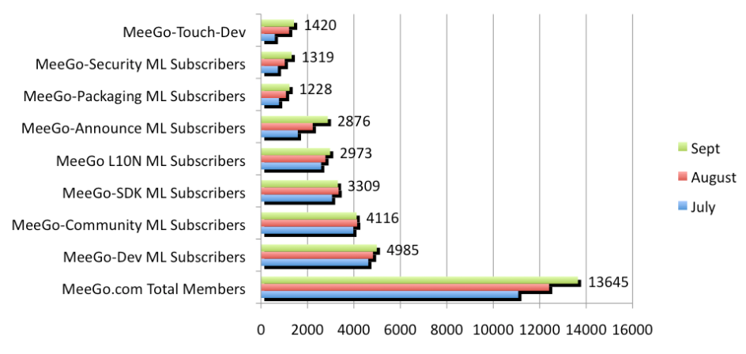
and growing...
http://wiki.meego.com/Metrics

Slide 17

… and expanding
Local MeeGo Network
http://wiki.meego.com/Local_MeeGo_Networks
Candidate

Slide 18
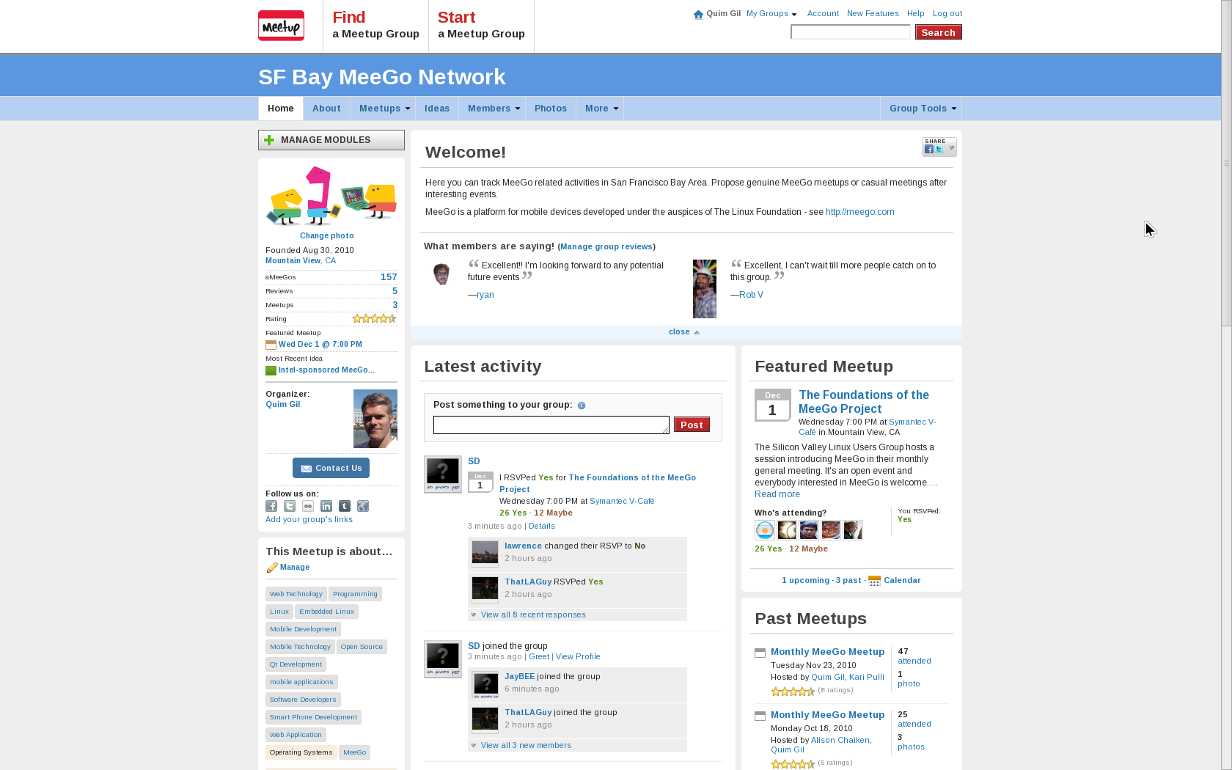
SF Bay MeeGo Network

Slide 19
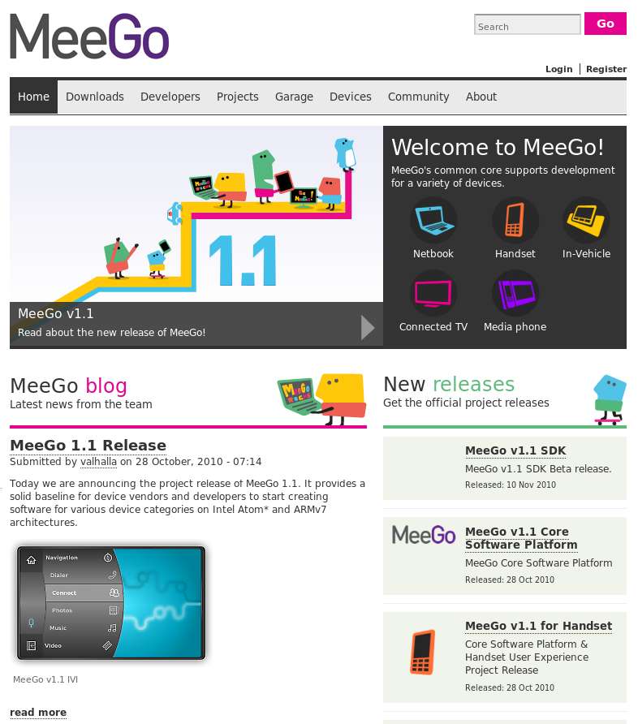
meego.com
Small core team &
  Program Office
  Media team (soon)
Upcoming revamp
  Project background
  News & Media
  Developer site
  Connections to wiki
meegocom @ Twitter

Slide 20

Events
MeeGo Conference
Regional summits
Support to MeeGo tracks, speakers, booths, swag
Sponsoring?
Thanks to sponsors!
http://wiki.meego.com/Events

Slide 21

Spread MeeGo
Show off your avatar
Tag, Forward, RT, Become a fan...
Become a Greeter
Join/create a local network
Submit MeeGo proposals in events
Ask for MeeGo ports of your preferred apps

Slide 22
Thank you!
http://meego.com
http://forum.meego.com
http://meetup.com/SFBay-MeeGo-Network
Quim Gil – quim.gil@nokia.com

