Slide 1
My God, it's full of games!
- or -
How to stop futzing, and start playing
Dan Kegel
Scale 9X, Los Angeles, February 2011
Presentation online at kegel.com/wine/scale9x
The opinions expressed in this talk are my own, not my employer's.

Slide 2
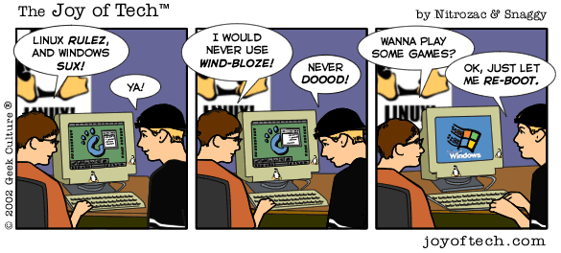
How do you play Windows games on Linux?

Slide 3

Dual booting Windows works, but rebooting is a pain, and you have to buy Windows ($100)

Slide 4

Windows XP in VMware works, but it's a bit klunky, and you have to buy Windows ($100) and Vmware ($189)

Slide 5

Windows in VirtualBox works somewhat*, but it's a bit klunky, and you have to buy Windows ($100)

Slide 6


Wine works somewhat*, is nicely integrated, and is totally free
=

Slide 7
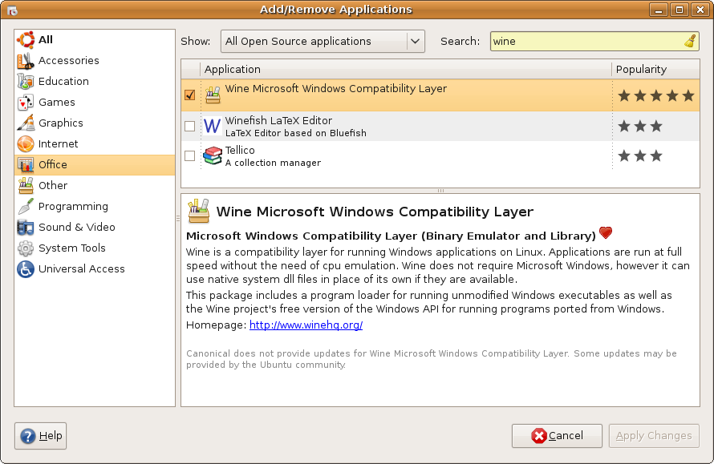
In theory, you can just install Wine...

Slide 8
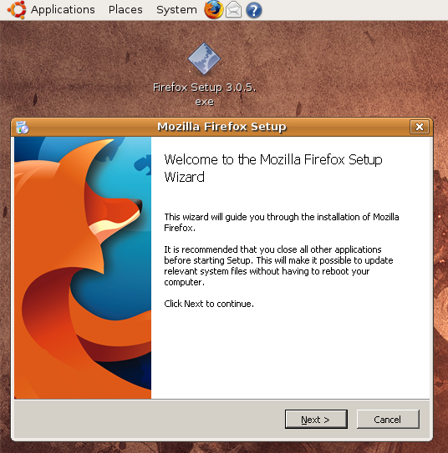
… double-click any Windows app's installer...

Slide 9
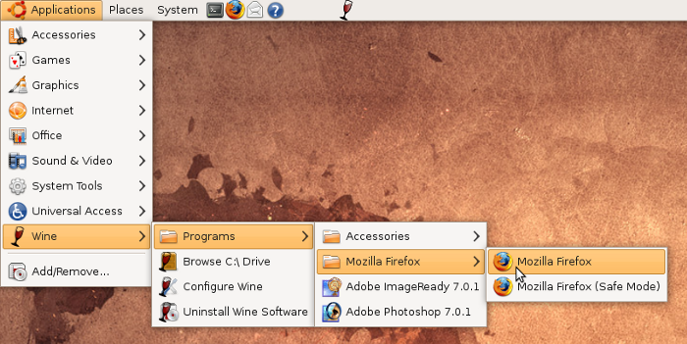
… and voila, working app!

Slide 10
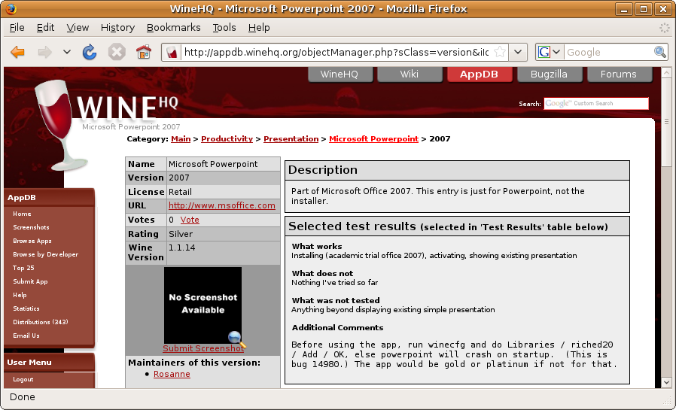
Except - some apps have crash bugs you have to work around ...

Slide 11
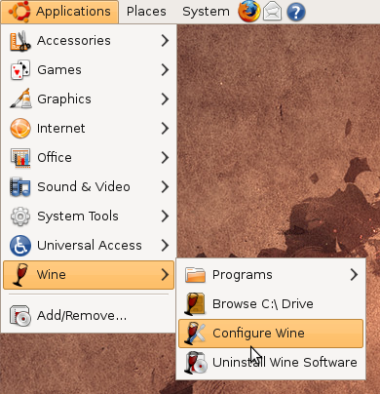
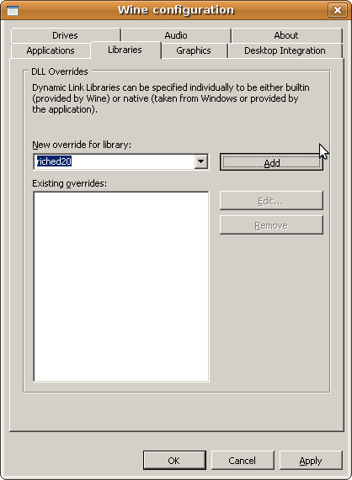
… with winecfg

Slide 12
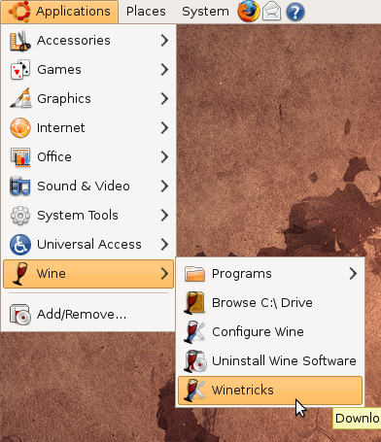
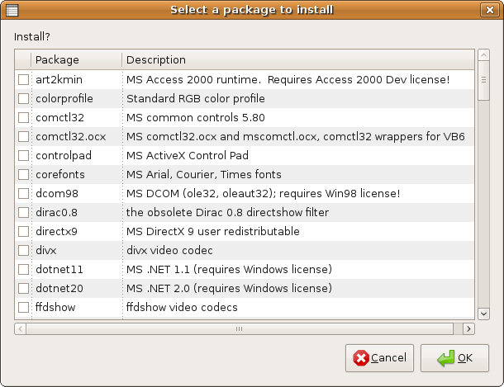
… or Winetricks

Slide 13
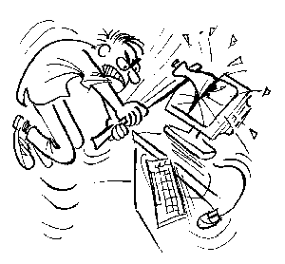
The search for workarounds is tedious and frustrating, especially when there is no workaround.

Slide 14
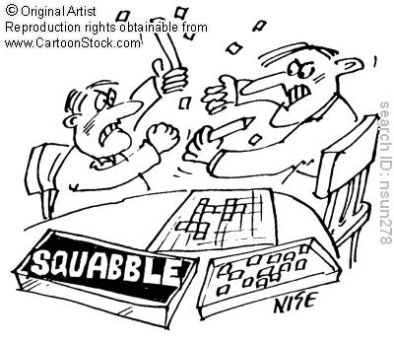
Sometimes, the workarounds for app X will break app Y

Slide 15
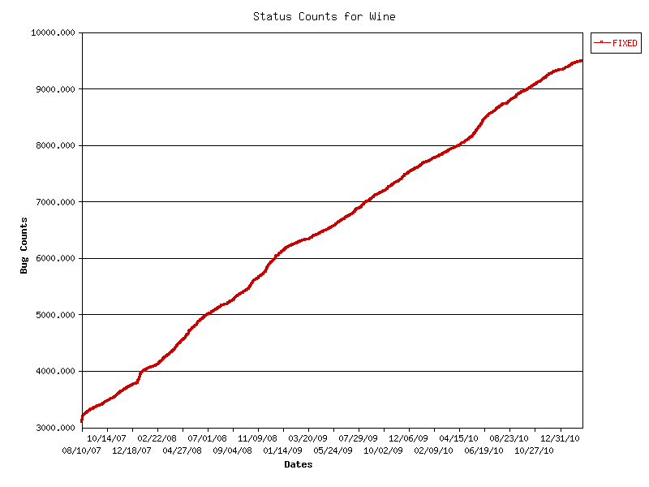
Wine bugs are fixed steadily, so eventually, no workarounds will be needed...

Slide 16
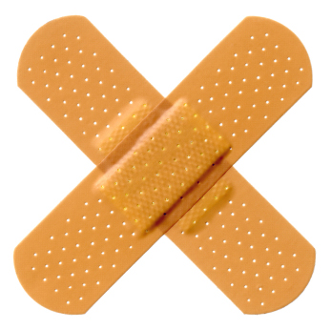
… but until then, we need a way to shield users from the complexity.

Slide 17
- Codeweavers Crossover (2002…)
- Winetricks (2007...)
- PlayOnLinux (2007...)
Popular wine frontends:

Slide 18
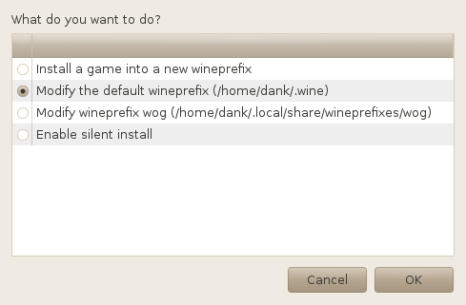
The Winetricks gui puts each game into its own wineprefix

Slide 19
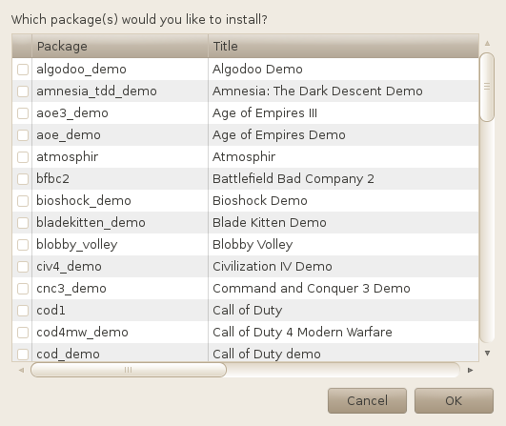
Only games known to work in Wine are listed

Slide 20
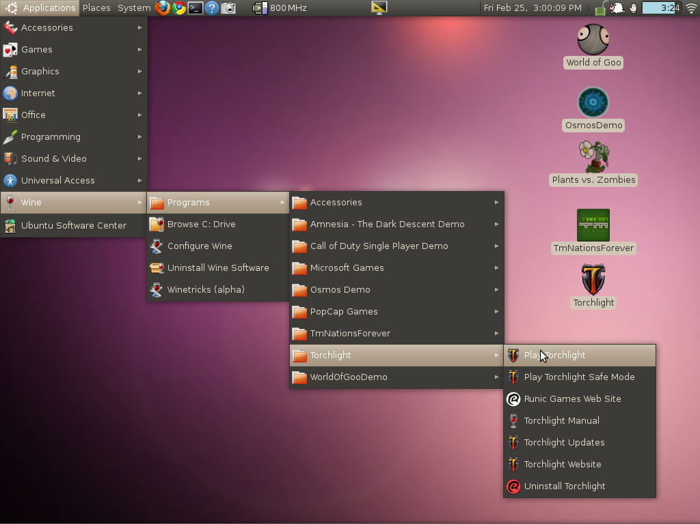
The games show up in the system menu

Slide 21
If your game is missing, add it yourself, and contribute your change to winetricks.org
w_metadata osmos_demo games \
title="Osmos demo" \
publisher="Hemisphere Games" \
year="2009" \
media="download" \
file1="OsmosDemo_Installer_1.5.6.exe" \
installed_exe1="$W_PROGRAMS_X86_WIN/OsmosDemo/OsmosDemo.exe"
load_osmos_demo()
{
w_download \ http://gamedaily.newaol.com/pub/OsmosDemo_Installer_1.5.6.exe
cd "$W_CACHE/$W_PACKAGE"
$WINE OsmosDemo_Installer_1.5.6.exe
}

Slide 22
for verb in `winetricks games list`
do
if ! winetricks -q $verb
then
echo FAIL: $verb failed
fi
done
winetrickstest uses “silent mode” to verify all verbs download and install ok

Slide 23
Remaining Problems
- ActiveX
- Relative mouse motion
- Performance
- MS .Net
- WPF
- DirectX11

Slide 24

#1 bug requiring a patch to Wine: support relative mouse events (bug 6971)

Slide 25
Opportunities abound
- Do a Google Summer of Code project
- Contribute game scripts to Winetricks
- Help companies using Wine
- Know C & GPUs? Talk to Codeweavers

Slide 26

Questions?
Slides online at kegel.com/wine/scale9x
Text copyright 2011, Dan Kegel
Please copy - see Attribution-ShareAlike license
If your group would like a Wine presentation, please contact me
The opinions expressed in this talk are my own, not those of my employer

