Slide 1

Lights. Camera. Action!
An in-depth look at OpenShot Video Editor.
By Jonathan Thomas

Slide 2
Introduction
OpenShot is a free, open-source, non-linear video editor for Linux.
It can create and edit videos
It can edit and arrange audio
It can export in many different formats
In other words, it is a “video editor”.

Slide 3
Presentation Videos
Feature Videos:
  Videos which showcase a single feature
Release Videos:
  Videos which announce a new version of OpenShot
User Videos:
  Videos which are created by users, and tagged “made with OpenShot”

Slide 4
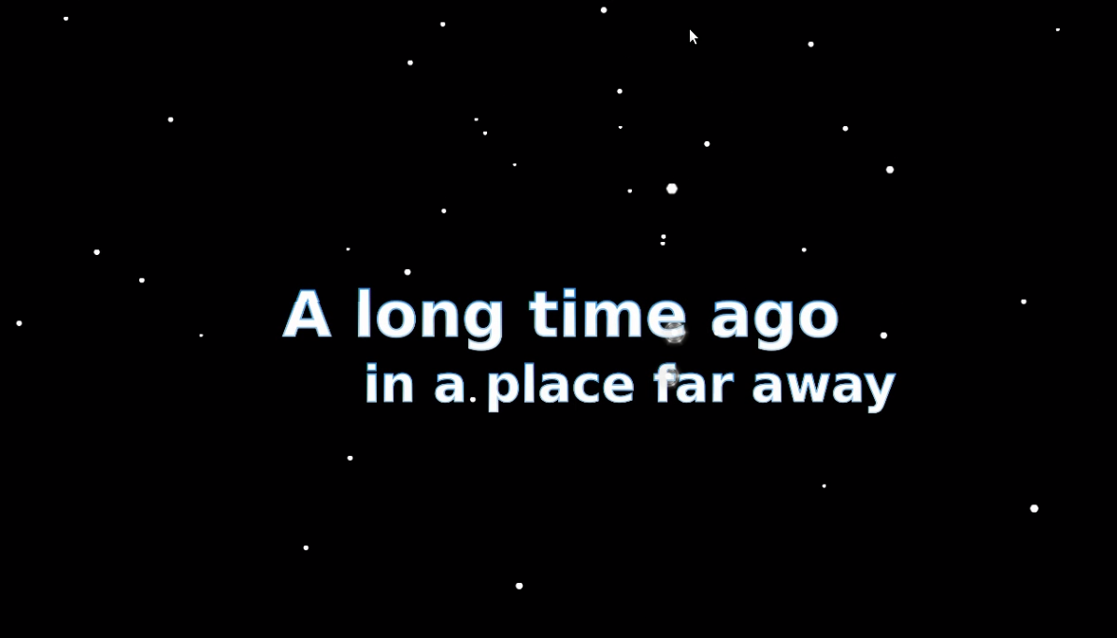
Introducing OpenShot!
Click here to watch this video

Slide 5
Goals for OpenShot
Simple:
  Easy enough for anyone to use
Powerful:
  Powerful as possible, without being complicated
Flexible:
  Provide a wide range of creative freedom

Slide 6
About the Project
Project started:
  August 2008
Programming language:
  Python & GTK
License
  GPL v3
Video editing library:
  MLT Framework
Blog everything...
  Every idea, decision, success, and mistake has been shared on my blog during the development of OpenShot.

Slide 7
Basic Features
Arrange videos, pictures, and audio clips
Trim off unwanted parts of video and audio
Smoothly transition between two videos
  Fades & Wipes
Add Effects
  Video and audio effects, such as black & white, old video grain, echoes, etc...
Export
  Export your arrangement to a single video file

Slide 8
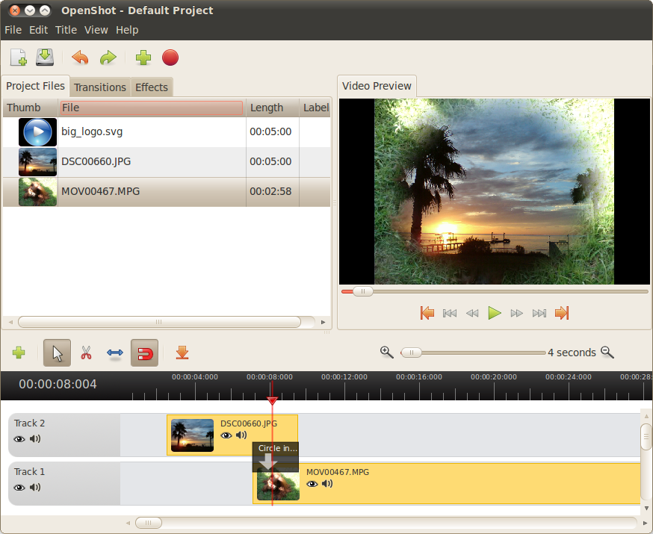
Export Video
Project Files
Preview Video
Time-line

Slide 9
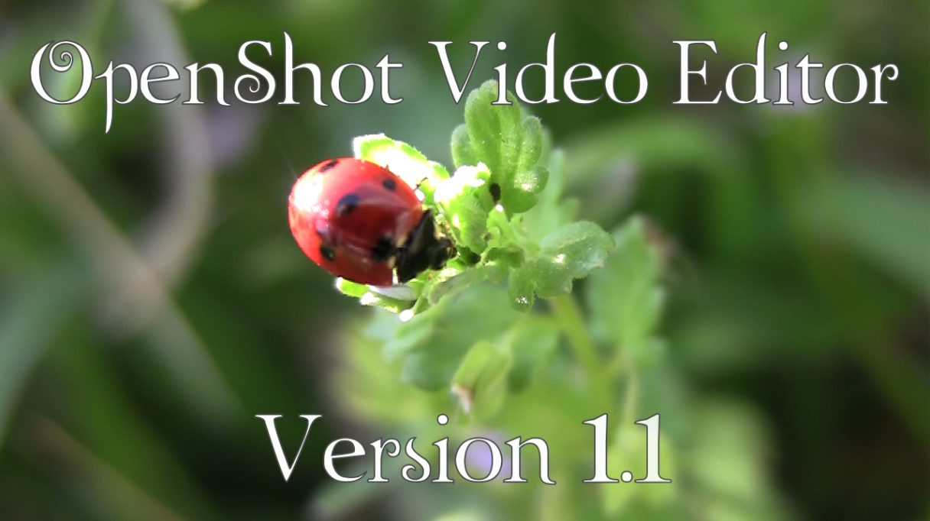
Video Showcasing Basic Features
Click here to watch this video

Slide 10
Advanced Features
Layer and composite (or mix) videos
Mask (or hide) parts of a video
Remove a color (making it transparent)
  Chroma-key / bluescreen / greenscreen
Key-frame animation
  Animate videos moving, zooming, or fading
3D animation
  Create stunning 3D animations for titles
Stop-motion
  Create, edit, and import sequences of images

Slide 11
3D Animation
Integration with Blender 2.56+
Easy interface (simple menu)
Create animated titles
  Text flying towards the camera
Create animated simulations
  Particle simulations (sparkles, snow, rain)
  Animated Maps (based on latitude / longitude)

Slide 12

Snow Simulation!
Click here to watch this video

Slide 13
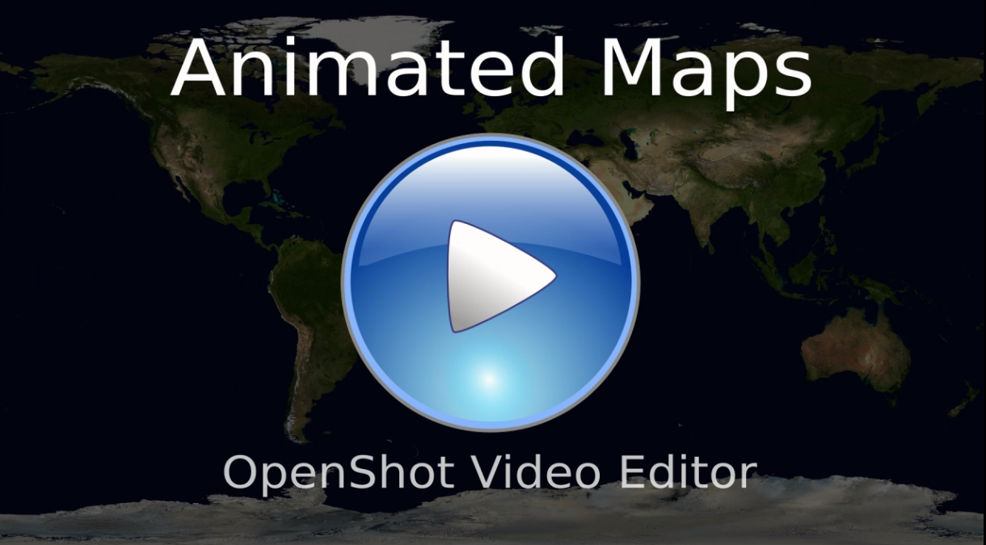
Animated Map Simulation!
Click here to watch this video

Slide 14
Compositing Demo Video
The following video demonstrates video compositing and layering:
Video 1: Raw Footage
Video 2: Edited with effects

Slide 15
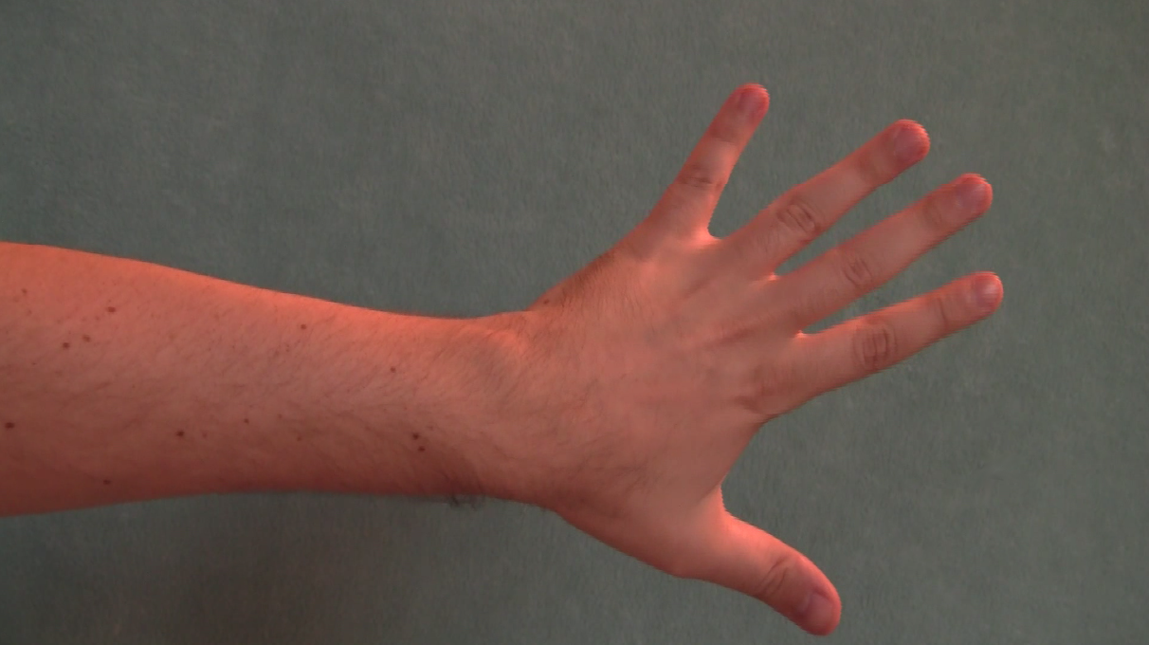
Compositing Demo: Raw Footage
This video is not available

Slide 16
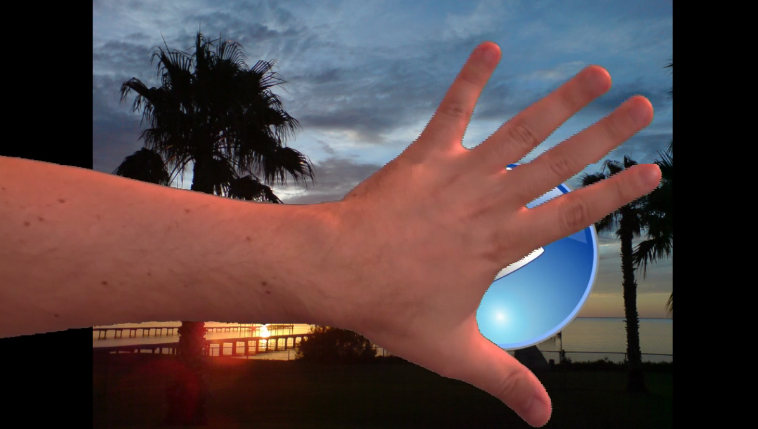
Compositing Demo: Edited
Click here to watch this video

Slide 17
Community
OpenShot is hosted on LaunchPad.net
16 developers contribute to our project. About 5 developers contribute heavily.
We have 2000+ members on Facebook
We have an active forum with over 500 users
We have a very popular blog, which keeps us connected to the community.
To join the OpenShot community, visit LaunchPad.net/openshot/

Slide 18
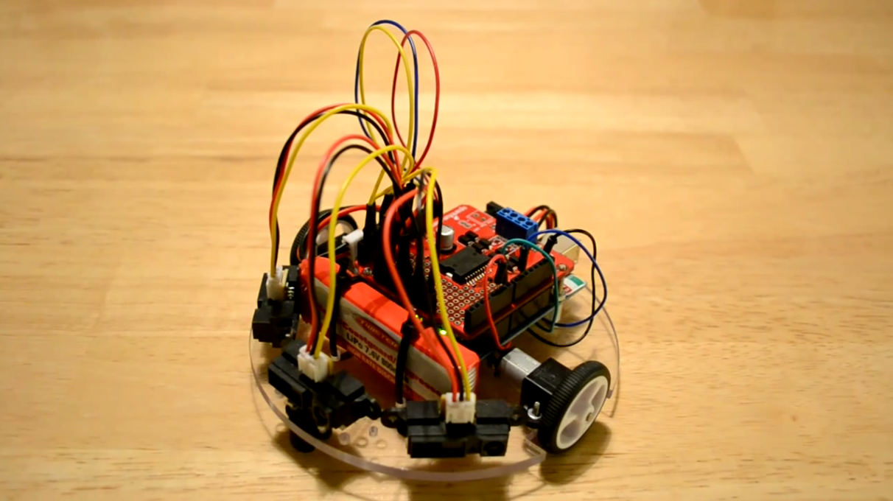
What Will You Create?
Click here to watch this video

Slide 19
What's Next?
Improved crop, zoom, and layout tools
Improved key-frame support
Improved audio support
More usability enhancements

Slide 20
Questions?

