Slide 1
about:openSUSE
SCALE 2011
Los Angeles, USA
Jos Poortvliet
openSUSE Community manager Novell
jos@opensuse.org

Slide 2
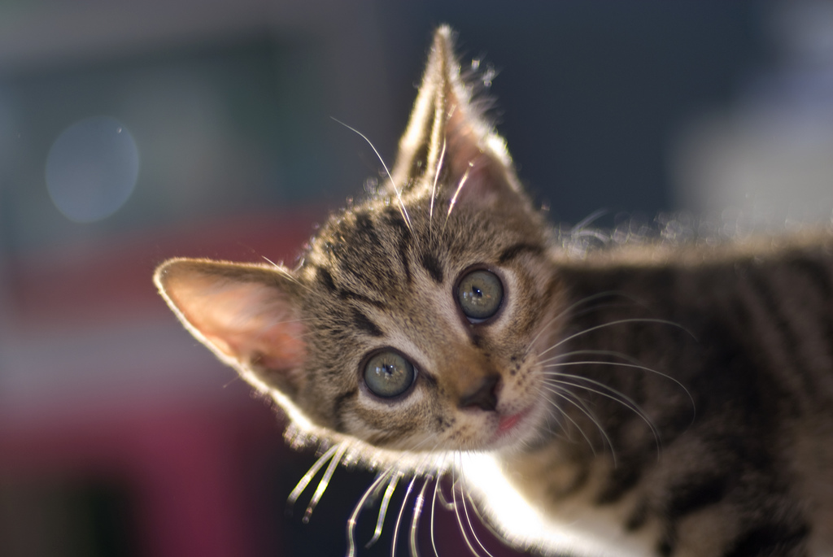
Me
Notes:
about me!

Slide 3
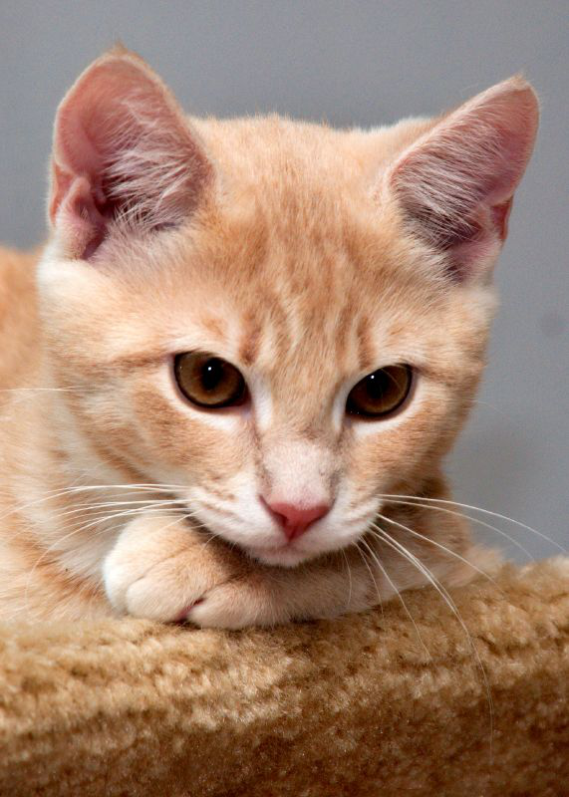
You
Notes:
why listen
Technology
community
Awesomeness
Agenda:
- openSUSE history
- openSUSE now
- openSUSE technology
- openSUSE Future
- questions

Slide 4
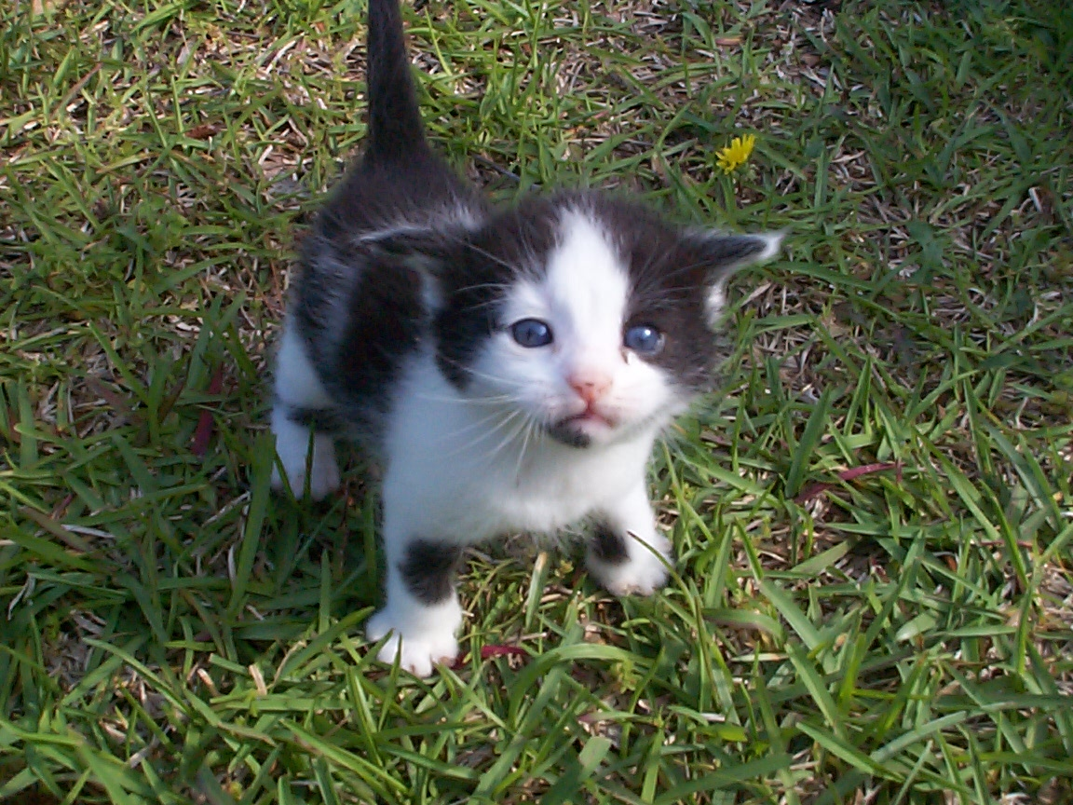
openSUSE
Notes:
openSUSE young?
SUSE GmbH 1994 - oldest commercial linux distro.
Older than Debian and Red Hat. Initially German translation of Slackware!
Novell bought SUSE in 2004.

Slide 5
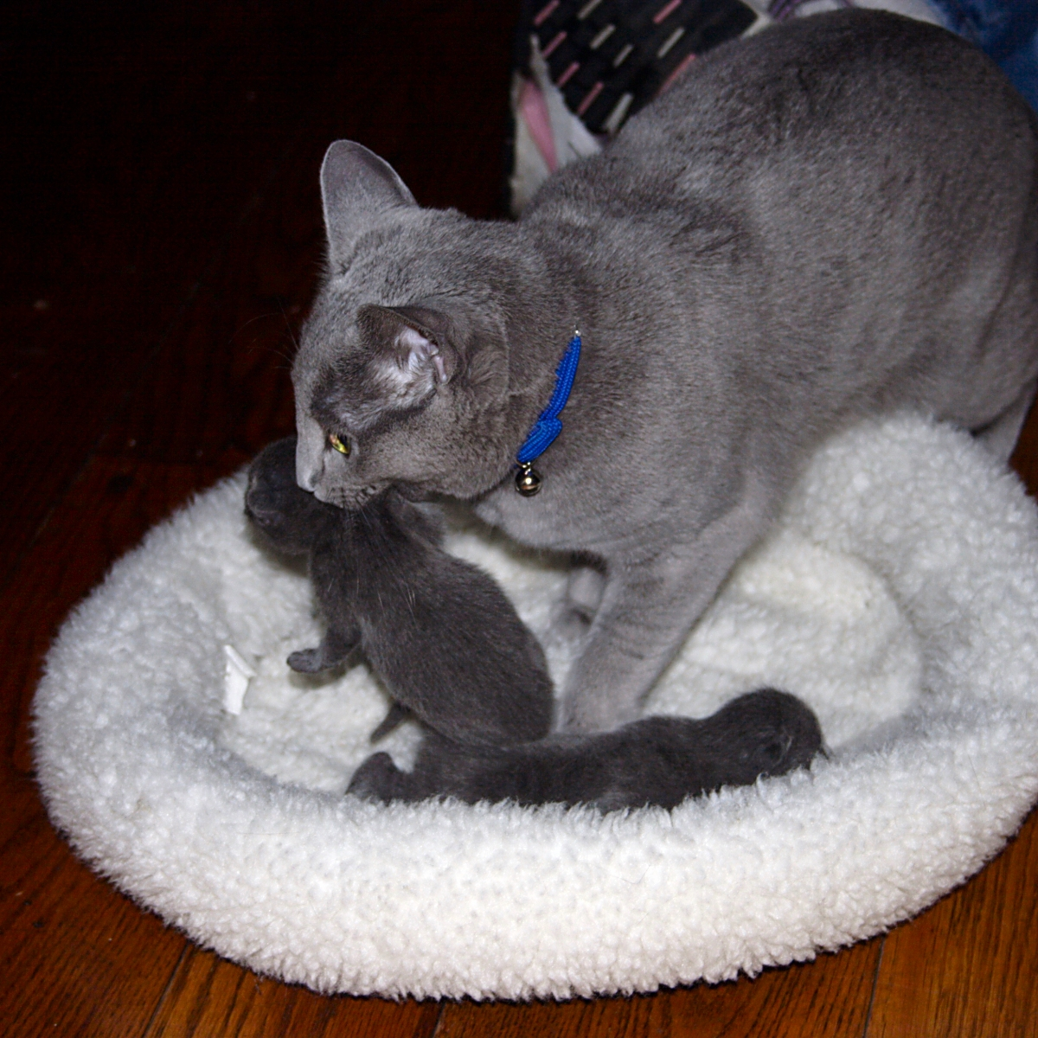
Novell
Notes:
Role of Novell
consumer version of SUSE not very interesting so it became free. Later on decided to open up development - community development ensured openSUSE was what users wanted.
Goal of Novell simple: make openSUSE successful

Slide 6
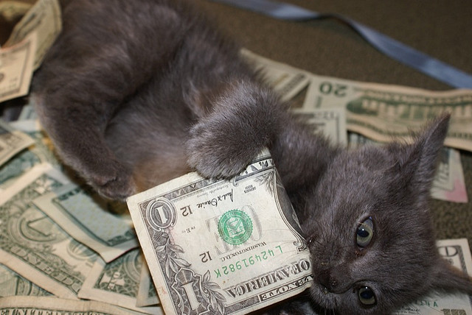
Business
Notes:
Business model Novell
openSUSE is and will stay free
Enterprise version with Hardening, Indemnification, hard- and software certification and professional support - costs (and thus makes) money.

Slide 7
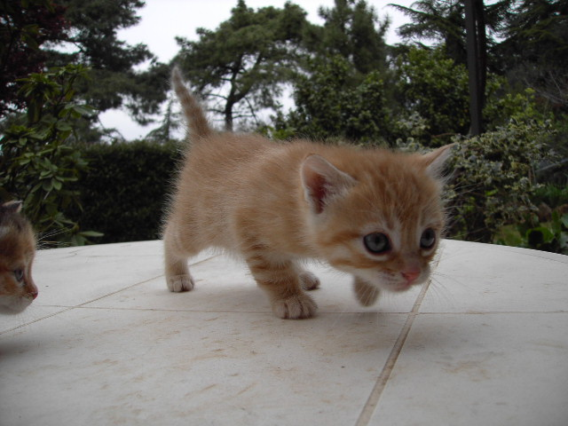
Strategy
Notes:
openSUSE young. Looking for it's spot - Strategy discussion (fedora now too)
Current conclusion:
not limit the user but empower them - as simple as possible but no simpler
New community: no red tape, very flexible
bottom-up unlike other commercial-sup communities
community is in charge, Novell interferes barely, no offical structures
In process of setting up an openSUSE foundation to govern the project by community
So openSUSE is a real free software project: open for newcomers, you can make a difference.

Slide 8
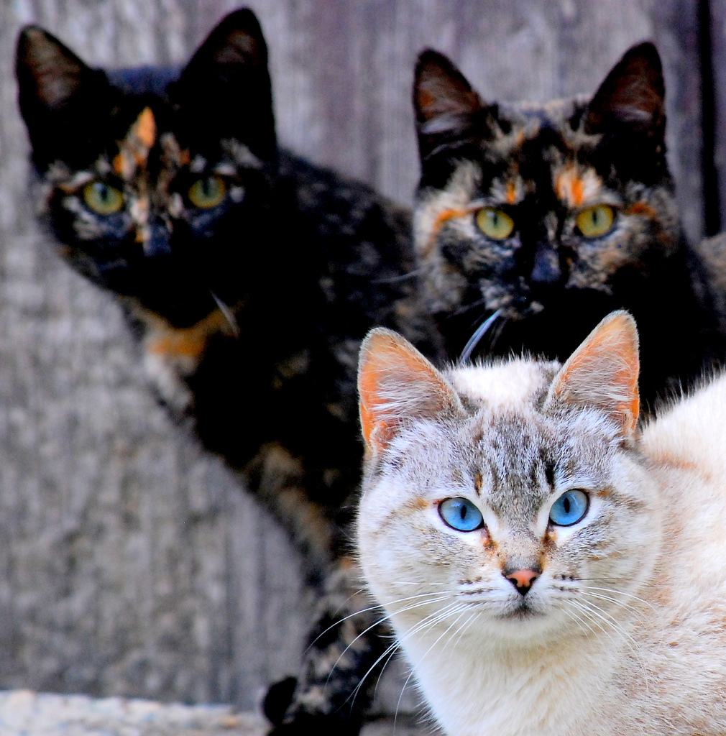
Others
Notes:
One more aspect: as FOSS community openSUSE very open for collaboration
"collaboration across borders" conference
- people from Red Hat, Debian, Mandriva...
- cooperate on dracut (mkinitrd replacement), pulse audio, systemd
- red hat developers even using build service
- push forward FOSS, not just openSUSE!

Slide 9
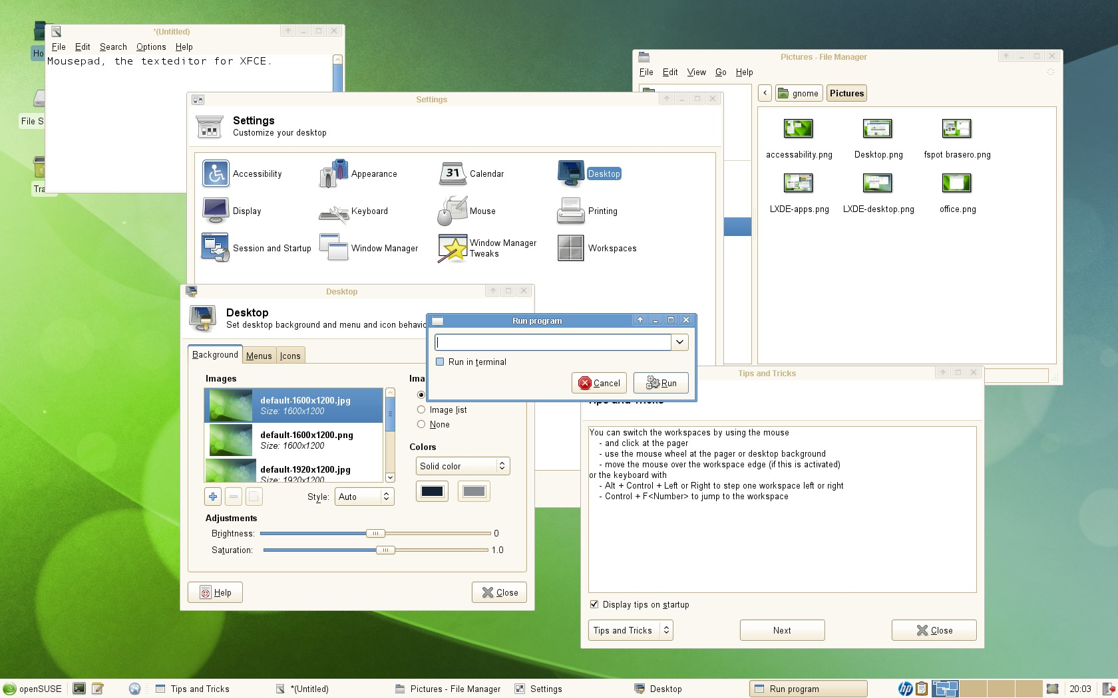
Notes:
openSUSE the distro: Choice.
XFCE

Slide 10
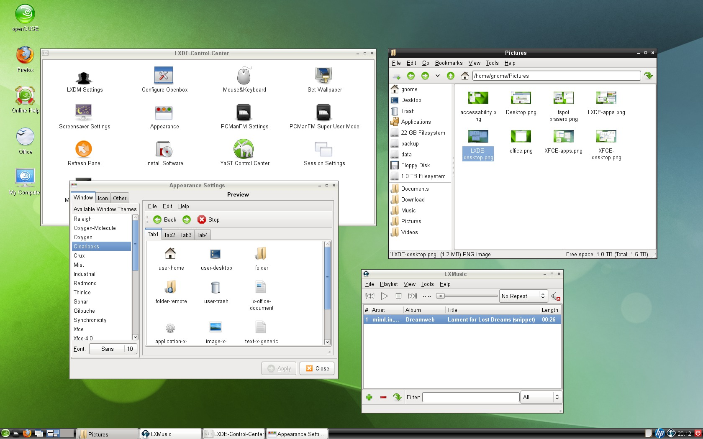
Notes:
LXDE

Slide 11
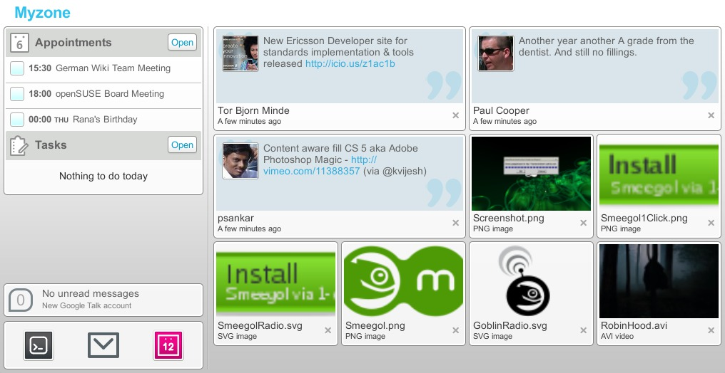
Notes:
Meego - Smeegol - community effort by Andrew "Funky Penguin" Wafaa and others
Really cool - we beat official MeeGo (tm) project (Linux Foundation) with the release in terms of date (few weeks earlier) and features!
Power of openSUSE community (and infrastructure!)

Slide 12
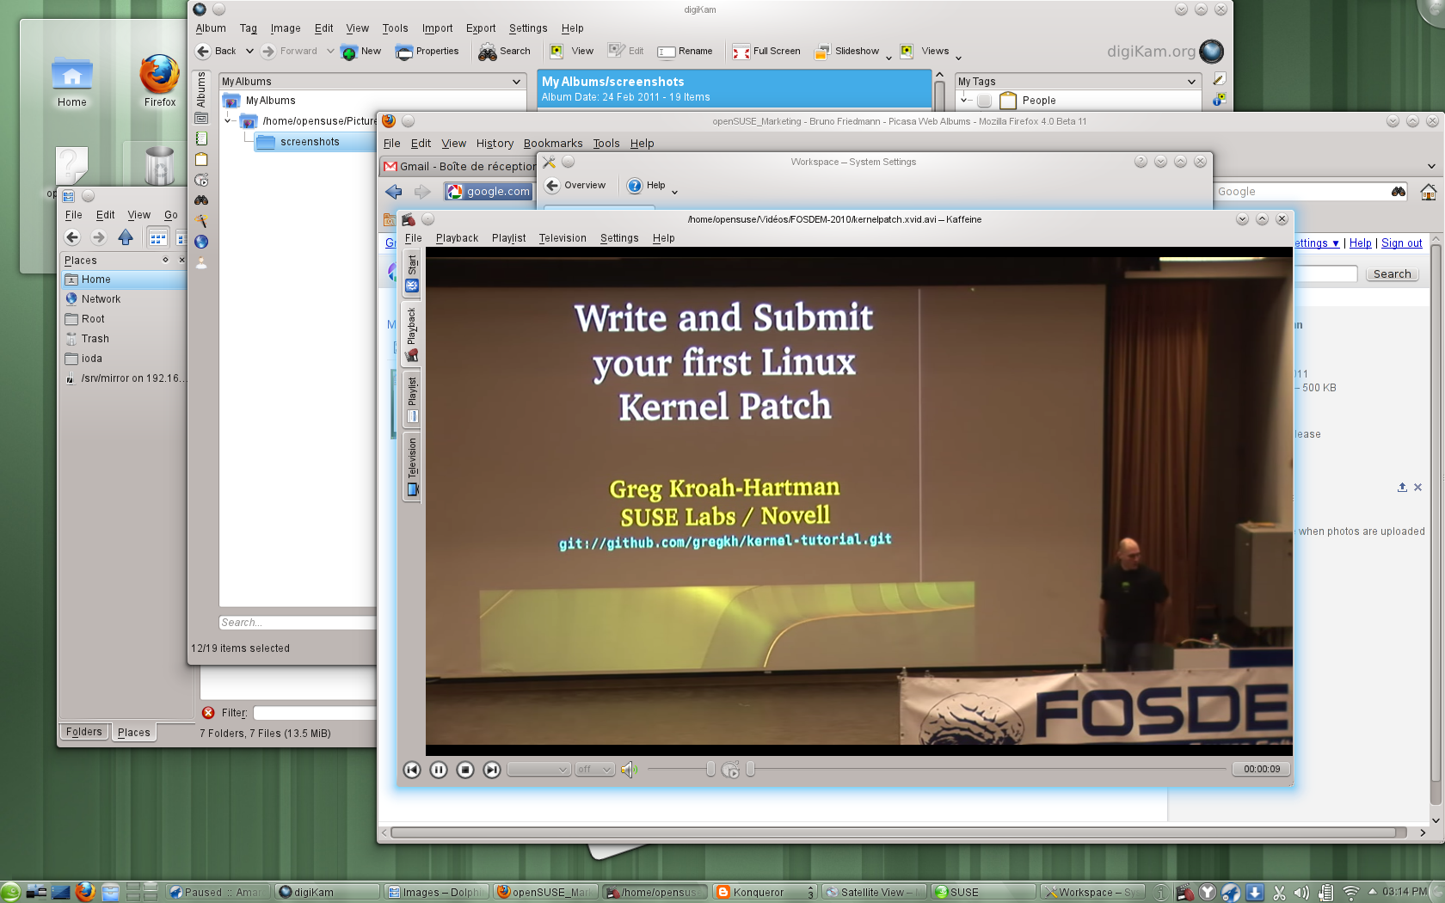
Notes:
KDE - Plasma Desktop

Slide 13
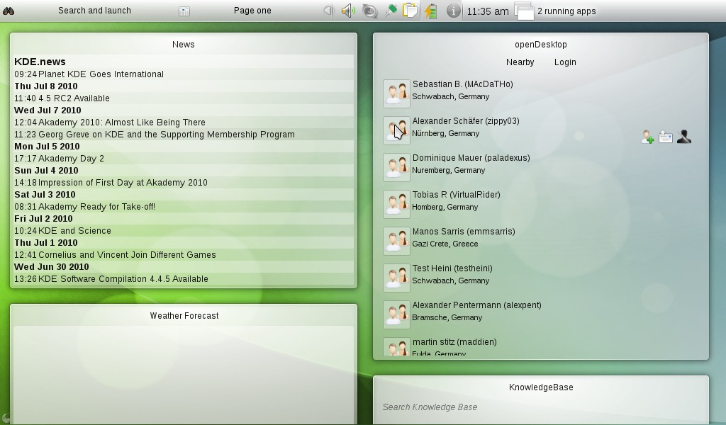
Notes:
KDE - Plasma Netbook

Slide 14
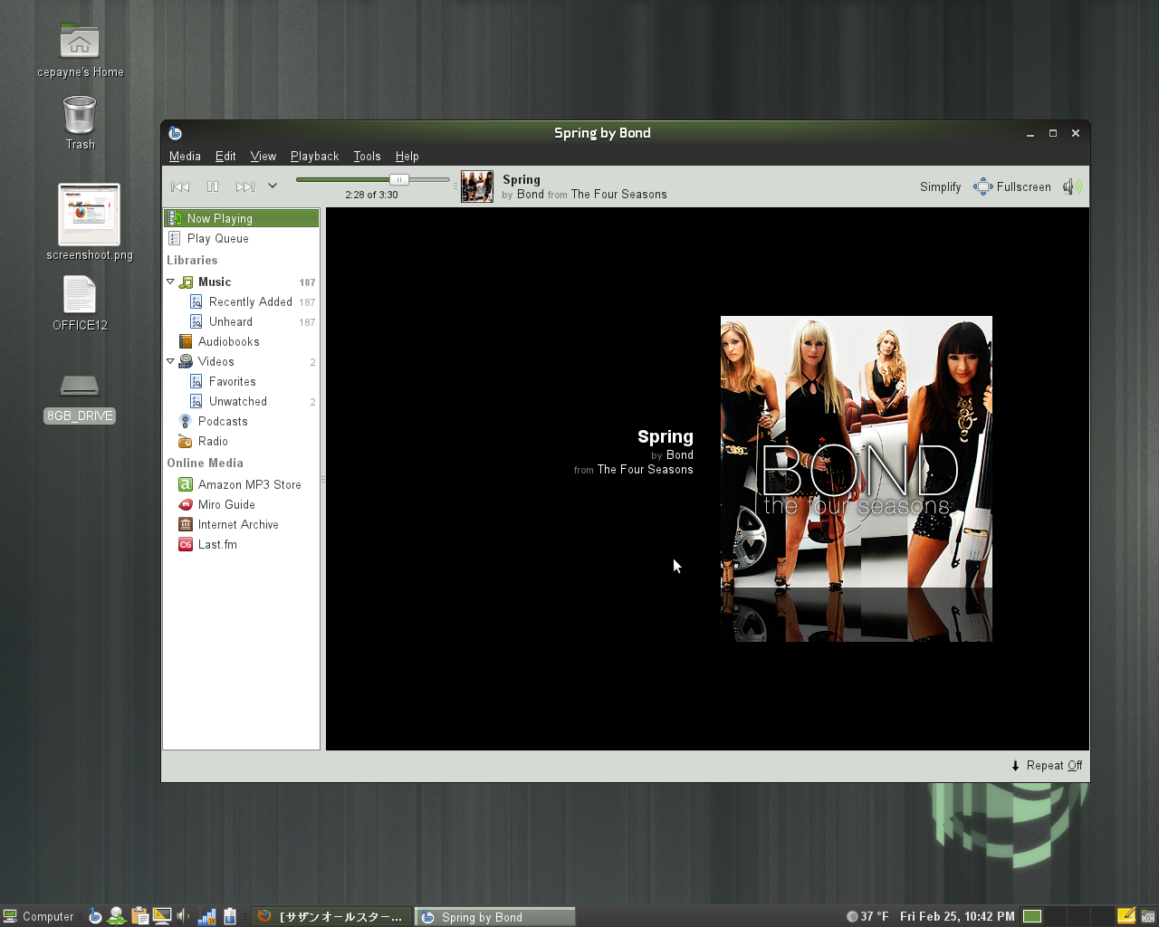
Notes:
GNOME 2.x desktop

Slide 15
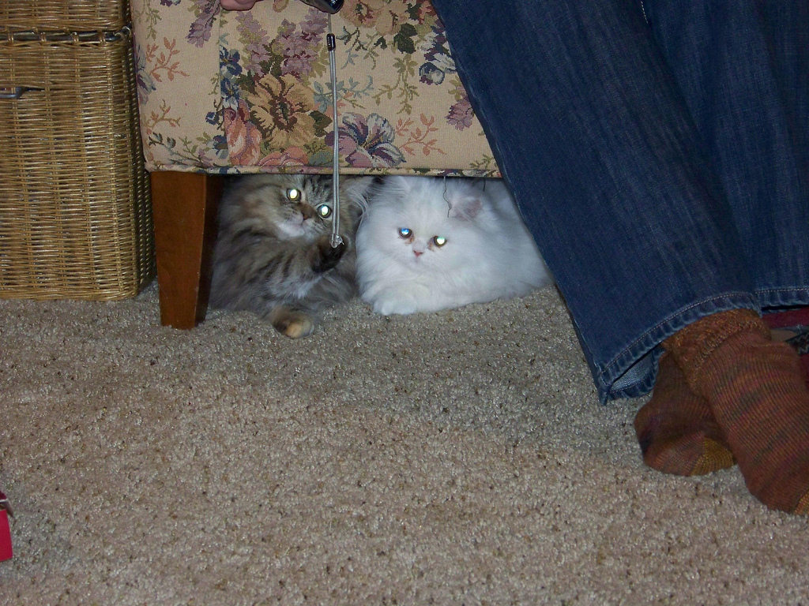
We are nice
Notes:
young
friendly
cooperative
open

Slide 16
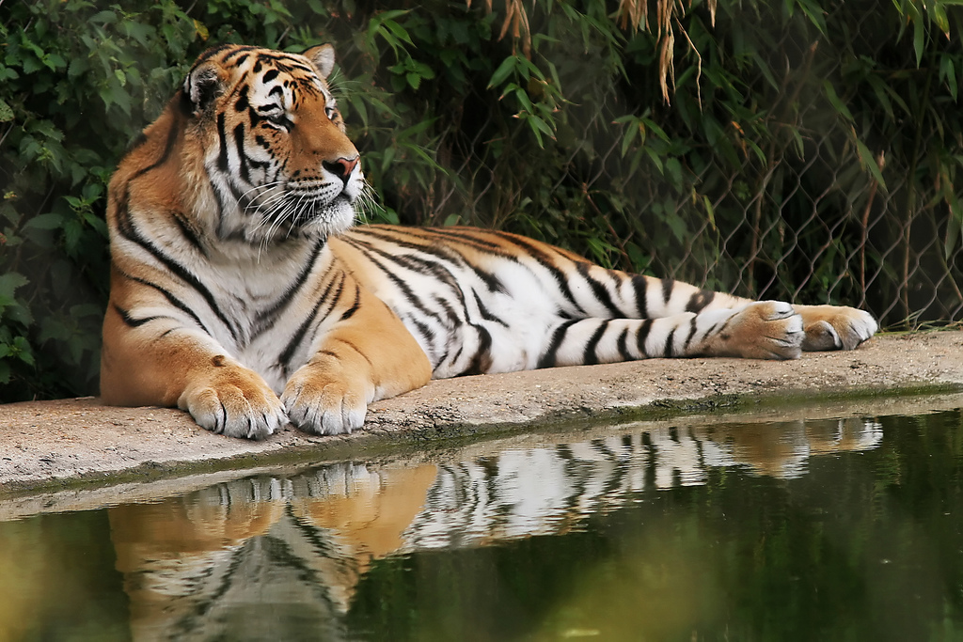
Beware...
Notes:
not complete pussy
Very powerful and unique technology
which is the next topic.

Slide 17
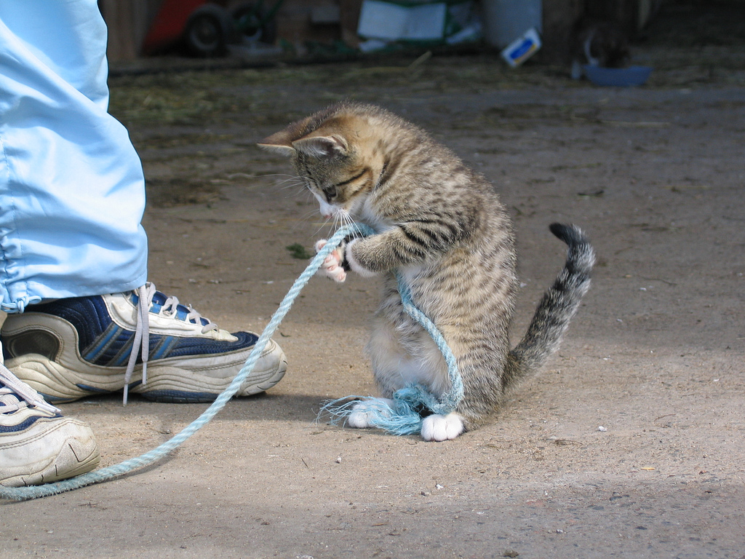
Hard work
Notes:
Build Service
The problem to solve: As developer you write software. How to get the product to many linux distro's and even other platforms?
Not an issue for established projects but esp for new ones!

Slide 18
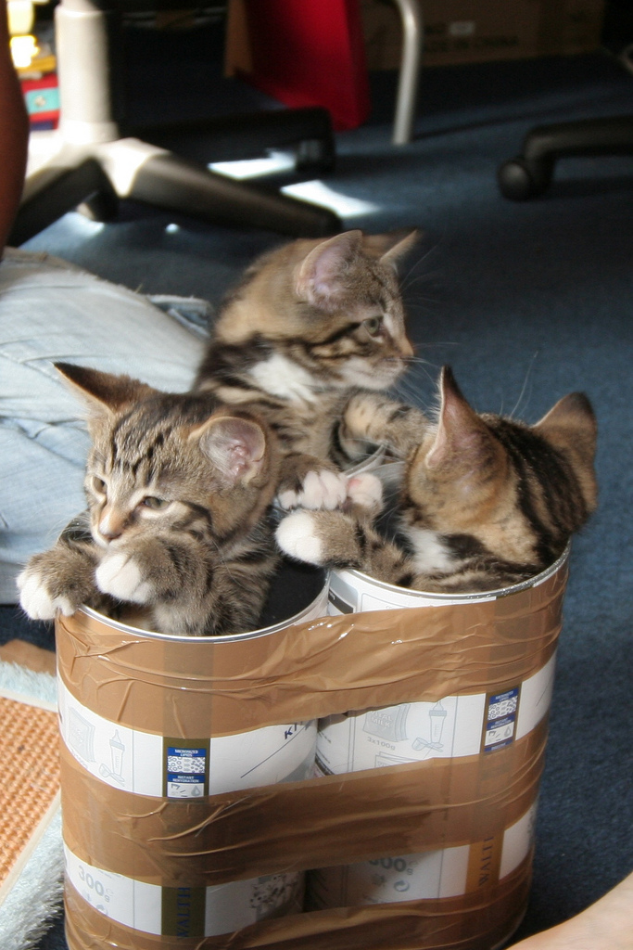
Packages
Notes:
solution: the build service
builds packages for 20+ distributions
Fedora/Red Hat, Ubuntu, Mandriva, SUSE (enterprise and openSUSE), CentOS etc
Windows in development
Mac possible
Let's go through it

Slide 19

OBS...
Builds RPM & Deb
Automatic rebuild when needed
Building in VM
Collaborative (access rights, teams)
Web interface and commandline
open source & development
Run your own OBS
external API (OCS)
Notes:
build.opensuse.org only supports x86, windows is experimental but MeeGo and other communities and companies use OBS for mobile (ARM) already. All major linux distributions supported: Fedora/Red Hat/CentOS, Ubuntu (incl LTS) and debian, openSUSE and SLE, Mandriva and more. OBS also has building of live/install CD's build in.
* OBS can get source code directly from GIT, SVN, CVS etc. Automatically rebuilds packages when dependencies change to avoid ABI issues; can rewrite dependency names for different distro's; can rebuild packages automatically if source code repository changes; and automatically rebuild live/install CD's if any of it's packages changes
* In projects teams can work together on a subset of packages. Has maintainers, access rights, merge requests etc etc
* Web interface (build.openSUSE.org) is easy to use; oSC commandline client offers a little bit more functionality
* Developed together with Intel, Nokia, Linux Foundation, Cray and many others
* You can dowload a liveCD to test running OBS; OBS instances can connect to each other. Used by MeeGo, Cray, VLC and many others to build anything from packages up to complete distributions.
* OBS supports the Open Collaboration Services (freedesktop.org spec) to make it easy to integrate with app stores. OpenSUSE project Bretzn is working on integrating in appstores like gtk-apps.org, kde-apps.org, MeeGo Appstore and more

Slide 20

Notes:
Center: Merge request
Right: Build status.
OBS users virtual machine (right OS & architecture) to build packages.
Installs dependencies - always clean, consistent and stable.
compilation errors fed back to developer.
Whole workflow can be done from web ui
contribute to openSUSE from a windows Netbook :D
OBS awesome so adopted by MeeGo (whole distro), VLC many others.

Slide 21
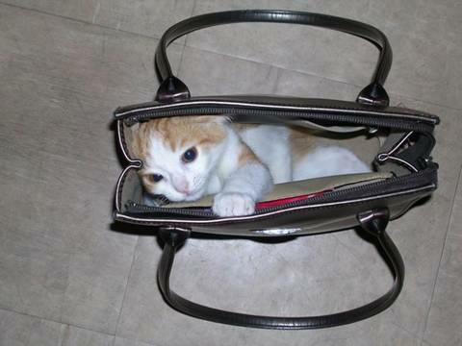
Tidy!
Notes:
So in the end you have packages for all major platforms! Awesome, right?

Slide 22
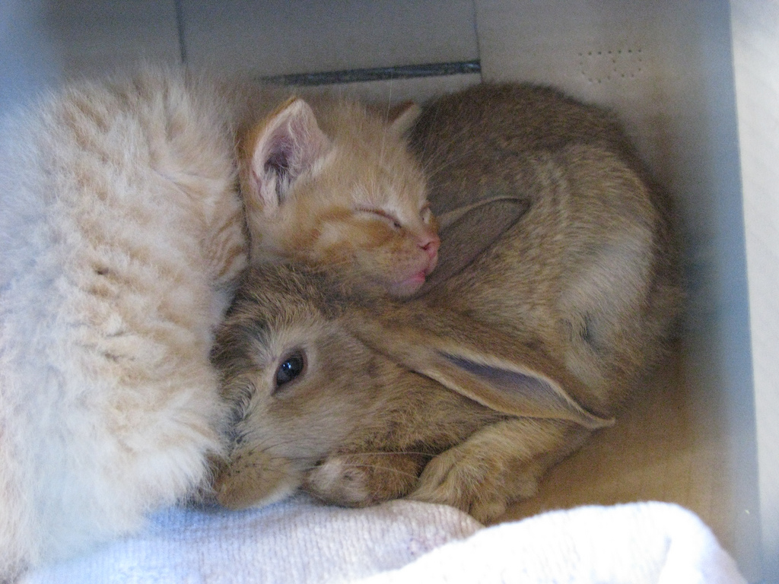
Collaboration
Notes:
Not all!
OBS is very collaborative platform
supports access regulation, multiple ppl working on one project, merge requests, commenting, reviewing - whole process of building a linux distro!!!
openSUSE uses it, but so does MeeGo and many companies and universities around the world. Easy, fast, powerful...

Slide 23
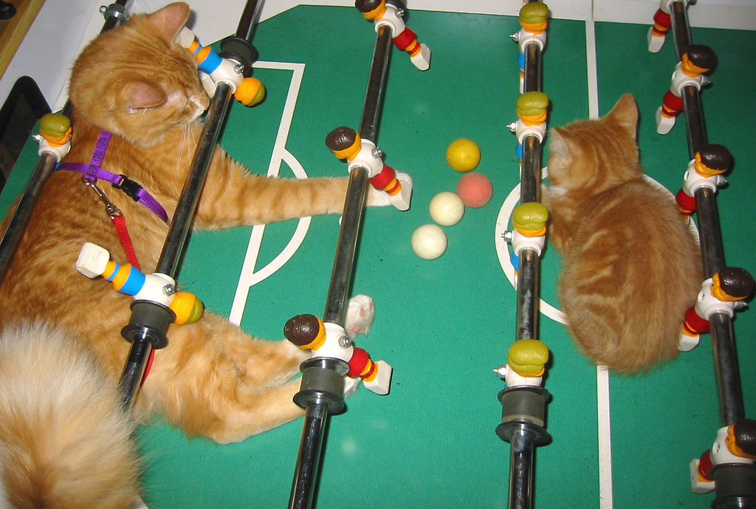
Come play!
Notes:
Go to build.openSUSE.org and play around!

Slide 24
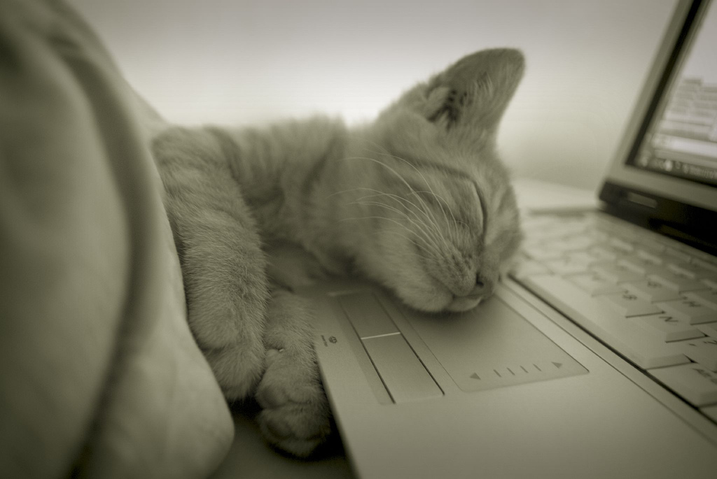
Not impressed?
Notes:
Now for those who are not convinced time for the next step:
SUSE Studio

Slide 25
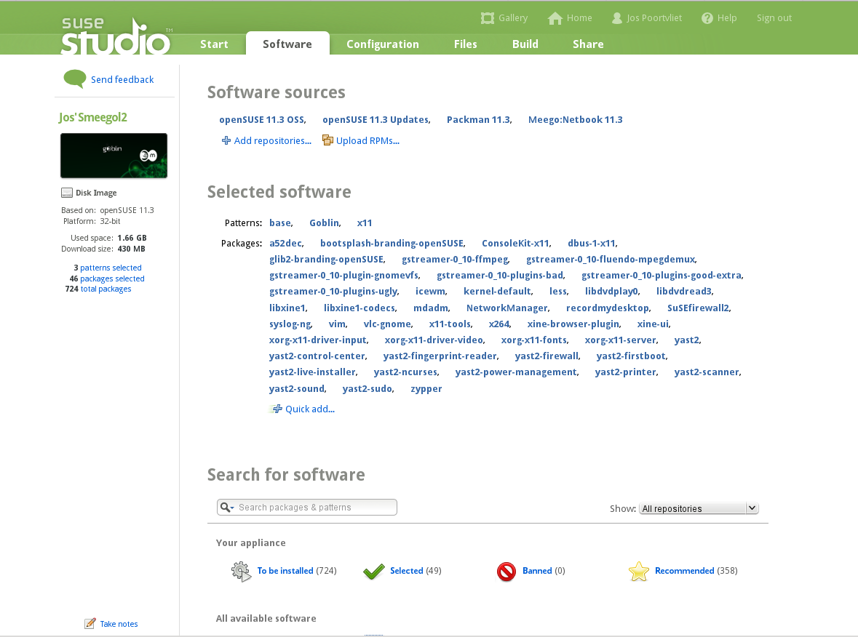
Notes:
SUSE Studio walkthrough - see screenshots.

Slide 26
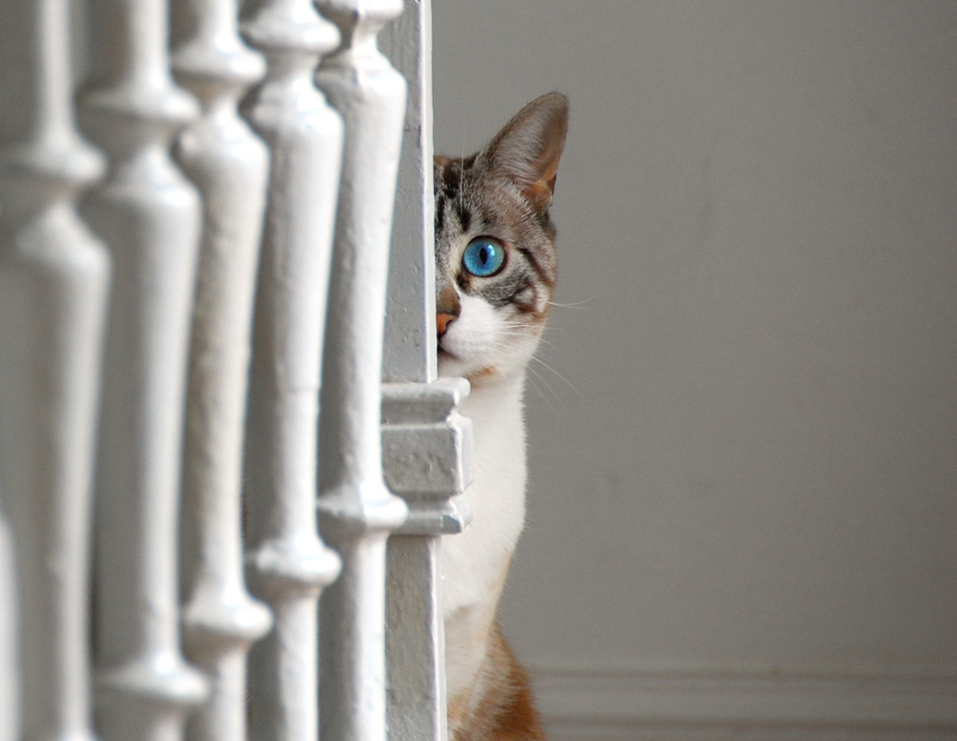
Upcoming
Notes:
move to future
latest & hottest projects

Slide 27
11.4
Coming 10th of March

Slide 28

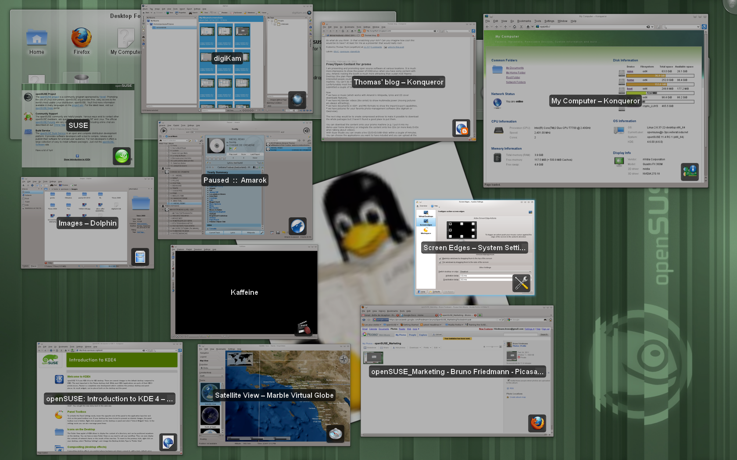
Notes:
Plasma Workspaces
Activities system
Revised power management
KWin new scripting language.
Plasma Netbook faster & touchscreen friendly.
Nepomuk backup.
BlueDevil,wizzards for device pairing, file browsing integration to KDE applications.

Slide 29
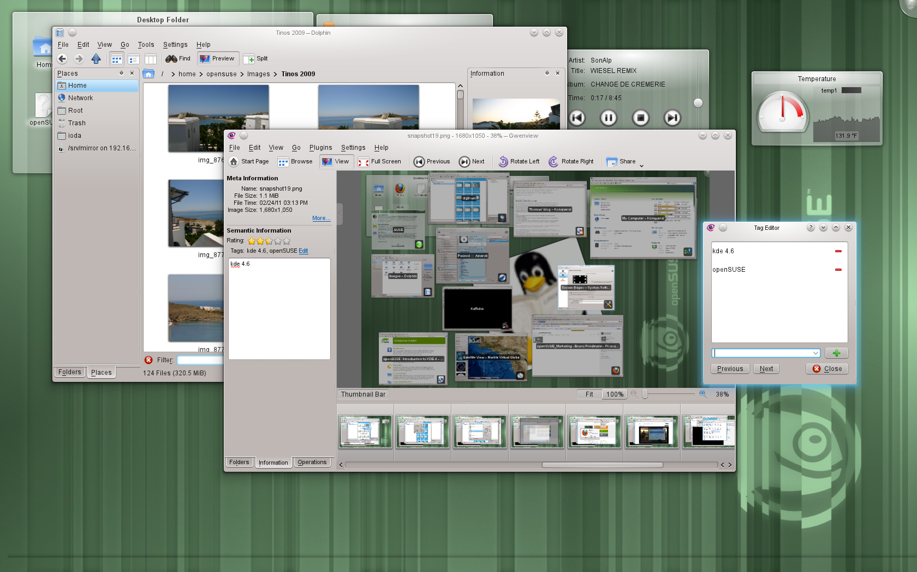
Notes:
Amarok 2.4.0 faster, write to audio files, MusicBrainz tag retrieval, Guitar and Bass tab fetching, upcoming events, UpnP.

Slide 30
Notes:
Media player Banshee 1.8 is the latest stable release and will be shipped by openSUSE 11.4. The most important highlights in this release are a Now Playing simplify mode, play queue shuffle action, better downloading of cover art, MusicBrainz ID support and improved Last.FM integration and several developer features like improved WebBrowser API for WEbKit browsers and DBus API additions. Finally, device support has been improved a lot. Among others, Banshee works more smoothly with the Droid X, Galaxy Portal, Xperia X10, Maemo and MTP devices in general.

Slide 31
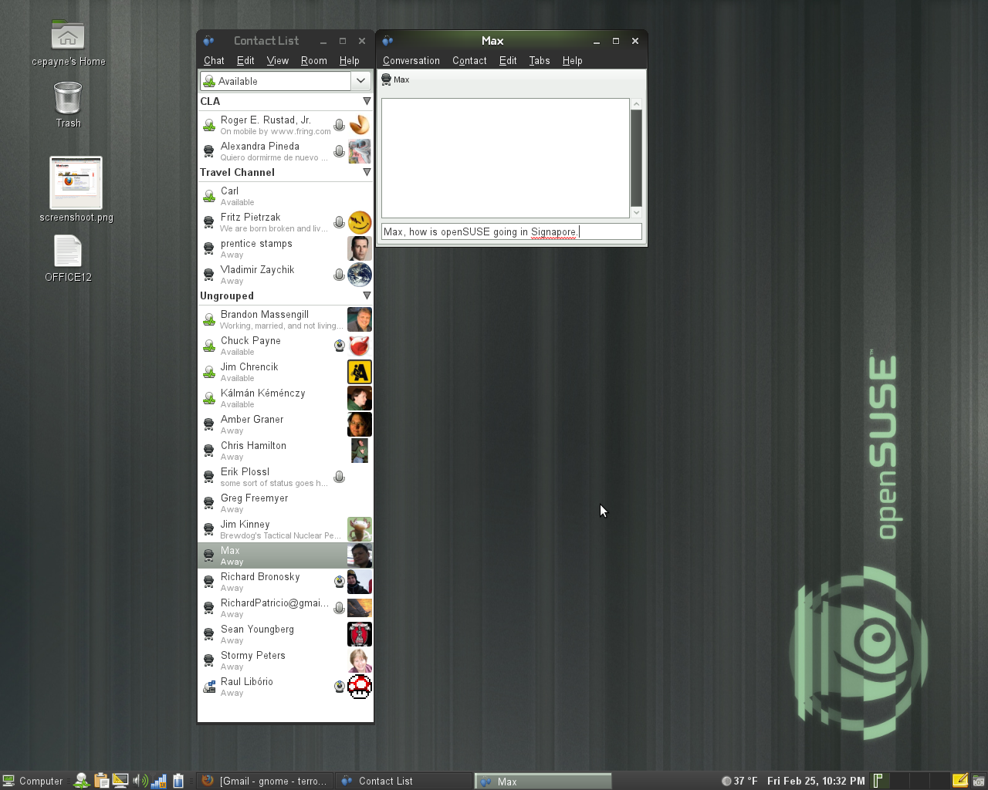
Notes:
- Updates to Empathy include user contact grouping with metacontacts, logging of chat records, and security certificate import.

Slide 32
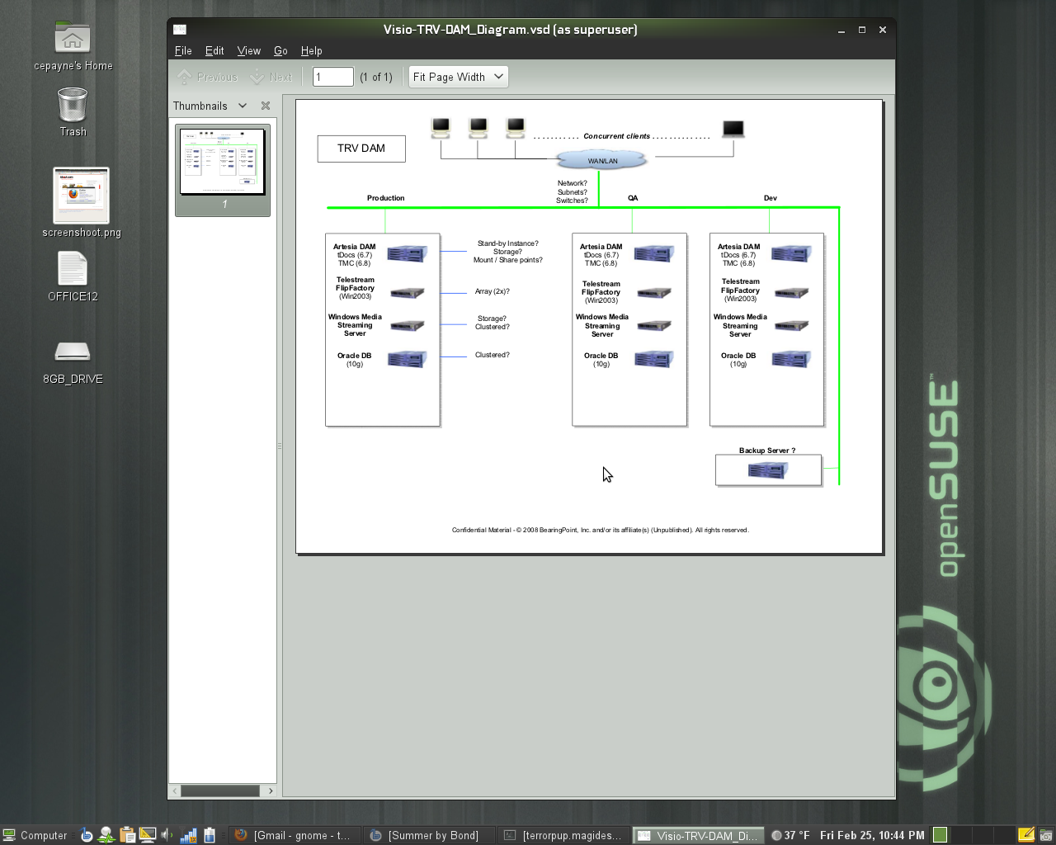
Notes:
- The Evince document viewer has improved accessibility support through the use of the AtkText interface, which allows Orca, the GNOME screen reader, to read documents in Evince. The maximum zoom level has also been increased when viewing a document. Annotation support has been improved and you can now add annotations from the side panel, change the default properties including author, color, transparency and more. Finally, SyncTeX support has been added to Evince. SyncTeX is a method that enables synchronization between a TeX source file and the resulting PDF (or DVI) output.
- Mousetweaks, which makes it easier to use a mouse for those users who may have limited mobility, has updated documentation

Slide 33
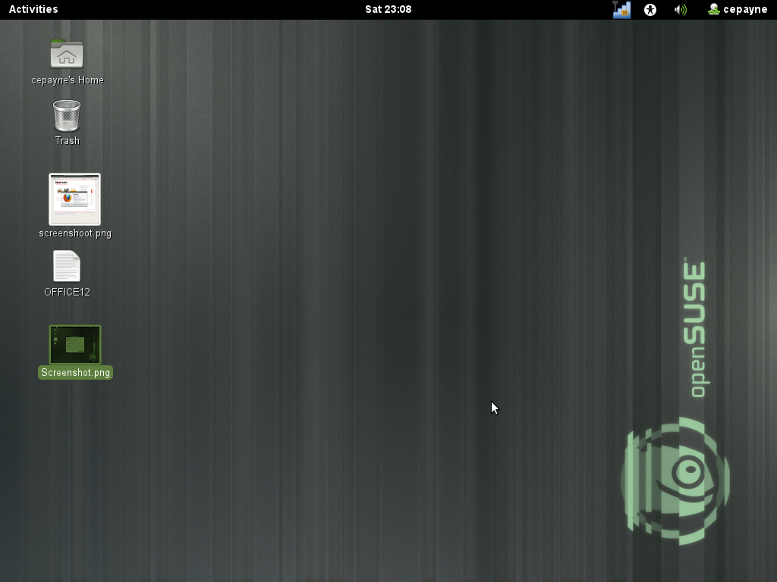
Notes:
GNOME 3.x Desktop (GNOME Shell)
GNOME Shell is the new face of GNOME. The goal of the project is to create a better design for the look and feel of the desktop and the key functions the desktop provides. These functions include enabling the user to find and open applications and documents, switch between various activities, and view incoming information such as chat messages or stock price updates.

Slide 34
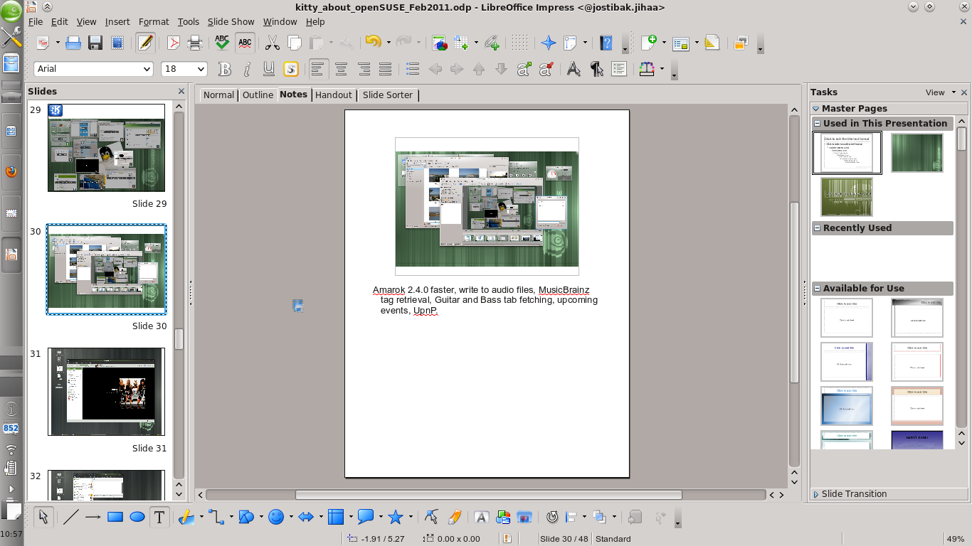
Notes:
LibreOffice 3.3.1 (SVG files in Draw, 1 million rows in Calc but real feature is community)
Firefox 4.0 – new UI, better performance, Sync between Firefoxes
Scribus 1.4.0 – Major rewrite, 1,5 year of work. Rewritten canvas (cairo), update to Qt4, usability.
Inkscape 0.48
* multipath editing
* improved text tool: subscript, superscript, numerical input for text kerning, tracking and more
* new Airbrush tool
* LaTeX export with PDF/PS/EPS
Krita 2.3 enduser ready. New features: brush settings presets, canvas rotation, warp transform, new color selector & new brush engines.

Slide 35
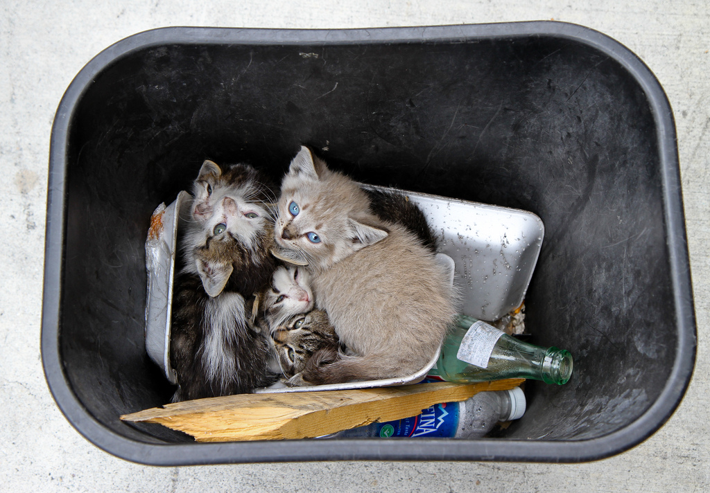
Down there
Notes:
Underlying:
Zypper: download delta's from multiple servers
Install: LVM, Encryption
2.6.37: hardware, memory management (performance)
Broadcom drivers, graphics
HAL gone
Experimental: grub2, systemd

Slide 36
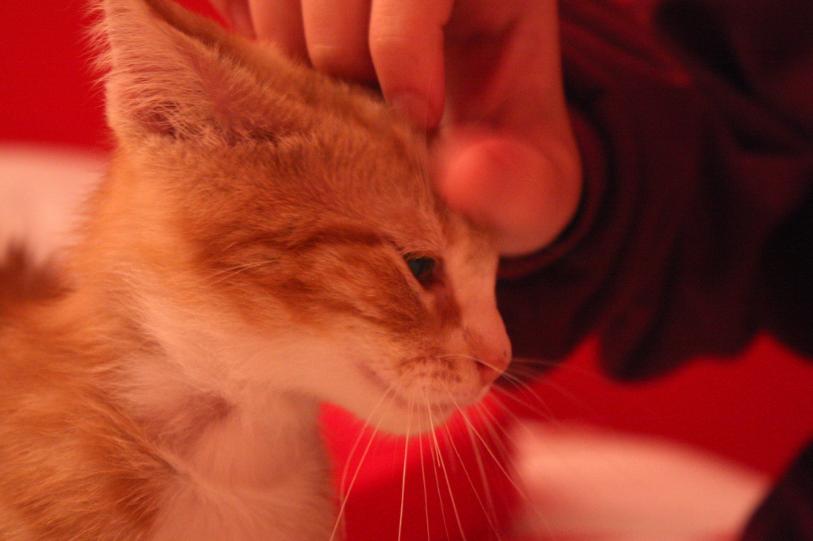
We take good care of sysadmins
Notes:
Databases: Sqlite, MySQL, PostgreSQL
Languages: perl, python, ruby
Servers: Apache, Tomcat, lighthttpd
VM: KVM, Xen, Virtualbox, Hyper-V support
Tools like Wireshark
YaST: set up server or VM in few clicks!
Developers:
All major IDE's, KDE & GNOME libs. LibreOffice split libraries – perfect to join them. Always known for best KDE and GNOME development. Latest Qt 4.7, GTK 3.0 available.. YaST: development libs in 1 click!

Slide 37
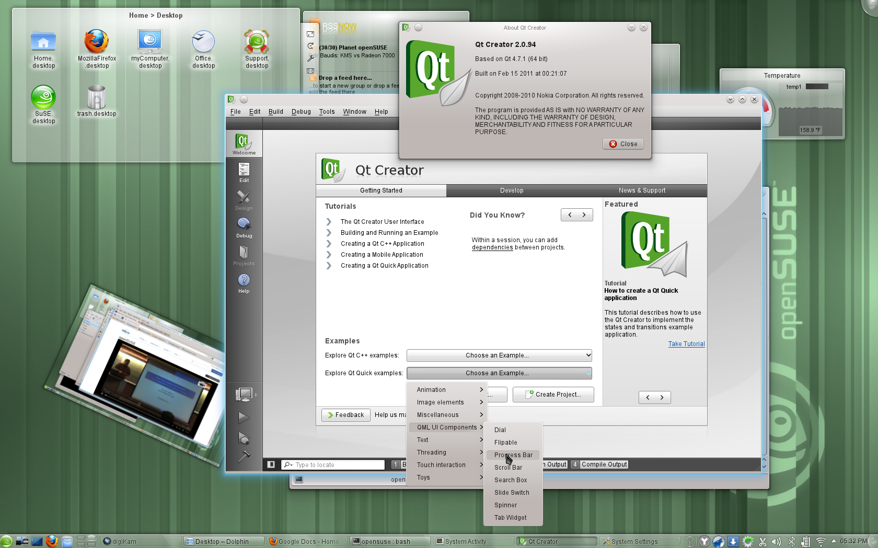

Slide 38
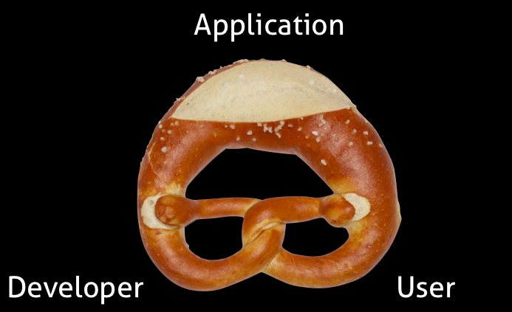
Notes:
Icing on the cake: collaboration with Project Bretzn (german pretzl)
Bring App developers and users closer together!
OBS solves building
but you need to distribute it pro-actively: website, bug tracker, submitting to app stores. Receiving complaints: "how do I build this" "it doesn't build" "where can I find package for <insert obscure distribution here>"
Still manual process. Utterly and completely boring for developer...

Slide 39
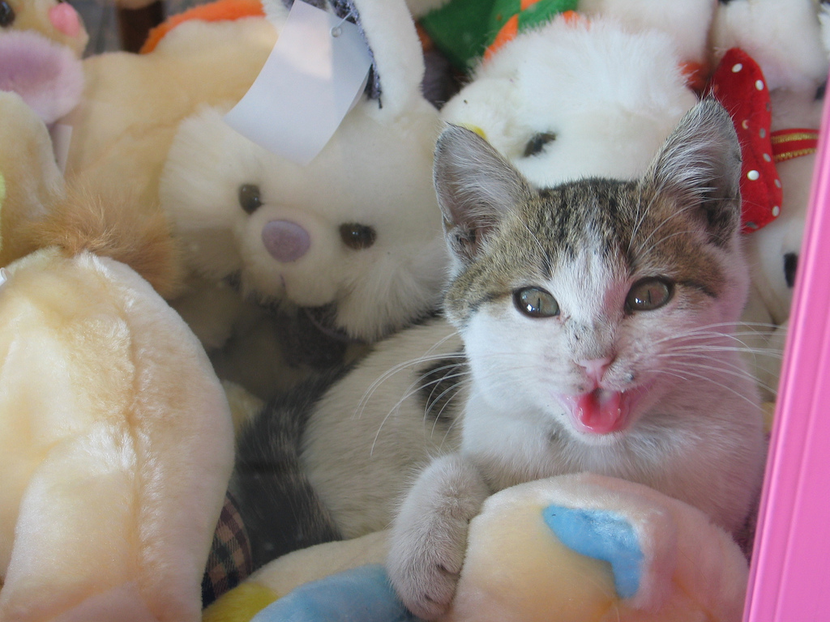
Together
Notes:
Bretzn ties it together:
Build Service (incl auto-generating build files, upcoming feature)
Open Collaboration Services (freedesktop.org API) for publishing
Appstores etc; social desktop, twitter, facebook etc
OCS again for feedback collection

Slide 40
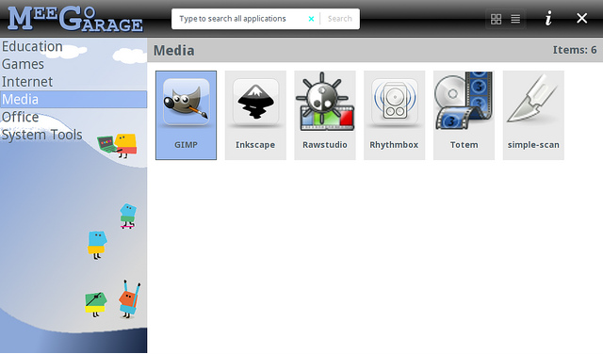
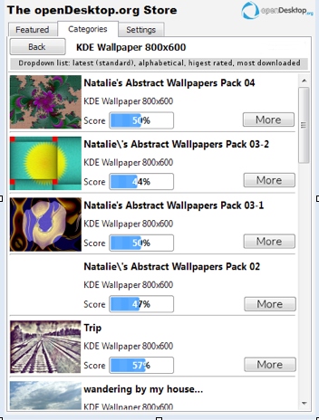
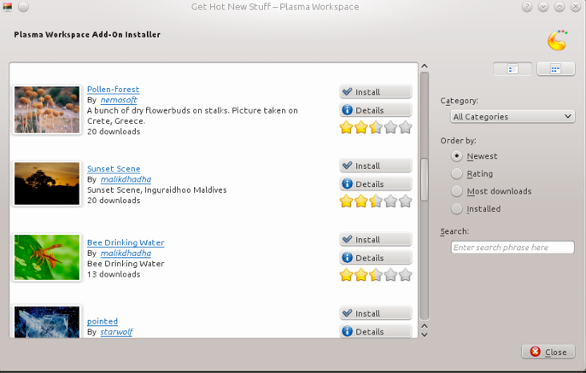
Notes:
Screenshot s howing some current app stores.
MeeGo, OVI, AppUp (intel), OpenDesktop (kde-apps, GTK-apps etc), Qt and GTK clients
Shipping December!

Slide 41

Tumbleweed
Notes:
Project Tumbleweed
Proposed by Greg Kroah-Hartman
Rolling release openSUSE
build upon OBS
Maintainers decide
Starting 11.4

Slide 42

SuperKitty!
Notes:
By now everyone has to be convinced. openSUSE = super Kitty!
Awesome technology
Great plans

Slide 43
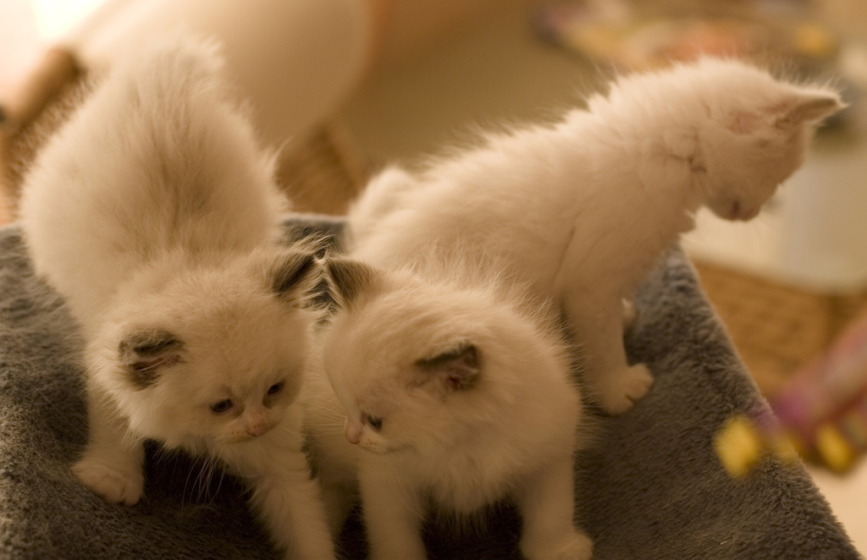
Cuddly kittens!
Notes:
Very FRIENDLY and CUDDLY superkitty!
A real Free Software community. Open, flexible, focussed on Freedom and opportunity, making a difference.

Slide 44

Newcomers welcome
Notes:
Which is always looking for new volunteers
people who actually want to make a difference!

Slide 45
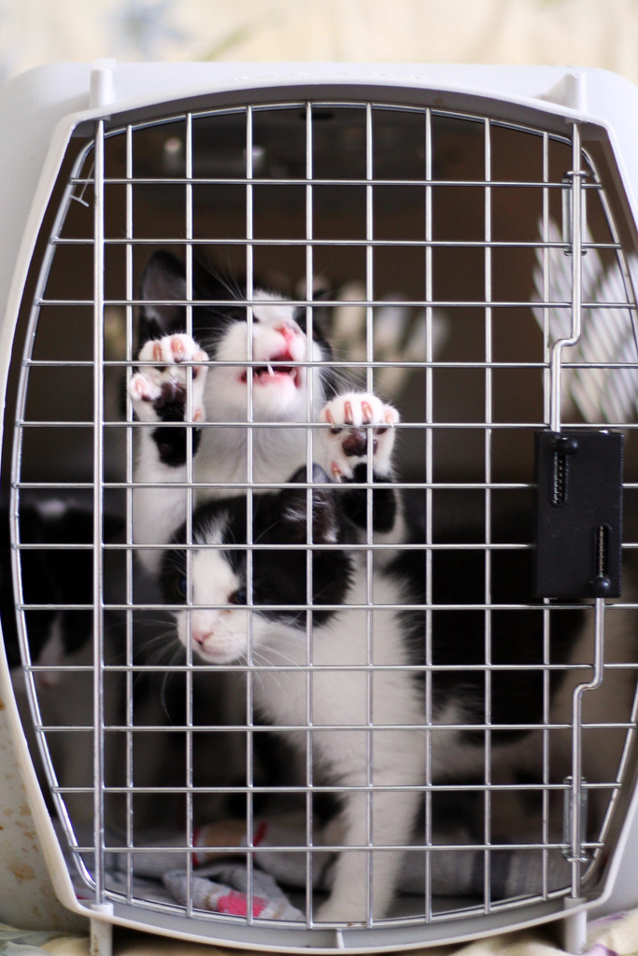
No barriers!
Notes:
Note - we don't lock you up :D
We don't tell you what to do or not to do. No limits. It's OPEN suse after all...

Slide 46
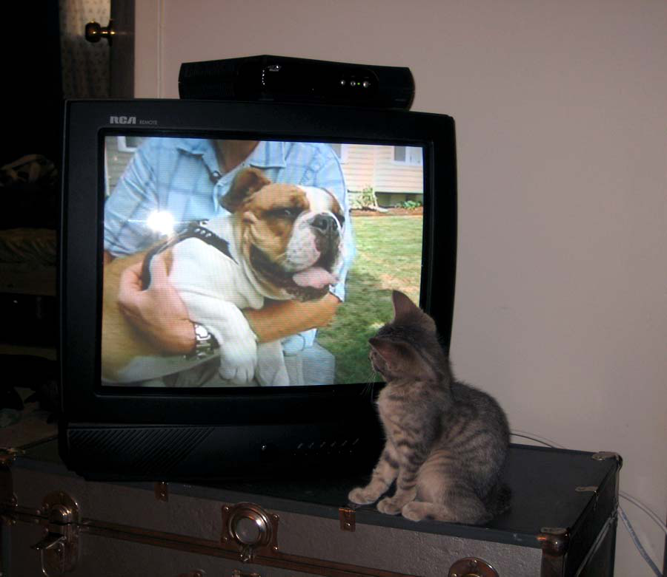
Stop looking in from outside!
Notes:
So if you no longer want to be looking from the outside-in...
Seeing those cool people do cool stuff...

Slide 47

Join the gang
Notes:
... come join us and have fun...
Try SUSE Studio, TRY OBS, play with us!

Slide 48

Be a Geeko/Kitten
Notes:
Be the Geeko you can be!

Slide 49
Kitty Image credits
Slide 1: Merlijn Hoek
Slide 2: artolog
Slide 3: Atli Harðarson
Slide 4: aloha orangeneko
Slide 5: ClintJCL2
Slide 6: Catpiper
Slide 7: eran finkle
Slide 8: Dan Coulter
Slide 9: cwalker71
Slide 10: clevergrrl
Slide 11: sensual shadows
Slide 12: marissa cap
Slide 13: dabogirl
Slide 14: pasotrapaso
Slide 22: cseeman
Slide 23: ian
Slide 26: anzaq78
Slide 27: metacheetr
Slide 28: anjaka
Slide 29: Clarea_vsAngel
Slide 30: ClintJCL
Slide 31: nathonline-beta
Slide 33: Project Bretzn
Slide 34: begemot
Slide 36: malingering
Slide 37: andreas solberg
Slide 38: abcrumly
Slide 39: freakgirl
Slide 40: tashalutec
Slide 41: malingering
Slide 42: angi_nelson
To be found on Flickr under the above names with a Creative Commons license. Thanks all!

Slide 50
Your next Linux Distribution!

