Slide 1
Web Application (LAMP*) Security
Attack and Defense for System Administrators
*LAMP (linux, apache, mysql, php/perl/python) application security.
Notes:
This talk will cover both some basic attack methods against most any website and simple defense tools that exist for the LAMP (Linux, Apache, MySQL, PHP/Perl) web server platform.

Slide 2
A little intro
Robert Rowley
Security/Abuse
DreamHost.com
Notes:
Dreamhost hosts 1million+ domains. (somewhere around 1% of the registered domains)
Pirmarily a shared hosting provider, who allows customers “free” reign to install what they want.
Handle security in a field where I'm not allowed to touch a customer's code, hence this specialize method of security.

Slide 3


Scenario:
Assessing and securing a (LAMP) web application as soon as possible when changing code is not an option.
Attack (Hired Pen test)
Cross Site Scripting (XSS)
SQL injection
Insecure Code
Defense (Sys Admin)
Application level (mod_sec)
Network level (snort)
File tampering detection
Notes:
Each of the attack and defense methods in this talk are only briefly covered due to time constraints (really this could be expanded to an entire day of discussion). In order or keep this talk relatively short I have included a list of links and resources for you to keep if you wish to continue learning a specific topic on your own time.

Slide 4
Backups!
  They are the first priority.
  They cover your ass.
  Asset for quick code comparison.
  Store on read-only media (CD, DVD etc..)
  Don't assume anyone else is already handled it.
But how should I back up my data?
Notes:
Backups, they keep your shit secured.
Ex: If a host is compromised the attackers may edit existing vital files and inject backdoors into them for later use.
Ex: Having a backup store on secured media, will allow you to either quickly re-upload the entire site or easily find discrepancies/changes.

Slide 5
Version control
rsync/tar work fine, but CVS, SVN, GIT, etc... are far better.
Use them, master them, love them.
They not only allow you to identify and quickly correct bugs, flaws, etc... caused by bad code (and help you identify bad coders). They can be used to mitigate attacks, allowing quick distribution of clean code.
Not only for code! Use SVN for configuration files, etc..
Having a code repository does not mean you do not need to keep backups! Backup your repository too (now use rsync/tar etc..)!
Notes:
While not necessarily security related, it's important to know if that new “problem” on the website was submitted by one of your developers or from an unknown source.
They also allow you to quickly re-upload clean (possibly insecure) code back to your site.
Keep backups of your version control file system.

Slide 6
Attack: Cross Site Scripting (XSS)
Type 1: Reflected attacks
The payload exists in the URL and the server side code re-prints the malicious content. (echo $_GET['varname'];)
Type 2: Stored attacks
The XSS payload is stored on the server (in MySQL, files etc..) and every subsequent request to the same page displays the injected payload.
Type 3: DOM attacks
Adjusting DOM attributes on the client's browser directly. (When designers go bad! javascript adjust data directly, nothing is actually handled in the server side code itself)
Affect:
Anyone who visits the page/link is initiating an attack on third party web servers
Mis-information, changing/reposting information on a credible website
Leaked information (javascript can access cookie information, HTTP variables etc..)
Notes:
Three types, and I will only show one attack with DOM and reflected examples, but technically all are persistant or “stored” attacks
Know the slight difference between these in respect to how you can mitigate attacks.
Have a greater goal.

Slide 7
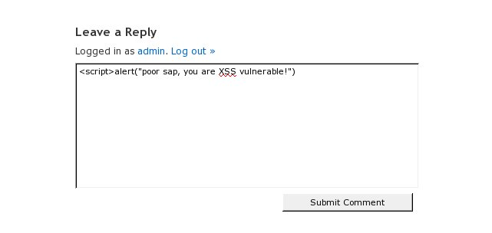
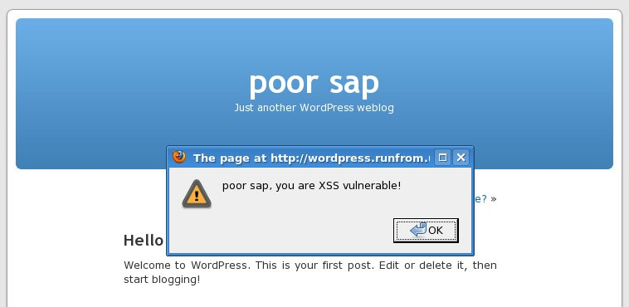
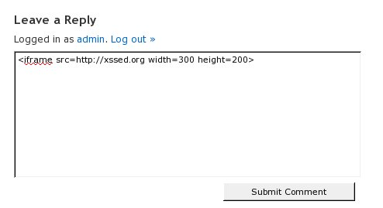
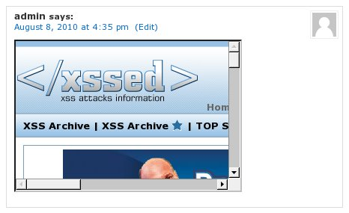
Leads to:
Leads to:
This really is just fun stuff, know enough javascript and you can cause major havoc or do a 0 height iframe for “click jacking”
Notes:
The top half shows the standard javascript alert() warning that a site is vulnerable.
The lower half shows that inframes can be easily injected. Typically they will use height=0 width=0 and use the site to force every browser to load a site under their control when the page is visited. (and have a custom attack to attempt to break into that person's machine)

Slide 8
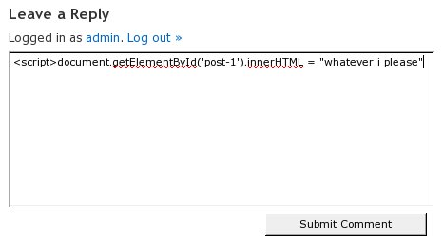
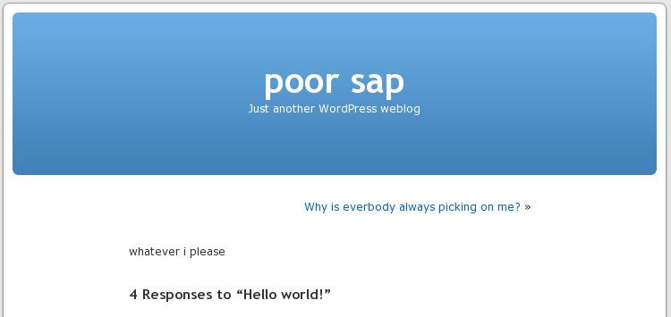
“FUN”
Notes:
For the real fun stuff, using javascript can allow you to edit effectively any component on the page.
Here, I just changed the entire blog post. (this was not SQL injection, this was all done via javascript)

Slide 9
XSS recap
While limited in it's abilities, that is it's strength. Most developers do not consider XSS a security risk leaving a plethora of vulnerable sites.
Familiarize yourself with the slight differences between persistent, reflected and DOM XSS attacks
Study javascript and be multiple browser compliant.
Notes:
See slide

Slide 10
Defense: mod_security
Apache module to quickly mitigate and prevent identified attacks.
Notes:
mod_security is an apache module (loaded in at run time, or compiled in) which acts as an application level firewall.
It has some great benefits compared to a normal firewall, as well as some shotcomings.
It is fairly easy to get setup and with a good ruleset will serve you well.
Extendibility with scripting (lua, etc..)
+trustwave bought the company who devels it

Slide 11
You will need to first install mod_security and then include it in your apache configuration. Instructions vary, but modsecurity.org has what you will need.
(example httpd.conf changes after the .so has been compiled)
LoadModule security2_module modules/mod_security2.so
SecRuleEngine On
Include conf/modsecurity.conf
...
Now all you will need are rules!
There are extensive rule sets available at gotroot.com and owasp.org
but ... it is always best to roll your own.
Here is a list of variables you will have available to scan/review:
ARGS
ARGS_COMBINED_SIZE
ARGS_NAMES
REQBODY_PROCESSOR
REQBODY_ERROR
REQBODY_ERROR_MSG
XML
WEBSERVER_ERROR_LOG
FILES
FILES_TMPNAMES
FILES_NAMES
FILES_SIZES
FILES_COMBINED_SIZE
ENV
REMOTE_HOST
REMOTE_ADDR
REMOTE_PORT
REMOTE_USER
PATH_INFO
QUERY_STRING
AUTH_TYPE
SERVER_NAME
SERVER_ADDR
SERVER_PORT
TIME_YEAR
TIME_EPOCH
TIME_MON
TIME_DAY
TIME_HOUR
TIME_MIN
TIME_SEC
TIME_WDAY
TIME
REQUEST_URI
REQUEST_URI_RAW
REQUEST_LINE
REQUEST_METHOD
REQUEST_PROTOCOL
REQUEST_FILENAME
REQUEST_BASENAME
SCRIPT_FILENAME
SCRIPT_BASENAME
SCRIPT_UID
SCRIPT_GID
SCRIPT_USERNAME
SCRIPT_GROUPNAME
SCRIPT_MODE
ENV
REQUEST_HEADERS
REQUEST_HEADERS_NAMES
REQUEST_COOKIES
REQUEST_COOKIES_NAMES
REQUEST_BODY
RESPONSE_LINE
RESPONSE_STATUS
RESPONSE_PROTOCOL
RESPONSE_HEADERS
RESPONSE_HEADERS_NAMES
RESPONSE_BODY
RULE
SESSION
WEBAPPID
SESSIONID
USERID
Notes:
Compile, apt-get, rpm whatever. Install the module and get it into your apache configuration.
Now you can start adding rules, look at all of the optional variables you can scan
They're basic variables related to the request and response payload, as well as session, server information and the remote (visitor's) IP etc..

Slide 12
Here is a quick rule to stop those simple script/iframe injections via the WP comment form:
(contents of conf/modsecurity.conf)
SecRule REQUEST_FILENAME wp-comments-post.php chain,deny
SecRule ARGS:comment "(<script|<iframe)"
Check if the requested filename is wp-comments-post.php and chain (continue checking) with the next rule ...
Check if the argument (POST or GET) named “comment” has the string <script or <iframe.
If both are true then take the specified action (deny)
Over-zealous version:
SecRule ARGS "(<script|<iframe)" deny
Any argument (POST/GET variable) that matches the pattern “<script” or “<iframe” will be denied.

Slide 13
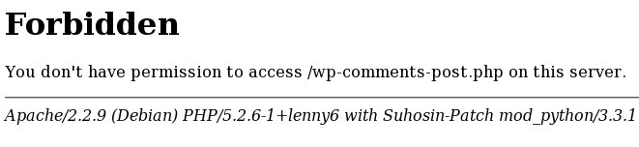
Remember from earlier?
Leads to:
Leads to:
Notes:
How awesome is that? You can prevent the XSS injection from ever taking place. This will also work for code exploits, SQL injection and anything you can imagine to detect using the access (variables) you have at hand.

Slide 14
mod_security recap
Pro
Prevents attacks from succeeding
Application level access (no worries about SSL needing to be intercepted/decrypted)
Very flexible rule sets
Extendibility with scripting
  (something for another time)
Con
Only as powerful as the rules used
Bad rules will create false positives.
Detectable by attackers, who can adjust their attacks
  (something for another time)
Notes:
See slide

Slide 15
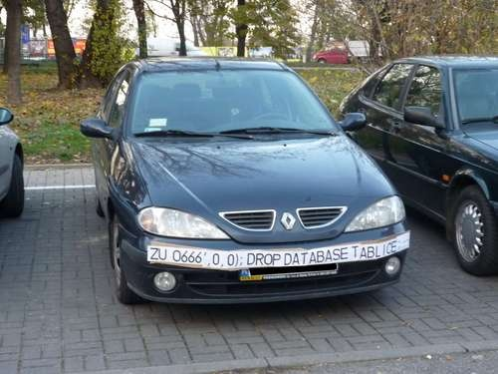
Attack: SQL injection
Do (almost) anything you want to the database!
Notes:
Never trust your visitor's input.
An SQL injection is basically piggybacking a malicious SQL query onto the tail of an existing (insecure) query.
Typically this is when the coder expected the user to input something that doesn't have a quote or other special character in it (maybe they used javascript to secure the form? Too bad that is useless).

Slide 16
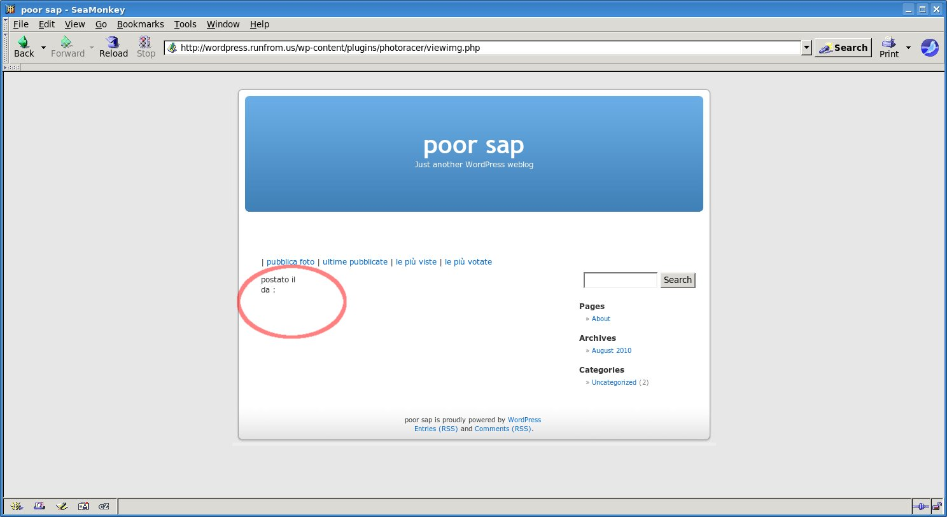
SQL injection with “photoracer” plugin.
Notes:
This is a wordpress plugin with a known (and simple) SQL injection vulnerability.
Notice the circled area. It's happily not printing anything because I have not uploaded any images.

Slide 17
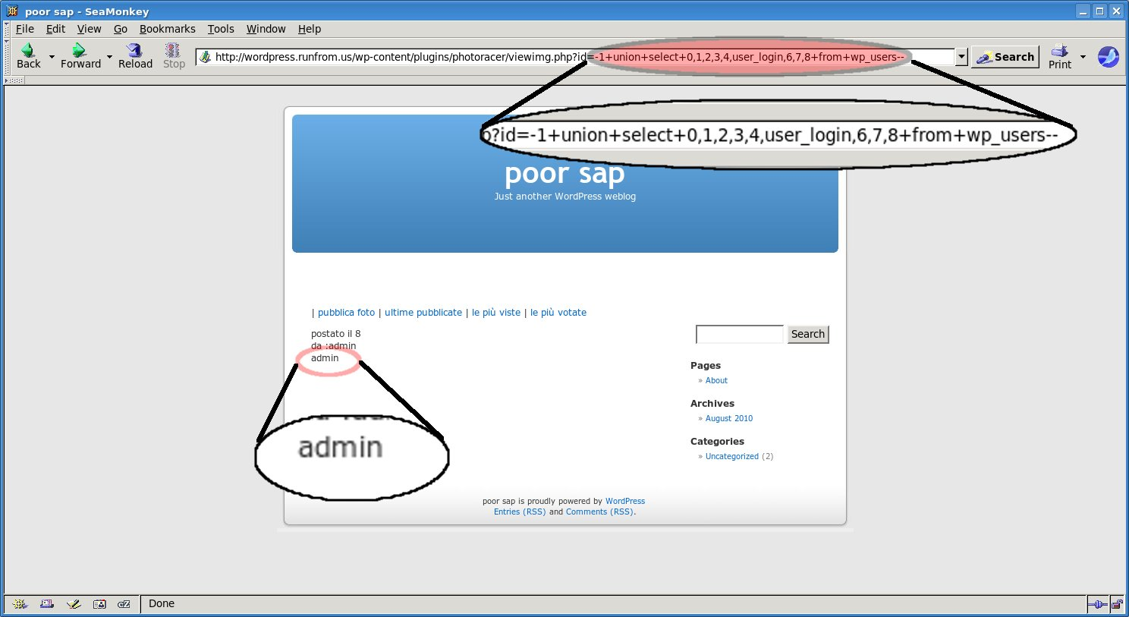
Simplest form, just add a union statement added to one of the GET/POST
variables that gets appended to the select query
Notes:
Now, I'm simply stating the id of the image I want to display is 1, oh yea and a union select statement.
The extra numbers are fillers for the select statement's response to make sure the data I want (WP's user_login) comes in the right place... more of this should be covered in a proper SQL injection talk.

Slide 18
Here is what went wrong in the code:
16 $imgid = $_REQUEST['id'];
17 $q1 = "SELECT raceid, wpuid, imgid, imgpath, imgname, imgcomment, sumvotes, imgcountview, tinsert FROM ".
18 $wpdb->prefix."photoracer WHERE imgid=$imgid";
19
20 $out = $wpdb->get_row($q1);
...
157 "da :".get_author_name($out->wpuid)."<br/>".
158 $out->imgcomment."<br/>".
Expected SQL statement:
SELECT raceid, wpuid, imgid, imgpath, imgname, imgcomment, sumvotes, imgcountview, tinsert FROM wp_photoracer WHERE imgid=10
Injected SQL statement:
SELECT raceid, wpuid, imgid, imgpath, imgname, imgcomment, sumvotes, imgcountview, tinsert FROM wp_photoracer WHERE imgid=-1 union select 0,1,2,3,4,user_login,6,7,8 from wp_users--
Notes:
Here is the only bit of code I'm going to show you in this talk (I hope)
It hopefully will clarify that you should never trust user input.

Slide 19
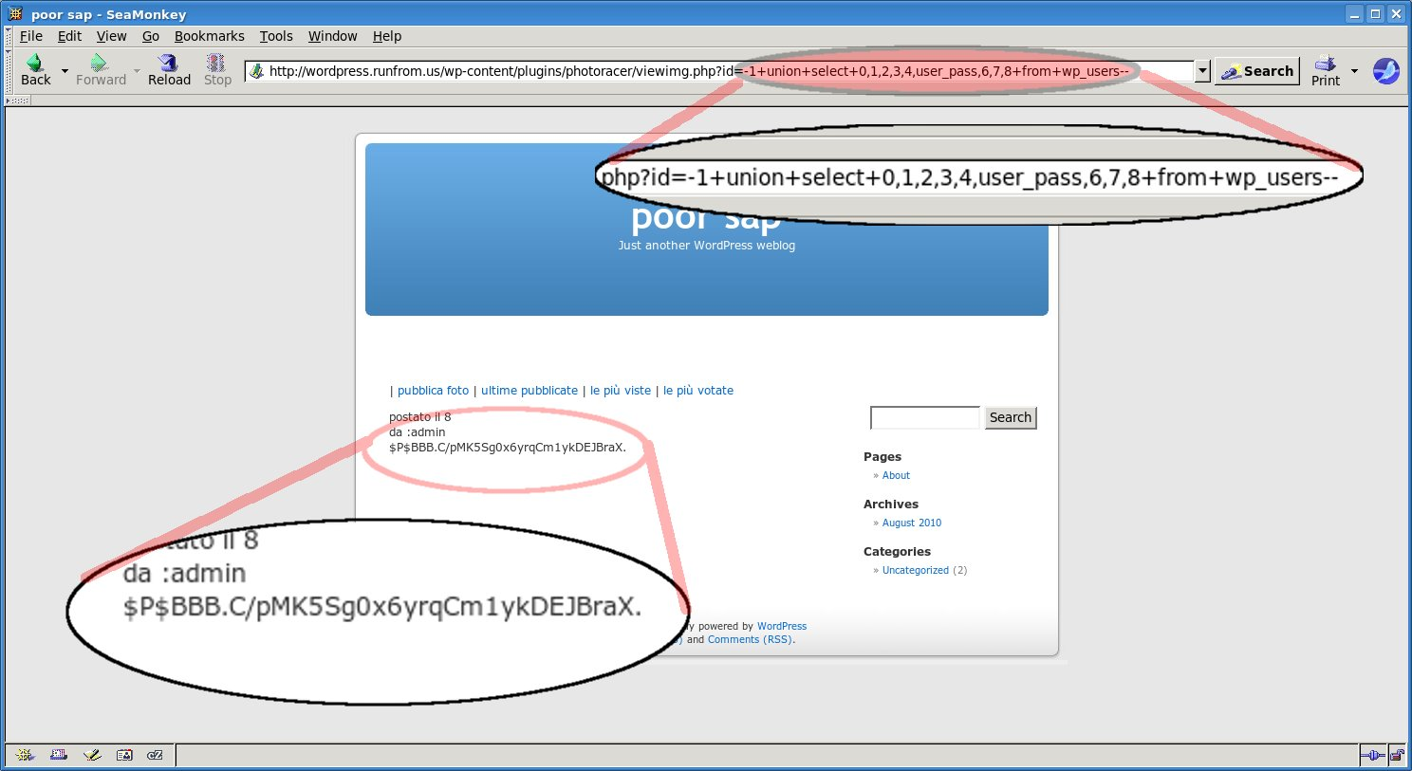
But wait ... there is more. Let's get some password hashes!
Notes:
Now, back to the attack ... having the login is fine, now how about we get the password hash, user_pass.
Run this through any password cracking utility and eventually you will have their blog's admin password.
This is not the MySQL login, just the blog. But that can have it's fun too.
You also are not neccesarily restricted to SELECT. You could alter data, add posts as well!

Slide 20
SQL injection recap
Requires an understanding of SQL statements
Very “noisy” if the database structure is not known
Time consuming (if not automated)
Can do more than SELECT based on user's privileges!
(DROP, ALTER, CREATE, GRANT statements are all possible.)
Notes:
See slide
noisy == detectable

Slide 21
DEFENSE: IDS/IPS (snort and more)
Excellent method to monitor network traffic and retrieve information on attacks.
Don't forget your whitelist!
Notes:
Seriously, don't forget a whitelist for any automated ip blocking.

Slide 22
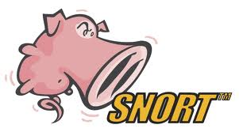
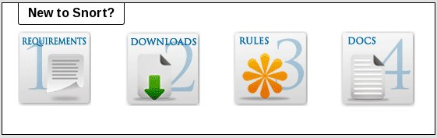
Snort is a widely used IDS (intrusion detection system)
Lightweight
Large user base for example rulesets and help
Snort can detect more than just web application attacks (unlike mod_security.)
Setup is easy: download, compile, configure, monitor and update!
By itself snort will only log the attacks for review, plugins like SnortSam/Guardian.pl will turn snort into a powerful IPS (intrusion prevention system)
Notes:
Snort is a widely used IDS and some prevention utilities for it.
Installing a basic snort setup is quick and easy, download the tarball or install from packages. The basic rulesets are sufficient, yet overkill; detecting way more than you may need like detecting MySQL, ORACLE, MS-SQL attacks all included in the basic rulesets.
lightweight and large user base for example rulesets makes it very user friendly. Snort runs on it's own and can detect more than just web application attacks (unlike mod_security.)
Setup is easy: download, compile, configure, monitor and update!
Remember, Snort is primarily a detection system. By itself snort will only log the attacks for review. Plugins like SnortSam/Guardian.pl will turn snort into a powerful IPS (do not forget to whitelist your own IP addresses so you don't block yourself!)

Slide 23
Example code to block the SQL injection attack:
alert tcp $EXTERNAL_NET any -> $HTTP_SERVERS $HTTP_PORTS (
msg:"SQL-INJECTION photoracer Sql Injection attempt";
flow:to_server,established;
uricontent:"viewimg.php"; nocase;
uricontent:"id=";
uricontent:"union"; nocase;
uricontent:"select"; nocase;
classtype:web-application-attack;
sid:100000691; rev:2;)
(detects http:// ... /viewimg.php ... id=...union...select...
What the attack looks like in the logs:
[**] [1:100000691:2] SQL-INJECTION photoracer Sql Injection attempt [**]
[Classification: Web Application Attack] [Priority: 1]
08/08-23:26:50.252829 67.159.5.99:39314 -> 66.249.129.23:80
TCP TTL:55 TOS:0x0 ID:63052 IpLen:20 DgmLen:444 DF
***AP*** Seq: 0x4A59450C Ack: 0x9CB41D1A Win: 0x16D0 TcpLen: 20
Notes:
Lets block that SQL injection!
Typically these rules are on a single line as there will be lots of them to fit in the rule file(s), my hope is for easy reading here.
$EXTERNAL_NET, $HTTP_SERVERS $HTTP_PORTS are all custom variables already declared for their clearly identified parts.
This rule sets an alert for TCP traffic from the external network to the listed http server/port.
MSG: is the logging message
URICONTENT are the key variables.

Slide 24
SNORTSAM/Guardian.pl
These scripts watch the snort log files, upon evidence of an attack they will use iptables/ipfwadm etc... to firewall the attacker's IP.
The most important thing to remember is: whitelist your system's IP if you plan to test new rules. (this prevents you from locking yourself out of the server)
Example:
Using a script like snortsam/guardian.pl the attacker's IP is blocked.
# iptables -n -L
Chain INPUT (policy ACCEPT)
target prot opt source destination
DROP all -- 10.0.0.5 0.0.0.0/0
...

Slide 25
Snort recap
Pros
Lightweight
Runs independently
Powerful as an IDS or IPS
Network level can see more than application level(mod_security)
Large user base, lots of help available
As an IPS will stop the attacker in their tracks (at least their IP)
Cons
Only as good as your rules
False positives
Can become very daunting to customize
Requires third party scripts to be an IPS
False positives when running a IPS may leave your IP blocked, don't forget to whitelist yourself!
Notes:
See slide

Slide 26
Attack: Code Vulnerability
Code can be attacked!
The fault is, trusting user input.
RISK: Attackers get to do whatever they want.
Notes:
Do I even want to?

Slide 27
Attack:
Badly Coded Upload form!
Allowing people to upload files “willy nilly” will get you compromised quickly.
RISK: Allowing users to upload executable files (.php .pl .cgi etc..) or even .html files is giving away the keys to the castle.
Notes:
Allowing people to upload files “willy nilly” will get you compromised quickly.
RISK: Allowing users to upload executable files (.php .pl .cgi etc..) or even .html files is giving away the keys to the castle.

Slide 28
// Where the file is going to be placed
$target_path = "images/";
/* Add the original filename to our target path.
Result is "uploads/filename.extension" */
$target_path = $target_path . basename( $_FILES['uploadedfile']['name']);
if(move_uploaded_file($_FILES['uploadedfile']['tmp_name'], $target_path)) {
echo "The file ". basename( $_FILES['uploadedfile']['name']).
" has been uploaded";
} else{
echo "There was an error uploading the file, please try again!";
}
The flaw? No checking the file's extension or checking if it is really an image image, movie, etc...
Find any php shell (http://sh3llz.org/) and upload for “FUN”!
Notes:
OK, a little more code.
Any poor schmuck who just wants an upload form online now and working right away will probably end up with the above code. Why? It's the first result in google for “PHP upload file”
(in their defense they do say not to use the example code as-is.)

Slide 29
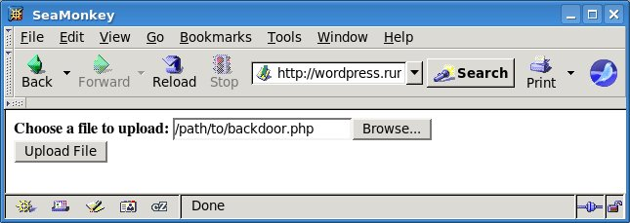
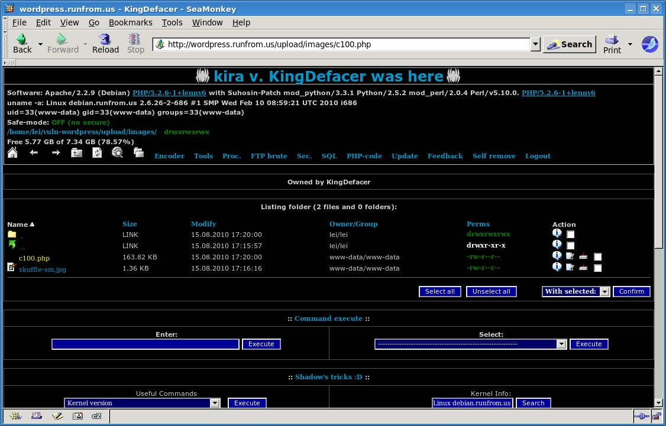
The upload page
Example backdoor
Notes:
This isn't even worth commenting further on.

Slide 30
DEFENSE: File monitoring
inotify
also:
(fschange, kqueue utilities etc..)
Notes:
I'm going to discuss tripwire (it's been out for a while) but fschange (available in the linux kernel only) and the fschange tools are a great open source solution for this matter as well.

Slide 31
Inotify an you...
Kernel module (released in 2.6.13)
Monitors file system changes
Improvement from “dnotify”
Inotify-tools, incron, iwatch, pynotify

Slide 32
inotify-tools
libinotifytools
inotifywait
inotifywatch
Notes:
C library and some tools that utilize inotify
Not the only tools available
Lead In to incron!

Slide 33
inotify/incron quick and easy
Verify your kernel has inotify enabled, install incrond
Setup incrontab to monitor fies/directores
  (directory) (mask) (command)
Start/Restart incrond
Example incrontab:
/home/user/website IN_CREATE mail -s 'File created!' admin@website.com

Slide 34
More about masks
IN_ACCESS File was accessed (read)
IN_ATTRIB Metadata changed (permissions, timestamps,
extended attributes, etc.)
IN_CLOSE_WRITE File opened for writing was closed
IN_CLOSE_NOWRITE File not opened for writing was closed
IN_CREATE File/directory created in watched directory
IN_DELETE File/directory deleted from watched directory
IN_DELETE_SELF Watched file/directory was itself deleted
IN_MODIFY File was modified
IN_MOVE_SELF Watched file/directory was itself moved
IN_MOVED_FROM File moved out of watched directory
IN_MOVED_TO File moved into watched directory
IN_OPEN File was opened

Slide 35
Passing Variables
The command may contain these wildcards:
$$ - a dollar sign
$@ - the watched filesystem path (see above)
$# - the event-related file name
$% - the event flags (textually)
$& - the event flags (numerically)
Example incron entry: /directory/to/watch IN_MODIFY /path/to/script $@/$#
This will execute the script and pass it the file name which triggered the rule

Slide 36


A “diff”erent solution...
Compare your live data to a backup!
A utility you are probably familiar with “diff” can do this for you.
Just run “diff -r (live directory) (backup directory)”
You will receive a report of file differences.
Notes:
Command line utilities in most any unix system can help speed up tracking down backdoors on any site.
Another option, if you're using SVN you can quickly “svn diff” any suspicious files!

Slide 37
DEFENSE: Forensics
It's Logs, it's Logs
It's better than bad, it's good.
Logs, logs, logs!

Slide 38
Useful logs:
  Apache (website)
  Auth.log, FTP.log
  Syslog / messages
  Specific IDS logs
Tools to know:
  Grep
  Awk
  Perl/shell scripting

Slide 39
Coorealation of timestamps is key (most of the time)
Use NTP or a central logging server.
Previous attack (detected by tripwire)
Modified object name: /home/user/website/upload/images/c100.php
Property: Expected Observed
------------- ----------- -----------
* Inode Number 245157 245158
* Modify Time Sun 15 Aug 2010 06:24:38 PM PDT
Sun 15 Aug 2010 06:26:49 PM PDT
* Change Time Sun 15 Aug 2010 06:24:38 PM PDT
Sun 15 Aug 2010 06:26:49 PM PDT
Data found in the logs:
debian:~/apache_logs$ grep 18:24: wp-access.log
10.0.0.5 - - [15/Aug/2010:18:24:37 -0700] "POST /upload/uploader.php HTTP/1.1" 200
Confirm the file exists on the server:
debian:~$ ls -la /home/user/website/upload/images/c100.php
-rw-r--r-- 1 www-data www-data 167753 2010-08-15 18:26 /home/user/website/upload/images/c100.php

Slide 40
Wrap up
Writing secure code will prevent the need for all of this. Until that day comes, enjoy what you have learned and apply it.
Attacks are mostly automated; happening daily, hourly, right now...

Slide 41
From here on out...
You're on your own to continue researching the subject matters covered briefly in this talk. I have a list of URLs you are free to copy, as well as ideas for more talks if anyone wants to throw their hat in the ring.
  Writing secure code!
  Penetration testing!
  Why your firewall is racist.
  SELECT “MBA” != “DBA”.

Slide 42
Further reading!
General Security
  http://www.owasp.org (Excellent resource for many security topics)
  http://www.securityfocus.com (Pay attention to the latest security concerns)
  http://www.packetstormsecurity.com (Exploit/tools resource)
Snort
  http://www.snort.org (IDS)
  http://www.snortsam.net (Turns snort into an IPS)
mod_security
  http://www.modsecurity.org (Web application level firewall)
  http://www.gotroot.com (mod_security rule list)
iNotify (file change detection)
  http://inotify.aiken.cz (incron etc..)
  http://inotify-tools.sourceforge.net/ (iNotify toolset)
Cross Site scripting:
  http://www.xssed.org (Cross site scripting attacks archive)
Backdoor web shells:
  http://www.sh3llz.org (list of backdoor shells)
SQL Injection
  http://www.google.com/search?q=sql+injection (plenty of information available)

