Slide 1

Ceph: petabyte-scale
storage for
large and small
deployments
Sage Weil
DreamHost / new dream network
sage@newdream.net
February 27, 2011

Slide 2
What makes it different?
Scalable
  1000s of servers, easily added or removed
  Grow organically from gigabytes to exabytes
Reliable and highly available
  All data is replicated
  Fast recovery from failure
Object storage for the private cloud
  Native and RESTful object interfaces, network block device
Distributed file system with advanced features
  Snapshots, recursive quota-like accounting

Slide 3
Design motivation
Avoid traditional system designs
  Single server bottlenecks, points of failure
  Symmetric shared disk (SAN etc.)
    Expensive, inflexible, not scalable
Avoid manual workload partition
  Data sets, usage grow over time
  Data migration is tedious
Avoid ”passive” storage devices

Slide 4
Ceph storage services
Ceph distributed file system
  POSIX distributed file system with snapshots
RBD: rados block device
  Thinly provisioned, snapshottable network block device
  Linux kernel driver; Native support in Qemu/KVM
radosgw: RESTful object storage proxy
  S3 and Swift compatible interfaces
librados: native object storage
  Fast, direct access to storage cluster
  Flexible: pluggable object classes

Slide 5
Key design points
Segregate data and metadata
  Object-based storage
  Functional data distribution
Reliable distributed object storage service
  Intelligent storage servers
  p2p-like protocols
POSIX file system
  Adaptive and scalable metadata server cluster

Slide 6
Object storage
Objects
  Alphanumeric name
  Data blob (bytes to megabytes)
  Named attributes (foo=bar)
Object pools
  Separate flat namespace
Cluster of servers store all data objects
  RADOS: Reliable autonomic distributed object store
Low-level storage infrastructure
  librados, RBD, radosgw
  Ceph distributed file system

Slide 7
Data placement
Allocation tables
  File systems
– Access requires lookup
– Hard to scale table size
+ Stable mapping
+ Expansion trivial
Hash functions
  Web caching, DHTs
+ Calculate location
+ No tables
– Unstable mapping
– Expansion reshuffles

Slide 8
Placement with CRUSH
Functional: x → [osd12, osd34]
  Pseudo-random, uniform (weighted) distribution
Stable: adding devices remaps few x's
Hierachical: describe devices as tree
  Based on physical infrastructure
  e.g., devices, servers, cabinets, rows, DCs, etc.
Rules: describe placement in terms of tree
  ”three replicas, different cabinets, same row”

Slide 9
Ceph data placement
Files/bdevs striped over objects
  4 MB objects by default
Objects mapped to placement groups (PGs)
  pgid = hash(object) & mask
PGs mapped to sets of OSDs
  crush(cluster, rule, pgid) = [osd2, osd3]
  Pseudo-random, statistically uniform distribution
  ~100 PGs per node
File
…
Objects
…
PGs
…
…
…
…
OSDs
(grouped by
failure domain)
  Fast– O(log n) calculation, no lookups
  Reliable– replicas span failure domains
  Stable– adding/removing OSDs moves few PGs

Slide 10
Outline
Segregate data and metadata
  Object-based storage
  Functional data distribution
Reliable distributed object storage service
  Intelligent storage servers
  p2p-like protocols
POSIX file system
  Adaptive and scalable metadata cluster

Slide 11
Passive storage
In the old days, ”storage cluster” meant
  SAN: FC network lots of dumb disks
  Aggregate into large LUNs, or let file system track which data is in which blocks on which disks
  Expensive and antiquated
Today
  NAS: talk to storage over IP
  Storage (SSDs, HDDs) deployed in rackmount shelves with CPU, memory, NIC, RAID...
But storage servers are still passive...

Slide 12
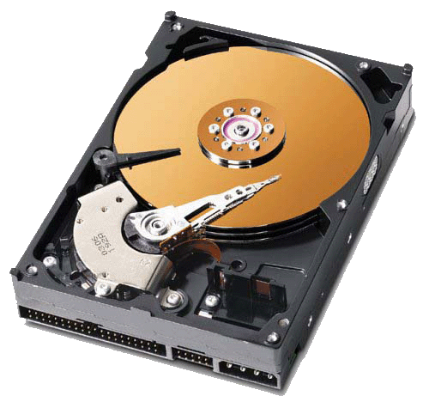
Intelligent storage servers
Object interface
Ceph storage nodes (OSDs)
  cosd object storage daemon
  btrfs volume of one or more disks
Actively collaborate with peers
  Replicate data (n times–admin can choose)
  Consistently apply updates
  Detect node failures
  Migrate objects
cosd
cosd
btrfs
btrfs

Slide 13
It's all about object placement
OSDs can act intelligently because everyone knows and agrees where objects belong
  Coordinate writes with replica peers
  Copy or migrate objects to proper location
OSD map completely specifies data placement
  OSD cluster membership and state (up/down etc.)
  CRUSH function mapping objects → PGs → OSDs

Slide 14
Where does the map come from?
Monitor Cluster
Cluster of monitor (cmon) daemons
  Well-known addresses
  Cluster membership, node status
  Authentication
  Utilization stats
Reliable, highly available
  Replication via Paxos (majority voting)
  Load balanced
Similar to ZooKeeper, Chubby, cld
  Combine service smarts with storage service
OSD Cluster

Slide 15
OSD peering and recovery
cosd will ”peer” on startup or map change
  Contact other replicas of PGs they store
  Ensure PG contents are in sync, and stored on the correct nodes
    if not, start recovery/migration
Identical, robust process for any map change
  Node failure
  Cluster expansion/contraction
  Change in replication level

Slide 16
Node failure example
$ ceph -w
12:07:42.142483 pg v17: 144 pgs: 144 active+clean; 864 MB data, 442 GB used, 2897 GB / 3518 GB avail
12:07:42.142814 mds e7: 1/1/1 up, 1 up:active
12:07:42.143072 mon e1: 3 mons at 10.0.1.252:6789/0 10.0.1.252:6790/0 10.0.1.252:6791/0
12:07:42.142972 osd e4: 8 osds: 8 up, 8 in
$ service ceph stop osd0
12:08:11.076231 osd e5: 8 osds: 7 up, 8 in
12:08:12.491204 log 10.01.19 12:08:09.508398 mon0 10.0.1.252:6789/0 18 : [INF] osd0 10.0.1.252:6800/2890 failed (by osd3)
12:08:12.491249 log 10.01.19 12:08:09.511463 mon0 10.0.1.252:6789/0 19 : [INF] osd0 10.0.1.252:6800/2890 failed (by osd4)
12:08:12.491261 log 10.01.19 12:08:09.521050 mon0 10.0.1.252:6789/0 20 : [INF] osd0 10.0.1.252:6800/2890 failed (by osd2)
12:08:13.243276 pg v18: 144 pgs: 144 active+clean; 864 MB data, 442 GB used, 2897 GB / 3518 GB avail
12:08:17.053139 pg v20: 144 pgs: 144 active+clean; 864 MB data, 442 GB used, 2897 GB / 3518 GB avail
12:08:20.182358 pg v22: 144 pgs: 90 active+clean, 54 active+clean+degraded; 864 MB data, 386 GB used, 2535 GB / 3078 GB avail
$ ceph osd out 0
12:08:42.212676 mon <- [osd,out,0]
12:08:43.726233 mon0 -> 'marked out osd0' (0)
12:08:48.163188 osd e9: 8 osds: 7 up, 7 in
12:08:50.479504 pg v24: 144 pgs: 1 active, 129 active+clean, 8 peering, 6 active+clean+degraded; 864 MB data, 2535 GB / 3078 GB avail; 1/452 degraded (0.221%)
12:08:52.517822 pg v25: 144 pgs: 1 active, 134 active+clean, 9 peering; 864 MB data, 2535 GB / 3078 GB avail; 1/452 degraded (0.221%)
12:08:55.351400 pg v26: 144 pgs: 1 active, 134 active+clean, 4 peering, 5 active+degraded; 864 MB data, 2535 GB / 3078 GB avail; 1/452 degraded (0.221%)
12:08:57.538750 pg v27: 144 pgs: 1 active, 134 active+clean, 9 active+degraded; 864 MB data, 2535 GB / 3078 GB avail; 1/452 degraded (0.221%)
12:08:59.230149 pg v28: 144 pgs: 10 active, 134 active+clean; 864 MB data, 2535 GB / 3078 GB avail; 59/452 degraded (13.053%)
12:09:27.491993 pg v29: 144 pgs: 8 active, 136 active+clean; 864 MB data, 2534 GB / 3078 GB avail; 16/452 degraded (3.540%)
12:09:29.339941 pg v30: 144 pgs: 1 active, 143 active+clean; 864 MB data, 2534 GB / 3078 GB avail
12:09:30.845680 pg v31: 144 pgs: 144 active+clean; 864 MB data, 2534 GB / 3078 GB avail
up/down – liveness in/out – where data is placed

Slide 17
Object storage interfaces
Command line tool
$ rados -p data put foo /etc/passwd
$ rados -p data ls -
foo
$ rados -p data put bar /etc/motd
$ rados -p data ls -
bar
foo
$ rados -p data mksnap cat
created pool data snap cat
$ rados -p data mksnap dog
created pool data snap dog
$ rados -p data lssnap
1 cat 2010.01.14 15:39:42
2 dog 2010.01.14 15:39:46
2 snaps
$ rados -p data -s cat get bar /tmp/bar
selected snap 1 'cat'
$ rados df
pool name KB objects clones degraded
data 0 0 0 0
metadata 13 10 0 0
total used 464156348 10
total avail 3038136612
total space 3689726496

Slide 18
Object storage interfaces
radosgw
  HTTP RESTful gateway
    S3 and Swift protocols
  Proxy: no direct client access to storage nodes
http
ceph

Slide 19
RBD: Rados Block Device
Block device image striped over objects
Shared storage
  VM migration between hosts
Thinly provisioned
  Consume disk only when image is written to
Per-image snapshots
Layering (WIP)
  Copy-on-write overlay over existing 'gold' image
  Fast creation or migration

Slide 20
RBD: Rados Block Device
Native Qemu/KVM support
Linux kernel driver (2.6.37+)
Simple administration
$ qemu-img create -f rbd rbd:mypool/myimage 10G
$ qemu-system-x86_64 --drive format=rbd,file=rbd:mypool/myimage
$ echo ”1.2.3.4 name=admin mypool myimage” > /sys/bus/rbd/add
$ mke2fs -j /dev/rbd0
$ mount /dev/rbd0 /mnt
$ rbd create foo --size 20G
$ rbd list
foo
$ rbd snap create --snap=asdf foo
$ rbd resize foo --size=40G
$ rbd snap create --snap=qwer foo
$ rbd snap ls foo
2 asdf 20971520
3 qwer 41943040

Slide 21
Object storage interfaces
librados
  Direct, parallel access to entire OSD cluster
  When objects are more appropriate than files
  C, C++, Python, Ruby, Java, PHP bindings
rados_pool_t pool;
rados_connect(...);
rados_open_pool("mydata", &pool);
rados_write(pool, ”foo”, 0, buf1, buflen);
rados_read(pool, ”bar”, 0, buf2, buflen);
rados_exec(pool, ”baz”, ”class”, ”method”,
inbuf, inlen, outbuf, outlen);
rados_snap_create(pool, ”newsnap”);
rados_set_snap(pool, ”oldsnap”);
rados_read(pool, ”bar”, 0, buf2, buflen); /* old! */
rados_close_pool(pool);
rados_deinitialize();

Slide 22
Object methods
Start with basic object methods
  {read, write, zero} extent; truncate
  {get, set, remove} attribute
  delete
Dynamically loadable object classes
  Implement new methods based on existing ones
  e.g. ”calculate SHA1 hash,” ”rotate image,” ”invert matrix”, etc.
Moves computation to data
  Avoid read/modify/write cycle over the network
  e.g., MDS uses simple key/value methods to update objects containing directory content

Slide 23
Outline
Segregate data and metadata
  Object-based storage
  Functional data distribution
Reliable distributed object storage service
  Intelligent storage servers
  p2p-like protocols
POSIX file system
  Adaptive and scalable metadata cluster

Slide 24
Metadata cluster
Create file system hierarchy on top of objects
Some number of cmds daemons
  No local storage – all metadata stored in objects
  Lots of RAM – function has a large, distributed, coherent cache arbitrating file system access
  Fast network
Dynamic cluster
  New daemons can be started up willy nilly
  Load balanced

Slide 25
A simple example
fd=open(”/foo/bar”, O_RDONLY)
  Client: requests open from MDS
  MDS: reads directory /foo from object store
  MDS: issues capability for file content
read(fd, buf, 1024)
  Client: reads data from object store
close(fd)
  Client: relinquishes capability to MDS
  MDS out of I/O path
  Object locations are well known–calculated from object name
Client
MDS Cluster
Object Store

Slide 26
Metadata storage
Conventional Approach
Embedded Inodes
etc
100
home
hosts
201
usr
1
mtab
202
var
etc
100
passwd
203
vmlinuz
home
101
…
…
usr
102
var
103
102
vmlinuz
104
bin
317
hosts
…
include
318
mtab
lib
319
passwd
…
…
bin
include
lib
…
Directory
Dentry
123
Inode
Each directory stored in separate object
Embed inodes inside directories
  Store inode with the directory entry (filename)
  Good prefetching: load complete directory and inodes with single I/O
  Auxiliary table preserves support for hard links
Very fast `find` and `du`

Slide 27
Large MDS journals
Metadata updates streamed to a journal
  Striped over large objects: large sequential writes
Journal grows very large (hundreds of MB)
  Many operations combined into small number of directory updates
  Efficient failure recovery
New updates
time
Journal segment marker

Slide 28
Dynamic subtree partitioning
Root
MDS 0
MDS 1
MDS 2
MDS 3
MDS 4
Busy directory fragmented across many MDS’s
Scalable
  Arbitrarily partitioned metadata, 10s-100s of nodes
Adaptive
  Work moved from busy to idle servers
  Popular metadata replicated on multiple nodes

Slide 29
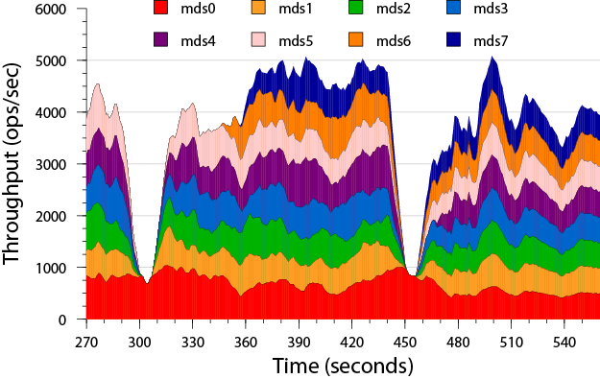
Workload adaptation
Extreme shifts in workload result in redistribution of metadata across cluster
  Metadata initially managed by mds0 is migrated
many directories
same directory

Slide 30
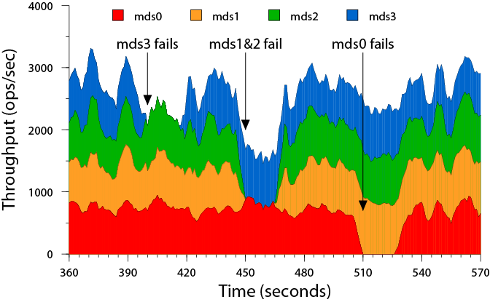
Failure recovery
Nodes quickly recover
  15 seconds—unresponsive node declared dead
  5 seconds—recovery
Subtree partitioning limits effect of individual failures on rest of cluster

Slide 31
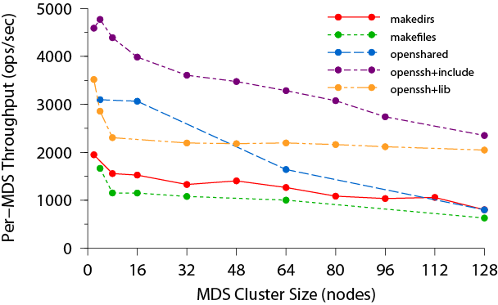
Metadata scaling
Up to 128 MDS nodes, and 250,000 metadata ops/second
  I/O rates of potentially many terabytes/second
  File systems containing many petabytes of data

Slide 32
Recursive accounting
Subtree-based usage accounting
  Solves “half” of quota problem (no enforcement)
  Recursive file, directory, byte counts, mtime
$ ls -alSh | head
total 0
drwxr-xr-x 1 root root 9.7T 2011-02-04 15:51 .
drwxr-xr-x 1 root root 9.7T 2010-12-16 15:06 ..
drwxr-xr-x 1 pomceph pg4194980 9.6T 2011-02-24 08:25 pomceph
drwxr-xr-x 1 mcg_test1 pg2419992 23G 2011-02-02 08:57 mcg_test1
drwx--x--- 1 luko adm 19G 2011-01-21 12:17 luko
drwx--x--- 1 eest adm 14G 2011-02-04 16:29 eest
drwxr-xr-x 1 mcg_test2 pg2419992 3.0G 2011-02-02 09:34 mcg_test2
drwx--x--- 1 fuzyceph adm 1.5G 2011-01-18 10:46 fuzyceph
drwxr-xr-x 1 dallasceph pg275 596M 2011-01-14 10:06 dallasceph
$ getfattr -d -m ceph. pomceph
# file: pomceph
ceph.dir.entries="39"
ceph.dir.files="37"
ceph.dir.rbytes="10550153946827"
ceph.dir.rctime="1298565125.590930000"
ceph.dir.rentries="2454401"
ceph.dir.rfiles="1585288"
ceph.dir.rsubdirs="869113"
ceph.dir.subdirs="2"

Slide 33
Fine-grained snapshots
Snapshot arbitrary directory subtrees
  Volume or subvolume granularity cumbersome at petabyte scale
Simple interface
Efficient storage
  Leverages copy-on-write at storage layer (btrfs)
$ mkdir foo/.snap/one # create snapshot
$ ls foo/.snap
one
$ ls foo/bar/.snap
_one_1099511627776 # parent's snap name is mangled
$ rm foo/myfile
$ ls -F foo
bar/
$ ls foo/.snap/one
myfile bar/
$ rmdir foo/.snap/one # remove snapshot

Slide 34
File system client
POSIX; strong consistency semantics
  Process on different hosts interact as if on same host
  Client maintains consistent data/metadata caches
Linux kernel client
Userspace client
  cfuse FUSE-based client
  libceph library (ceph_open(), etc.)
  Hadoop, Hypertable client modules (libceph)
# modprobe ceph
# mount -t ceph 10.3.14.95:/ /mnt/ceph
# df -h /mnt/ceph
Filesystem Size Used Avail Use% Mounted on
10.3.14.95:/ 95T 29T 66T 31% /mnt/ceph

Slide 35
Deployment possibilities
cmon
Small amount of local storage (e.g. Ext3); 1-3
(Big) btrfs file system; 2+
No disk; lots of RAM; 2+ (including standby)
cosd
cmds
cosd
cmon
cmon
cmds
cosd
cmon
cmon
cmds
cosd
cmon
cmds
cmon
cmds
cosd
cosd
cosd
cmds
cosd
cosd
cosd
cosd
cosd
cosd
cosd
cmon
cmds
cosd
cosd
cosd
cosd
cosd
cosd
cosd
cosd
cosd
cosd
cosd
cosd

Slide 36
cosd – storage nodes
Lots of disk
A journal device or file
  RAID card with NVRAM, small SSD
  Dedicated partition, file
Btrfs
  Bleeding edge kernel
  Pool multiple disks into a single volume
ExtN, XFS
  Will work; slow snapshots, journaling

Slide 37
Getting started
Debian packages
From source
More options/detail in wiki:
  http://ceph.newdream.net/wiki/
# cat >> /etc/apt/sources.list
deb http://ceph.newdream.net/debian/ squeeze ceph-stable
^D
# apt-get update
# apt-get install ceph
# git clone git://ceph.newdream.net/git/ceph.git
# cd ceph
# ./autogen.sh
# ./configure
# make install

Slide 38
A simple setup
Single config: /etc/ceph/ceph.conf
  3 monitor/MDS machines
  4 OSD machines
Each daemon gets type.id section
Options cascade
  global → type → daemon
[mon]
mon data = /data/mon.$id
[mon.a]
host = cephmon0
mon addr = 10.0.0.2:6789
[mon.b]
host = cephmon1
mon addr = 10.0.0.3:6789
[mon.c]
host = cephmon2
mon addr = 10.0.0.4:6789
[mds]
keyring = /data/keyring.mds.$id
[mds.a]
host = cephmon0
[mds.b]
host = cephmon1
[mds.c]
host = cephmon2
[osd]
osd data = /data/osd
osd journal = /dev/sdb1
btrfs devs = /dev/sdb2
keyring = /data/osd/keyring
[osd.0]
host = cephosd0
[osd.1]
host = cephosd1
[osd.2]
host = cephosd2
[osd.3]
host = cephosd3

Slide 39
Starting up the cluster
Set up SSH keys
Distributed ceph.conf
Create Ceph cluster FS
Start it up
Monitor cluster status
# ssh-keygen -d
# for m in `cat nodes`
do scp /root/.ssh/id_dsa.pub $m:/tmp/pk
ssh $m 'cat /tmp/pk >> /root/.ssh/authorized_keys'
done
# for m in `cat nodes`; do scp /etc/ceph/ceph.conf $m:/etc/ceph ; done
# mkcephfs -c /etc/ceph/ceph.conf -a --mkbtrfs
# service ceph -a start
# ceph -w

Slide 40
Storing some data
FUSE
Kernel client
RBD
$ mkdir mnt
$ cfuse -m 1.2.3.4 mnt
cfuse[18466]: starting ceph client
cfuse[18466]: starting fuse
# mount -t ceph 1.2.3.4:/ /mnt/ceph
# rbd create foo --size 20G
# echo ”1.2.3.4 - rbd foo” > /sys/bus/rbd/add
# ls /sys/bus/rbd/devices
0
# cat /sys/bus/rbd/devices/0/major
254
# mknod /dev/rbd0 b 254 0
# mke2fs -j /dev/rbd0
# mount /dev/rbd0 /mnt

Slide 41
Current status
Current focus on stability
  Object storage
  Single MDS configuration
Linux client upstream since 2.6.34
RBD client upstream since 2.6.37
RBD client in Qemu/KVM

Slide 42
Current status
Testing and QA
  Automated testing infrastructure
  Performance and scalability testing
  Clustered MDS stability
  Disaster recovery tools
RBD layering
  Image migration
v1.0 this Spring

Slide 43
More information
http://ceph.newdream.net/
  Wiki, tracker, news
LGPL2

