Slide 1
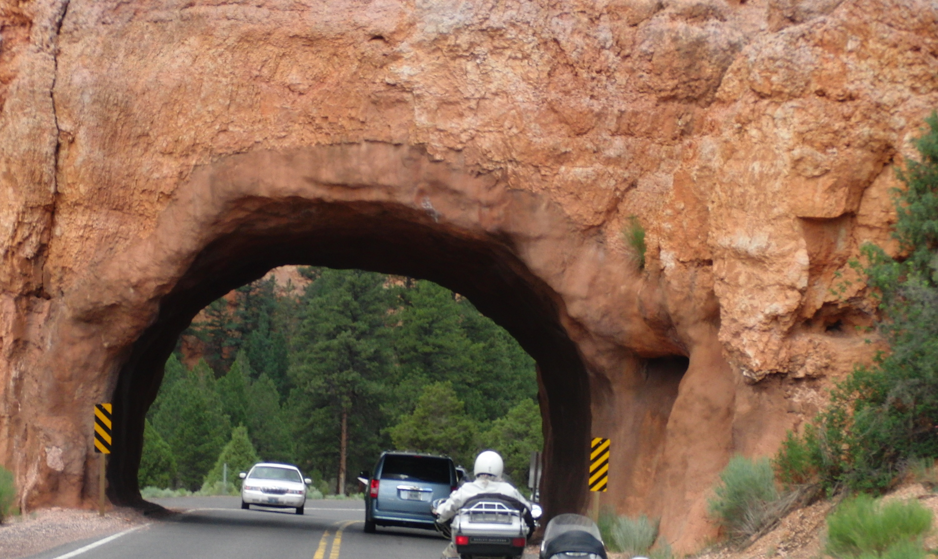
Tunneling with SSH
der.hans
ScaLE 9x
2011Feb27

Slide 2
Presumed Knowledge
Basic SSH usage
Filesystem permissions required by SSH
Basic SSH key and fingerprint usage
Notes:
Not going to cover perms on .ssh or authorized_keys

Slide 3
SSH
Secure SHell
Allows encrypted connections to other computers
Allows passing data across the encrypted connections
Requires an account on the remote computer

Slide 4
Basic Tunnel
ssh -L 2222:firewall.example.com:22 firewall.example.com
Notes:
-N == no remote command
-f == background before command exec
Rope and sheet demo

Slide 5
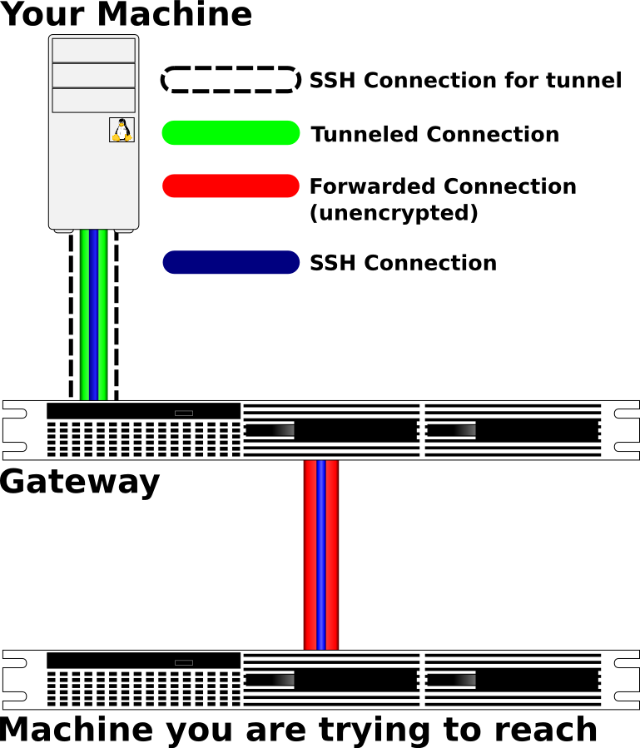
Entering the Tunnel
ssh -p 2222 localhost
Notes:
Someone passing through rope tunnel

Slide 6
Throwing the Connection
ssh -N -f -L 8000:server.example.com:80 firewall.example.com
Notes:
Have three volunteers: two can't see each other, but both can see the third. The third enables communication between the first two.
Have the server toss out a single rope to the third person to indicate the thrown connection.
Someone passing through the tunnel to someone else in the room, note that no longer protected.

Slide 7
Careful of the Unencrypted Leg
desktop ==== firewall ---- internalserver

Slide 8
SOCKS
ssh -D 1080 firewall.example.com
Notes:
Mention SOCKS clients like Firefox and Thunderbird
Mention SOCKS wrappers for cliens, e.g. KDE, that don't supports SOCKS

Slide 9
Going in Reverse
host1$ ssh -R 2112:firewall.example.com:22 firewall.example.com
host2$ ssh -L 3113:firewall.example.com:2112 firewall.example.com
Notes:
Use rope to build tunnel from destination server to client
Use rope to build two tunnels to same server from two clients

Slide 10
Double Reverse
host1$ ssh -L 3113:firewall.example.com:3113 -R 2112:firewall.example.com:22 firewall.example.com
host2$ ssh -L 3113:firewall.example.com:3113 -R 2112:firewall.example.com:2112 firewall.example.com

Slide 11
Simplified Double Reverse
host1$ ssh -L 3113:localhost:3113 -R 2112:localhost:2112 firewall.example.com
host2$ ssh -L 2112:localhost:2112 -R 3113:localhost:3113 firewall.example.com

Slide 12
Keys
ssh-keygen -f .ssh/id_new
authorized_keys
  ssh-copy-id
command="id"

Slide 13
Service Examples: Email
ssh -L 2143:imap.example.com:143 -L 2993:imap.example.com:993 -L 2025:smtp.example.com:25 firewall.example.com

Slide 14
Service Examples: Web
ssh -L 8080:www.example.com:80 -L 8443:www.example.com:443 firewall.example.com
ssh -D 1080 firewall.example.com
FoxyProxy

Slide 15
Extra Stuff
ssh firewall.example.com "sudo tar -C /etc cfz -" | tar -C /tmp xfz -
ssh firewall.example.com "ps auxw " | tee /tmp/server_ps.txt | less
scp
sftp
rsync -e ssh -avHS photos/ mybackupserver:photos/

Slide 16
Resources
http://www.OpenSSH.com/
http://www.LinuxJournal.com/magazine/use-ssh-cross-suspect-host-securely
http://en.wikibooks.org/wiki/OpenSSH

