Slide 1

Fun with Bash
Learning the syntax by examples
Alex Perry
Feb 2011

Slide 2
Outline
  Getting Started
  Invoking bash
  Using data passed in, arithmetic
  Running commands
  Text as image vs binary data
  Pipelines
  Success, failure, conditional execution
  Iterating and functions
  Expansions
  Backgrounding
  Locks, xargs, interaction
  ... Conclusions and Questions

Slide 3
Getting started with learning bash
  man man ... learn the documentation tools (also xman)
  man bash ... learn about bash, using those tools
    Already included with your installation
    65 searchable pages, concise, always ready to hand
  Read any of over a dozen books
    http://www.google.com/search?q=bash#tbs=bks:1
  Study and understand other people's code
    Search for example problems on the Internet, eg
    http://www.google.com/search?q=bash+sudoku
  Practice by solving your own problems for fun

Slide 4
Invoking bash
  Interactively, just type "bash"
    Lets you have a temporary environment
    Type "exit" to leave that and go back again
  Use -c to run a command: bash -c './mandel.sh'
    You can put quite complicated things after the -c
  Running a script, "bash script.sh my arguments"
  Usually you can instead type "./script.sh my arguments"
  It depends on the first line of the script being:
    #! /bin/bash

Slide 5
Using data passed into a bash script
  Command line arguments
    Successive arguments are numbered ${1} ${2} ...
    They're all strings, even if digits, or filename, or ...
    "shift" to discard ${1} and renumber the rest down
    "${*}" is all as one string, "${@}" as many strings
  Environment variables
    Use them in braces like ${USER} ${HOME} ${greet}
    Set them: export greet='hi there'
  Can omit braces if only letters or a single symbol inside
    $8 $9 ${10} $greet
  Many more powerful features; eg default ${1:-0} to zero

Slide 6
Arithmetic, calculating new values
  Use the $(()) notation to perform integer arithmetic
  You can pass the result directly into a command
inmandelbrot $rv $iv $rv $iv 0 $(( n - 1 ))
  You can store the calculation result for later
one=1000000 # bash has no floating point
two=$(( one + one ))
fourXone=$(( two * two ))
s=$(( ( r * r - i * i ) / one + $3 ))
i=$(( ( r * i + i * r ) / one + $4 ))
r=$s

Slide 7
Shift, arrays and arithmetic
$ echo $(( 12#20 ))
24
$ cat sumbase.sh
#! /bin/bash
base=$1
shift
echo $(( ${*/#/+${base}#} ))
$ ./sumbase.sh 12 10 5
17

Slide 8
Running ordinary commands
  A command name without "/" ... bash looks for a built-in
    cd, echo, test, kill, ...
    These are fast, do not involve creating processes
    Use "enable -n" to hide incompatible built-ins
  If not a built-in, each command creates a new process
    Therefore, generally quite expensive to launch
    NB: commands implemented in bash are not cheaper!
    Uses specified binary if has "/", eg. "/bin/grep"
  If no "/" and not built in, bash has to find the binary for you
    Looks in each ":" separated directory in ${PATH}
    Slow, but once found, the location is remembered
    Use "hash" command if binaries were moved around

Slide 9

A greyscale image - as text
P2
# feep.pgm
24 7
15
0 0 0 0 0 0 0 0 0 0 0 0 0 0 0 0 0 0 0 0 0 0 0 0
0 3 3 3 3 0 0 7 7 7 7 0 0 11 11 11 11 0 0 15 15 15 15 0
0 3 0 0 0 0 0 7 0 0 0 0 0 11 0 0 0 0 0 15 0 0 15 0
0 3 3 3 0 0 0 7 7 7 0 0 0 11 11 11 0 0 0 15 15 15 15 0
0 3 0 0 0 0 0 7 0 0 0 0 0 11 0 0 0 0 0 15 0 0 0 0
0 3 0 0 0 0 0 7 7 7 7 0 0 11 11 11 11 0 0 15 0 0 0 0
0 0 0 0 0 0 0 0 0 0 0 0 0 0 0 0 0 0 0 0 0 0 0 0

Slide 10
Bash only processes textual data
  If the shell is interacting with the data, it should be text
{ echo -e "P2\n ${#axes[@]} ${#axes[@]} 127"
... print a square grid of numbers
}
  This is very limiting - no binary, data structures, pointers
  Command line tools can convert text to other formats
    portable bitmap, ghostscript, html renderers,
    audio synthesis, video conversion, ...
  So bash can use those other tools to manipulate that data

Slide 11
Pipelines combining commands
  Data between commands and/or files can be binary
    Here we have null terminated strings
find / -xdev -type f -iname "*.sh" -print0 2>/dev/null |
xargs -0 file | grep Bourne-Again | wc -l
67
  If the shell is interacting with the data, it should be text
    Bash makes a grid of numbers as text for the image
    Pipeline "|" into commands that make a binary JPEG
{...} | pnmgamma 3 | pnmtojpeg | xloadimage -onroot stdin

Slide 12

Mandelbrot set, drawn by bash

Slide 13
Success or failure ... for decisions
  Every process, when it exits, returns a code (integer)
    Generally listed in the program's documentation
    You can retrieve that exit code in scripts as "$?"
    When exiting your script, its code is set eg "exit 1"
  Bash assumes a convention for what the codes mean
    There is only one way to be successful, return 0
    But many ways to be unsuccessful, return non-zero
  The built-ins "true" and "false" return status 0 and 1
    $ true || false
    $ echo $? vs $(( 0 || 1 ))
    0 vs 1
  Programmers familiar with C/C++ are often [err] confused

Slide 14
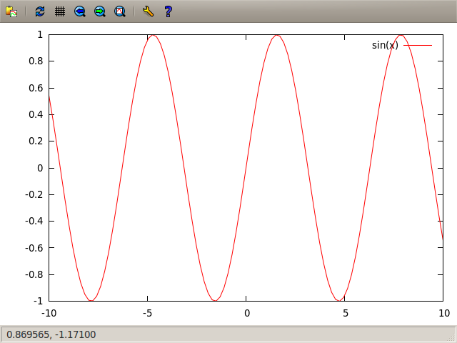
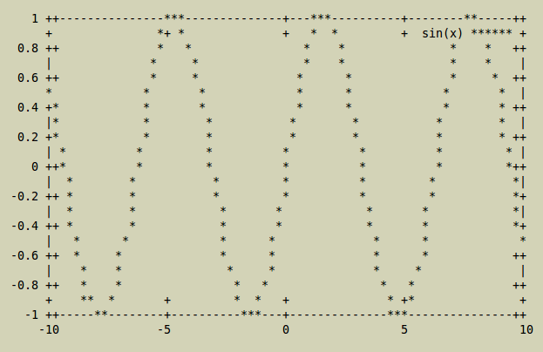
Conditionally executing a command
echo "plot sin(x)" |
if echo "$DISPLAY" |
grep -q "^:"; then
gnuplot -persist $@
else
{ echo "set term dumb"
cat } |
gnuplot $@
fi
  "!" before command negates
  "always && only-if-succeeded" vs "always || only-if-failed"
! false || date # Does not show the date
! solved && echo "No solution..." && exit 1

Slide 15
Write scripts to test for failure: set -e
  Programs that scripts invoke can fail for many reasons
    Avoid taking success of trivial commands for granted
    Maybe locale is different: currency, date, decimal point
    Maybe standard output is not writable - "echo" fails
  It gets tedious to write "|| exit 9" after every command
    You get the same effect with "set -e" once at the top
    But be careful, it ignores conditional operations
    "false" has code 1 and therefore would force exit
    "! true" also has code 1, "set -e" does not force exit
  Can be a bad idea to exit if you're in a critical section
    Consider cleanup by "trap some-command ERR"

Slide 16
Iterating to achieve a result
  while result-is-successful; do activity; done
while xmessage -center -buttons \
Done:1,Snooze:0 $(date); do
sleep 2
done
  until result-is-failing; do activity; done
    Yes, "until" is just like "while !" but it reads better
  All the iteration commands support short circuiting
    "break" goes immediately to "done" and exits loop
    "continue" goes immediately to the result-is- test

Slide 17
Iterating for many values: for loops
  for ((;;)) implies arithmetic evaluation inside
for (( i=0, ival = -two; ival <= two; i++, ival += one / 100 )); do
axes[i]=$ival
done
  for variable in value1 value2 value3; do something; done
    Arrays work especially well here, very powerful
for i in ${axes[@]}; do
for r in ${axes[@]}; do
inmandelbrot $r $i $r $i 0 126; printf "%2i " $?
done
done

Slide 18
code reuse - function definitions
  Functions in bash do not involve creating a process
    Therefore much faster to invoke than a shell script
  ${1} variables are locally scoped, use "local" for others
    Beware, "exit" leaves script, "return" leaves function
function inmandelbrot() {
local r=$1 i=$2 c s
for (( c=$5; c < $6; c++ )); do
test $(( r * r + i * i )) -ge $fourXone && return $c
... etc
done
return $6
}

Slide 19
Expansions ~/my?{foo,bar}[._]htm*
  Bash assumes most parameters try to be files ...
  If not "in quotes", will try to find matching filename
    ~ is your home directory, ~someone for other users
    ? matches exactly one character (but not a slash)
    * matches zero, one or many more (also not slash)
    [abc] matches the listed characters only
    {foo,bar} will be replaced by each of those strings
  If it isn't a filename, it should probably be in quotes!
    Double quotes "${var}" still expand variables fine
    Single quotes '${literal}' do no expansion

Slide 20
background & wait
  So far, bash was only running one command at a time
    seq 10 | xargs -P4 -n 1 xterm -e sleep
  That was more than one, but bash had no clue
    And can't find out which of those commands failed
  Command "&" suffix to background it, and this sets $!
    for i in $(seq 10); do xterm -e sleep $i & done; wait
  We can "wait" for everything to be done, or ...
    To see whether just the last one is done, "kill -0 $!"
    To wait for the last one to finish, "wait $!"
    If waiting for a specific one, wait returns its exit code

Slide 21
lockfiles - avoiding script collisions
if ( set -o noclobber;
echo "$$" > "$lockfile") 2> /dev/null; then
trap 'rm -f "$lockfile"; exit $?' INT TERM EXIT
# critical-section ... guaranteed only one script at a time
rm -f "$lockfile"
trap - INT TERM EXIT
else
echo "Failed to acquire lockfile: $lockfile."
echo "Held by $(cat $lockfile)"
fi

Slide 22
xargs: Unreliable parallelism
  "xargs" doesn't keep track of which of the arguments failed
    Avoid keep tweaking the command for corner cases
    Instead recover the failing arguments for next time
  find | xargs -n 1 savefail.sh failures.txt wc > wc.txt
#! /bin/bash
saves="$1"
shift
$@ && exit
shift
echo >>"$saves" "$@"
  You can start reading "failures.txt" while the command runs

Slide 23
Selective interaction when parallel
  Some slow commands usually run without user input
    But a few corner cases will require a user decision
    ssh some-host sudo aptitude upgrade
  Easy solution is to use X terminal windows
    xargs < all-servers.txt -n1 -I{} xterm -e "ssh {} sudo ..."

Slide 24
Conclusions
  You can't avoid reading the man page or a book
    Most features can't be inferred from each other
  Many problems can be solved in several different ways
    Choose one that makes the solution obvious
    Compactness does not necessarily imply speed
  Check for errors, especially simple commands
    eg: Maybe disk is suddenly full, or read only
  Filenames and pipes may be devices or sockets
    Commands may have their own subprocesses

Slide 25
Questions?
  mail -s scale9 \
    Alex.Perry@PAMurray.com

Slide 26
#! /bin/bash
one=1000000 two=$(( one + one )) fourXone=$(( two * two ))
function inmandelbrot() {
local r=$1 i=$2 c s
for (( c=$5; c < $6; c++ )); do
[[ $(( r * r + i * i )) -ge $fourXone ]] && return $c
s=$(( ( r * r - i * i ) / one + $3 ))
i=$(( ( r * i + i * r ) / one + $4 )); r=$s
done; return $6
}
for((i=0, ival=-two; ival <= two; i++, ival+=one / 100)); do
axes[i]=$ival
done
{
n=255
echo -e "P2\n ${#axes[@]} ${#axes[@]} $n"
for ival in ${axes[@]}; do
for rval in ${axes[@]}; do
inmandelbrot $rval $ival $rval $ival 0 $(( n - 1 ))
printf "%2i " $?
done
echo
done
} | tee the.pgm | pnmtojpeg | xloadimage -onroot stdin

