Slide 1
KIWI
Building OS images and Appliances
Alan Clark
Alan@linux.com
Chuck Payne
terrorpup@gmail.com

Slide 2
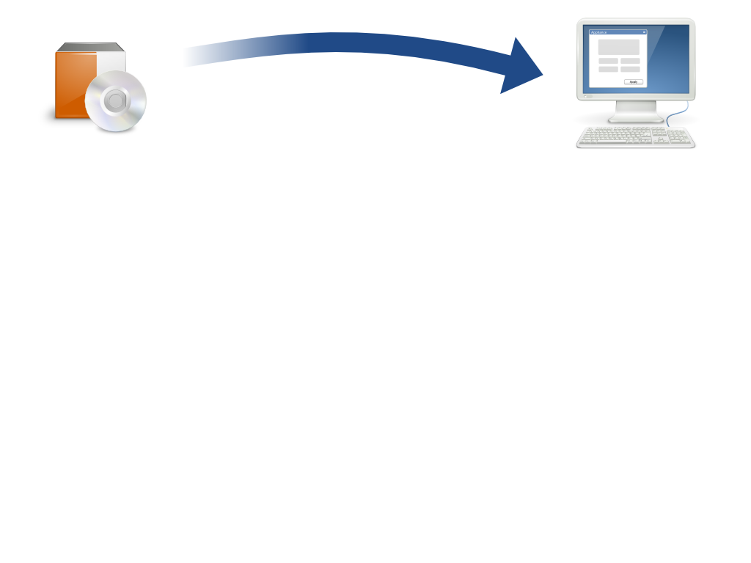
Today’s Application Landscape Brings Complexity
Traditional deployments repeat…
Pre-Installation
Proper OS version
Proper OS patches
Application dependencies
Config and kernel parameters
Directories
Hardware dependencies
Services enabled
Installation
File system location
Compile necessary modules
Address prerequisites
Permissions
Create users and groups
Application incompatibilities
Post-Installation
Updates
App configuration
Services setup
Upgrades and patch
management
Notes:
Many ISVs grapple daily with a long laundry list of details that need to be tweaked to make an application stack work just right – and typically all that legwork has to be repeated, one customer at a time!

Slide 3
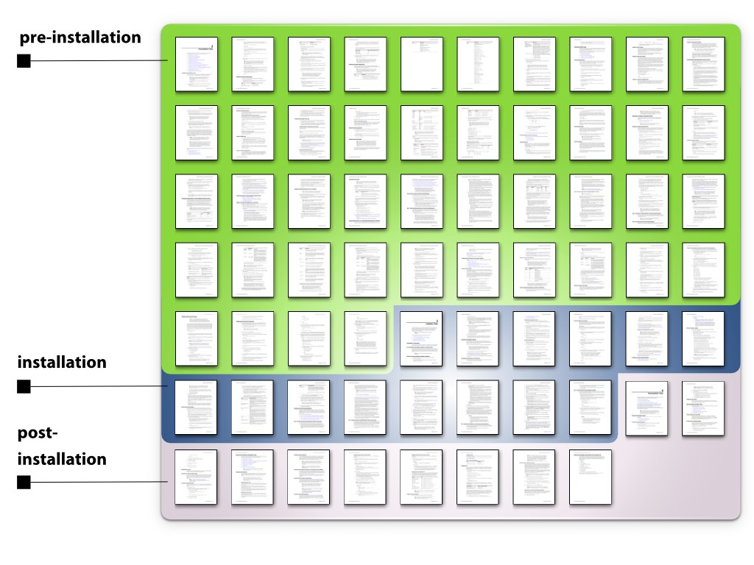
68 pages!

Slide 4
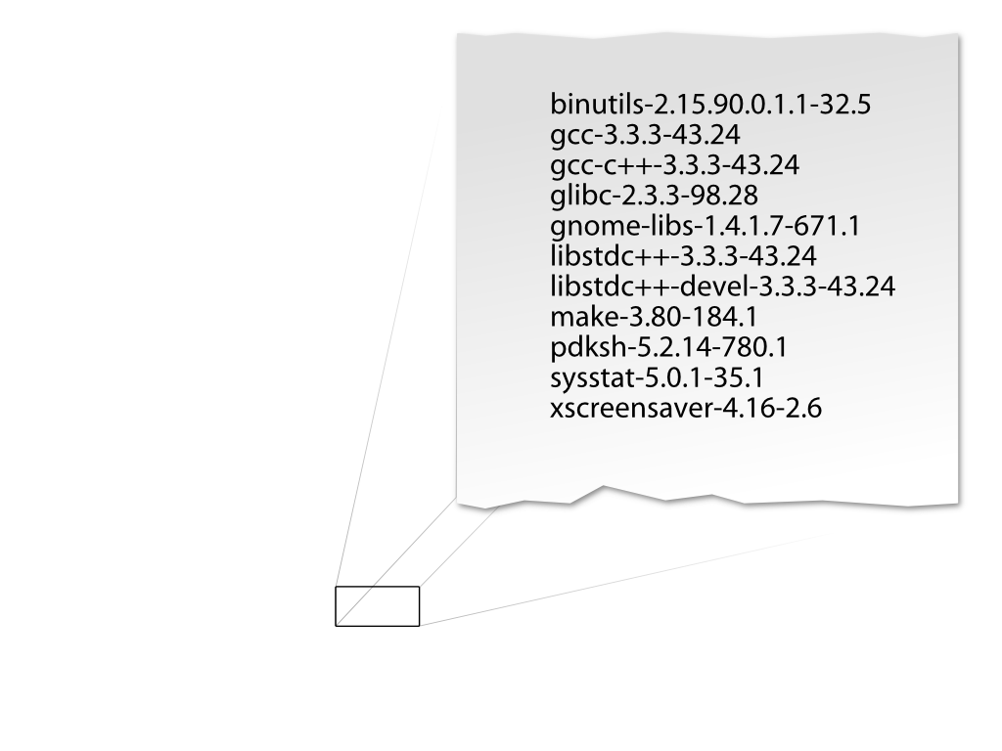
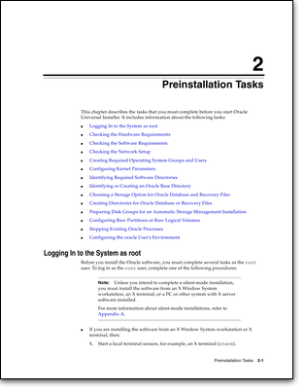
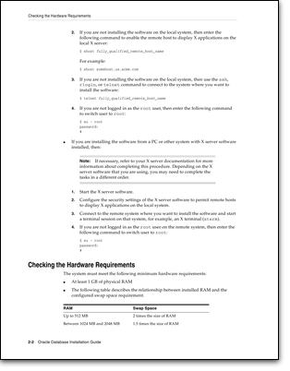
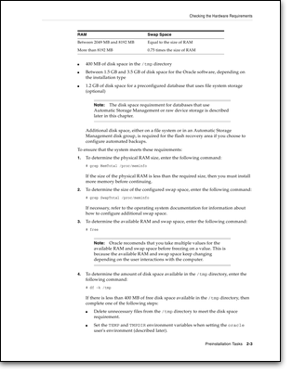
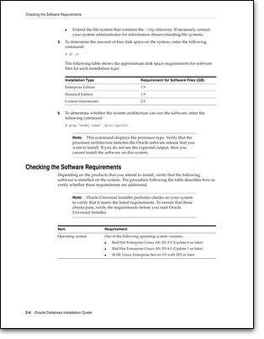
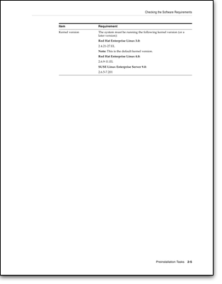
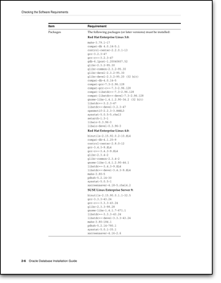
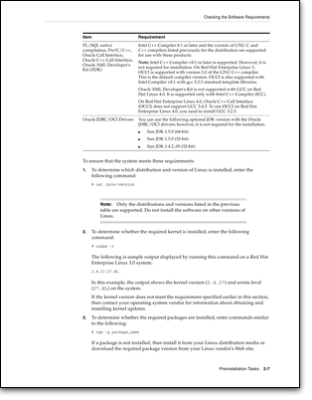
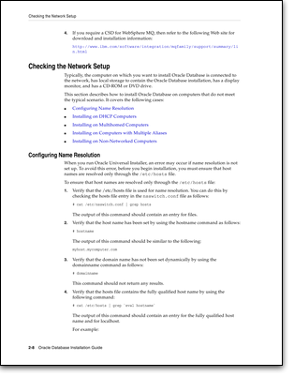

Slide 5
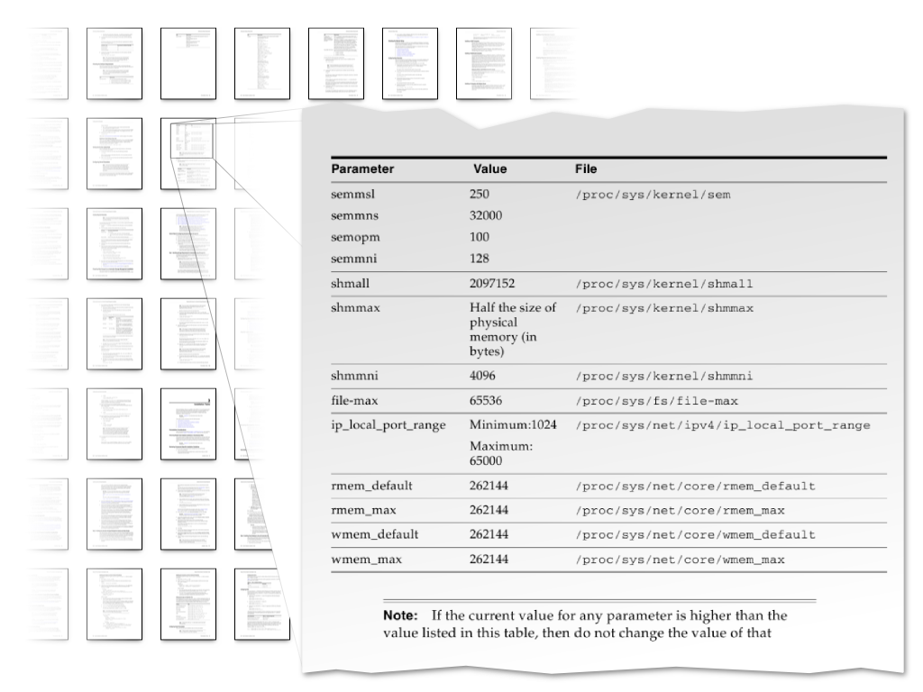

Slide 6
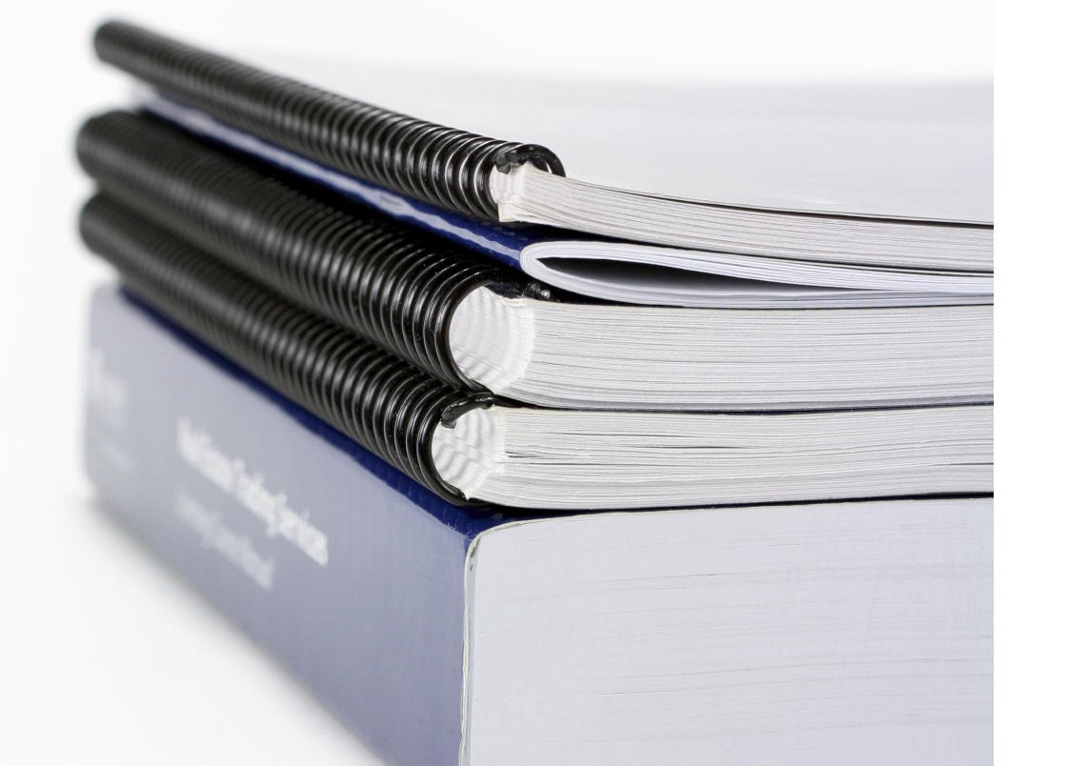
Installing Software is Error-Prone

Slide 7


Slide 8
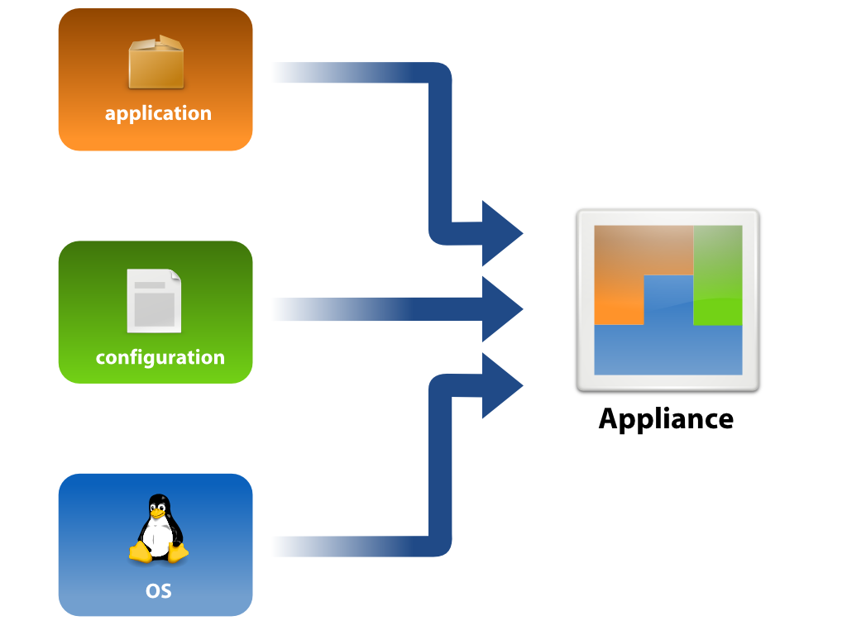
Why not do most of that just once?
Notes:
Appliances package applications in an easier to consume model. As a preconfigured, ready to run image that combines the operating system and application in a single pre installed file – appliances greatly reduce the complexity of installing enterprise software.
An appliance is a pre-installed and pre-configured OS and Application image.
An appliance typically targets a single use case and environment.

Slide 9

Hit Multiple Targets
Pre-Formatted As
Live CD
Bootable USB
ISO
VMware
Xen / XenServer
Hyper-V
Amazon EC2
x86 32- and 64-bit
Image
Software
Appliance
Pre-Formatted For
Virtual
Appliance
Image
Image
Pre-Installed On
Hardware
Appliance

Slide 10

Make it simple...
Press-play deployment

Slide 11
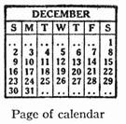


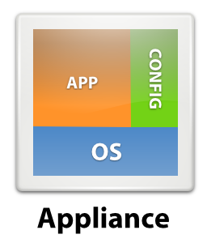

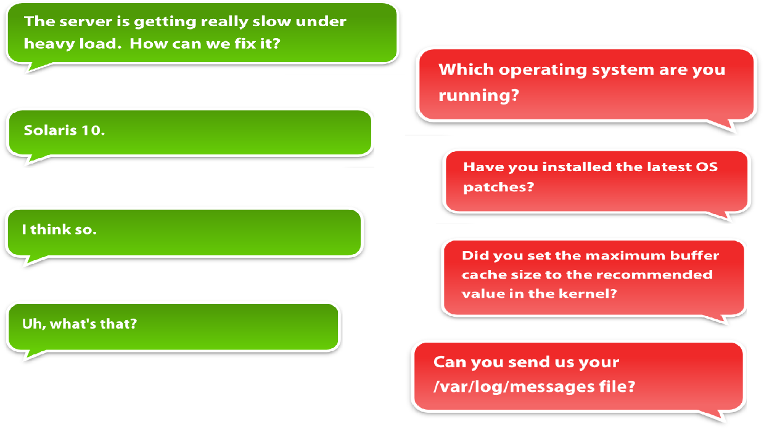


Appliances Simplify and Create Market Opportunities
Traditional
Appliance
Shorter Sales Cycle
Simpler Installation
Easier support
New Market Access
Notes:
Customers want simplication and flexibility
The answer is appliances
Simplified distribution channel offerings
Integrated, proven, tested complete solutions
Press play deployment, simplified support - appliances
Deployable across platforms
For application vendors, this has added advantages:
Reduction of support costs (test matrix, simpler support)
Simplification of existing products for new markets
Shorter sales cycles
Increased customer satisfaction

Slide 12

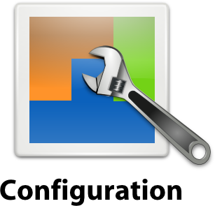

The SUSE Appliance Program – Technology & Tools
SUSE Studio
Kiwi
JeOS
AutoYast
Tool Features
Online, On-site
Build system connect-able
Interchangeable
Multiple target platforms
WebYast
SUSE Studio
Kiwi
Tool Features
Online
On-site
Remote Capable
SUSE Lifecycle Management Server
SUSE Studio
Tool Features
Online
On-site
Remote Capable
Entitlement Based

Slide 13


That's Kiwi
It is a Linux image build system
  Command line driven for easy integration into any build process
  Supports creation of many image formats from one prepared image tree
  Kiwi is an open source project hosted at kiwi.berlios.delicensed under GPL v2 with roots in the openSUSE build service.
  Kiwi is mostly written in Perl
  Kiwi is the engine behind SUSE Studio

Slide 14
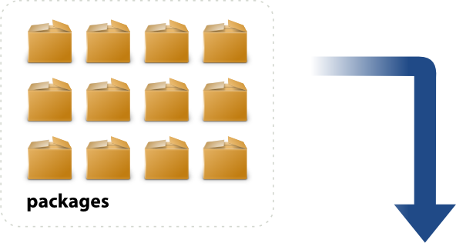
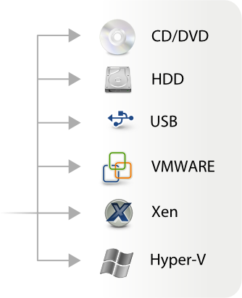




Slide 15
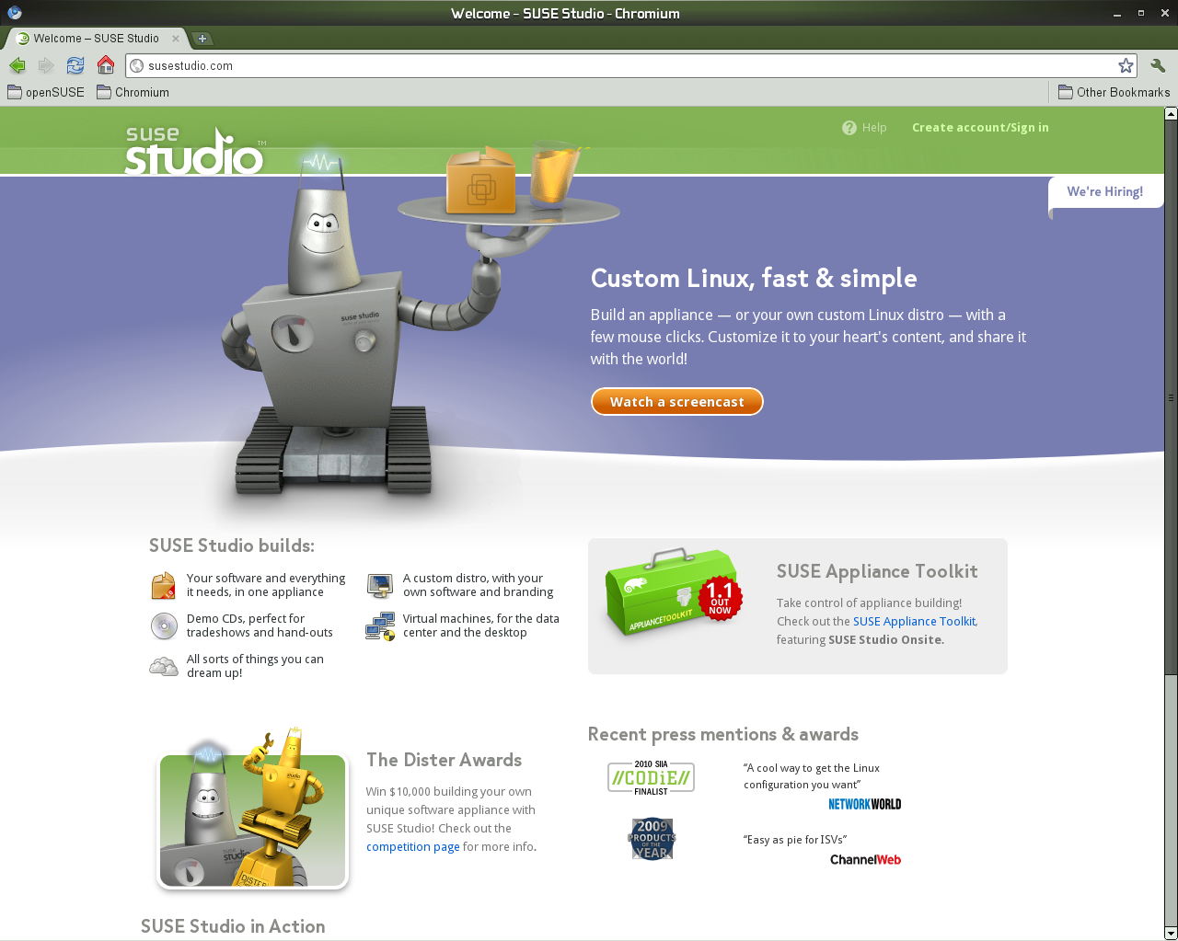
www.SUSEStudio.com

Slide 16
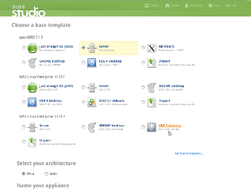
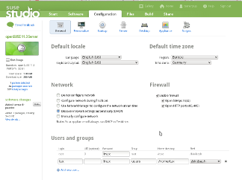

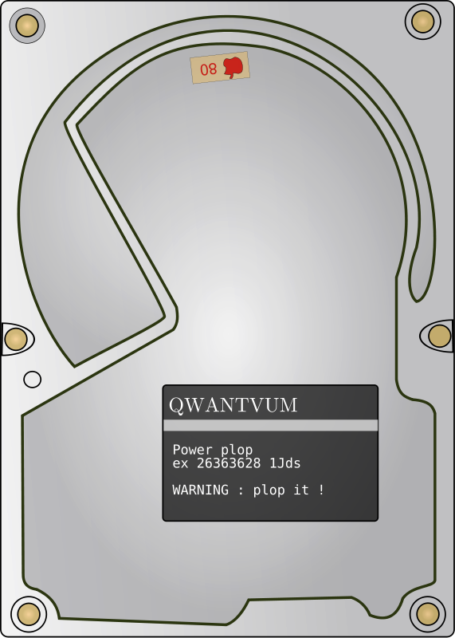
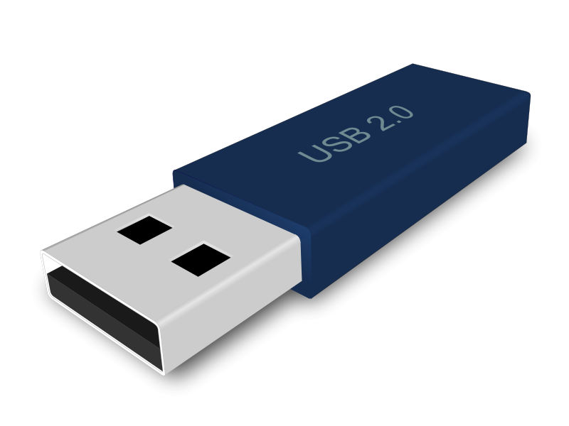
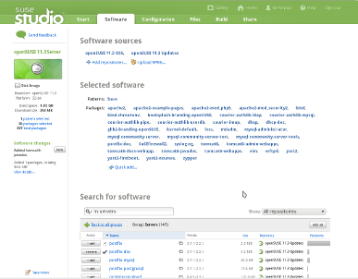
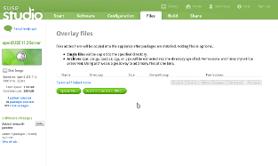

SUSE Studio
Configuring
Running your App
Selecting a template
Add Custom Files
Adding Software Packages

Slide 17
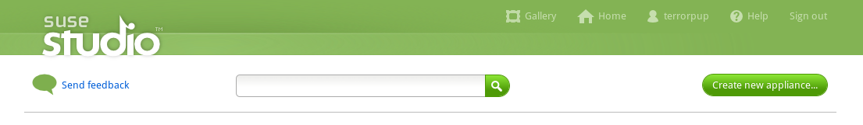
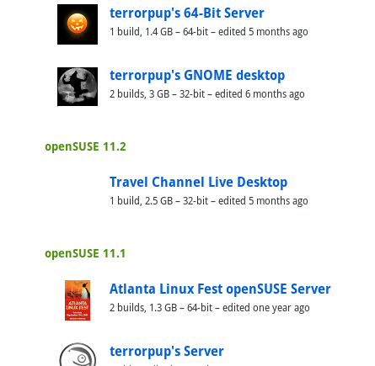
Your Gallery
All Your Applications
Creating New Applications
News about new features
SUSE Gallery
SUSE Studio Blog

Slide 18
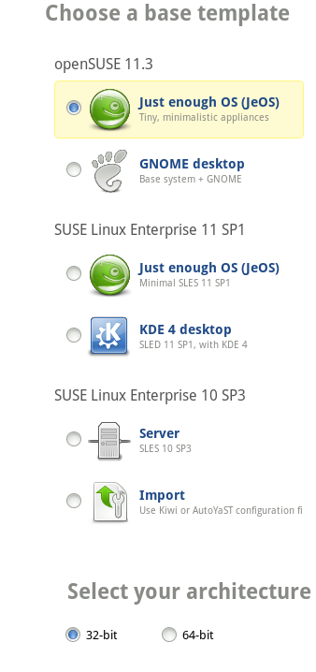
Choose Your Templates
OpenSUSE 11.3
  JeOS
  GNOME/KDE/Minimal X
  Server
  Import Kiwi or AutoYast
SUSE Linux Enterprise 11 SP1
  JeOS
  GNOME/KDE/Minimal X
  Server
  SLES for VMware
  Import Kiwi or AutoYast
SUSE Linux Enterprise 10 SP3
  Server
  GNOME/KDE
  Import Kiwi or AutoYast

Slide 19
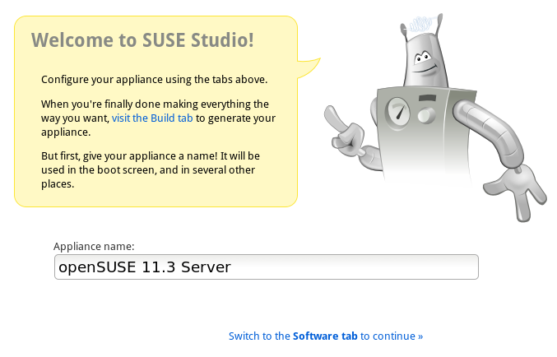
Creating Your New Appliance
Start
Software
Configuration
Files
Build
Share

Slide 20
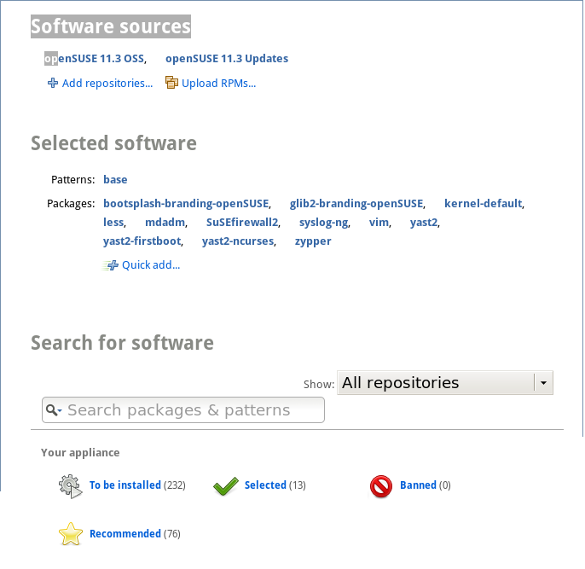
Software
Software Source
  Add Repositories
  Upload RPMS
Select Software
  Patterns
  Packages
Search Source

Slide 21
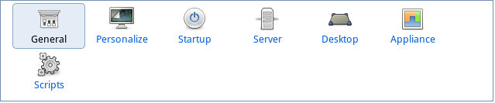
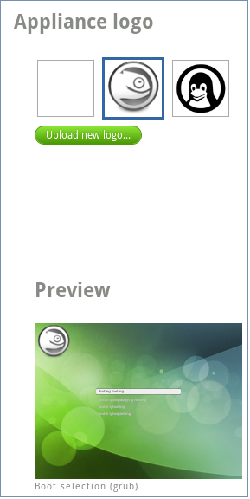
Configuration / Personalize
Default locale
  Language
Default Time Zone
Network
Firewall
User and groups
Upload Logo
Upload Wallpaper

Slide 22
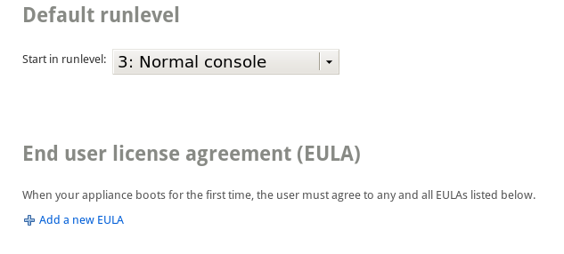
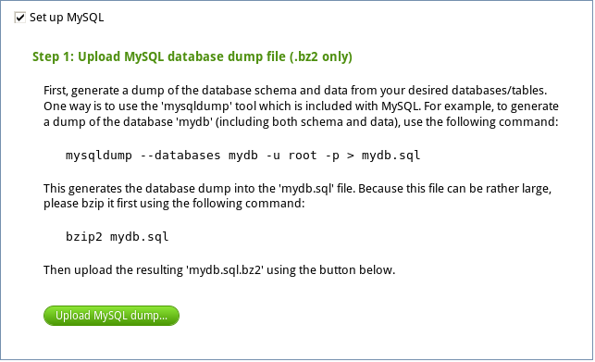
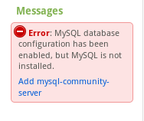
Start Up/Server
Select A Default
Runlevel
Create Custom
End User License
Set up PostgreSQL/MySQL
Upload Database Dump
Add Database
SUSE Studio will help if it detects an issue

Slide 23
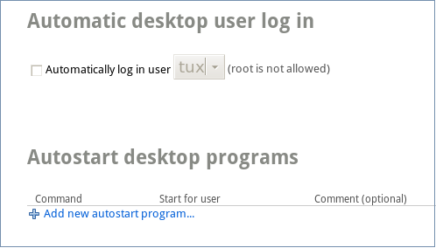
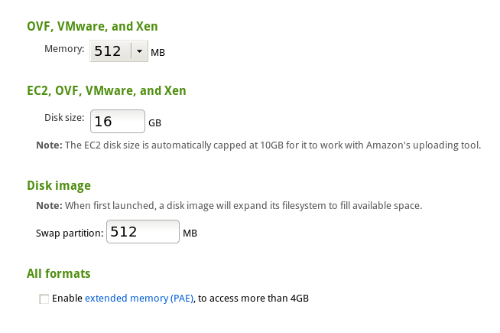
Desktop/Appliance
Automatic Login
Autostart programs
Disk and Memory
Logical Volume Manager
Additional options
  Add Installer
  XEN/VMWARE Support
  Enable WebYaST

Slide 24
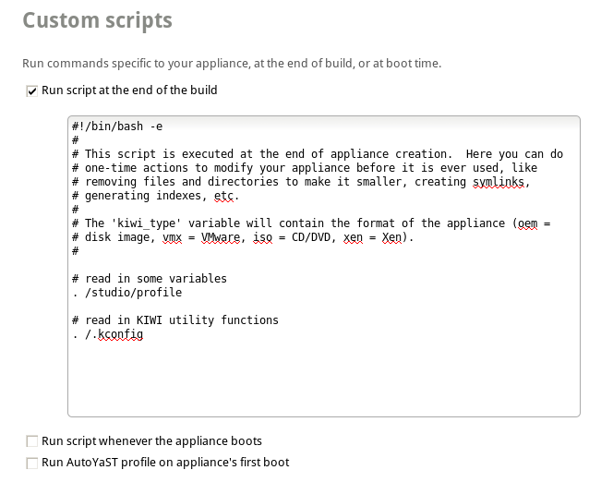
Scripts
Custom Scripts
Running Scripts
  End of the build
  Appliace boots
  Run AutoYast

Slide 25
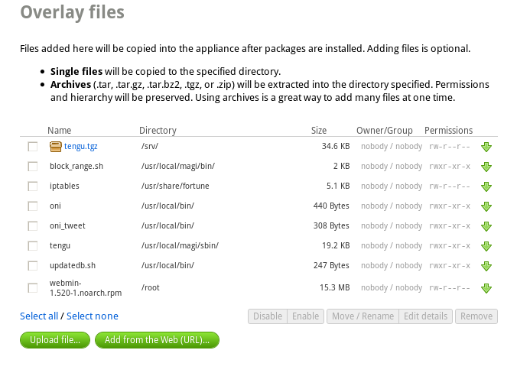
Files
Upload
  Your Custom Files
    Single Files
    Archives
  Place them where you want
  Set permissions
  Now you are really to build Appliance

Slide 26
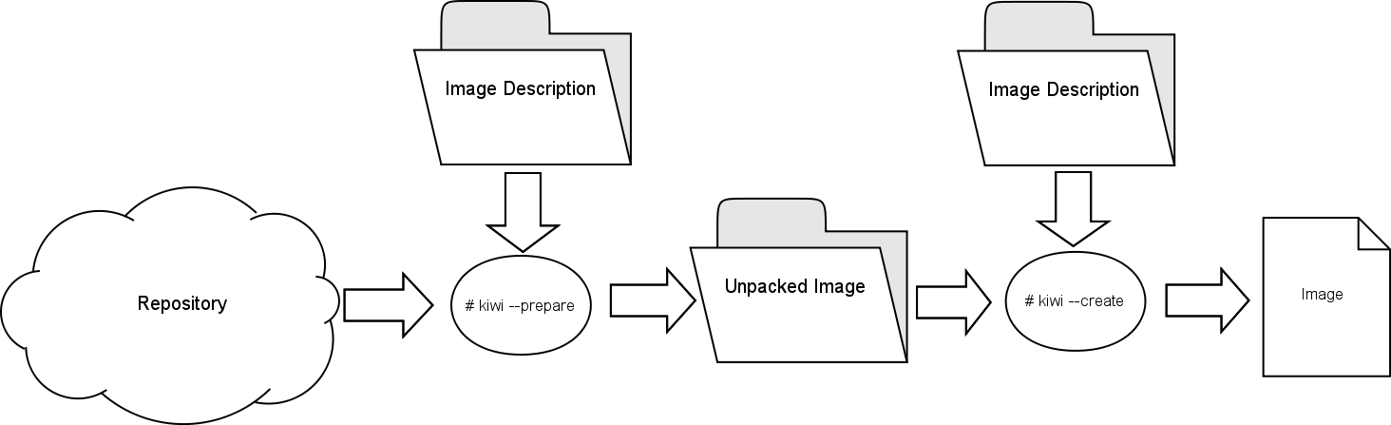
High level Kiwi image build process overview
Two step process
  Prepare step
    Output is unpacked image directory
  Create step
    Output is the desired image

Slide 27
Prepare step
Kiwi reads information from configuration tree
Kiwi initializes the configured repositories
Kiwi installs the configured packages into specified directory
  Dependency resolution occurs automatically and dependent packages are installed
  This is called the “unpacked image tree”
Kiwi applies overlay files
Kiwi executes config.sh script from configuration tree
Generic command line
  kiwi –prepare PATH_TO_CONFIG –root PATH_TO_DEST

Slide 28
Create step
Kiwi reads information from the configuration tree
Kiwi accesses the unpacked image tree
Kiwi executes images.sh from configuration tree
Kiwi creates the boot image (initrd)
  Boot image created by another instance of Kiwi
  Uses Kiwi configuration installed with the kiwi-desc-*boot packages
Kiwi builds the specified image in the appropriate format
Example
  Kiwi –create /tmp/mystick –type usb -d /tmp/mystick -result

Slide 29
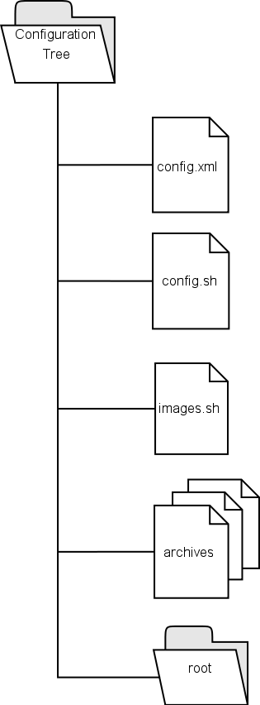
The Kiwi configuration tree
Kiwi uses a directory structure as configuration
  config.xml → required
  config.sh → optional
  images.sh → optional
  archives → optional
  root → optional
A

Slide 30
The Kiwi configuration tree
config.xml – required
  Configuration file used to specify attributes of the image to be created, packages to be included, image type, etc.
config.sh - optional
  Shell script executed at the root level at the end of the prepare step.
images.sh - optional
  Shell script executed at the root level at the beginning of the create step.

Slide 31
The Kiwi configuration tree
archive – optional
  One or more archives in a known format, tar, tar.gz, tar.bz2, etc. The archive name is specified in config.xml. The archive will be extracted at the root level prior to the execution of config.sh during the prepare step
root – optional directory
  A directory that may represent the structure of the root file system of the image. Files and directories in this tree are copied to the image root tree after the extraction of any archives in the prepare step. Files in this directory are referred to as overlay files.

Slide 32
Kiwi configuration - config.xml
XML file following XML rules
  File is validated as part of the build process against schema
    Schema is covered later
  When schema is updated automatic upgrade functionality is provided via XSLT
Specify aspects of the image to be created
Specify packages to be installed

Slide 33
Kiwi configuration - config.xml
<?xml version="1.0" encoding="utf-8"?>
<image schemaversion="" name="">
<description type="system">
<author></author>
<contact></contact>
<specification></specification>
</description>
<preferences>
<type image="" primary="true" filesystem="" boot="" format=""/>
<version>1.0.0</version>
<packagemanager>zypper</packagemanager>
<rpm-check-signatures>false</rpm-check-signatures>
<rpm-force>true</rpm-force>
<locale>en_US</locale>
<keytable>us.map.gz</keytable>
</preferences>

Slide 34
Kiwi configuration - config.xml
<users group="root">
<user pwd="" home="/root" name="root"/>
</users>
<repository type="yast2">
<source path=""/>
</repository>
<packages type="image">
<package name=""/>
</packages>
<packages type="bootstrap">
<package name="filesystem"/>
<package name="glibc-locale"/>
</packages>
</image>

Slide 35
Kiwi configuration - config.xml
Kiwi config.xml file is governed by a schema
Schema is implemented in RELAX NG (relaxing) compact notation
  http://www.relaxng.org/
  http://www.relaxng.org/tutorial-20011203.html
  http://en.wikipedia.org/wiki/RELAX_NG
The schema document is installed by the kiwi package in /usr/share/kiwi/modules/KIWISchema.rnc
Schema may change between Kiwi releases
  Kiwi provides automatic upgrades of config.xml files via XSLT (XSL Transformations)

Slide 36
Exploring image types
Image types are determined by the value of the “image” attribute of the <type> element.
ec2
  An Amazon Machine Image for the Amazon Elastic Compute Cloud image
  Requires the use of the <ec2config> element for configuration purposes of the image
  Requires the installation of the Amazon tools
    http://docs.amazonwebservices.com/AmazonEC2/gsg/2006-06-26/
  Kiwi provides the “suse-ec2-guest” example in the kiwi-doc package
  Resulting AMI can be uploaded and registered on EC2

Slide 37
Exploring image types
iso
  Generates a Live system ready to run from CD/DVD
  Burn the .iso file to CD/DVD
  Include the yast2-live-installer to provide the option to install the image
  Read only image
    Write operations occur in RAM and are lost on exit
  Use the “flags” attribute to select a compression file system
    unified, compressed, dmsquash, clic
      On SLE this will require packages from the SDK media/channel as aufs is not supported
    The flags attribute is optional

Slide 38
Exploring image types
oem
  Image within an image
    Inner image is the image configured in config.xml ready for deployment onto HW
    Outer image is a live system with an “auto installer”
      Detects storage media and dumps inner image onto storage media
        Either dump to partition or to entire drive is possible, dump to drive erases any pre-existing data
    Inner image will automatically adapt to disk geometry
  Use <oemconfig> child element to influence configuration of the deployed image
    Configure swap space, separate home partition, image size, etc.

Slide 39
Exploring image types
usb
  Build a Live system on a USB stick, i.e. a portable system with full read/write access
  Supports LVM, use <lvmvolumes> child element
  Kiwi has –bootstick option to deploy image on USB stick
    Can use “dd” utility to dump the image onto the stick, don't forget the bs=32k option or stick will not boot

Slide 40
Exploring image types
vmx
  Generates a virtual disk image
  Format of image determined by “format” attribute
    bochs → Bochs emulator disk format
    cloop → compressed loop
    cow → qemu disk format
    dmg → Mac OS disk format
    ovf → Open Virtual Format (requires VMmare ovftool)
    qcow & qcow2 → qemu disk format
    vmdk → VMware disk format, also generates .vmx config file
    vpc → Virtual PC disk format (read only)
    vvfat → DOS 32 file system

Slide 41
Exploring image types
xen
  Build a Xen image
    Host
      Set “bootprofile” attribute to “xen”
      Set “bootkernel” attribute to “xenk”
      Set “domain” attribute of <xenconfig> to “dom0”
  Use <xenconfig> child element to configure Xen options
  Specify installation of kernel-xen and xen packages
    Potentially in <packages type=”xen”></packages> section
  Kiwi creates the name.xenconfig file

Slide 42
Setting up a Kiwi build environment on SLE
root access is required
Kiwi is part of the SLE-SDK
  Add the SDK as a repository through YaST
  Detailed description at
  http://www.novell.com/communities/node/10464/step-step-guide-set-kiwi-build-environment-sle
Live on the bleeding edge
  http://download.opensuse.org/repositories/Virtualization:/Appliances/
In YaST or via zypper search for kiwi, install the packages

Slide 43
Using the Kiwi build environment
Kiwi is a command line tool
  GUI front end is SUSE Studio
Most Kiwi commands require root privileges
  Kiwi needs to access package management
  Kiwi installs packages into the unpacked image tree
  Kiwi needs to perform operations on the image being created that require root access
    Setup users
    Setup networking
    ......

Slide 44
Simple way to give kiwi a try
System To Image Migration
  Turns your running system into an image description
  kiwi –migrate mySystem

Slide 45
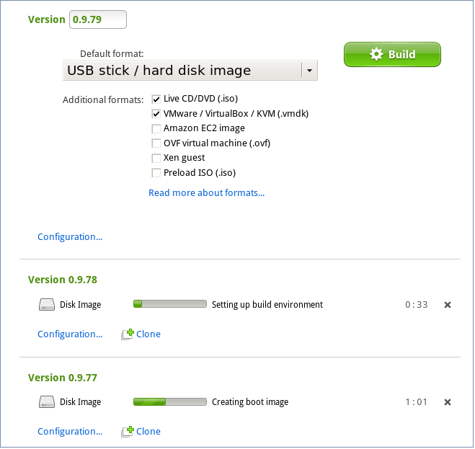
Building Your Appliance
Format
  Live CD/DVD
  USB Stick / Hard Drive
  Vmware / VirtualBox / KVM
  Amazon EC2 Image
  OVF Virtual Machine
  Xen Guest
  Preload ISO

Slide 46
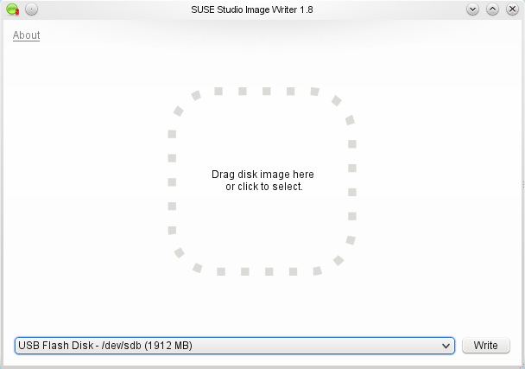
Explore Image Types
USB Stick / Hard Disk Image
  Images that you can lay on top of
  a USB Drive or a Physical
  Hard Drive, this can easily be done
  with SUSE Studio Image Writer .
VMWare/VirtualBox/KVM
  A format that can be use between the three virtual host. The file is a .vmdk, a Virtual Machine Disk Format

Slide 47

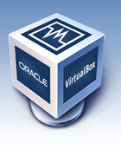
Explore Image Types
XEN Guest
  Use by Xen Hypervisor
OVF Virtual Machine
  Standard Open Virtualization Format. Used by VMWare another other Leaders. Design to address the portability, enable simplified and error deployment.

Slide 48

Explore Image Types
Amazon EC2 Image
  Used by Amazon Elastic Compute Cloud.
  Allowing you to run SUSE in Amazon Cloud
Amazon EC2 Image
  Used by Amazon Elastic Compute Cloud.
  Allowing you to run SUSE in Amazon Cloud
Amazon EC2 Image
  Used by Amazon Elastic Compute Cloud.
  Allowing you to run SUSE in Amazon Cloud
Preloaded ISO
  This is great for setting up, say a computer lab or a server farm, where you want all systems to have the same software and configuration. It is also a step that system hardware vendors (OEMs/IHVs) often include in their production process.

Slide 49
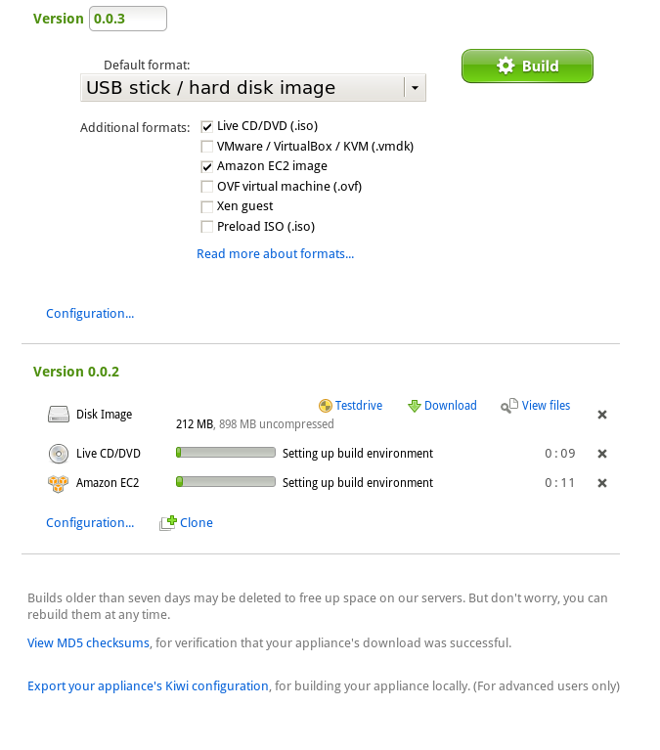
Building
Build more than
one format.
Review configuration
Clone Appliance
View MD5 Checksums
Export Kiwi Configuration

Slide 50
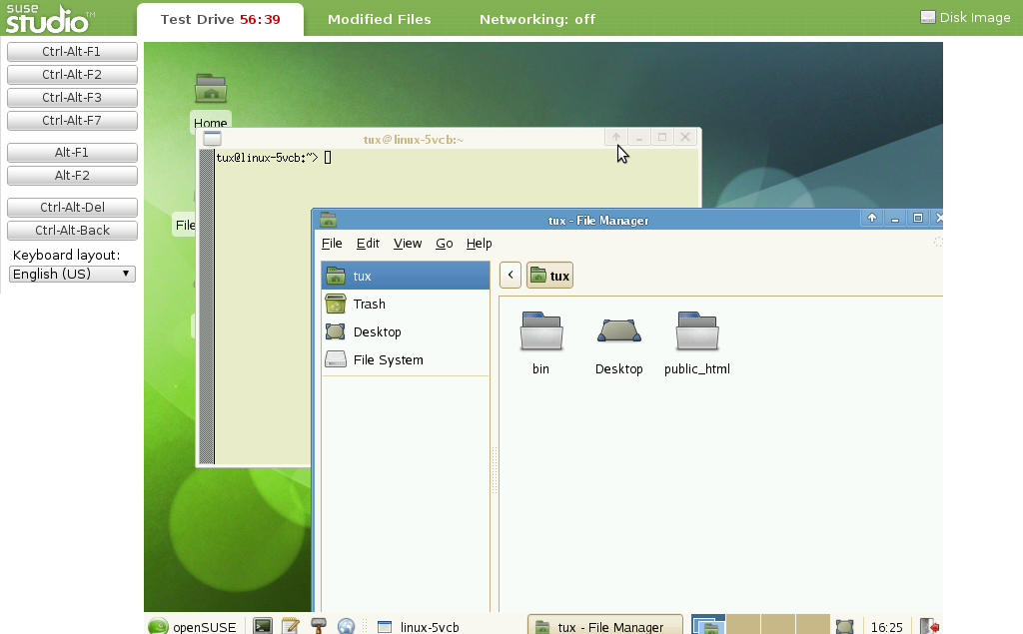
Test drive
No need to down or install
Runs directly from any browser
Networking

Slide 51
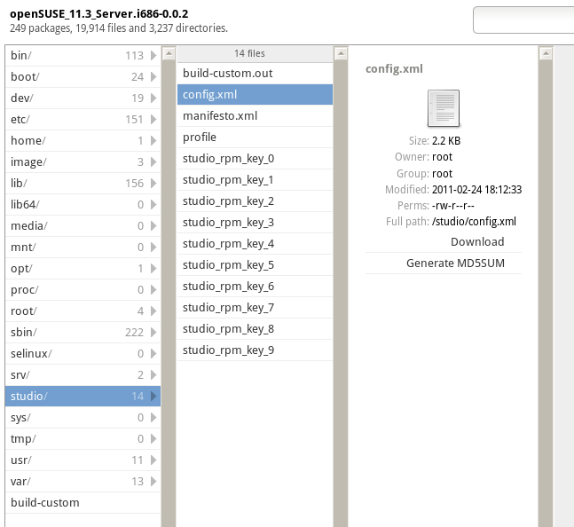
Exporting Kiwi

Slide 52
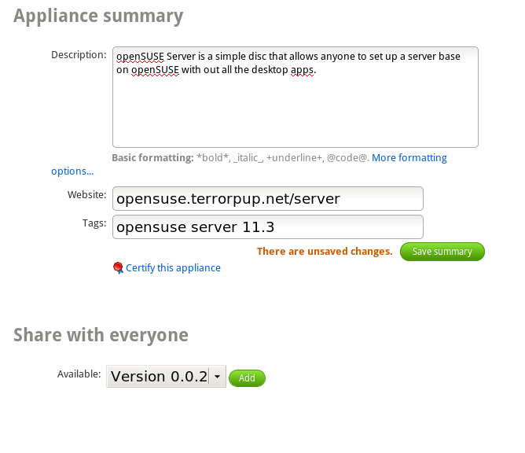

Sharing
Description of the Appliance
Links to website to share
Certify Your Appliance
Version Control
Listing on SUSE Gallery

Slide 53

SUSE Gallery
Great to share your appliance
There are over than XXX appliance
Clone others appliance

Slide 54


Cloning...
A great way to take others
appliances and make it your own
Cloning appliance is an simple as
one click

Slide 55

What is an appliance?
An appliance is the combination of the OS, an application and any middle ware and configuration in one package
Notes:
What is an appliance?
Another delivery mechanism for your application
Saves installation effort at the customer
Saves configuration effort at the customer
Deliver as hardware appliance
OEM image “factory installed” + hardware
OEM image
Customer provides hardware
Customer boots of media and appliance proceeds with self installation
Virtual appliance
Deliver the virtual disk image
Customer simply drops image into their virtual infrastructure

Slide 56
kiwi.berlios.de
Notes:
Summary:
Kiwi is very flexible image build tool
Command line driven for easy integration into any build process
Supports creation of many image formats from one prepared image tree
Open source licensed under GPL v2
Post questions to: kiwi-users@lists.berlios.de
Developers: kiwi-devel@lists.berlios.de
Git repository: git.berlios.de/kiwi

Slide 57

Access is easy, You can use any of of the following open ids....
Or you can create and open id or Novell account to get access.

Slide 58


Slide 59
References

Slide 60
Kiwi documentation resources
Cookbook
  On the web:
    http://git.berlios.de/cgi-bin/gitweb.cgi?p=kiwi;a=blob;f=doc/kiwi.pdf
  From the kiwi-doc package:
    /usr/share/doc/packages/kiwi/kiwi.pdf
Schema documentation
  Point your browser at:
    file:///usr/share/doc/packages/kiwi/schema/kiwi.html
Online Example Cookbook
  http://en.opensuse.org/Build_Service/KIWI/Cookbook

Slide 61
Studio Documentation Sources
SUSE Studio
http://www.susestudio.com
SUSE Studio Image Writer
http://en.opensuse.org/SDB:Live_USB_stick
Different Formats
http://en.opensuse.org/openSUSE:SUSE_Studio_howtos

