Slide 1
Herding Cat5
Keeping the infrastructure maintainable
David Trott

Slide 2
Dev-Ops
DRY – Don’t Repeat Yourself
Example Problem
Dev-Ops Solution (ETM)
Issue Resolution
ETM - Demo
Q & A
Notes:
Developer Standing behind the op’s guy saying just type in what I told you.

Slide 3
Don’t Repeat Yourself
How many times is the information entered ?
What information is necessary ?
Do you trust the decision maker ?
Notes:
Talk about information needed for how to create a new vip
Dev- Know they need one.
Ops know the IP needed.

Slide 4

Example Problem
Articles
Inventory
Leads
Notes:
Big Bad SEO

Slide 5
Context Paths
http://www.edmunds.com/…
http://www.edmunds.com/inventory/…
http://www.edmunds.com/leads/…
Articles
Inventory
Leads

Slide 6
SEO Controls the URL’s
/Make/Model/Year/…
http://www.edmunds.com/bmw/3-series/2011
http://www.edmunds.com/ford/f-150/2011
http://www.edmunds.com/saab/9-3/2003
http://www.edmunds.com/certified-cars/…
http://www.edmunds.com/certified-cars/certified-pre-owned-vs-extended-service-contract.html

Slide 7
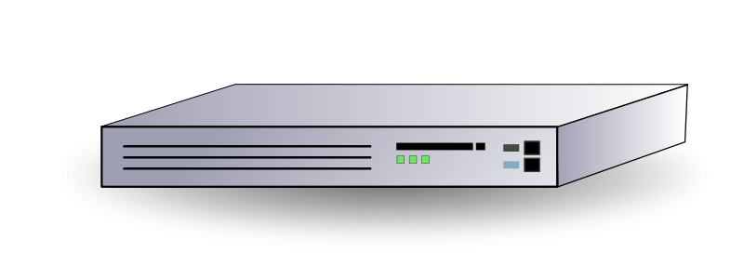
Setup Steps
Provision App Servers
Create VIP
Add Servers to VIP
LB Health Check
Add DNS for VIPs
Configure Apache
Apache
Articles
Inventory
Leads
Notes:
DNS Views Per Environment
Provision new application
Do that for each environment.
Health Check changes ?
Last four steps are all repeats

Slide 8
Information Needed
Information | Old Way | Dev-Ops
IP of App Server | Assign Static IP to host Enter IP in Load balancer | Auto assign IP to host (DHCP) Auto detect Host IP and update LB
IP of VIP | Track IP in Excel Cut and paste to create VIP | Allocate Range for all VIP’s Assign free IP’s automatically
DNS for each VIP | Cut & paste IP to DNS config Reload DNS | …
Page Layout/SEO Rules | Manually edit 8 pages of mod-rewrite rules | Rules are packaged with the Application
LB Health Check | Check the home page is up!! | Build page per application that does detailed checks.
Notes:
When problems occur:
Log into production to investigate
Verify configuration settings
Manually fix load balancers
Restart processes

Slide 9

Solution - ETM
Agent
Apache
Controller
Client
ZooKeeper
Articles
Inventory
Leads
Notes:
DNS Views Per Environment
Provision new application
Do that for each environment.
Health Check changes ?
Last four steps are all repeats

Slide 10
Solution – Config By Exception
Implemented Today
Uses DNS and Spring
Two configurations (Local, Managed)
Variable Substitution
Property file based overrides
Future
ZooKeeper
Expose defaults

Slide 11
Tasks
Stage | Dev | Ops
Planning/Design | Discuss Solution Evaluate Technologies | Discuss Solution Choose Hardware Provide Requirements Created Deployment Layout
Implementation | Write Code Create Unit Test | Shared Domain Expertise Created Deployment Packages
Deployment | Drink Beer | Dev Read-only Prod Access Automation Accounts Allocated IP Ranges
Deployed | Investigates Issues Fix Bugs | Investigates Issues Fix Configuration
Notes:
When problems occur:
Log into production to investigate
Verify configuration settings
Manually fix load balancers
Restart processes

Slide 12
Issue Investigation
Apps Unreachable
Load Balancer Rest Service - Not Responding
ETM Controller – Continuous Change
Dropped Zookeeper Connections ~ 20 p/hour
Random, except occur one at a time.
Pattern – Dropping exactly once per hour
TCP Dump – Out of order packets.
Time Drift (~ 1 minute) – App server logs
Notes:
Once different times for different servers
Is it a timeout?

Slide 13
Issue Resolution
Ops
Kernel Parameters
NTPD
Meshed Time Servers
Dev
Added master on/off switch
Added “Quiet Period”
Notes:
clock=tsc divider=10

Slide 14
Demo

Slide 15
Conclusion
Discuss the solution
Embrace automation
Don’t repeat yourself

Slide 16
Questions ?
Edmunds is hiring:
http://www.edmunds.com/about/jobs/

