Slide 1
Greetings SCALE!
Building Free Software Groups:
Lessons from the World of Community Organizing
Deb Nicholson
Feb. 25th, 2011

Slide 2
What I'm going to talk about
Why free software is critical
The state of the movement
Strategy and perception
Specific tactics for growth

Slide 3

In the 60's, people believed that computers would be used primarily to enhance the power of the individual
CC-BY-SA -- DJ Brandon on Flickr

Slide 4
Freedom of speech and freedom of assembly are meaningless if the methods of doing so are not
controlled by the people.

Slide 5
“Power concedes nothing without a demand. It never did and it never will. “ -- Frederick Douglass

Slide 6
What is free software?
The freedom to run the program, for any purpose
The freedom to study and change the program
The freedom to share copies so you can help your neighbor
The freedom to distribute copies of your modified versions to others

Slide 7
How does our society benefit?
Human knowledge about software and computers is pooled, no need to ”reinvent the wheel”
Individuals and their expertise are valued instead of corporate monopolies
Everyone is empowered to write software, or modify the programs they use daily
Effort is not wasted policing ”intellectual property”

Slide 8
Free software is distributed power.

Slide 9
Free software users are currently in the minority
“As an organizer
I start from where the world is, as it is,
not where I would like it to be.” -- Saul Alinsky

Slide 10
The “low hanging fruit” is already here.

Slide 11
According to FLOSSPOLS, women comprise less than 2% of the free software community.

Slide 12
We have a movement that needs to grow and a huge population we haven't reached.

Slide 13
Lots of opportunity!
More people would mean :
  More users
  More designers
  More developers
  More people spreading the word

Slide 14
Organizing is recursive
More people spreading the word:
  More users
  More designers
  More developers
  More people spreading the word

Slide 15
Diversity
People of color
Gays, lesbians, bisexuals, transgendered people and the folks who love them, resemble them or otherwise do not fit into the category of straight
People with disabilities
People from a working class background
People who don't identify as “computer people”

Slide 16
However, the tactics I'm about to share aren't only for increasing diversity – they're good guidelines for reaching out to anyone.

Slide 17
There are no shortcuts
“Effective organization is thwarted by the desire for instant and dramatic change.”
“To build a powerful organization takes time.”
-- Saul Alinsky

Slide 18
How do we get there?
Cesar Chavez was once asked how he did all that organizing. His answer, “I talked to one person, then I talked to another person, then I talked to another person...”

Slide 19
Talking to people effectively
Define your purpose
Plan an event or meeting
Who is your target?
Make it personal

Slide 20
Define your goal
It's hard to invite people in when you can't articulate what you're inviting them to.

Slide 21

Stay on message
CC-BY – photogirl7 on flickr
Be up front about your goal
Try to keep attention getting measures thematically related
Consider #off-topic or post-meeting beers

Slide 22
Events or meetings
Give you a specific time and place to focus on
Newcomers' events cut out the weirdness of inviting new people one at a time
Face to face helps people feel connected

Slide 23
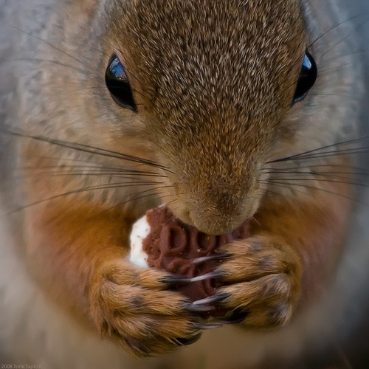
Planning your event...
CC-BY Tomi Tapio on flickr
A public place
Entice people with snacks
Have a plan! “Disorganized” doesn't encourage people to stay involved

Slide 24
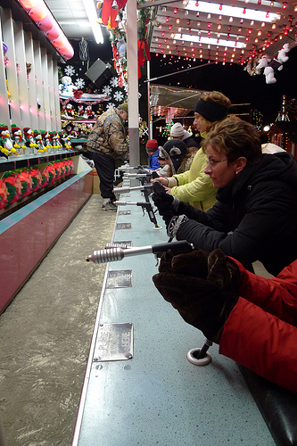
Stay on target, stay on target...
CC-BY-SA Eric Kilby on Flickr
Who are you inviting?
What's in it for them?
Tailor your approach
Repeat and repeat and repeat

Slide 25

Perception & Recruitment
CC-BY-SA smws on Flickr
The easiest recruit is a clone of yourself
Cultural stereotypes about geeks
“Just another member” is much more comfortable than “unicorn”

Slide 26
Making it personal
Find out what people are interested in and make a connection
Send personal emails
Talk to people in person
Repeat and repeat and repeat

Slide 27
They're here! Now what?
Run a good meeting
Follow up with people
Analyze what you just did
Improve it for next time!

Slide 28
A few things to remember
Introductions at the beginning of every gathering
Always thank people for coming!
Use inclusive language, explain your acronyms
Make sure people know what they can do next

Slide 29
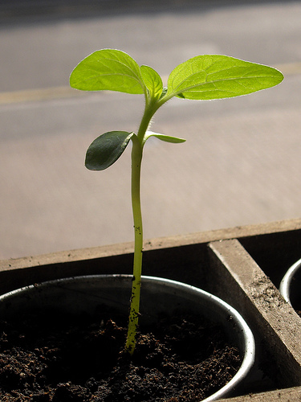
Growing
CC-BY – Rev Stan on flickr
Think of your new participants as seedlings, they'll need care and feeding -- but not smothering.

Slide 30
90% of organizing is follow-through

Slide 31
Tools for follow-through
Take notes at your meetings
Keep institutional knowledge up to date and somewhere everyone can access it
Set deadlines and stick to them
Thank people for the tasks they've completed -- publicly if possible!

Slide 32

Share the work
CC-BY – Steven Depolo on flickr
Work is “digital”
Bus factor
Burnout factor
Documentation is key

Slide 33
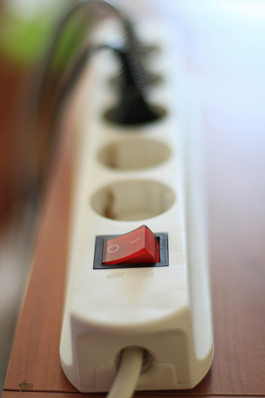
Shared Power
Don't be “the boss”
Mission matters more than details
If it's not the way you would do it, then ID why and articulate it
Invested people stick around
CC-BY-SA Tom Raftery on flickr

Slide 34
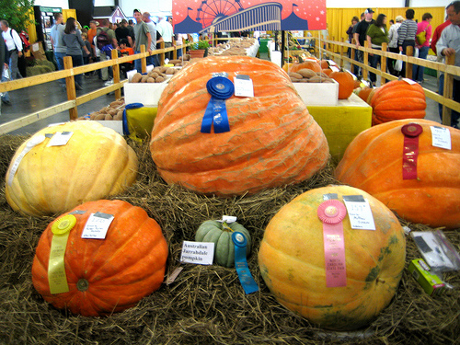
Fostering Leadership
CC-BY – moonlightbulb on flickr
Titles and recognition can go a long way
Reward people with more responsibility
Teach/empower people to recruit others

Slide 35
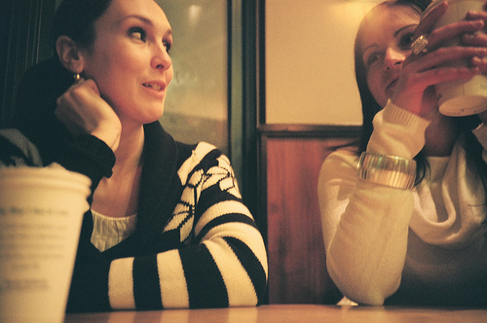
One on Ones
CC-BY – Anya Logic on flickr
In person or online
Build accountability
Listen to how things are going
Make it better
Stay on topic

Slide 36
Just to recap
Free software is distributed power
More people and different people == larger and more successful free software movement!
Invite people thoughtfully and repeatedly
Share the work and the decision making!
Make sure people are getting something back
Always be fostering leadership

Slide 37
Resources
“Rules for Radicals” by Saul Alinski
Some free software specific organizing resources http://groups.fsf.org/wiki/Womenscaucus/resources
Email me, deb@eximiousproductions.com

