Slide 1
Finding Help in Ubuntu
By Elizabeth Krumbach

Slide 2
Elizabeth Krumbach
By day: Debian Systems Administrator at LinuxForce.net
By night: Ubuntu Beginners, Ubuntu Classroom, Partimus.org
lyz@ubuntu.com
@pleia2

Slide 3
Why this talk?

Slide 4
Installing Software
Documentation
User Support
Best Practices and Etiquette

Slide 5
The First Question
How do I install...?

Slide 6
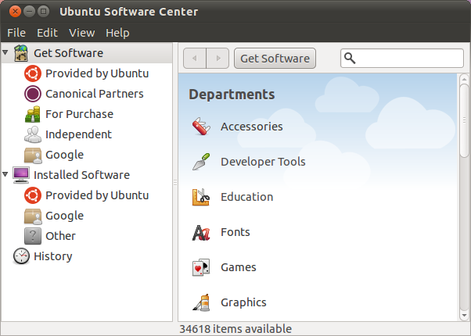
Ubuntu Software Center

Slide 7
Basic Offline Documentation
Help menu or ”man” page for the software you're using
Help resources in your system menu
/usr/share/doc

Slide 8
Basic Online Documentation
Official:
help.ubuntu.com
Community: help.ubuntu.com/community/

Slide 9
Solving Problems

Slide 10
Search Engines
Exact error message
Simple way to describe problem
Hardware? Model + ”ubuntu” or ”linux”

Slide 11
Forums
ubuntuforums.org

Slide 12
Mailing Lists
lists.ubuntu.com
lists.ubuntu.com/mailman/listinfo/
ubuntu-users

Slide 13
Chat
Internet Relay Chat at irc.ubuntu.com
#ubuntu
#ubuntu-beginners
#ubuntu-us-ca
webchat.freenode.net
ubuntu-california.org/chat

Slide 14
Question Sites
Launchpad Answers
answers.launchpad.net/ubuntu
AskUbuntu
askubuntu.com

Slide 15
What did I miss?

Slide 16
Best Practices and Etiquette

Slide 17


Slide 18
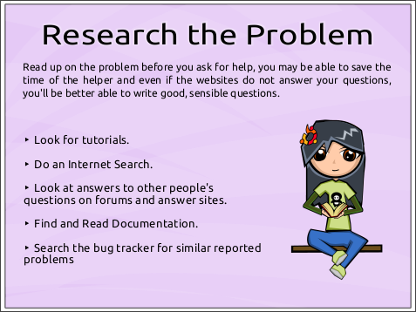

Slide 19
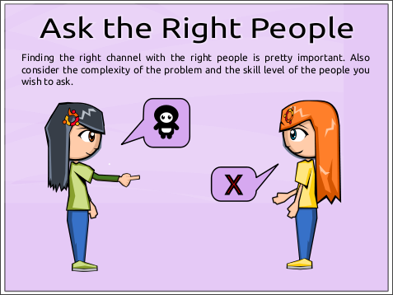

Slide 20
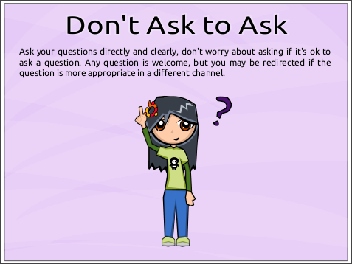

Slide 21
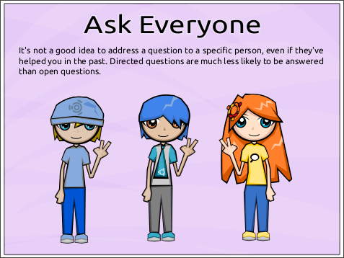

Slide 22
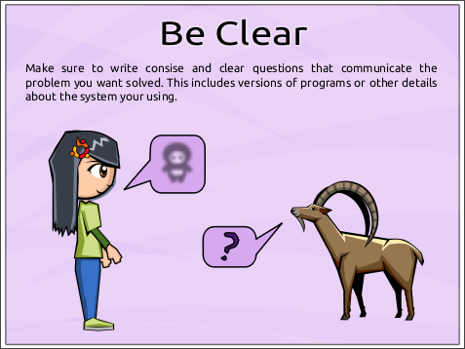

Slide 23
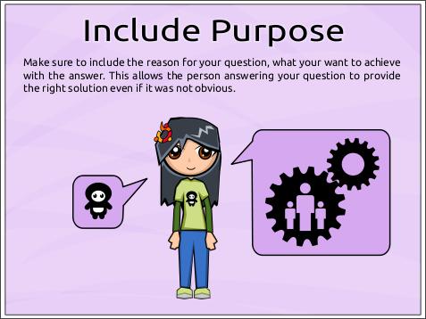

Slide 24
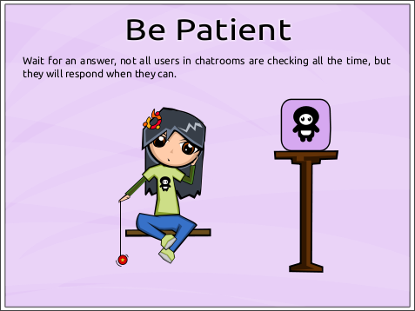

Slide 25
Observe the Rules
ubuntu.com/community/conduct
ubuntu.com/support/community/
mailinglists
ubuntuforums.org/index.php?page=policy
wiki.ubuntu.com/IRC/TermsOfService

Slide 26
Remember! We're Volunteers!

Slide 27
Paid Support
Canonical:
ubuntu.com/support/services
Other:
webapps.ubuntu.com/marketplace
webapps.ubuntu.com/partners

Slide 28
Other Resources
help.ubuntu.com/community/
SwitchingToUbuntu
help.ubuntu.com/community/
GettingAnswers
wiki.ubuntu.com/Classroom
search.ubuntu.com

Slide 29
Questions & Feedback

Slide 30
Credits:
”How to Ask Smart Questions” slides © Martin Owens, license CC-BY-SA
Slides License:
CC-BY-SA
© Elizabeth Krumbach

