Slide 2
Introduction
Who am I?
Notes:
My name is David Wonderly.
I am one of the leaders of Ubuntu California
I am the lead in Kubuntu Documentation
I have been involved with Ubuntu and Kubuntu since 2007

Slide 3
What is KDE?
KDE is the Desktop Environment that Kubuntu uses
KDE is based on the Qt Framework. This allows KDE software based on Qt to also be distributed to Microsoft Windows and Mac OS X.
Notes:
Qt (Pronounced cute) is a Framework that allows the deployment of software over a wide range of platforms. It is actively developed by Nokia.
It would be good to note that with the recent Microsoft/Nokia merger that this will not effect Qt development in any way. If anything Nokia has increased the numbers of Qt developers since the merger.

Slide 4
What is KDE?
Plasma Desktop
This allows the user to have a computing experience that is not only pleasant to the eyes but with the use of Widgets and Plasmoids, allows the user to customize their workspace to fit their computing needs.

Slide 5
What is Kubuntu?
Kubuntu is the combination of Ubuntu the project and KDE. While Ubuntu uses GNOME as the default Desktop Environment, Kubuntu uses KDE.
Kubuntu shares the same repositories and allows for the installation of your favorite software.

Slide 6
What is Kubuntu?
Kubuntu is community built and driven.
While Ubuntu has many “hired” programmers for Ubuntu the project, Kubuntu only has one. Because of this Kubuntu has a unique relationship with upstream KDE. This means that our changes, fixes and bug patches get sent up to KDE to help improve the end user experience.
Notes:
Give a bit of history behind this.

Slide 7
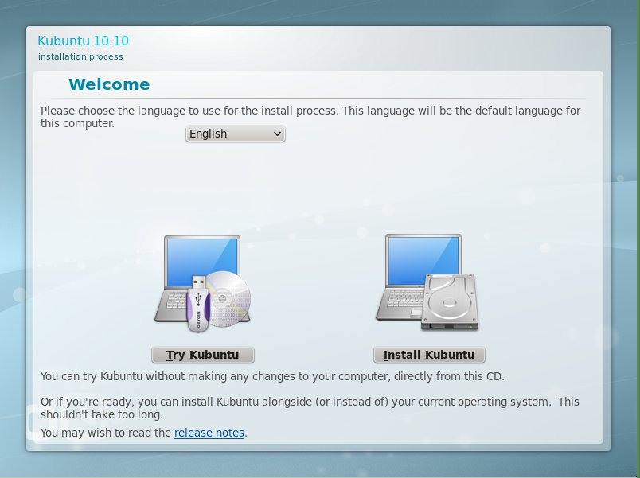
The Kubuntu Experience!
Notes:
Welcome to the Kubuntu Experience!
During the next bit of I time we will explore what Kubuntu 10.10 has to offer over the current Long Term Support release of 10.04.
Then, we will have a little preview of Natty Narwhal.

Slide 8
The Kubuntu Experience!
But, isn't Kubuntu full of bugs?
Notes:
This this the number one question I get from people. They gave up on Kubuntu after the switch from KDE3 to KDE4. At that time there were loads of experimental things going into KDE4 and to be honest it was released before it was ready. Since then HUGE progress has been made in the realm of KDE4.X.

Slide 9
Kubuntu 10.10
KDE 4.5
Notes:
KDE 4.5 gave us a few things. Improved Netbook (We will cover in a bit)
A new high-speed cache system
Better Application support for WebKit

Slide 10
Kubuntu 10.10
Combined Desktop/Netbook ISO Image
Notes:
Kubuntu has merged the Desktop and Netbook images into one featuring both the Plasma Desktop and Plasma Netbook workspaces. The appropriate workspace for your machine will be launched at login; you can also change the workspace in System Settings.

Slide 11
Kubuntu 10.10
Ubiquity Installer
Notes:
Our installer has had a few changes. On boot Ubiquity will offer you the option of running the live system or installing directly.
Ubiquity now lets you download restricted packages such as MP3 playing during the install so you do not have to do them later (of course you will need internet access for this).
The installation process starts right after the disk setup page, before you have completed the remaining setup tasks, so it'll be ready to use sooner.

Slide 12
Kubuntu 10.10
Improved KPackageKit
Notes:
KPackageKit for Kubuntu now has an application-focused view as part of it's updated user interface. You now can find individual packages by searching by name. The backend has been changed to the much faster aptcc to ensure your installs are as quick as possible.
New features such as application screenshots and update changelogs are just a few of the enhancements KPackageKit provides to give Kubuntu users a better, polished and stable package management tool.

Slide 13
Kubuntu 10.10
New Web Browser - Rekonq
Notes:
Rekonq is now the web browser for Kubuntu. It is built on both KDE Platform and Qt WebKit technologies and sports a modern, clean interface that maximizes space for web browsing and does not get in your way. Both Konqueror and the Kubuntu Firefox Installer are still available for users who prefer these options

Slide 14
Kubuntu 10.10
New Ubuntu Font
Notes:
The default font on the install media is now the Ubuntu font. It features a distinctive design which remains undistracting. It makes Kubuntu the first distro to ship with the new Indian Rupee symbol.

Slide 15
Kubuntu 10.10
Global Menu in Plasma Netbook
Notes:
Plasma Netbook now sports the Global Menu by default. This innovation helps conserve vertical space on small netbook screens.

Slide 16
Kubuntu 10.10
Message Indicator
Notes:
Kubuntu's Message Indicator Plasma widget is now on by default for IRC and Instant Messaging applications. You can also shift-click on the tray icon to open the application with the most recent event.

Slide 17
Kubuntu 10.10
Improved Bluetooth Support with BlueDevil
Notes:
BlueDevil has become the default Bluetooth program to make file transfer and other Bluetooth operations much more reliable.

Slide 18
Kubuntu 10.10
PulseAudio
Notes:
Kubuntu now uses the PulseAudio sound server by default. Building on the efforts of Ubuntu over the last several release cycles, this system is now used by Kubuntu to give users enhanced configurability, flexibility and ease of use. System Settings and KMix have been updated to enhance Pulseaudio control integration.

Slide 19
What's New?
What do we have to look forward to?
Notes:
In this next addition we will give you just a small look into what is coming up for the 11.04 Natty Narwhal release.

Slide 20
Kubuntu 11.04
KDE 4.6
Notes:
The latest stable release of KDE's Plasma Workspaces and Applications brings new features and improvements all around. This includes:
* KWin sees significant performance improvements and better detection of graphic driver capabilities
* You can now associate programs with specific Plasma activities
* The power management configuration area has been given a new, easier to use interface

Slide 21
Kubuntu 11.04
LibreOffice
Notes:
We are packaging Kubuntu 11.04 with LibreOffice instead of OpenOffice.
A lot of people ask why we do not package and ship KOffice with Kubuntu. Simply put, the developers of Koffice do not believe that Koffice is ready for mass deployment. If you would like to help test and get Koffice ready please see me afterward.

Slide 22
Kubuntu 11.04
HAL is replaced
Notes:
With KDE Platform 4.6, we are now able to transition to the new udisks and upower systems.

Slide 23
Kubuntu 11.04
GTK Oxygen Theme
Notes:
GTK applications such as Firefox or Inkscape now fit in with KDE's Plasma desktop.

Slide 24
Kubuntu 11.04
Phonon GStreamer backend
Notes:
Our multimedia system has changed to GStreamer. This offers consistency with the rest of Ubuntu, HTML5 video in our web browser and improved codec install facilities.

Slide 25
Kubuntu 11.04
Redesigned Activities System
Notes:
This makes it easy to associate applications to activities - once you create some new activities, right clicking an window title you'll have an option to make that application part of a certain activity

Slide 26
Conclusion
Where do we go from here?

Slide 27
Contribute
So, how do I get involved?

Slide 28
Contribute
http://www.kubuntu.org/community/contribute
#kubuntu-devel on FreeNode IRC

Slide 29
Questions?
Questions?
If I am not able to get to your questions please feel free to e-mail me or talk to me at either the Ubuntu or KDE booths during the Expo.
David “DarkwingDuck” Wonderly
david.wonderly@kubuntu.org

