Slide 1

Drink the Kool Aid
Notes:
The famed New York Times columnist, Thomas Friedman, wrote a column in which he said America needs more jobs—Steve Jobs. He meant that innovation and creativity must be nurtured and encouraged to help the U.S and other countries emerge from the global recession. Everyone wants to learn more about Steve Jobs, yet very few journalists have identified the principles that drive Steve Jobs and his success. Until now, that is.

Slide 2
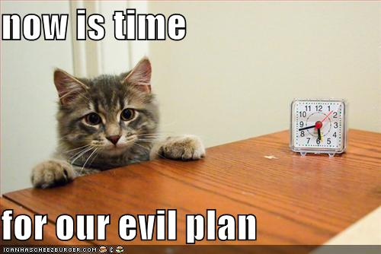

Slide 3
What is a cult anyway?
Short answer:
Any belief system different than
your own.
Notes:
Have the courage to follow your heart and intuition. They somehow already know what you truly want to become.

Slide 4
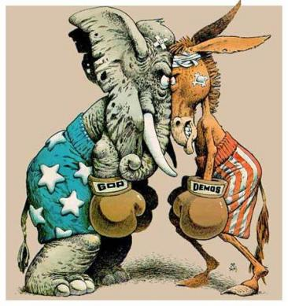

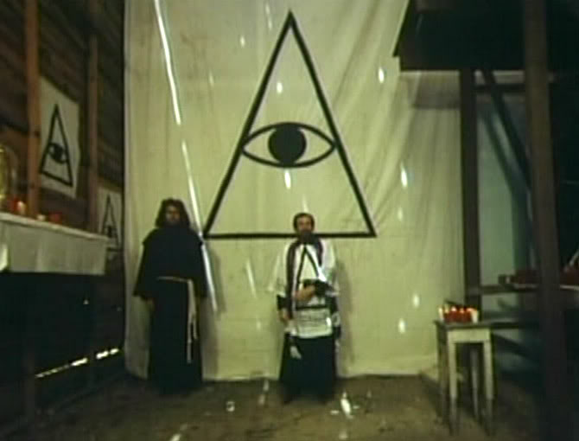



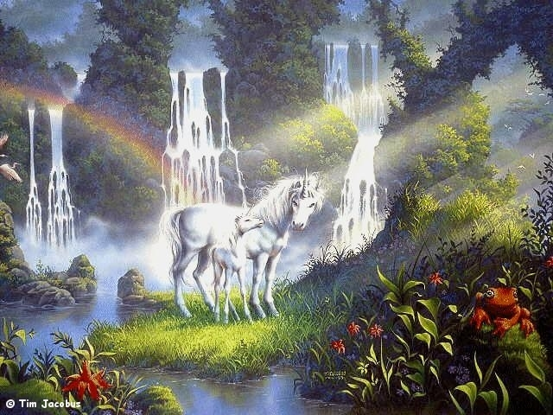




Slide 5

Two types of geeks?

Slide 6
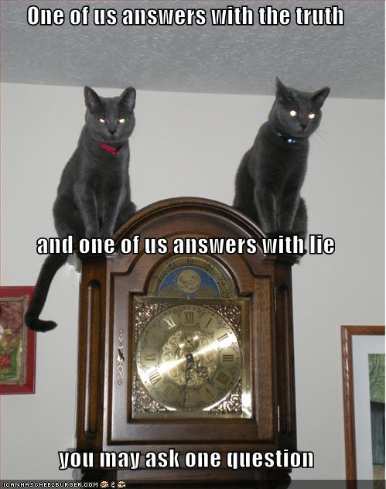

Slide 7

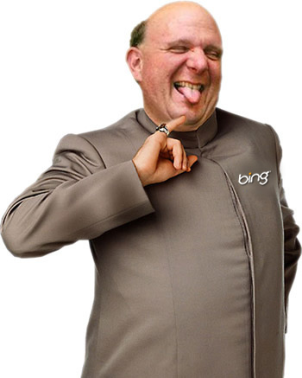
Things change...
Notes:
Being the richest man in the cemetary doesn’t matter to me. Going to be bed at night saying, we’ve done something wonderful. That’s what matters.

Slide 8
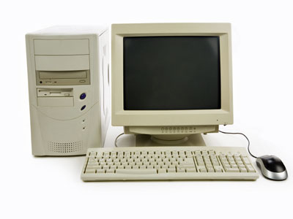

The Macintosh was the world’s first computer with beautiful fonts and typography. If Steve Jobs hadn’t followed his passion, we’d still be entering line commands.
Notes:
The Macintosh was the world’s first computer with beautiful fonts and typography. If Steve Jobs hadn’t followed his passion, we’d still be entering line commands.

Slide 9
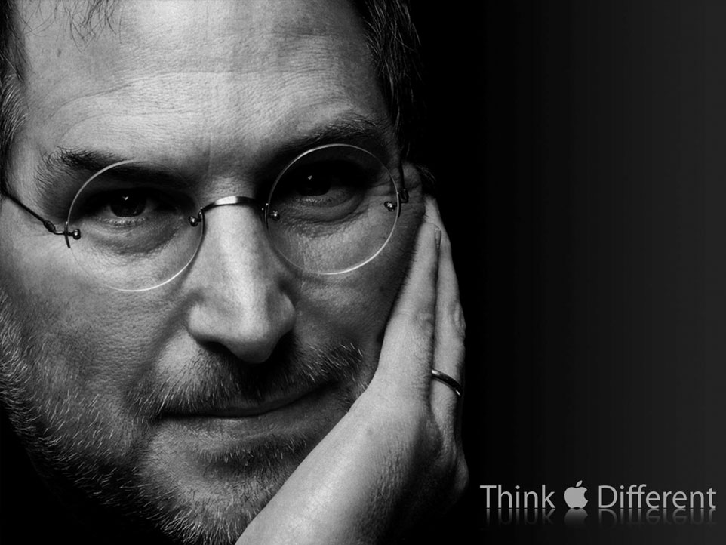
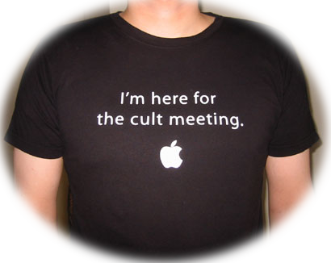
Notes:
How to do find your passion? Passions are those ideas that don’t leave you alone. They are the hopes, dreams and possibilities that consume your thoughts. Follow those passions despite skeptics and naysayers who do not have the courage to follow their dreams.

Slide 10

When Jobs returned to Apple in 1997 after a 12-year absence, Apple faced an uncertain future. Jobs closed his presentation that year at Macworld in Boston with an observation that set the tone for Apple’s resurgence: “I think you have to think differently to buy an Apple computer. A lot of times people think they’re crazy, but in that craziness we see genius.”
Notes:
How do you see your customers? Help them unleash their inner genius and you’ll win over their hearts and minds. Nobody cares about your company or product. They care about themselves, their dreams, and their goals. Help them achieve their aspirations and you’ll win them over the Steve Jobs way.

Slide 11

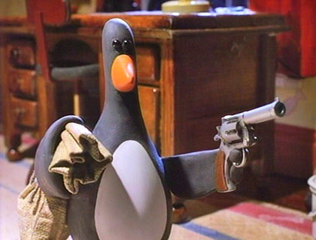
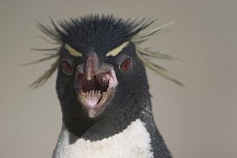
Not *all* penguins are friendly

Slide 12
Is Linux a cult?
Notes:
Steve Jobs’ advice to the new Nike CEO, Mark Parker.

Slide 13
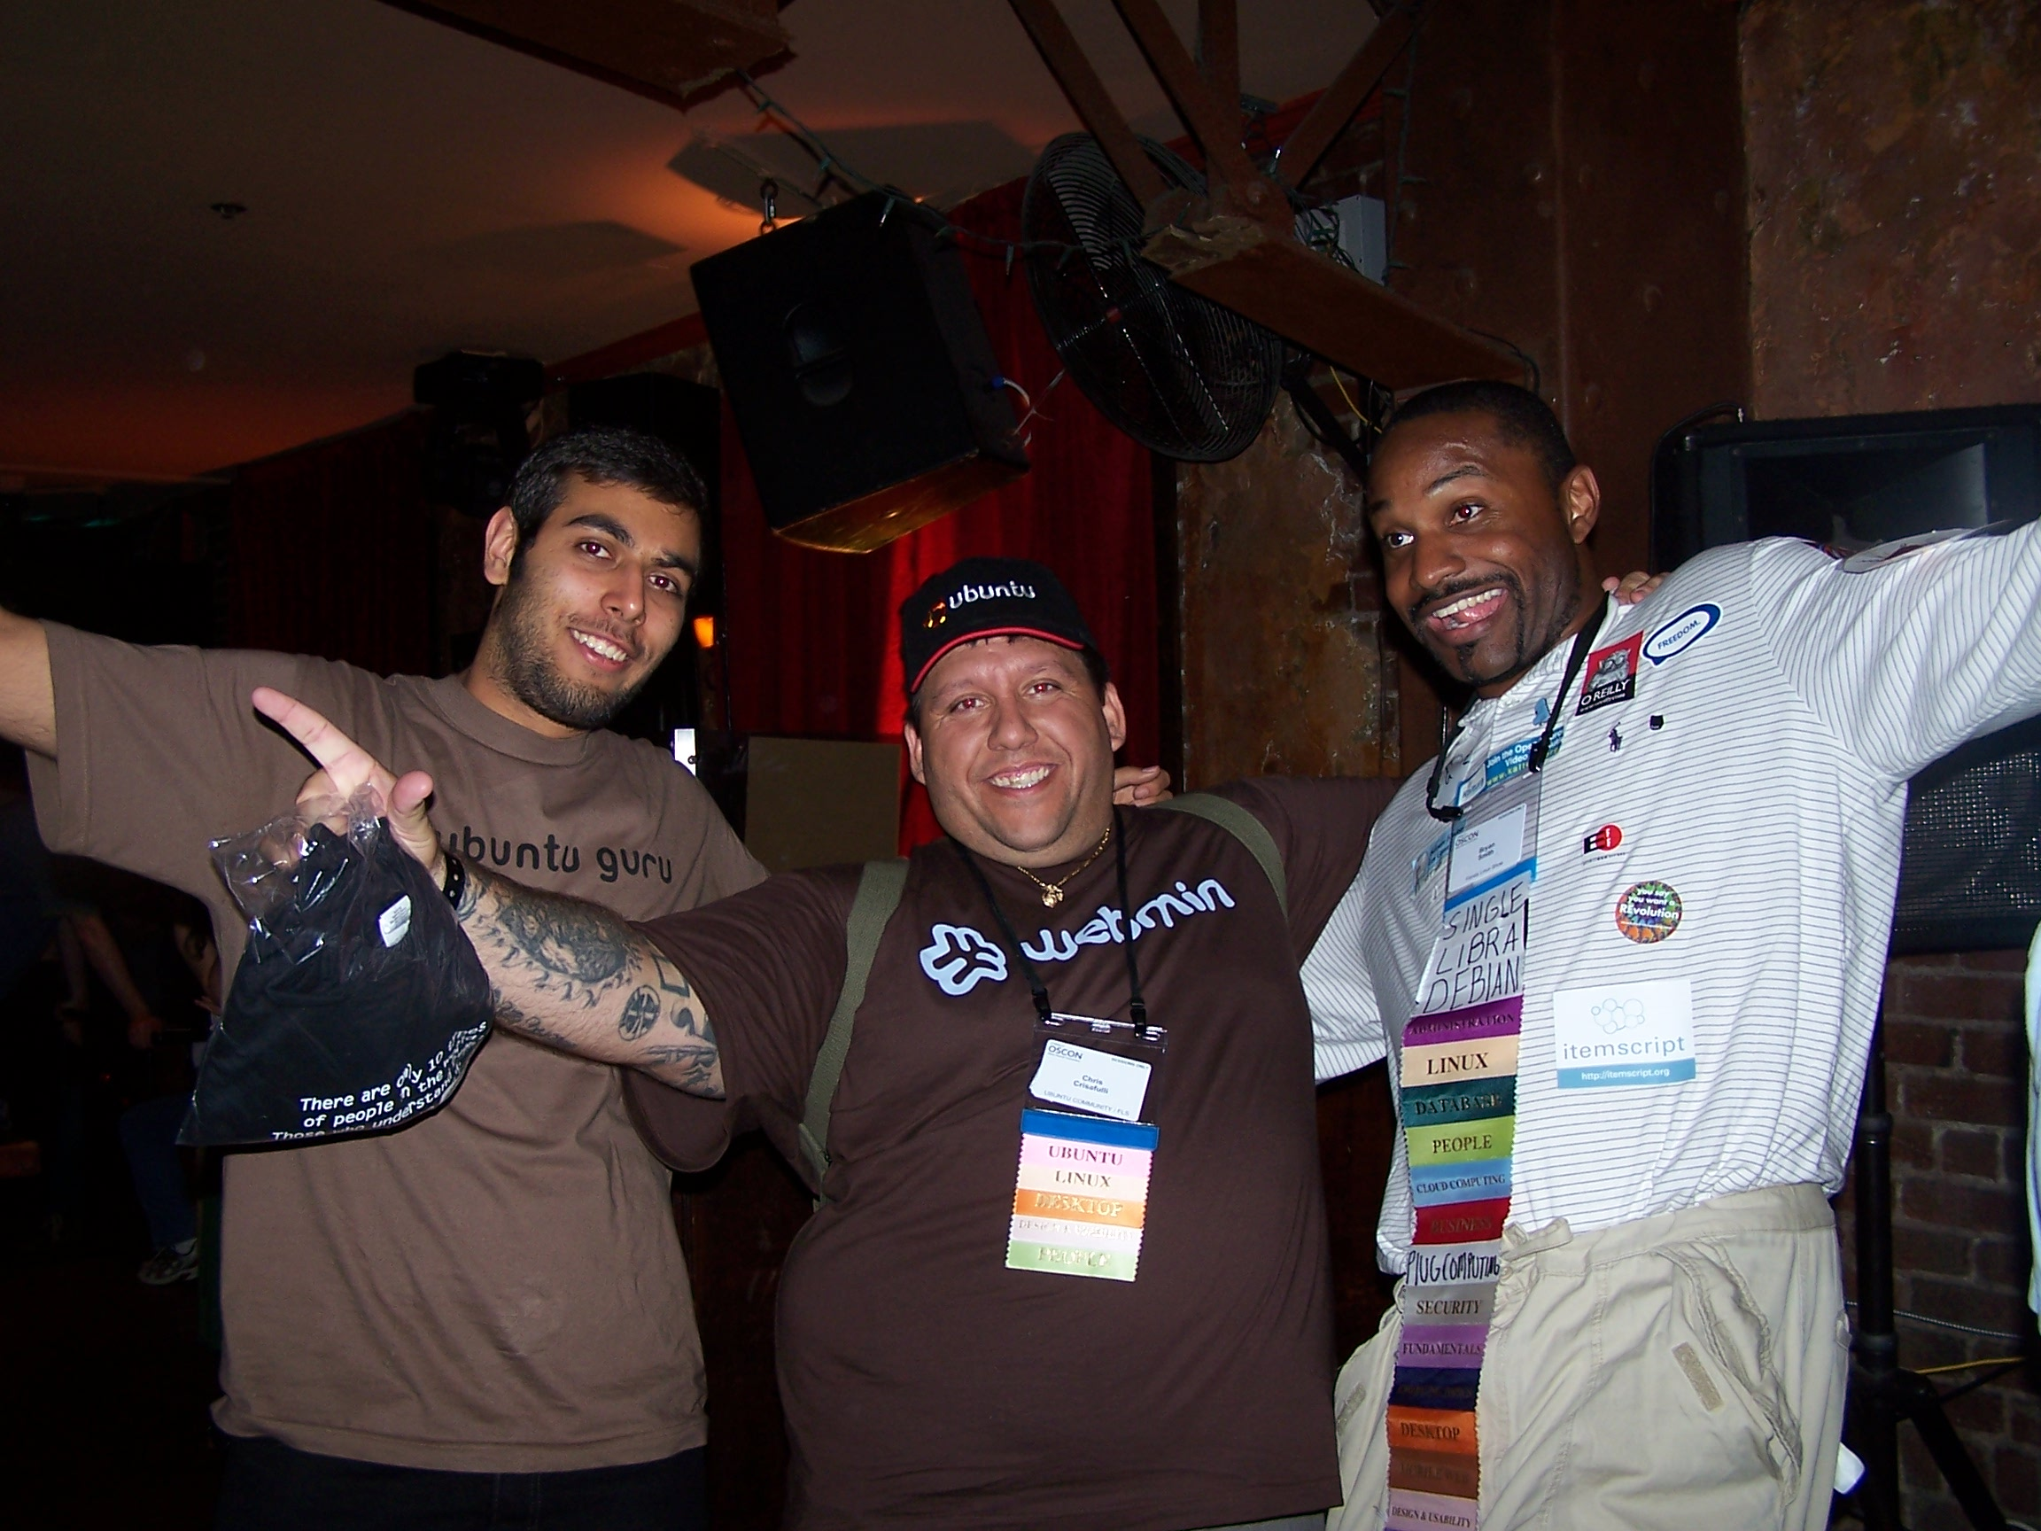
Notes:
Steve Jobs’ advice to the new Nike CEO, Mark Parker.

Slide 14
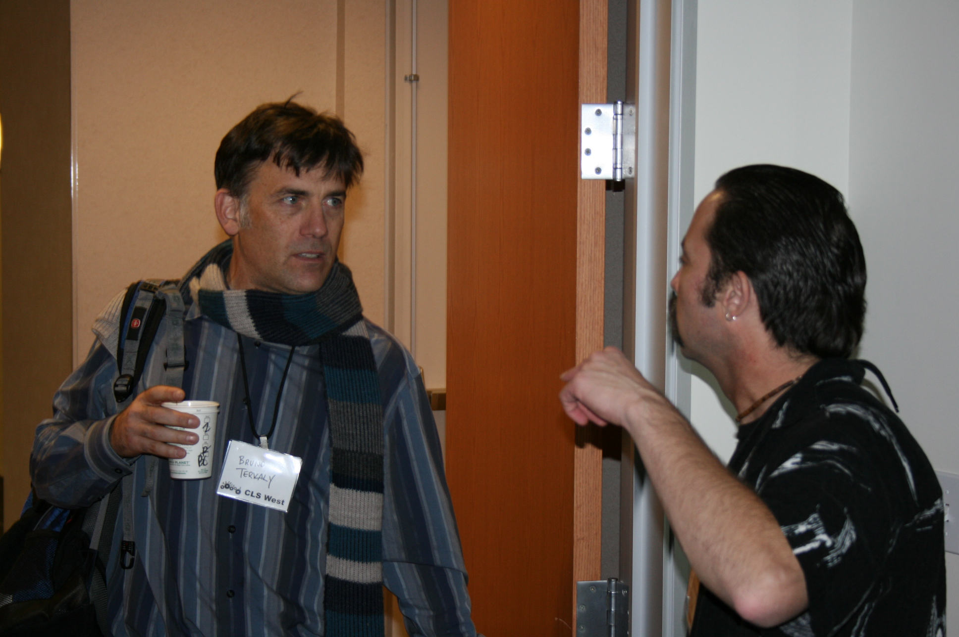
M, 9

Slide 15

The answer?

Slide 16
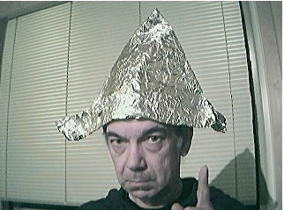
Are you still following along?

Slide 17

Notes:
How do you see your customers? Help them unleash their inner genius and you’ll win over their hearts and minds. Nobody cares about your company or product. They care about themselves, their dreams, and their goals. Help them achieve their aspirations and you’ll win them over the Steve Jobs way.

Slide 18
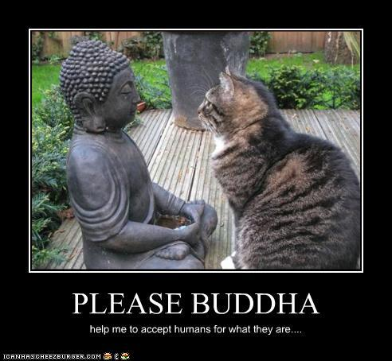
Talk to others

Slide 19

Destroy!

Slide 20
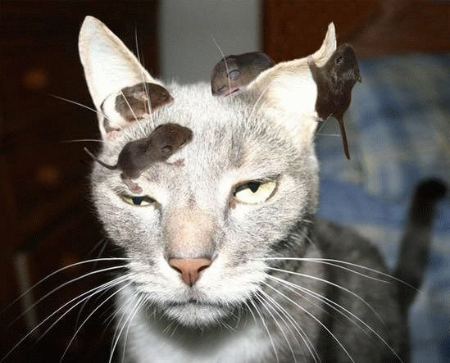

Slide 21

All sorts of distractions
Notes:
The idea fell from a tree, literally. Steve Jobs had returned from visiting a commune-like place in Oregon located in an apple orchard. Apple co-founder and Jobs’ pal, Steve Wozniak, picked him up from the airport. On the drive home, Jobs simply said, “I came up with a name for our company—Apple.” Wozniak said they could have tried to come up with more technical sounding names but their vision was to make computers approachable. Apple fit perfectly.

Slide 22
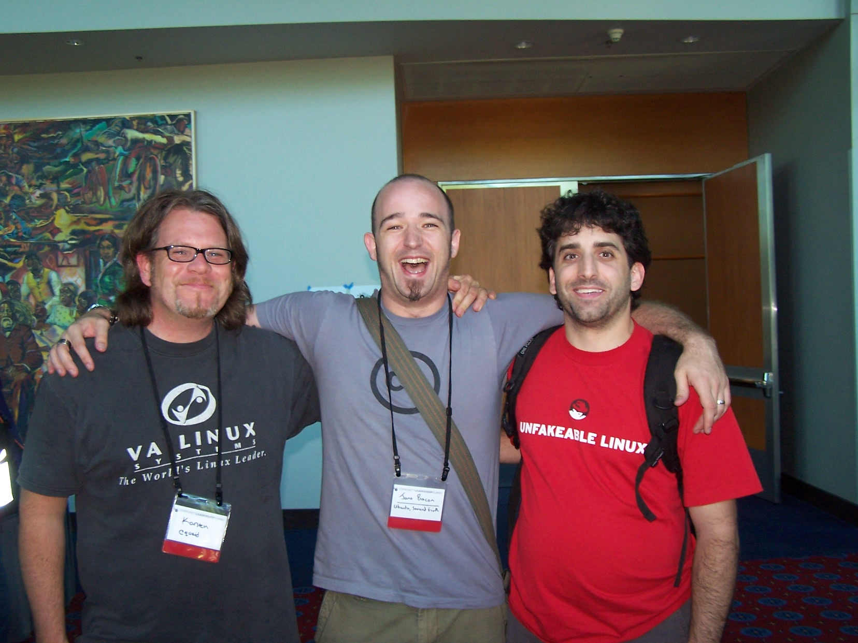

Slide 23
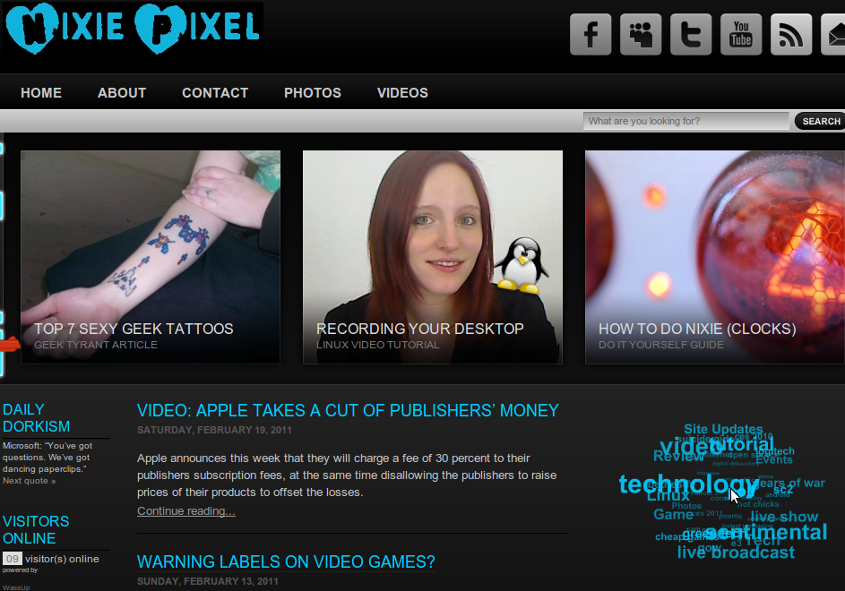

Slide 24

Join the Alliance

Slide 25
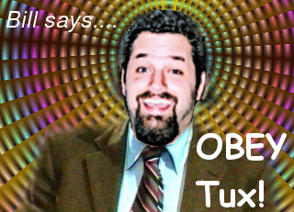
Notes:
In Apple’s design world, simplicity is the elimination of clutter. The same holds true for a Steve Jobs presentation.

Slide 26
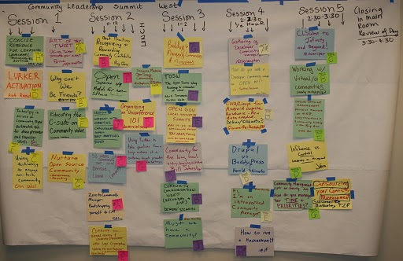
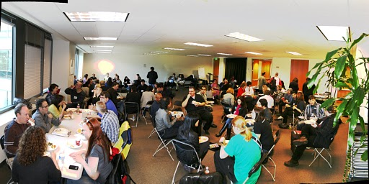
Talk to others

Slide 27
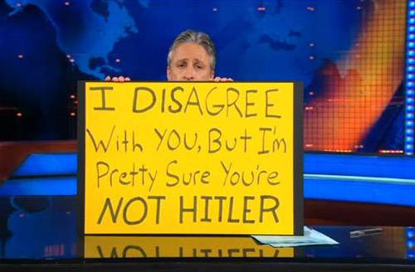
Avoid Godwin FAIL!

Slide 28


One more thing…
Don’t let
the bozos
get you down
Notes:
One More Thing…
Don’t let the bozos get you down

Slide 29
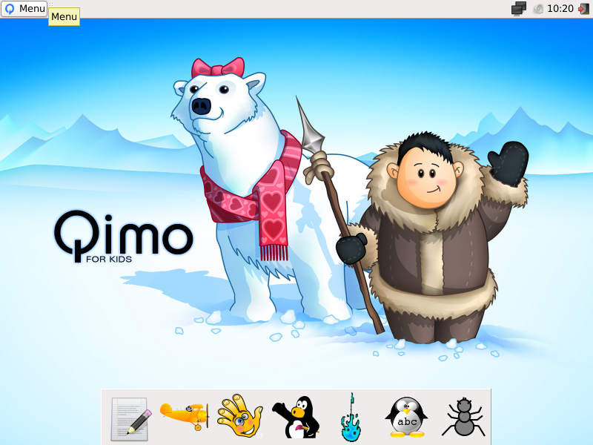

Slide 30
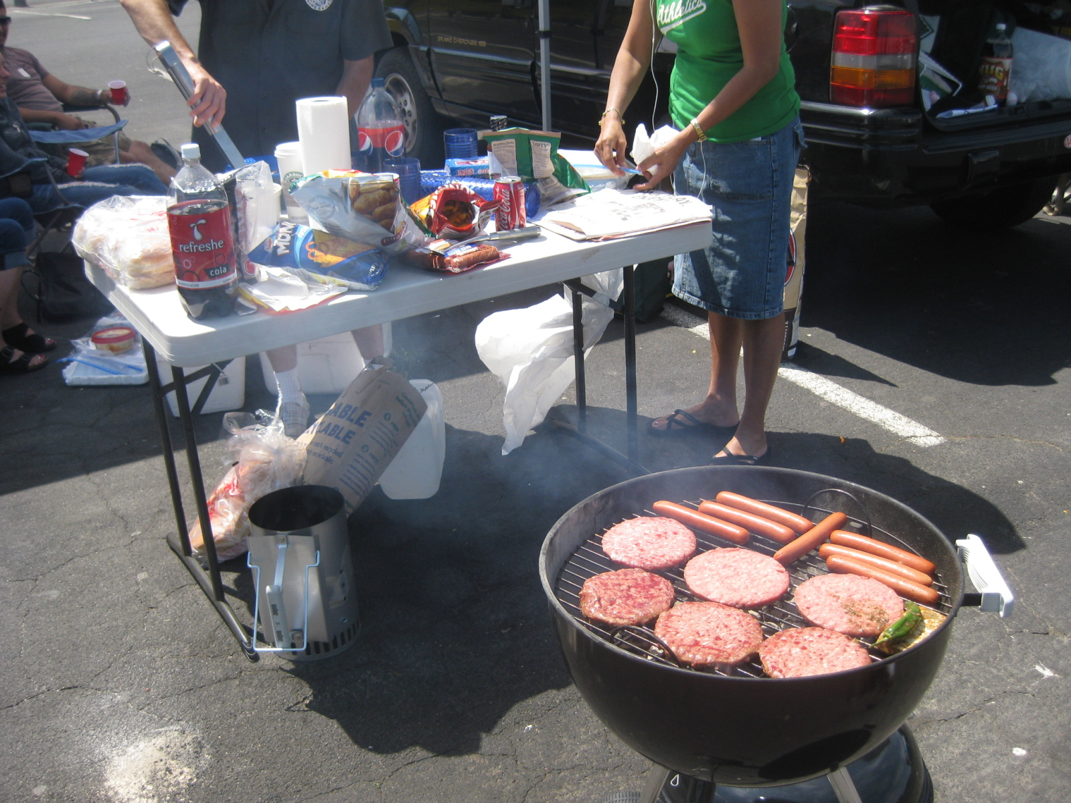
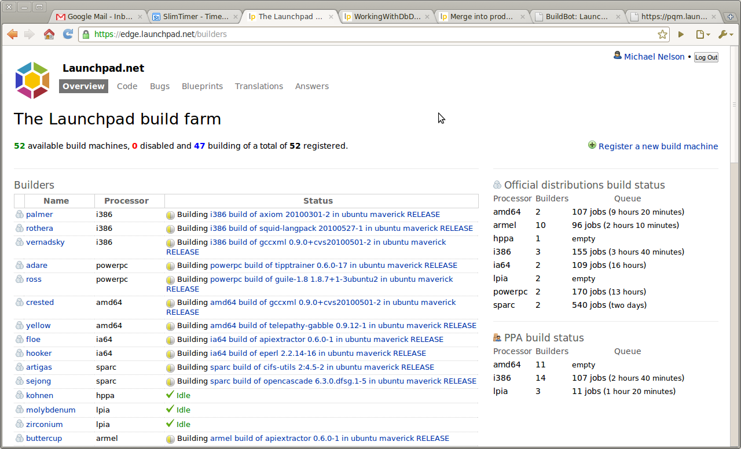

Fun Stuff

Slide 31
Drink the Kool Aid
Questions?
mark@gidgetkitchen.org
FreeNode
MarkDude on #gidgetkitchen,#fedora-ambassadors,#ubuntu-us-ca,#geeknic
mark@gidgetkitchen.org

Slide 32


