Slide 1

HOW OPEN IS CHANGING
THE WORLD—YOUR WORLD
Ruth Suehle
Editor, Red Hat and opensource.com
February 27, 2011

Slide 2
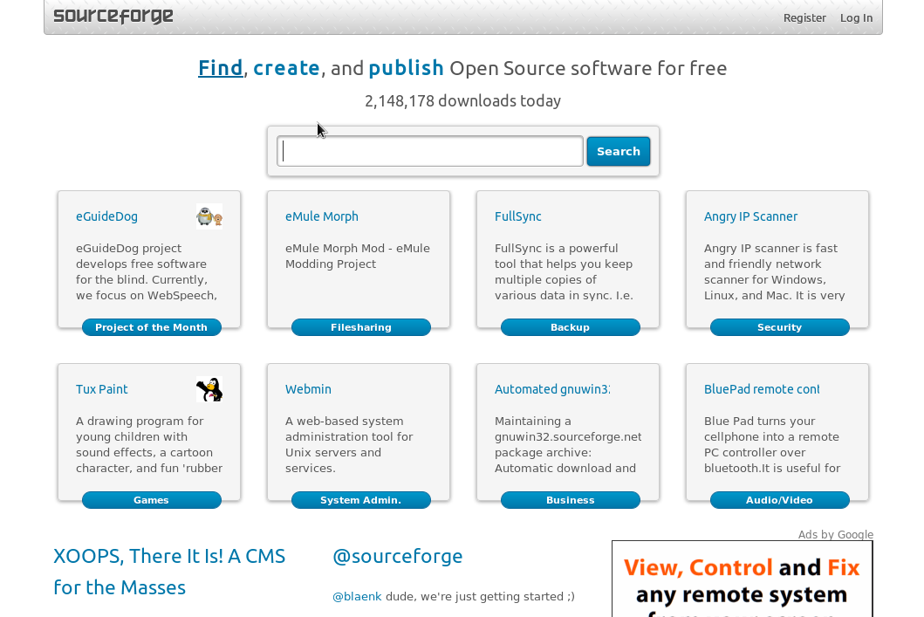

Slide 4
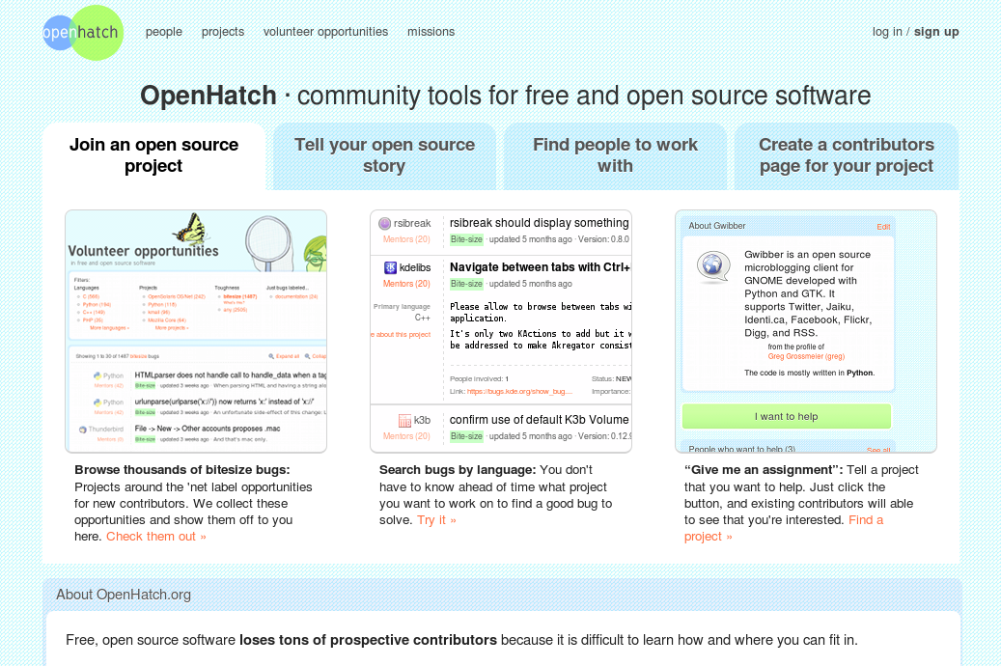

Slide 5
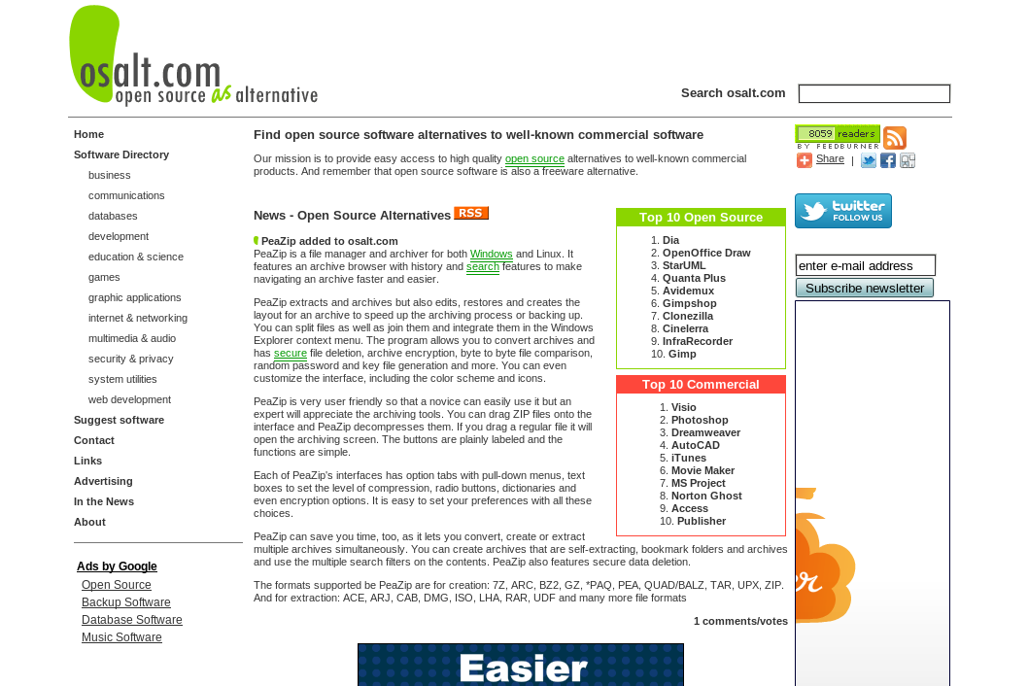

Slide 7


Slide 8
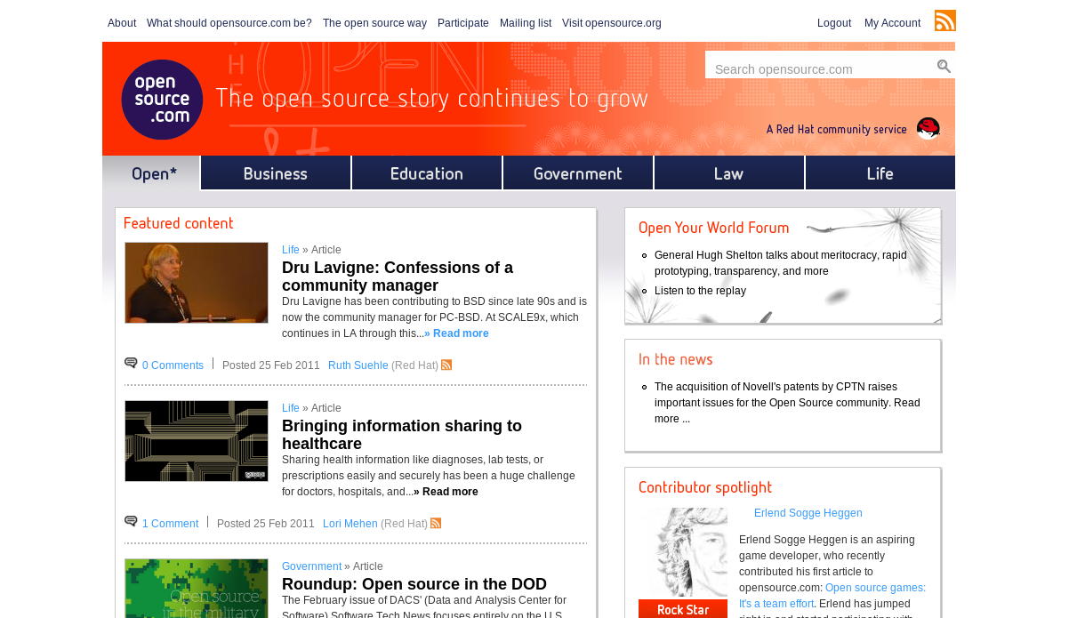

Slide 9
COMMUNITY
SHARING
TRANSPARENCY
MERITOCRACY
RAPID PROTOTYPING

Slide 10
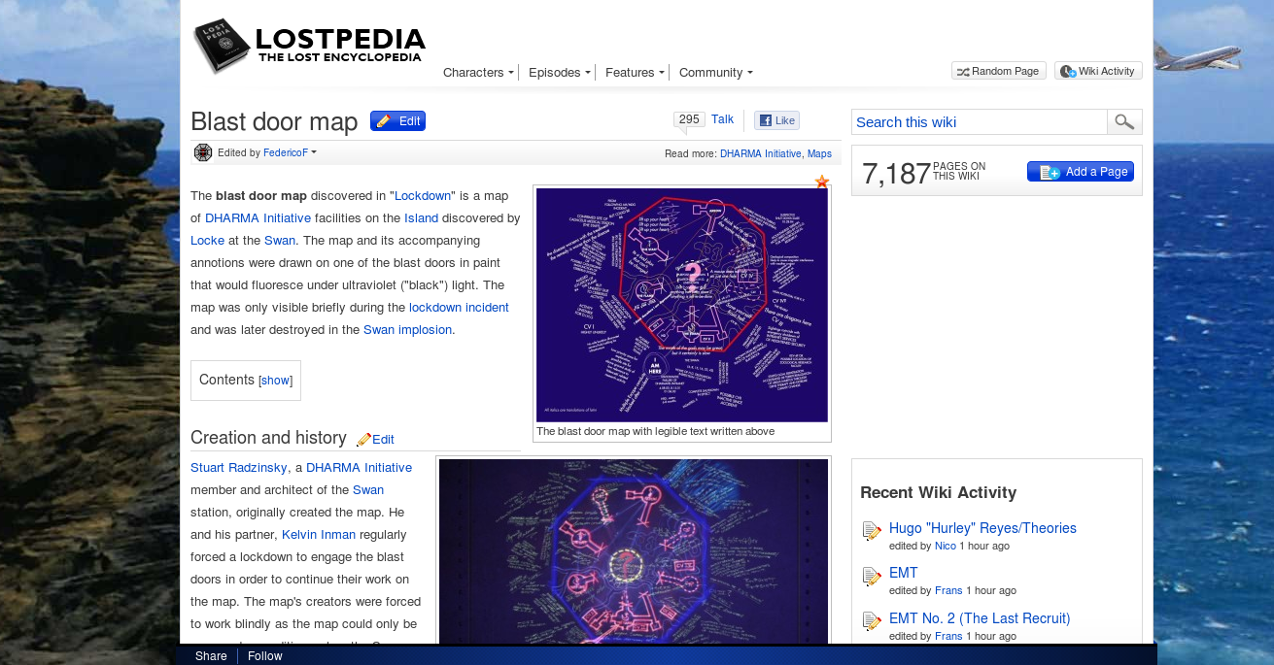

Slide 11
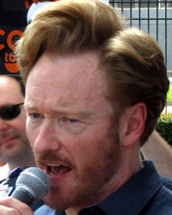

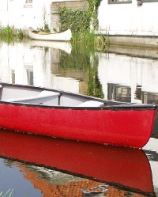
+ +
Dan Perry Mak Thorpe Amarant

Slide 12
COMMUNITY
SHARING
TRANSPARENCY
MERITOCRACY
RAPID PROTOTYPING

Slide 13
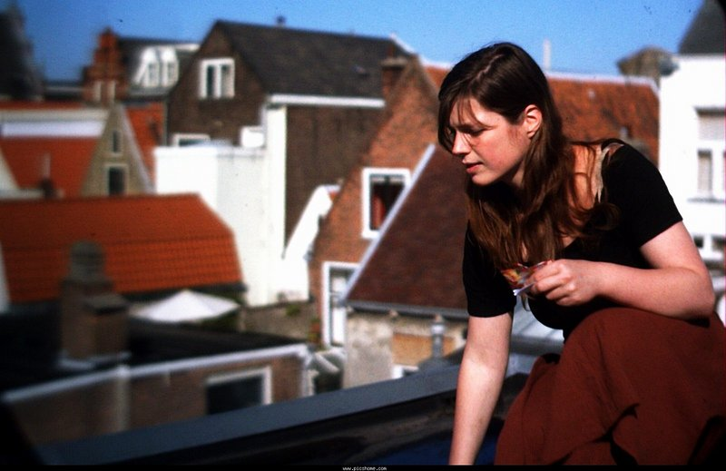
APERTUS
older footage using the Elphel 333 and a MicroWax 35mm adapter
CC-BY-SA Apertus Community

Slide 14

APERTUS
Elphel 353 macro footage processed with JP4 RAW to DNG workflow
CC-BY-SA Apertus Community

Slide 15
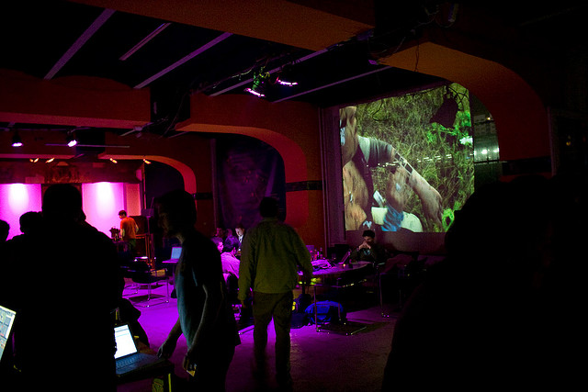
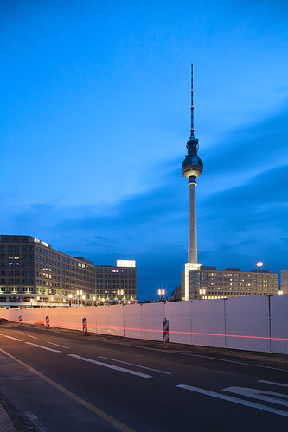
HACKERSPACES
Flickr: leafnode and tmesis

Slide 16
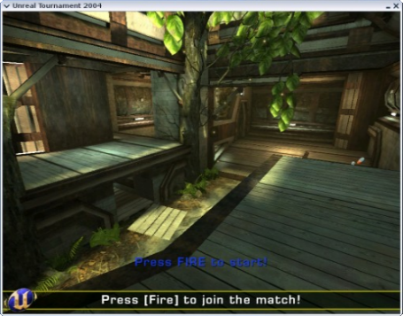
FRAGGERS ROCK—IN LINUX
Unreal Tournament 2004 running in Linux

Slide 17
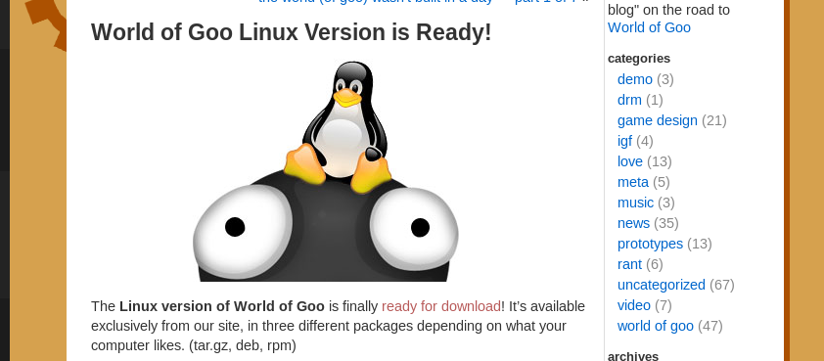
GOO IS LOVE

Slide 18
COMMUNITY
SHARING
TRANSPARENCY
MERITOCRACY
RAPID PROTOTYPING

Slide 19
OPEN HIGH SCHOOL OF UTAH

Slide 20
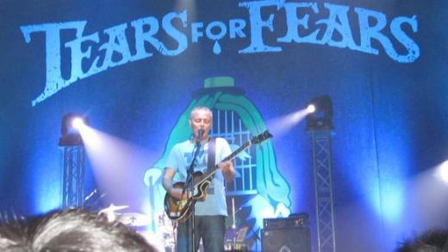
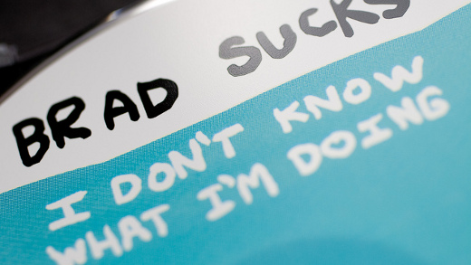
EVERYBODY WANTS TO RULE THE WORLD
By Florence Yum, courtesy Curt Smith Flickr user patrick h. lauke6t

Slide 21
ROBOTS THAT MAKE THINGS

Slide 22
THE PUBLIC DOMAIN
?

Slide 23
THE PUBLIC DOMAIN BLACK HOLE
0

Slide 24
THE PUBLIC DOMAIN BLACK HOLE
Copyright then Copyright now
- 14 years - 95 years
- opt-in - opt-out
- renew for another 14 - The mouse will keep you in copyright forever
Things you won’t see added to Project Gutenberg this year
Lord of the Flies | Waiting for Godot | Horton Hears a Who | Cat on a Hot Tin Roof | The Fellowship of the Ring | The Two Towers | Rear Window | Creature from the Black Lagoon | On the Waterfront | 20000 Leagues Under the Sea | Histoire d'O | No Time for Sergeants | I Am Legend | The Deep Range (Arthur C. Clarke) | The Star Beast (Robert Heinlein) | 1st issue of Sports Illustrated | Dial M for Murder | White Christmas | The Barefoot Contessa | Brigadoon

Slide 25
CURETOGETHER.COM
    34 people reporting infertility
      38% reported having asthma
    290 people reporting no infertility
      20% reported having asthma
    38% vs. 20% relative risk is statistically significant, with a 95% confidence interval of 1.4-2.6

Slide 26
COMMUNITY
SHARING
TRANSPARENCY
MERITOCRACY
RAPID PROTOTYPING

Slide 27

FACEBOOK AND (the) DIASPORA (?)

Slide 28
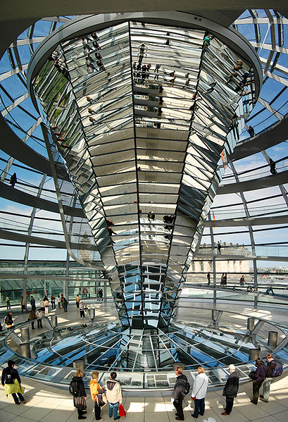
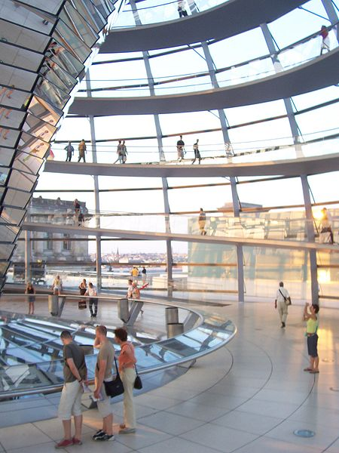
TRANSPARENCY IN GOVERNMENT

Slide 29

OPENNESS COULD SAVE YOUR LIFE

Slide 30
COMMUNITY
SHARING
TRANSPARENCY
MERITOCRACY
RAPID PROTOTYPING

Slide 31
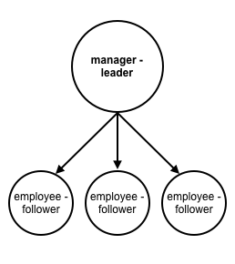
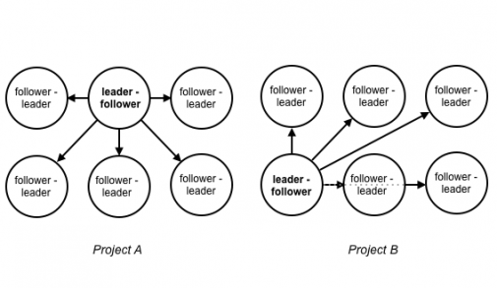
REINVENT MANAGEMENT

Slide 32
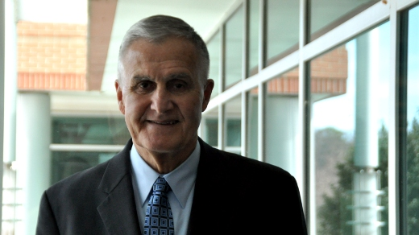

WHERE THE MILITARY MEETS OPEN

Slide 33
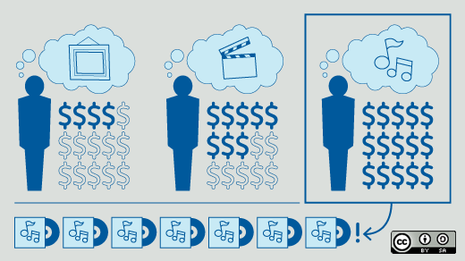
KICKSTARTER
Diaspora
The Glif (tripod)
Musopen
Punk Mathematics

Slide 34
COMMUNITY
SHARING
TRANSPARENCY
MERITOCRACY
RAPID PROTOTYPING

Slide 35
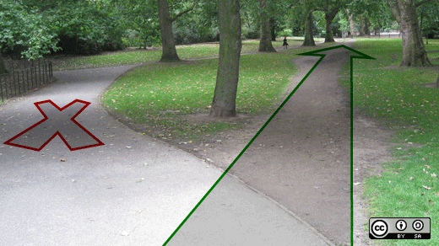
DESIRE LINES

Slide 36
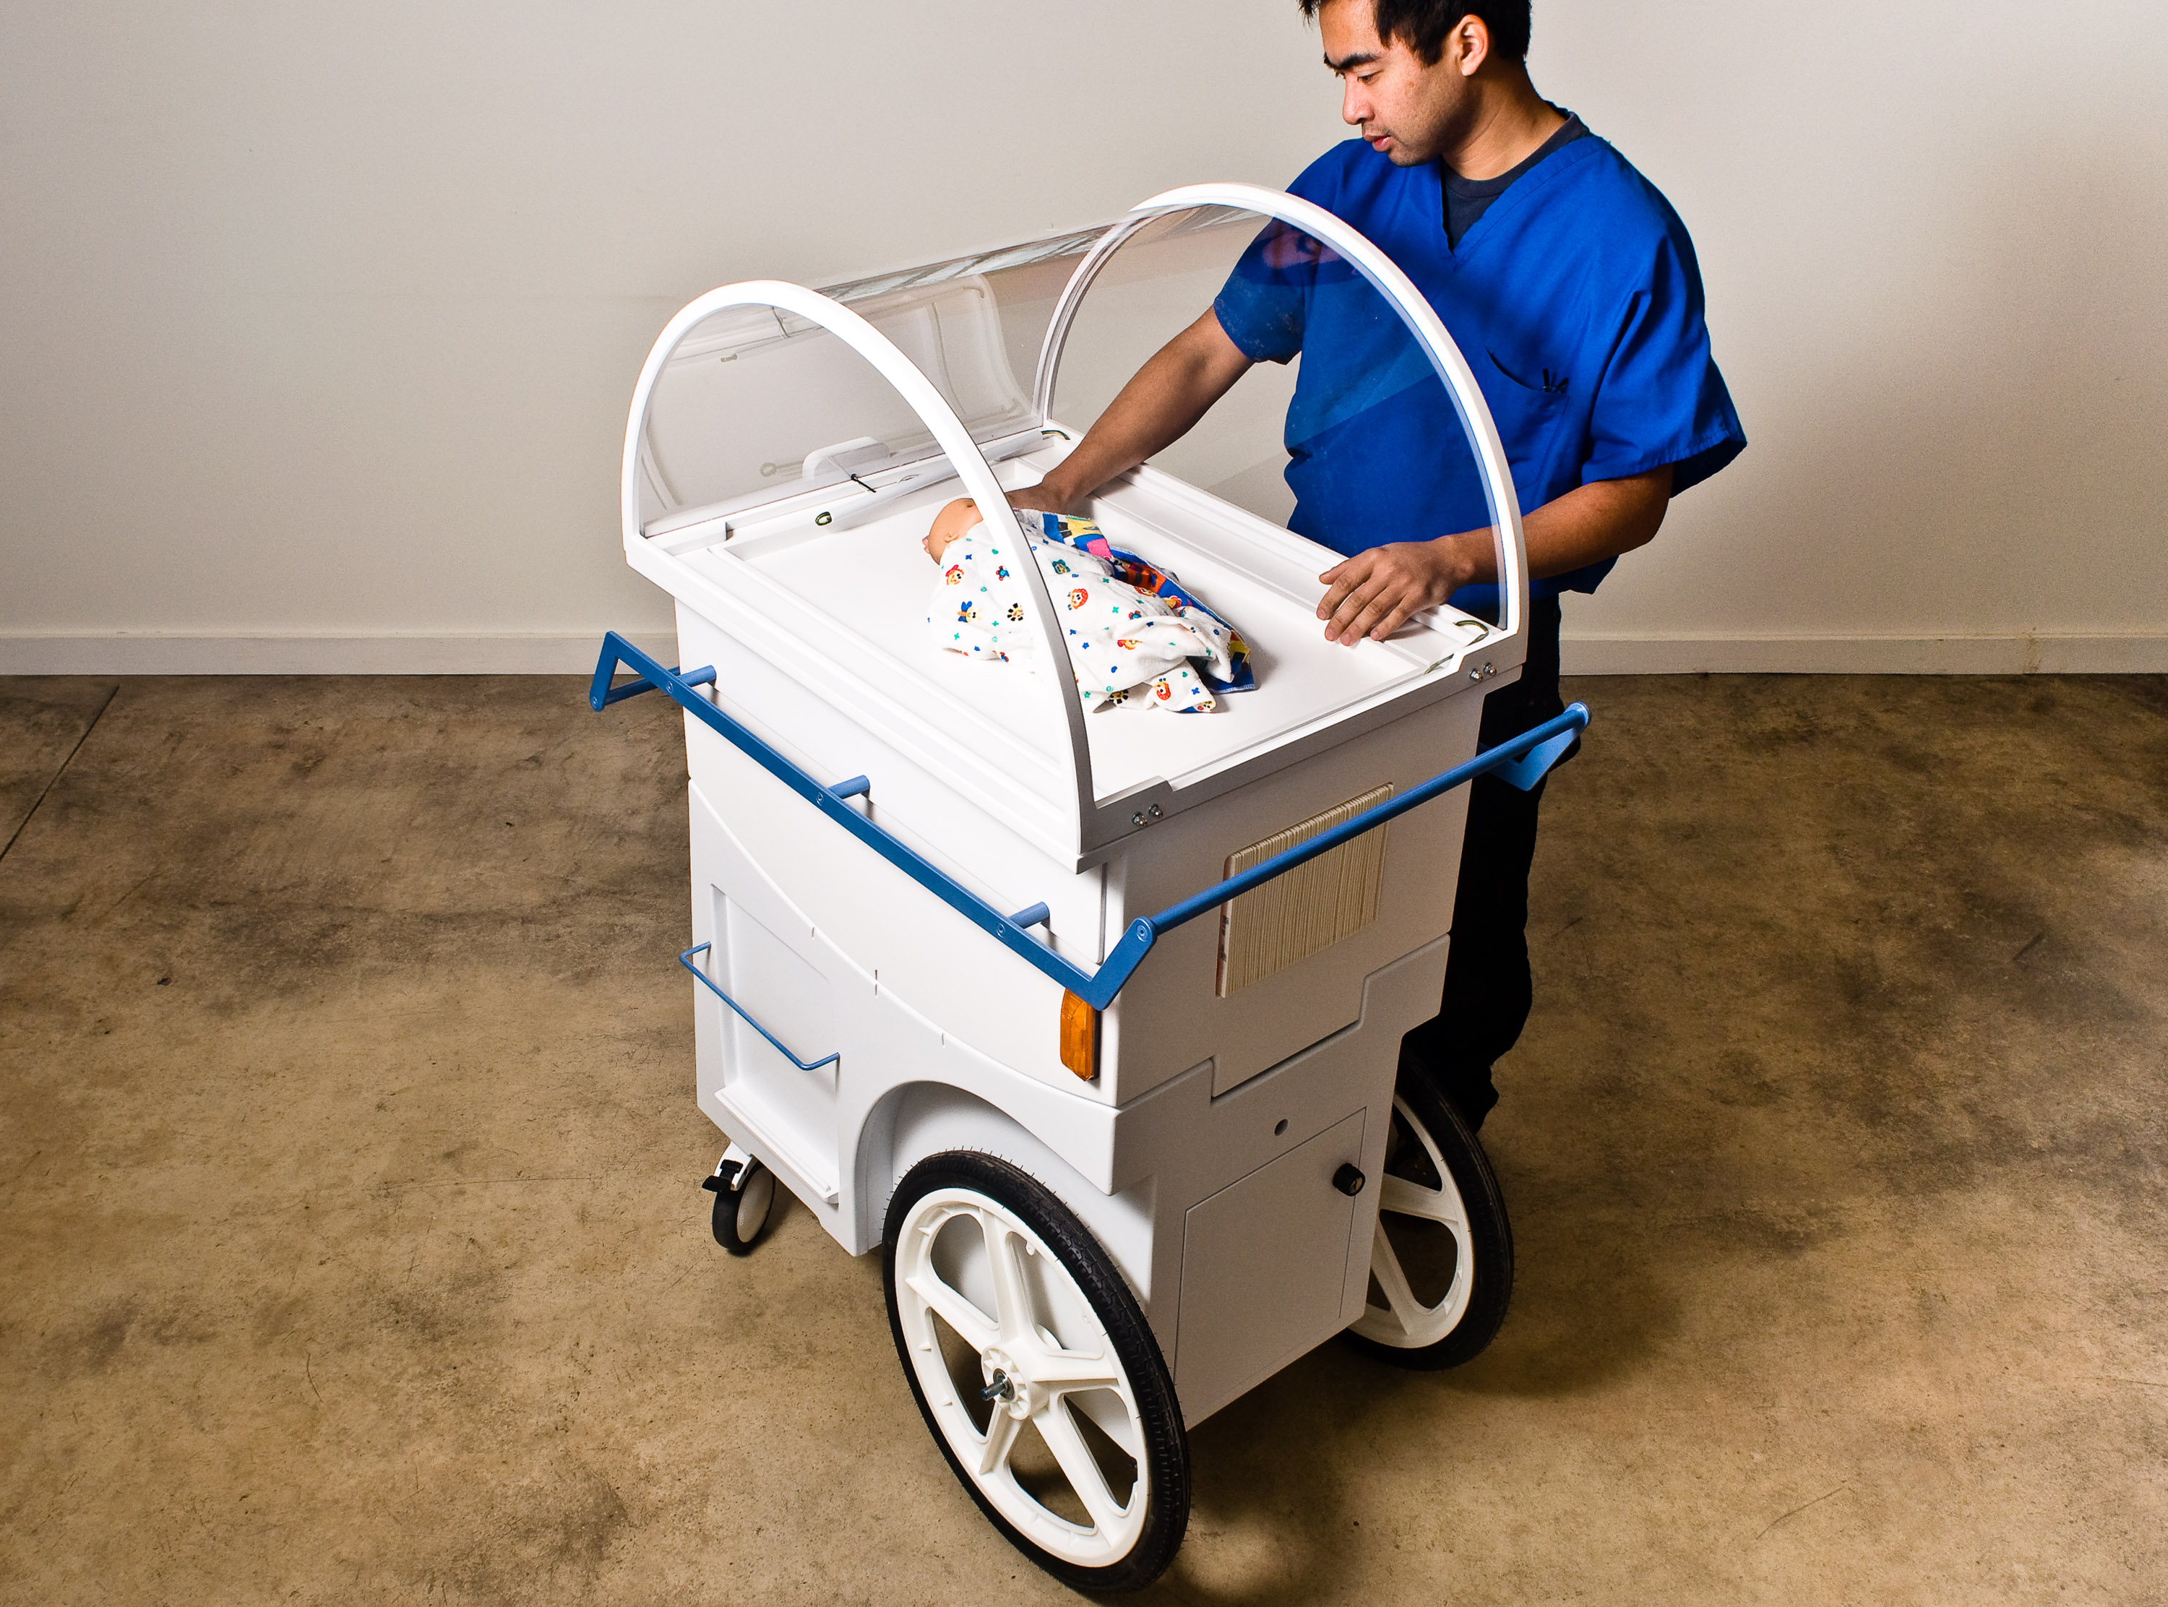
DESIGN THAT MATTERS
Photo courtesy of Design that Matters

Slide 37
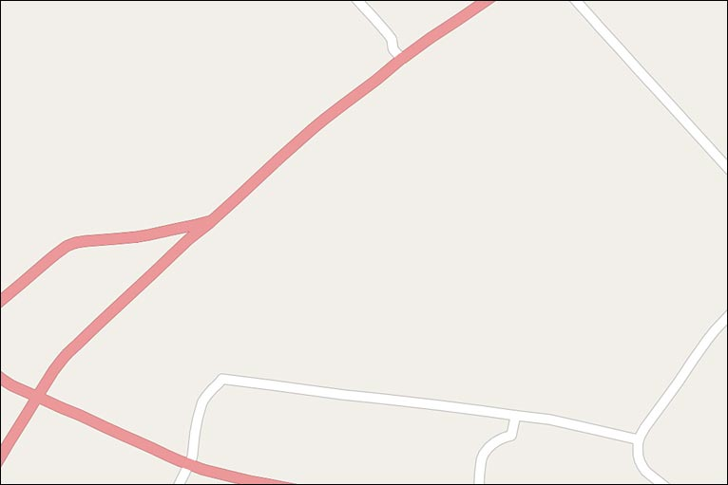
OpenStreetMap: HAITI

Slide 38
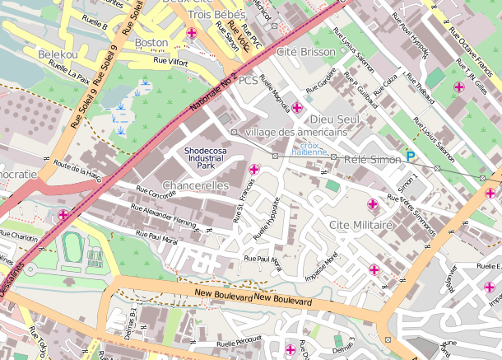
OpenStreetMap: HAITI

Slide 39
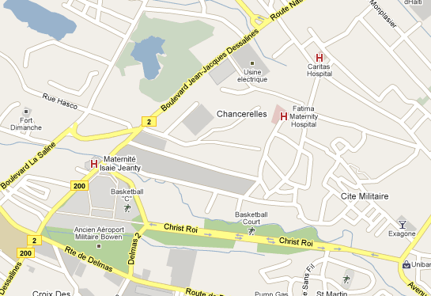
OpenStreetMap: HAITI

Slide 40
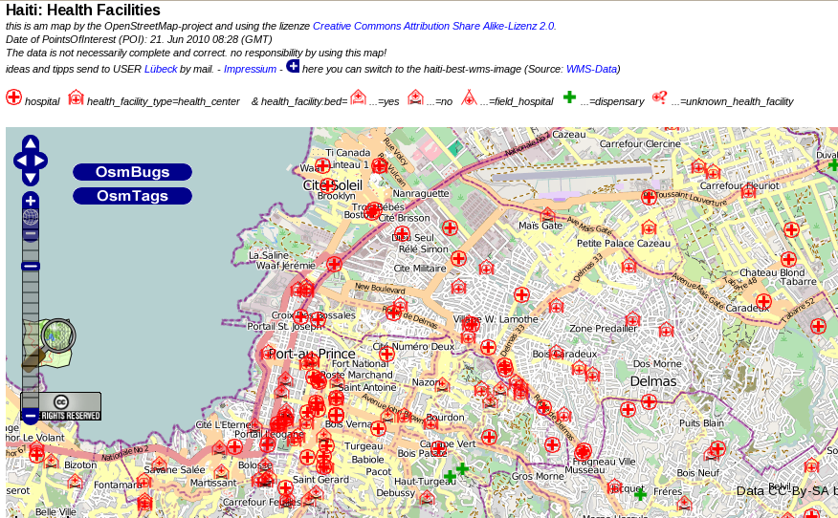
OpenStreetMap: HAITI

Slide 41
BUT YOU
DO
TALK ABOUT
SOFTWARE

Slide 42

PATENTING YOUR INSIDES

Slide 43
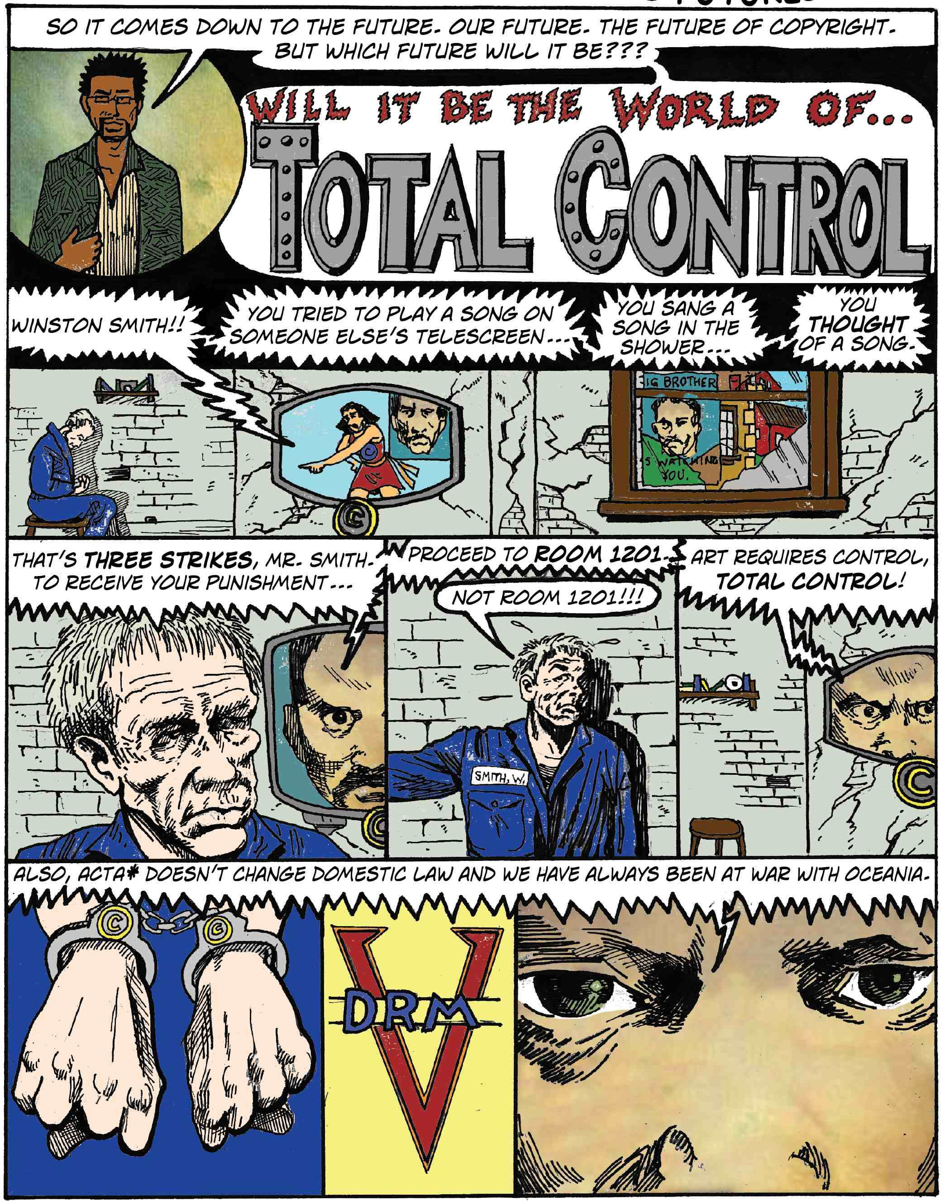
THEFT! A HISTORY OF MUSIC

Slide 44
AND BECAUSE OPEN HW AND SW ARE
STILL IMPORTANT. AND COOL.

Slide 45



GET IN TOUCH
opensourceway
Ruth Suehle
ruth@redhat.com
@suehle
IRC: suehle
Links:
opensource.com/
scale9x

