Slide 1
This is why you FAIL
and how to avoid it
Presented by
Tom “spot” Callaway
Fedora Engineering Manager
This presentation is licensed under a Creative Commons Attribution-Share Alike 3.0 Unported License (“CC-BY-SA”).
This presentation uses the Droid Sans (http://www.google.com/webfonts/family?family=Droid+Sans) and
Comfortaa ( http://fedoraproject.org/wiki/Comfortaa ) font families. If you want it to look nice, please install them.

Slide 2

Today's Topics
About the Speaker
Success
Points of FAIL

Slide 3


About the Speaker
Maintainer of 350+ Fedora packages
Maintaining Chromium browser packages for Fedora in an external repository
Packaging third-party software in RPM format since 2001
Responsible for handling Fedora's Legal issues
  IANAL, but I work regularly with Red Hat Legal

Slide 4
Success

Slide 5
What Does Success Mean
Users good, contributors better
Distribution friendly software
  Most Linux users get their software from their distribution package set
Healthy community
  Helping improve the project (not just the code)
  Users helping each other
  Regular releases

Slide 6
Summary
No FOSS project wants to fail...
... but there is more to success than just working code.

Slide 7
Points of FAIL

Slide 8
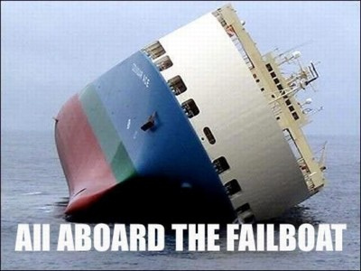
All aboard the FAILBOAT
In 2009, I was feeling pain with Chromium
To explain the pain to others, I started a list of the things they had done (or not done)
The list grew to include things that I had seen other projects do
Each item received a point score
Licensed CC-BY
http://www.flickr.com/photos/styro/3250091087/

Slide 9
Feel Free To Keep Score

Slide 10

Size of Codebase
The bigger it is, the harder it fails
If the source code is more than 100MB
[ +5 Points ]
If the source code is more than 100MB when compressed
[ +5 Points ]
Licensed CC-BY
http://www.flickr.com/photos/stignygaard/2456796208/

Slide 11

Source Control
This is where the source lives (e.g. cvs, svn, bzr, git)
There is no good reason for a FOSS project to not have public source control
Nevertheless, if the project doesn't have it...
[ +10 Points ]
Licensed CC-BY
http://www.flickr.com/photos/spadgy/313252221/

Slide 12
Source Control Continued
If you have public source control, but...
No Web Viewer
[ +5 Points ]
  If it exists but doesn't work, you get the +5 Points too.
No documentation on how to use it
[ +5 Points ]
Licensed CC-BY
http://www.flickr.com/photos/spadgy/313252221/

Slide 13
Source Control Gone Wild
If you've written your own source control system for this project (and the project is not a source control system)
[ +30 Points ]
If you don't actually use the existing public source control
[ +50 Points ]
Licensed CC-BY
http://www.flickr.com/photos/spadgy/313252221/

Slide 14
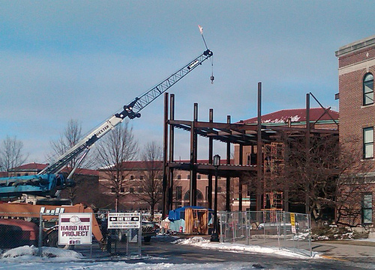
Building From Source
Code that doesn't build is usually worse than no code.
If there is no documentation on how to build the project from source
[ +20 Points ]
  If documentation exists but does not work
  [ +10 Points ]
Licensed CC-BY
http://www.flickr.com/photos/english106/4358187780

Slide 15
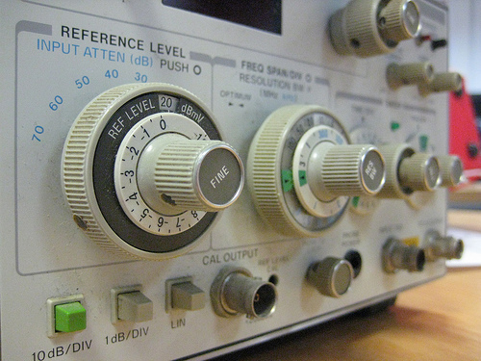
Configuring the Source
If your source is configured by...
  A handwritten shell script
  [ +10 Points ]
  Editing flat text config files [ +20 Points ]
  Manually editing code header files [ +30 Points ]
If your source isn't configurable...
[ +50 Points ]
Licensed CC-BY
http://www.flickr.com/photos/philliecasablanca/2327115948

Slide 16

Build Tools
If your source builds using something that isn't GNU make
[ +10 Points ]
If your source only builds with third-party proprietary build tools
[ +50 Points ]
You wrote your own build tool for this code
[ +100 Points ]
Licensed CC-BY
http://www.flickr.com/photos/hikingartist/4193330368

Slide 17

Bundling
If your source includes copies of other code projects it depends on
[ +20 Points ]
  If your code cannot be built without first building the bundled code bits
  [ +10 Points ]
  If you have modified the bundled code bits
  [ +40 Points ]
Licensed CC-BY
http://www.flickr.com/photos/craftybunny/301369032

Slide 18

Libraries
If your code only builds static libraries
[ +20 Points ]
Your code can build shared libraries, but only unversioned ones
[ +20 Points ]
Your code does not try to use existing system libraries
[ +20 Points ]
Licensed CC-BY
http://www.flickr.com/photos/friarsbalsam/4609212148

Slide 19
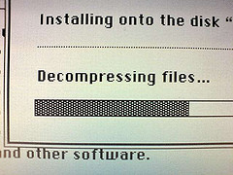
System Install
If your code forces an install into /opt or /usr/local
[ +10 Points ]
Your code has no “make install”
[ +20 Points ]
Your code does not work outside of the source directory
[ +30 Points ]
Licensed CC-BY
http://www.flickr.com/photos/kalleboo/2240831010

Slide 20


Code Oddities
If your code...
  Uses Windows line breaks (“DOS format”) [ +5 Points ]
  Depends on specific compiler features [ +20 Points ]
  Depends on specific compiler bugs [ +50 Points ]
  Depends on Microsoft Visual Anything [ +100 Points ]
Licensed CC-BY
http://www.flickr.com/photos/alex_ford/3223363085

Slide 21

Communication
If your project...
  Does not announce releases on a mailing list [ +5 Points ]
  Does not have a mailing list
  [ +10 Points ]
  Does not have a bug tracker
  [ +20 Points ]
  Does not have a website
  [ +50 Points ]
  Is sourceforge vaporware
  [ +100 Points ]
Licensed CC-BY
http://www.flickr.com/photos/indi/4243069097

Slide 22

Releases (Versioning)
Your project...
  Does not do sanely versioned releases (major & minor)
  [ +10 Points ]
  Does not version releases
  [ +20 Points ]
  Does not do releases
  [ +50 Points ]
  Only releases as attachments in web forum posts [ +100 Points ]
Licensed CC-BY
http://www.flickr.com/photos/fishking1/5241857487

Slide 23
Releases (Format)
Your releases are...
  Only in ZIP format
  [ +5 Points ]
  Only in OSX-compat ZIP
  [ +10 Points ]
  Only in RAR format
  [ +20 Points ]
  Only in ARJ format
  [ +50 Points ]
  Only in an encapsulation format that you invented
  [ +100 Points ]
Licensed CC-BY
http://www.flickr.com/photos/fishking1/5241857487

Slide 24
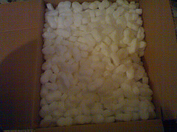
Releases (Unpack)
Your releases...
  Do not unpack into a an versioned top-level directory (e.g. glibc-2.4.2/ )
  [ +10 Points ]
  Do not unpack into a top-level directory (e.g. glibc/ )
  [ +25 Points ]
  Unpacks into an absurd number of useless directories (e.g. home/john/doe/glibc-svn/tarball/glibc/src )
  [ +50 Points ]
Licensed CC-BY
http://www.flickr.com/photos/roland/168791534

Slide 25

History (Forking)
If your code is a fork of another project
[ +10 Points ]
  If your primary developers were not involved with the parent project
  [ +50 Points ]
Sometimes forking is necessary, but usually it isn't.
Licensed CC-BY
http://www.flickr.com/photos/dvs/71316775

Slide 26

History (Age)
Until open sourcing it, your code was proprietary for:
  1-2 years [ +10 Points ]
  3-5 years [ +20 Points ]
  6-10 years [ +30 Points ]
  10+ years [ +50 Points ]
You cannot change the past, but you may be doomed to FAIL because of it.
Licensed CC-BY
http://www.flickr.com/photos/dinowww/4557829098

Slide 27


Licensing
Your code does not have per-file licensing [ +10 Points ]
The licenses in your code conflict [ +20 Points ]
Your code does not contain any notice of licensing intent
[ +30 Points ]
Your code doesn't include a copy of the license text [ +50 Points ]
Your code doesn't have a license
[ +100 Points ]
Licensed CC-BY
http://www.flickr.com/photos/psd/3462273887

Slide 28

Documentation
Your code doesn't have a Changelog
[ +10 Points ]
Your code doesn't have any documentation
[ +20 Points ]
Your website doesn't have any documentation
[ +30 Points ]
Licensed CC-BY
http://www.flickr.com/photos/mwichary/2356592808

Slide 29

FAIL METER
0 Points: Perfect! All signs point to
success
5-25 Points: You're probably doing
okay, but you could do better
30-60 Points: Babies cry when your
code is downloaded
65-90 Points: Kittens die when
your code is downloaded
95-130 Points: You're riding the FAILBOAT
135+ Points: Your code should have its own reality TV show
Licensed CC-BY
http://flickr.com/photos/fireflythegreat/2845637227

Slide 30
FAQ
What about the Linux Kernel? Doesn't it FAIL a lot on this stuff?
  Sure, but it is the exception, rather than the rule.
Have you actually seen projects do these things?
  Yes. Every single one, although, not in one project.
What was Chromium's score?
  285
  Yes, Google knows. No, Google doesn't care.

Slide 31
The Open Source Way
The Open Source Way is a handbook that distills years of knowledge about running open source projects
  I'm humbled that they've chosen to include my “Points of FAIL” system in that handbook
You should definitely read it over (the whole handbook, not just my chapter)
http://www.theopensourceway.org/

Slide 32
Questions?
Contact:
spot@fedoraproject.org

