Slide 1

LPIC-1 Certification Exam Preparation
Kenny Armstrong
April 23, 2022

Slide 2


Agenda
What is Linux Professional Institute (LPI) and how do I benefit from being certified?
Which exams and certifications exist?
How do I prepare for a LPI exam?
What should I expect during a LPI exam?
What happens after the exam?

Slide 3

Disclaimer
Hints on exam preparation and exam strategies are the speaker's personal opinions
LPI tests your knowledge and not how you obtained it
Use your own judgment on how to prepare!

Slide 4
What is Linux Professional Institute and how can I benefit from being certified?

Slide 5
Linux Professional Institute
Linux Professional Institute (LPI)
Mission: Linux Professional Institute promotes the use of open source by elevating the people who work with it.
Non-profit organization based in Canada
Regional partners provide local support around the world
Independent from vendors and Linux distributions

Slide 6
LPI By the Numbers
1999
190,000
735
LPI Certified
Professionals
Started as a Nonprofit
Global Partners
675,000
9
193
Total exams delivered
Exam Languages
Countries/territories

Slide 7
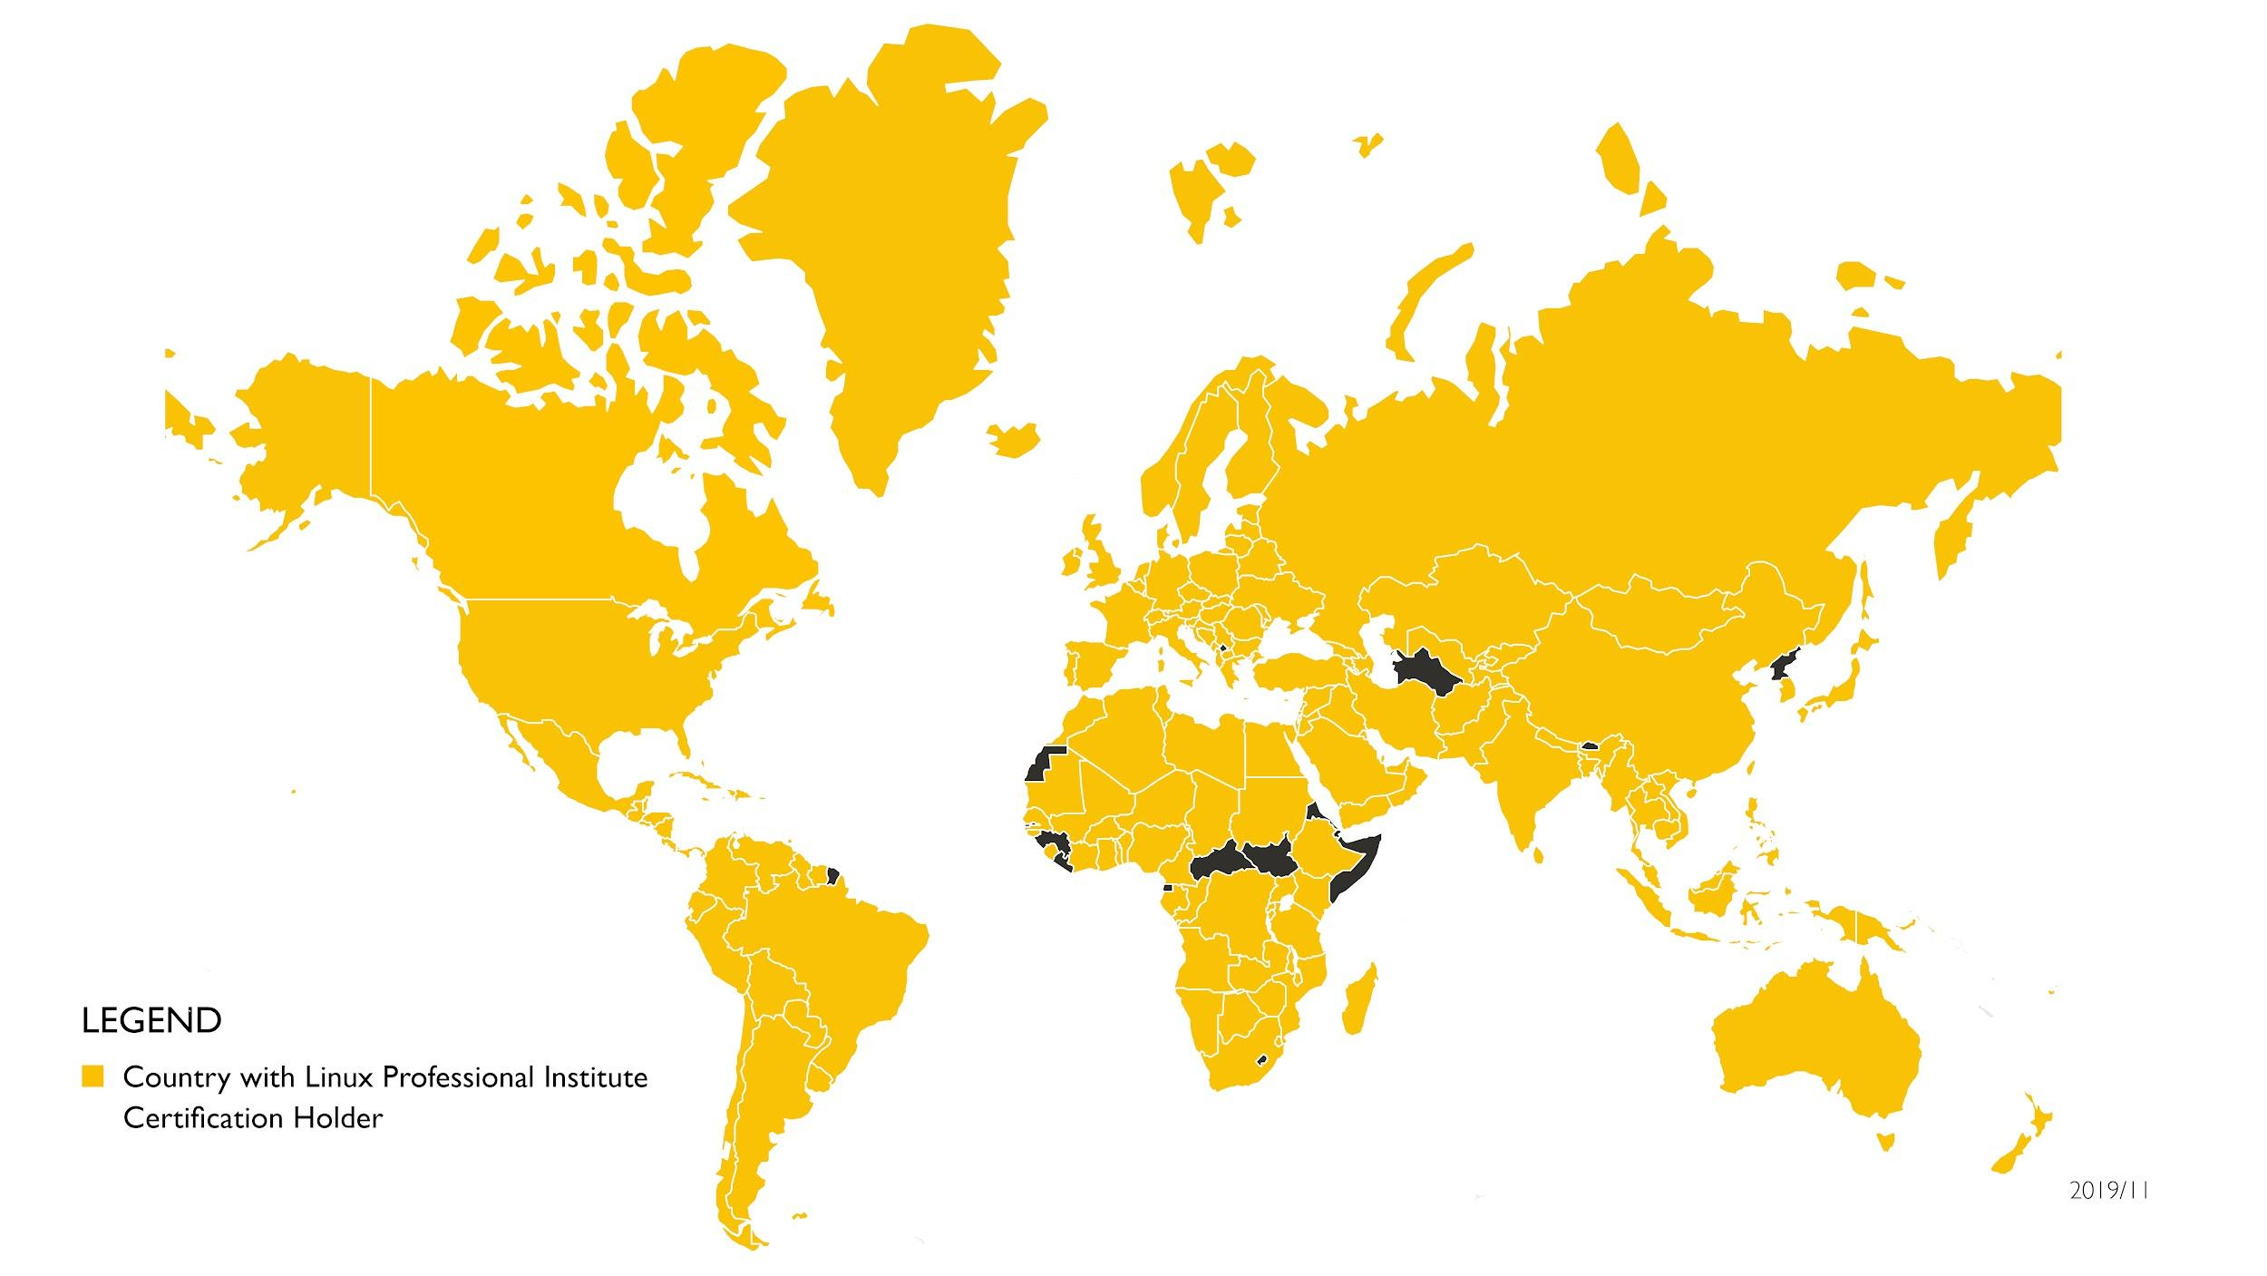
Where we are

Slide 8
Benefits of Linux Professional Institute Certifications
A LPI certification
  Encompasses numerous qualifications and skills
  Affirms professional competencies as well as engagement in continuing education
  Represents a common standard in both content and quality
  Is not a comprehensive professional qualification on its own...
  … but is the best unique and distinguishing credential!

Slide 9
Advantages of Linux Professional Institute Certifications
A LPI certification
Globally recognized and highly reputable
  Recognized by other certification vendors
  Prerequisite for other exams
Multiple options for study materials and training
No requirement to participate in specific training, courses, books, seminars, etc.

Slide 10
Which exams and certifications exist?

Slide 11
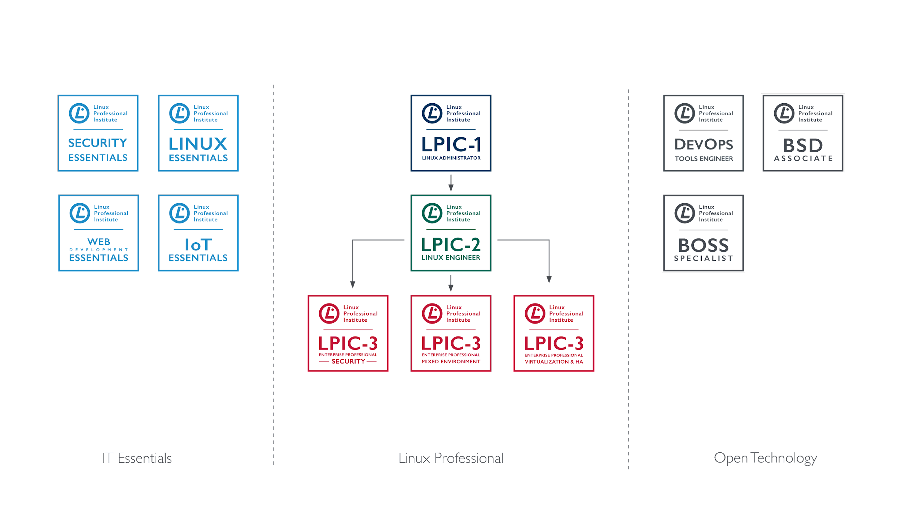
Our programs
Notes:
This is one of the first examples of a Linux distro circa 1993
Yggdrasil
Slackware
Red Hat
Caldera
Debian
How to install
originally floppies,
floppies + CD
DVD
now USB and by network
Community
who created
how mig a developer team
just creation, or also support?

Slide 12
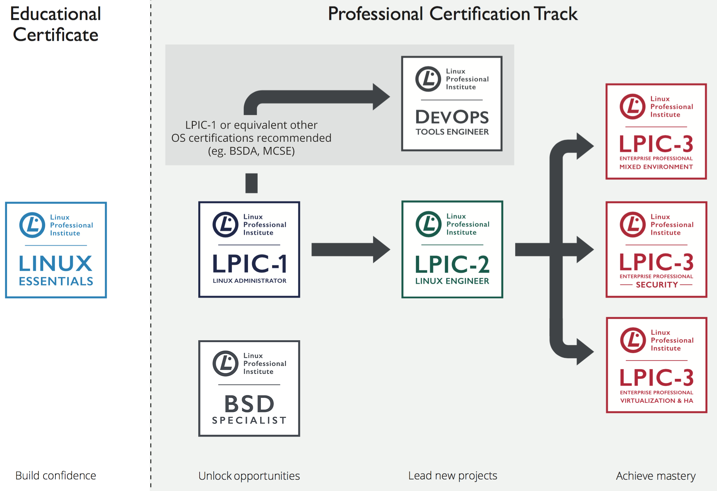

Slide 13

LPIC-1
Level 1 Linux Certification
  Know your system
Prerequisite: None
Exams:
  LPIC 101 & LPIC 102

Slide 14
How do I prepare for an LPI exam?

Slide 15
LPI Exam Format
90 minutes, 60 questions (LPIC, DevOps)
60 minutes, 40 questions (Essentials)
Multiple Choice:
  Four or five given answers
  Choose one correct answers unless another number is explicitly requested in the question
Fill In The Blank:
  Free text: for example a command, a parameter, a configuration option, a path, a file name, …
  Only one correct response is required

Slide 16
LPI Exam Format
It's all about passing
  There is no final grade on the certification
  Nobody knows everything
  But one should have a general clue
  … and know those details one stumbles upon in real life
Scores range from 200 to 800, 500 is a pass
  Number of correct answers required to pass varies with questions used on the exam because each item has its own difficulty

Slide 17
Exam Objectives
Objectives
  Describes the content covered by an exam
  Contain examples of commands, files and terms (but examples are only a partial list)!
  https://wiki.lpi.org/ or on the main lpi.org site
  IMPORTANT: Double check that you study the most recent version of your exam's objectives!
  Take a look at https://learning.lpi.org/
  Examples!

Slide 18
Where to Take an LPI Exam
Paper based exam labs at events, such as
  LinuxFest (Ohio, Northwest), SCALE,FOSDEM, FrOSCon, OpenRheinRuhr, etc.
  Results will be available after four (4) weeks
  Discounted price on writing exams for attendees at events

Slide 19
Where to Take an LPI Exam
Computer based exams at a test center
  Test centers from Pearson VUE
  http://vue.com/lpi
  Results are available immediately after the exam
Online testing through Pearson VUE
  https://home.pearsonvue.com/lpi/onvue
  Sorry for the system requirements - changes are in the works for the future

Slide 20
What should I expect during an LPI exam?

Slide 21
On Exam Day
Bring with you:
  Official photo document
    Government issued ID card (driver's license, passport)
  LPI ID number
    Register online at http://cs.lpi.org/caf/Xamman/register

Slide 22
During the Exam
Handling the exam
  Read all questions as carefully as possible
  LPI doesn't have trick questions – but we expect exact understanding and accurate knowledge of technical terms
  For Multiple Choice questions:
    There is always one correct answer unless the question explicitly requires more than one
  For Fill In The Blank questions:
    Watch out for hints such as expecting paths, additional options or parameters or not!

Slide 23
During the Exam
Uncertainties in the exam
  We do our best to ensure that this doesn't happen
  Very carefully read the question again
  Proctors are not allowed to talk about exam content
  Leave a note on the note paper provided – LPI checks for comments!
Take your time, it's not a race
  Proctors will announce the time left
  Don't panic because others have finished the exam first, they could be writing a different exam than you.

Slide 24
What happens after the exam?

Slide 25
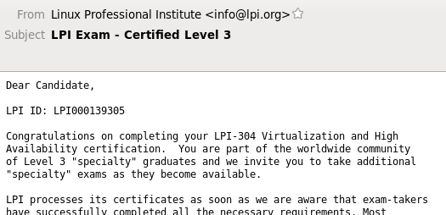
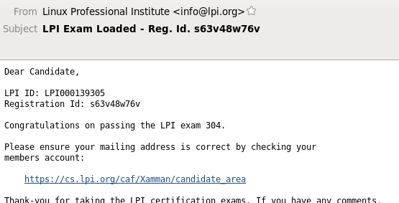
After the Exam
Results
  Paper based exams are centrally scored
  It takes about four (4) weeks until you receive your results by email:

Slide 26
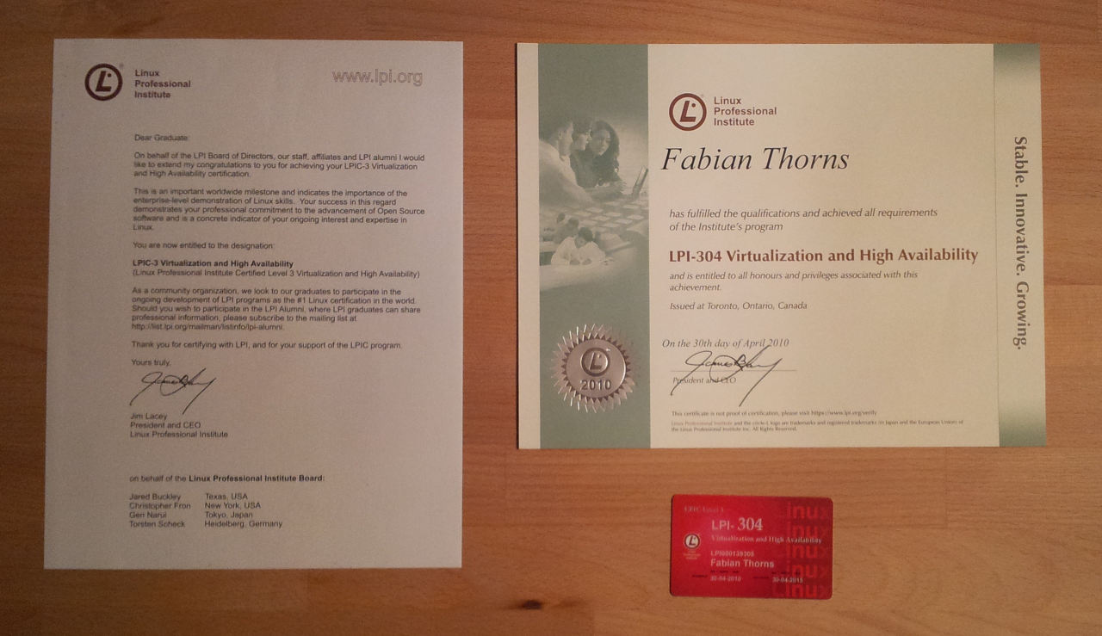
After the Exam
Results
  Certificates are sent out within an additional four (4) week period

Slide 27
After the Exam
Candidate Area
  Login at www.lpi.org
  Overview of your exams and certificates
  Check your postal address (Important for the delivery of the certificate!)
  Verification codes for certificates

Slide 28
After the Exam
Recertification
  After five years your LPI certification becomes inactive
    You still are “LPI Certified”
    Your certification no longer serves as a base for higher certifications!
    LPI recommends re-certifying every 2.5 to 3 years
  A higher level certification extends all lower level certifications
    LPIC-2 certification extends your LPIC-1 certification
    LPIC-3 certification extends your LPIC-1 and LPIC-2 certification

Slide 29
After the Exam
In case you didn't pass ...
  Continue to learn and fill in knowledge gaps
    The results email shows the percentage of correct answers that you got in each topic
    LPI can't provide you with per question feedback on your exam
  The second try is possible one week after the first try
  Each additional try is possible 90 days after the subsequent attempts

Slide 30
Membership
https://www.lpi.org/member
  Help shape the Board of Directors for LPI
    Members can vote for Board of Director candidates
    Members can run for a Board of Director position provided they have the backing of other members
  Discount services from other vendors
  Free beta exams
  Approved Trainers program
  Extend your certification through the submission of PDUs
  And more!

Slide 31

Now that you made it this far!
To claim your 50%-off SCaLE 19x coupon,
Go to
https://lpi.org/ZPR
(You’ll need an LPI ID to get it)

Slide 32

Questions?
www.lpi.org
Linux Professional Institute Inc.
41 Queen Street
Upper Suite 1
Port Hope, Ontario
L1A 2Z3 Canada

