Slide 1
Rules of the Road for Distributed Compute
Christopher Smith
VP of Engineering
h/t: Greg Bowyer
Distinguished Engineer

Slide 2
Distributed Computing @ Ticketmaster
Quiz: Ticketmaster’s First Distributed System?

Slide 3
Distributed Computing @ Ticketmaster
January 23, 1977
UNM’s Johnson Gym
Electric Light Orchestra
Notes:
First “electronic ticket” were sold for events at UNM’s Popejoy Hall Performing Arts Center ~September 1, 1976

Slide 4
Distributed Computing @ Ticketmaster Today
17K virtual servers (private cloud)
5K physical servers
6K EC2 instances
1K Kubernetes nodes
16K Kubernetes pods
300+ products
887 Components

Slide 5

Problem
Unhappy developer

Slide 6

Goal
Happy developer

Slide 7
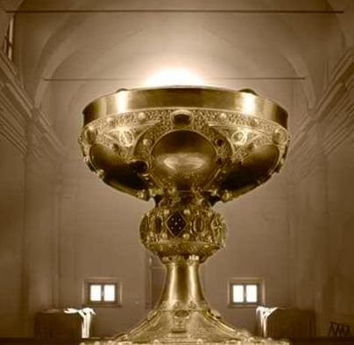
High level Systemic Targets
Generic Query Dispatch
Composable Functions
Distributed Tracing
Bulkheads and circuit breakers
Stream all the things!
Composable data

Slide 8
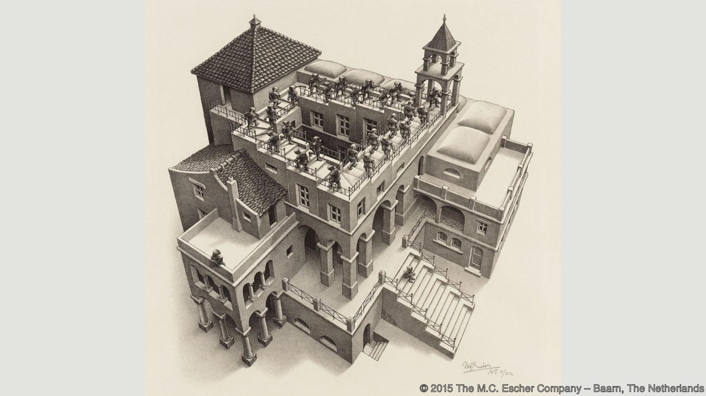
Enemy #1
The sad tale of uncoordinated caching

Slide 9

Enemy #2
Inscrutable state

Slide 10

Enemy #3
The return of the multi-master replica

Slide 11

Enemy #4
Empowering a fly to take out a carrier group.

Slide 12

Enemy #5
Service is slow… but I can’t see why.

Slide 13
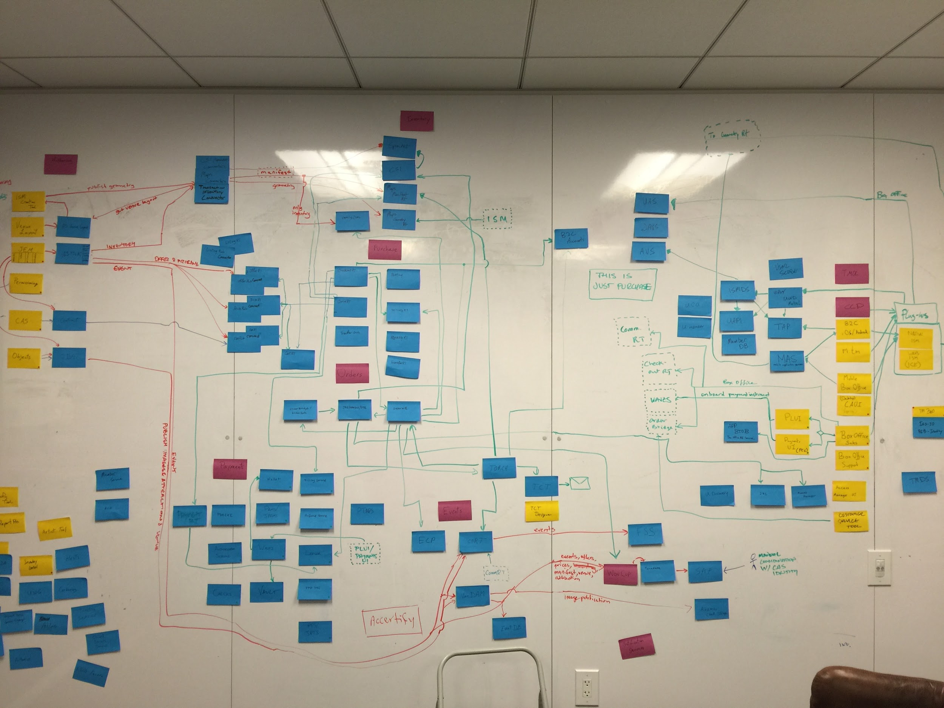
Distributed Tracing
How to debug?
How to profile?
How to refactor?

Slide 14
Generic Query Dispatch - Composable Queries
GraphQL for clients
Kafka Streams/Streamsets/KSQL for backend
Requires consistent schema
  No such thing
  Reality: Schema Versioning (distributed)
Requires navigable access to all the data
Materialized Views for app specific performance

Slide 15
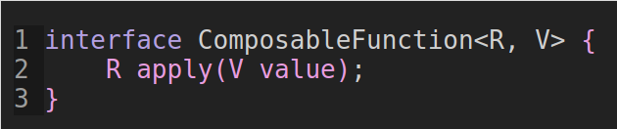
Composable Functions

Slide 16

Bulkheads and circuit breakers

Slide 17
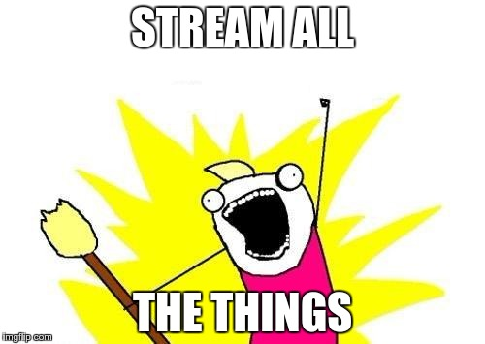
Stream all the things!

Slide 18
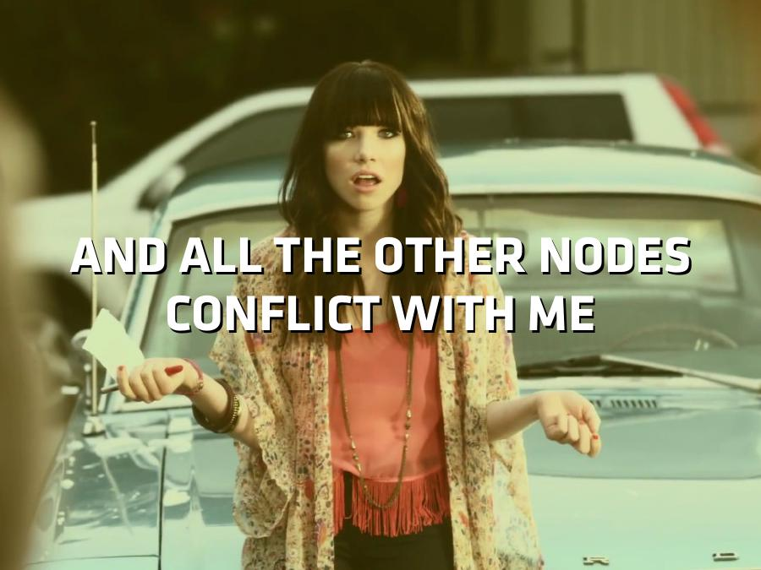
Composable data - the problem

Slide 19
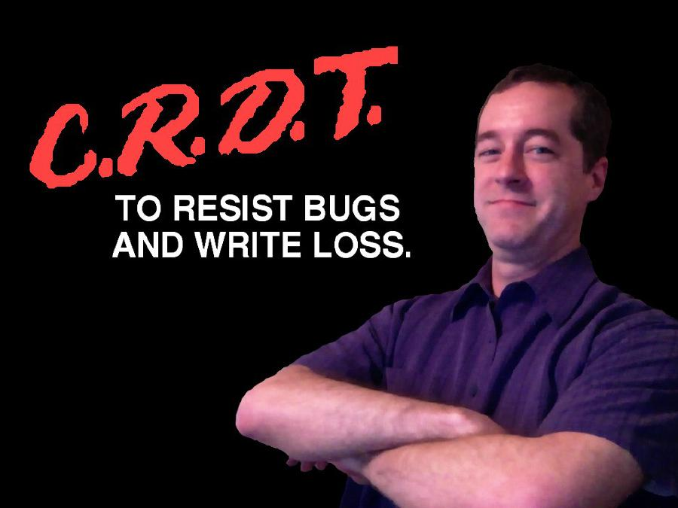
Composable data - the solution
Conflict-free replicated data type
Commutative.
Associative.
Almost idempotent.
One must ensure that all replicas are in sync without duplication.
(Which is what Kafka does no?)

Slide 20
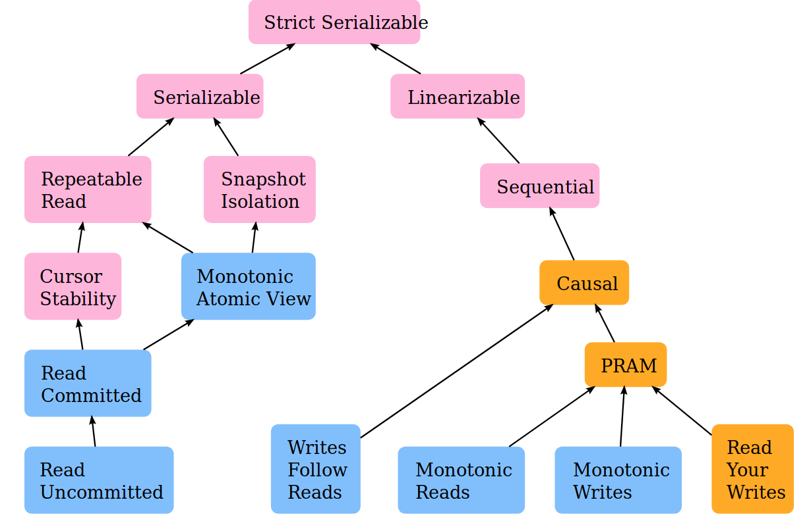
Composable data - CRDT’s

Slide 21
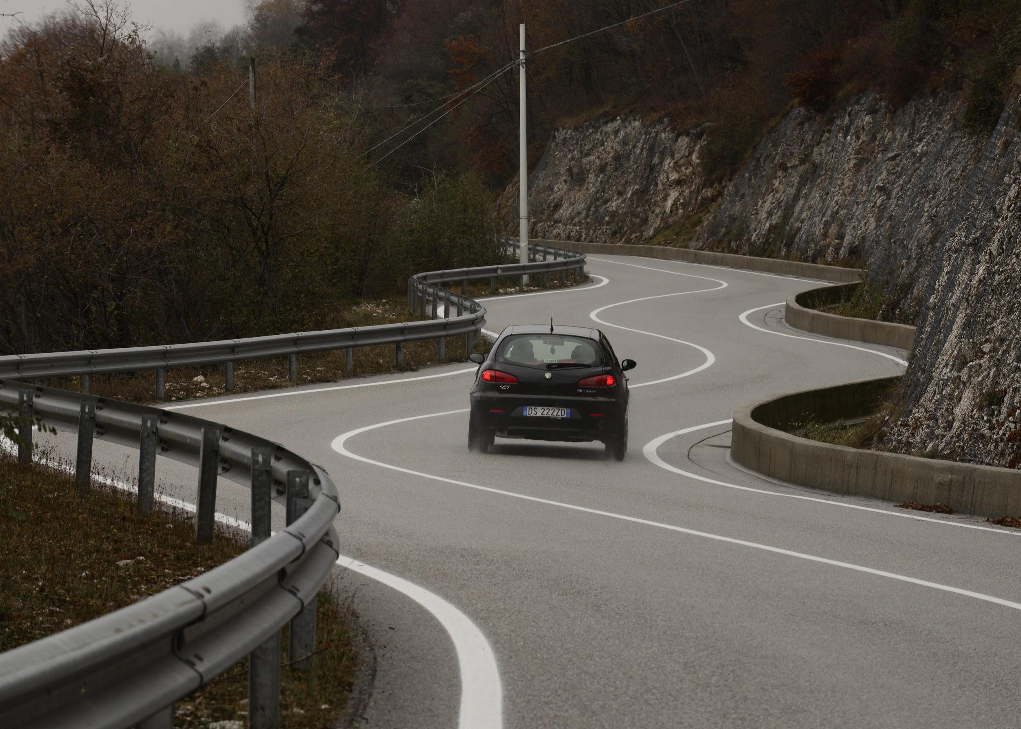
Safe Driving!

