Slide 1



Project Gating
with Zuul
James Blair
Acme Gating
jim@acmegating.com
@acmegating
zuul-ci.org

Slide 2
Zuul
Project gating system developed for OpenStack
Now used by countless other projects and companies
I started and help maintain the Zuul project
I help companies use and scale Zuul effectively

Slide 3
Why Zuul?
Git Driven
Centralized / decentralized control
Gating
Speculative Execution
Cross-project collaboration
Scalable

Slide 4
Git Driven
Code and infrastructure changes
are committed together

Slide 5

Goldilocks Control Model
Control
Central
Local

Slide 6
Past
Post-merge
Present
Pre-merge
Future
Gating

Slide 7
Gating
Every change proposed for a repository is tested before it merges.

Slide 8
Co-Gating
Changes to a set of repositories merge monotonically such that each change is tested with the current state of all the other related repositories before it merges.

Slide 9
Parallel Co-Gating
Changes are serialized such that each change is tested with all of the changes ahead of it to satisfy the co-gating requirement while being able to run tests for multiple changes simultaneously.

Slide 10
Speculative Execution
Merged #1
Merged #2
Testing #3
Failing #4
Testing #5

Slide 11
Cross-Repo Dependencies
Library Change
Library Change
Frontend Change
Infra Change
Other Change

Slide 12
Depends-On
Git commit footer:
  Depends-On: https://example.com/123456

Slide 13

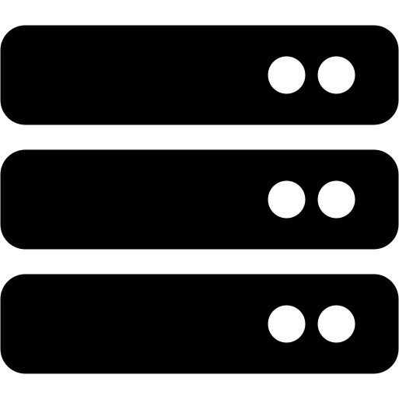

Speculative Systems
Infrastructure
Change
Frontend
Change
Library
Changes
Icons by Font Awesome: CC-By 4.0

Slide 14


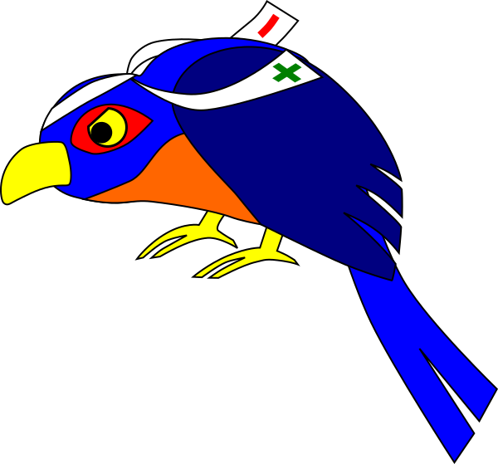
Cross-Source Dependencies

Slide 15
You Don’t Need a Monorepo
Cross-repo dependecies let you test closely affiliated components
Combination methods:
  Library relationships
  Network (microservices)
  Submodules

Slide 16
Linear Dependencies
OpenStack enforced linear dependencies for continuous deployment
Zuul (originally) enforced that by design

Slide 17
“We update the whole car at once”

Slide 18
Circular Dependencies
AKA Submit Whole Topic (Gerrit)
If SubmitWholeTopic is enabled, Zuul treats changes under same topic as a unit

Slide 19

Ephemeral Test Nodes
Cloud VMs
  OpenStack
  AWS
  GCE
  Azure
  IBM
Kubernetes / OpenShift
Static nodes

Slide 20
Multi-Node Jobs
- job:
name: 'devstack-multinode'
parent: 'base'
nodes:
- name: 'controller'
image: 'ubuntu-xenial'
- name: 'compute'
image: 'ubuntu-xenial'

Slide 21
Ansible Playbooks
- hosts: controller
roles:
- setup-controller
- hosts: compute
roles:
- run-compute

Slide 22
Example: Grafana Deployment
base playbook
grafana playbook
inventory file
bastion host (named bridge)
service host (named grafana01)
/etc/ansible.cfg
/etc/ansible/hosts (hostvars)

Slide 23
The Grafana Test Job
- job:
name: system-config-run-grafana
requires: grafana-container-image
required-projects:
- opendev/system-config
- openstack/project-config
nodeset:
nodes:
- name: bridge99.openstack.org
label: ubuntu-bionic
- name: grafana01.opendev.org
label: ubuntu-focal
vars:
run_playbooks:
- playbooks/letsencrypt.yaml
- playbooks/service-grafana.yaml
run_test_playbook: playbooks/test-grafana.yaml

Slide 24
The Test Run
Run run-base-pre.yaml playbook
  Sets up hosts
  Sets up test mirrors, etc
Run run-base.yaml playbook
  Zuul -> Ansible inventory
  Templated hostvars for private data
  Runs base playbook
  Runs run playbook
  Runs test playbook

Slide 25
Test Playbook
Check ports are listening
HTTP queries
Any other validations
Capture screenshots
Capture Logs

Slide 26
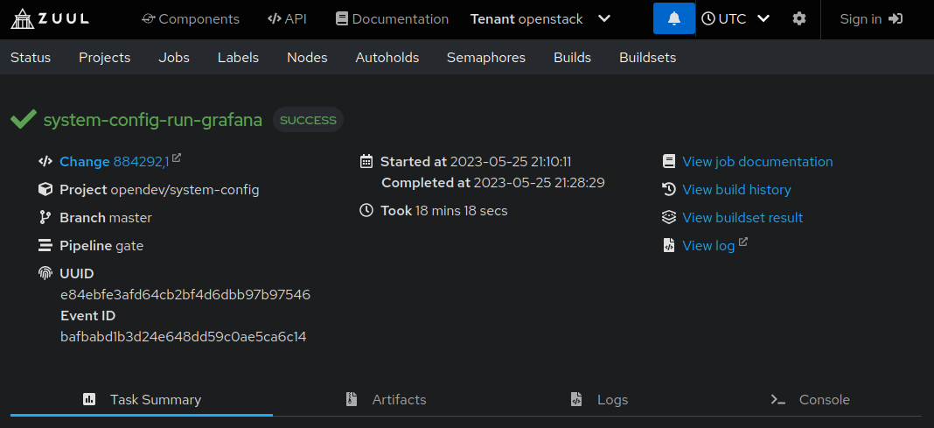

Slide 27
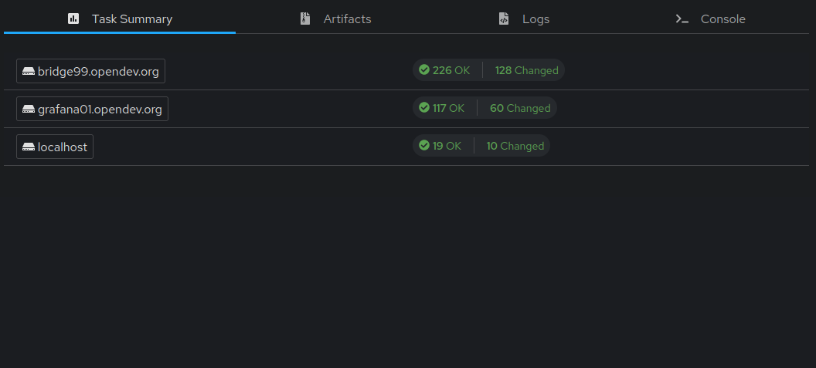

Slide 28
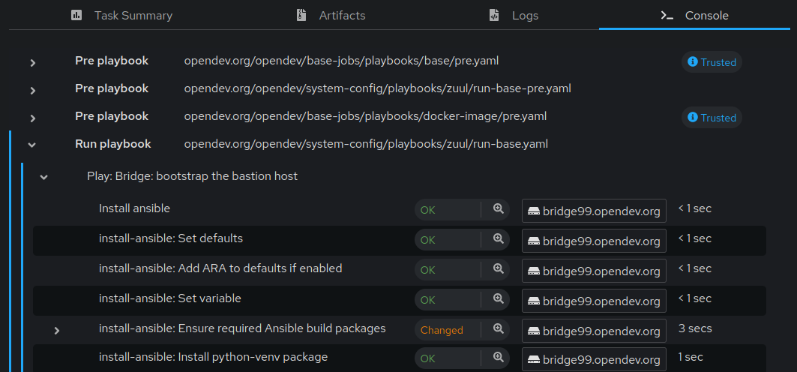

Slide 29
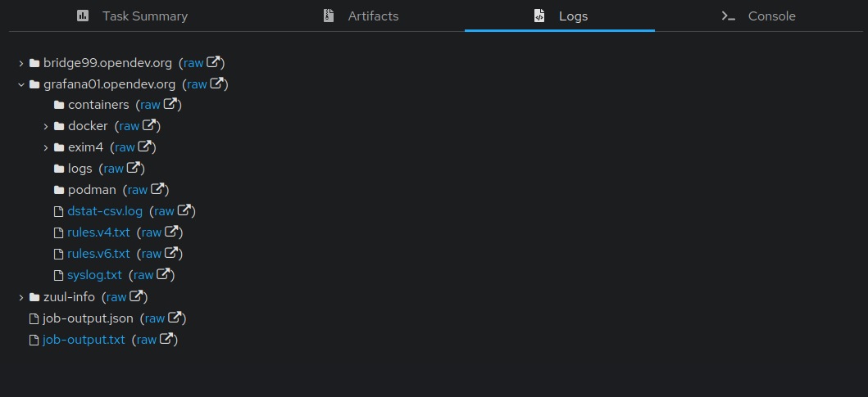

Slide 30
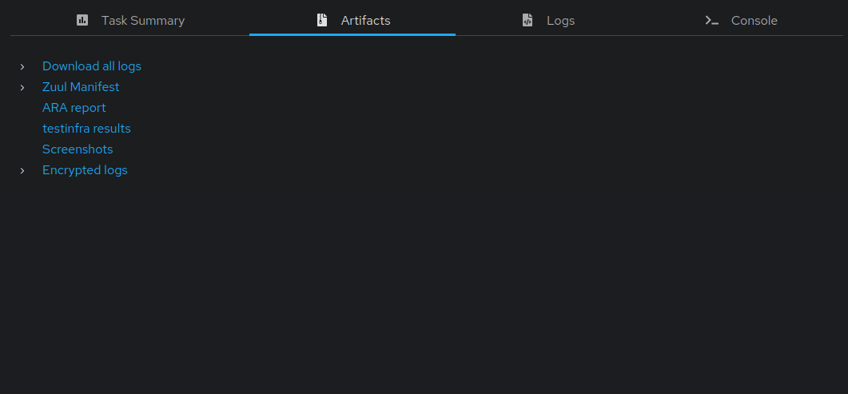

Slide 31
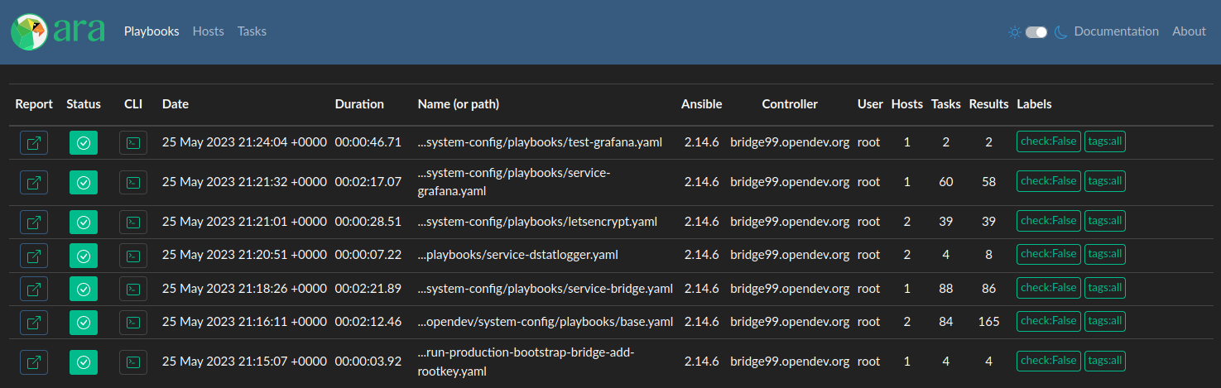

Slide 32
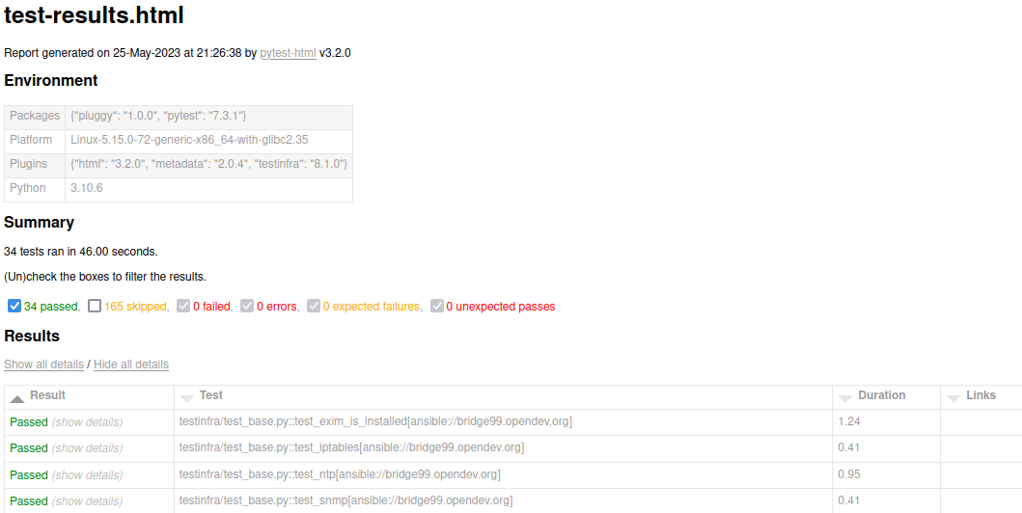

Slide 33
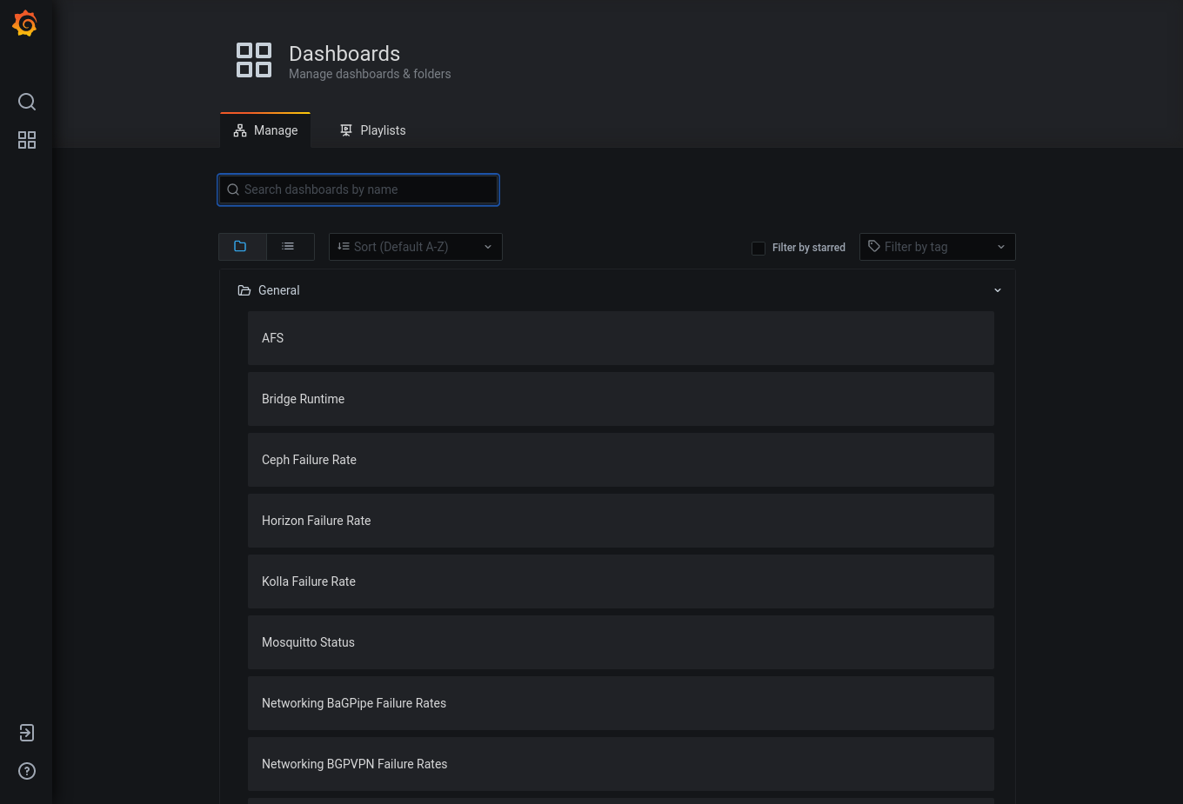

Slide 34
Bonus: Actual Production
- job:
name: infra-prod-service-grafana
parent: infra-prod-service-base
description: Run service-grafana.yaml playbook.
vars:
playbook_name: service-grafana.yaml

Slide 35
Next Steps
More about Zuul:
zuul-ci.org
More about Acme:
acmegating.com
Enterprise Zuul. Support.
Consulting. Development.
James Blair
Acme Gating
jim@acmegating.com
@acmegating

