Slide 1
Securing the Connected Car
Eystein Stenberg
CTO
Mender.io

Slide 2

The software defined car
Electronics
Telematics
Infotainment
Connected
Assisted driving
Autonomous
Hardware enabled
Software enabled
Software defined
1990
2000
2010
2020

Slide 3
About me
Eystein Stenberg
  7 years in systems security management
  M. Sc., Computer Science, Cryptography
  eystein@mender.io
Mender.io
  Over-the-air updater for Linux, Yocto Project
  Open source (Apache License, v2)
  Dual A/B rootfs layout (client)
  Remote deployment management (server)
  Under active development

Slide 4
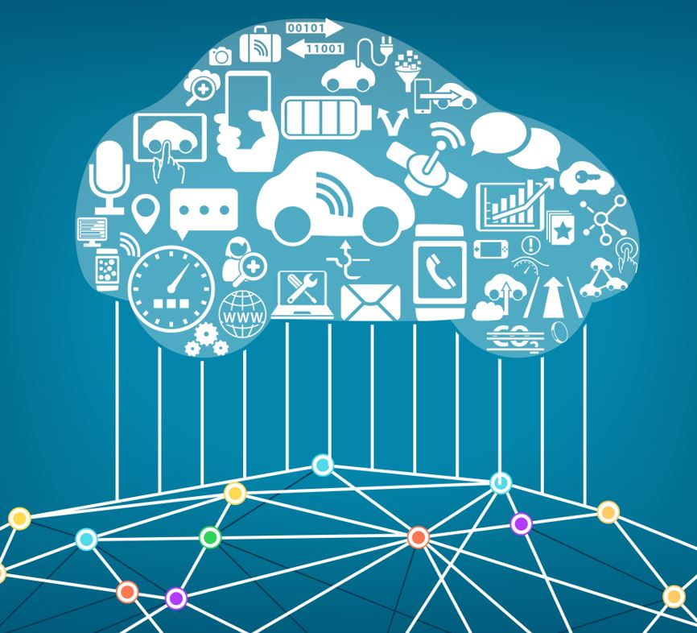
Session overview
Opportunities with the software defined car
Anatomy of an attack: security risks of the connected car
The patching problem & solution designs

Slide 5
Software defined car: New revenue streams
“Automakers could add up to $27.1B annually from services such as car sharing and more” - Navigant Research
Tesla
  An OTA update system allows for easy additional software purchases after buyers drive their cars off the lot
  Semi-autonomous Autopilot feature allows current Model S owners to add the feature for $2,500 USD when they order the vehicle or they can pay $3,000 USD to upgrade later

Slide 6
Cost savings by using open source platforms
IVI stack
Cost
HMI
Differentiation
10%
Apps
Lower layers are expensive and provides no differentiation
Use open source here to
  Shorten time-to-market
  Lower cost
  Reallocate development to differentiating features
30%
Middleware
OTA updater
60%
Operating system
Board support pkg.
Focus on open source here
Hardware

Slide 7
The software defined car requires OTA updates
Increased software complexity requires more frequent improvements
“33% of current recalls are for problems that could be fixed OTA” - ABI Research
“OTA updates will save carmakers $35B in 2022” - IHS Automotive
Fiat Chrysler hack (next up) required a recall of 1.4 million vehicles that could have been avoided with an OTA update

Slide 8
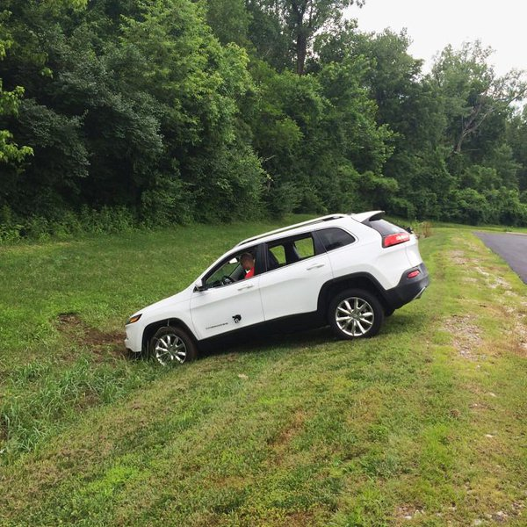
Jeep Cherokee hacked in July 2015
Presented at Black Hat USA 2015
  Charlie Miller
  Chris Valasek
Remote exploit giving full control of the car
Clearly demonstrates physical safety risk
No way to fix remotely
1.4 million cars recalled
August 2016: Extended to unauthorized ECU update via CAN

Slide 9

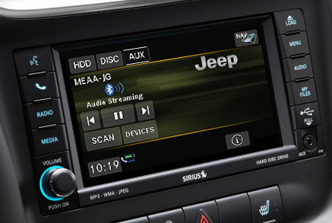
Jeep Cherokee Head Unit with Wifi
Cherokee customers can buy wifi subscription as an add-on (~$40/month)
Connect devices in the car to the car’s wifi to get online (phones, tablets, …)
Wifi is password protected
Wifi hotspot offered as a service
“Head unit”, “IVI”

Slide 10
Wifi-based breach: Short-range
Wifi password based on system time after provisioning
January 01 2013 00:00 GMT +- 1 minute
Multimedia system breached due to software vulnerability
Scope: Control music player/radio/volume and track GPS coordinates when within wifi range
Guessable password
Software vulnerability

Slide 11

Cellular-based breach: Country-wide
Scope: Control music player/radio/volume and track GPS coordinates countrywide
Can also select a specific Jeep based on its GPS-coordinates
Breach Sprint Cellular network
Software vulnerability

Slide 12
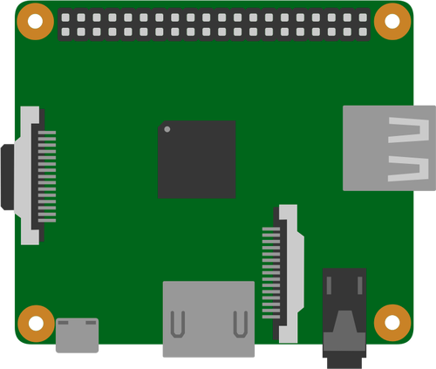
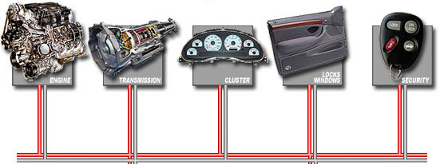
The Controller Area Network (CAN) bus
The CAN bus connects ~70 electronic control units (ECUs), including engine control, transmission, airbags, braking
V850 chip is designed to only read from the CAN bus, to isolate components
Diagnostics
V850 chip
Read-only

Slide 13
Unauthorized update to write to the CAN bus
The head unit can update the firmware of the V850
Firmware update authenticity not checked properly
Malicious firmware update
V850 chip
Full control

Slide 14
Putting it together
Cellular breach
Lessons
Wifi hotspot password was predictable
Remotely accessible service (in head unit) was vulnerable (and not updated)
Firmware update (for V850) did not have proper authenticity checks
The only way to fix the vulnerabilities is through a manual update (by customer or dealership)
Vulnerability
FW update

Slide 15
More complexity leads to larger attack surface
1-25 bugs per 1000 lines of code*
  Assume that all software components have vulnerabilities
Rely on well-maintained software and keep it updated
  Open source vs. proprietary is a red herring
  Do not build all the software in-house
Principle of least privilege
Separation of privilege
Kerckhoff’s principle
*Source: Steve McConnell, Code Complete

Slide 16
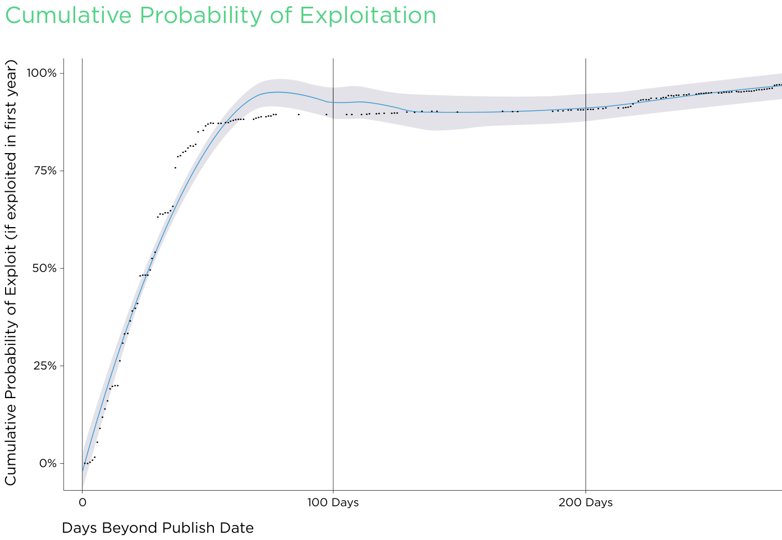
Security patching is done too late
110 days: remediation time avg.
60 days: >90% probability it is exploited
5-10 days: <10% probability it is exploited
Source: How the Rise in Non-Targeted Attacks Has Widened the Remediation Gap, Kenna Security

Slide 17
Why security patching happens too late
The value is invisible until too late
Too costly or risky
  Manual? Too expensive to integrate updater?
  Requires downtime of production? Risk of breaking production?
Politics
How often do you patch?
  Do you have a way to do it? A process?
  Often not a core competence and not a priority to develop updater

Slide 18
Patching connected devices is harder
No/expensive physical access
  Need failure management
Unreliable power
  What if power disappears in the middle of patching?
Unreliable (wireless) network connectivity
  Handle partial downloads
  Ideally resume downloads in expensive networks like 3G
Public and insecure (wireless) networks
  Can someone inject arbitrary code during the update process?
  Verify authenticity of update

Slide 19
Generic embedded updater workflow
Detect update
(secure channel)
Compatibility check
Download
(secure channel)
Integrity
(e.g. checksum)
Pre-install actions
Extract
Decrypt
Authenticate
(e.g. signature)
Install
Post-install actions
Sanity checks
Failure recovery
(e.g. roll back)
Choose a strategy
Must-have
Environment-specific

Slide 20
Choice of update type has tradeoffs
 | Full image | Package (opkg, …) | tar.gz | Docker/Containers
Download size | Large* | Small | Small | Medium
Installation time | Long* | Short | Short | Short
Rollback | Yes (dual partition) | Hard | Hard | Yes
Consistency | Yes | Medium | Hard | Yes
Design impact | Bootloader, Partition layout | Package manager | tar, ... | Kernel, docker
* Can mitigate with compression or binary diffs

Slide 21

Strategies to reduce the risk of bricking
Integrity checking
  This must be done
  Easy to implement
Rollback support
  This should be a requirement: power loss, installation error, etc.
  Could be hard depending on update type (tarball, package)
Phased rollout
  I.e. don’t deploy update to all devices in one go
  Most do this to some extent: test & production environments
  Can be more granular on device population (1%, 10%, 25%, 50%, …)
What can
go wrong?

Slide 22
Prepare for securing the software defined car
Open source software where no differentiation
Well-maintained software
Over-the-air updates
Apply well-known security design principles

Slide 23
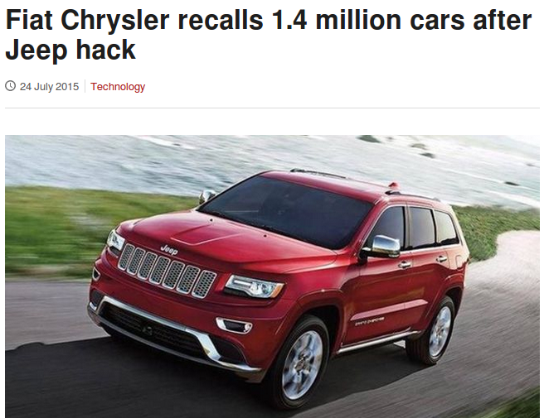
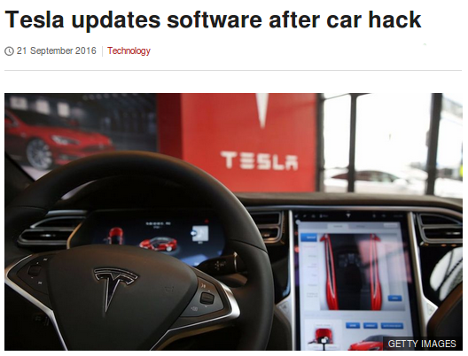
The best way to respond to hacking?
Fiat Chrysler said exploiting the flaw "required unique and extensive technical knowledge, prolonged physical access to a subject vehicle and extended periods of time to write code" and added manipulating its software "constitutes criminal action".
Straubel [Tesla CTO] credits KeenLabs’ researchers [...] says Tesla will pay KeenLabs’ team a monetary reward for its work [...] “They did good work,” Straubel says. “They helped us find something that’s a problem we needed to fix. And that’s what we did.”
Sources: BBC News, Wired

