Slide 1

Linux, I2C, and me
Michael Welling (m_w)
mwelling@ieee.org
March 8th, 2018

Slide 2
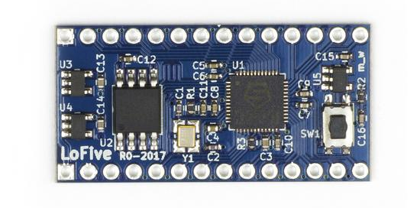
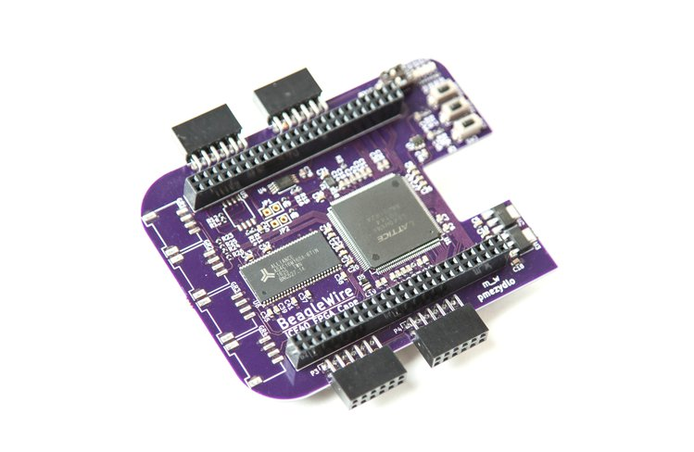
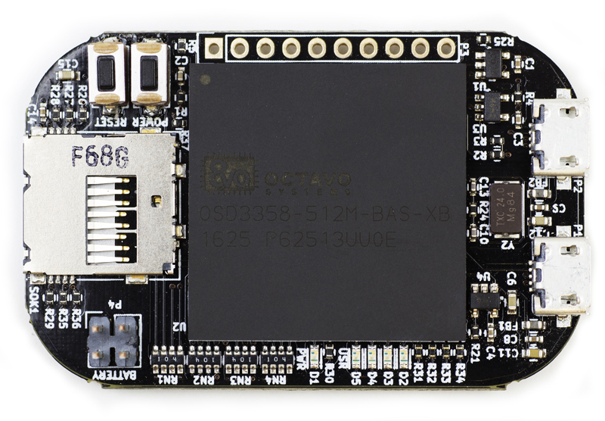

whoami
Michael Welling
Embedded Systems Architect
MS in Electrical and Computer Engineering
PCB Design
Linux Board Support
Community Efforts
Beagleboard.org GSoC Mentor
96Boards.org Community Mezzanine Initiative
E-ale.org Instructor
KiCAD Training

Slide 3
Overview
What is I2C?
Example I2C Devices
I2C Protocol
Linux I2C Subsystem
Linux I2C Drivers
  I2C Bus Drivers
  I2C Device Drivers
  I2C Slave Interface
Instantiating I2C Devices
User-space tools
Demo
Questions

Slide 4
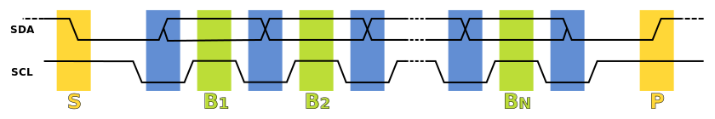
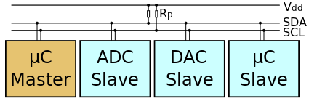
What is I2C?
I²C stands for inter-integrated circuit
First developed by Philips Semiconductor in 1982
Synchronous multi-master multi-slave serial bus
Half duplex protocol
Open-drain signaling
Only two signal wires
  SDA: data
  SCL: clock
en:user:Cburnett, I2C, CC BY-SA 3.0
https://en.wikipedia.org/wiki/I%C2%B2C

Slide 5
What is I2C?
I²C addressing is typically 7 bits per the original specification
I²C clock speed is typically 100KHz per the original specification
Later versions of the specification introduced faster clock modes and 10 bit addressing:
  Version 1 added 400KHz Fast mode and 10 bit addressing
  Version 2 added 3.4MHz Hs mode
  Version 3 added 1MHz Fast mode+ and ID mechanism
  Version 4 added unidirectional 5Mhz Ultra Fast mode
SMBus (System Management Bus) is a subset of I²C defined by Intel
  Typically used on PC motherboards for power control and sensors
  Stricter tolerances on voltage levels and timing
  Adds an optional software level address resolution protocol

Slide 6
Example I2C Devices
Real time clock
EEPROM
Analog converters (ADC, DAC)
Sensors (Temperature, Pressure)
Microcontrollers
Touchscreen controllers
GPIO expanders
Monitor and TV adapters

Slide 7
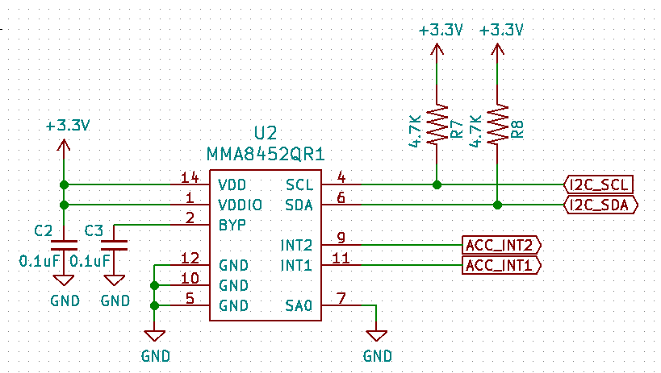
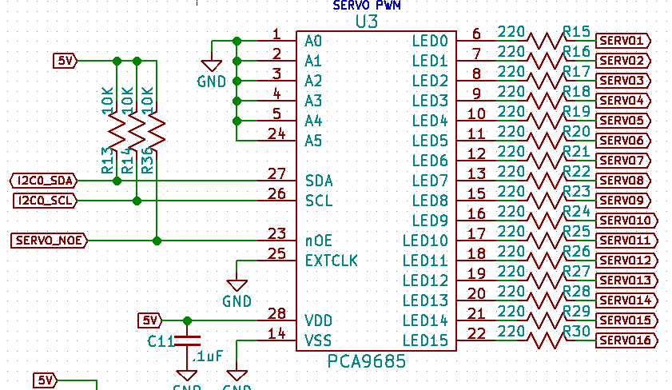
Example I2C Hardware

Slide 8
I2C Protocol
Start
SDA goes low before SCL to signal the start of transmission.
Addr
7 bit address that determines the slave device to be accessed.
R/W
Transaction data direction bit. (1 = read, 0 = write)
Data
Byte data read from or written to the slave device. Can be multiple bytes.
ACK
Acknowledge bit. (0 = ack, 1 = nak)
Stop
SDA goes high after SCL to signal the end of transmission.

Slide 9
Linux I2C Subsystem
Early implementations were from Gerd Knorr and Simon G. Vogl.
Migrated to the device model by Greg KH in late 2.5 versions of Linux.
Integrated into standard device driver model by David Brownell and Jean Delvare in Linux 2.6.
Currently maintained by Wolfram Sang.

Slide 10
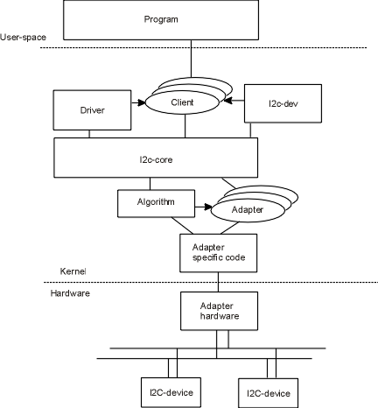
Linux I2C Subsystem
https://i2c.wiki.kernel.org

Slide 11
Linux I2C Subsystem
List: linux-i2c; ( subscribe / unsubscribe )
Info:
Linux kernel I2C bus layer mailing list.
Archives:
http://marc.info/?l=linux-i2c
http://www.spinics.net/lists/linux-i2c/
https://git.kernel.org/pub/scm/linux/kernel/git/wsa/linux.git/

Slide 12
Linux I2C Drivers
I2C Bus Drivers
Bus → Algorithm
Adapter
An Algorithm driver contains general code that can be used for a whole class of I2C adapters. Each specific adapter driver either depends on one algorithm driver, or includes its own implementation.
https://www.kernel.org/doc/Documentation/i2c/summary

Slide 13
Linux I2C Drivers
I2C Device Drivers
Device → Driver
Client
A Driver driver (yes, this sounds ridiculous, sorry) contains the general code to access some type of device. Each detected device gets its own data in the Client structure. Usually, Driver and Client are more closely integrated than Algorithm and Adapter.
https://www.kernel.org/doc/Documentation/i2c/summary

Slide 14
Linux I2C Drivers
I2C Slave Interface
e.g. sysfs I2C slave events I/O registers
+-----------+ v +---------+ v +--------+ v +------------+
| Userspace +........+ Backend +-----------+ Driver +-----+ Controller |
+-----------+ +---------+ +--------+ +------------+
| |
----------------------------------------------------------------+-- I2C
--------------------------------------------------------------+---- Bus
echo slave-24c02 0x1064 > /sys/bus/i2c/devices/i2c-1/new_device
https://www.kernel.org/doc/Documentation/i2c/slave-interface
https://www.youtube.com/watch?v=JdQ21jlwb58

Slide 15
Instantiating I2C Devices
Device tree
i2c1: i2c@400a0000 {
/* ... master properties skipped ... */
clock-frequency = <100000>;
flash@50 {
compatible = "atmel,24c256";
reg = <0x50>;
};
pca9532: gpio@60 {
compatible = "nxp,pca9532";
gpio-controller;
#gpio-cells = <2>;
reg = <0x60>;
};
};

Slide 16
Instantiating I2C Devices
Platform device
static struct i2c_board_info h4_i2c_board_info[] __initdata = {
{
I2C_BOARD_INFO("isp1301_omap", 0x2d),
.irq = OMAP_GPIO_IRQ(125),
},
{ /* EEPROM on mainboard */
I2C_BOARD_INFO("24c01", 0x52),
.platform_data = &m24c01,
},
{ /* EEPROM on cpu card */
I2C_BOARD_INFO("24c01", 0x57),
.platform_data = &m24c01,
},
};
static void __init omap_h4_init(void)
{
(...)
i2c_register_board_info(1, h4_i2c_board_info,
ARRAY_SIZE(h4_i2c_board_info));
(...)
}

Slide 17
Instantiating I2C Devices
From user-space
echo eeprom 0x50 > /sys/bus/i2c/devices/i2c-3/new_device
https://www.kernel.org/doc/Documentation/i2c/instantiating-devices

Slide 18
User-space Tools
Simple character device driver (i2c-dev)
  Device nodes at /dev/i2c-x
  Slave address set by I2C_SLAVE ioctl.
  Simple access using read() / write()
  i2c_smbus_{read,write}_{byte,word}_data()
i2ctools
  i2cdetect
  i2cget
  I2cset
https://www.kernel.org/doc/Documentation/i2c/dev-interface

Slide 19
Demo
Hold my beer and watch this.
Notes:
Debian I2C tools demo
i2cset 2 0x1c 0x2a 0x00
i2cset 2 0x1c 0x0e 0x00
i2cset 2 0x1c 0x2a 0x01
while [ 1 ]; do yes | i2cdump -r 1-6 2 0x1c; done

Slide 20
Questions?
My name is Michael Welling, ask me anything.

